Slide 1




Listening the Womb of the Earth
iXblue sonars, transponder & rotational seismometers for extreme environment imaging & monitoring
Guillaume Jouve
Frédéric Guattari, Théo Laudat, Hubert Pelletier, Nathalie Olivier, Maurizio Ripepe, Heiner Igel, Joachim Wassermann, Felix Bernauer, Thomas Braun, Corentin Caudron, Marc-André Gutscher
Notes:
Dear everybody,
I would like to thank conveners for accepting us to present some recent advances using iXblue systems for monitoring and imaging extreme environments, and especially marine and continental volcanic environments.

Slide 2

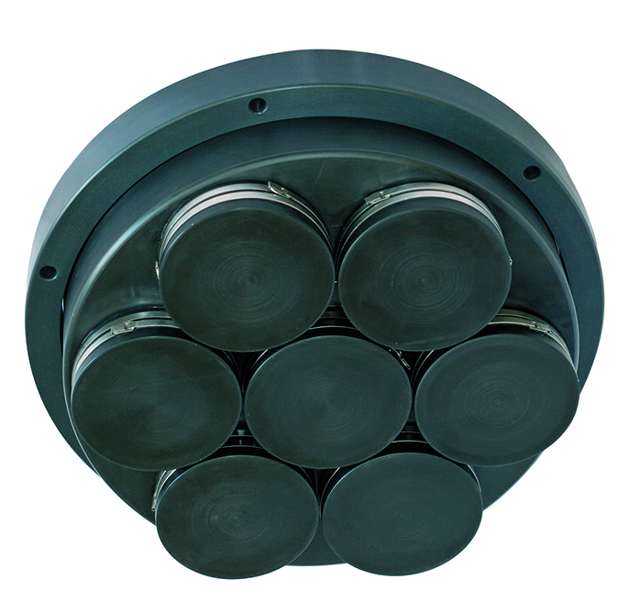
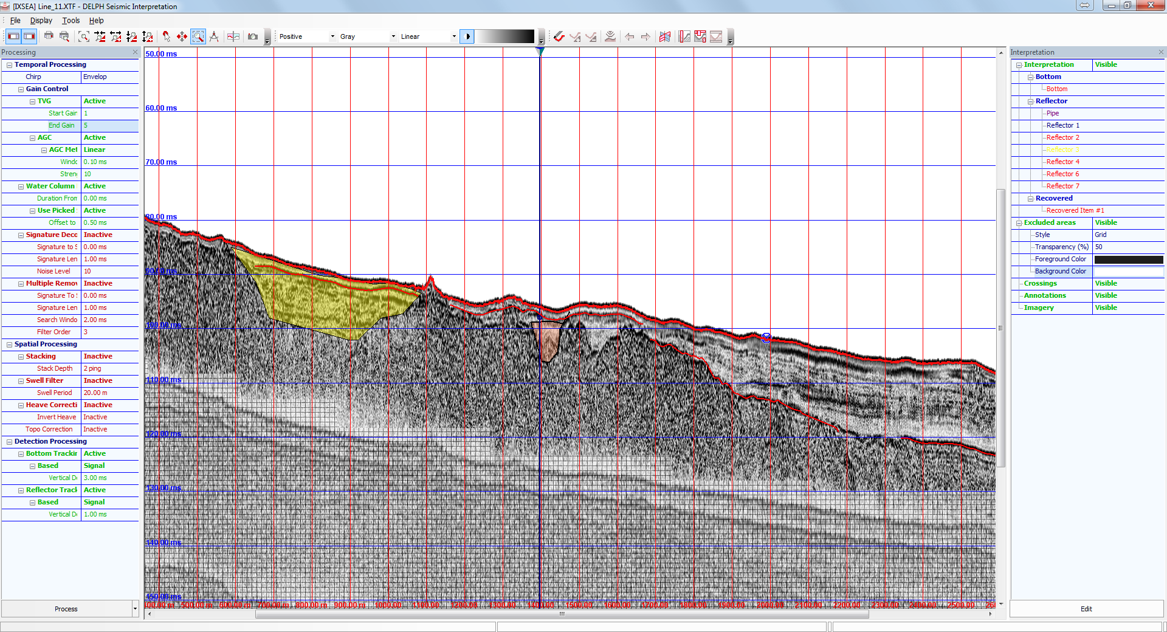
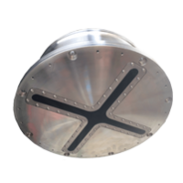
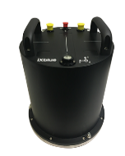
Let’s focus on iXblue systems to understand volcanic environments !
Echoes 10 000
Delph Geophysical Software
Canopus
SeapiX
blueSeis 3-A
Sub-bottom profiler
Seismic reflexion / SBP
Transponder
3D Multibeam echosounder
Rotational seismometer
Notes:
iXblue company develops technologies to listen and image the Earth dynamics. Among them, Echoes high-resolution sub-bottom profilers, Seapix 3D multibeam echosounder, Canopus transponder and blueSeis rotational seismometers are particularly useful for imaging and monitoring marine and continental volcanic activities. Here, we present recent implementations and acquisitions of those systems, demonstrate the great potential of these technologies to record present and past volcanic dynamics in Hawaii, Stromboli, Sicilia and Eifel region, and emphasize their benefits to better anticipate volcanic hazard.

Slide 3

  Echoes 10 000, Delph Seismic Software & SeapiX 3D MBES for water column, seafloor and sub-bottom imagery

Slide 4
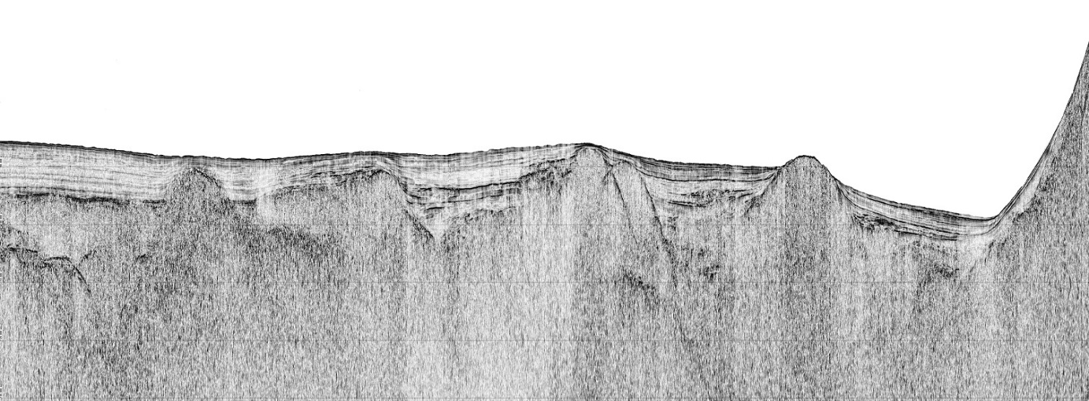
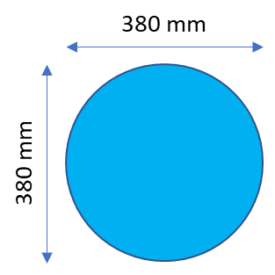
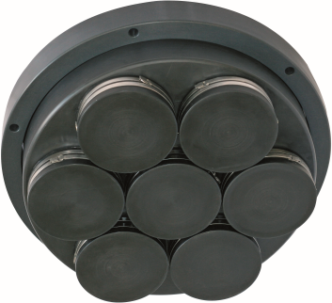
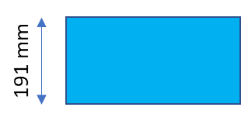
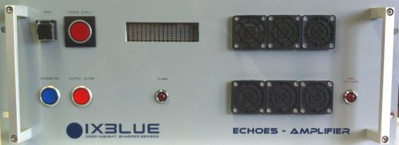
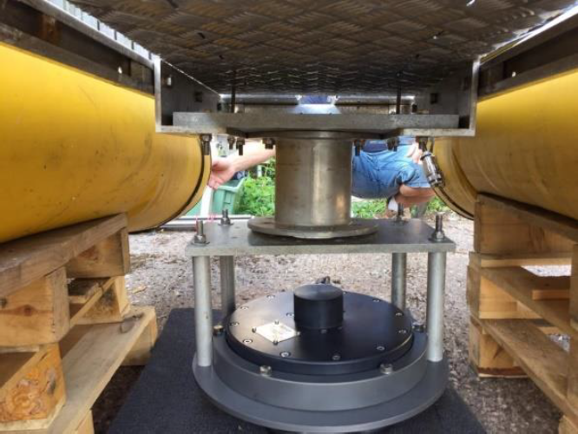
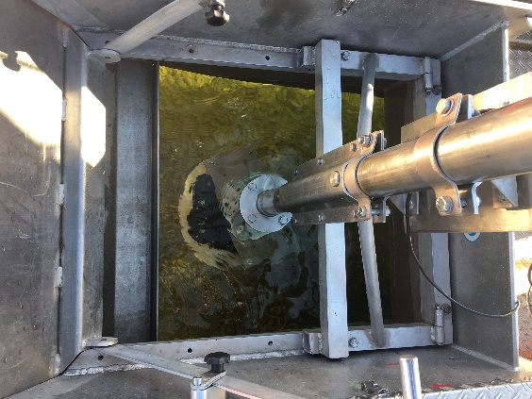
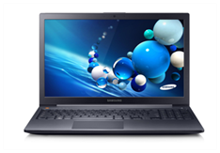

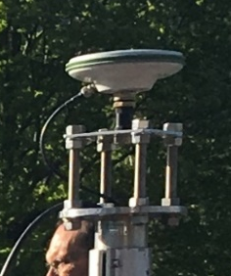
Echoes 10 000
Specification
Bandwidth: 5 – 15 kHz @-3dB
(natural)
Transducers: x7 iXblue Tonpiltz
Diameter: 380 mm
Weight: 26 / 12 kg (air / water)
From above
From front
Amplifier 2 kVA
Or
Laptop
GNSS
Pole mounted
Cataraft
Notes:
Echoes 10 000 (10 kHz) is a CHIRP sub-bottom profiler that provides high-resolution seismic profiles. This portable system can be pole mounted or implemented on small vessel such as cataraft. Onboard, this system require only an amplifier, a laptop with Delph Seismic Software (work also with third party software) and a GNSS.

Slide 5
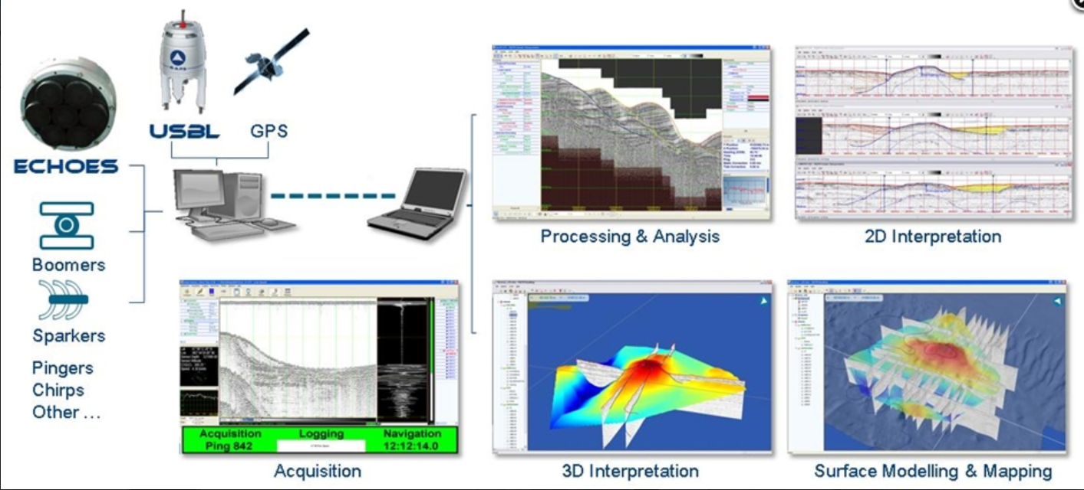
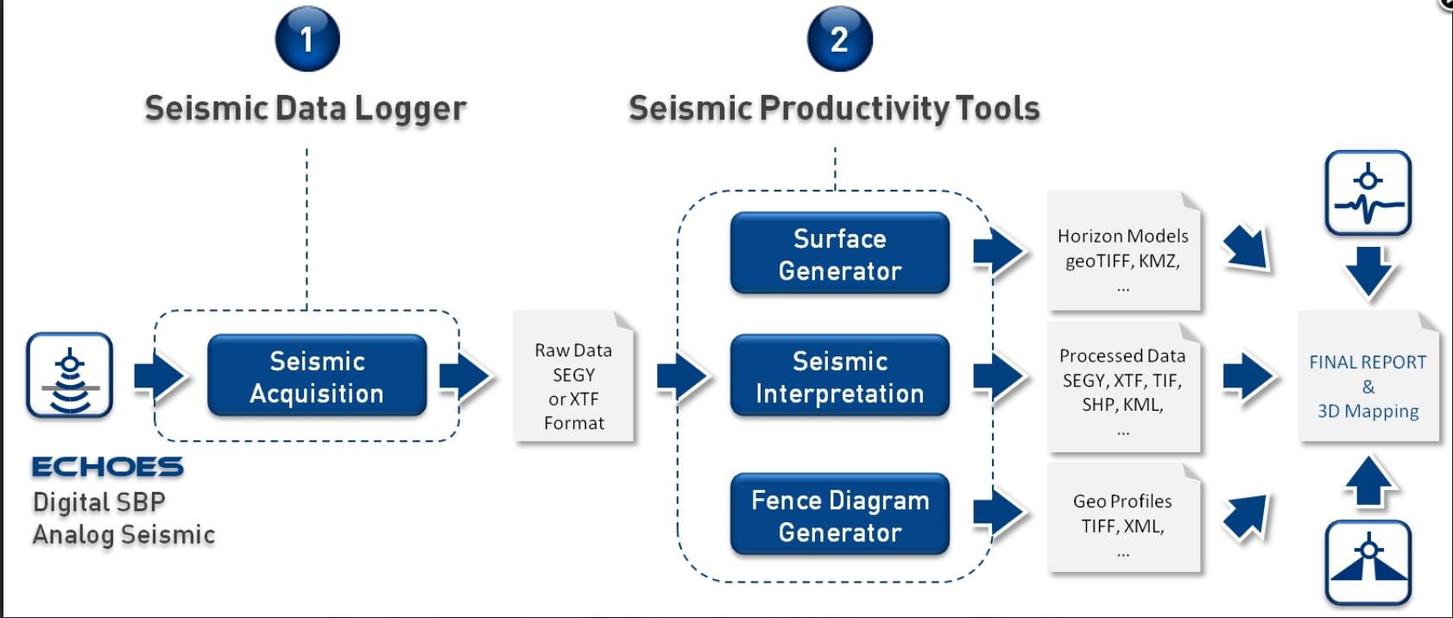
Delph Seismic
Solution concept & Advantages
Most advanced and complete acquisition, processing and interpretation software package
Provides geologists & geophysicists with an easy access to ALL data collected from shallow seismic systems and sub-bottom profilers.
Ideal solution for use in all types of surveys, from scientific to hydrography, dredging, oil & gas, geosciences, archaeology and others.
Process & Architecture
Intuitive modular architecture
High-quality data management & optimal data processing and interpretation workflow.
Compatible with leading industry sensors and formats
Best possible 2D/3D QC
Visualization and reporting capabilities.

Slide 6
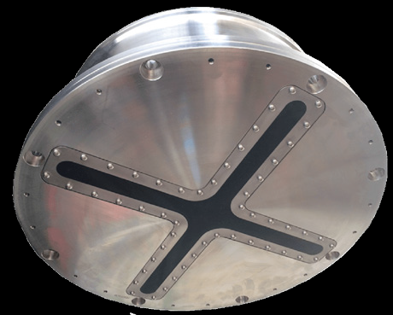
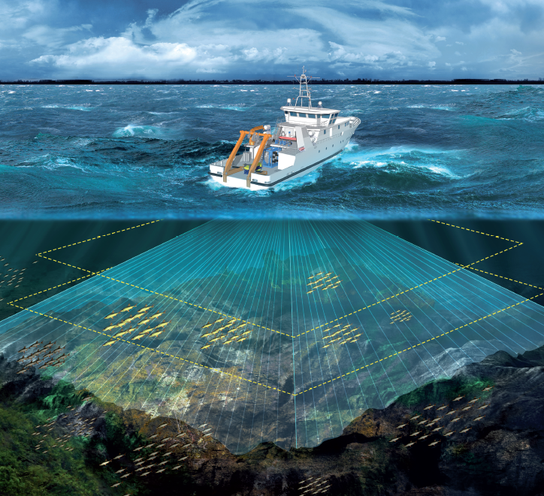
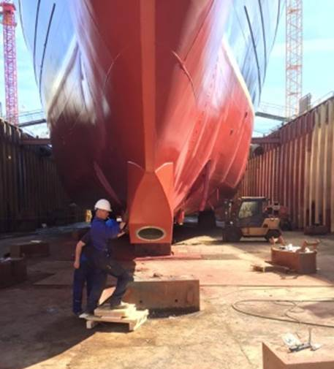
SeapiX : 3D Multibeam Echosounder
Steerable Double Mills Cross Architecture
Central frequency: 150kHz
400m typical range
120° x 120° angular coverage
64 beams per swath
1.6° to 3.2° angular resolution
7.5cm range resolution
Hull/Buoy/Pole Mounted
Embedded IMU
48cm x 18cm
58kg (in-air), 31kg (in-water)
Portable version:
24kg (in-air), 4kg(in-water)

Slide 7
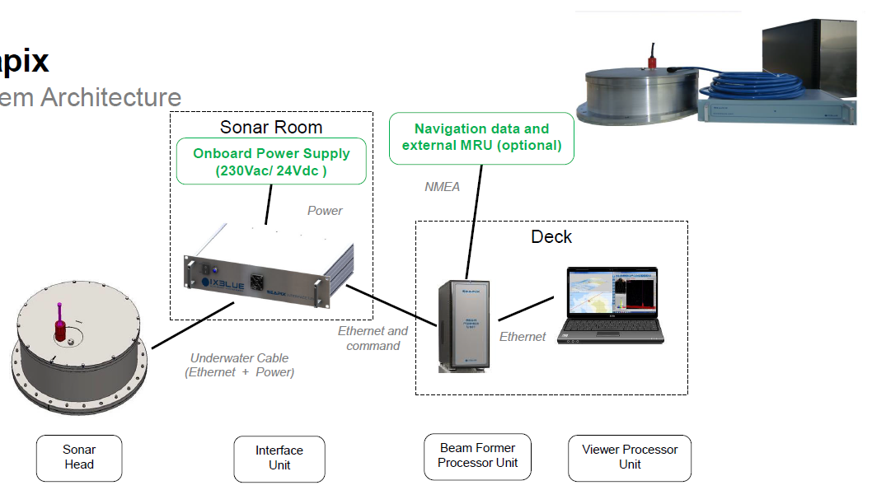
SeapiX : 3D Multibeam Echosounder
System Architecture

Slide 8
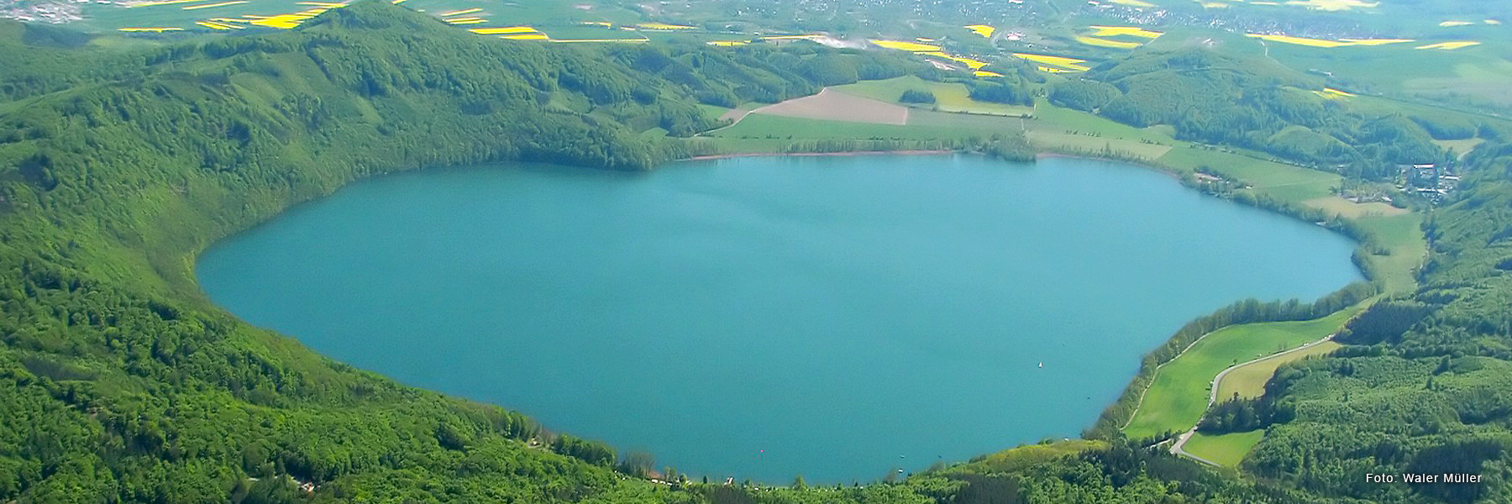
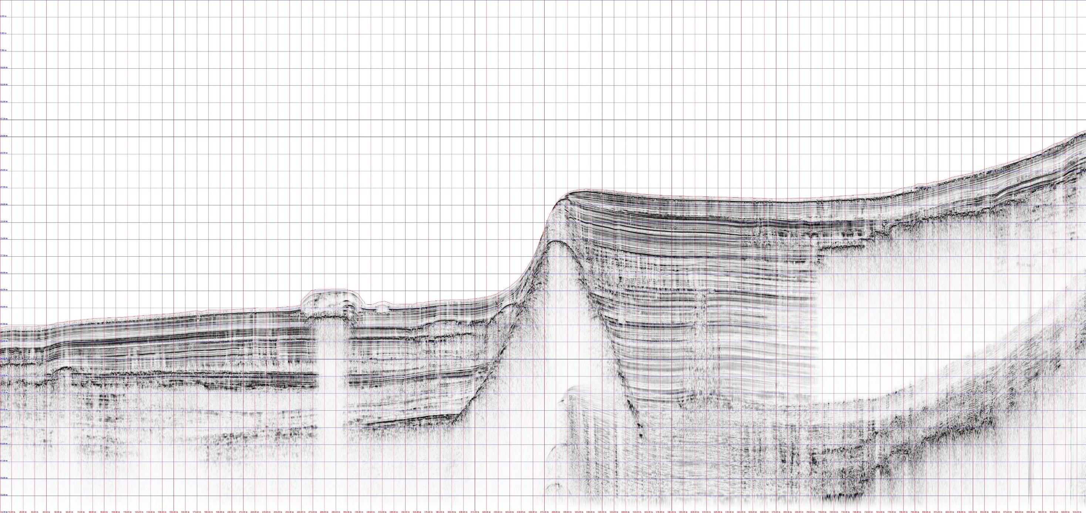
Echoes 10 000 results on Laacher See (volcanic lake)
Delph Seismic
Laacher See
51m max depth
2km diameter
2- High-resolution images of sediment layers
Volcanic Gas
Penetration: 40 m
Resolution: < 8 cm
Notes:
In collaboration with French, Belgian and German geoscience laboratories, Echoes 10 000 (10 kHz) sub-bottom profiler and Seapix 3D multibeam echosounder, both installed on the kiXkat cataraft and remotely controlled, were mobilized to produce images of the water column and sediments of a lake formed in a volcanic crater in Germany (Laacher See).
Seismic reflexion survey provided high resolution images of sediment layers suggesting great potential to reconstruct climate/geohazard at millennial time-scales. Using Delph Seismic software, we used real-time observation of seismic profiles to define the best 3 coring locations for the day after. Next step is to use Delph Seismic Interpretation to construct DTM of all main reflectors, thus providing 3D modeling of the sedimentary infill and to allow interpretation in terms of sedimentary dynamics.

Slide 9
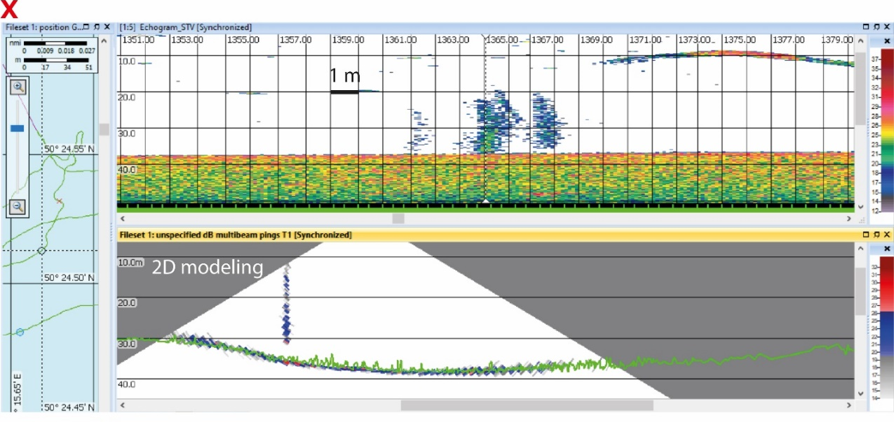

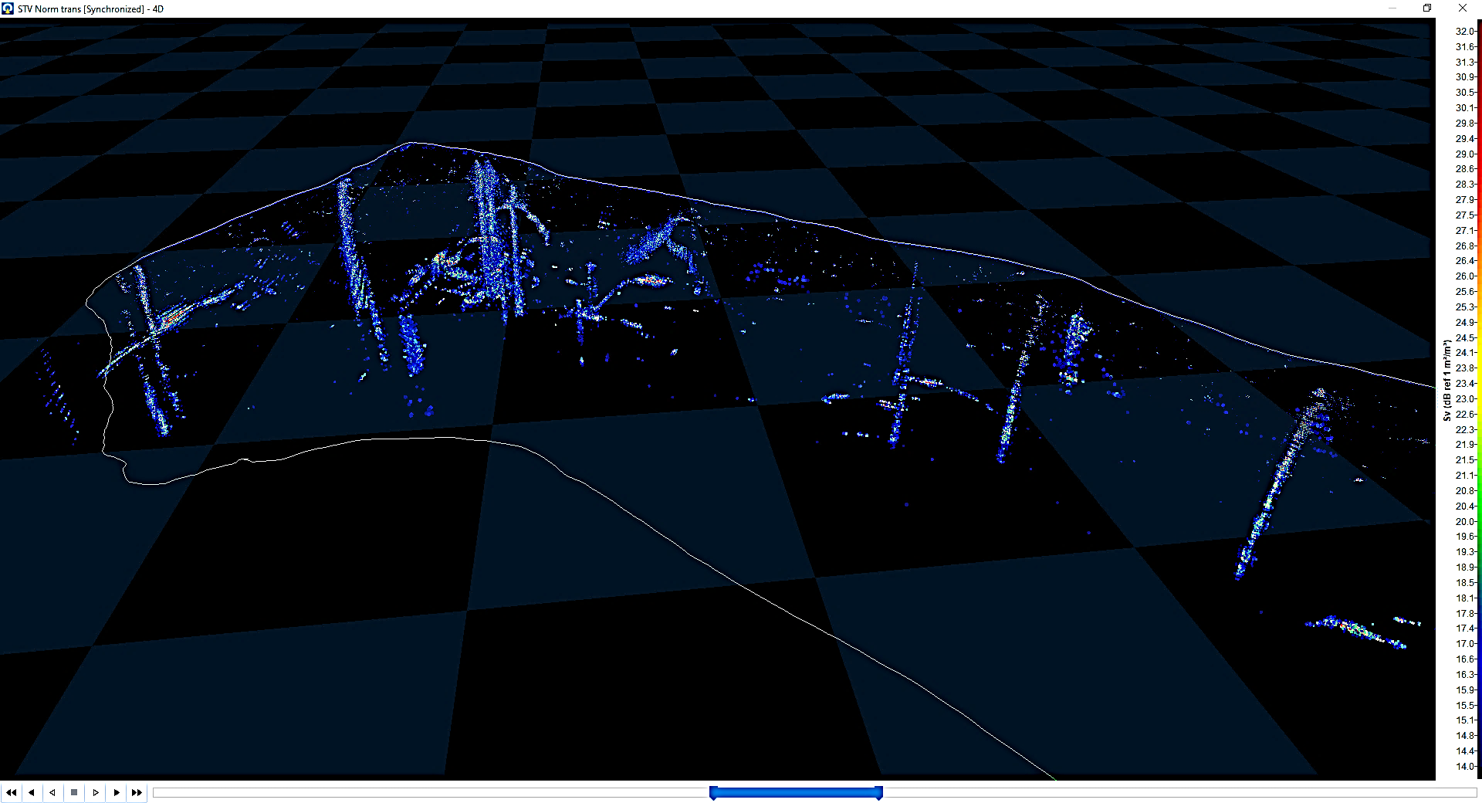

Results: Gas bubbles
Echoes VS SeapiX
fish
(a)
(b)
(c)
Notes:
By using Seapix to obtain backscatter profiles of elements in the water column, it was possible to clearly distinguish fish and gas bubbles, which demonstrates a potential for the development of an automatic gas detection module using the Seapix software.
The upper left figure noted (a) is the resulting historic echogram built from assembling all beams from all previous acoustic swaths represented in (b). The visualisation of this same data is also possible in 3D as shown on figure (c) The overall signal from the bubbles and fish detected in the water column can be represented over the whole path of the multibeam echosounder as depicted on this 3D view. Here is a concentrated colocation of Bubble plumes.
Ongoing research on the Target Strengh (TS) of bubbles suggest they are of very small size (35 µm), which also explain why, in the same spot, we did not observe gas bubbles using camera mounted on ROV. This also raises new perspectives to improve CO2 budget modeling from volcanic bubbles release

Slide 10
  Canopus System for science

Slide 11
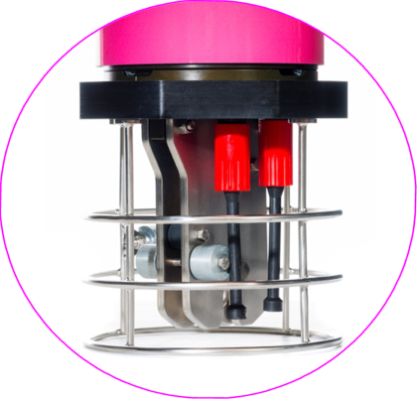
iXblue solution for geodetic measurement is
The Canopus system based on LBL transponder
  4,000 m water depth, corrosion resistant
  Medium frequency bandwidth (MF) – 20 kHz to 30 kHz.
  Multiple users capability (up to 500 addresses),
  Internal environment sensors (pressure, temperature, inclinometer, sound velocity),
  External sensors management (Power supply, Communication, Synchronization)
Quick and easy deployment
  From shallow water to deep ocean
  Internal and external sensors
  User friendly interface
  Acoustic release system
  Accurate range measurements (1cm)
  Pressure sensor: 400 bar range, +/-0.02%FS
  Temperature sensor: -10°C to +60°C, +/-0.1°C
  Inclinometer: +/-90deg 2 axis, +/-0.5deg
  Sound velocity (optional): 1375 to 1900m/s, +/-0.02m/s
  Digiquartz pressure sensor (optional) : 400 bar range, +/-0.01%FS
  All measurements synchonized
Precision, accuracy and reliability
  Milimetrics measurements needed
Data storage capacity and communication
  Telemetry & modem
  Telemetry link (500 bps), modem 4 kbps
  Data logging: SD Card, 32GB
Long term deployment
  Many years of measurements needed
  Housing: aluminum, hard anodizing (Integral), Titanium as an option,
  4 years battery life (alkaline) 7 years lithium (optional)
Notes:
iXblue has designed a system base on LBL technology to measure millimetric (or centimetric ?) drift of the oceanic plate thanks to a USBL antenna, a range metter beacon and the canopus beacon, presented here. The chalenge in geodetic observations is having beacons able to stay on the sea bed for long term measurement, able to range the distance between each other and to communicate with the surface. iXblue did it with canopus system, integrating a beacon submersible up to 4000m watter depth, to stay up to 4 years underwatter, with telemetry and modem communication plus data storage capabilities.

Slide 12
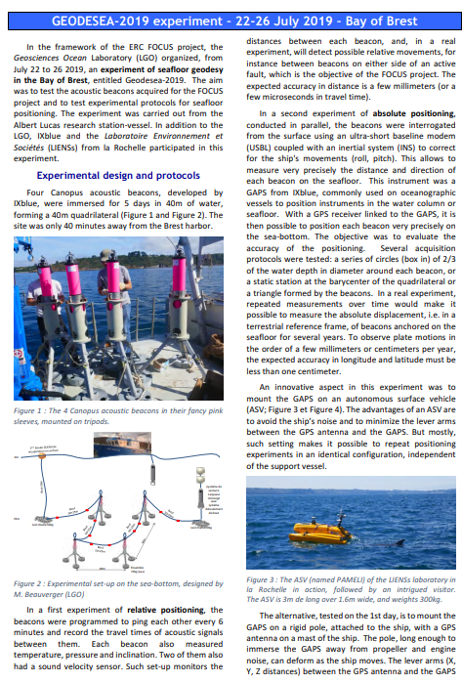
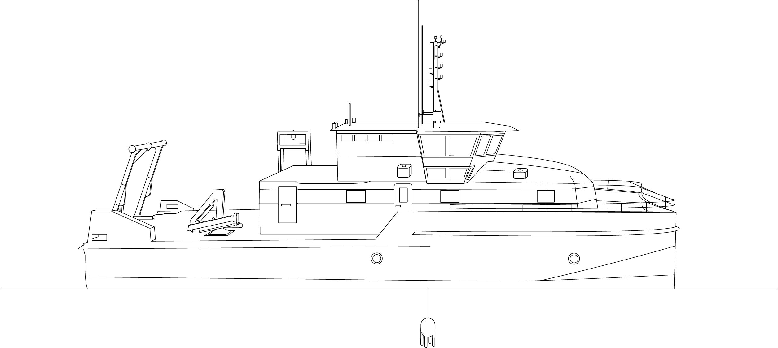


Canopus system Applications
Monitor displacement of the seafloor: Step by step …
Principle
  Network of ‘N’ Transponders
  Calibration
  Ranging & Sensors monitoring
  Data recovery (Modem)
  Data processing
  Transponder recovery
https://www-iuem.univ-brest.fr/lgo/wp-content/uploads/2019/08/20190802_geodesea_EN.pdf
Notes:
The principle of the station is to install these beacons each part of the active fault. To ensure the communication capability between the beacons, we modelized the deployment with our simulation software DSP, before the mission. The beacons will record at specified interval of time, the relative distance between them. They will also measure the pressure, the temperature and their inclination. This information will be stored in the internal memory and thanks to the modem, send to the surface boat at regular time intervals.
This system was tested successfully on Brest Bay in July 2019 By IUEM and LIENS team under the geodesea project.

Slide 13

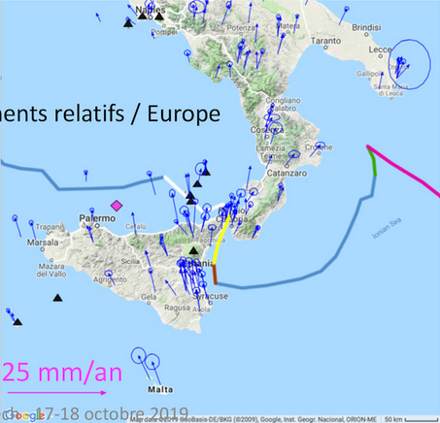
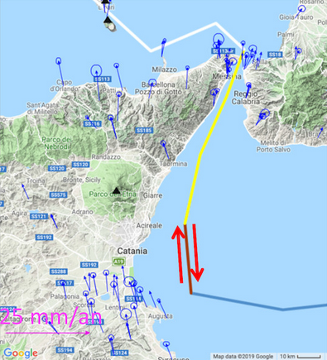
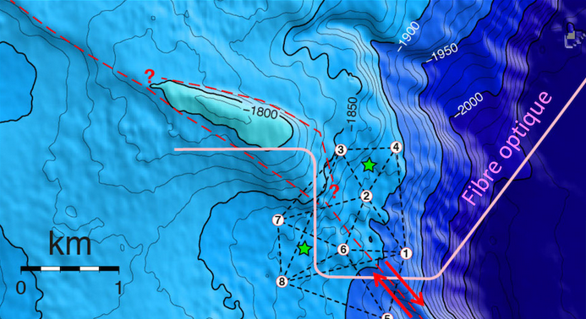

Underwater geodesy, the ERC FOCUS project
An active volcanic & seismic area in Sicily, at the foot of the Etna volcano.
A few mm to a few cm displacement / year, long term observation is required (3 to 4 years)
A 6km long optical fiber deployed across the trench
2 groups of 4 x transponders deployed on tripods each side of the trench
Water depth 1500 ~ 2000m
Project starts mid 2020
Notes:
The system is going to be deployed on Q2 this year in Sicily, at the foot of the Etna Volcano, as part of the Focus Project. The aim is to measure very small displacements during years for long term oceanic plate observation. 2 groups of 4 TP will be deployed on tripods each side of the fault in a water depth around 1500 up to 2000 meters
Doit-on laisser le commentaire ci-dessous ?
In post-processing, we get with 1x TP only almost the same perfs as 3xTP real-time.
Decimeter accuracy without the need to calibrate !
Indeed, precise calibration is required when using >1xTP, to guarantee good heading and scaling accuracy of the baseline…
At the end with 1xTP we get:
Extremely efficient deployment time ➔ one single USBL fix or box-in… or even none if the TP purpose is just to fix the drift!
Live non-drifting navigation, but with slightly lower redundancy ➔ higher sensitivity to acoustic noise
Optimum performance with post-processing

Slide 14
  blueSeis rotational seismometer

Slide 15
From navigation to ground motion product line
Offer the ability to measure a new dimension : ROTATION
, and to do this : ON THE FIELD !
Most intersting places for ground rotation measurement are :
When time difference no longer allows to distinguish P and S waves
When assumption of uniform motion on an array fails
When complex motion could happen leading to strong tilt signal
=> Close to the epicenter (=near field)
blueSeis – 3A
Portable, 3 component rotational seismometer
=> And/or for large events
=> Dangerous places : Iceberg crack, Volcano…
Notes:
Coming from our expertise in navigation, we were more used to measured the motion of boats and ships. But, if you have some friends working in seismology, you may already know that there are a lot of thing to learn measuring the ground motion too. But what your friend may not have mentionned is that until recently, he was only able to measure translation, while rotation contains a lot of information, and above all, offer the ability to solve the 6 Deggre of freedom equation of the motion without assumptions (like homogenous motion on the array, or phase velocity profil to assume etc…)
First, it was written in books that rotation is understanding (since ~1970), second (~20 years ago) Giant Ring Laser gyroscope were build to get the firstrotation measurement, and third, our instrument allows to make these measuremnt on the field thanks to a PORTABLE instrument (ok ~20kg is heavy, but less thant 5 tons=giant RLG)

Slide 16
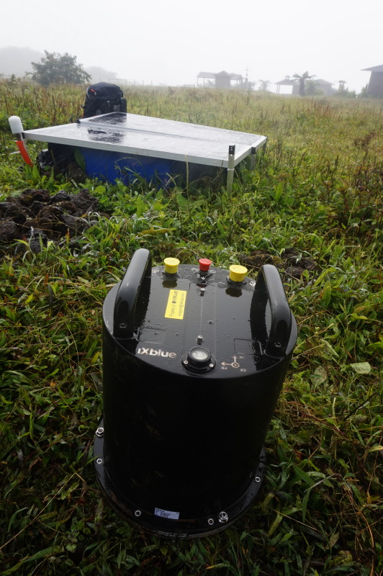
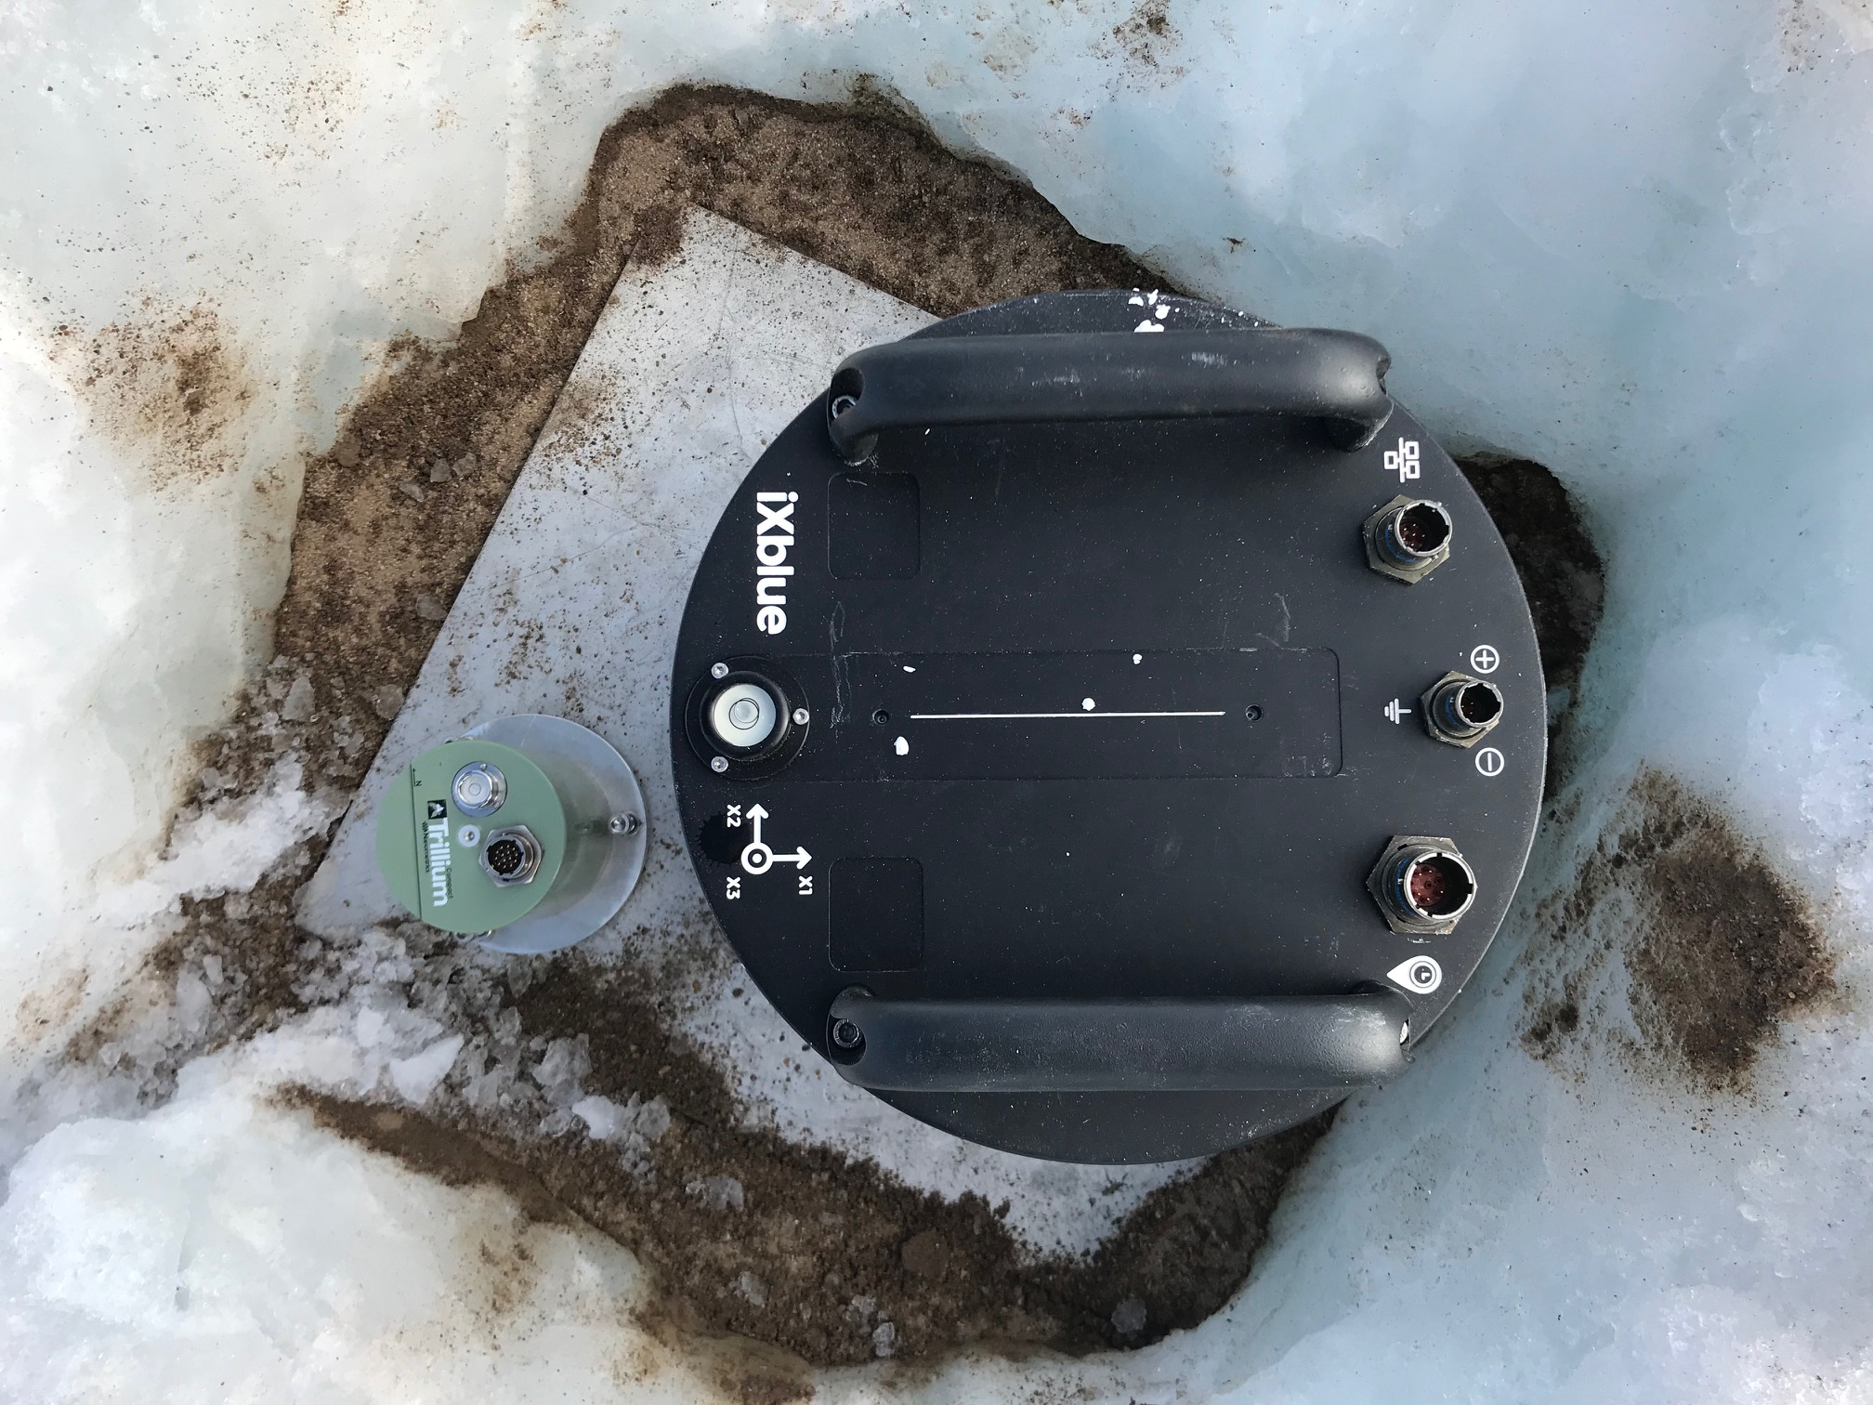
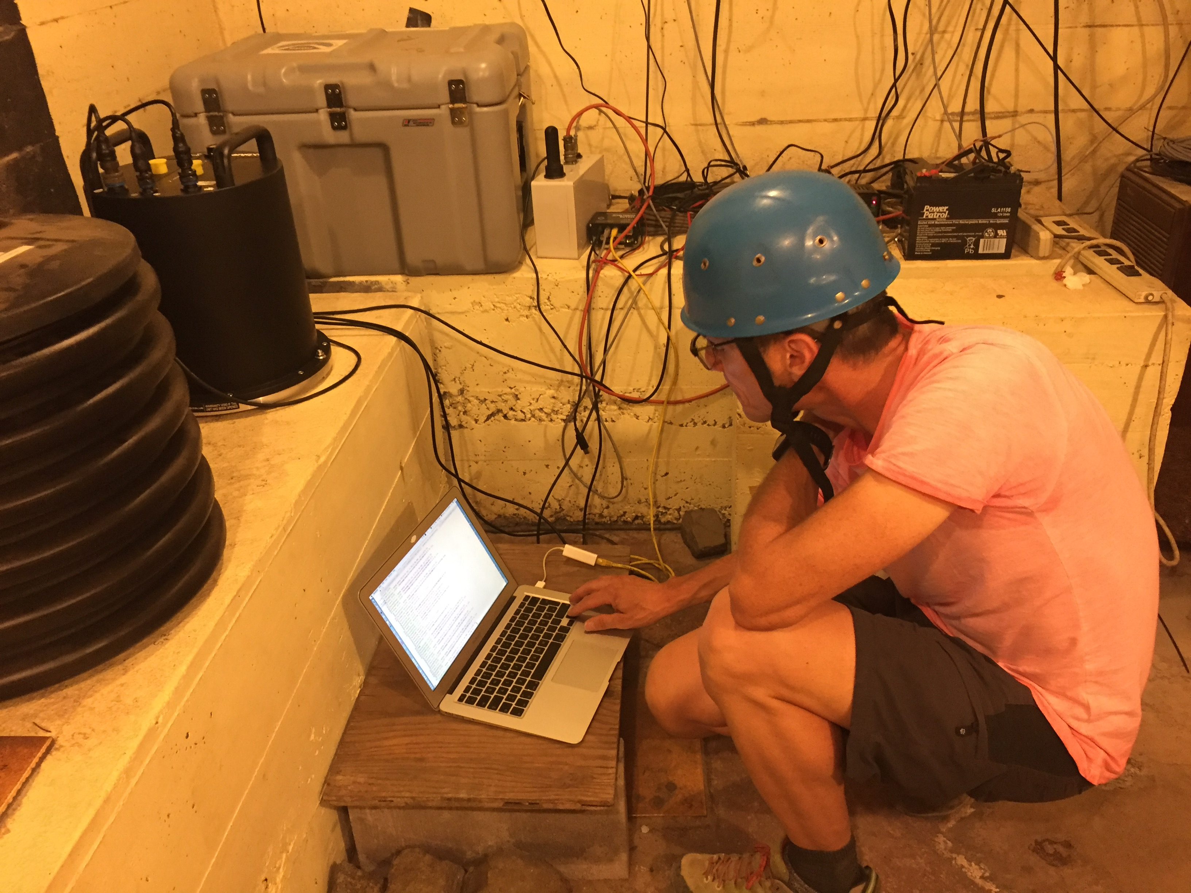
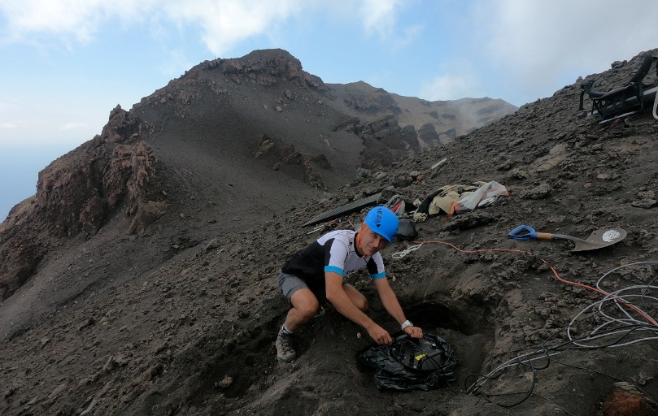
6 C measurements in harsh environement
-20°C in Greenland
100% humidity at Galapagos
In a vault…at 1km of
erupting crater (Kilauea, Hawaii)
+35°C at Stromboli

Slide 17
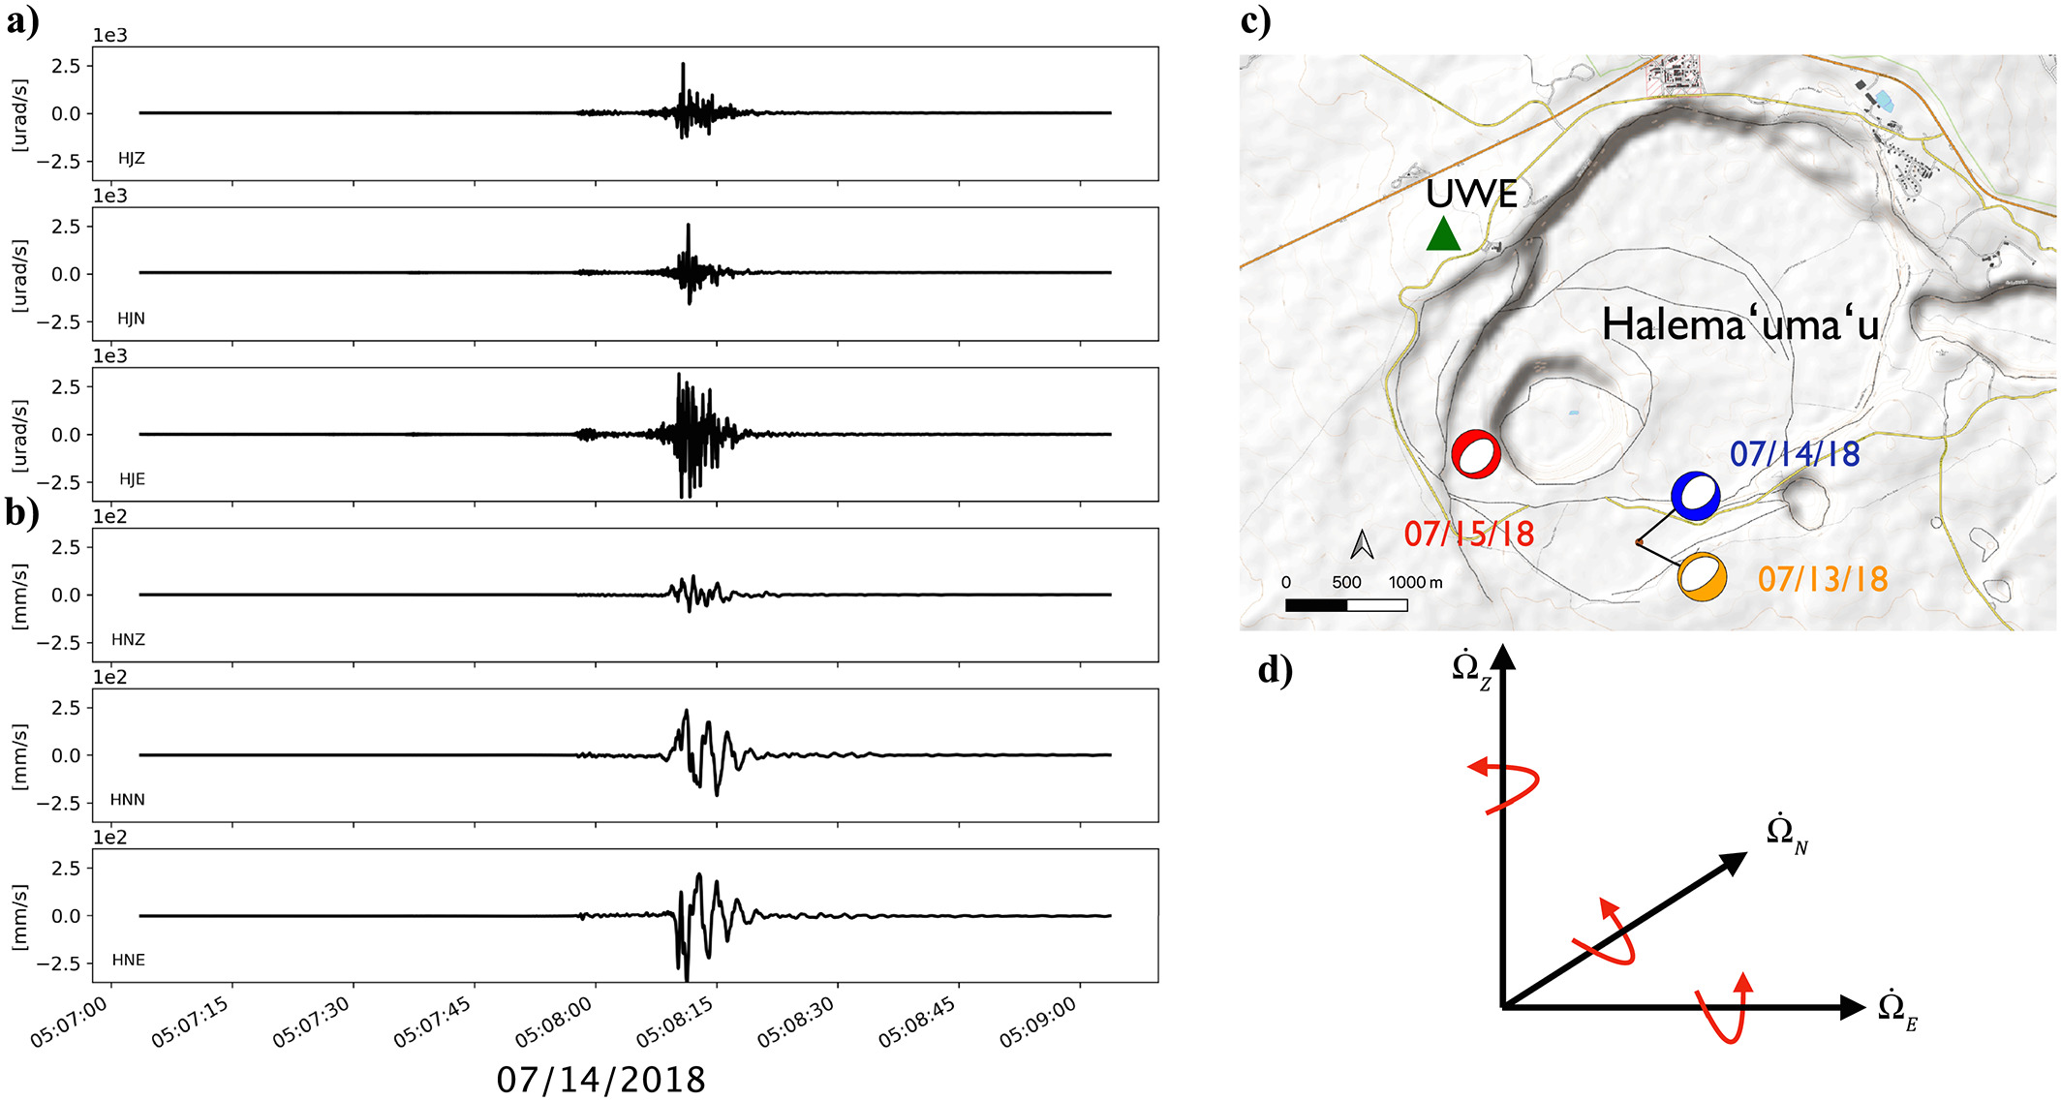
Six‐Axis Ground Motion Measurements of Caldera Collapse at Kīlauea Volcano, Hawai’I (J. Wasserman and al.), GRL 2020
The May to August 2018 eruption of Kīlauea volcano = one of the largest eruptions of the volcano in over 200 years https://agupubs.onlinelibrary.wiley.com/doi/full/10.1029/2019GL085999
blueSeis-3A installed closed to the volcano collocated with broadband 3 axes seismometer and tiltmeter
“Rotational sensor allows to distinguish local effect due to vault motion during collapse , which would normally pass unseen and lead to an incomplete picture of the total motion and partially incorrect interpretations”
rotation
translation
From Wasserman et al. 2019,
‘Six-Axis Ground Motion
Measurements of
Caldera Collapse at
Kīlauea Volcano, Hawai'i’
Notes:
A blueSeis‐3A rotational seismometer was installed in the Uwekahuna (UWE) station vault of the Hawaiian Volcano Observatory (USGS‐HVO) monitoring network (Figure 1c).
Colocated with a Streckeisen STS‐2 broadband seismometer, Kinemetrics EpiSensor accelerometer

Slide 18
Back-Azimut estimation from single 6C station in near field
Italian seismic Crisis 2017
Yuan, S., Simonelli, A., C.J. Lin, F. Bernauer, T. Braun, J. Wassermann, H. Igel, (2020), 6 Degree-of-Freedom Broadband Ground-Motion Observations with Portable Sensors: Validation, Local Earthquakes, Signal Processing, Bulletin of Seismological Society of America, in press.

Slide 19
Volcanic activity at Stromboli
Rich and interesting information derived from rotational signals helps understanding internal volcanoe processes
Yuan, S., Simonelli, A., C.J. Lin, F. Bernauer, T. Braun, J. Wassermann, H. Igel, (2020), 6 Degree-of-Freedom Broadband Ground-Motion Observations with Portable Sensors: Validation, Local Earthquakes, Signal Processing, Bulletin of Seismological Society of America, in press.

Slide 20
Thank you !!!
Listening the Womb of the Earth
iXblue sonars, transponder & rotational seismometers for extreme environment imaging & monitoring

