Slide 1

On the applicability of ICESat-2 and off-nadir SkySat satellite datasets for the estimation of water storage in medium and small reservoirs at the global scale
Gennadii Donchyts¹, Dirk Eilander^{1,2}, Antonio Moreno-Rodenas¹, Maarten Pronk¹,
Samapriya Roy³, and Hessel Winsemius¹
¹Deltares, Delft, Netherlands
²Vrije Universiteit Amsterdam, Netherlands
³Planet, Raleigh, NC, USA
Notes:
This presentation shows some early results of using ICESat-2 data and SkySat satellite imagery to reconstruct storage dynamics in reservoirs. It starts with a current progress of building a global small and medium size reservoirs database (N~=80000, slide 5), including surface water dynamics (time=[1985,2018]). The database includes reservoirs of the size >5ha (0.05km^2). The observation frequency of the area dynamics could be greatly increased by using satellite image where water surface is partially visible (slide 6). The resulting surface water area dynamics of reservoirs is being aggregated on a country / drainage basin level, to explore global changes. Changes in small reservoirs seem to be more sensitive to seasonality and climate (droughts, slide 8). The A(t) time series were validated using in-situ data from four countries: India, South Africa, Spain, and USA. This kind of in-situ data collection is very unharmonized and requires time-consuming manual efforts searching for proper data feeds (slide 9). The validation of the resulting time series show a very good fit with the in-situ data (r2 > 0.8-0.9, with a low RMSE ~1-2% of mean area, slides 10-16).
One way to turn EO-based surface water area estimates into storage time series is to estimate elevation changes for dynamic pixels of the reservoir. Currently, we explore three directions: 1) Using InSAR to generate DEM (as discussed in Donato et. al. 2017) 2) Using photogrammetry combined with high-resolution satellite imagery, and 3) using ICESat-2 LiDAR tracks covering dynamic reservoir water pixels and acquire during dry seasons. We have started exploring and developing methods ICESat-2 and Photogrammetry. The first results show that for roughly 1/3 part of Spain with 231 reservoirs, about 51% have overlap with ICESat-2 tracks. Some reservoir have multiple intersection (with a total number reaching 26). The ICESat-2 seems to have a very high vertical accuracy (0.2-1m) but we will have to perform independent accuracy analysis, using LiDAR measurements, since dynamic pixels of reservoirs mostly have homogeneous structure. We have imported some ICESat-2 track data into Google Earth Engine to perform further analysis on a large scale, e.g. compare with existing DEMs such as SRTM, ALOS and also intersect with satellite imagery (Sentinel-2, 1 and Landsat), slides 21-22. ICESat-2 elevations are measured relative to WGGS84 ellipsoid, so a trivial correction using EGM96 geoid is needed to convert everything to the reference level used by SRTM and ALOS, slide 23. Slides 24 and 25 show that for this particular reservoir (randomly selected) in Spain, Embalse de Gabriel y Galan reservoir and overlap with ICESat-2 track allows estimating storage with a high accuracy (elevation measurements correlate very well with the water occurrence data). However, a small part (<20km2) is not covered. However, extrapolation regression line should give a reasonable estimates for that part. An alternative, probably less accurate, technique which could be used to estimate storages is by reconstructing the actual DSM using stereo-photo pairs acquired during dry season and photogrammetric software like MicMac (slide 26). Currently, we have started exploring this option, but access to commercial high-resolution data (<1m) would be crucial in this case.

Slide 2
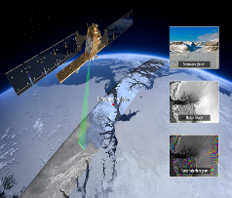
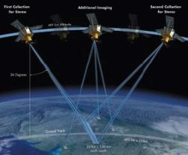
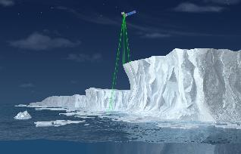
How to measure storage changes from Space in small reservoirs?
InSAR
Photogrammetry
Space LiDAR
How to measure surface water area changes?
How to identify reservoirs?

Slide 3
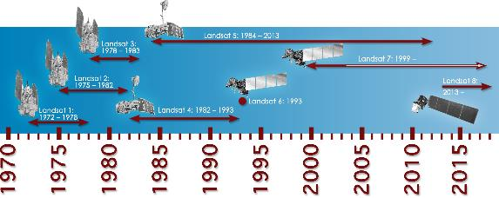
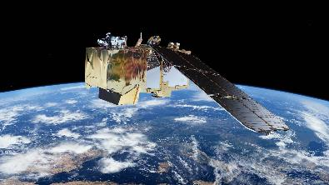
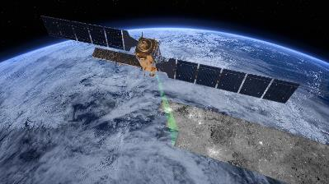
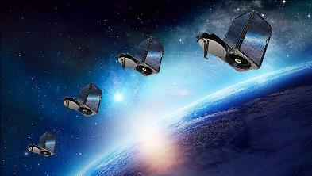
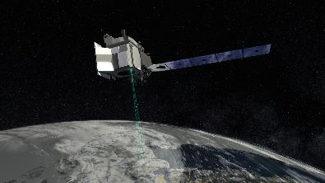
Satellite Missions
Landsat
Sentinel-2
Sentinel-1
SkySat
ICESat-2

Slide 4
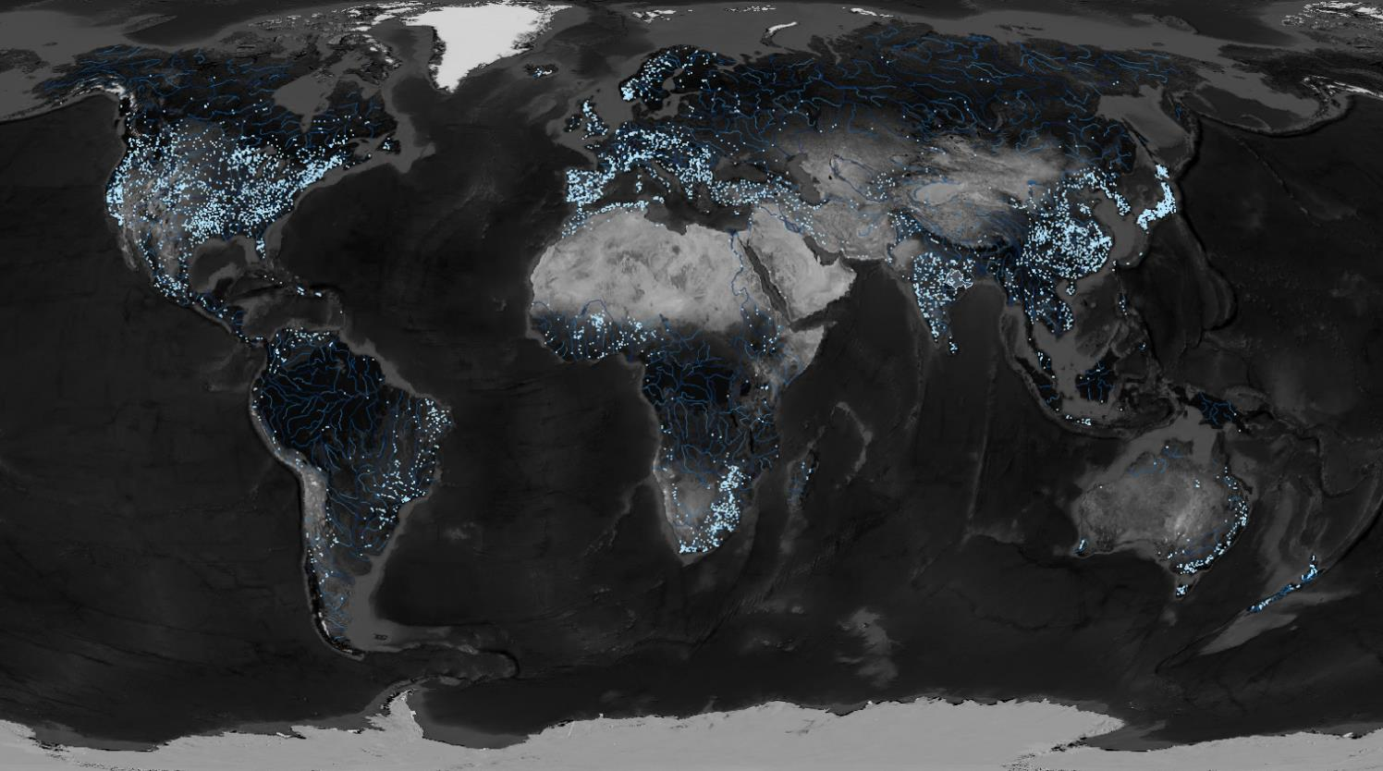
Where are the reservoirs?
GRaND, N = 7320
Lehner et.al., 2011

Slide 5
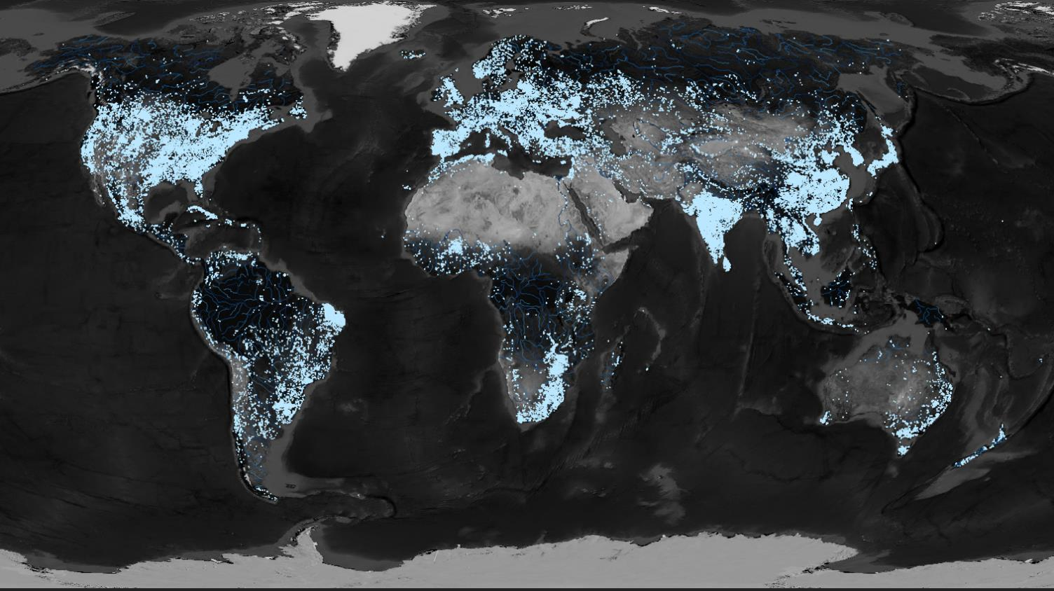
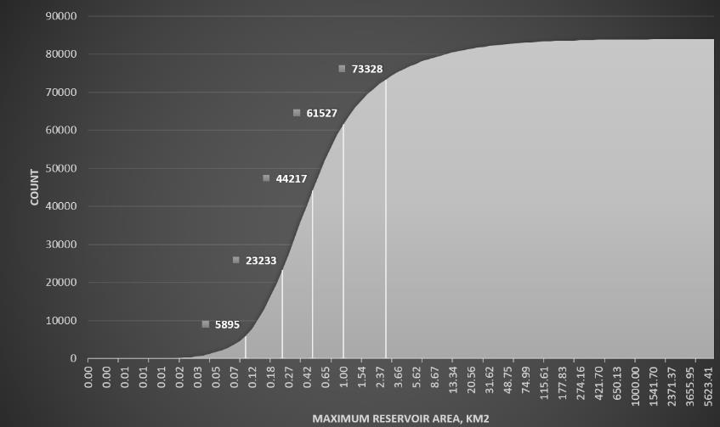
Where are the reservoirs?
This research, N = 80 776, A < 5 ha
Sources: GRaND, GOOD², HydroLAKES, Wikipedia, OpenStreetMap

Slide 6
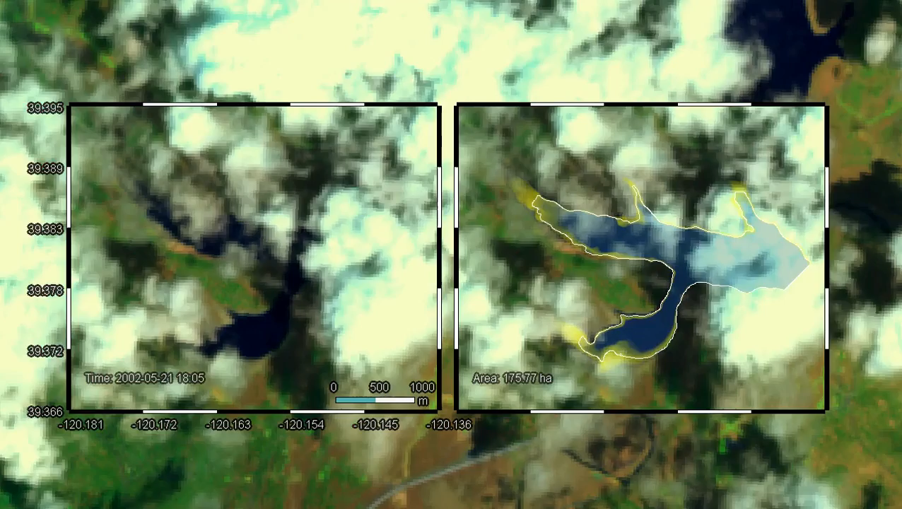
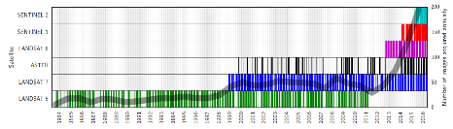
Can we monitor surface water area changes
from Space in all these reservoirs with free data?
Yes, almost daily!

Slide 7
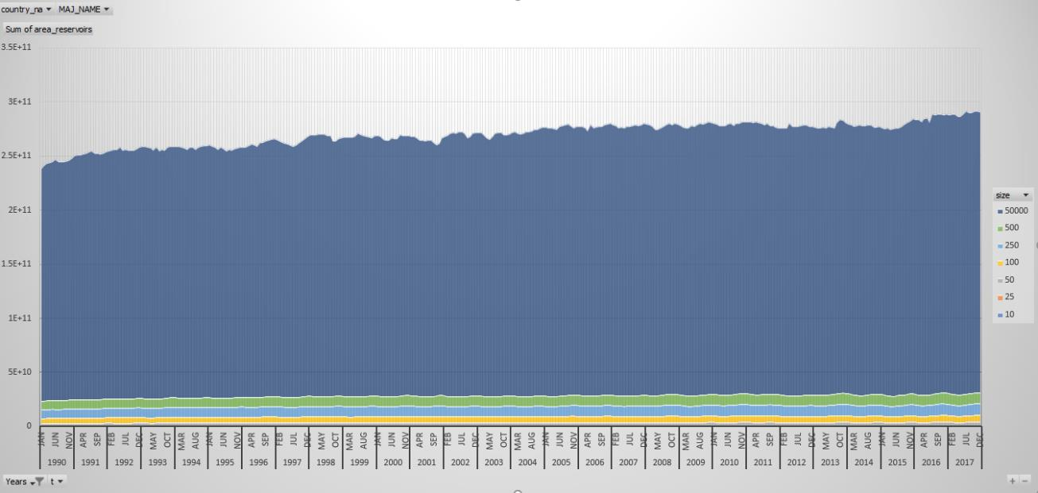
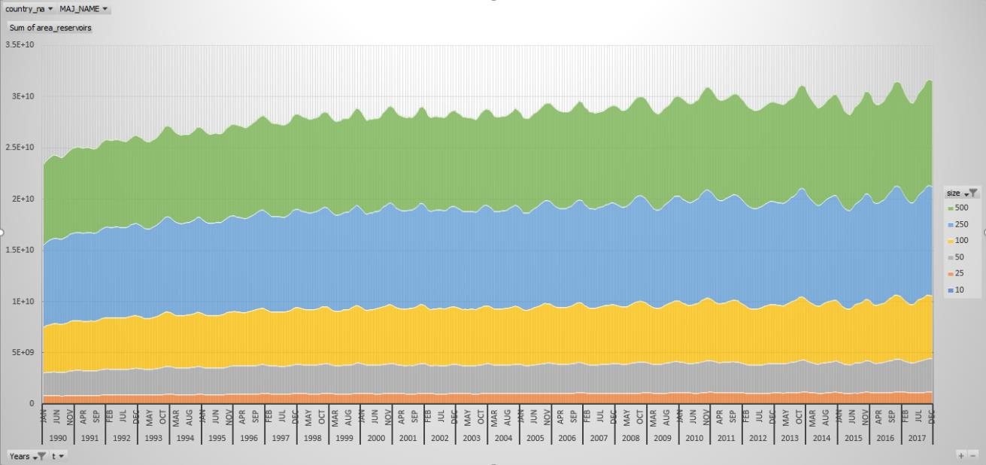
… 6 month of runtime using Google Earth Engine
~80 000 x 1000 images later

Slide 8
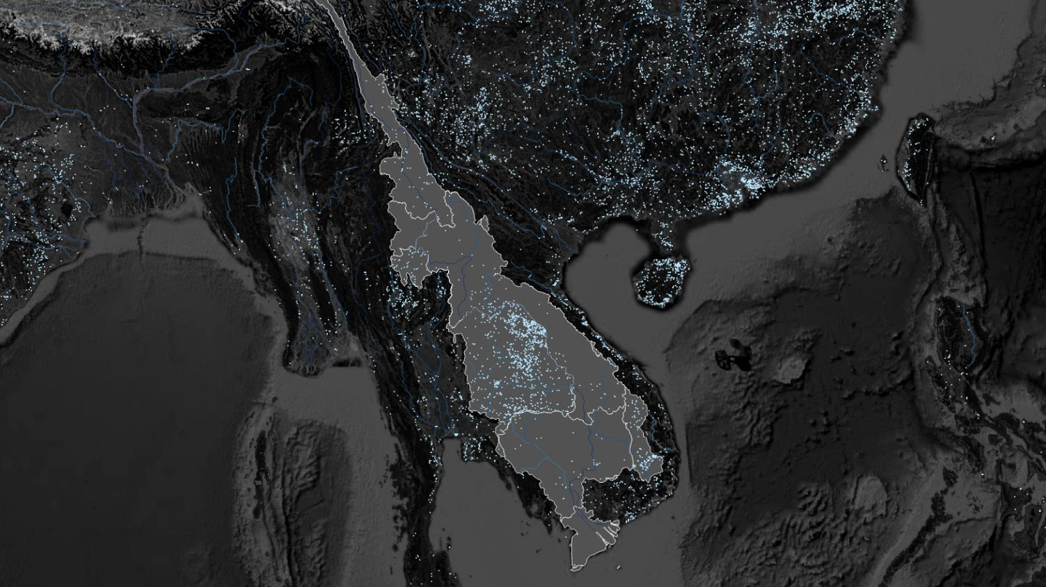
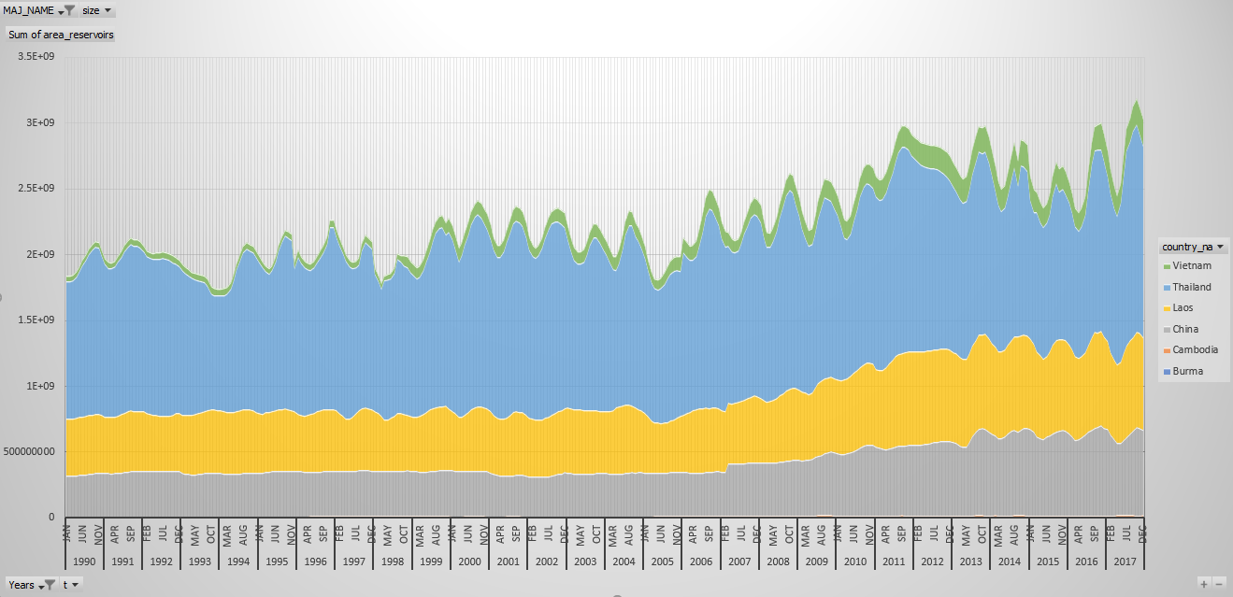
… 6 month of runtime using Google Earth Engine
~80 000 x 1000 images later
Mekong River Basin

Slide 9
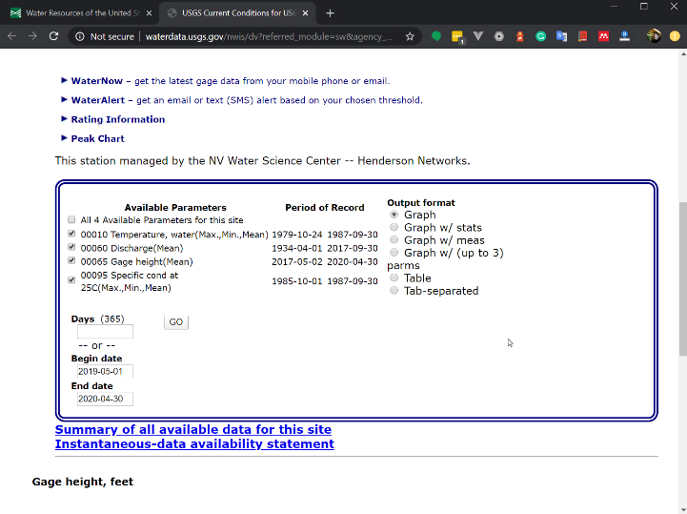
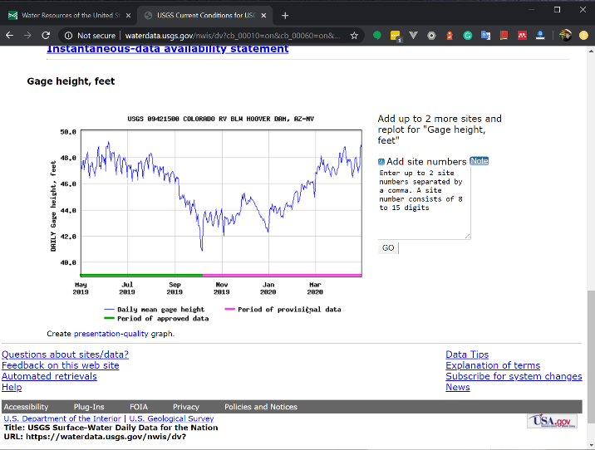
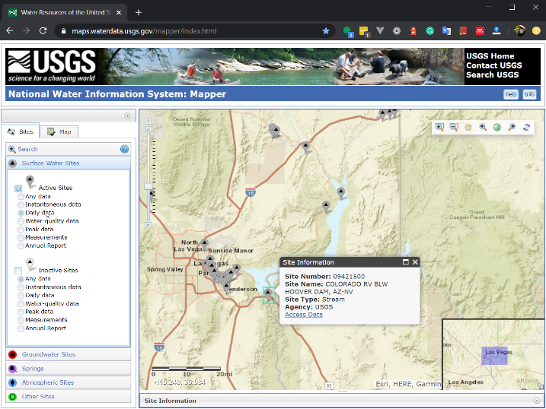

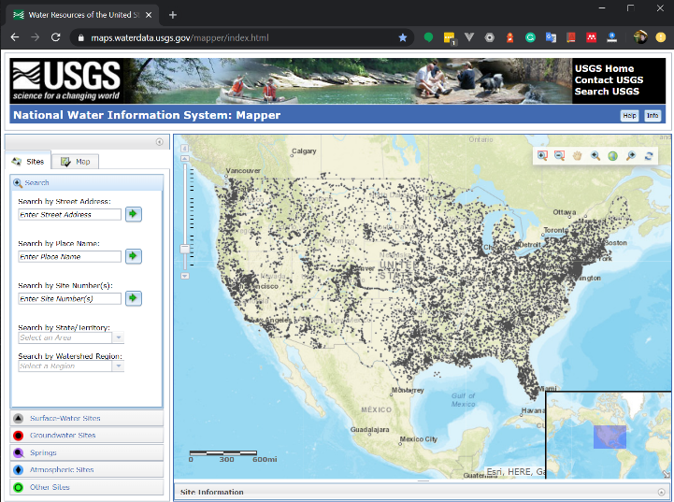
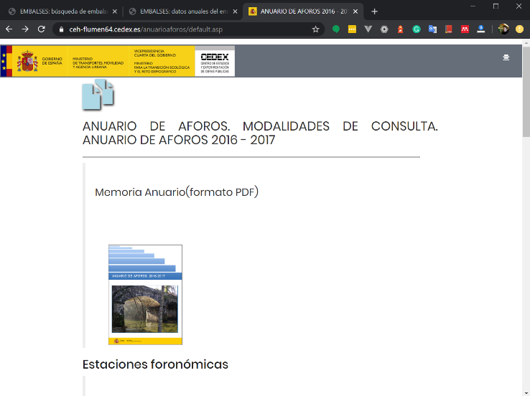
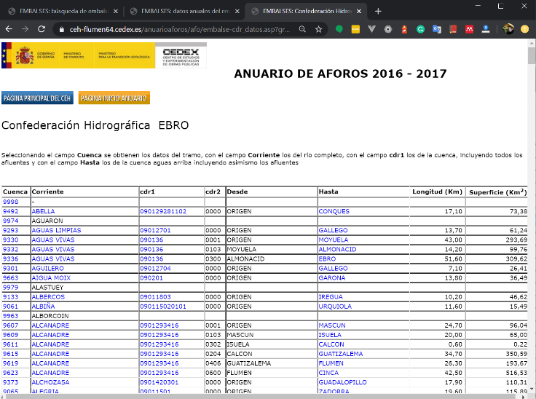
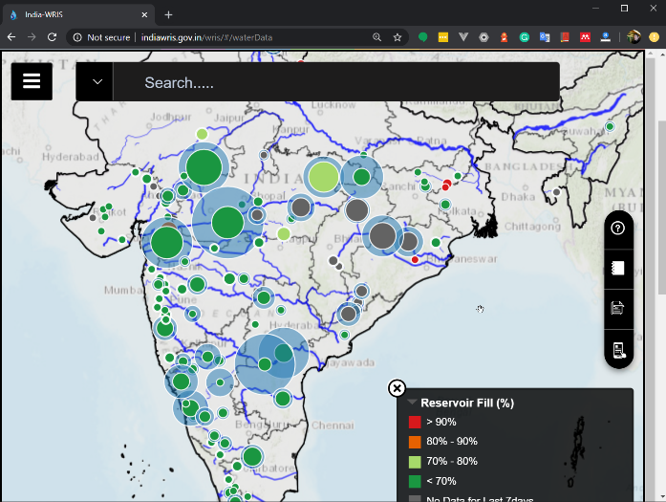

How to validate it?
USA
Spain
India
South Africa

Slide 10
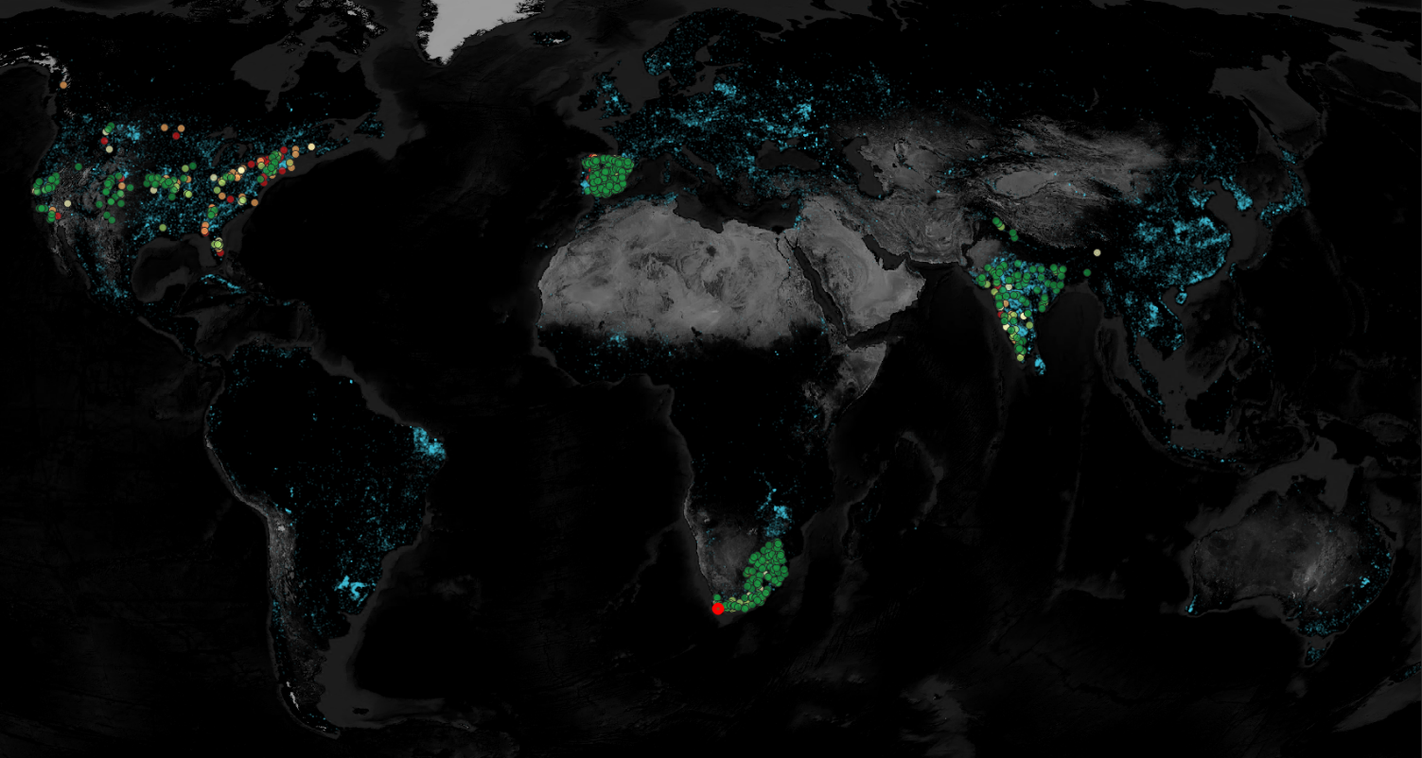

Validation using 786 in-situ measurements (daily data)
r²

Slide 11
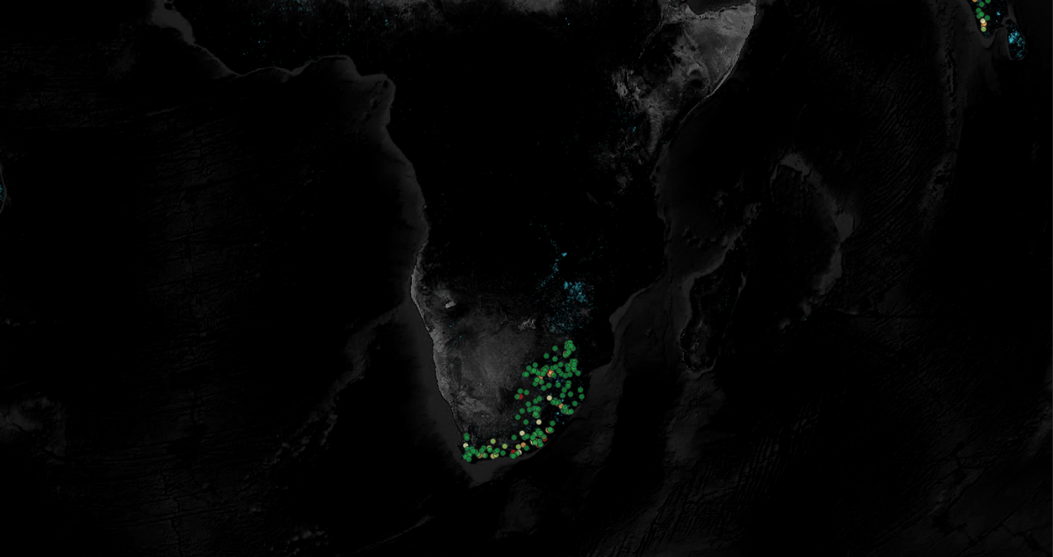
Validation using 786 in-situ measurements (daily data)
r²

Slide 12
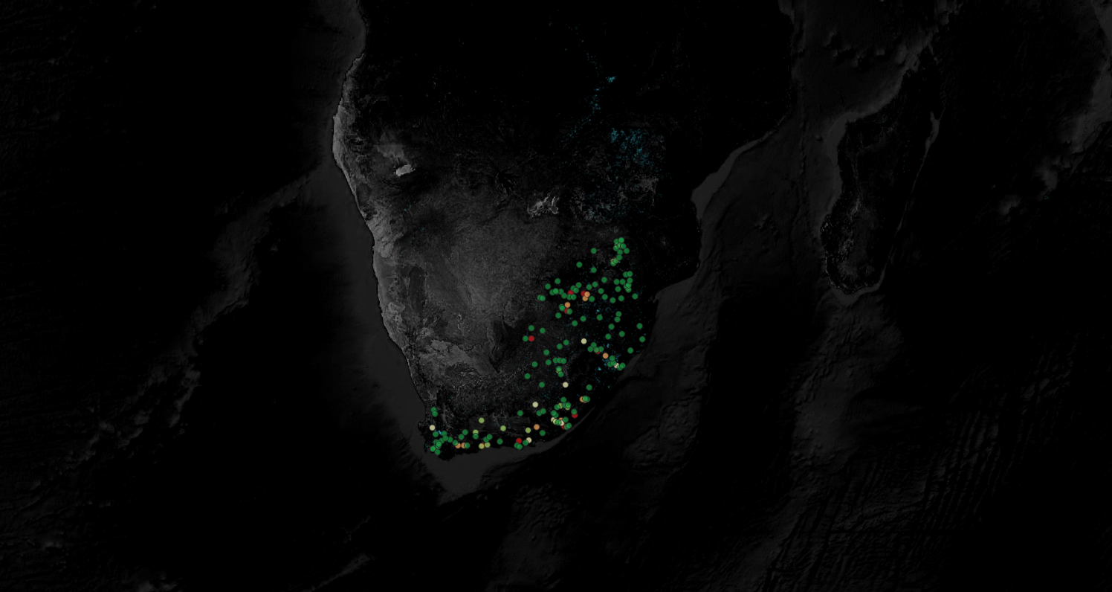
Validation using 786 in-situ measurements (daily data)
r²

Slide 13
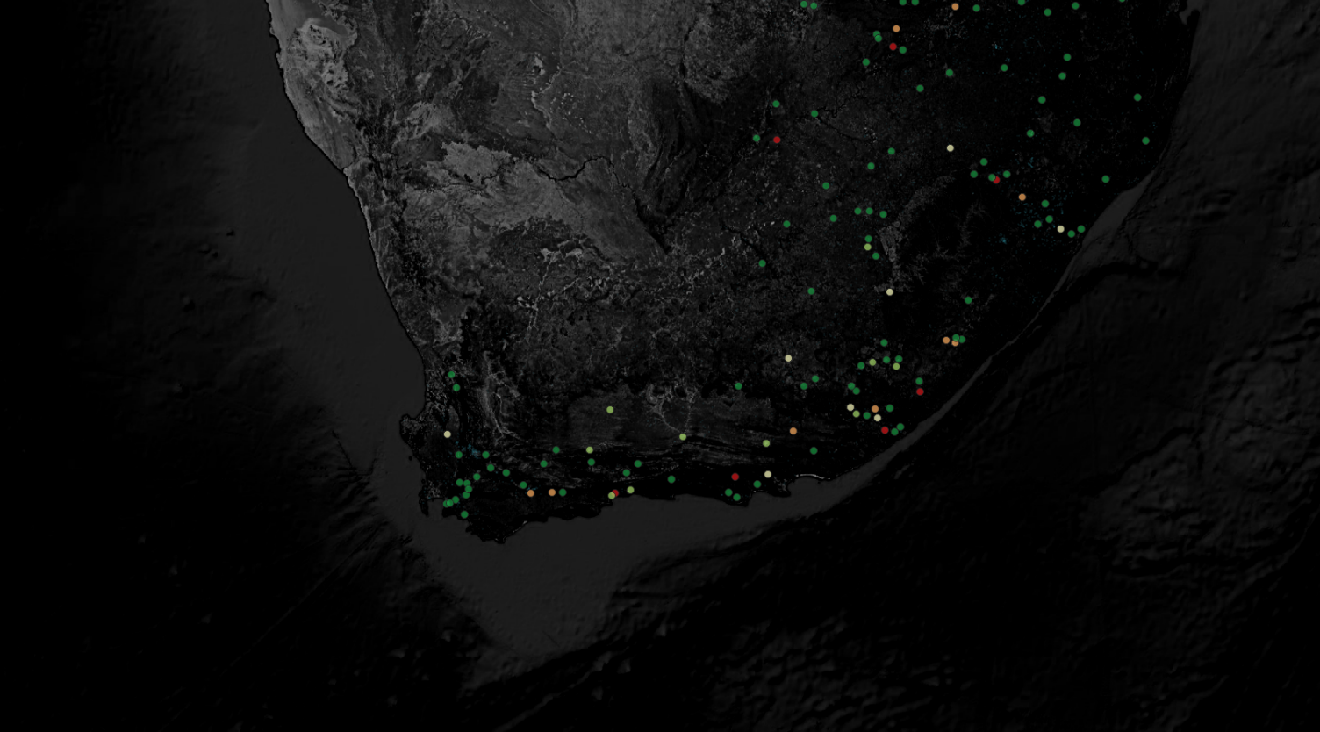
Validation using 786 in-situ measurements (daily data)
r²

Slide 14
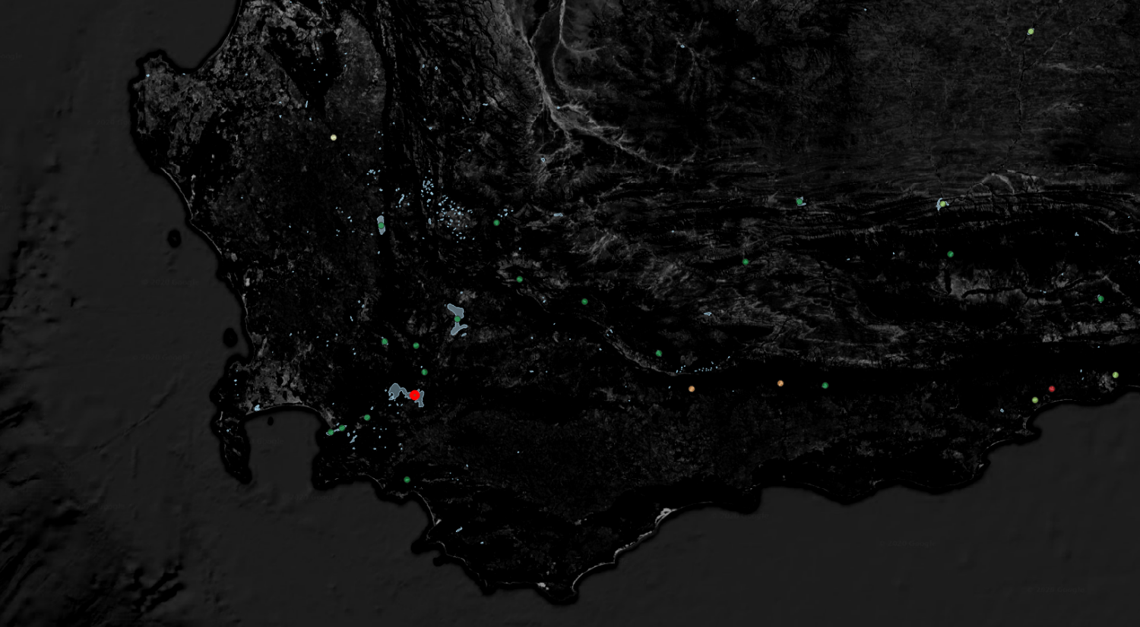
Validation using 786 in-situ measurements (daily data)
r²

Slide 15
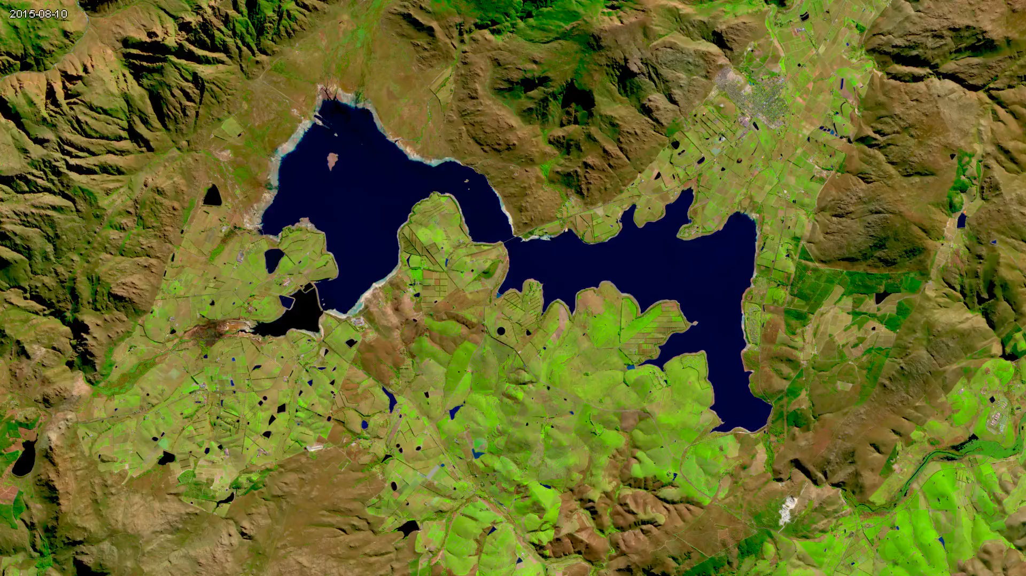
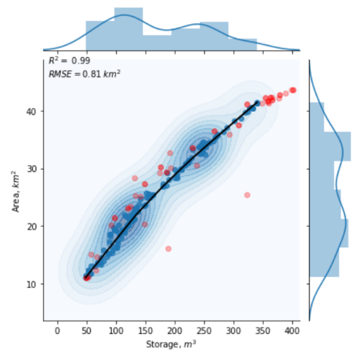
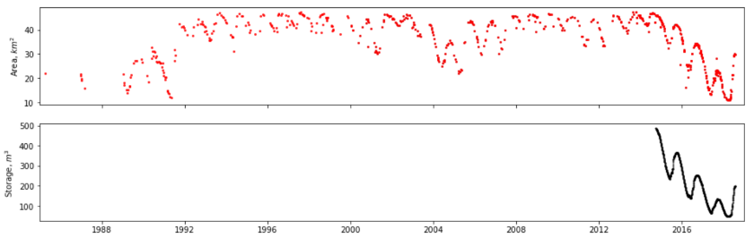
Theewaterskloof Dam

Slide 16
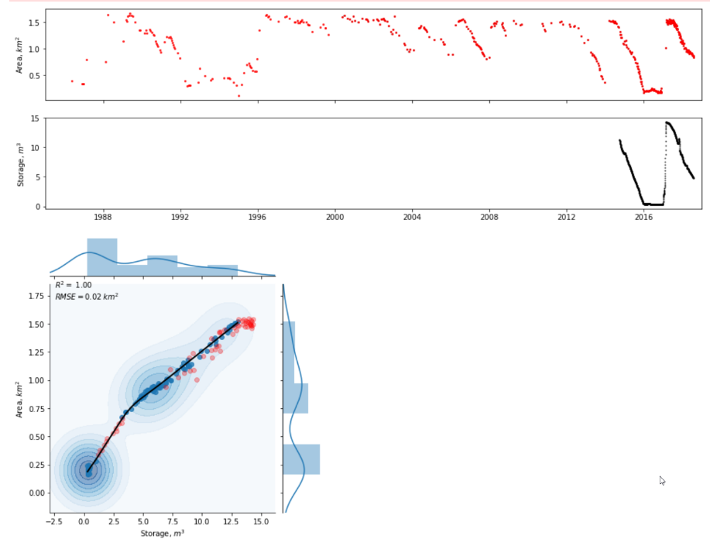
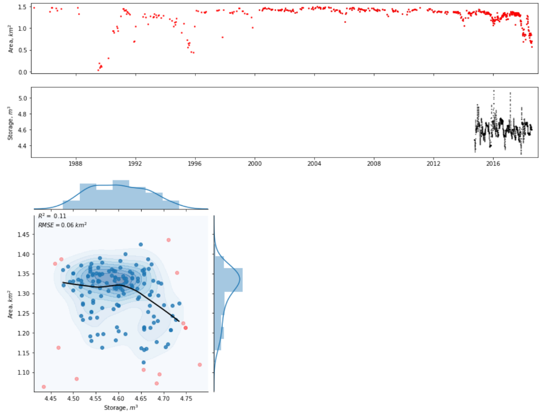
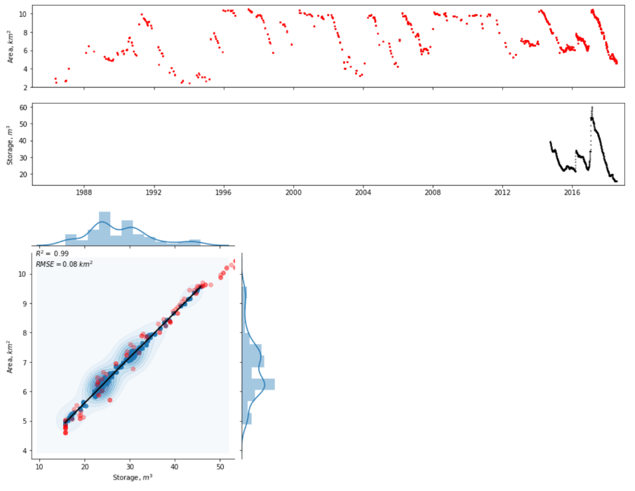
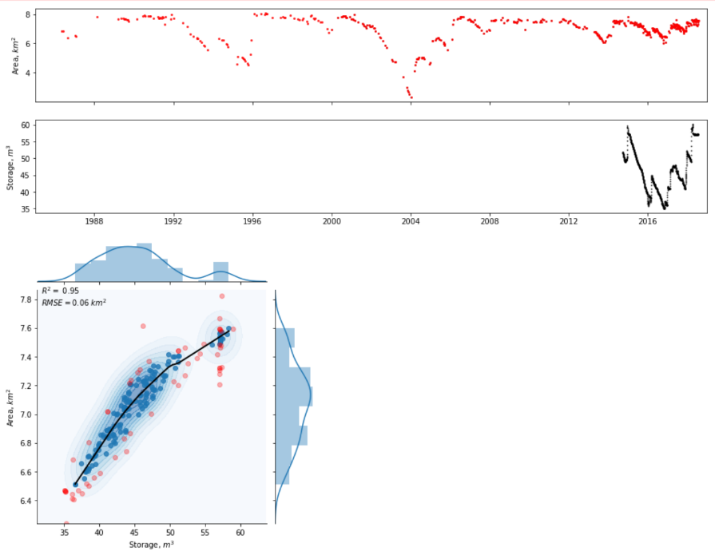
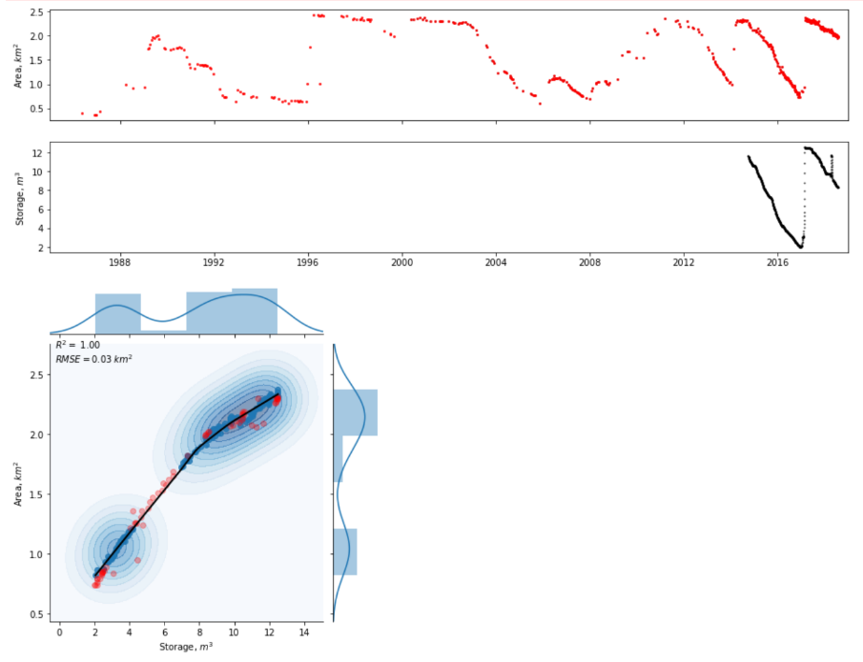
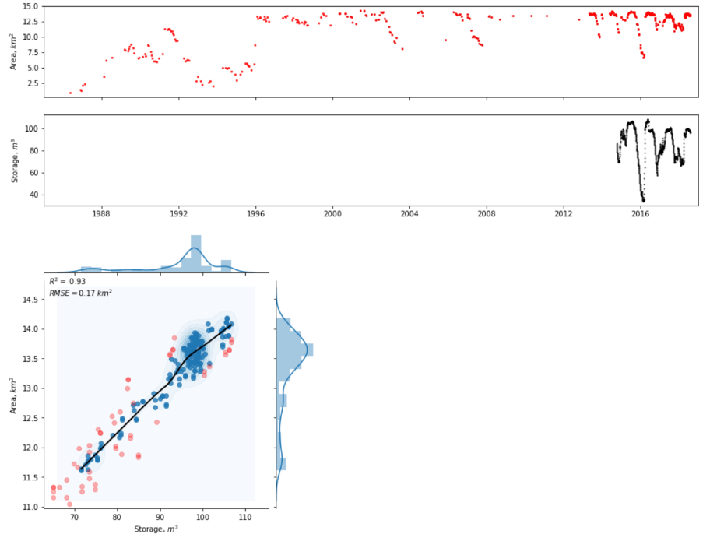
Validation using 786 in-situ measurements (daily data)
r²

Slide 17
How to measure storage in tiny reservoirs without in-situ data?
InSAR
Photogrammetry
Space LiDAR

Slide 18
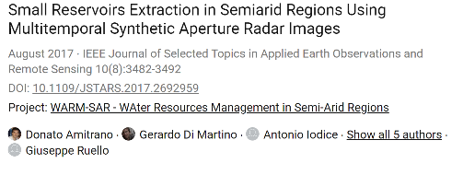

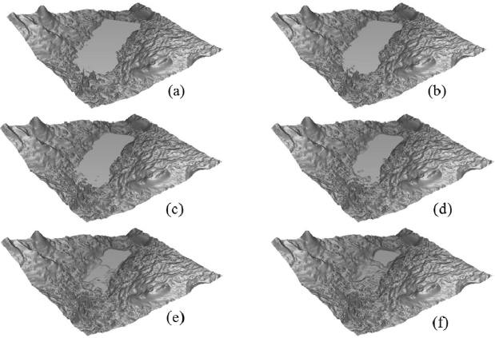
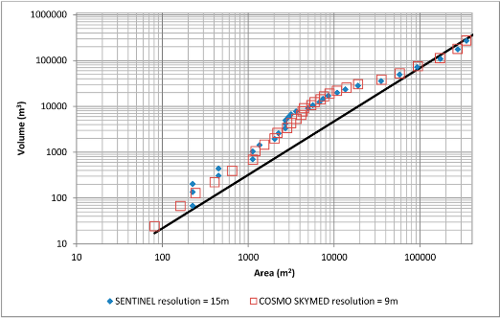
SAR + InSAR
Hypotheses to be checked:
          1. Automation is not easy
          2. Getting high vertical accuracy can be challenging

Slide 19
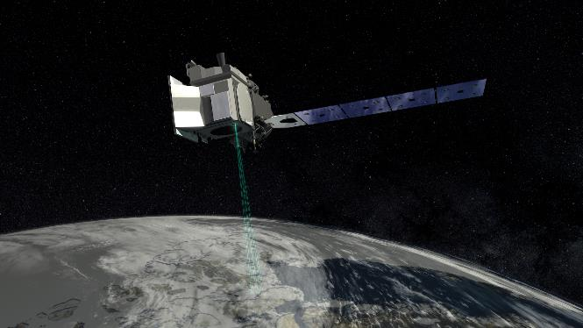
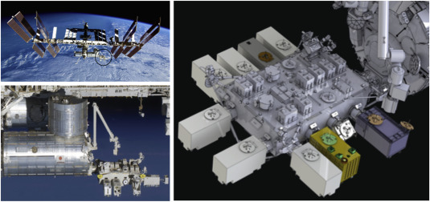

LiDAR from space
ICESat-2 / ATLAS
GEDI
Footprint size: 15m, Pulse frequency 10KHz (0.5m!)
Wang et.al., 2019:
Parrish et.al., 2019: RMSE for Bathymetry = 0.43–0.60 m
Footprint size: 25m along track spacing 60m ☹
Dubayah et.al., 2020: “… horizontal geolocation accuracy for calibrated final products is between 10 and 20 ​m and the vertical accuracy is on the order of 50 ​cm”

Slide 20
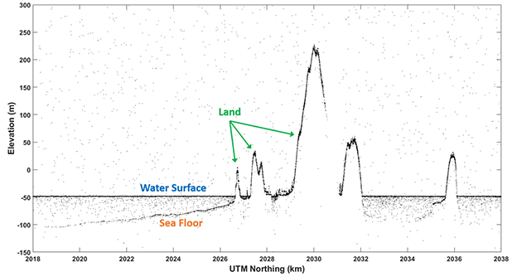
ICESat-2

Slide 21
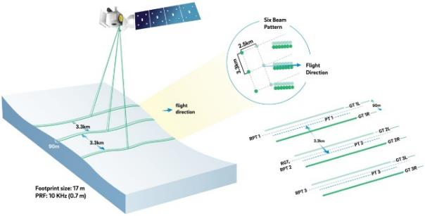
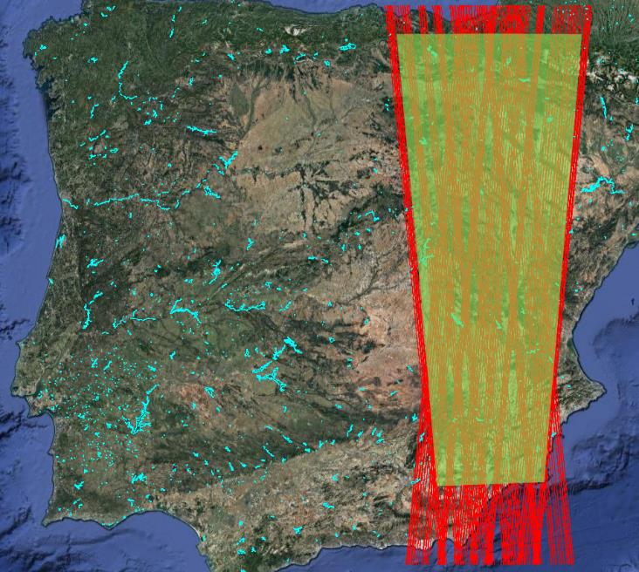
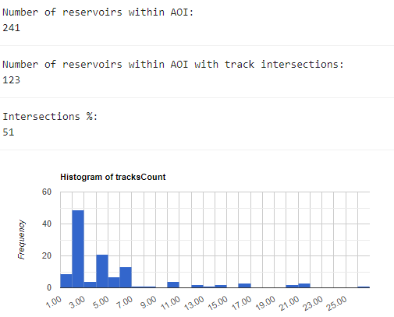
ICESat-2

Slide 22
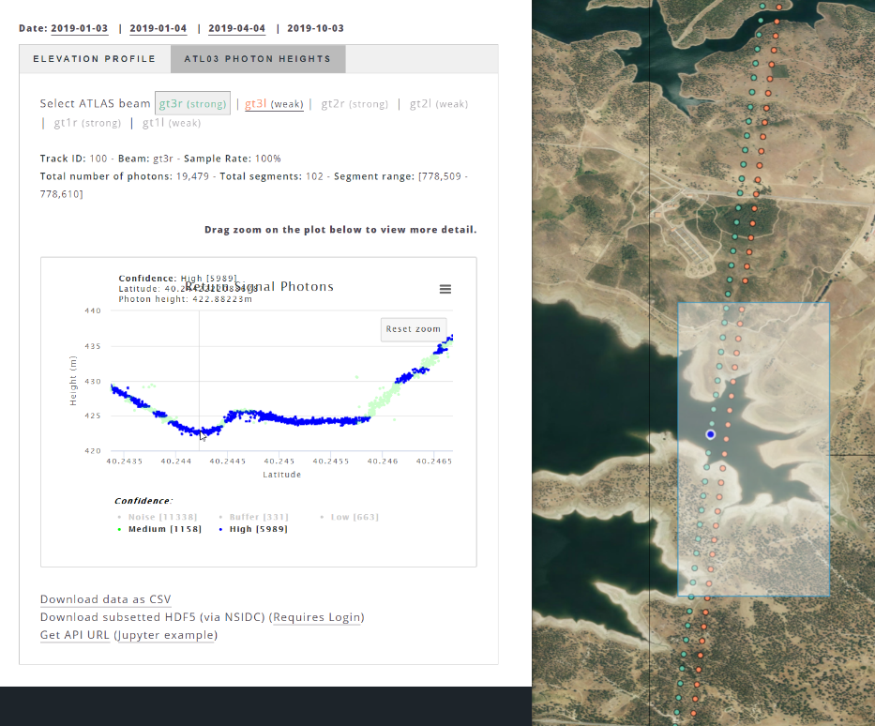
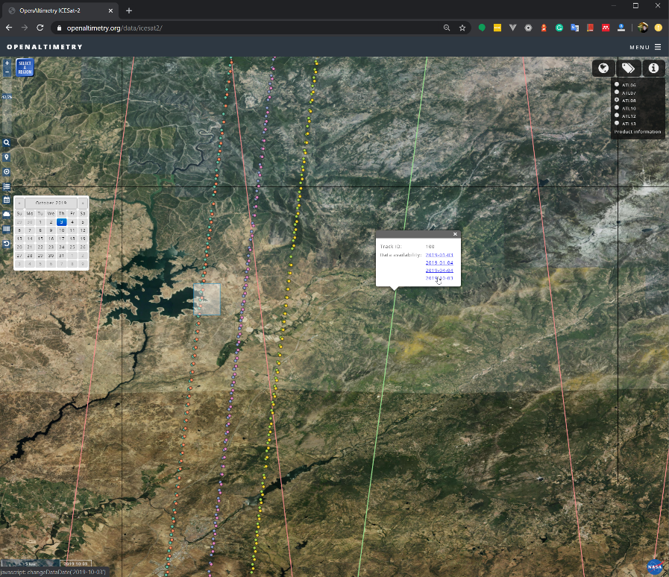
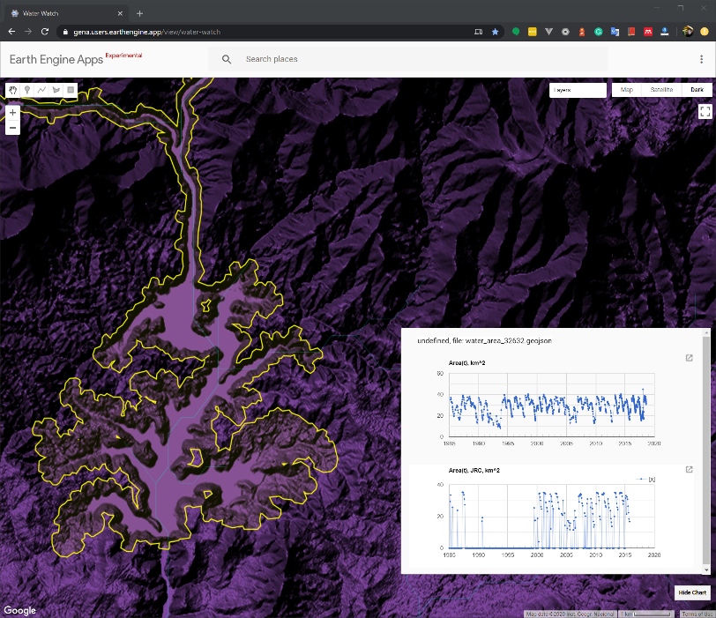




ICESat-2
Embalse de Gabriel y Galan
https://gena.users.earthengine.app/view/water-watch

Slide 23





ICESat-2
Embalse de Gabriel y Galan
EGM96 geoid vs WGS84 ellipsoid
Getting data into Earth Engine https://code.earthengine.google.com/1a2b5a90ac69acc01179ac86bd032f23
+/-50m
Notes:
https://code.earthengine.google.com/?scriptPath=users%2Fgena%2Fdefault%3AICESat-2.js

Slide 24




ICESat-2
Embalse de Gabriel y Galan
No information in this track for water levels below this value
Notes:
https://code.earthengine.google.com/?scriptPath=users%2Fgena%2Fdefault%3AICESat-2.js

Slide 25



ICESat-2
Embalse de Gabriel y Galan
Missing for this ICESat-2 track
Notes:
https://code.earthengine.google.com/?scriptPath=users%2Fgena%2Fdefault%3AICESat-2.js

Slide 26



Optical off-nadir + Photogrammetry … to be continued
Rupnik et.al., 2018: 3D reconstruction from multi-view VHR-satellite images in MicMac

Slide 27
Summary and Next Steps
Global ~80 000 small reservoirs database A < 5ha
35 years re-analysis of surface water dynamics
Validation shows mostly a very high accuracy for A(t)
ICESat-2 (if available) can be perfectly used to generate storage dynamics
Photogrammetry + $$$ imagery needed to increase coverage – tbc
InSAR and Sentinel-1 can be potentially used as well – tbc.

Slide 28



Thank you for your attention!
gennadii.donchyts@deltares.nl
@gena_d
@gena
facebook.com/deltaresNL
linkedin.com/company/deltares
@deltares
@deltaresNL

