Slide 1
Field observation of hydroxy diacids (DCAs) in PM2.5 and insights into their formation from aliphatic diacids through heterogeneous oxidation

Slide 2
Outline
Semi-volatile properties of DCAs
hDCA/DCA ratio correlation with ion/gas species
Correlation with species (outliers influence)
Diurnal variation features
Relationship with RH and H2O(aq)
Short Conclusions
Proportion of DCA in gas/PM phase affect their formation pathways and thus correlation behavior with species

Slide 3
Samples details
Sampling location
An urban site in Yuen Long (YL), Hong Kong
Sampler located on the roof of a five-floor building
Sampling duration
Short duration sampling divided into 4 period in one day, sampled every 3 or 4 days.
P1: 06-00-11:00
P2: 1100:-16:00
P3: 16:00-21:00
P4: 21:00-06:00
Samples were collected in Summer and Winter.
Total samples=64 (Summer:36,Winter:28)
Sample analysis
filter-based samples were extracted by distilled 4:1 (DCM:MeOH). It was then blow-dried by UHP nitrogen and derivatized by MSTFA (in distilled hexane) before analyzed by GCMS. Internal standard (C24D50,C16D32O2) and authentic standards were used for quantification.

Slide 4
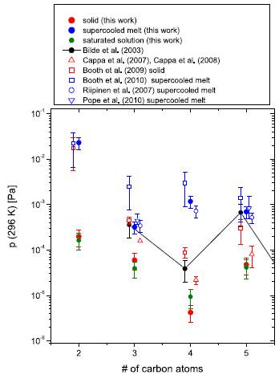
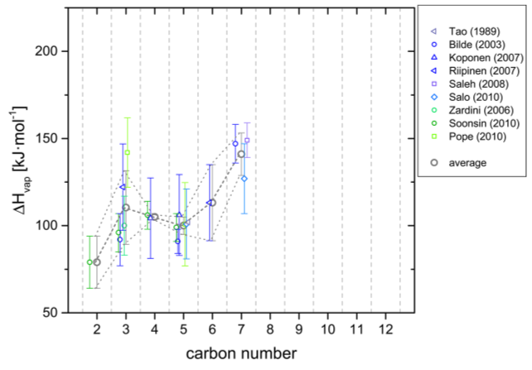
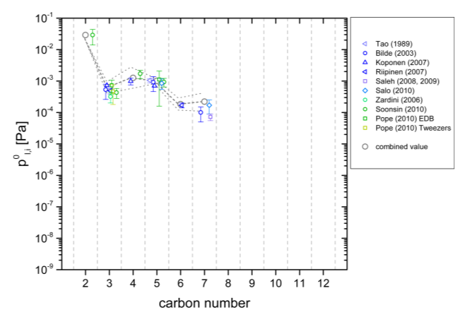
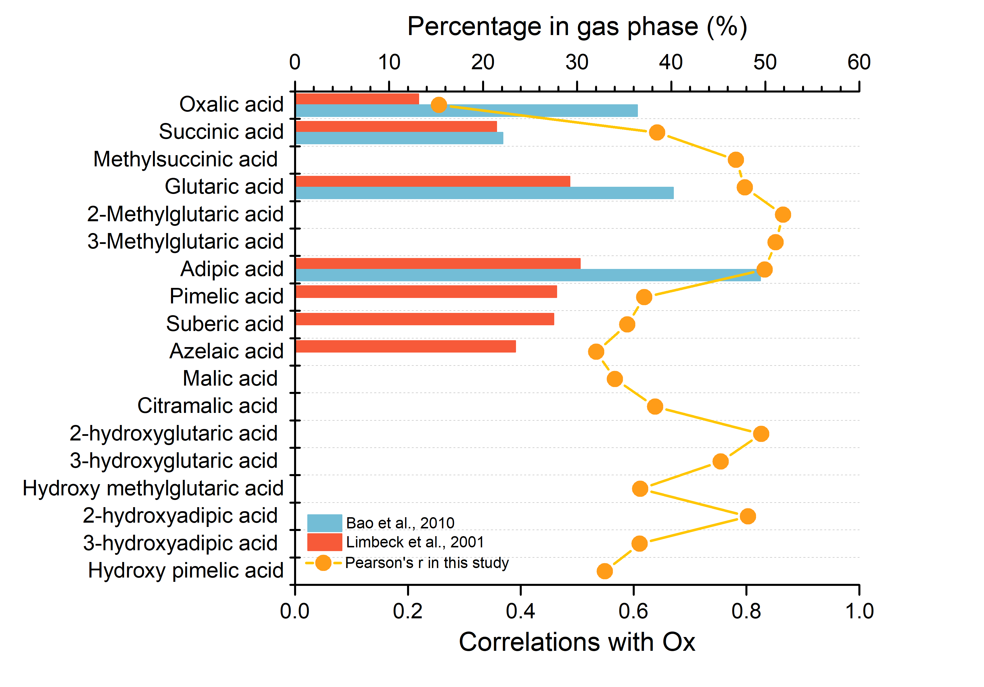
Vapor pressure
Enthalpies of Vaporization
DCAs is believed to be mainly in the PM phase but they also exist in the gas phase
Their proportion in the gas phase is not solely depend on vapor pressure.
Acidity (pKa) : low pKa for smaller C chain DCA can be more easily to dissociate/absorb in aq phase of the aerosol, e.g. C2 to C5, reverse trend of vapor pressure
Other factors: aerosol characteristics/atmospheric state/even-odd features
Subcooled liquid saturation vapor pressures
Limbeck et al. (2005)
Limbeck et al. (2001)
Bao et al. (2012)
Soonsin et al. (2010)

Slide 5
The proportion in gas phase can be related to the correlation strength of DCAs with Ox
Stronger correlation with Ox might imply higher proportion of gas phase reactions ➔ C5/C6 DCAs, also C5,C6 2-hydroxy DCAs

Slide 6
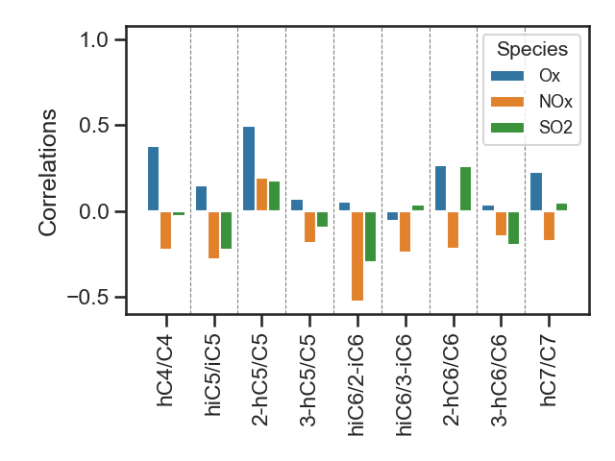
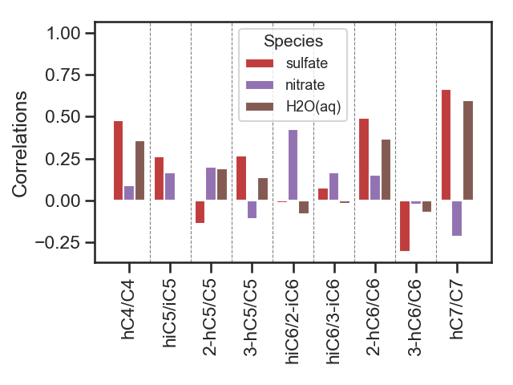
Ratio correlations (Pearson’s r)_YL summer data
Aliphatic DCA is believed to be important precursor for hydroxy DCA
Correlations using whole summer data with species show generally weak relationships (<0.5)
Note that 2-hC5/C5 show highest correlation with Ox
Some species shown moderately good correlation with sulfate and H2O(aq) estimated by E-AIM
The relationship might be masked by the diurnal features of the ratios➔ divide the data by periods

Slide 7
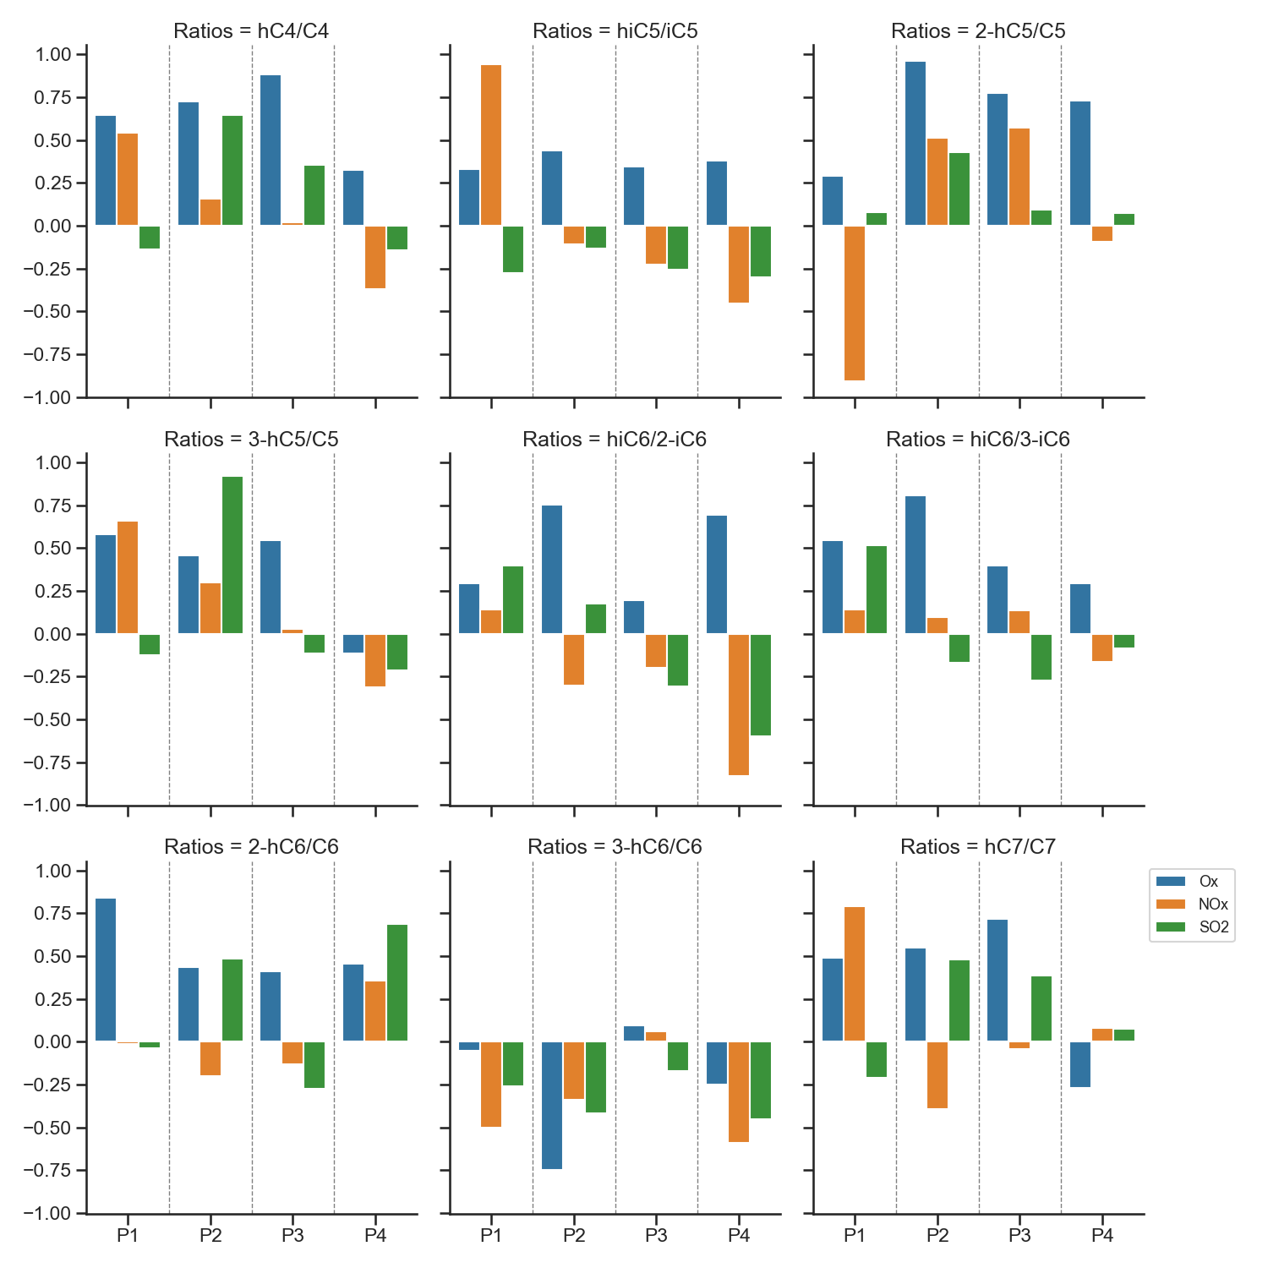
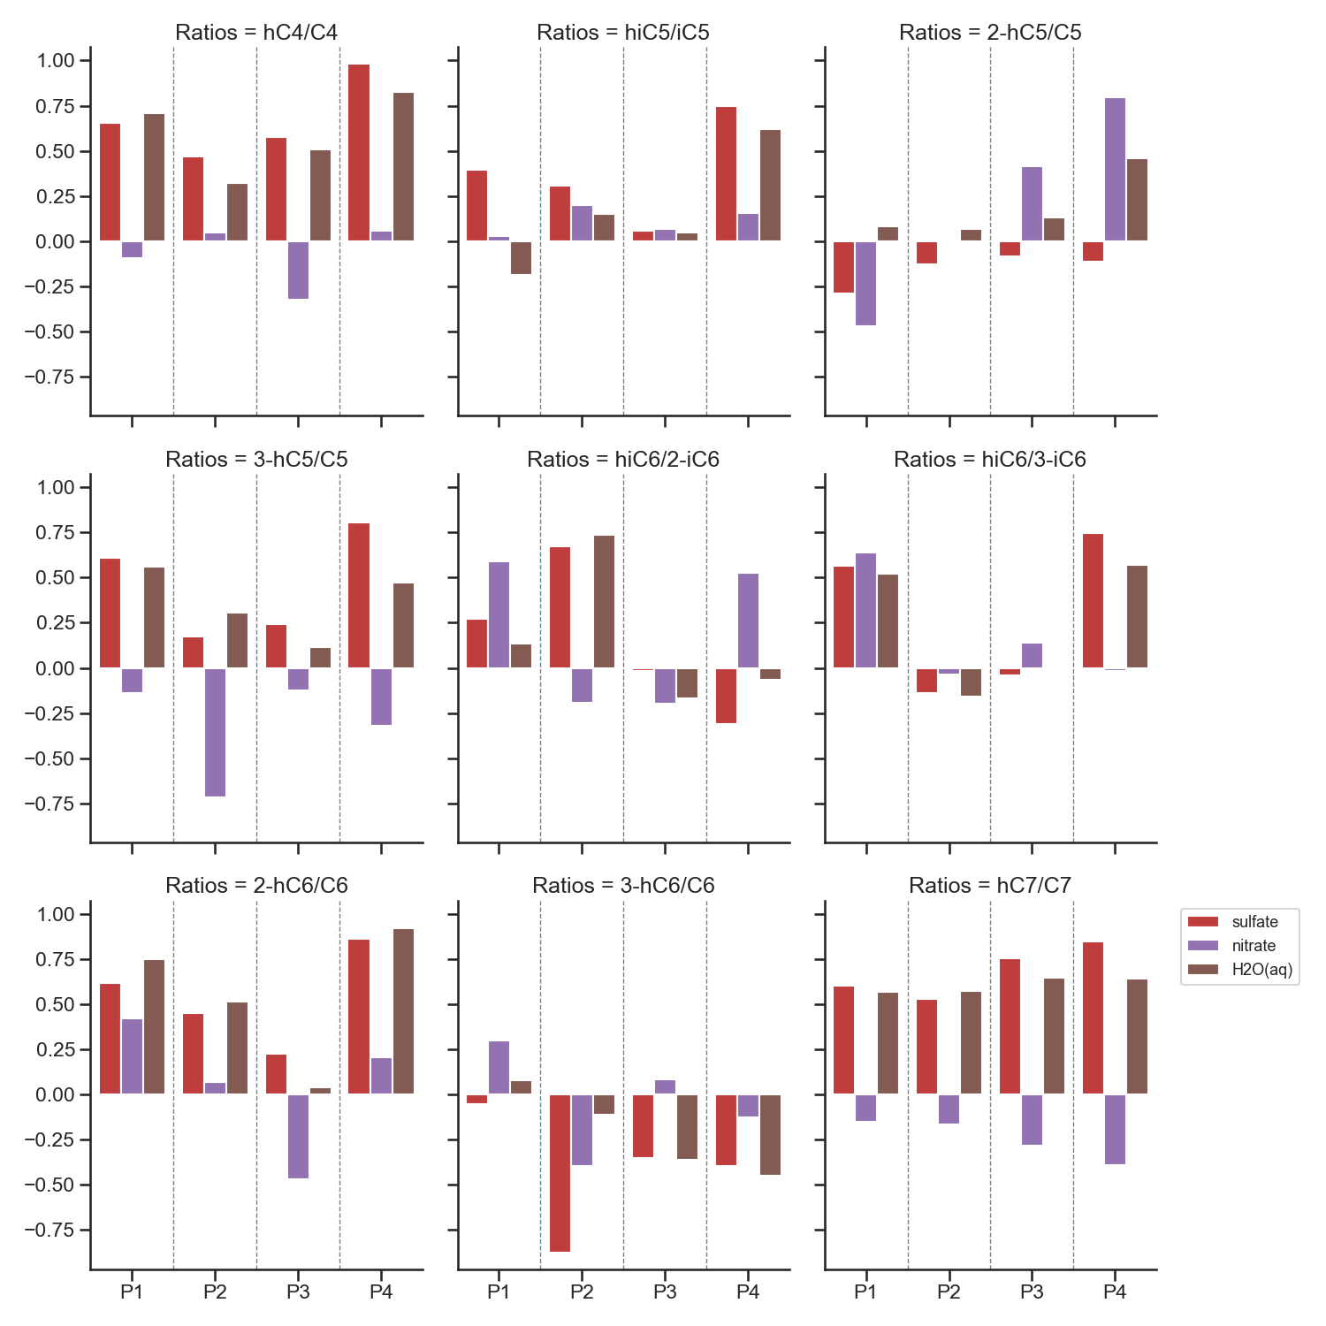
**plots were drawn after removing outlier(s)
Pearon’s r
Scatter plot of sulfate vs hDCa/DCA ratios at P4➔
Correlation with Ox (blue bar)
Strongest correlation at daytime
Sulfate and H2O(aq) (red and brown bars)
Increased correlation at nighttime
Imply heterogeneous aqueous phase oxidation at night

Slide 8
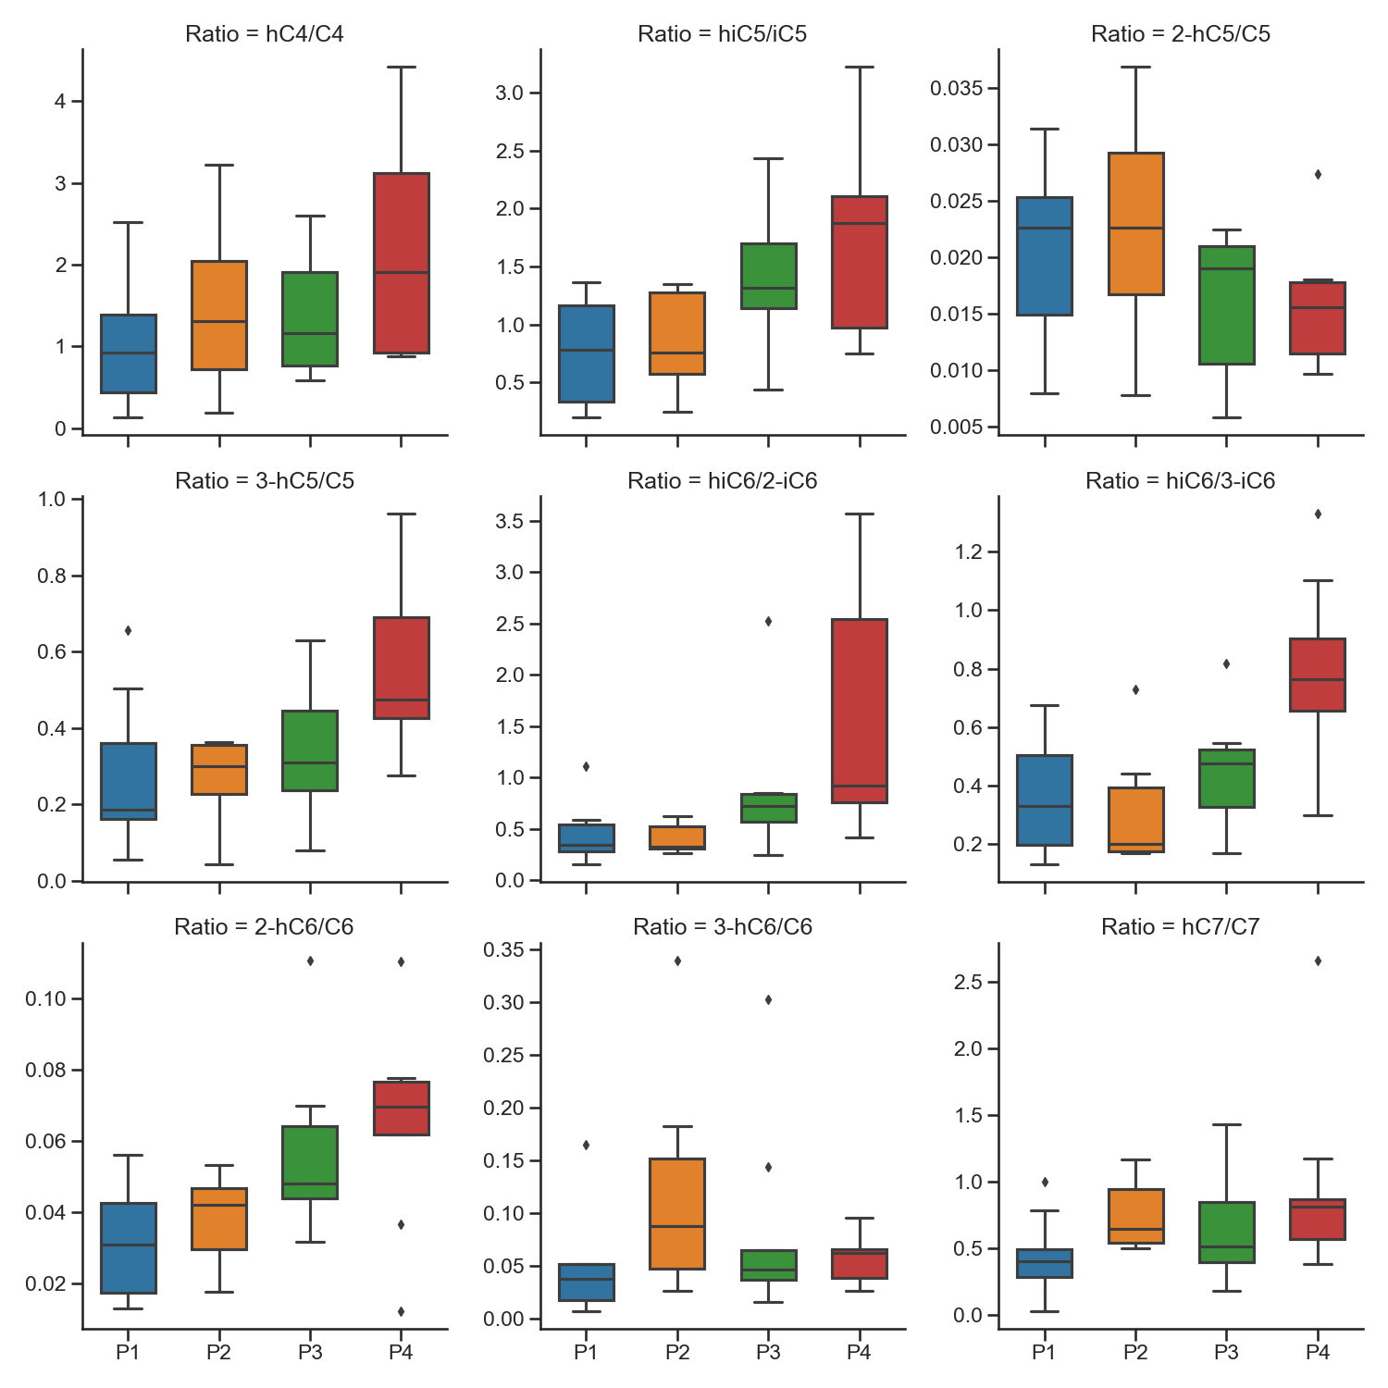
Implications:
Net production of hydroxy DCA from DCA at nighttime
2-hC5: photochemical oxidation at daytime, probably gas phase (along with high corr with ox at daytime but not sulfate)
Sulfate and H2O(aq) (red and brown)
Increased correlation at nighttime
Imply heterogeneous aqueous phase oxidation at night
Those that shown increased correlation with sulfate at night also show higher ratios at night
hC5 has highest ratio at P2 and did not shown increased correlation with sulfate at night

Slide 9
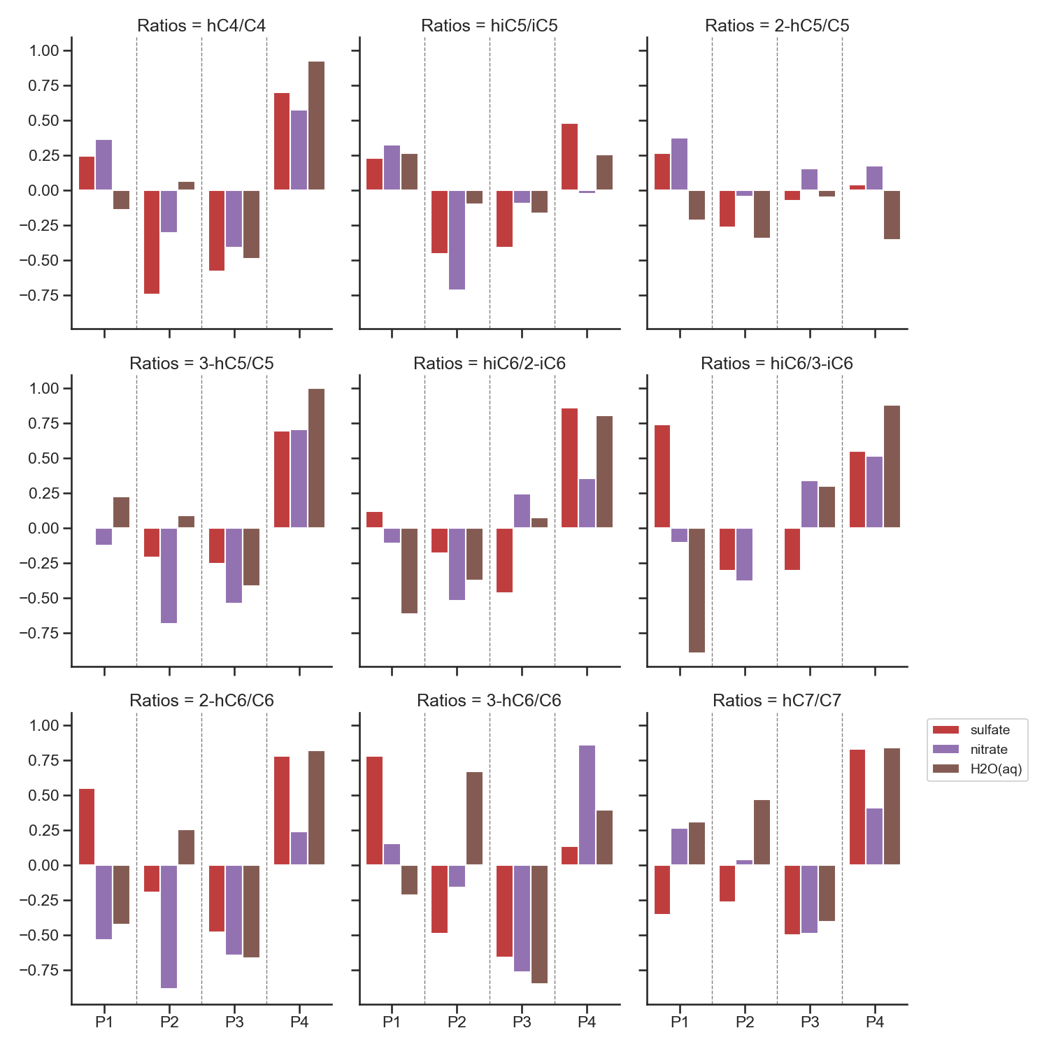
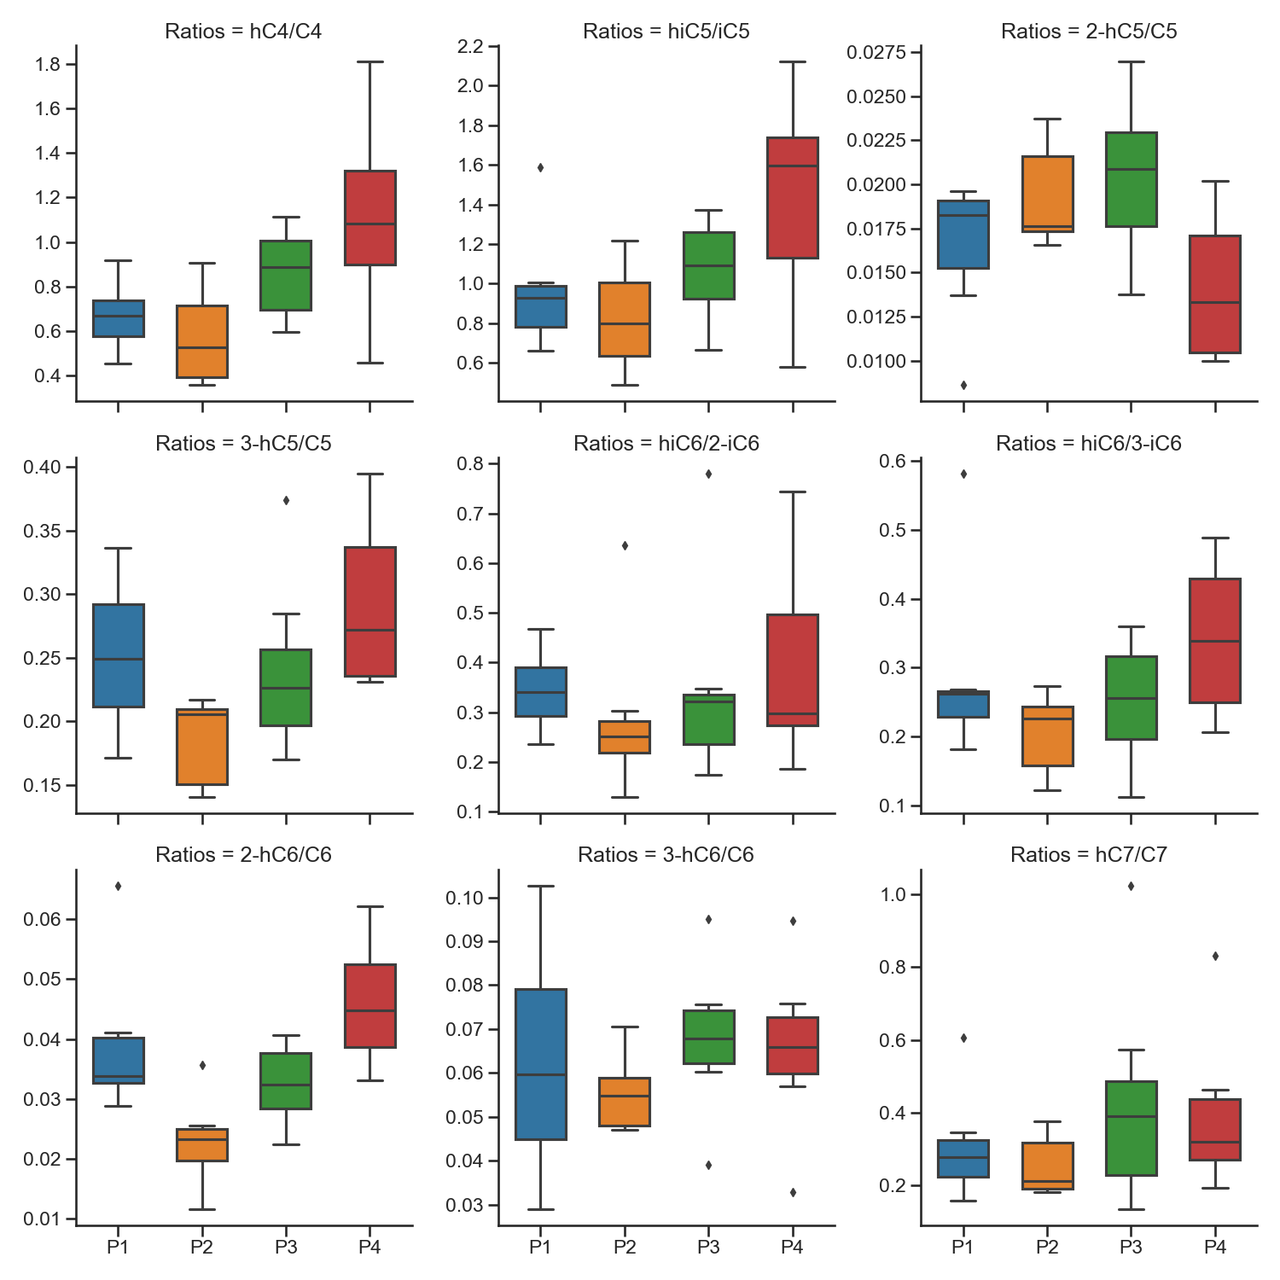
YL sum
This behavious was the same for YL winter data
↓
Sulfate and H2O(aq) (red and brown)
Increased correlation at nighttime
Imply heterogeneous aqueous phase oxidation at night

Slide 10
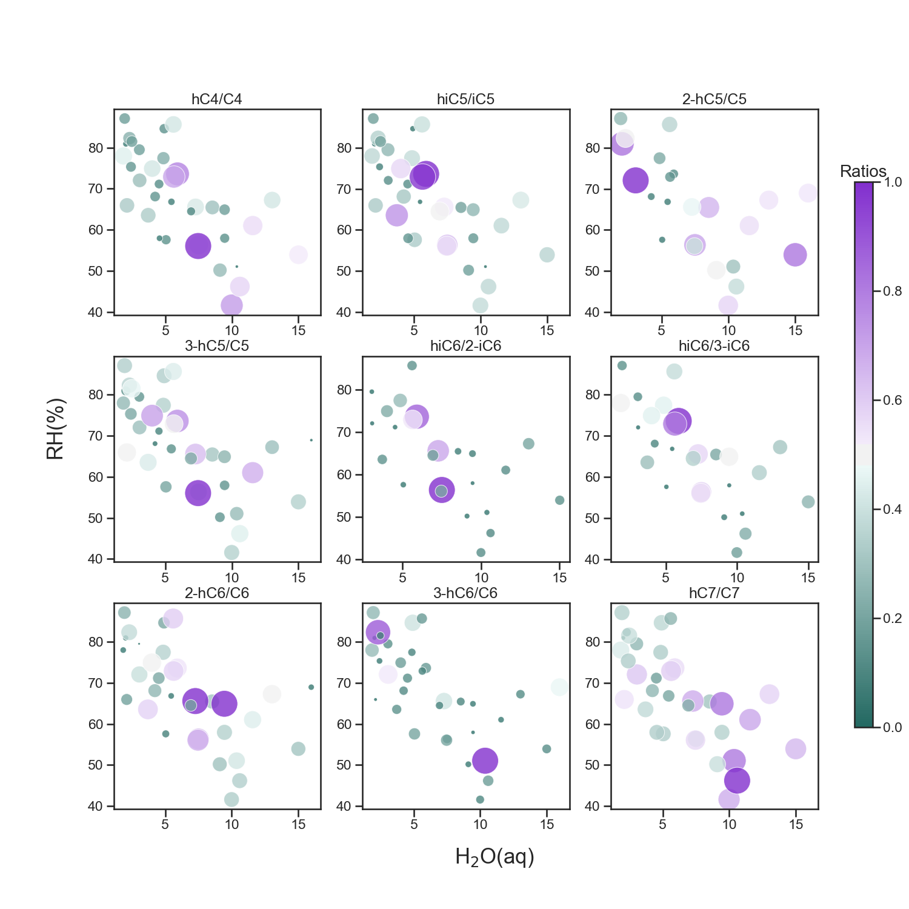
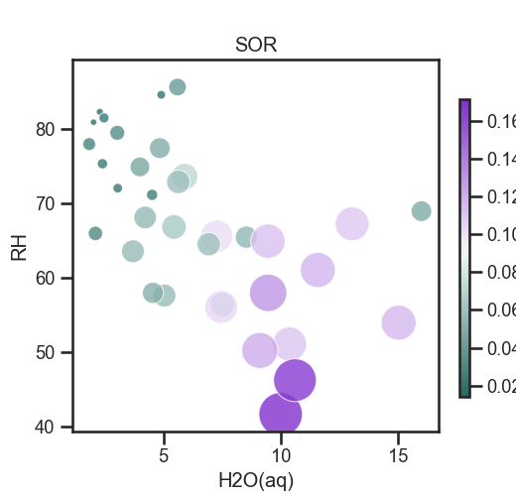
Sulfate oxidation rate
YL sum data
The reaction is more dependent on H2O(aq) in aerosol than atmosphere condition RH% for hC4 and hC7 (similar to sulfate oxidation, SOR), higher values with higher H2O(aq), more related to aqueous phase oxidation?
C5-C6 DCAs shown no dependence, due to complexity from gas and aqueous phase reactions?

Slide 11
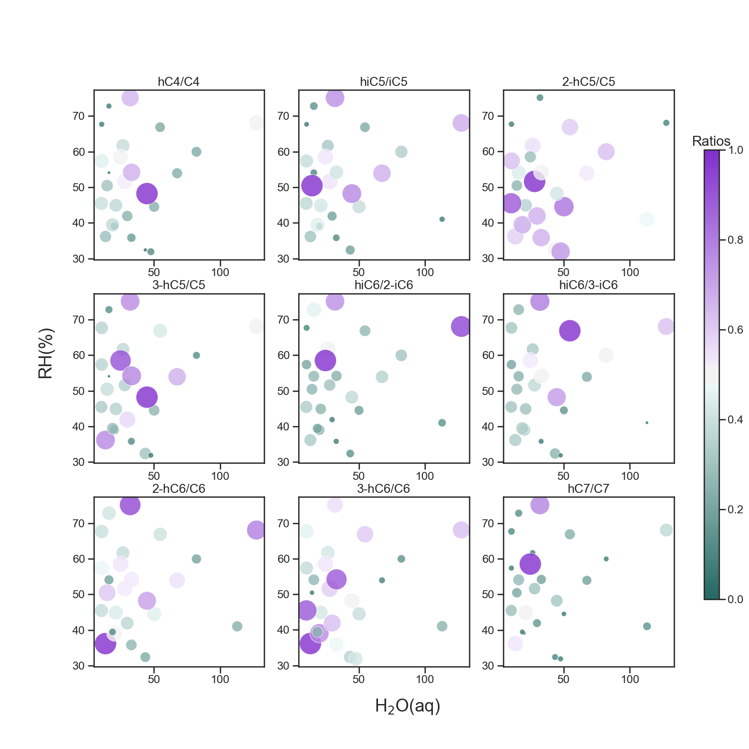
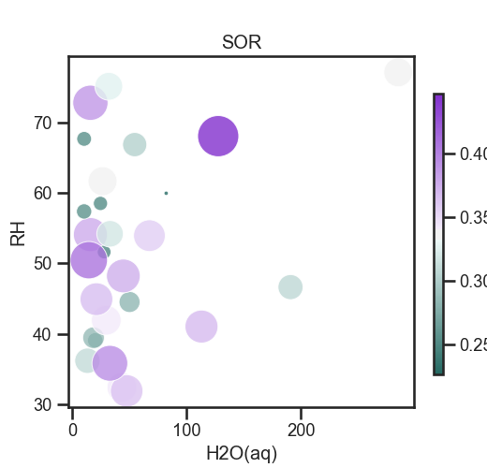
YL win data
Complication from long range transport, independent of in-situ RH or H2O but liquid water content history should important.

Slide 12
Summary
hDCAs (C5-C6) that have higher proportion in the gas phase did not show dependence on H2O(aq), those that have lower proportion in gas phase (hC4 and hC7) showed dependence on H2O(aq).
Physical state of DCAs affect the reaction mechanisms (in gas/PM phase)
Physical state of DCAs affected by atmosphere conditions, aerosol characteristics/compositions➔ observe outliers
Different relationships in different periods
Possible heterogeneous aqueous phase reaction at nighttime shown at P4

