Slide 1
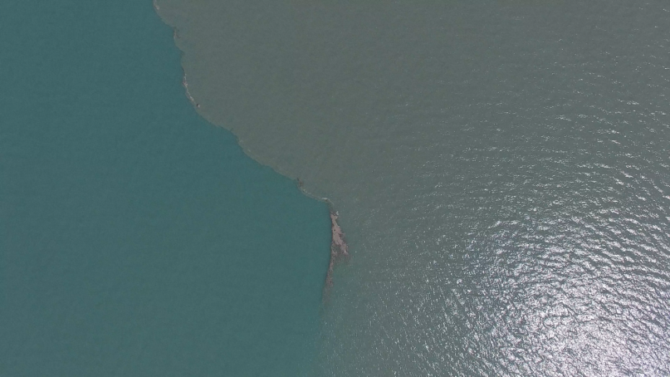
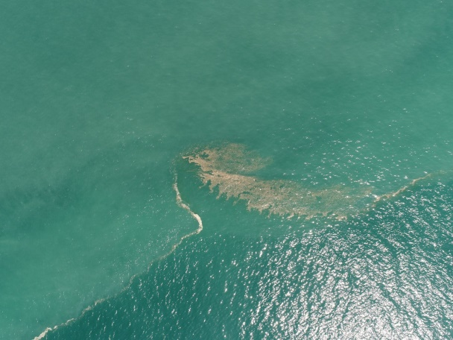
Zubov State Oceanographic Institute
Shirshov Institute of Oceanology
Water Problems Institute
The fate of river-borne floating marine litter in the coastal sea: a case study of flooding discharge from numerous small rivers in the northeastern part of the Black Sea
Evgeniya Korshenko, Victor Zhurbas, Alexander Osadchiev, Pelagiya Belyakova
E-mail: zhenyakorshenko@gmail.com

Slide 2
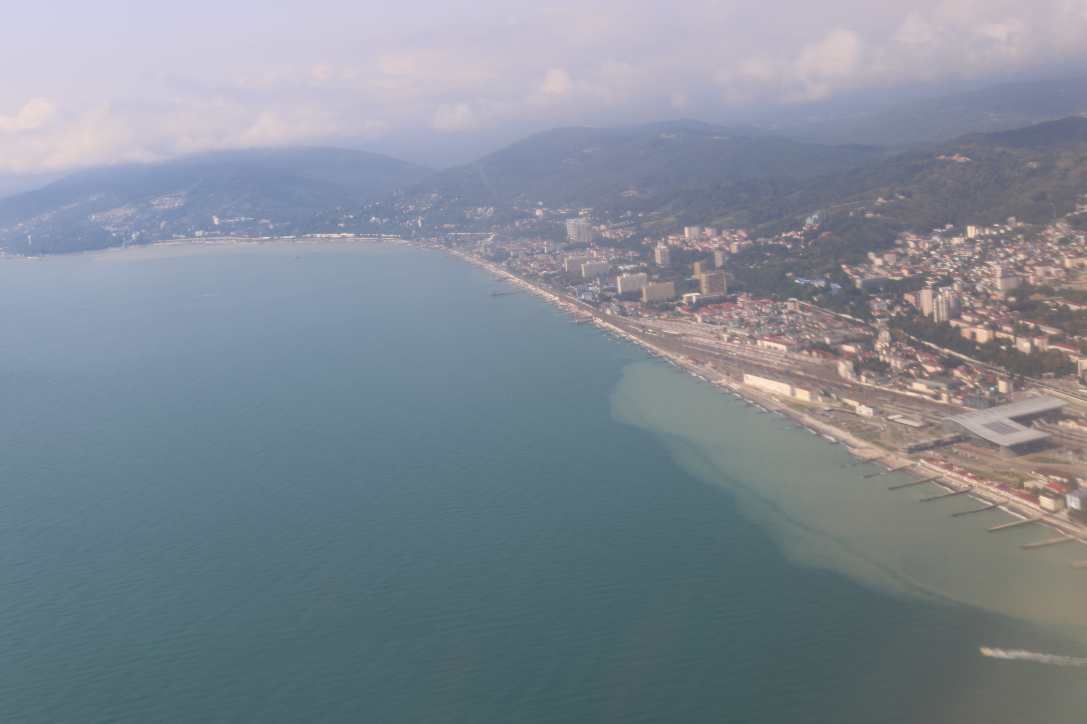
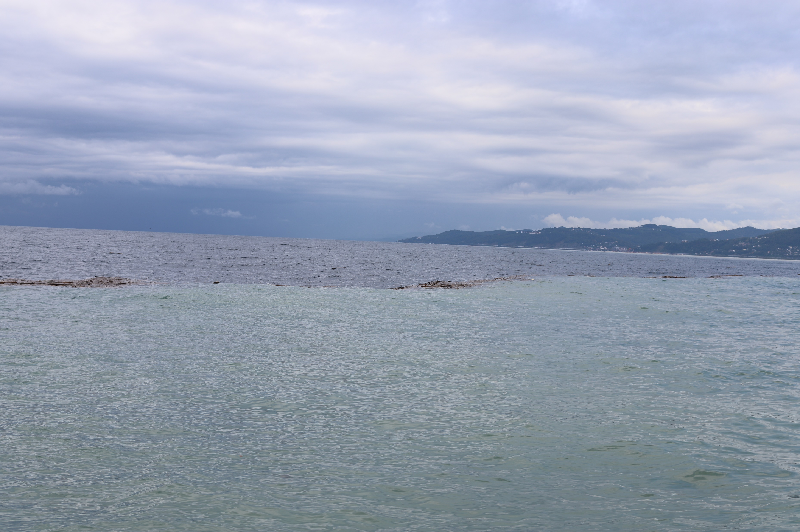
Introduction
The majority of marine litter is estimated to originate from land-based sources and rivers that are responsible for up to 80% of the floating marine litter (FML) including plastic in the sea (Allsopp et al., 2006). It is considered, that large and heavily polluted rivers provide predominant volume of the river-borne plastic pollution on a regional scale (Fok and Cheung, 2015; Veerasingam, 2016). However, rivers with relatively small total annual discharge estimations that can abruptly increase their discharge rates during rain-induced flooding events are another important source of regional marine pollution. As a result, this study is focused on a large flooding event which happened in the northeastern part of the Black Sea in October 2018, reconstruction of spreading patterns of FML at the coastal sea area and detection of potential areas of its coastal accumulation caused by washing ashore.

Slide 3
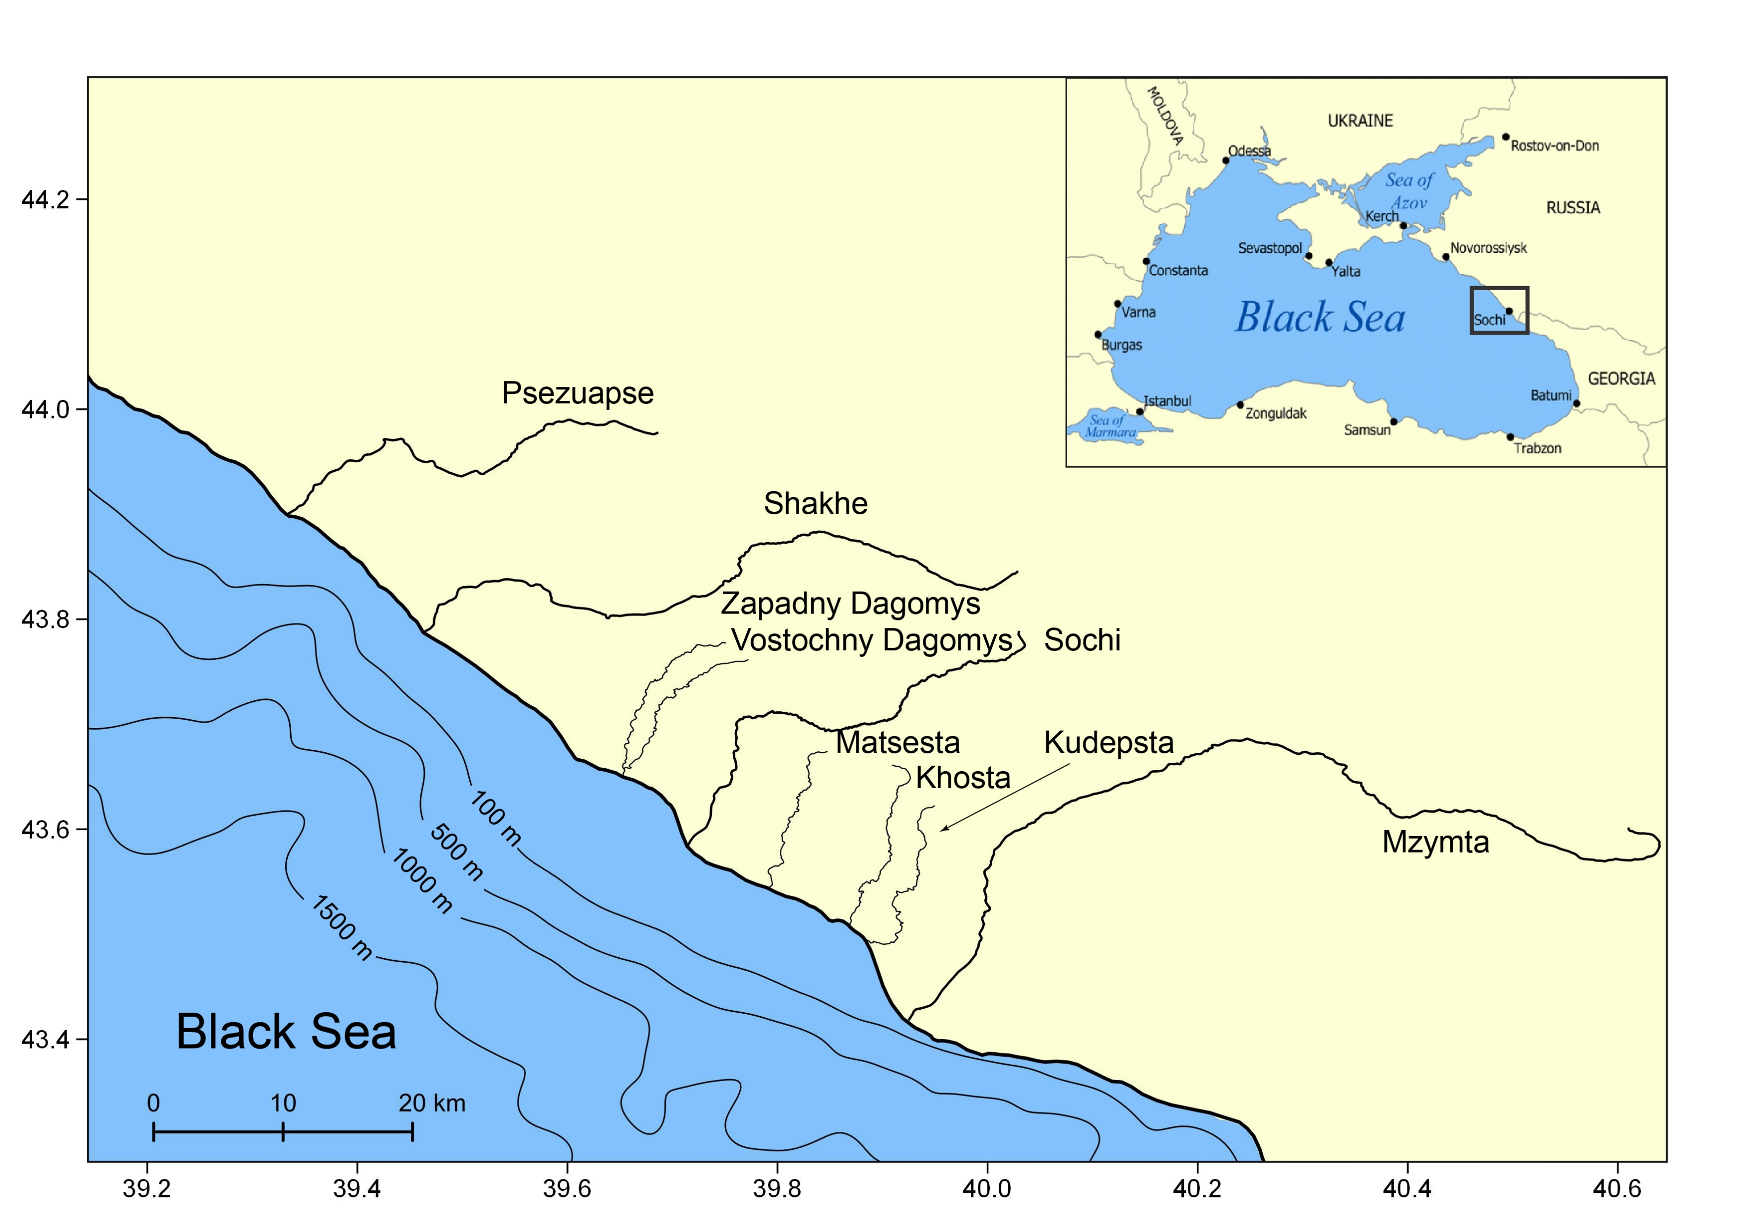
Study area
The northeastern part of the Black Sea is a densely populated area and the most important recreational area of Russia. Considered coastal area is drained by numerous rivers that inflow from multiple gorges of the Western Caucasus. These rivers are relatively small with total annual discharge estimated as 6.5-7.5 cubic km (Jaoshvili, 2002; Alexeevsky et al., 2016). Nevertheless, they are considered to be the main source of marine litter in the study area especially during rain-induced flooding events that can occur up to 25 times a year.

Slide 4
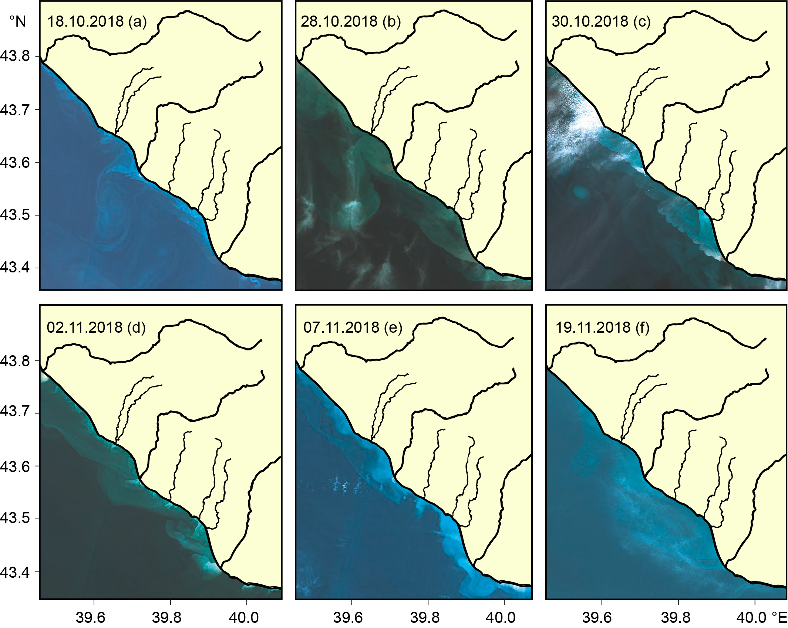
Flooding event
Regarded in our study rain-induced flooding event occurred on 24-25 October 2018. Good satellite imagery coverage of this period, including Sentinel-2 MSI (https://scihub.copernicus.eu/) and Landsat 8 OLI (http://earthexplorer.usgs.gov) data collected in October and November 2018 before, during, and after this flooding event on 18, 28, 30, October and 2, 7, 19 November provided an opportunity to analyze the processes of spreading, coalescence, transformation, and dissipation of multiple river plumes formed in the study area during and after the considered flooding event.

Slide 5
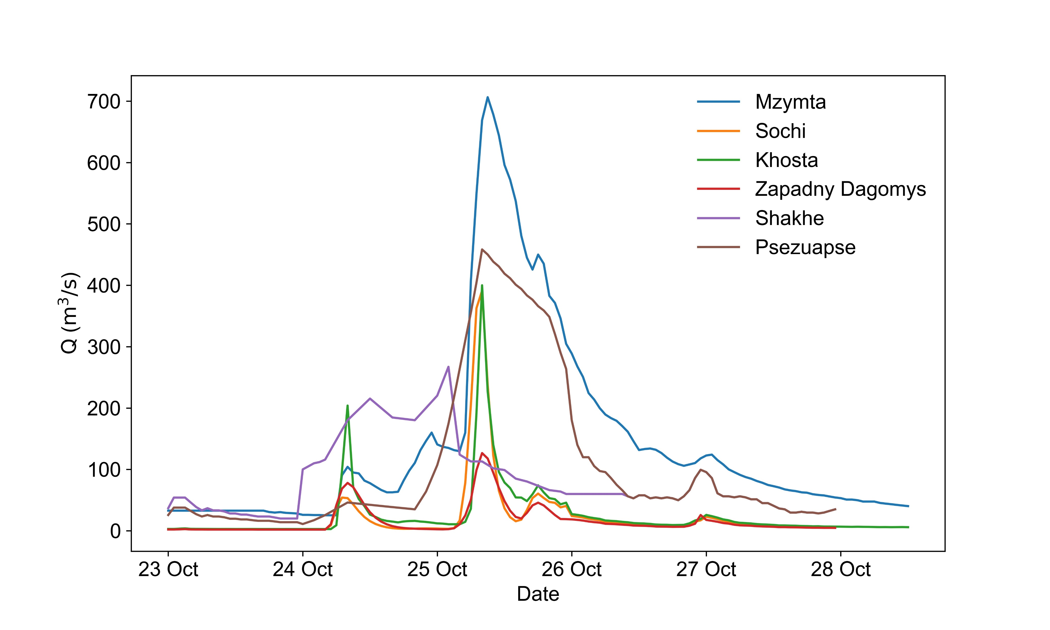
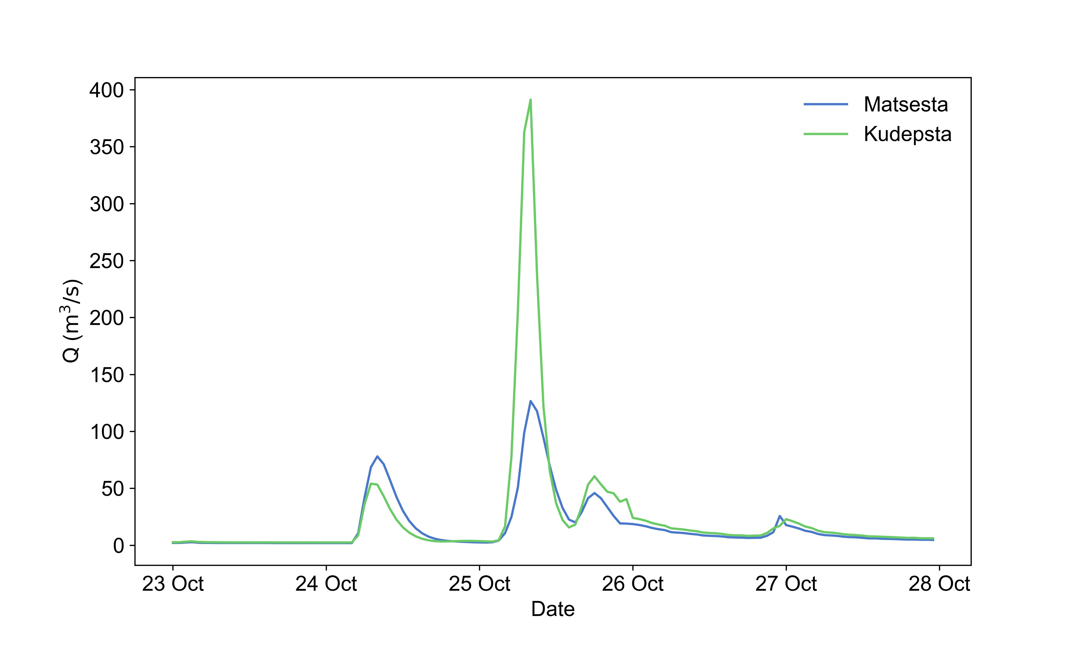
Reconstruction of the flooding event
For the numerical reconstruction of the considered flooding event a combination of the Eulerian INMOM model and the Lagrangian particle model was used. A regional version of the INMOM model with a non-uniform horizontal grid was applied to reproduce the general Black Sea circulation with an increased spatial resolution in the study area. The reconstructed current velocities in the uppermost model layer were applied for the Lagrangian particle model that simulated FML trajectories in the coastal sea, as well as their washing ashore.
The discharge data for the Mzymta, Khosta, Sochi, Zapadny Dagomys, Shakhe and Psezuapse rivers was obtained from the Russian Hydrometeorological Service (https://gmvo.skniivh.ru/) for the period 23 – 28 of October 2018. The discharge values from the ungauged rivers (Kudepsta and Matsesta) were reconstructed using an event-based rainfall-runoff KW-GIUH model. The model parameters were calibrated against the floods at the similar and adjacent Khosta and Zapadny Dagomys rivers.

Slide 6
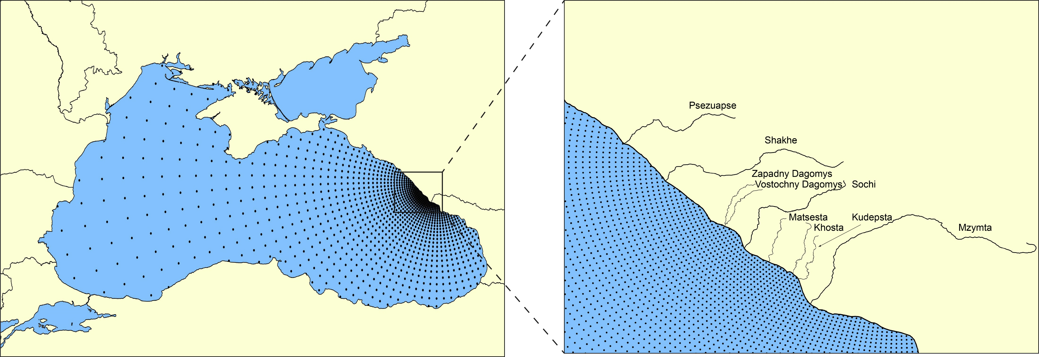
INMOM model
A regional version of the INMOM model with a non-uniform horizontal grid covers the whole Black Sea basin excluding the Azov and Marmara seas.
Model grid:
Spherical coordinate system with one of the poles located near Sochi (40.205°E, 43.84°N);
Non-uniform horizontal grid with ~200m near the pole and ~4.5km at the southeastern part of the Black Sea;
715х642 horizontal grid points along the model longitude and latitude;
Non-uniform vertical grid with 20 σ vertical levels.
Initial fields:
GEBCO bathymetry with a spatial resolution of 15” (www.gebco.net);
WRF atmospheric forcing with spatial and time resolutions of 10km and 1 hour;
3D monthly climatic mean thermohaline fields for the Black Sea with a horizontal resolution of 0.1°×0.0625° and 36 vertical z-levels from 0 to 2150m (Polonsky et al., 2013);

Slide 7
Lagrangian model and wind forcing
The reconstructed current velocities in the uppermost model layer were applied for the Lagrangian particle model with a Runge-Kutta scheme of higher order of accuracy (Väli et al., 2018) that simulated FML trajectories in the coastal sea, as well as their washing ashore during (24–25 October 2018) and after (26–31 October 2018) the flooding event. Before calculating the trajectories, velocities simulated by the INMOM on a non-uniform grid were interpolated to a uniform grid with 250m×250m bins. The particles were seeded in 250m×250m grid bins corresponding to the mouths of the main rivers of the study area (Mzymta, Kudepsta, Khosta, Matsesta, Sochi, Dagomys, Shakhe, Psezuapse).
The average 10-m level wind at the study region according to the WRF data during the simulation period was highly variable and switched twice between from downwelling-favorable on 24 and 26-28 October to upwelling-favorable on 25-26 and 28-31 October.

Slide 8
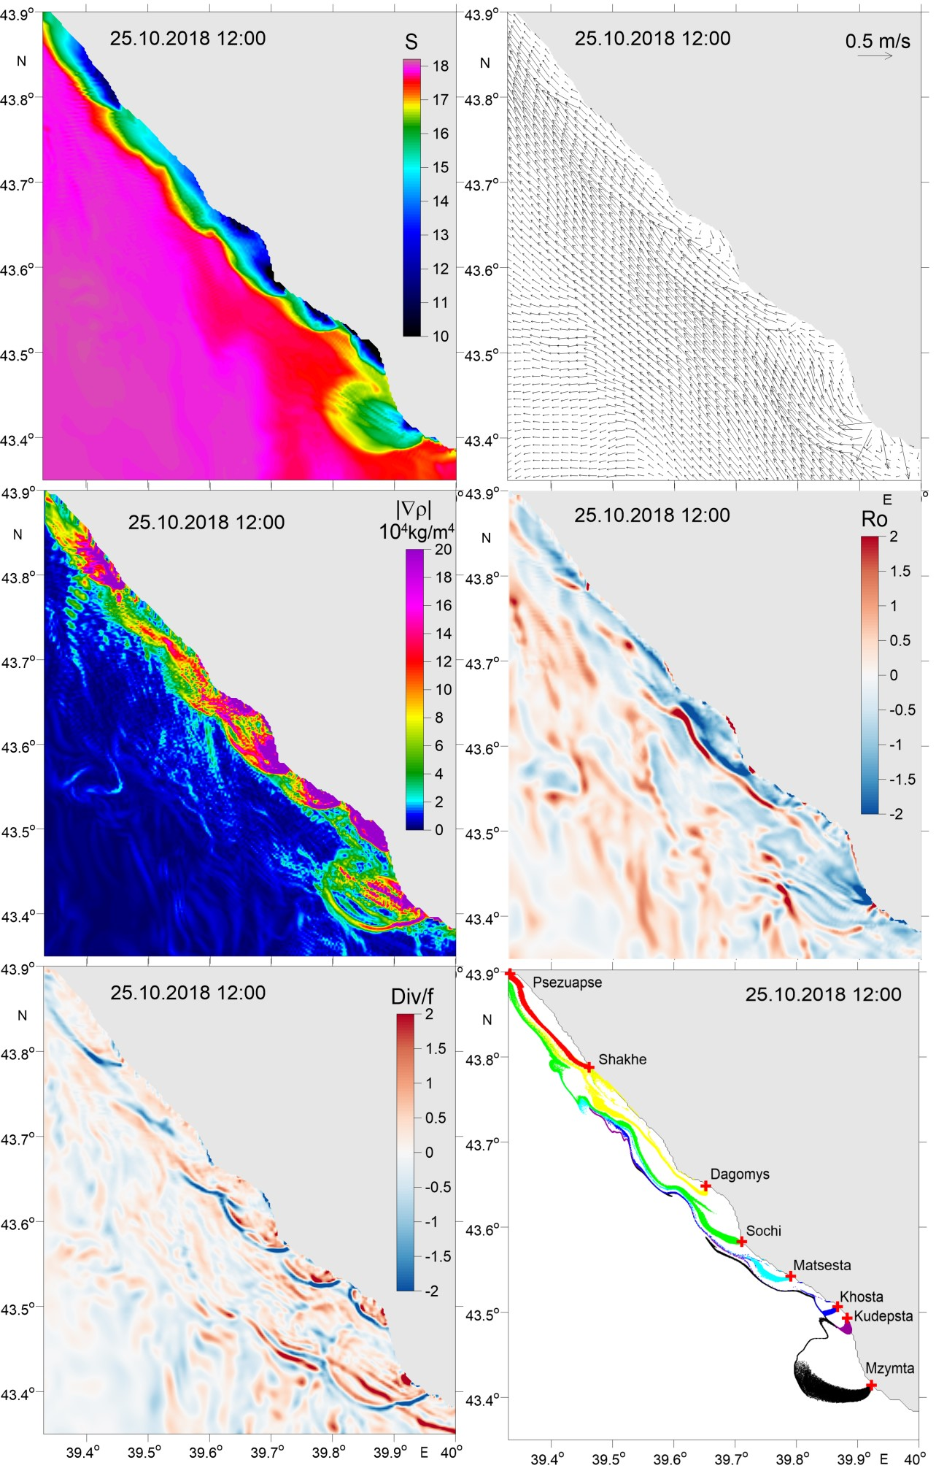
Results
Presented figures show daily simulated patterns of salinity $S,$ current velocity vectors $\left(u,v\right),$ horizontal density gradient scalar $\left|∇ρ\right|=\sqrt{ρ_{x}^{2}+ρ_{y}^{2}} ,$Rossby number $R_{o}=\frac{ζ}{f}=\frac{\left(v_{x}−u_{y}\right)}{f},$ normalized horizontal divergence $\frac{Div}{f}=\frac{\left(u_{x}+v_{y}\right)}{f}$ and distribution of synthetic floating particles seeded in river mouths in proportion to the actual river discharge rate during and after the flooding event.
$ζ$ is the relative vorticity, $f$ is the Coriolis parameter, $u$ and $v$ are the components of current velocity, $ρ$ is the water density.
On 25 October 2018, the northwestward alongshore flow controlled by the Rim Current (general circulation of the Black Sea) was slightly shifted offshore due to the formation of river bulges. A narrow strip of $\frac{Div}{f}$ negative values indicated convergence of surface flow at the
front between the river plumes and the saline sea waters.

Slide 9
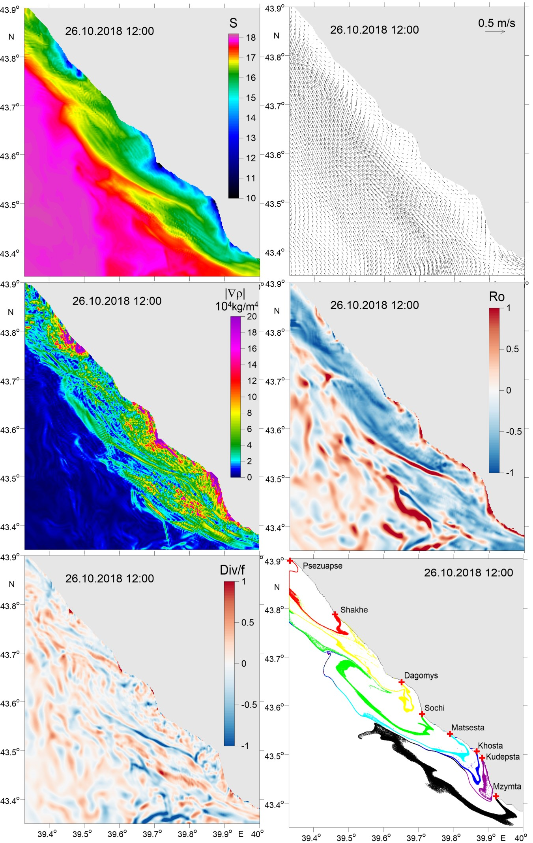
Results
On 26 October 2018, patterns considerably changed due to an upwelling-favoring northwestward wind during the previous day. The Ekman transport directed towards the open sea moved the northwestward current farther from the coast. As a result, the coastal stripe of reduced values of $S$and $R_{o}$ and increased values of $\left|∇ρ\right|$ widened approximately twice, as compared to that of the day before. Moreover, about 6-8km wide stripe formed between the current and the coast with weak water flow in the opposite, southeastward direction and weak anticyclonic vortices within this stripe.

Slide 10
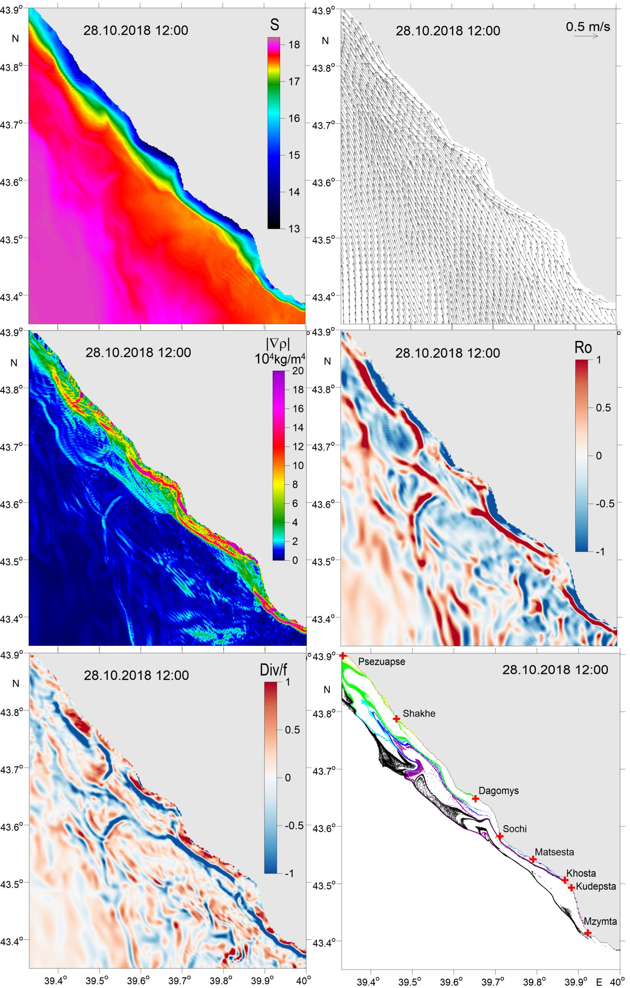
Results
On 28 October 2018, the velocity of the alongshore northwestward current increased up to 0.4–0.5 m/s and moved close to the shore due the change of wind direction to the downwelling-favored southeastward wind that occured during the period from 26 to 28 October and resulted in a situation when all three factors, namely, the Rim Current, the wind-driven coastal flow, and the coastal buoyant jet controlled by river discharge, contributed to the northwestward transport in the coastal area.

Slide 11
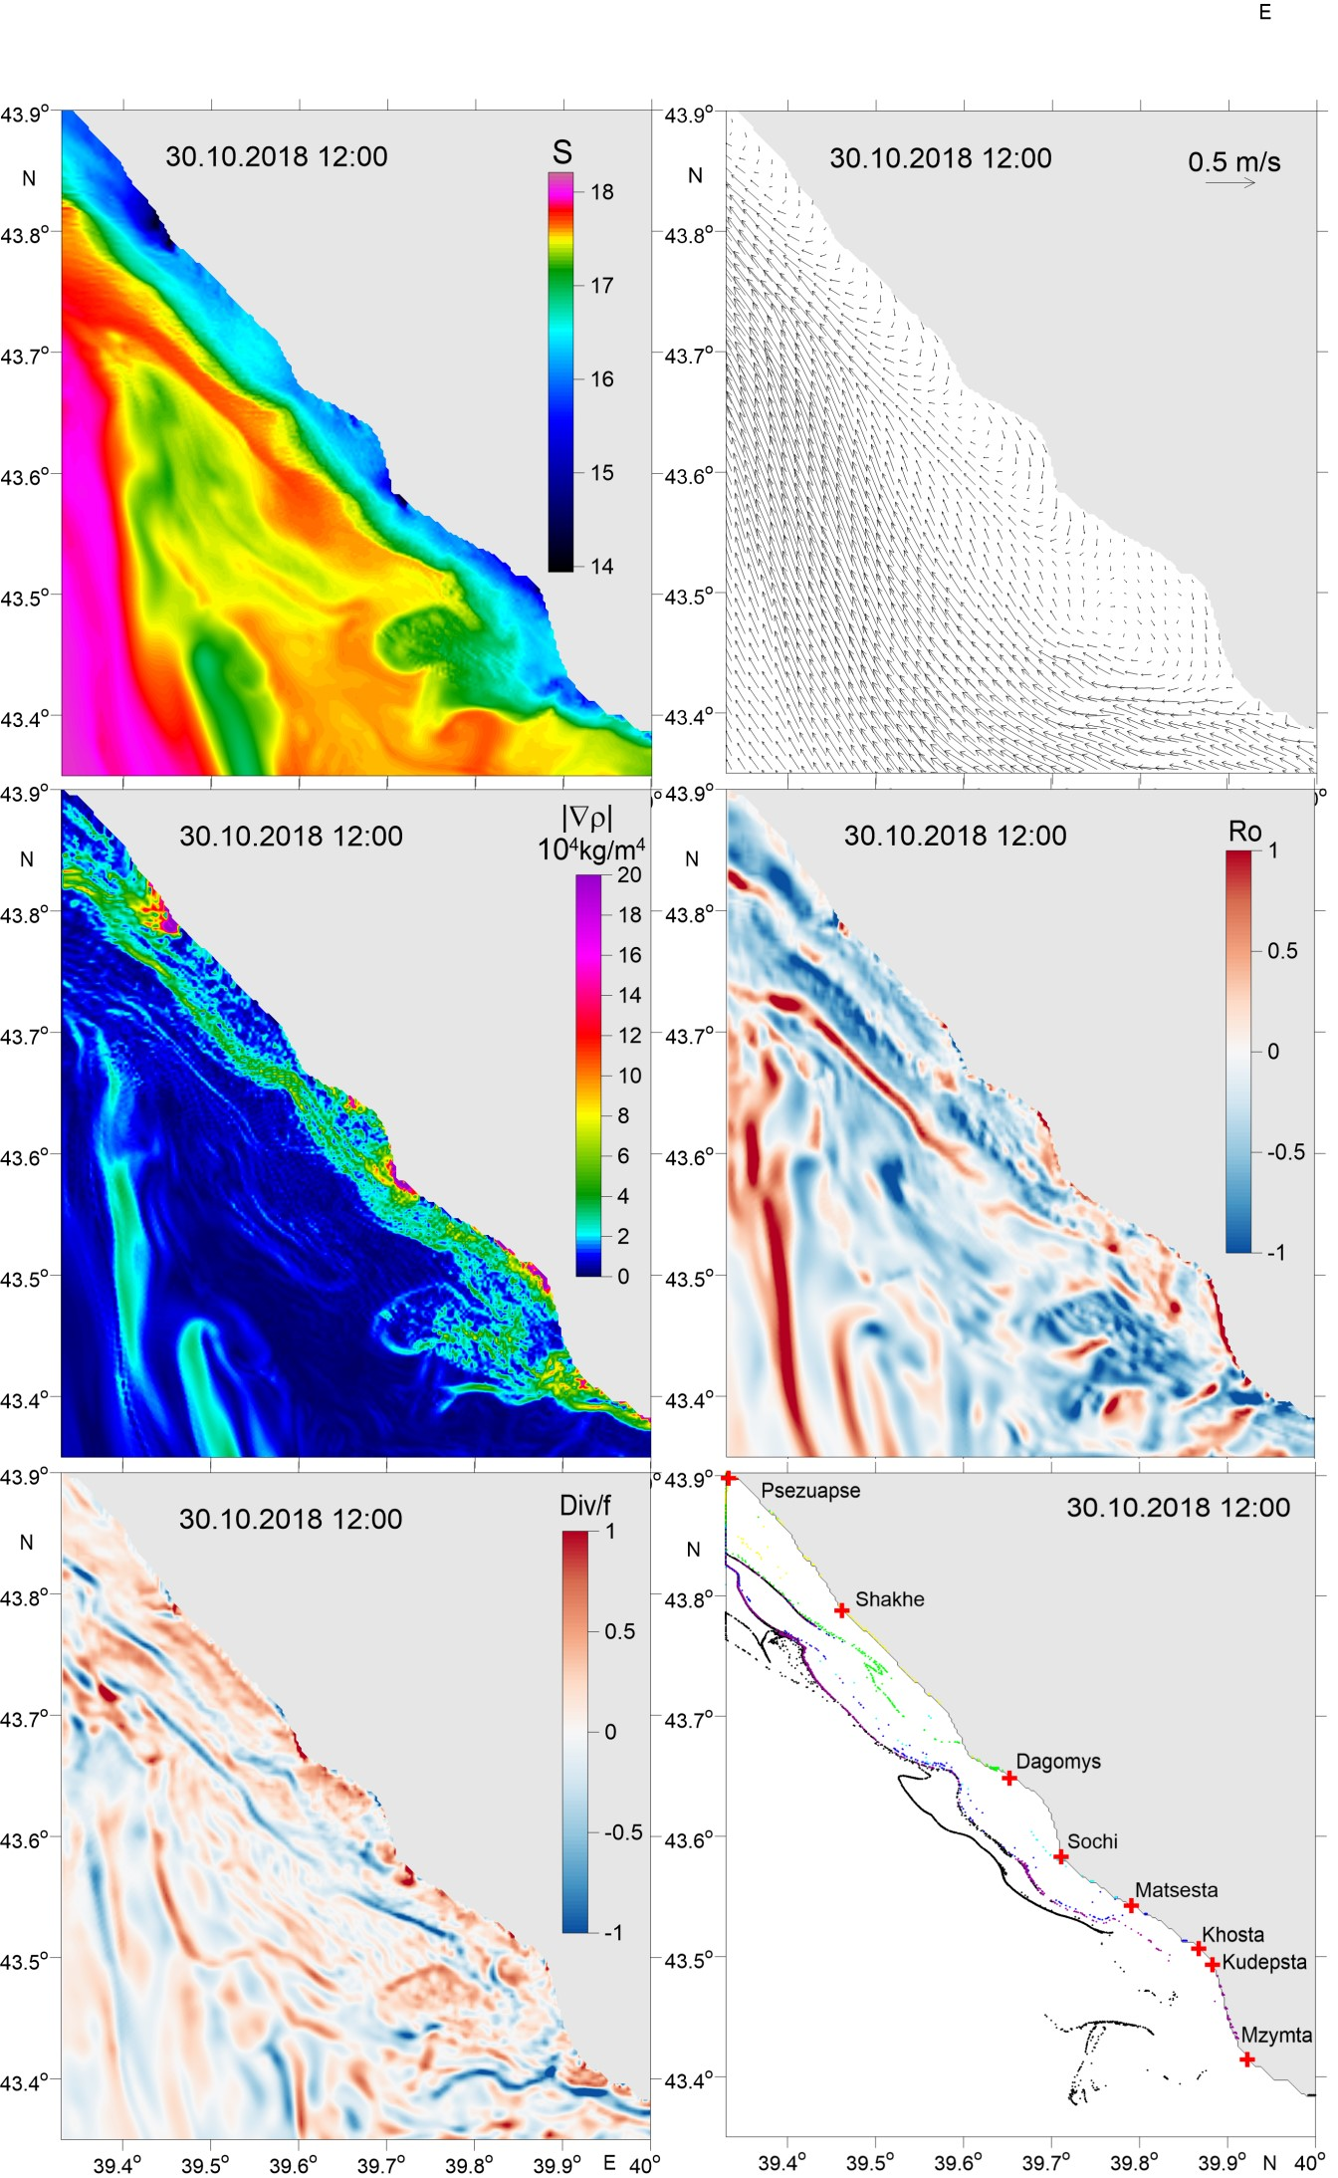
Results
On 30 October 2018, due to the change of the wind from noon on 28 October for upwelling-favored northeastward, 4 days after the flood, the flooding plumes dissipated. As a result, the northwestward flow again shifted towards the open sea, and the previously continuous coastal stripe of reduced values of $S$ and $R_{o}$ and increased values of $\left|∇ρ\right|$transformed to localized patches adjacent to the river mouths typical for average discharge conditions that were observed before the flood.

Slide 12
FML accumulation areas at the sea
FML accumulates at convergence zones between the freshened river plumes and saline ambient sea. These zones remain stable during several days and are then transported off the vicinity of the river mouths by a quasi-geostrophic alongshore current.
We suggest that transport of river-borne floating matter consists of two stages:
First
FML is transported to and accumulated at stagnation areas associated with large salinity gradients at the borders between river plumes and ambient sea
Second
FML is transported along these borders till their dissipation as a result of mixing between river plume and ambient sea
In the case of collision and coalescence of multiple river plumes during the considered flooding event the freshened stripe is formed along the large coastal sea area and plastic litter is transported far off the river mouths.

Slide 13
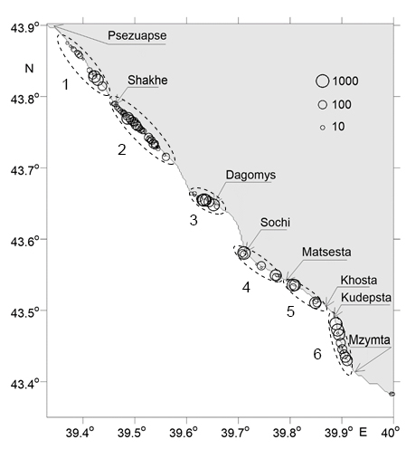
FML accumulation areas at the shoreline
During the study period, 5.1% (19118 particles) of the total number of released particles (372900) were washed ashore and non-uniformly accumulated along the shoreline.
The particle concentration (the number of particles per 250m×250m bin) is depicted by circles of different size.
When the Rim Current, the wind-driven coastal flow, and coastal buoyant jet controlled by river discharge dominate local circulation, the common northwestward alongshore direction of the flow causes appearance of typical areas of ashore discharge particles (accumulation areas 1, 2, 3, 4, 5). Significant variability of wind direction during the flood resulted in formation of an “uncommon” area of pollution at the shoreline (accumulation area 6).
typical areas
“uncommon” area

Slide 14
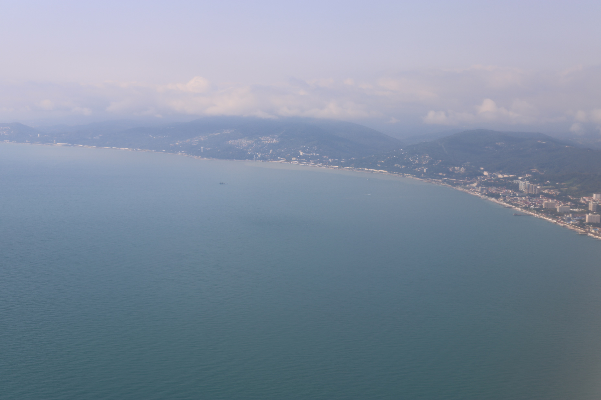
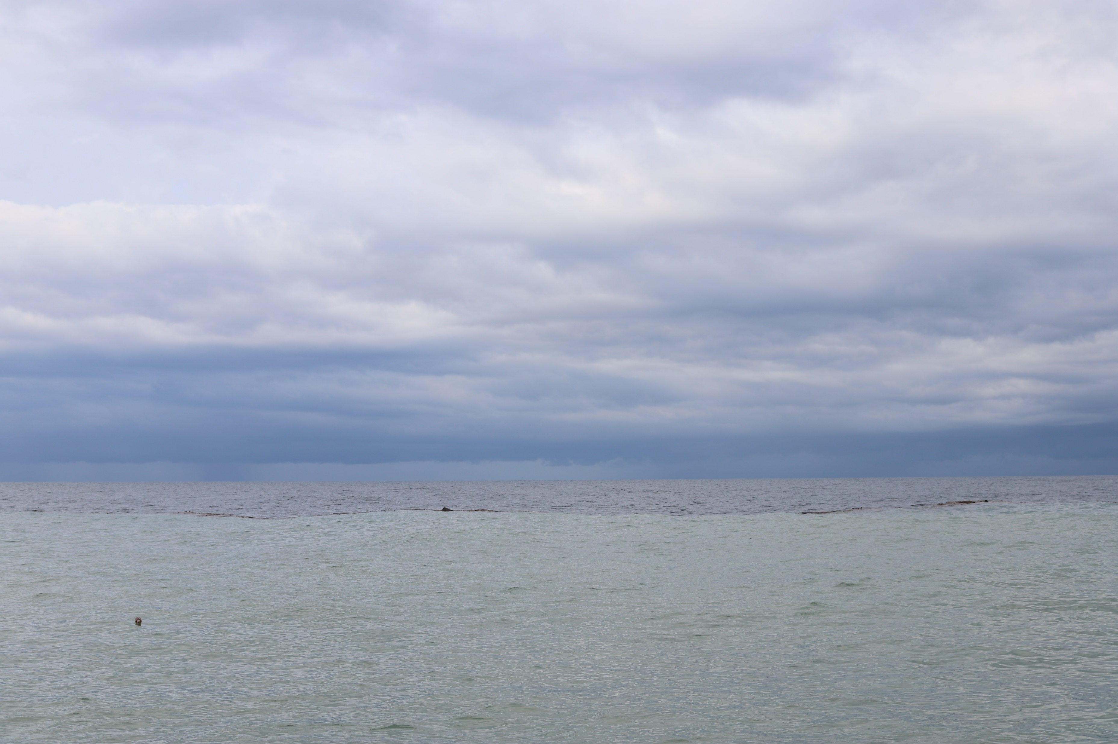
Conclusions
Small rivers can abruptly increase their discharge rates during flooding events and become an important source of regional marine pollution.
Shortly after flooding events river-borne floating marine litter accumulates at frontal zones of individual river plumes that with time merge into one convergence line stretched along the shoreline.
Transport of accumulated floating marine litter along the transported off the vicinity of the river mouths convergence line continues until the dissipation of the freshened strip.
During and several days after the flooding event large volume of river-borne floating marine litter is washed ashore and non-uniformly accumulates along the shoreline.
Accurate reconstruction of delivery and fate of river-borne floating marine litter in the sea requires numerical modelling with high spatial resolution.

Slide 15
Acknowledgements
This research was funded by the:
Ministry of Science and Higher Education of Russia, theme 0149-2019-0003 (numerical modelling of sea circulation);
Russian Science Foundation, research project 17-77-30006 (processing of river discharge data, flash flood simulation) and research project 18-17-00156 (study of spreading and dynamics of river plumes);
Russian Foundation for Basic Research, research project 19-45-233007 (data processing from an Automated Flood Monitoring System of the Krasnodar Territory) and research project 20-35-70039 (study of fate of the floating plastic litter).

Slide 16
References
Alexeevsky, N.I.; Magritsky, D.V.; Koltermann, K.P.; Krylenko, I.N.; Toropov, P.A. 2016. Causes and systematics of inundations of the Krasnodar territory on the Russian Black Sea coast. Natural Hazards and Earth System Sciences, 16, 1289–1308. doi:10.5194/nhess-16-1289-2016
Allsopp, M.; Walters, A.; Santillo, D.; Johnston, P. Plastic Debris in the World’s Oceans. 2006. Greenpeace: Amsterdam, The Netherlands
Fok, L.; Cheung, P.K. Hong Kong at the Pearl River Estuary: a hotspot of microplastic pollution. 2015. Marine Pollution Bulletin, 99, 112-118. doi: 10.1016/j.marpolbul.2015.07.050
Jaoshvili, S. 2002. The rivers of the Black Sea. European Environmental Agency, Technical Report No. 71.
Polonsky, A.B.; Shokurova, I.G; Belokopytov, V.N. 2013. Desjatiletnjaja Izmenchivost' Temperatury i Solenosti v Chernom More [Decadal Variability of Temperature and Salinity in the Black Sea]. Morskoy Gidrofizicheckiy Zhurnal, 6, 27-41. [in Russian]
Väli, G.; Zhurbas, V.M.; Laanemets, J.; Lips, U. 2018. Clustering of floating particles due to submesoscale dynamics: a simulation study for the Gulf of Finland. Fundamentalnaya i prikladnaya gidrofizika, 11(2), P. 21–35. doi: 10.7868/s2073667318020028
Veerasingam, S.; Mugilarasan M.; Venkatachalapathy, R.; Vethamony, P. 2016. Influence of 2015 flood on the distribution and occurrence of microplastic pellets along the Chennai coast, India. Marine Pollution Bulletin, 109, 196-204. doi: 10.1016/j.marpolbul.2016.05.082

