Slide 1
Contrasting atmospheric ozone chemical environments in China: the effectiveness of emission control strategies regionally
EGU General Assembly 2020
Session AS3.18 D3252 | EGU2020-18148
Zhenze Liuª, Ruth M. Dohertyª, Oliver Wild^{b}, Michael Hollaway^{c}, Fiona M. O’Connor^{d}
a School of GeoSciences, University of Edinburgh, UK
b Lancaster Environment Centre, Lancaster University, UK
c Centre for Ecology & Hydrology, Lancaster Environment Centre, Lancaster, UK
d Met Office Hadley Centre, UK
You can find me at Zhenze.liu@ed.ac.uk
07 May 2020

Slide 2
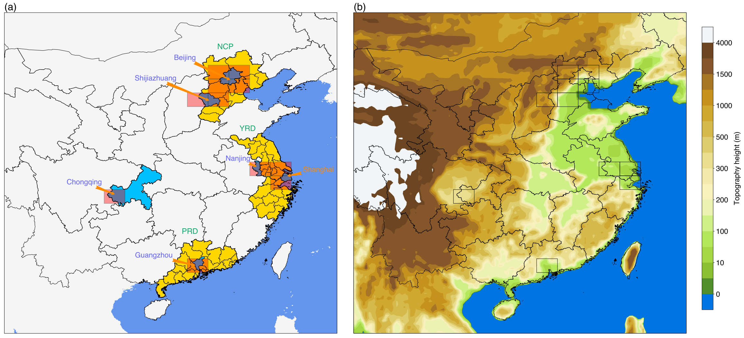
Where we look at for surface ozone pollution? Industrial regions typically with high emissions

Slide 3
UK chemistry and aerosol model (UKCA) configurations
Version
Chemical schemes
Met +SST
Emissions
Improvements and adjustments
Vn10.6
N96 resolution
Strat-trop +
GLOMAP aerosol scheme
Met:
Nudging with
ERA-interim
2016
Anthropogenic:
MEIC 2013 (China)
+
HTAP 2010 (the rest)
Add higher hydrocarbon and related reactions in the chemistry scheme
Apply diurnal and vertical profiles to emissions
Adjust emissions from 2013 to 2016
1.88°*1.25°
(192*145 grids)
85 layers
( up to 85000m)
84 species
291 reactions
SST: Climatology
mean of
1995-2004
Interactive BVOC emissions
Biomass burning emissions: GFED4
Details
Add highly reactive VOC tracers as well as related reactions and products in UKCA, including C₃H₆, C₄H₁₀ and lumped Toluene
Apply sectoral emissions (pow, ind, res, tra, agr) as input in UKCA, also with diurnal and vertical profiles
Adjust anthropogenic emissions from 2013 to 2016： National scalings + Regional scalings
National scalings: apply normal scalings of SO2, NOx, NMVOC, CO, BC, OC from 2013 to 2016 to the whole China, https://doi.org/10.5194/acp-18-14095-2018
Regional scalings: For the NCP, the YRD and the PRD, apply regional scalings of SO2, NOx, NMVOC, BC, OC in Beijing from 2013 to 2016 to these three regions separately, https://doi.org/10.5194/acp-19-6125-2019

Slide 4
Evaluation of the model We look at the diurnal profiles of surface O₃ and NO₂ _{Take Beijing for example：}
Averaging 3 lowest layers to look at the vertical distributions in PBL at nighttime
Underestimated O₃ and highly overestimated NO₂ at nighttime probably due to the shallow PBL
Overestimated O₃ and lowest NO₂ in the daytime, partly contributed by coarse model grid resolutions

Slide 5
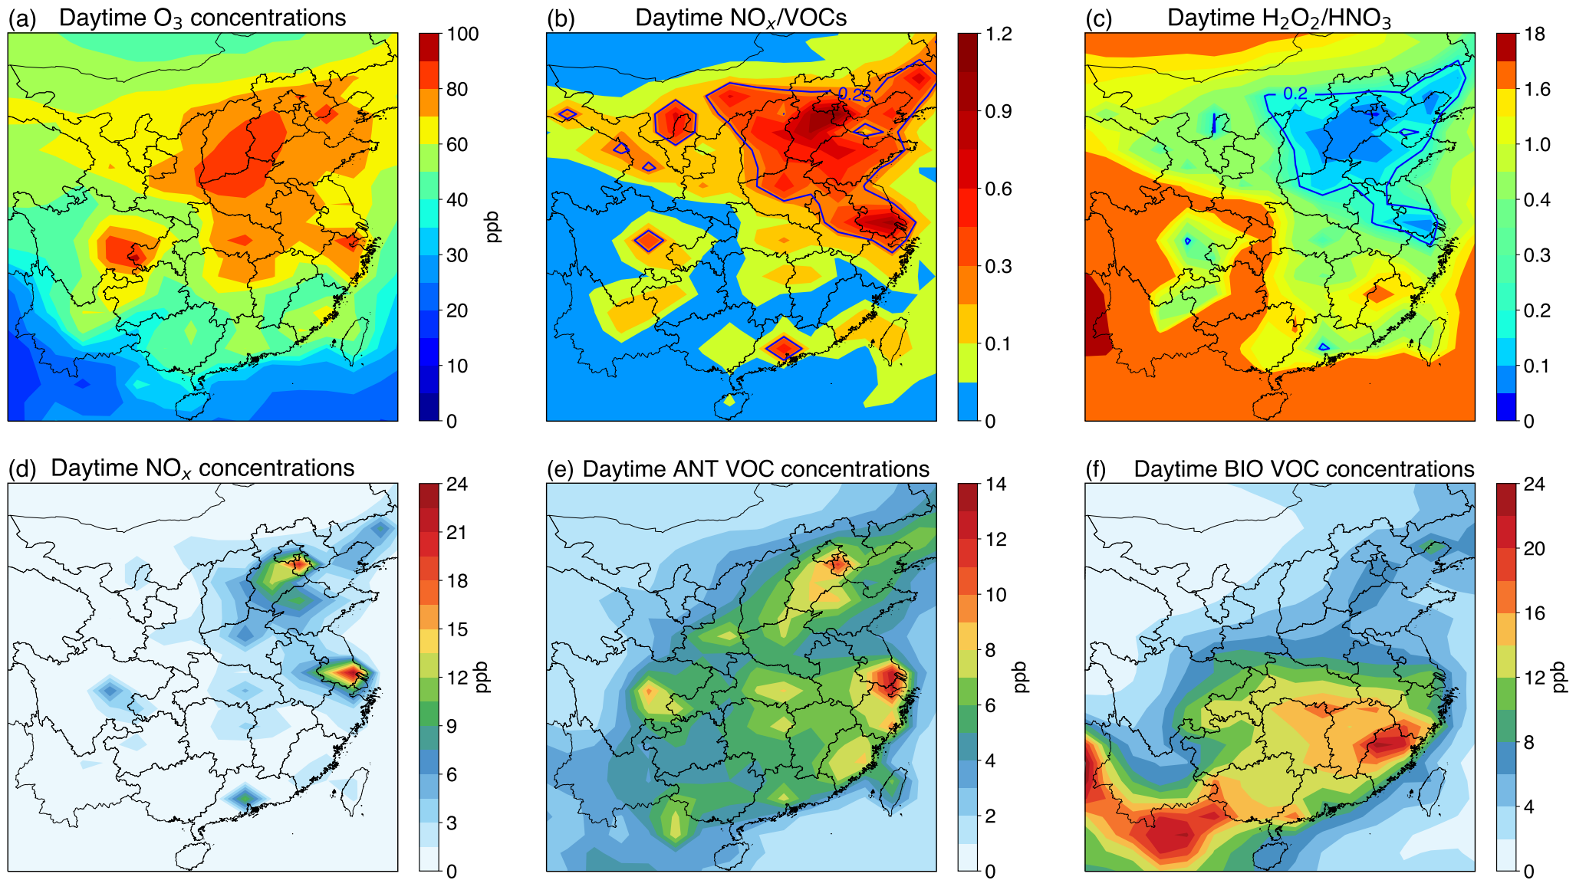
Spatial distributions of species and O₃ sensitivity indicators It shows the contrasting chemical environment in China!
Typically high NOx and anthropogenic VOCs in industrial regions
The YRD and the Sichuan basin have relatively high O₃ concentrations. Surface O₃ levels in the PRD are low.
Most industrial regions are VOC limited, reflected by high NOx/VOC and low H₂O₂/HNO₃ values.

Slide 6
Regional O₃ responses to emission scenarios
Increased O₃ levels in industrial regions that are VOC limited in the NOx emission control scenario
Decreased VOC emissions can partly offset the increased O₃ in the YRD and the PRD, and more strict VOC emission controls are required for the NCP

Slide 7
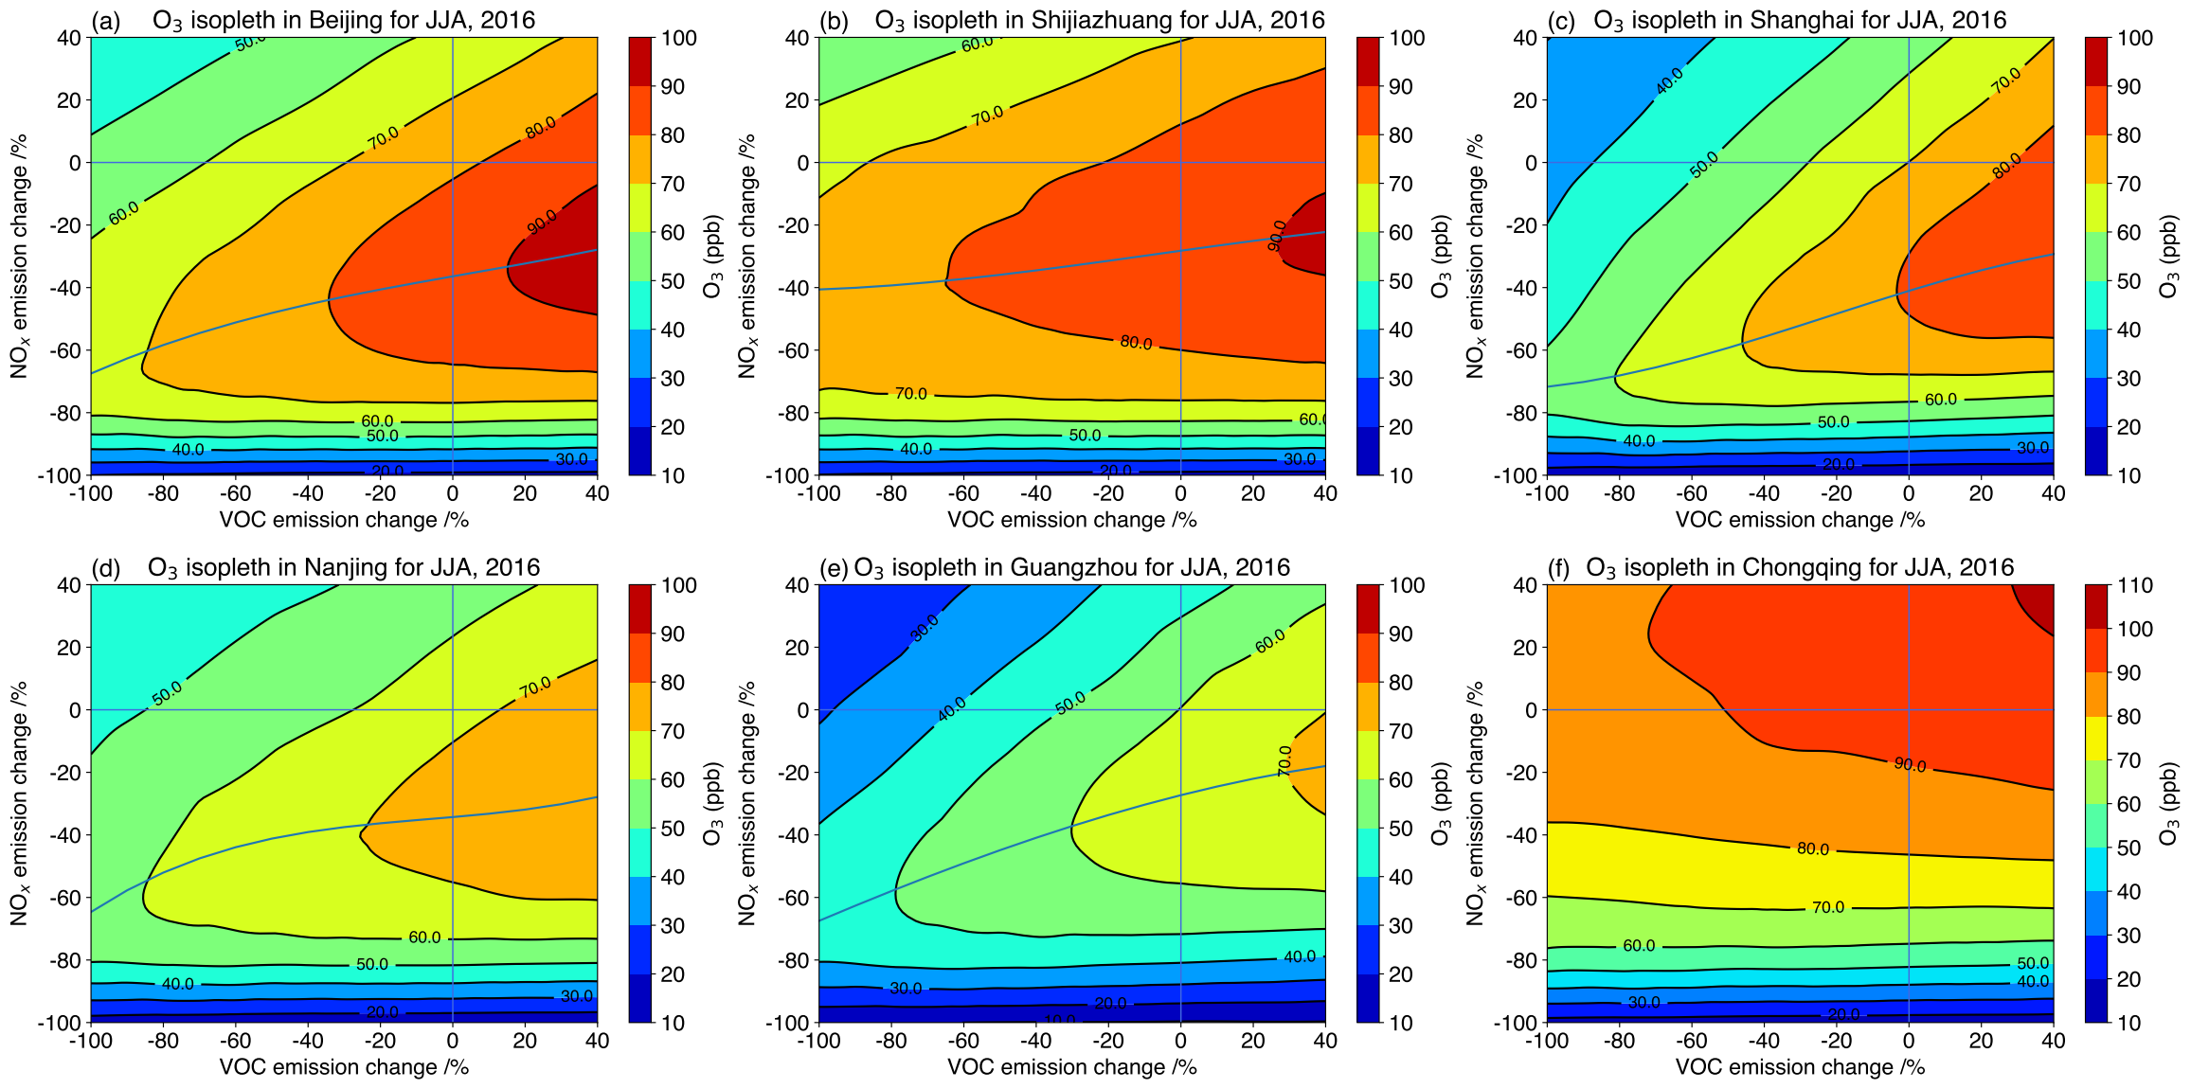
O₃ response surface
The current state of O₃ concentrations are higher in the NCP, slightly lower in the YRD and lowest in PRD, but O₃ levels inevitably increase when decreasing NOx emissions.
Large amount of NOx emissions should be decreased to shift from VOC limited to NOx limited. Decreasing VOC emissions have small impacts in Shijiazhuang and Chongqing.

Slide 8
Effectiveness of emission control strategies
>60% NOx emissions should be decreased in Beijing, Shanghai and Nanjing to reduce O₃ concentrations.
Combined reductions of NOx and VOC emissions make sure the decrease of O₃ concentrations.
Stronger O₃ responses regionally than in continents. In general, decreased NOx emissions reduce O₃ abundances in continents.

