Slide 1
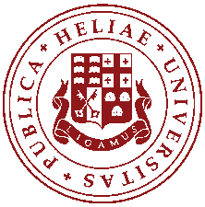
Cultural Heritage and Environment Research Center
ILIA STATE UNIVERSITY, GEORGIA
NH6.4
Cultural Heritage Monument Complex Monitoring Data Analyses Using Machine Learning Algorithms
David Kvavadze, Giorgi Basilaia, Tea Munchava, Giorgi Laluashvili, and Mikheil Elashvili
Ilia State University, I. Chavchavadze ave. 3/5, Tbilisi, Georgia
This work was supported by Shota Rustaveli National Science Foundation of Georgia (SRNSFG) [Grant Number fr17_90]

Slide 2
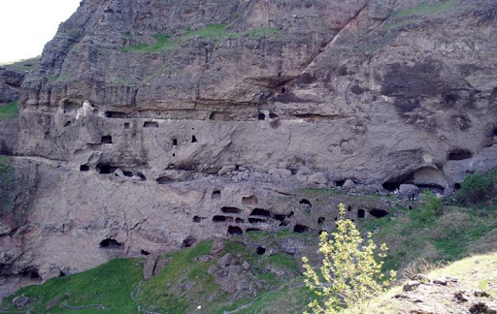
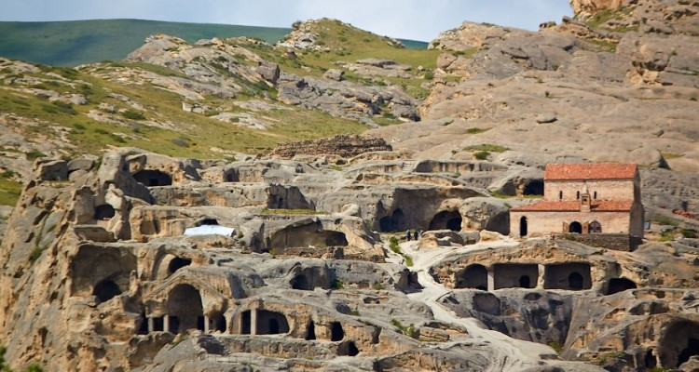
Cultural Heritage Monuments in Georgia
Ateni Sioni
Vardzia
Cultural heritage monuments, that were created by mankind for centuries are scattered throughout the world. Most of them are experiencing impacts coming from nature and humans each year that result in damage and changing their common state
Vani Caves
Uplistsikhe
Cultural Heritage and Environment
Research Center
ILIA STATE UNIVERSITY, GEORGIA
This work was supported by Shota Rustaveli National Science Foundation of Georgia (SRNSFG) [Grant Number fr17_90]

Slide 3
Monitoring network components
Many of the monuments are facing critical conditions and require diagnostics, study and planning, and management of conservation/rehabilitation works. Due to the impact of environmental factors such as temperature, humidity, precipitation, the existence of complex structure of cracks, infiltrated water and runoff water streams, together with active tectonics in the region, Uplistsikhe and Vardzia rock-cut city monuments located in Georgia face problems and permanent destruction.
We have developed continuous monitoring systems that are installed in Vardzia, Uplistsikhe, Vani Caves and Ateni Sioni Church.
Vardzia rock-carved Town
Radar
Weather station
Accelerometers
Humidity sensors
Temperature sensors
Extensometer
Camera
Uplistsikhe Cave Town
Humidity sensors
Temperature sensors
Extensometer
Weather station
Ateni Sioni Church
Humidity sensors
Temperature sensors
Extensometer
Weather station
Vani Caves
Humidity sensors
Temperature sensors
Extensometer
Accelerometers
Cultural Heritage and Environment
Research Center
ILIA STATE UNIVERSITY, GEORGIA
This work was supported by Shota Rustaveli National Science Foundation of Georgia (SRNSFG) [Grant Number fr17_90]

Slide 4
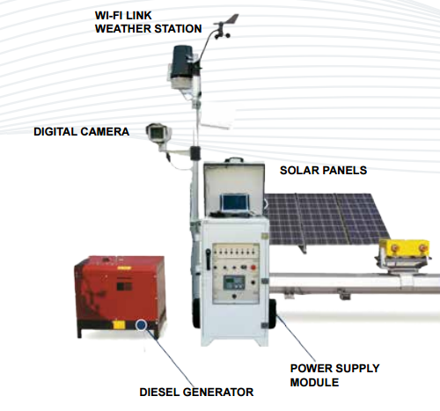
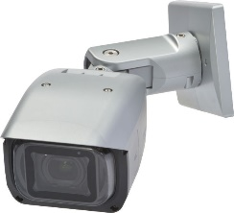
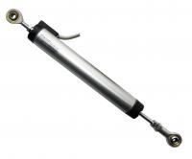
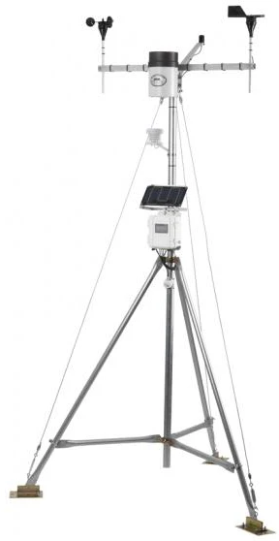
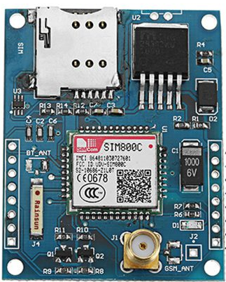
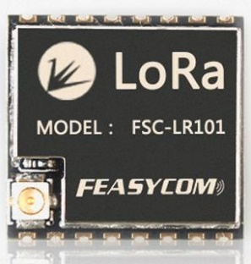
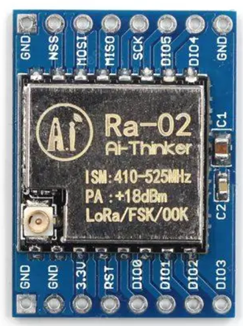
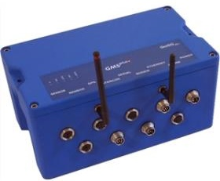
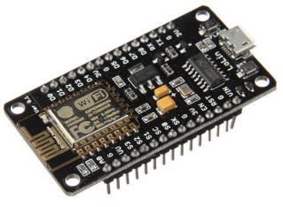
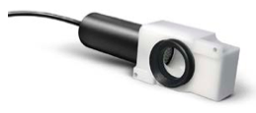
Monitoring network measurement and communication hardware
Continuous monitoring systems in Vardzia, Uplistsikhe, Vani Caves and Ateni Sioni are using different sensors and data transmission equipment.
GBR-Radar
Camera
Crackmeter
Temperature, Humidity, Pressure
3 Axis Accelerometer
Weather Station
2.4 and 5GhZ WiFi, LORA, GSM/GPRS Transmitters
Cultural Heritage and Environment
Research Center
ILIA STATE UNIVERSITY, GEORGIA
This work was supported by Shota Rustaveli National Science Foundation of Georgia (SRNSFG) [Grant Number fr17_90]

Slide 5
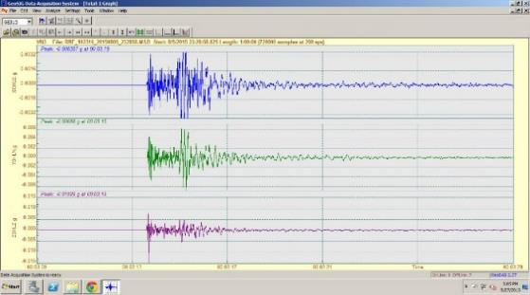
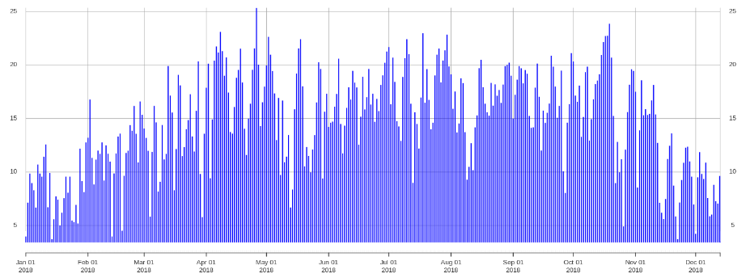
Data types and quantity
Systems are generating large amount of data that is almost impossible to analyze these data in conventional methods.
Radar: 8 MB file every 8 minute (monitors cliff movement)
Weather station: Generates samples every 5 minutes more than 10 different sensors (Measures weather data) – 3 Stations
Accelerometer: Continuous mode at 200 samples per second and has 3 channels – 7 stations (detects earthquakes and sudden displacement)
Extensometer: Measures once every 5 minutes – 14 different points of installation (measures displacement between rock cracks)
Humidity and temperature sensors: detects rock condition at different location, every 5 minutes, 14 different points of installation
Camera is taking a 4K resolution photo each 15 minutes
Amount of data points generated daily is -- 140,000
Daily size of data generated is about 500 Mb
Earthquake recording
6 month of Crack meter data
One year of single Temperature sensor data
Cultural Heritage and Environment
Research Center
ILIA STATE UNIVERSITY, GEORGIA
This work was supported by Shota Rustaveli National Science Foundation of Georgia (SRNSFG) [Grant Number fr17_90]

Slide 6
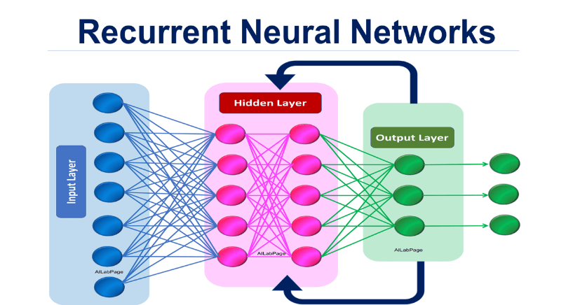
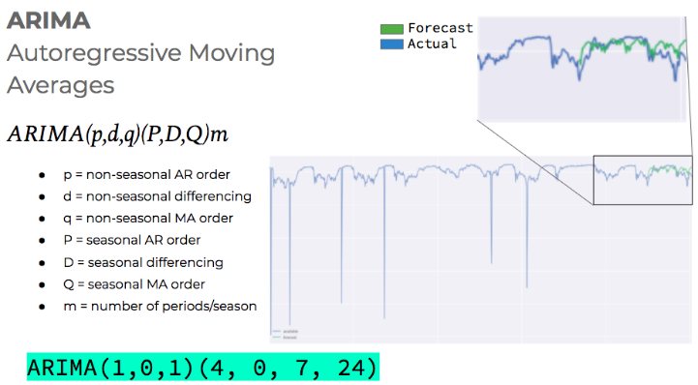
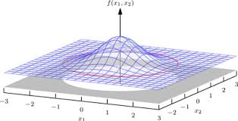
Working with data using machine learning
In parallel with technological development, it is now possible to analyze big data using machine learning.
We decided to use machine learning to address our problem
Here are some techniques used to analyze data
ARIMA (Auto Regressive Integrated Moving Average) models to predict possible values of our sensor data.
Multivariate normal distribution for anomaly detection
Recurrent neural networks (RNNs) to make better models (under development)
Cultural Heritage and Environment
Research Center
ILIA STATE UNIVERSITY, GEORGIA
This work was supported by Shota Rustaveli National Science Foundation of Georgia (SRNSFG) [Grant Number fr17_90]

Slide 7
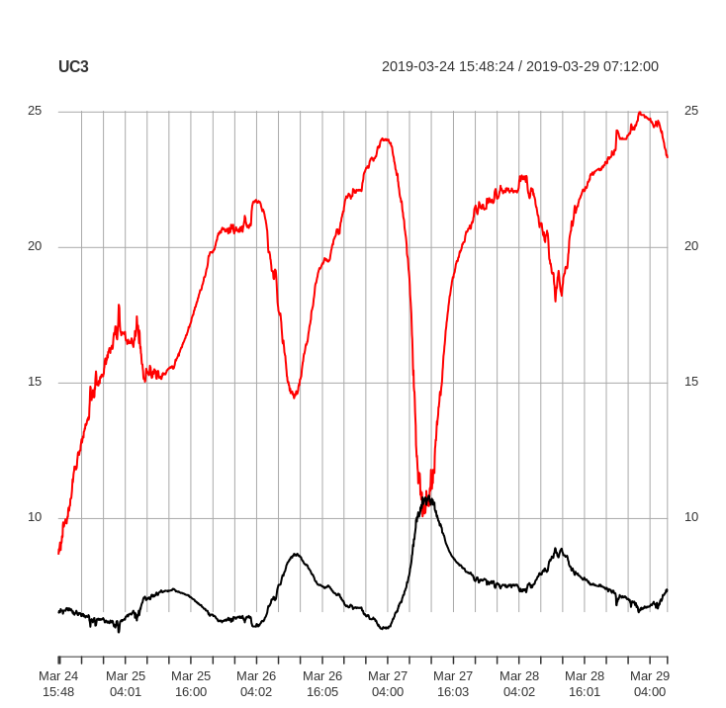
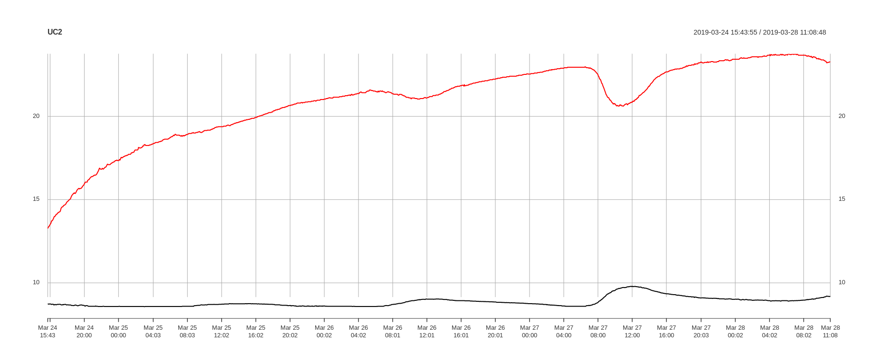
Results on data using machine learning
We were able to detect correlations between different sensors, see anomalies in data that gave us some clues about hazard zones. Models and predictions about the monument's condition were made.
Our work shows that machine learning could be used to estimate conditions make predictions about monuments state.
We have a promising results in using multivariate normal distribution to detect anomalies.
We are taking temperature date, humidity date and then try to detect anomalies in rock movement.
Cultural Heritage and Environment
Research Center
ILIA STATE UNIVERSITY, GEORGIA
This work was supported by Shota Rustaveli National Science Foundation of Georgia (SRNSFG) [Grant Number fr17_90]

