Slide 1
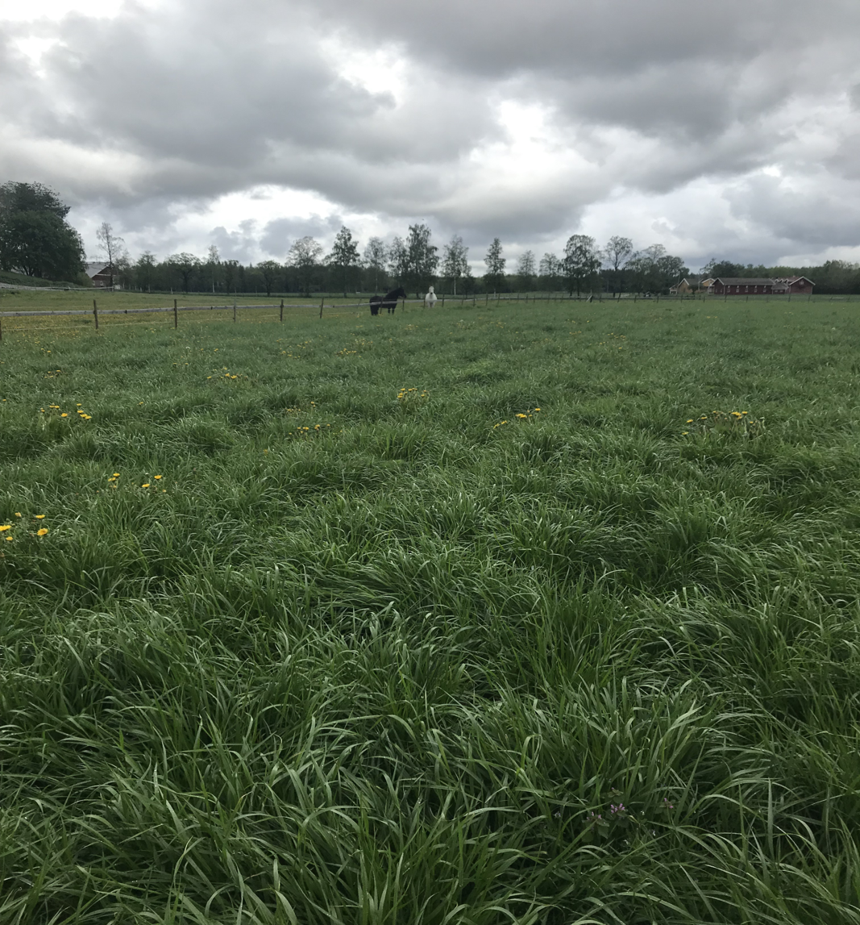


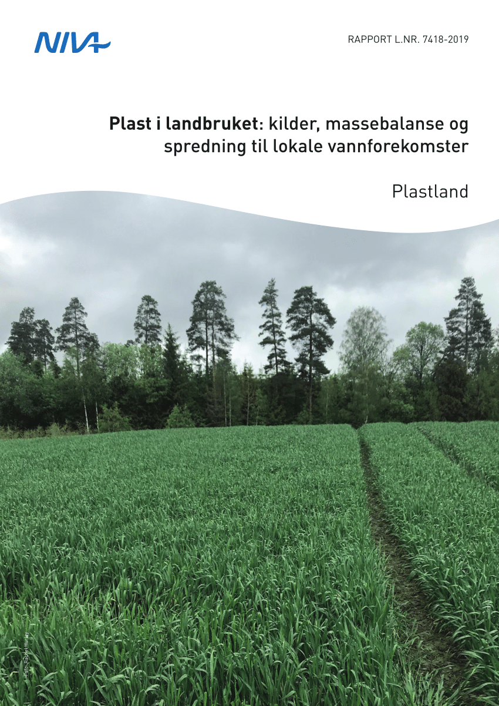
Plastics in Agriculture:
Sources, mass balance and transport to local aquatic environments
Nina T. Buenaventura ¹, Sissel Brit Ranneklev ¹, Rachel Hurley ¹, Inger Lise Nerland Bråte ¹, Christian Vogelsang ¹
¹ NIVA Norwegian Institute for Water Research Gaustadalleen 21, 0349, Oslo, Norway
E-mail contact: nina.buenaventura@niva.no
https://www.landbruksdirektoratet.no/no/fou-midler/jordbruks-og-matforskning/utredninger-og-forprosjekter/plast-i-landbruket-kilder-massebalanse-og-spredning-fra-jord-til-vann

Slide 2
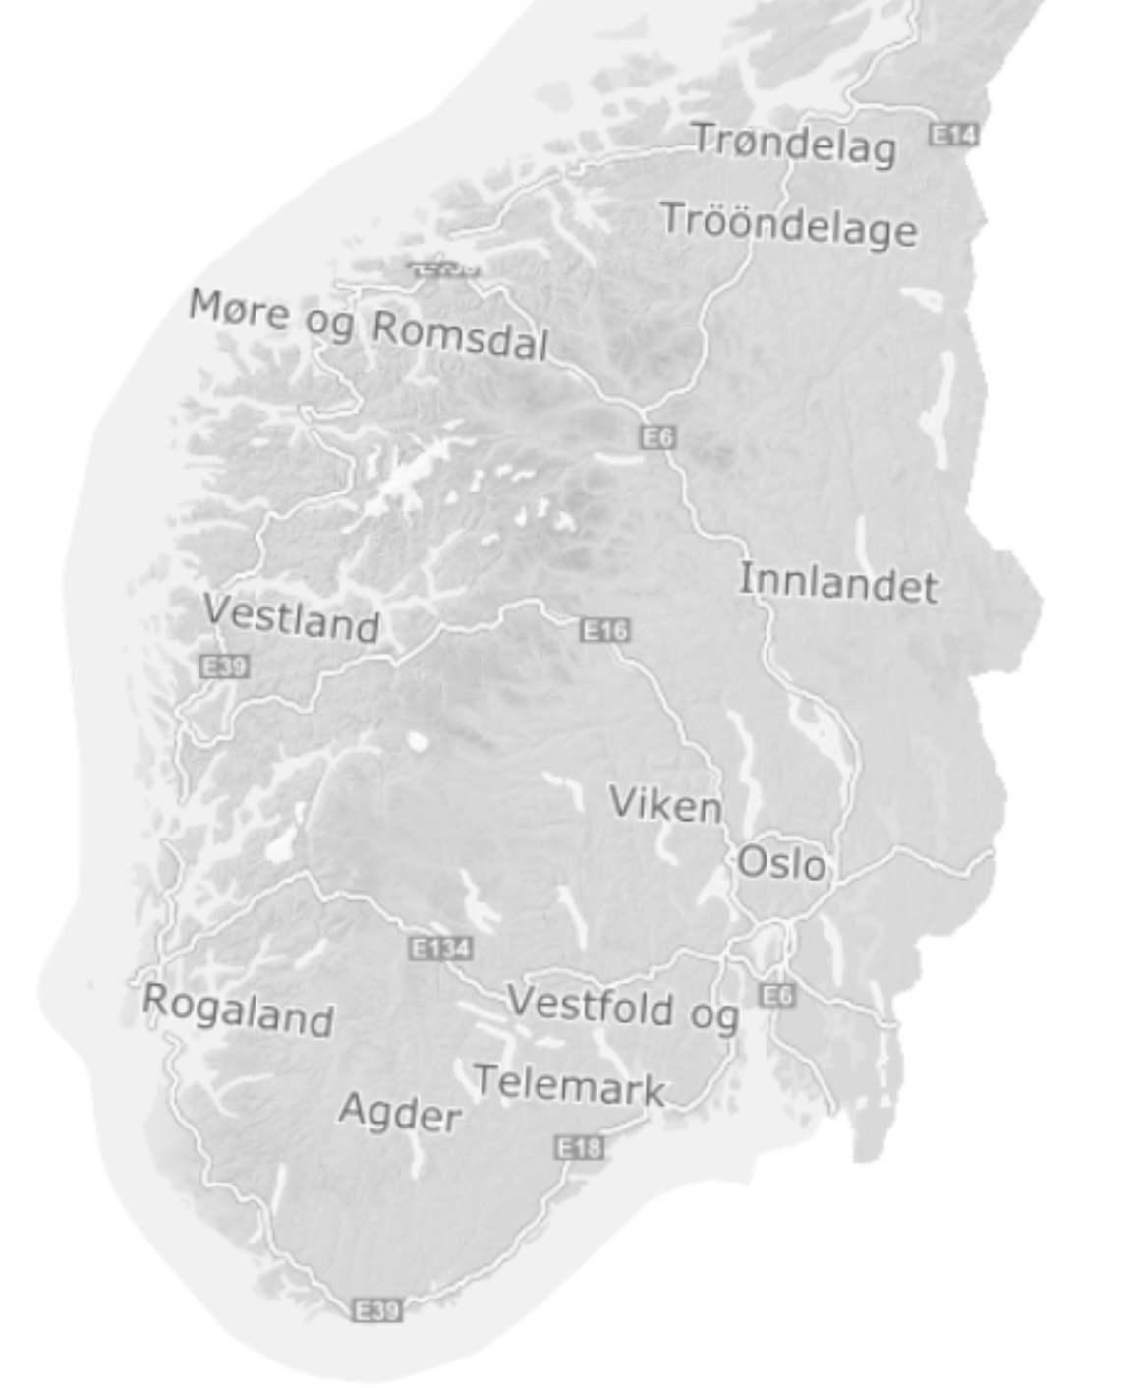
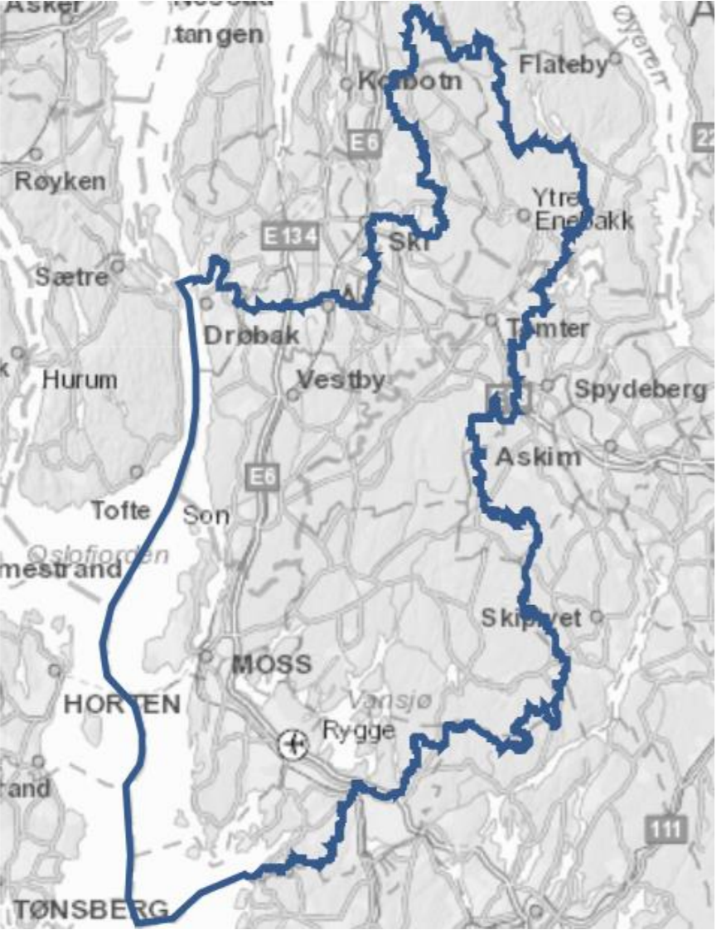
Preliminary study on agriculture in Norway.
The Morsa catchment (Vansjø-Hobølvassdraget) was selected due to its intensive agriculture within the catchment. Approximately 15 % of the are is agricultural land.
In Norway, agriculture is the third largest sector for plastic consumption.
Plastic wrap and films may be subjected to weathering. This can lead to fragmentation of micro- and macroplastics that may be dispersed in the soil and via drainage networks from agricultural soils into the local aquatic environments.
This preliminary study aim to:
Identify sources of plastic contamination in agriculture
Establish a mass balance
Investigate the possibility of plastic from land being transported to the aquatic environment
Figure 1: Morsa catchment area
Kartdata.no
https://www.vannportalen.no/globalassets/vannregioner/glomma/glomma---dokumenter/planperioden-2022-2027/hovedutfordringer-vo/morsa_hovedutfordringer_17.01.2019.pdf

Slide 3

Microplastic contamination of agricultural soils
Soil samples were collected at each field in the Morsa catchment in Norway.
Soil microplastic contamination > 50 µm is generally very low. Only a single field, Field 2 presents microplastic concentrations exceeding 100 particles kg⁻¹ (figure 1).
Table 1: presents the concentrations of microplastic in soil samples observed in the studied farms 1-5. Concentrations are reported by both particle number and mass.
Mass-based estimations indicate microplastic contributes > 0.001% of the d/w soil.
Field 3 not subject to any agricultural plastic application presented higher concentrations than some of the soils applied with sewage sludge (Fields 6 and 7).
Fields treated with sludge 7-8 years ago (Fields 5 and 8) show higher values than those treated recently (Fields 6 and 7).
Suggesting local variability influencing background concentrations may be important and that agricultural practices do represent significant sources of plastic debris in the majority of the studied fields.
A total of 14 polymer types were identified in the soil samples
Farm | Field | Crop | Plastic | Concentration
 |  |  |  | particles kg⁻¹ | mg kg⁻¹
1 | 1 | Berries | Mulching in and above soil | 76 ± 51 | 19 ± 27
2 | 2 | Vegetables | Mulching in and above soil | 2239 ± 1584 | 69± 72
 | 3 | Vegetables | No plastic use (control) | 36 ± 46 | 0.2 ± 0.4
 | 4 | Vegetables | Solar insulation block mulching | 99 ± 54 | 11 ± 10
3 | 5 | Grass and cereal | Sludge (7-8 y.a) | 73 ± 41 | 4 ± 4
4 | 6 | Grass for animal feed | Sludge (2018) | 22 ± 23 | 4 ± 4
5 | 7d | Grass and cereal | Sludge (2018) depot | 13 ± 23 | 0.3 ± 0.5
 | 7f | Grass and cereal | Sludge (2018) field | 6 ± 11 | 0.1 ± 0.2
 | 8d | Grass and cereal | Sludge (7-8 y.a) depot | 44 ± 44 | 0.5 ± 0.8
 | 8f | Grass and cereal | Sludge (7-8 y.a) field | 62 ± 41 | 3 ± 2

Slide 4
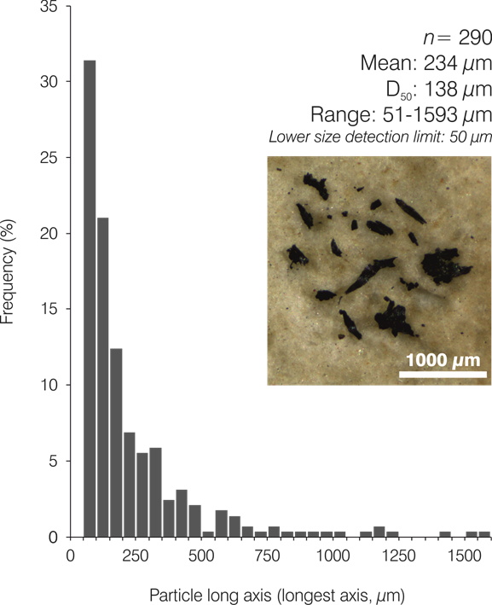
Microplastic contamination of agricultural soils
Field 2 had the highest concentration of microplastics in soil.
PBAT accounted for 95% of microplastic contamination in Field 2, where high particle counts were observed (Table 1).
The concentration of PBAT film particles increased exponentially with decreasing particle size, with many additional particles – suspected to also be PBAT films < 50 um fraction (not analysed in this study) (Figure 2).
PBAT films have been applied to Field 2 approximately 20 times.
In Norwegian agriculture, PBAT is the most frequently used non-biobased biodegradable plastic, and there are no requirements for removal after a season.
Figure 2: Particle size distribution of PBAT fragment found in soil samples from Field 2, Farm 2. The size is measured as the longest dimension.

Slide 5
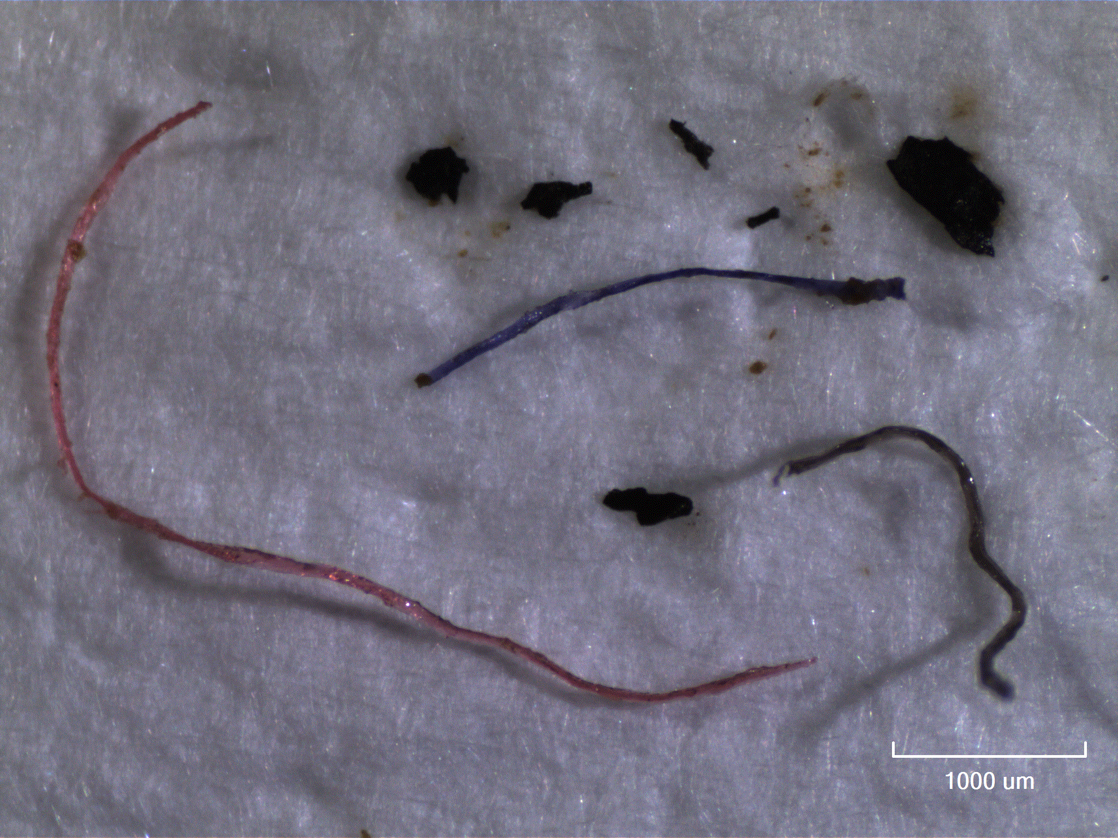
Microplastic contamination in water
Water samples
Due to higher particle counts in blanks than in the water samples, all water samples were excluded except from Farm 3.
Table 2: Microplastic contamination in discharge water from a pipe draining Field 5, Farm 3 and in the surface waters of the fangdam which receives the discharge and runoff.
Comparing soil and water data from Farm 3, fragment and polyethylene particles in the discharge water may have derived from the soil contamination at this site, where fragments represent the dominant particle type in the soil.
Farm | Field | Sample type | Crop | Plastic | Concentration
 |  |  |  |  | particles l⁻¹ | µg l⁻¹
3 | 5 | Pipe | Grass and cereal | Sludge applied 7-8 years ago | 1.85 | 83.1
 |  | Fangdam |  |  | 2.81 | 34.4
The fangdam (coffer dam) had higher particle count however, the particles identified in the discharge water had a greater mass, resulting in higher mass-based concentrations.
The presence of microplastic particles in water from the discharge pipe suggests that mobilisation of soil microplastic occurs at this site, and spreads contamination to nearby aquatic environments
Fibres were dominant in both water samples.
Figure 3: Comparison between microplastic contamination of soil and water samples collected from Farm 3. Particle morphology is shown in the upper pie chart, and polymer types in the lower chart. Water samples were collected from the water discharging from the pipe that drains the sampled field and in the receiving waters of the fangdam.

Slide 6
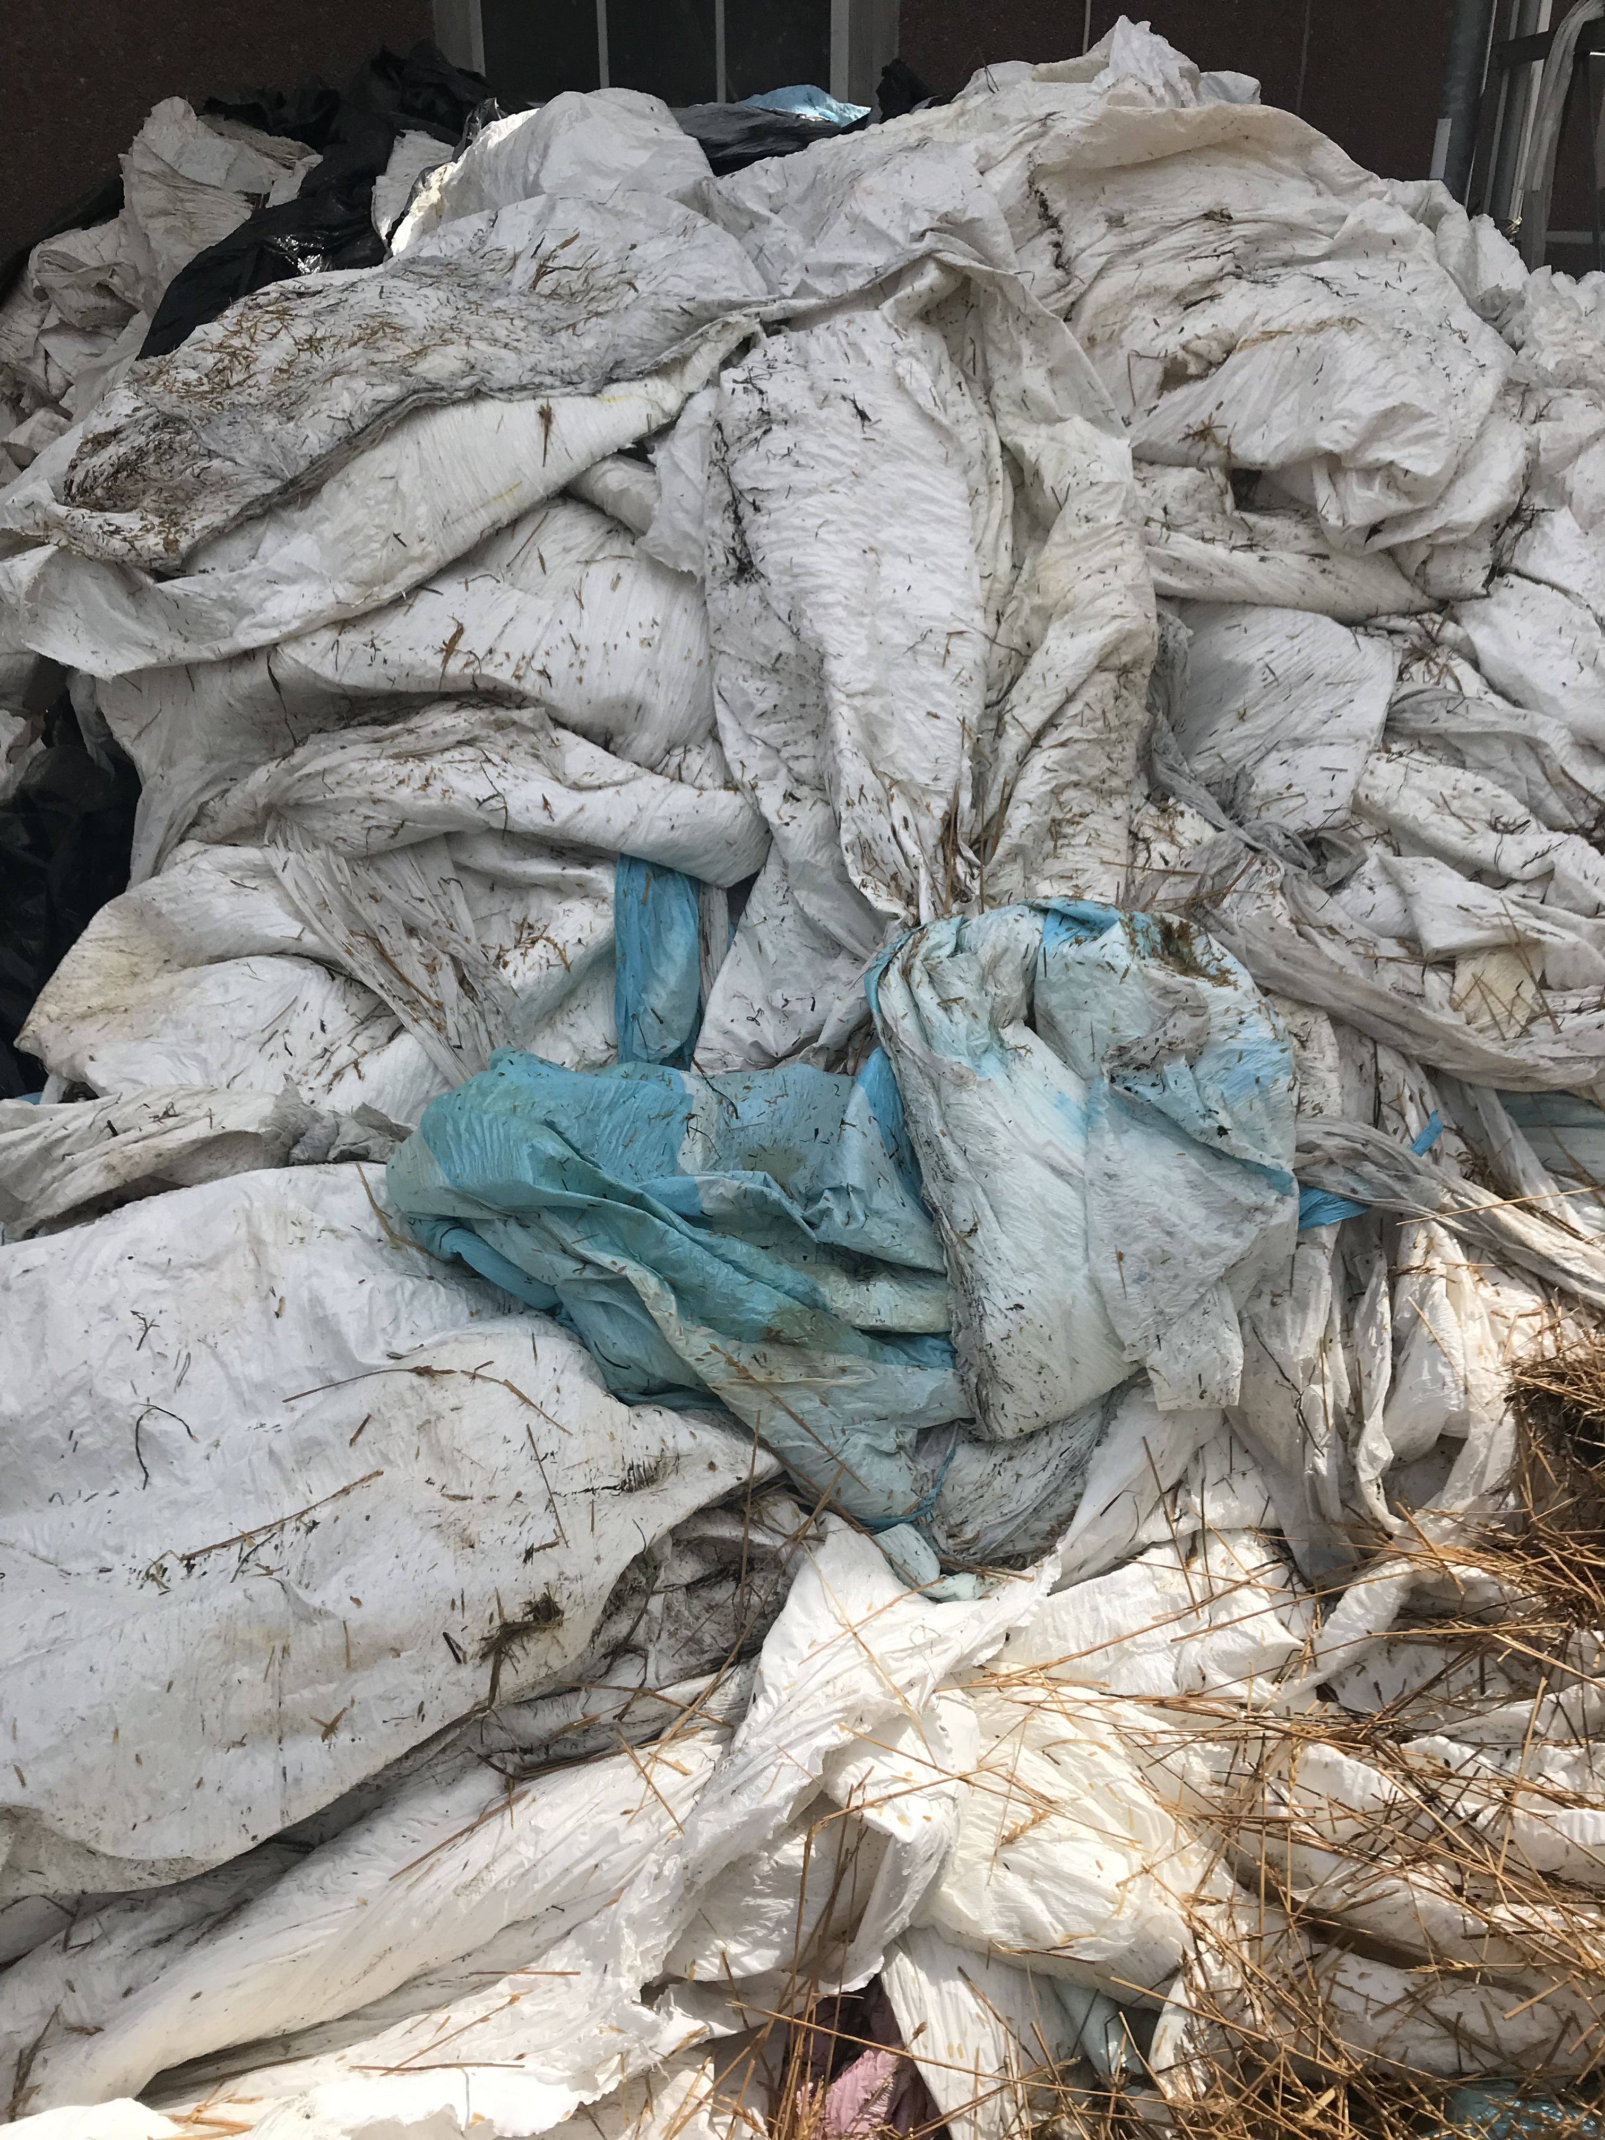
Macroplastic contamination of agricultural soils
Macroplastic items collected from farmlands. A total of 19 microplastic fragments were analysed.
Polymer types detected:
Black PE
White PE
Brown PE
Haybale (white) PE
Clear PE
White EVA
White PP (non-woven)
Clear PP
White PE (hard plastic)
PBAT
Blue rope PP
Figure 4: Macroplastics from farm (gård) 1-4. Photos with ruler for scale and FTIR spectra for that specific plastic polymer. PBAT and PE from farm 2 on the left are from unused agricultural film, while PBAT and PP to the right was found on the soil. PE from farm 4 was unused hay bale film.

Slide 7

Highlights
This preliminary work highlights that soil microplastic contamination in the Morsa catchment is not high. Concentrations are closer in value to ‘background’ contamination documented by Piehl et al. (2018).
The results show little significant contamination in Norwegian farmlands and may correspond to different agricultural practices, different soil types, or specific environmental conditions that may limit the incorporation of plastic particles into soils.
High levels of PBAT found in Field 2. These films should be 90 % degraded after two years at 25°C but degradation rate may not be relevant in cooler Nordic environments.
Only upper 5 cm of soil collected for analysis may have missed particles deeper down the soil and thus, this study may still be relevant with the proposed sources of plastics as particles may not have been captures.
Very little is known about the accumulation vs. mobilisation of plastic particles added to soils.
No clear patterns between the type of plastic exposure and subsequent soil microplastic concentrations (Table 1).
Based on these preliminary data, it is apparent that sources of plastic to fields are likely to be complex. Diverse sources acting across different spatial and temporal scales can be expected to add plastic particles to soils, including inputs from windblown particles and local littering.
Little is known about the fate of plastics once they enter a field environment and should be further investigated to better understand dynamics of contamination.

Slide 8
Further research
Analyse soil profiles for plastic to better understand patterns of contamination change with depth, shedding light on the influence of agricultural practices such as ploughing and tilling which interrupt soil profiles.
Systematic studies of macroplastic contamination in agricultural fields should be undertaken to quantify and map plastic debris in farm environments. This should extend beyond field boundaries to include other plastic waste sources in the vicinity and better illuminate the contribution of windblown debris to agricultural soils.
Assess temporal patterns of plastic (micro-, macro-) contamination following application of plastic products or plastic-containing materials (i.e. sludge). This will elaborate processes of mobilisation vs accumulation of plastic particles into the soil, and the potential for contamination of local aquatic environments.
Biodegradability and ecotoxicological testing should be conducted to identify the timescales and potential effects of biodegradable film residues (such as PBAT) in climate relevant agricultural soils.

