Slide 1
Fluid geochemistry in the Latronico thermal area (south Italy): new preliminary data for upcoming monitoring of a seismically active area
Paternoster M.^{1,2}, Apollaro C.³, Caracausi A.², Randazzo P.⁴, Aiuppa A.⁴, De Rosa R.³, Fuoco I.³, Mongelli G.¹,
Muto F.³, Vanni E., and Vespasiano G.³
¹Department of Sciences, University of Basilicata, Potenza, Italy (michele.paternoster@unibas.it)
²National Institute of Geophysics and Volcanology ( INGV), Section of Palermo, Palermo, Italy
³Department of Biology, Ecology and Earth Sciences (DiBEST), University of Calabria, Arcavacata di Rende (CS), Italy.
⁴Department of Earth and Marine Sciences (DiSTeM), University of Palermo, Palermo, Italy.
Dr Giovanni Vespasiano – giovanni.vespasiano@unical.it

Slide 2
AIMS – approach - metodology
Improve the knowledge about Terme Lucane (TL) area (South Italy) (Apollaro et al., 2020 submitted) in terms of:
Recharge area
Reservoir features (geological setting, temperature)
Fluid geochemistry (Gas and water)
Geothermal conceptual model
Approach:
Geological ⇒ Geological model
Geochemical ⇒ Water and gas chemical composition. Water-rock interaction.
Isotopic (δ²H, δ¹⁸O, δ¹³C and ³He/⁴He ) ⇒ Recharge areas; Gas origin.
Geo-thermometric ⇒ Reservoir features
SAMPLING AND ANALYTICAL TECHNIQUES
25 water samples were collected and analysed from cold and Terme Lucane hypothermal springs (TL) in the Mt. Alpi area.
Major anions and cations were obtained by High Performance Liquid Chromatography (HPLC).
²H/H and ¹⁸O/¹⁶O isotopic compositions were determined by isotope ratio mass spectrometry (IRMS).
Dissolved gas chemistry (H₂, O₂, N₂, CH₄, CO and CO₂) were measured by gas chromatography (GC) employing a Perkin Elmer Clarus 500 instrument.
³He/⁴He ratios were measured by a Thermo Helix SFT mass spectrometer with analytical error <4.0% and ²⁰Ne by using a Thermo Helix MC.
The ¹³C/¹²C isotopic ratios in TDIC were analyzed by using a Thermo Scientific Delta V Advantage continuous flow isotope ratio mass spectrometer.
Dr Giovanni Vespasiano – giovanni.vespasiano@unical.it

Slide 3
Terme Lucane Thermal area
In the study area, the Mesozoic succession, belonging to the Apulian Platform, is represented by the tectonic window of the Mount Alpi Unit consisting of Mesozoic successions (Jurassic-Cretaceous Limestone) and Messinian deposits (carbonates and terrigenous terrains).
Dr Giovanni Vespasiano – giovanni.vespasiano@unical.it

Slide 4
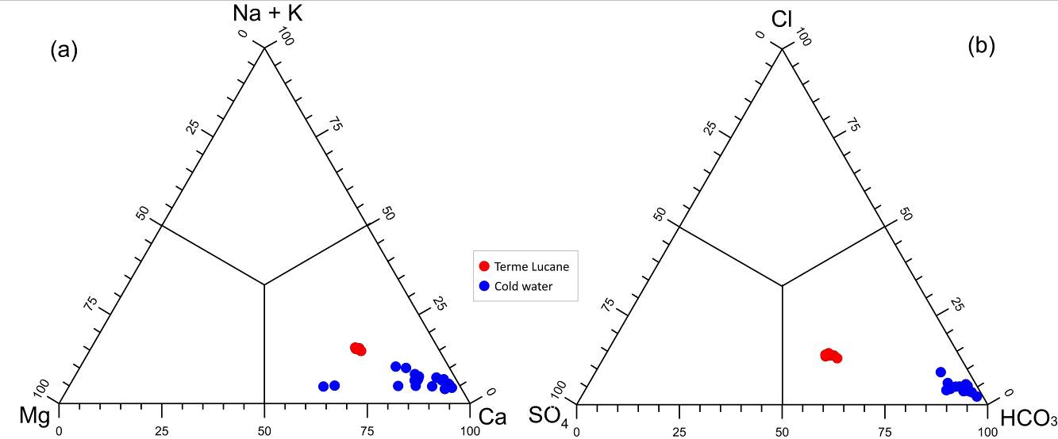
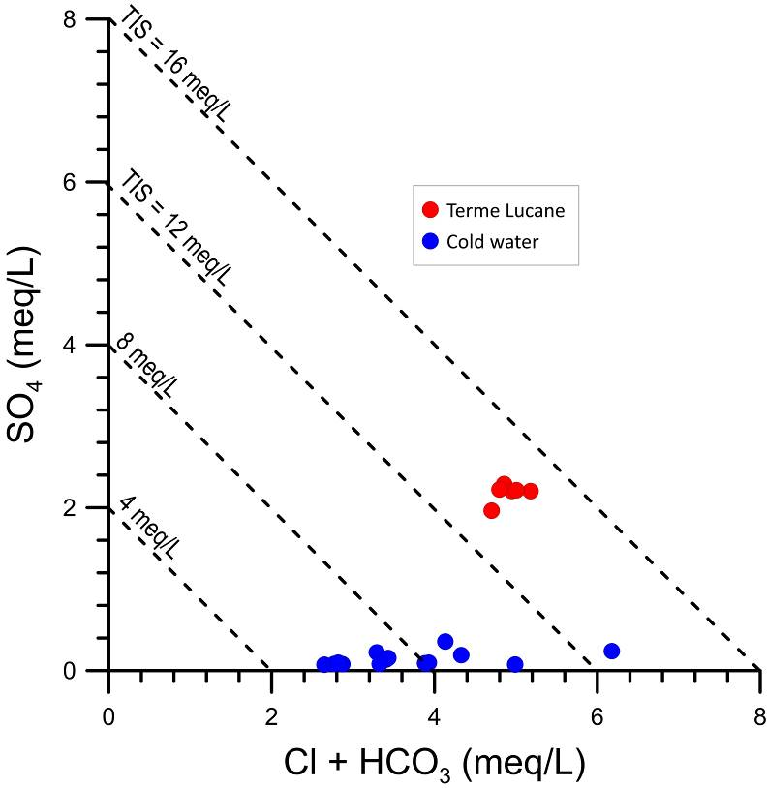
Chemical composition of waters
The dataset allows to identify two different subsets: cold and TL waters. The TL subset shows an average temperature of 21.0 ± 1.4 °C, an average EC value of 705 μS/cm, pH values between 7.12 and 8.3, and negative Eh.
Based on the triangular plots, the investigated waters have shown two hydrofacies:
Ca-HCO₃(SO₄) type for TL waters
Ca-HCO₃ type for cold waters.
The Total Ionic Salinity diagram highlights for TL samples TIS values between 12 and 16 meq L⁻¹ whereas, for cold waters, lowest TIS from 4 to 12 meq L⁻¹.
Dr Giovanni Vespasiano – giovanni.vespasiano@unical.it

Slide 5
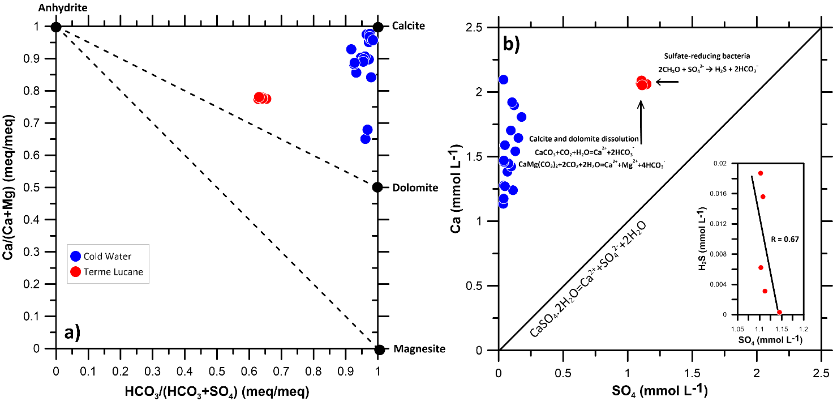
Water-rock interaction processes
The chemistry of TL and cold waters is linked to water rock-interaction processes during groundwater circulation in a system that is dominated by carbonate–evaporite rocks (Figure a). TL waters seem to react with carbonate and evaporitic (gypsum-anhydrite) lithologies. The deviation from gypsum dissolution line could be linked to either (i) a decrease of sulphate contents due to sulfate-reduction, or/and (ii) an increase in calcium concentrations because of carbonate rocks dissolution
Dr Giovanni Vespasiano – giovanni.vespasiano@unical.it

Slide 6
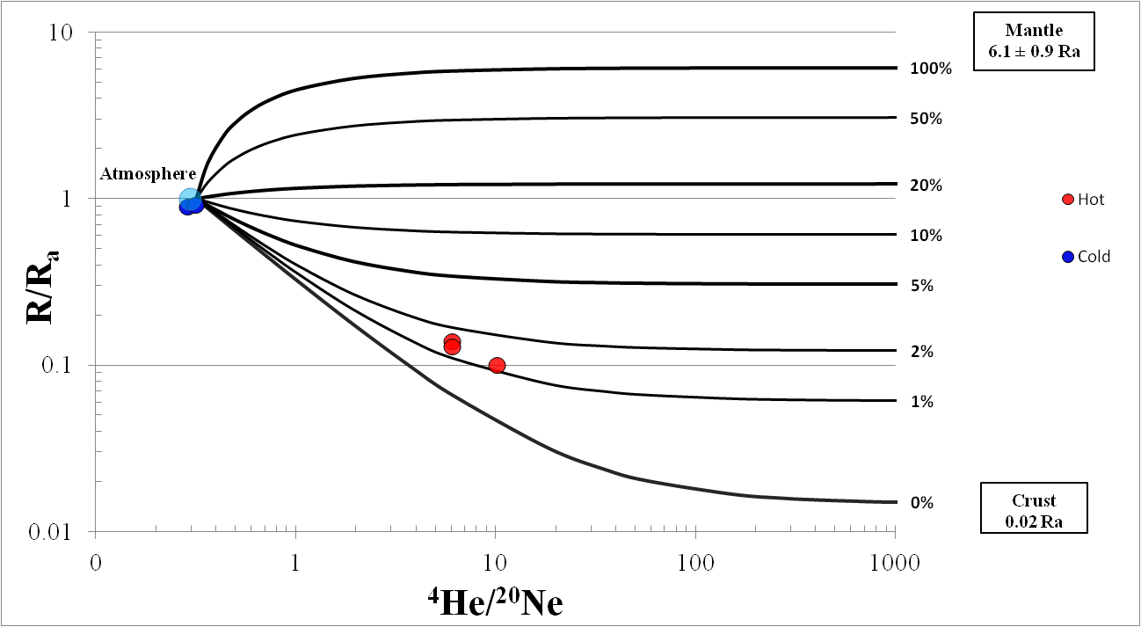
Gas origin
TL waters are CO₂-rich and have a He isotopic signature that point to the crustal radiogenic end member value (0.01-0.05Ra). Therefore, the atmosphere does not exclusively source the gases dissolved in the waters of the TL system.
The TL waters are dominated by crustal radiogenic ⁴He, but we cannot exclude the presence in traces of a mantle-derived He component.
Dr Giovanni Vespasiano – giovanni.vespasiano@unical.it

Slide 7
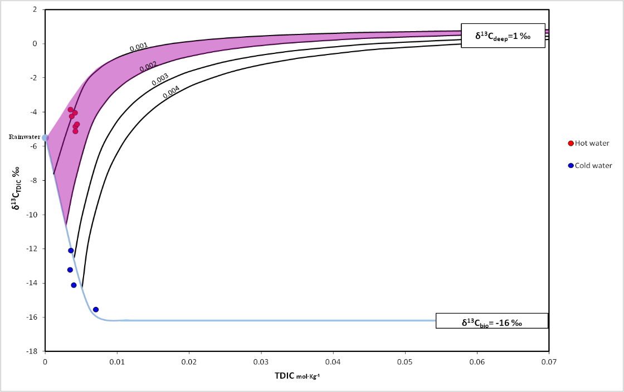
Gas origin
Cold waters are the results of a mixing, in different percentages, between a meteoric component (TDIC=2.5 x 10-5 mol/kg and δ¹³C_{TDIC}= 5.5 ‰) and a biogenic component (TDIC= 6.0 x 10-2 mol/kg and δ¹³C_{TDIC}= -16‰) that is characterized by negative carbon isotopic compositions. This is due to the dissolution of isotopically “light” biogenic CO₂ that probably occurs during water infiltration through the soil.
Conversely, TL waters are characterized by more positive δ¹³C_{TDIC} values (from -5.1 to -3.8‰), and their isotopic signature is consistent with the addition of inorganic CO₂ (black lines), characterized by relatively heavier δ¹³C values (crustal/mantle types) to the shallow groundwater (Chiodini et al., 2002).
Dr Giovanni Vespasiano – giovanni.vespasiano@unical.it

Slide 8
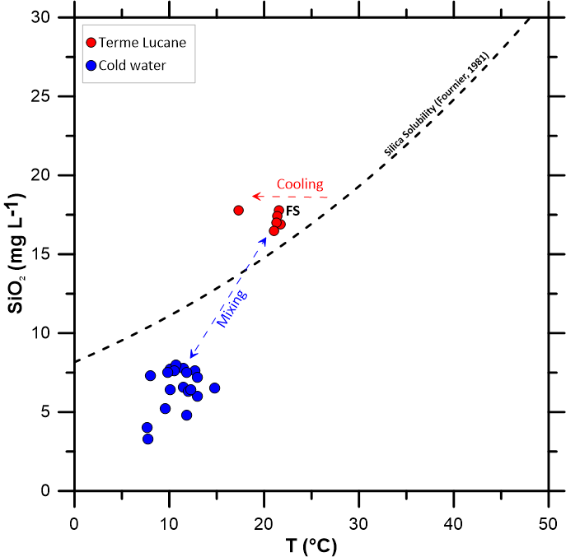
Geothermometry
(Chiodini et al., 1995; Fournier, 1977):
T(K) = (1032 / (4.69 – Log (SiO₂)) -273.15
T(K) = (896 / (3.408 – Log (Ca/Mg)) - 273.15
TL waters fall slightly displaced with respect to the silica solubility line at different temperatures, as proposed by Fournier (1977). This deviation from the equilibrium-line is probably due to a cooling of these waters and/or mixing with cold waters.
Geochemical data allow estimating a geothermal reservoir temperature between 30 and 60°C, according to silica and Ca/Mg geothermometers, respectively.
Dr Giovanni Vespasiano – giovanni.vespasiano@unical.it

Slide 9
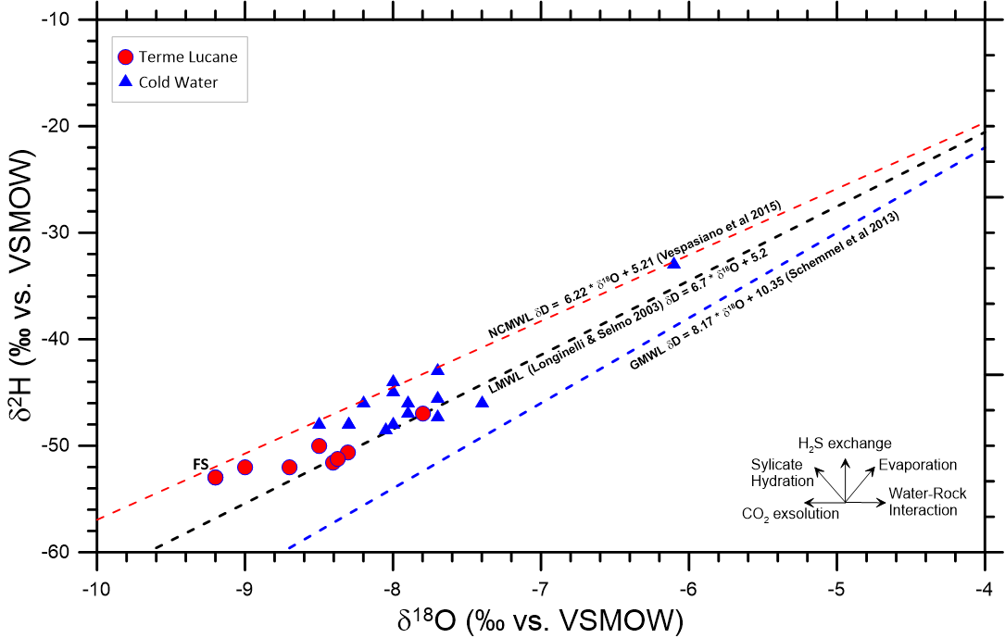
δ²H and δ¹⁸O of water
The investigated waters fall close to the Northern Calabria and South Italy meteoric water lines, denoting their meteoric origin.
The relation proposed by Vespasiano et al., 2015 for Northern Calabria was used to define the average infiltration altitude of the meteoric recharge:
δ¹⁸O = 0.00194 × Hi - 5.91
The waters are consistent with recharge (infiltration) elevations between 1300 and 1700 m a.s.l. compatible with a recharge in proximity of M. Alpi (La Bruna et al., 2017).
Dr Giovanni Vespasiano – giovanni.vespasiano@unical.it

Slide 10
Conclusion and Geothermal conceptual model
The collected geochemical data together with geological and structural knowledge of the study area allow to model the fluid circulation in the Mt. Alpi area:
The investigated area is characterized by two different types of waters: cold (10.98 ± 1.91 °C) and TL (up to 21.8°C), that showed a chemical composition largely explained by weathering and dissolution of carbonate–evaporite rocks.
The cold waters, with Ca-HCO₃ composition have mainly interacted with carbonate rocks (dolomite and calcite), whose dissolved gases show a dominant atmospheric contribution. TL group (with Ca-HCO₃[SO₄] composition) are characterized by water coming from sedimentary substratum (mainly carbonate rocks and interbedded evaporitic levels), with high CO₂ and N₂ concentrations.
These deep rising fluids represent the hydrothermal reservoir with minimum temperatures in depth in the 30-60°C range (based on chalcedony solubility and Ca/Mg geothermometer).
Carbon and helium isotope data suggest crustal-derived TL waters, although a slight contribution from the mantle cannot be ruled out.
Dr Giovanni Vespasiano – giovanni.vespasiano@unical.it

Slide 11
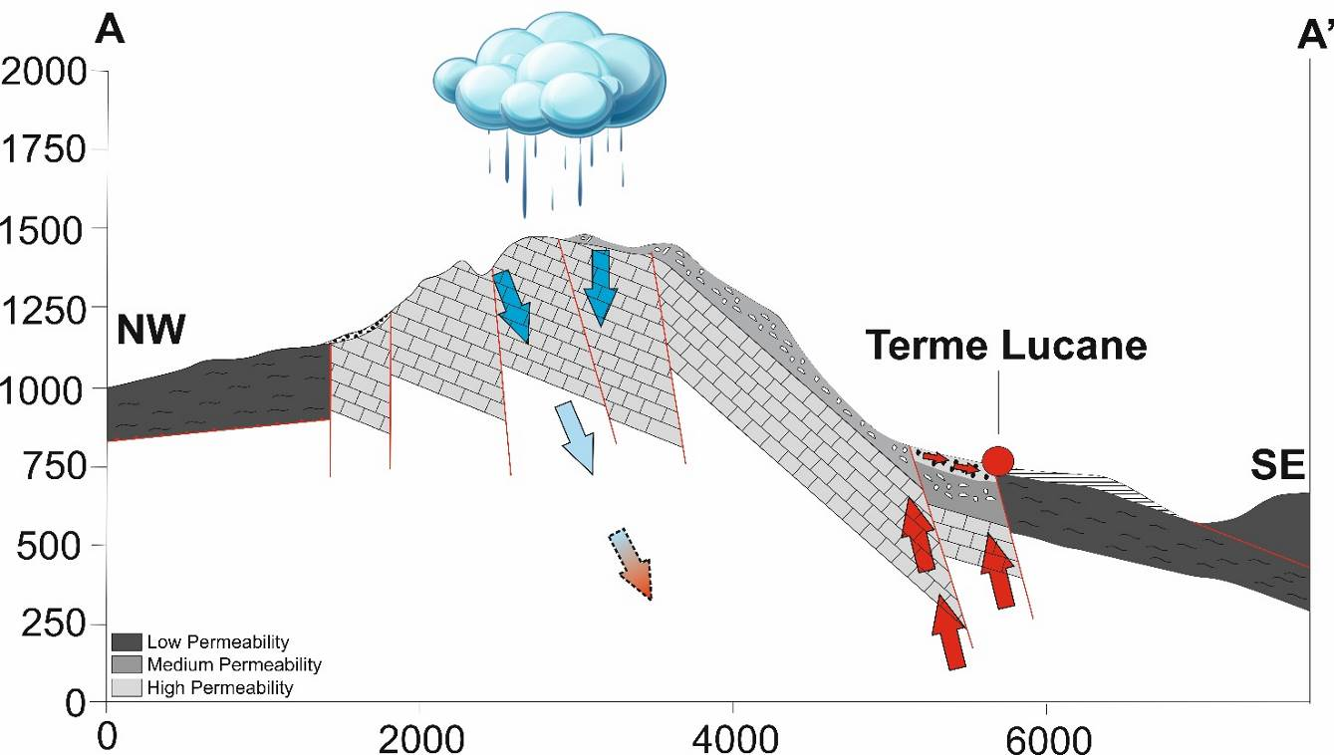
Conclusion and Geothermal conceptual model
Assuming a geothermal gradient of 33 °C km⁻¹, it is probably that deep aquifer is located to a depth of ~1.5 km below surface, where TL waters reach a thermo-chemical equilibrium with the carbonate-evaporite rocks.
Furthermore, TL waters are enriched in deep-sourced volatiles (CO₂, He), which isotopic signature (e.g., He) is stable over time. These waters emerge in correspondence of local tectonic discontinuities that are seismically active.
Known that TL waters are not dominated by the He atmospheric component and He isotopic signature did not overlap with the typical He radiogenic isotopic ratio (0.01-0.05Ra), TL springs are sites to be selected for a geochemical monitoring for the understanding of the seismogenetic processes.
Dr Giovanni Vespasiano – giovanni.vespasiano@unical.it

Slide 12
THANK YOU AND STAY SAFE!!!
All rights reserved. Any use, in whole or in part, of the contents included in this presentation is prohibited, including the storage, reproduction, re-elaboration, diffusion or distribution of the contents themselves through any technological platform, support or telematic network, without prior written authorization by the authors.
Dr Giovanni Vespasiano – giovanni.vespasiano@unical.it

