Slide 1
Long-term AOD trend analysis and Classification of major aerosol types over Iran from 1980 to 2018
EGU 2020
Robabeh Yousefi ^{1,2}, Fang Wang¹, Quansheng Ge¹, Abdallah Shaheen³, Juerg Luterbacher^{4,5}
1. Key Laboratory of Land Surface Pattern and Simulation, Institute of Geographic Sciences and Natural Resources Research, Chinese Academy of Sciences, Beijing100101, China;
2. College of Resources and Environment, University of Chinese Academy of Sciences, Beijing 100049, China;
3. Center for Monsoon System Research, Institute of Atmospheric physics, Chinese Academy of Sciences, Beijing, 100029;
4. Department of Geography and Centre of International Development and Environmental Research, Justus Liebig University of Giessen, Giessen, Germany;
5. World Meteorological Organization (WMO), Department for Science and Innovation, 7bis Avenue de la Paix, 1211 Geneva, Switzerland;
This study was supported by the National Key Research and Development Program of China (2016YFA0602704), the Strategic Leading Science and Technology Program of the Chinese Academy of Sciences (XDA20020202), and the National Natural Science Foundation of China (41771050).

Slide 2
Outline
CFSSN
Introduction
EGU 2020
UCAS
Hohai University
Study area
CFSSN
Methodology
Results and Discussion
Conclusion

Slide 3
Introduction
Atmospheric aerosols are considered as one of the most significant parameters of the ocean–earth–atmosphere system and are the biggest concern in the ongoing climate change (IPCC, 2013)
Aerosols play a major role in energy balance and hydrological cycle of the Earth’s climate system through radiation–aerosol interactions (direct impact) and cloud–aerosol interactions (indirect impact) (McCormick and Ludwig 1967; Ding et al., 2016)
Depending on aerosol’s chemical and physical properties as well as their structures, it can affect atmospheric visibility (Che et al., 2007), ecosystems (Yue et al., 2017), and even human health (Silva et al., 2013)
The Aerosol Optical Depth (AOD), which is spectral dependent, together with its derived parameter Ångström Exponent (AE) are widely taken into consideration as a fundamental optical property in terms of diagnosing the aerosols impacts on global climate change (Xia et al., 2006; Alam et al., 2011)
Remote sensing (MODIS) and the Re-analysis data (MERRA-2) have been widely employed to investigate the AOD (Pozzer et al., 2015; Mehta et al., 2016 )
CFSSN
EGU 2020
UCAS
Hohai University
CFSSN

Slide 4
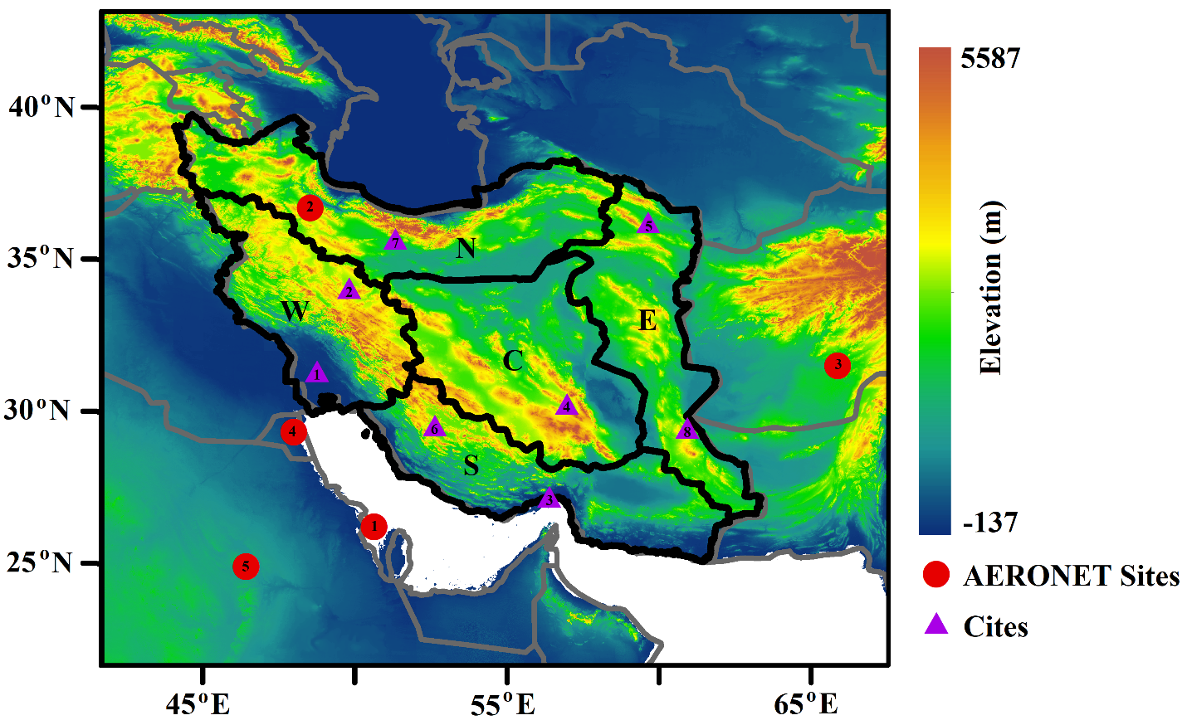
Study area
CFSSN
EGU 2020
UCAS
Hohai University
CFSSN
Fig.1. Study Area

Slide 5
Methodology Trend analysis
We deseasonalized the monthly AOD time series by calculating the monthly AOD anomaly time series for each grid cell to remove the seasonal effect
The AOD trend for each grid cell was calculated using least squares regression
$\left(AOD\right)anomaly;s;m=μ+β∗m+ε$
$\left(AOD\right)anomaly;s;m$ is the AOD anomaly at grid cells for month m during the calculating period;
$μ$ is the intercept
$β$ is the slope, which is also the trend of AOD
$ε$ is the error term.
Two-tailed Student’s t-tests were used to assess the robustness of each trend estimate, and the criterion for statistical significance was set at the 95% confidence level.
This method has been successfully applied to trend analyses of monthly mean PM2.5 and AOD anomaly time-series data (Hsu et al., 2012; Boys et al., 2014; Zhang and Reid, 2010; Xue et al., 2019).
EGU 2020

Slide 6
Methodology Classification of aerosols
In the present study, to classify the major aerosol types that originate from various sources, the daily values of AOD₅₅₀ and AE₄₇₀₋₈₇₀ from MERRA-2 (1980-2018) were used
the relationship between AOD₅₅₀ and AE₄₇₀₋₈₇₀ was investigated using a scatter diagram
Different aerosol types were defined as: clean marine aerosols (CM) from the sea and oceans, such as sea salt spray; continental clean (CC), the aerosols originating over the continents; , the dust (DD) originating from deserts; biomass burning/urban industrial (BB/UI) as anthropogenic aerosol; and the mixed type (MX) of aerosol, which is not in other clusters.
The ranges for each type of aerosol were chosen as :
CM: AOD < 0.2, AE < 0.9
CC : AOD < 0.2, AE > 1.0
DD: AOD > 0.5, AE < 0.7
BB/UI: AOD > 0.3, AE > 1.0
EGU 2020

Slide 7
Results and Discussion
EGU 2020
Fig.2. Spatial distributions of the linear trends in annual and seasonal MERRA-2 AOD calculated from the deseasonalized monthly anomaly during (a) 1980–2018, (b) 1980–1997, and (c) 1997–2018. Stippling indicates regions where the linear trend was statistical significant at the 95% confidence level by applying Students t tests for each grid.

Slide 8
Results and Discussion
EGU 2020
Fig. 3. As Fig.2, but for (a) MERRA-2, (b) MODIS during 2001-2018.

Slide 9
Results and Discussion
EGU 2020
Fig. 4. Time series of decadal trends of the annual and seasonal mean AOD from MERRA-2 for Iran and eight chosen cities (a-i): the trends are to calculate the trends for each 10-year interval considered from 1980 to 2008

Slide 10
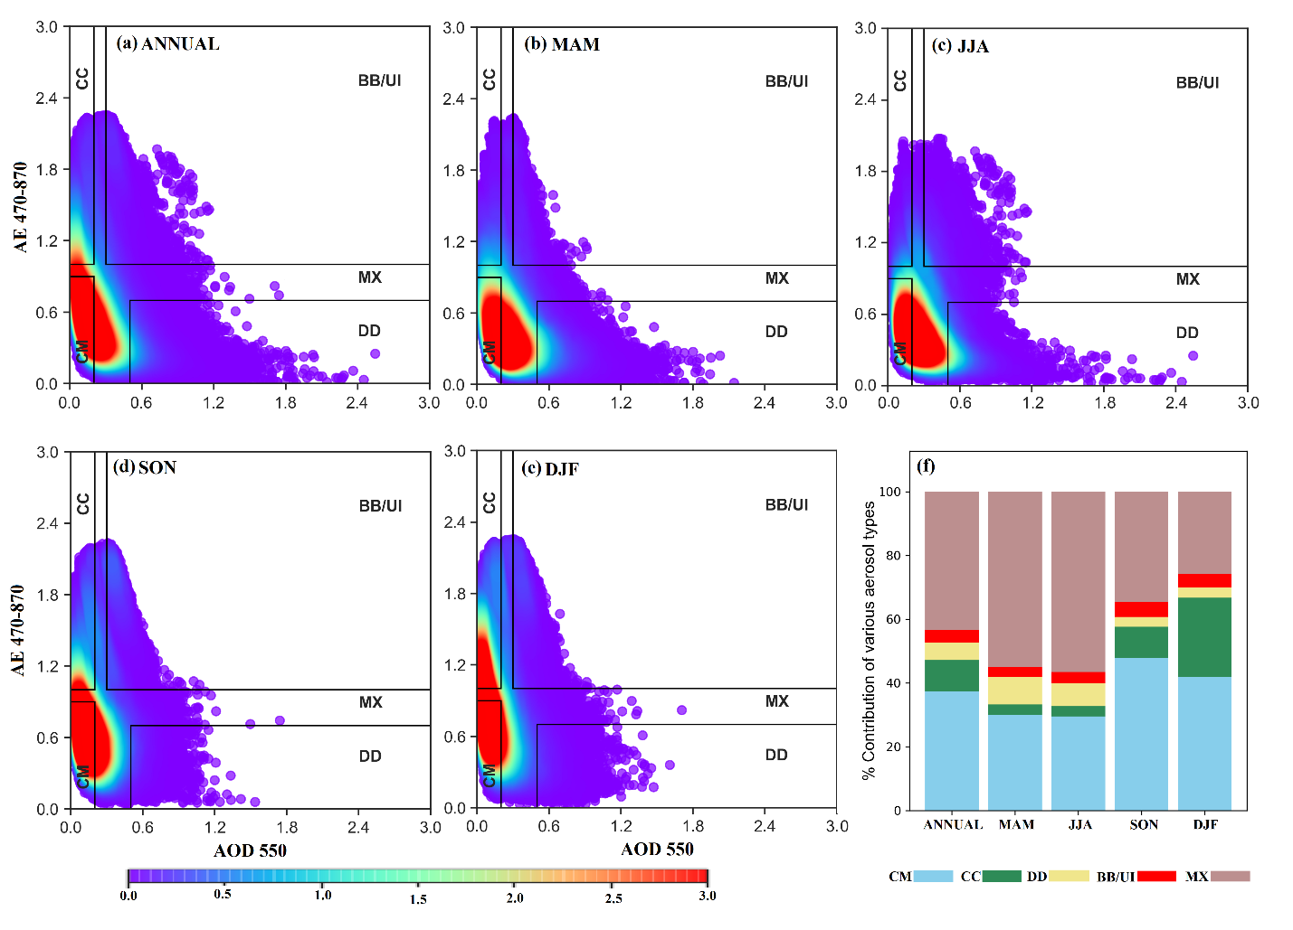
Results and Discussion
EGU 2020
Fig. 5. Seasonal and annual classification of aerosol types (a-e) based on aerosol optical depth (AOD) and Angstrom exponent (AE) daily data from MERRA-2 (1980-2018) and their percentage contribution obtained from the relationship (f): CM, CC, DD, BB/UI, and MX refer to clean marine, clean continental, desert dust, biomass burning/urban industrial, and mixed aerosols, respectively. The solid lines (a-e), indicate threshold values of AOD550 and AE470-870.

Slide 11
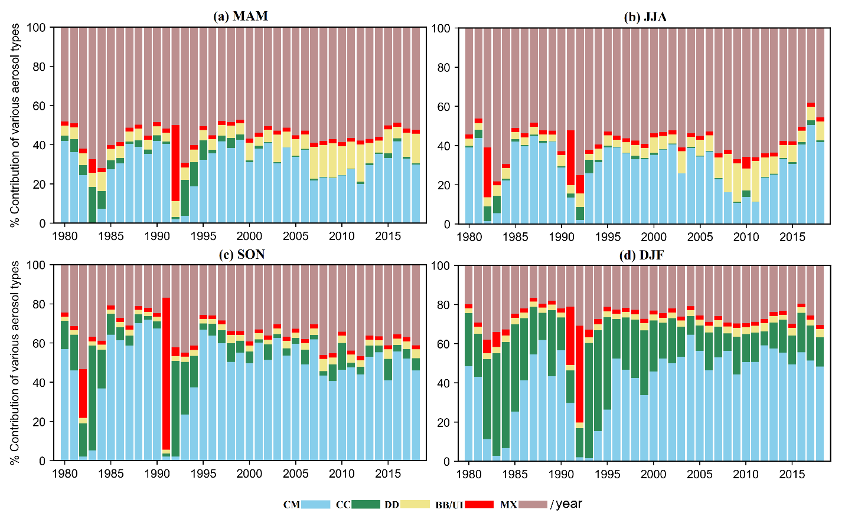
Results and Discussion
EGU 2020
Fig. 6. Seasonally percentage contribution of each aerosol types (CM, CC, DD, BB/UI, MX) that obtained from the relationship between AOD and AE daily data from MERRA-2 during 1980-2018.

Slide 12
Conclusion
The paper focuses on long-term AOD trend and Classification over Iran
The trend analysis of AODs revealed differences between the AOD datasets, but agree on the positive trends over southwestern Iran and negative trend in northern Iran
Classification of major aerosol types indicated that the clean marine and mixed aerosols were the dominant aerosol types during the cold and hot seasons, respectively, and the increase of desert dust around 2010 was another obvious result in spring and summer.
Our results indicate that the variation in dust aerosol has a key role in determining the AOD long-term changes in Iran which has contributed in regional climate change and environmental evolutions.
EGU 2020

Slide 13
Thank You !

