Slide 1
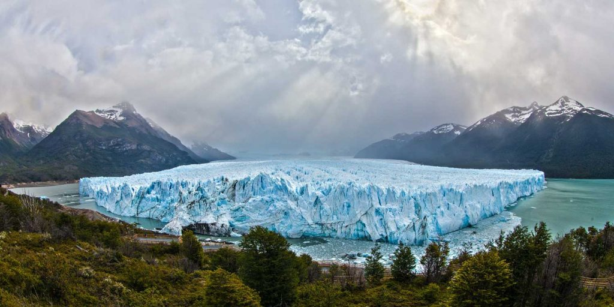
The evolution of the Patagonian Ice Sheet from 35 ka to the Present day (PATICE)
Funded by: RHUL, NERC, NERC DTP, NERC CIAF, QRA, BSG, GA, Leverhulme Trust, Fondecyt, National Science Foundation
Davies et al. 2020 (Earth-Science Reviews)
Bethan Davies
Christopher M. Darvill, Harold Lovell, Jacob M. Bendle, Julian A. Dowdeswell, Derek Fabel, Juan-Luis García, Alessa Geiger, Neil F. Glasser, Delia M. Gheorghiu, Stephan Harrison, Andrew S. Hein, Michael R. Kaplan, Julian Martin, Monika Mendelova, Adrian Palmer, Mauri Pelto, Ángel Rodés, Esteban A. Sagredo, Rachel Smedley, John L. Smellie, Varyl Thorndycraft.

Slide 2
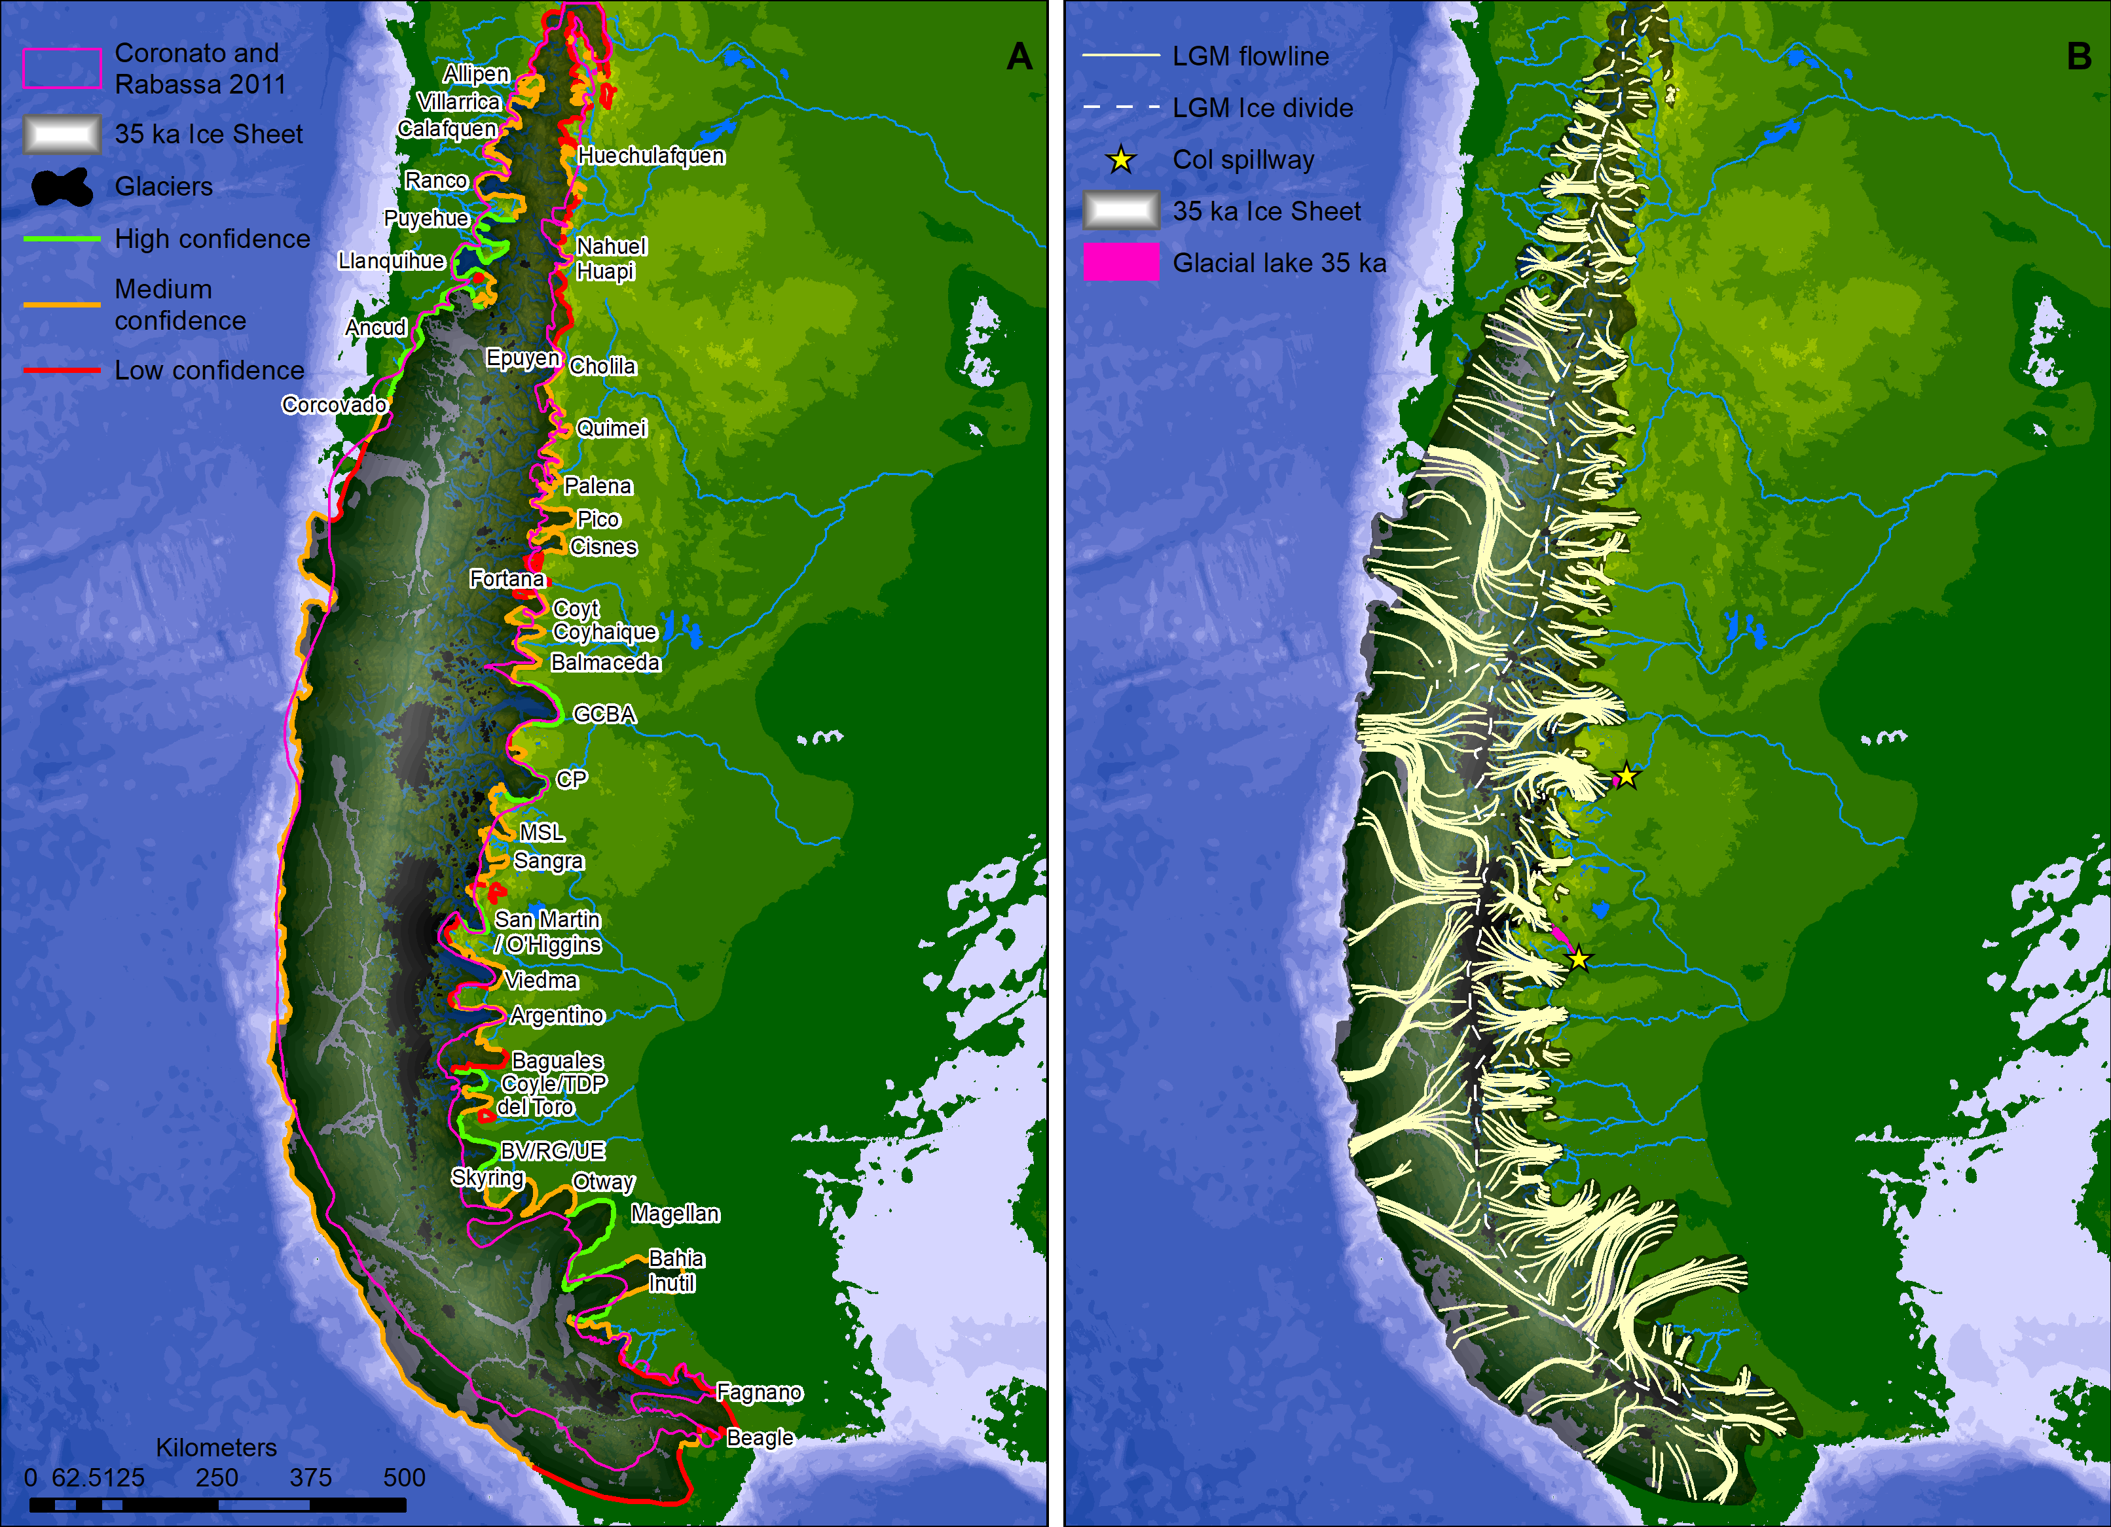
New LGM reconstruction.
Central ice divide, orthogonal flow – determined by glacial lineations & pattern of retreat.
First attempt at ice-sheet wide ice flow and palaeolakes.
First attempt at ice volume.
Updated ice area.
492.6 x 10³ km²
548.1 x 10³ Gt
SLE 1.5m
PATICE: 12% larger than last reconstruction

Slide 3
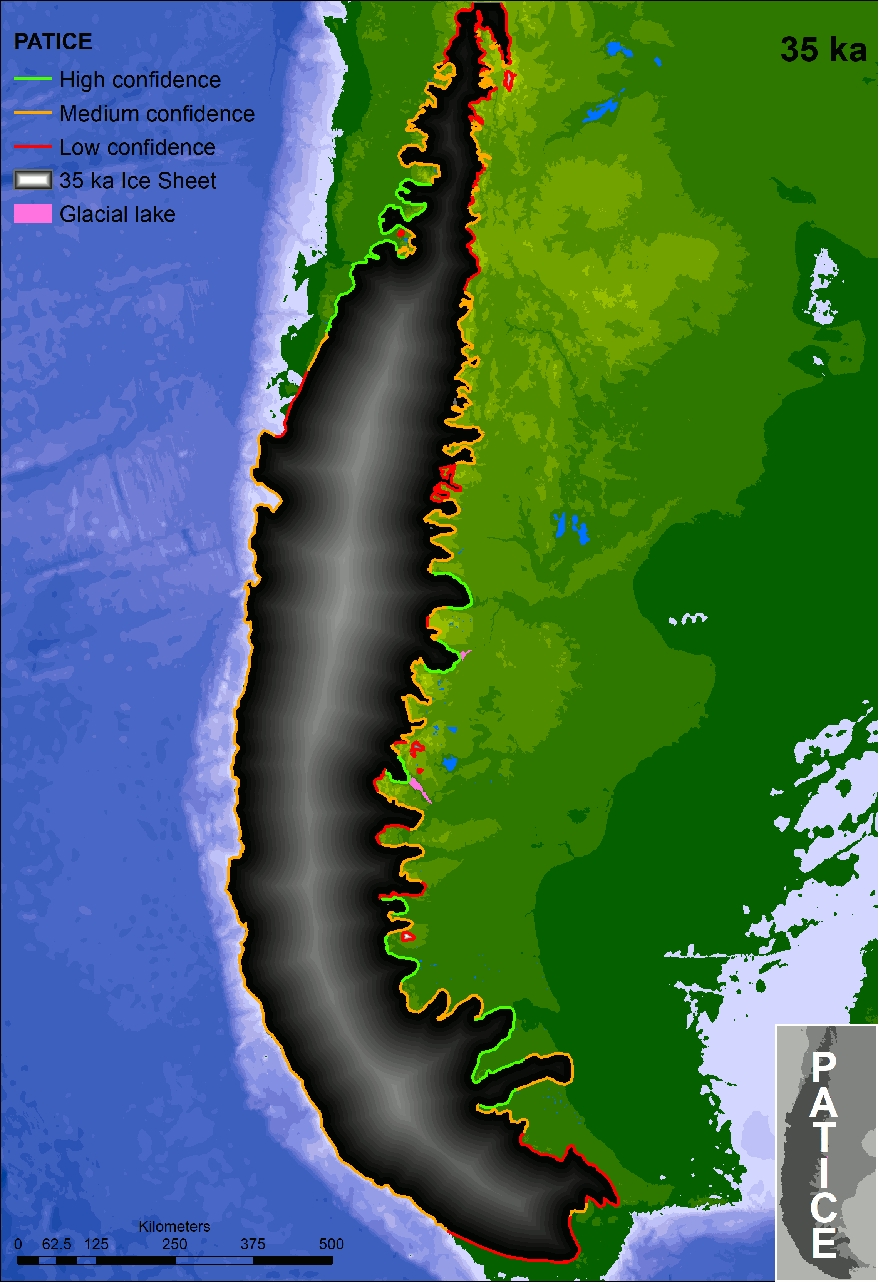
Patagonian Ice Sheet reconstruction
PIS at continental shelf edge at LLGM (47 – 30 ka), driven by Southern Ocean surface temperatures and low CO₂
Smaller extent during global LGM at 19 – 23 ka
Rapid recession after 19 ka; calving into deep ice-dammed lakes. Rapidly rising air temperatures & rising sea levels.
Stabilisation at 13-15 ka (through ACR); formation of numerous extensive ice-dammed lakes. Widespread readvances south of 46°S.
Small YD stabilisation (11-12 ka). Slightly cooler & drier.
PIS fragments into disparate ice-masses by 10 ka; drainage largely as it is today.
Smaller Holocene readvances at 4-6 ka, 1-2 ka and during latest Holocene (500 – 200 years ago). Related to –ve SAM conditions.
Evidence for latitudinal gradients across the PIS

Slide 4
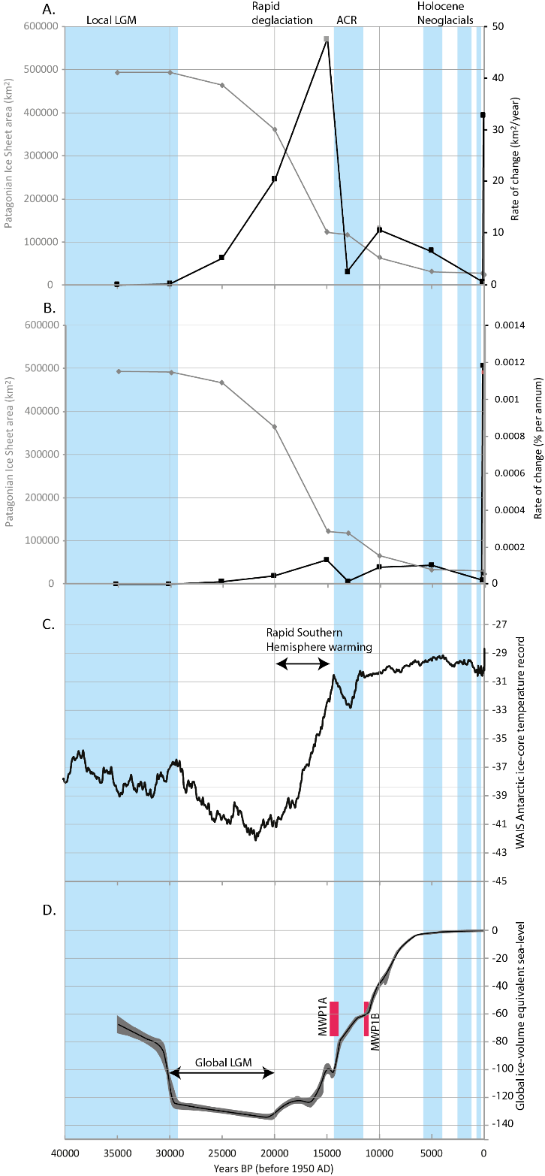
Annual rates of recession
Absolute rate of recession (km² a⁻¹)
PIS area (km²)
Current rates of recession rival those seen at the last glacial-interglacial transition, for an ice sheet 2 orders of magnitude larger (though faster rates can’t be ruled out here)
Current recession fastest observed in the Holocene, where there are fewer degrees of freedom in ice-sheet extent and lake size and calving dynamics remains similar
Twentieth Century: Fastest % change per annum rates observed since start of Holocene
Recent rapid recession related to –ve SAM conditions
Relative rate of recession (% a⁻¹)
PIS area (km²)
Antarctic ice-core temperature record
Global sea level
ACR
Notes:
20th Cy rates of recession from Davies and Glasser 2012

Slide 5
Data availability
Open access published article. Full dataset and shapefiles available on Mendeley Data (linked from article):
https://www.sciencedirect.com/science/article/pii/S0012825219306233#ab0005
https://data.mendeley.com/datasets/rjnw46vbdw/1
Ages with all data needed to recalculate
Geomorphology
All correctly cited and attributed to author
All Gold Open Access
Series of supporting public engagement resources on http://www.antarcticglaciers.org/glacial-geology/patagonian-ice-sheet/
Online interactive map using ArcGIS online: http://www.antarcticglaciers.org/glacial-geology/patagonian-ice-sheet/patice-interactive-map/
Notes:
Translation into Spanish coming soon!

Slide 6
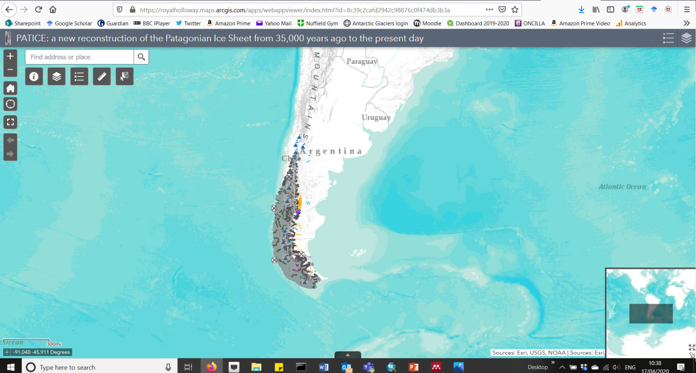
Online interactive map (publically accessible)
Notes:
Designed open access resources for anyone to use, to support public engagement and support school and university learning

Slide 7
Thank you! Please get in touch with any questions!
Calluqueo Glacier, MSL, 2017
Notes:
I look forward to the interactive discussion!

