Slide 1
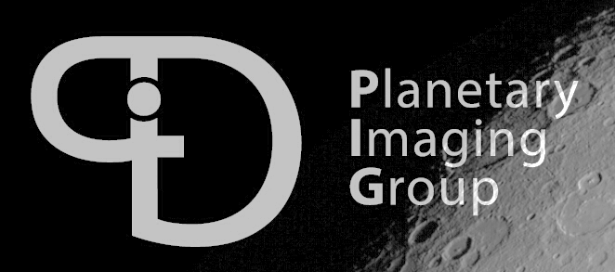

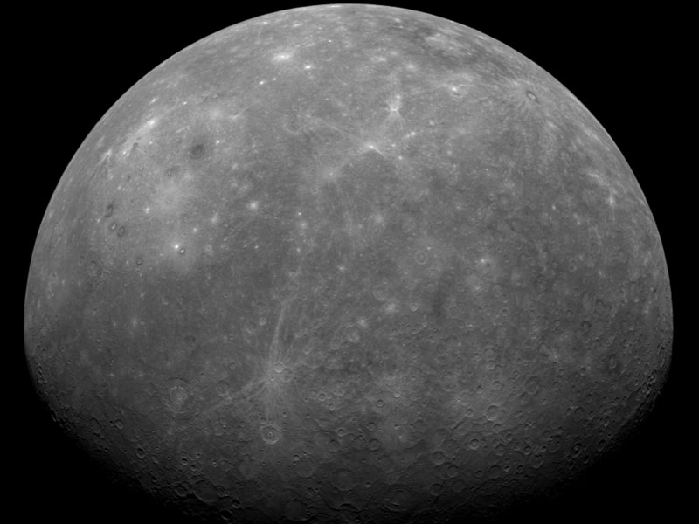
An independent solution for the precise orbit determination of Mercury planetary orbiter (MPO)
Alireza HosseiniArani
Stefano Bertone, Daniel Arnold, Adrian Jäggi, Nicolas Thomas
University of Bern

Slide 2
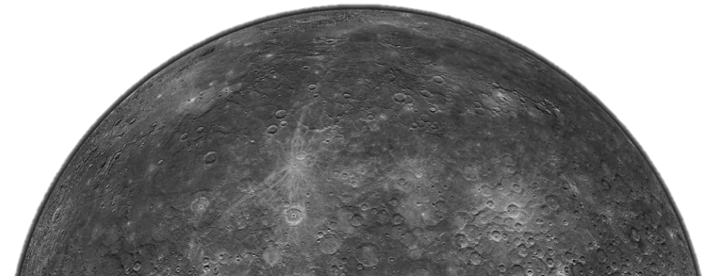
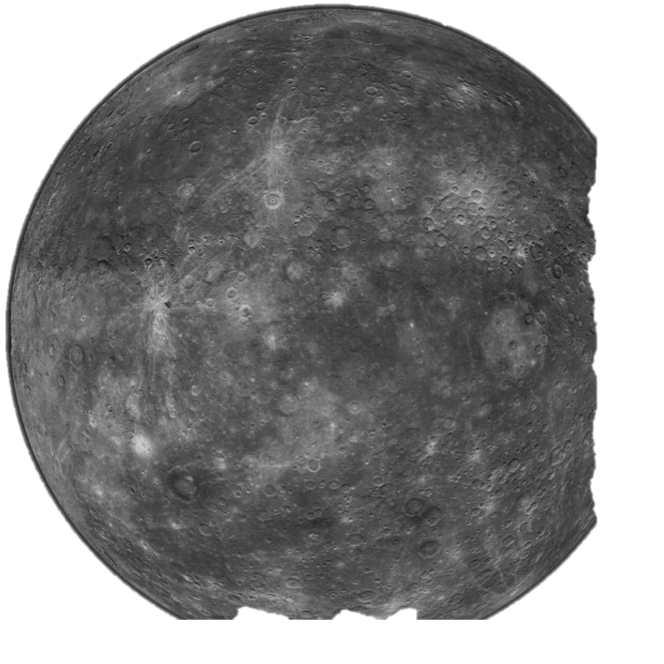
Introduction
Goal of this study:
An independent assessment of the accuracy of MPO orbit determination and Mercury gravimetry using Doppler observations
Closed loop simulation based on previous studies (Cicalo et al, 2016, Milani et al, 2001…)
Mercury: one of the least explored planets in the Solar System
BepiColombo: An ESA/JAXA mission to Mercury which will arrive in 2025
MPO: Mercury planetary orbiter
MORE: Mercury radio science experiment
University of Bern

Slide 3
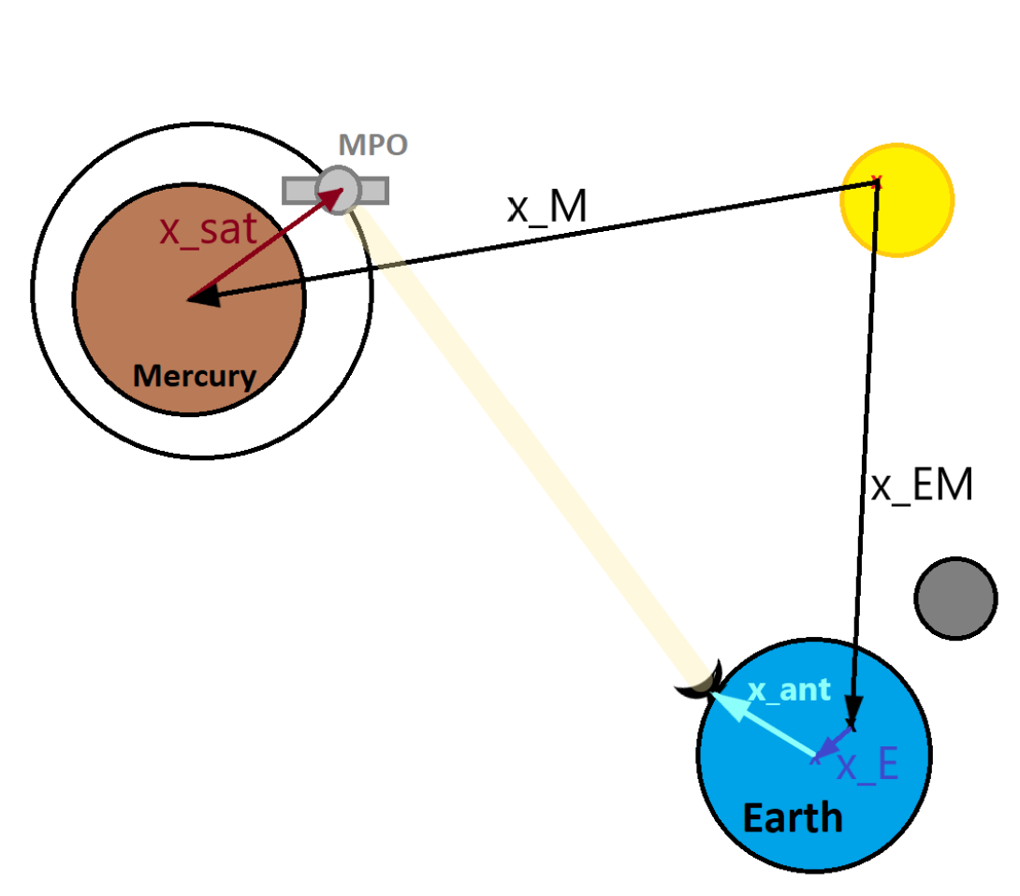
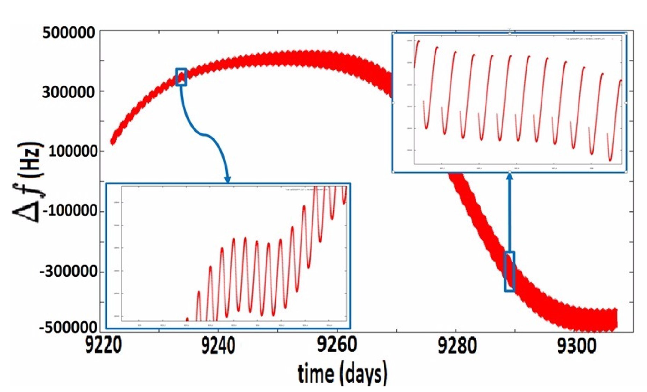
Model description
Force model:
  Gravity field HGM050 d/o 50
  Sun and planets third body gravitational perturbation
  Tidal perturbations (Sun)
  Solar and planetary radiation pressure
The S/C macromodel
  33 surfaces with area and normal directions
  Optical properties in visible and IR
Simulation of Doppler data:
  2-way X-band and K-band
  White noise on the observations:
    4 mHz on X-band
    1.5 mHz on Ka-band
  Station and planetary eclipses
Solar system barycenter
University of Bern

Slide 4
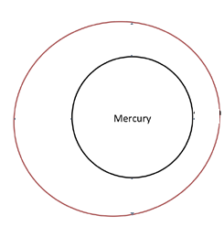

Model description
Orbit determination steps:
Use a full force model (gravity field d/o 50 + SRP) to produce synthetic Doppler observations
Use a degraded force model (gravity field d/o 30 + synthetic accelerometer measurements generated during the simulation) with errors on initial state vector (10 m RMS for initial positions, 0.01 m/s for initial velocities) as the “ a priori” knowledge of the orbit
Solve for the initial state vector of the arcs (pre-fit solution)
We combine normal equations over 1 year of mission and solve for the coefficients of the gravity field. Arc parameters are pre-eliminated
We will use the recovered gravity field to solve for the orbit in the second iteration (post-fit orbit)
Bernese GNSS software (BSW)
An orbit determination software developed at AIUB
Planetary extension of Bernese software also used, e.g., for lunar gravity field recovery based on GRAIL
University of Bern

Slide 5
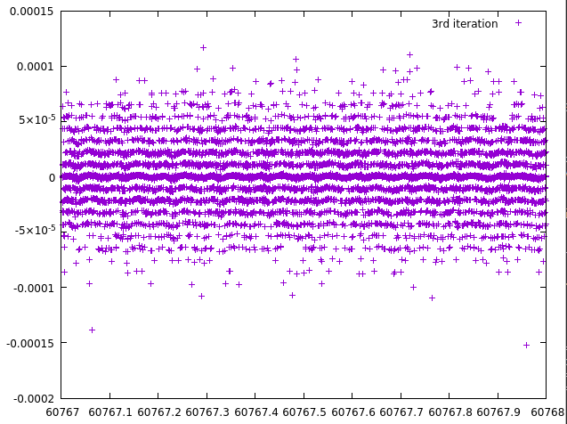
Model verification
Zero test: A test for model verification
No Doppler noise, No initial condition error
We use the same force model in simulation and parameter estimation
K-band Doppler residuals are in the order of 1E-5 Hz
Orbit verification
Propagated orbit has been verified against ESA’s orbit
Doppler residuals (Hz)
Time (days)
0 0.2 0.4 0.6 0.8 1
days
University of Bern
Notes:
Here you can see some of the previous studies that has been done on the performance evaluation of BELA. In short, Gunderson et al. [2006] presents an analytical performance model of the BELA. Gunderson and Thomas extended the above model in 2010 to contain the time-varying orbital conditions and instrument degradation.
The most recent one is Steinbrügge et al. [2018] presents a semi-analytical instrument performance model. in which signal-to-noise ratio, single shot probability of false detection, range errors and the accuracy of pulse width reconstruction are estimated
In this study we would like to do a

Slide 6
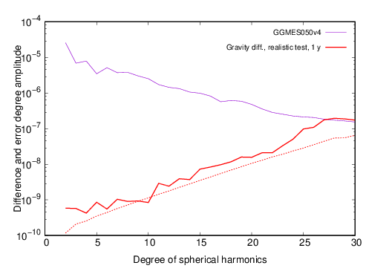
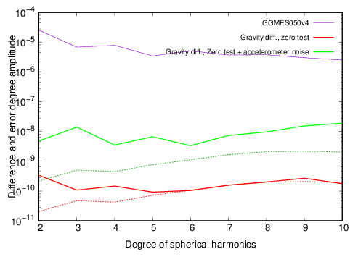
Recovery of Mercury gravity field
We use 1 year of Doppler observations
We solve for Mercury gravity field up to d/o 30
A posteriori RMS of unit weight 0.0013 Hz
Consistent with previous studies (Cicalo et al, 2016, Milani et al, 2001)
A zero test gravity recovery solution
Same force model for simulation and estimation
Solving for up to d/o 10
Red: No Doppler noise, No initial error
Green: Doppler noise , initial state error

Slide 7
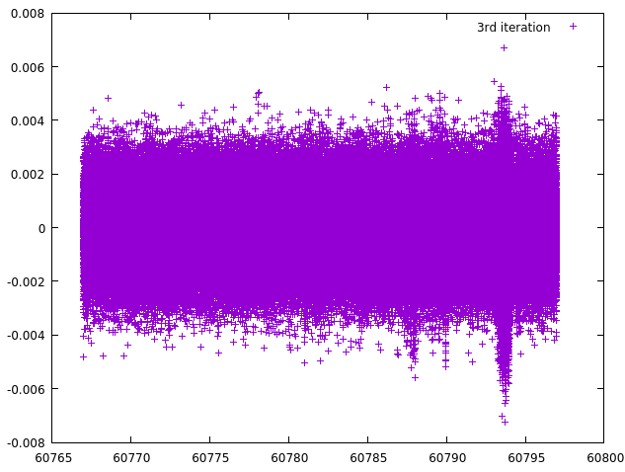
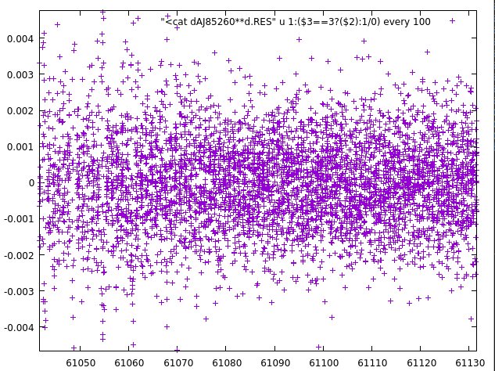
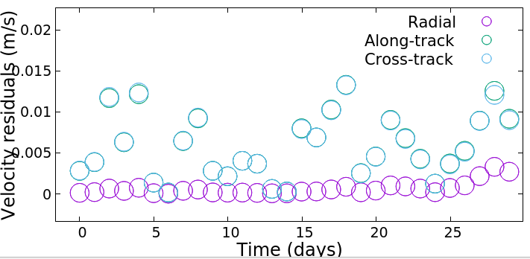
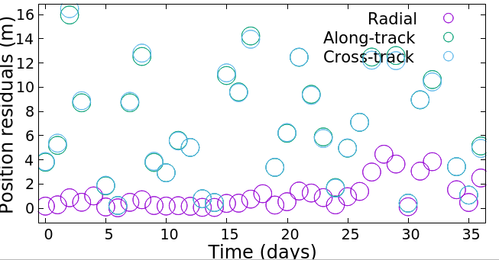
An orbit solution…
A fit with a perturbed field and starting from perturbed initial conditions
Daily RMS of position and velocity residuals are plotted in for 30 days of the mission.
RMS of position error:
  Around 0.5 m in the radial direction
  Around 10 meters in the other directions
Preliminary results, ongoing validation of iterated orbits
Doppler residuals
Notes:
Here you can see some of the previous studies that has been done on the performance evaluation of BELA. In short, Gunderson et al. [2006] presents an analytical performance model of the BELA. Gunderson and Thomas extended the above model in 2010 to contain the time-varying orbital conditions and instrument degradation.
The most recent one is Steinbrügge et al. [2018] presents a semi-analytical instrument performance model. in which signal-to-noise ratio, single shot probability of false detection, range errors and the accuracy of pulse width reconstruction are estimated
In this study we would like to do a

