Slide 1
Using N₂O to detect if a tipping point has been crossed in tropical soils after droughts
EGU2020 SSS4.11 – Responses of terrestrial biogeochemical cycles to climate change #shareEGU20
Simone Kilian Salas^{1*}, Elisa Díaz García², Alberto Andrino², Katharina H. E. Meurer³, Diana Boy⁴, Marcus A. Horn⁴, Jens Boy², and Hermann F. Jungkunst¹
1 University of Koblenz-Landau, iES Landau, Landau, Germany
^{* simone.kilian@uni-landau.de}
2 Leibniz Universität Hannover, Institute of Soil Science, Hannover, Germany
3 Swedish University of Agricultural Sciences, Department of Ecology, Uppsala, Sweden
4 Leibniz University Hannover, Institute of Microbiology, Hannover, Germany
@ProdigyBioTip

Slide 2
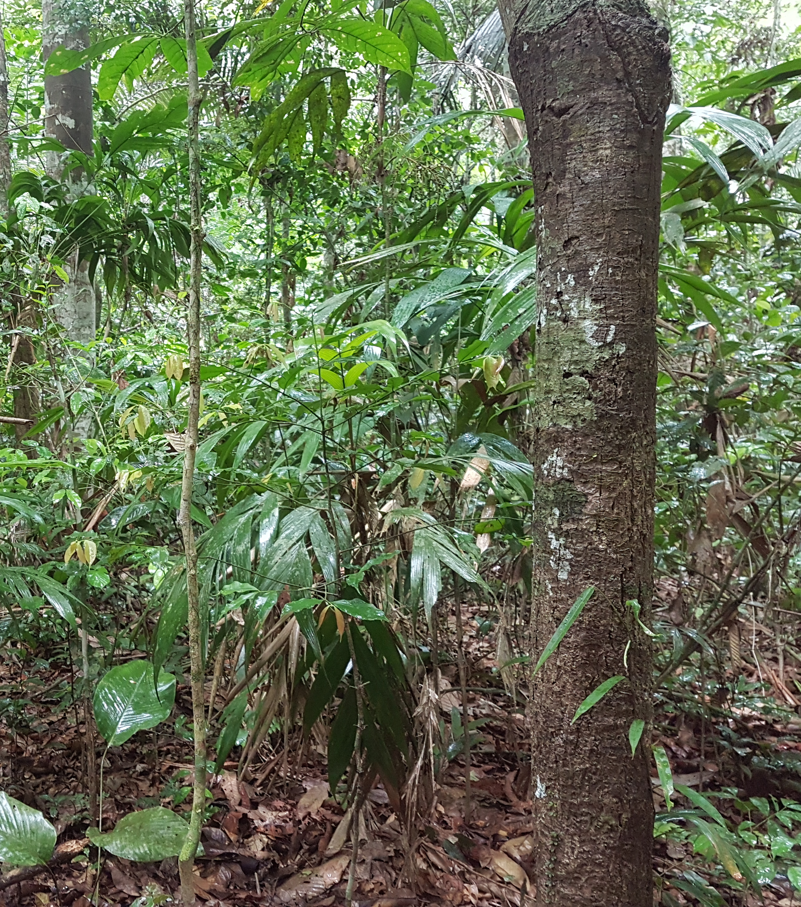
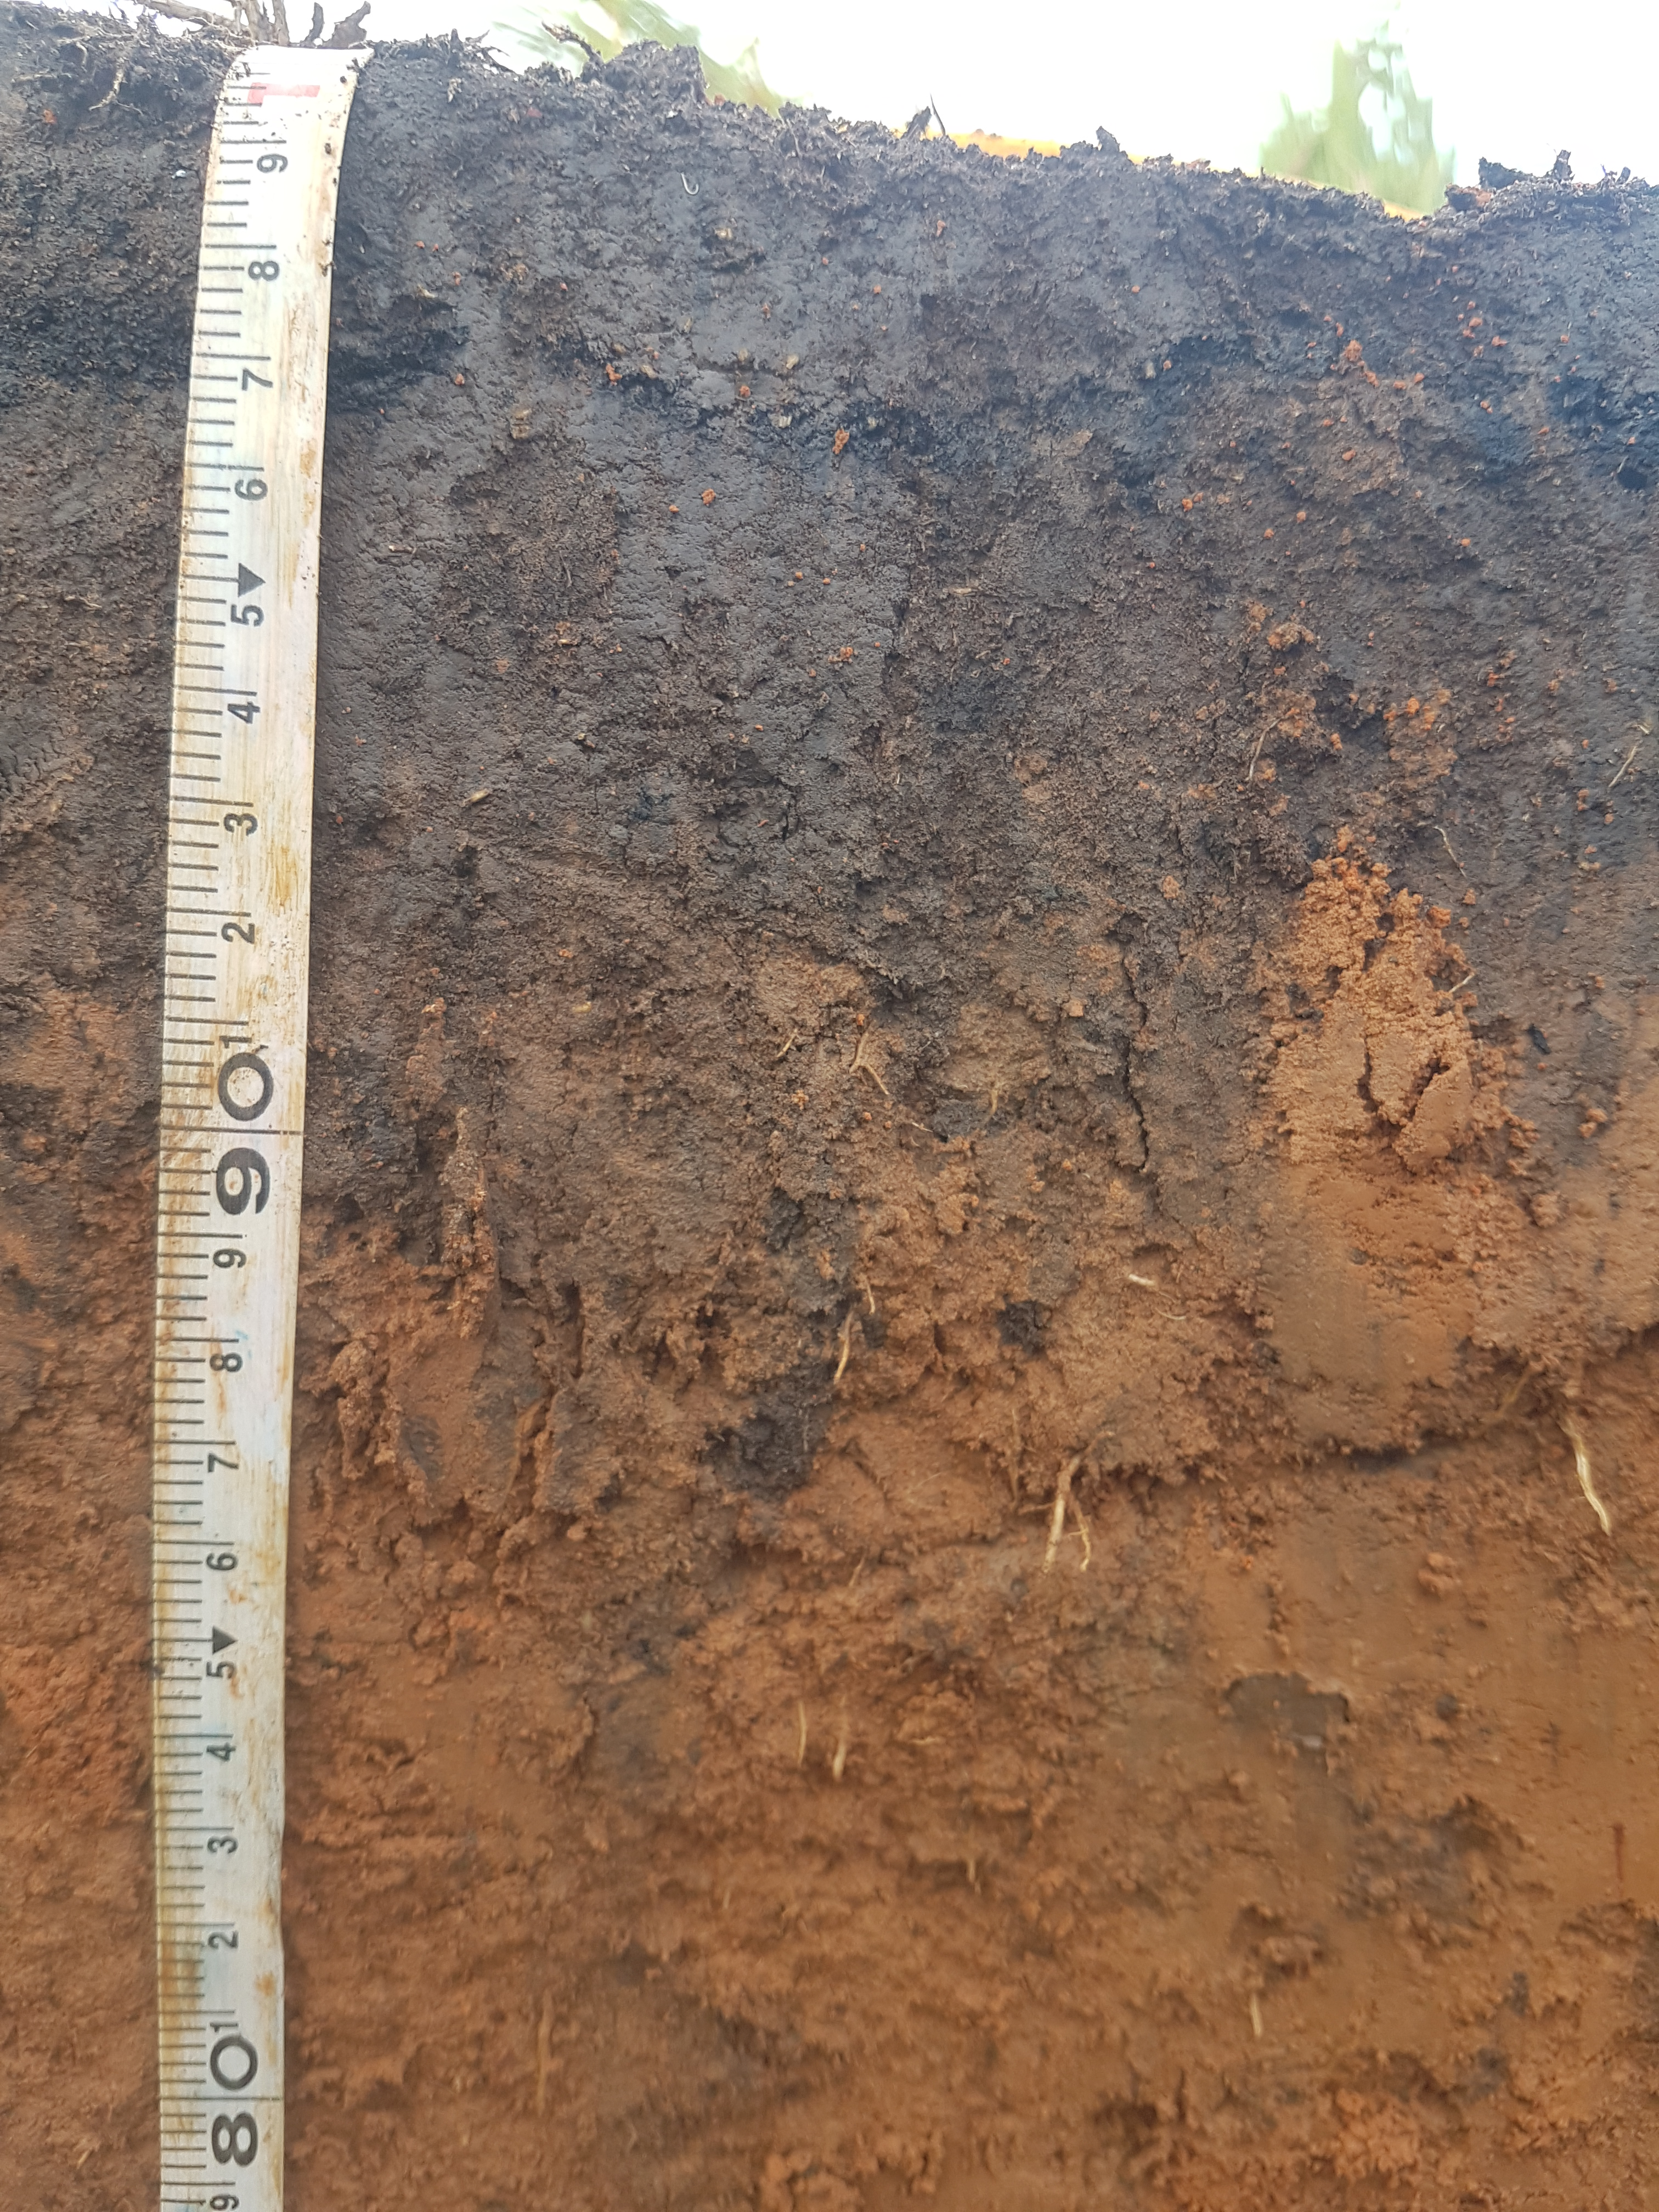
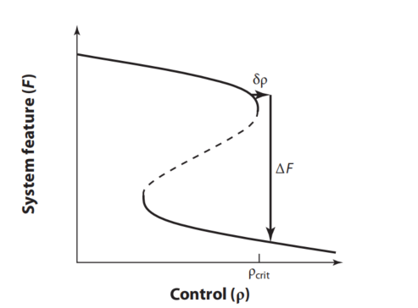
Introduction
Tipping elements and driving forces
Crucial system feature and control
© SimoneKilian Salas. All rights reserved
funcional biodiversity
© SimoneKilian Salas. All rights reserved
(c) Simon Scheiter
from Lenton, T. M. (2013). Environmental tipping points. Annual Review of Environment and Resources, 38, 1-29.
© SimoneKilian Salas. All rights reserved
© SimoneKilian Salas. All rights reserved
https://www.minerva-biolabs.com/produkt-kategorie/dna-rna-extraktion/ ; https://www.vectorstock.com/royalty-free-vector/bacteria-and-microbes-vector-18738920
EGU2020 SSS4.11 #shareEGU20
Notes:
tipping element: soil ecosystem // crucial system feature: soil functions // control: funcional biodiversity // critical control value : citical diversity of functional genes // driving forces: above-ground biodiversity

Slide 3
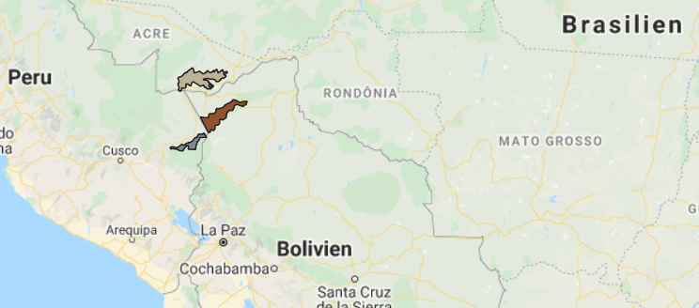
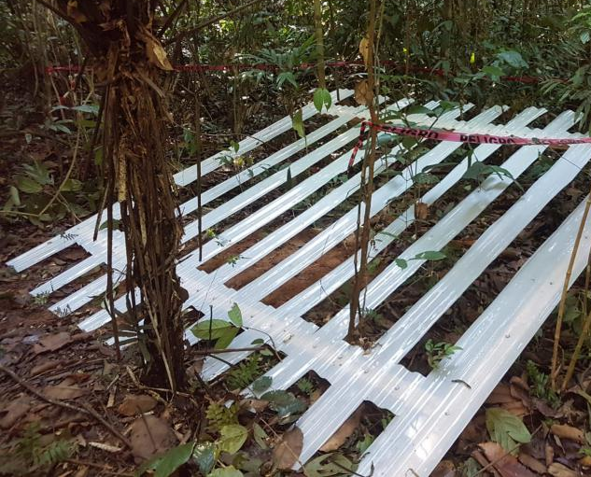
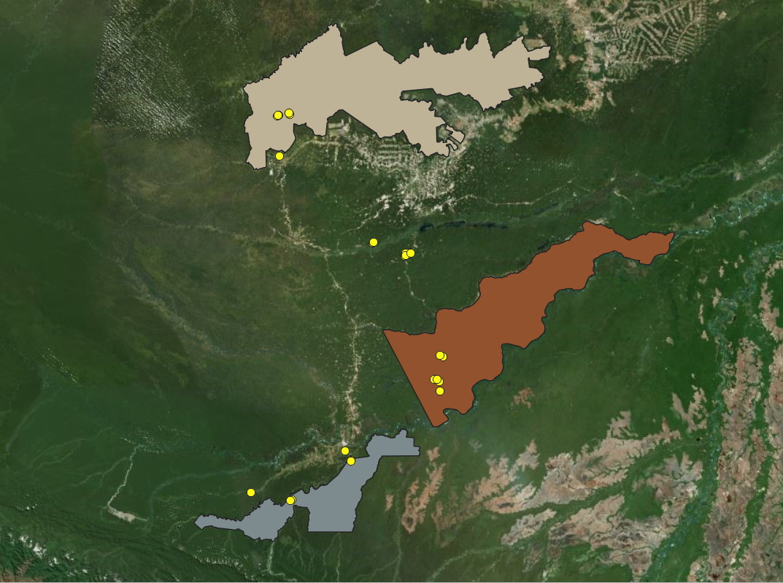
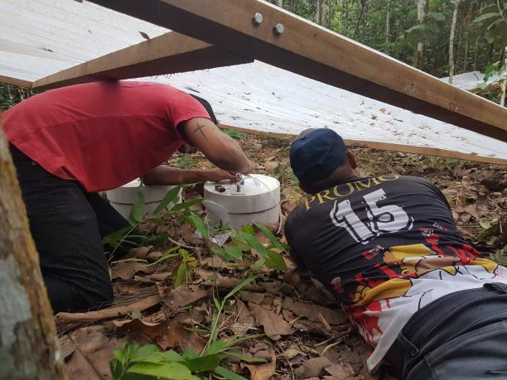
Material
1) Improve N₂O models for tropical ecosystems
2) N₂O as an indicator of tipping points (TP) and early warning
Field experiment
Modeling with CANDY
Lab experiment
Hypothesis:
Soil ecosystem of pastures are very likely to cross a TP when drought stress increases in comparison with forest ecosystems that have a greater safety net due to higher functional biodiversity
© SimoneKilian Salas. All rights reserved
EGU2020 SSS4.11 #shareEGU20
Notes:
zu1. (measured values are lower than modelled ones

Slide 4
Discussion
N₂O has already been proved to be an indicator of the impact of land use change in the tropics (Meurer et al. 2016)
N₂O emissions in a chronosequence (Davidson et al. 2001): young pasture (2yrs) > secondary forest > primary forest > old pasture (20yrs)
precipitation
[magnitude and intensity]
microbial biomass
= species?
= functions?
N₂O emissions
(C availability)
(Homyak et al. 2017)
Davidson, E. A., Bustamante, M., & de Siqueira Pinto, A. (2001). Emissions of nitrous oxide and nitric oxide from soils of native and exotic ecosystems of the Amazon and Cerrado regions of Brazil. The Scientific World Journal, 1, 312-319.
Homyak, P. M., Allison, S. D., Huxman, T. E., Goulden, M. L., & Treseder, K. K. (2017). Effects of drought manipulation on soil nitrogen cycling: A meta‐analysis. Journal of Geophysical Research: Biogeosciences, 122(12) Meurer, K. H., Franko, U., Stange, C. F., Dalla Rosa, J., Madari, B. E., & Jungkunst, H. F. (2016). Direct nitrous oxide (N2O) fluxes from soils under different land use in Brazil—a critical review. Environmental Research Letters, 11(2)
EGU2020 SSS4.11 #shareEGU20

