Slide 1
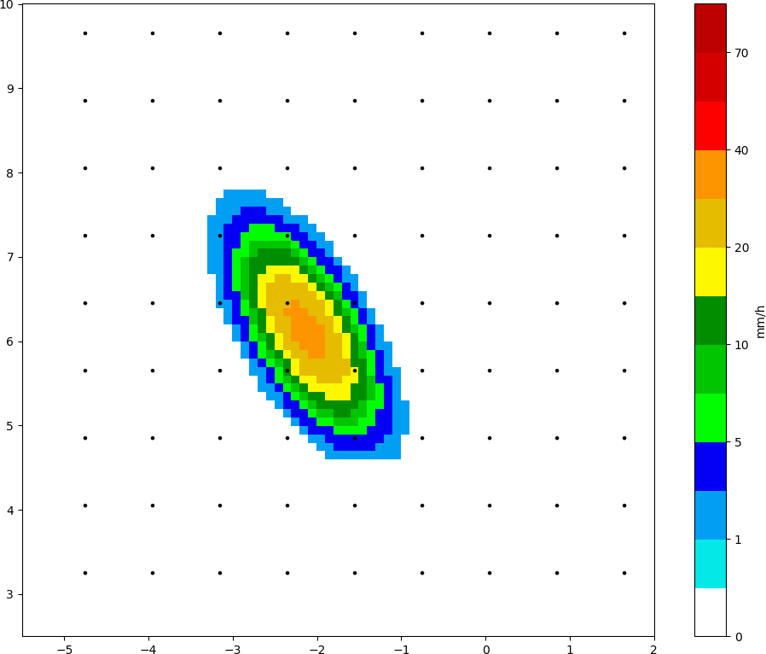
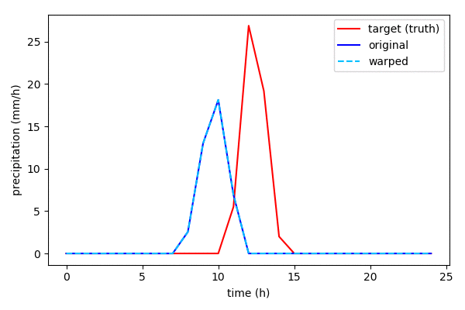
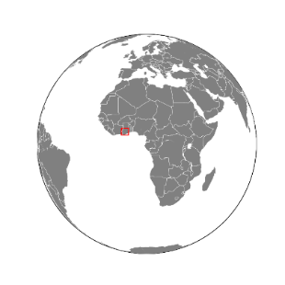
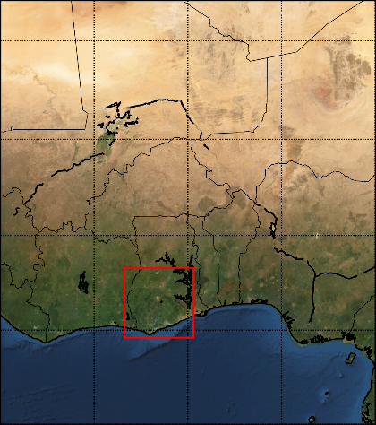
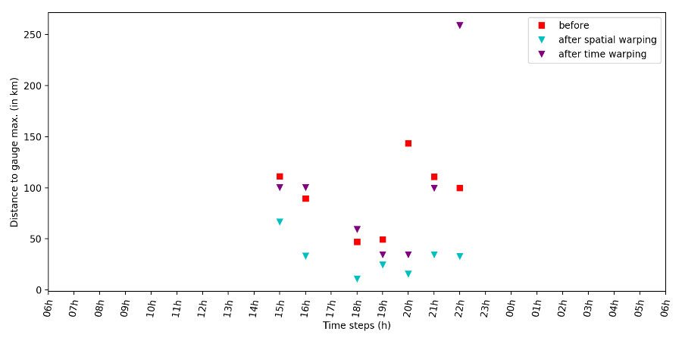
Correcting position error in rainfall estimates using temporal and spatial warping
Camille Le Coz*, Arnold Heemink, Martin Verlaan, Marie-Claire ten Veldhuis, and Nick van de Giesen
*c.m.l.lecoz-1@tudelft.nl
Motivation
Method
Problem:
Possible position mismatch between satellite-based rainfall and gauge measurements.
Goal:
Getting rainfall in the right place.
How?
Spatial or time warping.
Spatial warping
Time warping
Go to …
Go to …
Study case
Results
Position error of the rainfall peak before and after warping at each time.
Where?
Southern Ghana
When?
Rainy season 2018
Data?
IMERG-Late
TAHMO stations
 | Before | After space warping | After time warping
RMSE | 1,89 mm/h | 1,49 mm/h | 1,54 mm/h
MAE | 0,20 mm/h | 0,14 mm/h | 0,15 mm/h
Correlation | 0,18 | 0,62 | 0,59
Statistics before and after warping compared to the station measurements.
Go to …
Go to ...
Session AS1.36 | Display D3217 | Abstract EGU2020-18417

Slide 2
Motivation
Go to start
Satellite-based rainfall estimates are a valuable source of information. This is especially the case for regions with sparse radar and gauge networks, such as many regions in sub-Saharan Africa. However, satellite-based estimates can be subject to errors in the position and/or timing of the rainfall events, in addition to errors in the intensity. Such errors are particularly critical for localized events such as the convective storms occurring during the monsoon season which produce most of the rainfall in sub-Saharan Africa.
We propose to gauge-adjust the satellite-based estimates with respect to the position and time. We investigate two approaches: spatial and temporal warping. The first one is based on a spatial mapping and correct the spatial position while keeping the time constant. The second uses a temporal mapping and keeps the spatial domain unchanged.
Motivation

Slide 3
Method
Go to start
Goal: correcting possible position and time error in precipitation estimates using spatial and temporal warping.
Spatial warping: Distortion of an image based on a spatial transformation of the domain.
Time warping: Distortion of a timeseries based on a transformation of the time coordinates.
The spatial or temporal transformation is derived through an automatic registration method. That is, only the gauge and satellite-based estimates are needed as input. There is no need to manually predefine the rain features.
Method

Slide 4
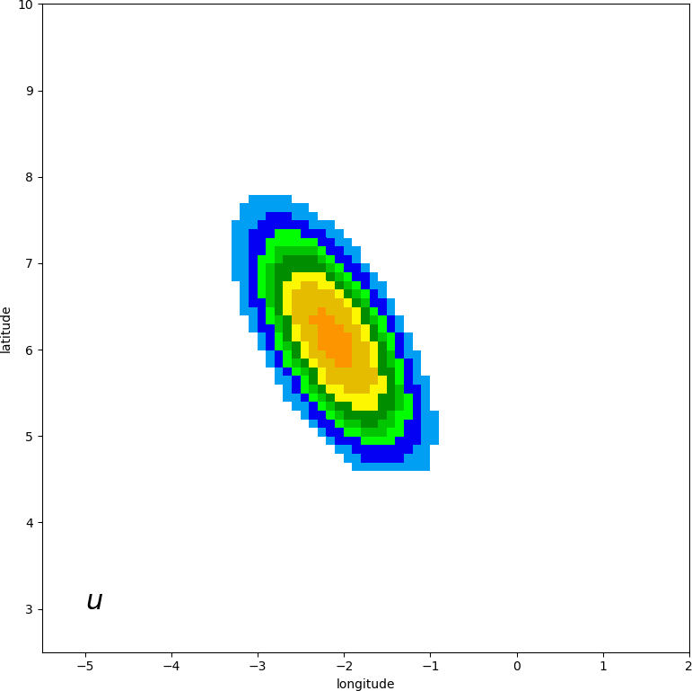
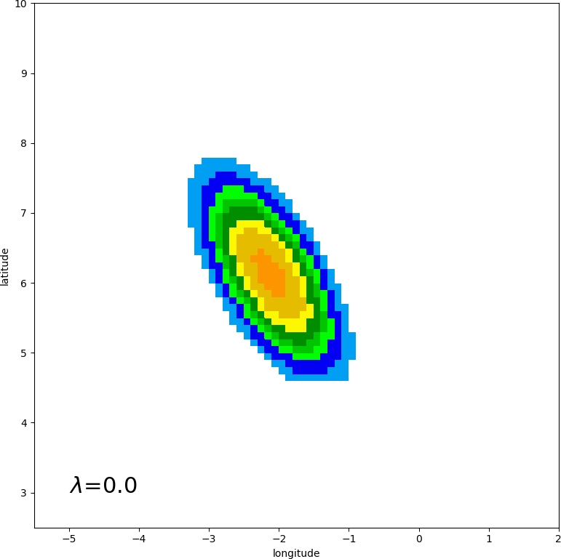
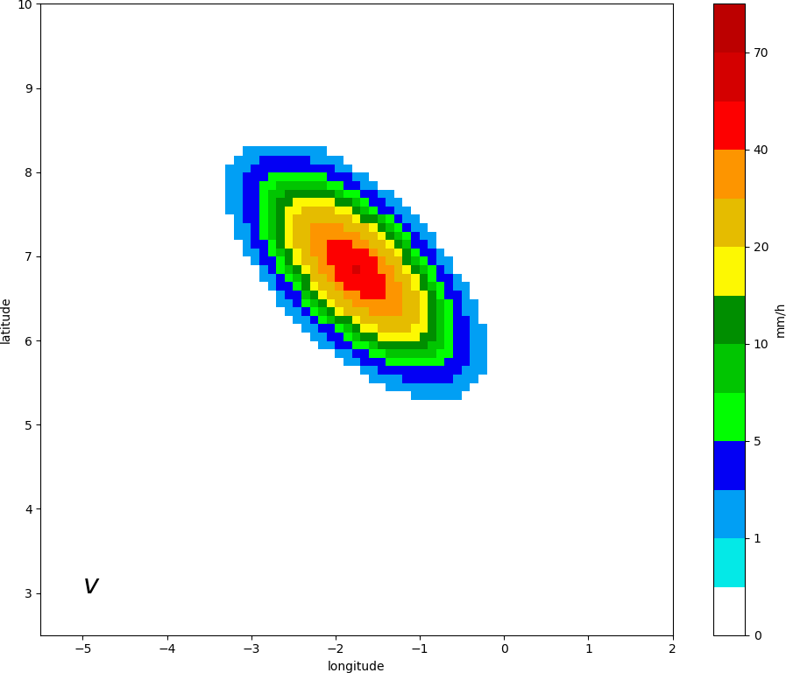
Method – Spatial warping
Go to start
Original field
Warped field
Target field (“truth”)
$$u_{warp(λ)}=u∘(I+λT)$$
$$\begin{aligned}u_{warp}\left(x,y\right)&≈u∘\left(I+T\right)\left(x,y\right) \\ &≈u[x+T_{x}\left(x,y\right),y+T_{y}\left(x,y\right)]\end{aligned}$$
Transform of the spatial coordinates
Method – spatial warping

Slide 5
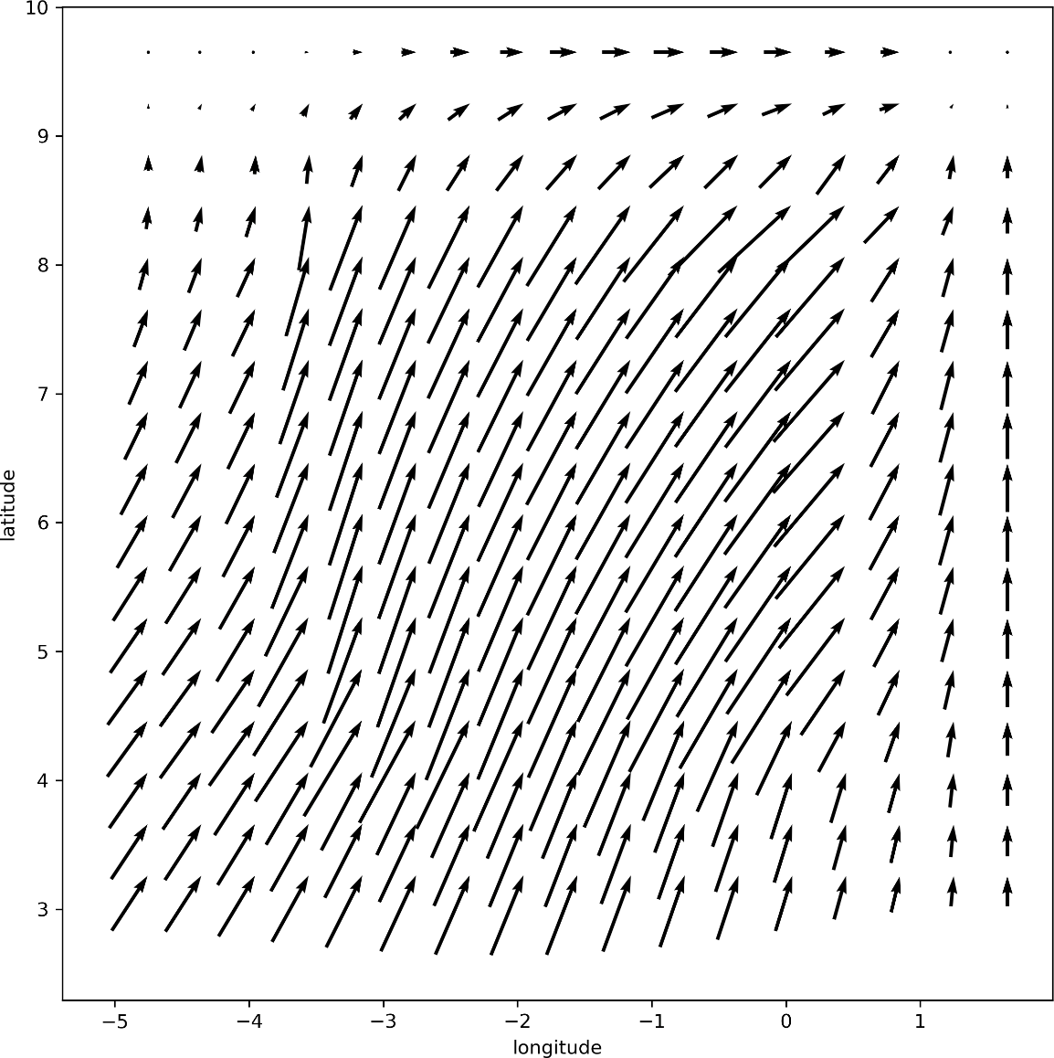
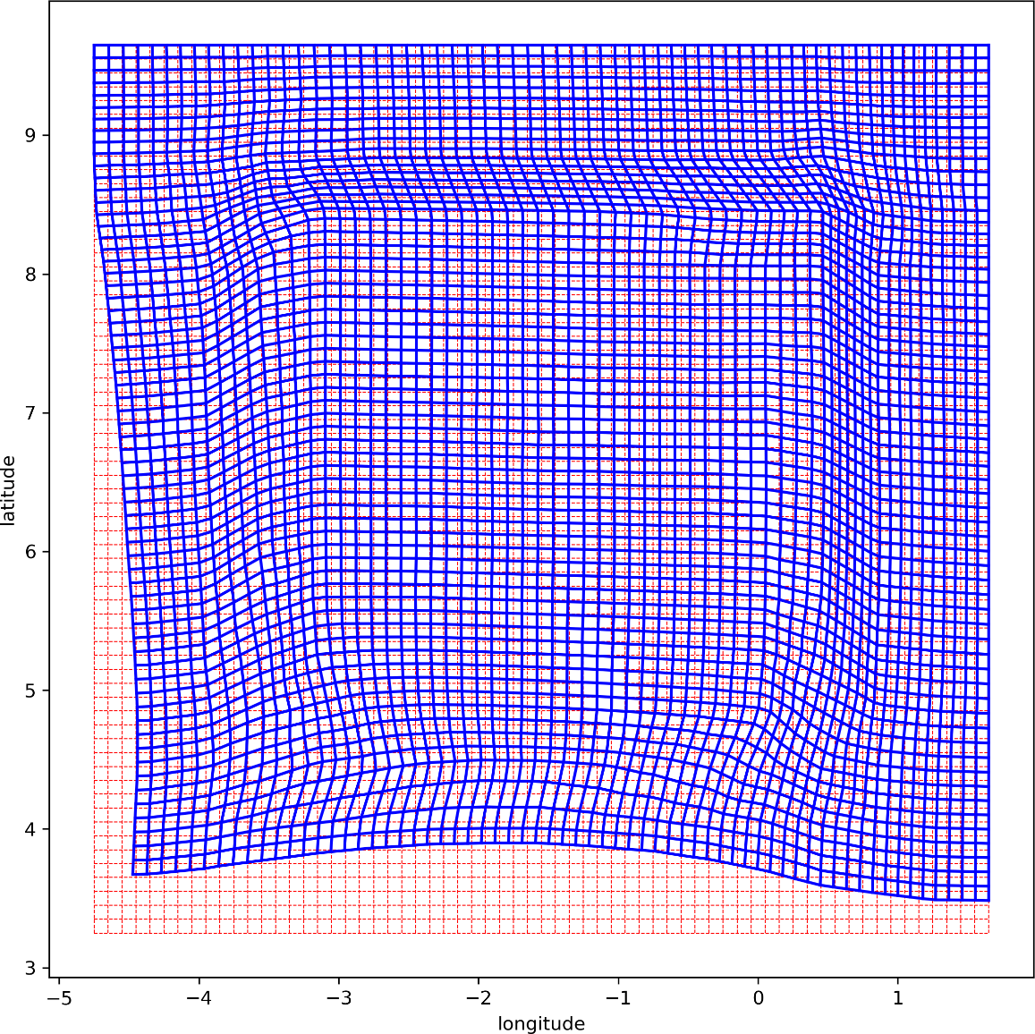
Method – Spatial warping
Go to start
Mapping $T$
Corresponding distorted grid
Method – spatial warping

Slide 6
Automatic registration
Go to start
Goal:
Find optimal spatial mapping $T$ such that:
$$\begin{aligned}v\left(x,y\right)&≈u∘\left(I+T\right)\left(x,y\right) \\ &≈u[x+T_{x}\left(x,y\right),y+T_{y}\left(x,y\right)]\end{aligned}$$
$u$ and $v$ are 2D spatial fields.
Criteria for optimal mapping:
Small $T≈0$
Smooth $∇T≈0$
Divergent free $∇∙T≈0$
Method – spatial warping

Slide 7
Automatic registration
Go to start
How?
Minimization of a cost function $J$:
$J\left(T\right)=\left\|v−u∘(I+T)\right\|$
$+C_{1}\left\|T\right\|+C_{2}\left\|∇T\right\|+C_{3}\left\|∇∙T\right\|$
$+c_{t}‖T_{t}−T_{t−1}‖$
with
$T= \left[T_{0}, T_{1},⋯, T_{t}, ⋯, T_{24}\right]$
Observation term
( = mismatch between target field and warped field).
Background term (corresponding to the three criteria for optimal mapping).
Temporal background term (ensure consistency through time steps).
A mapping for each time step
Method – spatial warping

Slide 8
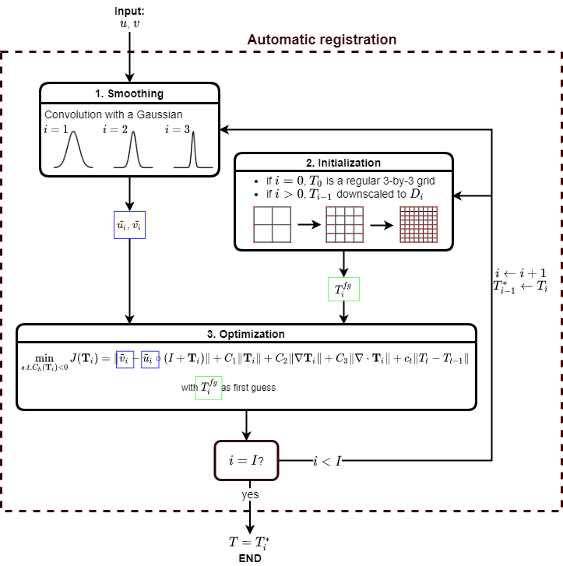
Automatic registration
Go to start
How?
Algorithm
Method – spatial warping

Slide 9
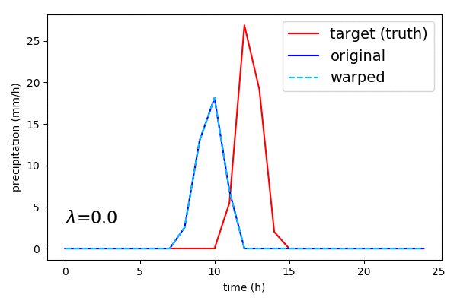
Method – Time warping
Go to start
$$\begin{aligned}u_{warp}\left(t\right)&≈u∘\left(I+T\right)\left(t\right) \\ &≈u[t+T_{t}\left(t\right)]\end{aligned}$$
$$u_{warp(λ)}=u∘(I+λT)$$
Transform of the time coordinates
Method – time warping

Slide 10
Automatic registration
Go to start
Goal:
Find optimal temporal mapping $T$ such that:
$$\begin{aligned}v\left(t\right)&≈u∘\left(I+T\right)\left(t\right) \\ &≈u[t+T_{t}\left(t\right)]\end{aligned}$$
$u$ and $v$ are timeseries.
Criteria for optimal mapping:
Small $T≈0$
Smooth $∇T≈0$
Method – time warping

Slide 11
Automatic registration
Go to start
How?
Minimization of a cost function $J$:
$J\left(T\right)=\left\|v−u∘(I+T)\right\|$
$+C_{1}\left\|T\right\|+C_{2}\left\|∇T\right\|$
$+c_{s}‖T_{k}−T_{j}‖$
with
$T= \left[T_{0}, T_{1},⋯, T_{k}, ⋯, T_{65}\right]$
Observation term
( = mismatch between target field and warped field).
Background term (corresponding to the two criteria for optimal mapping).
Spatial background term (ensure consistency in space).
A mapping at each station location
Method – time warping

Slide 12
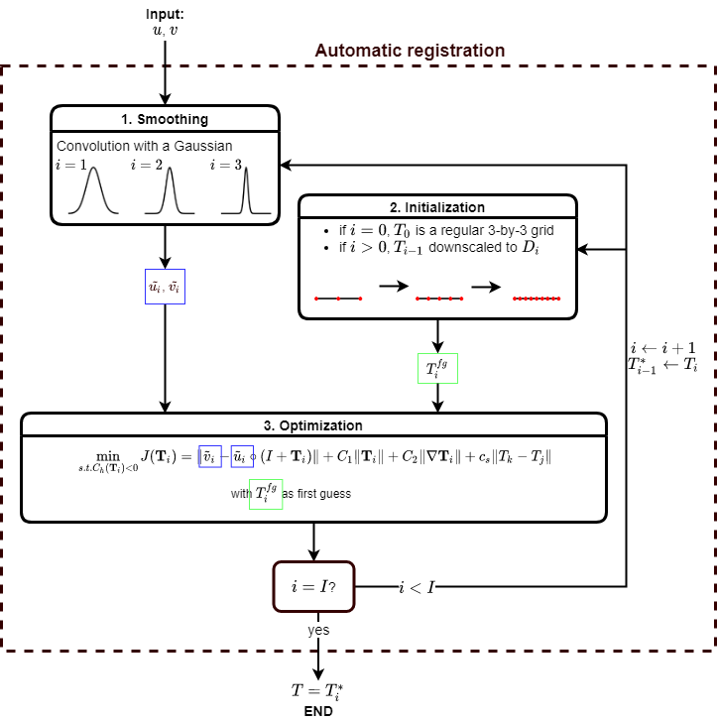
Automatic registration
Go to start
How?
Algorithm
(similar to spatial registration algorithm)
Method – time warping

Slide 13
Go to start
Spatial warping
Time warping
Method - workflow

Slide 14
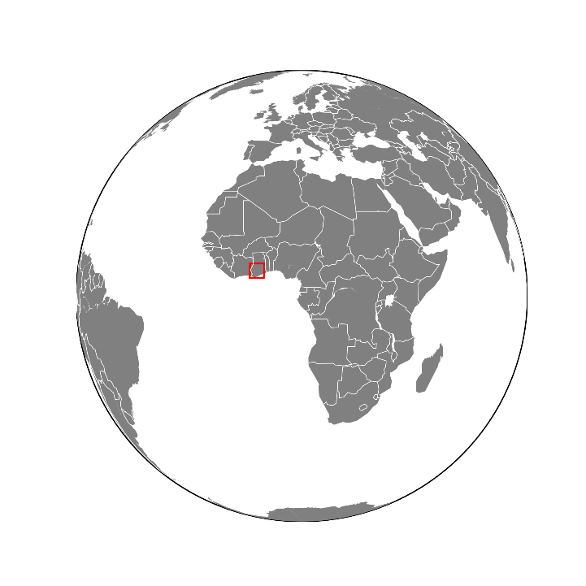
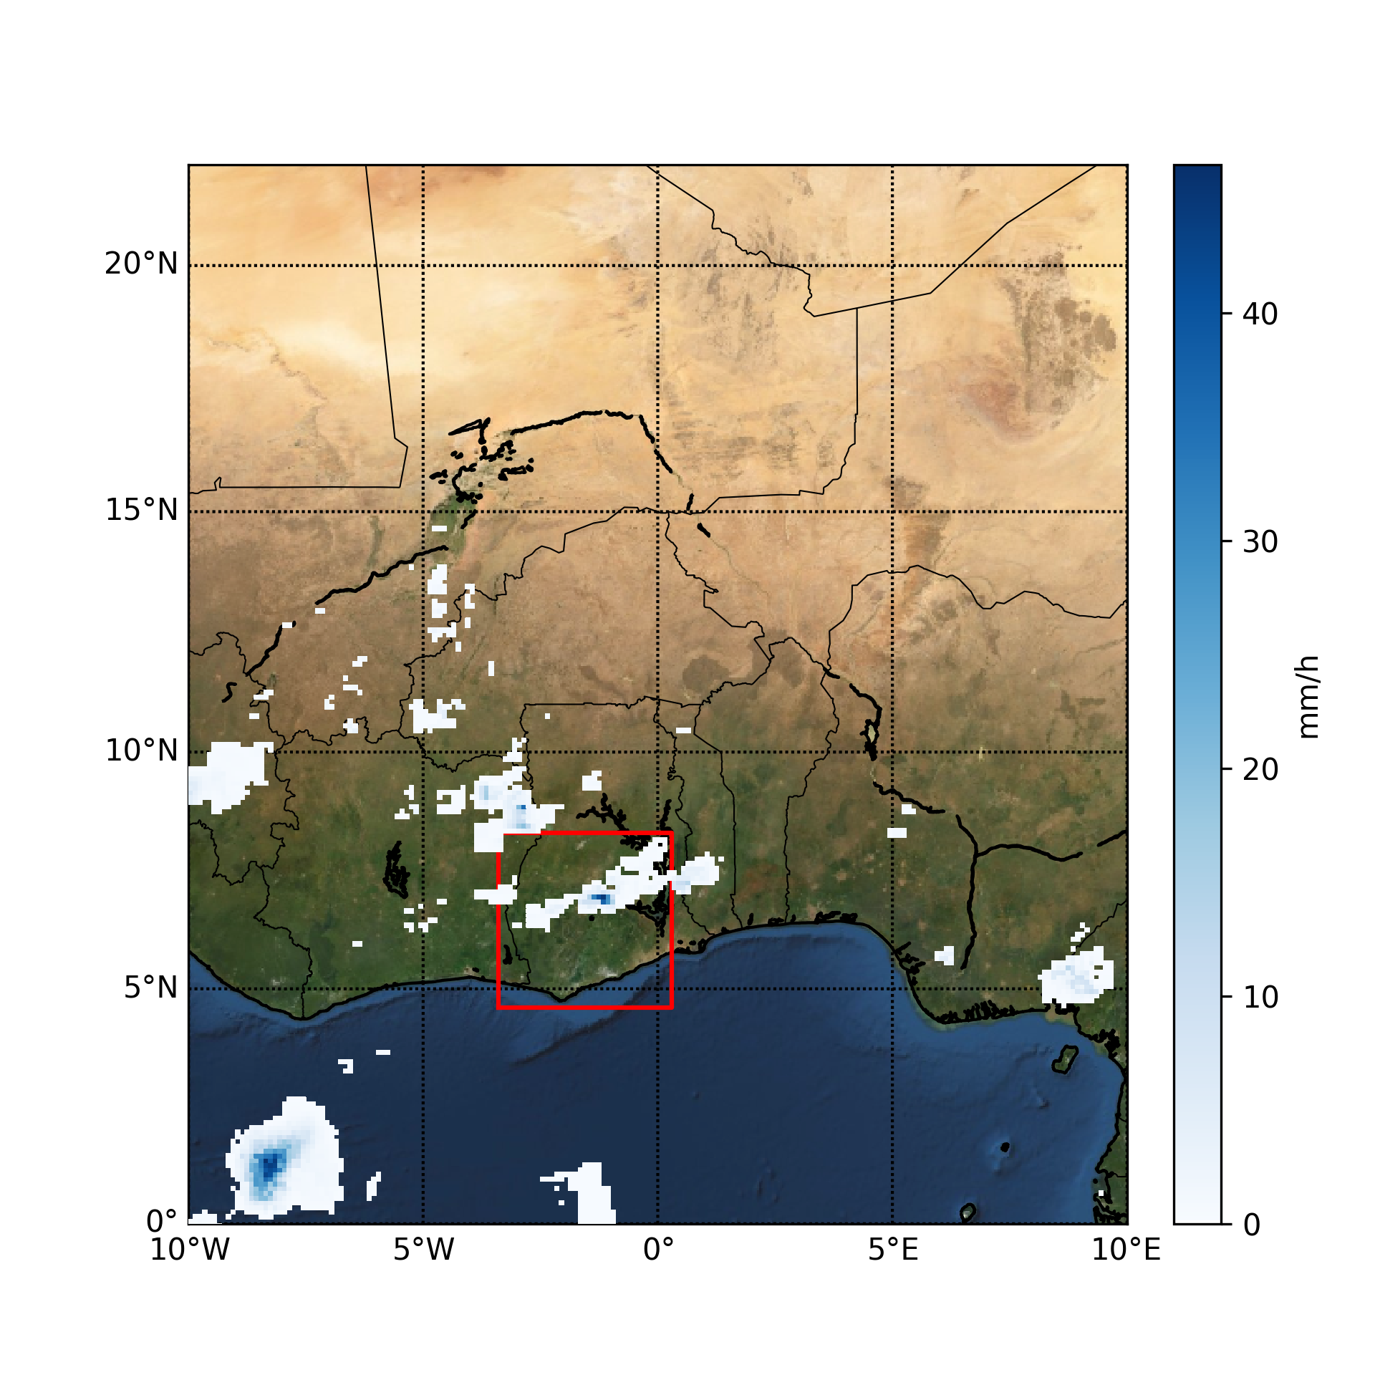
Case study
Go to start
Southern Ghana
Main rainy season (2018)
25h window:
from 06:00 April 22 to 06:00 April 23
Data (1h resolution)
IMERG-Late (Integrated Multi-satellite Retrievals for GPM) https://pmm.nasa.gov/data-access/downloads/gpm
65 TAHMO station (Trans-African Hydro-Meteorological Observatory) https://tahmo.org/
Case study

Slide 15
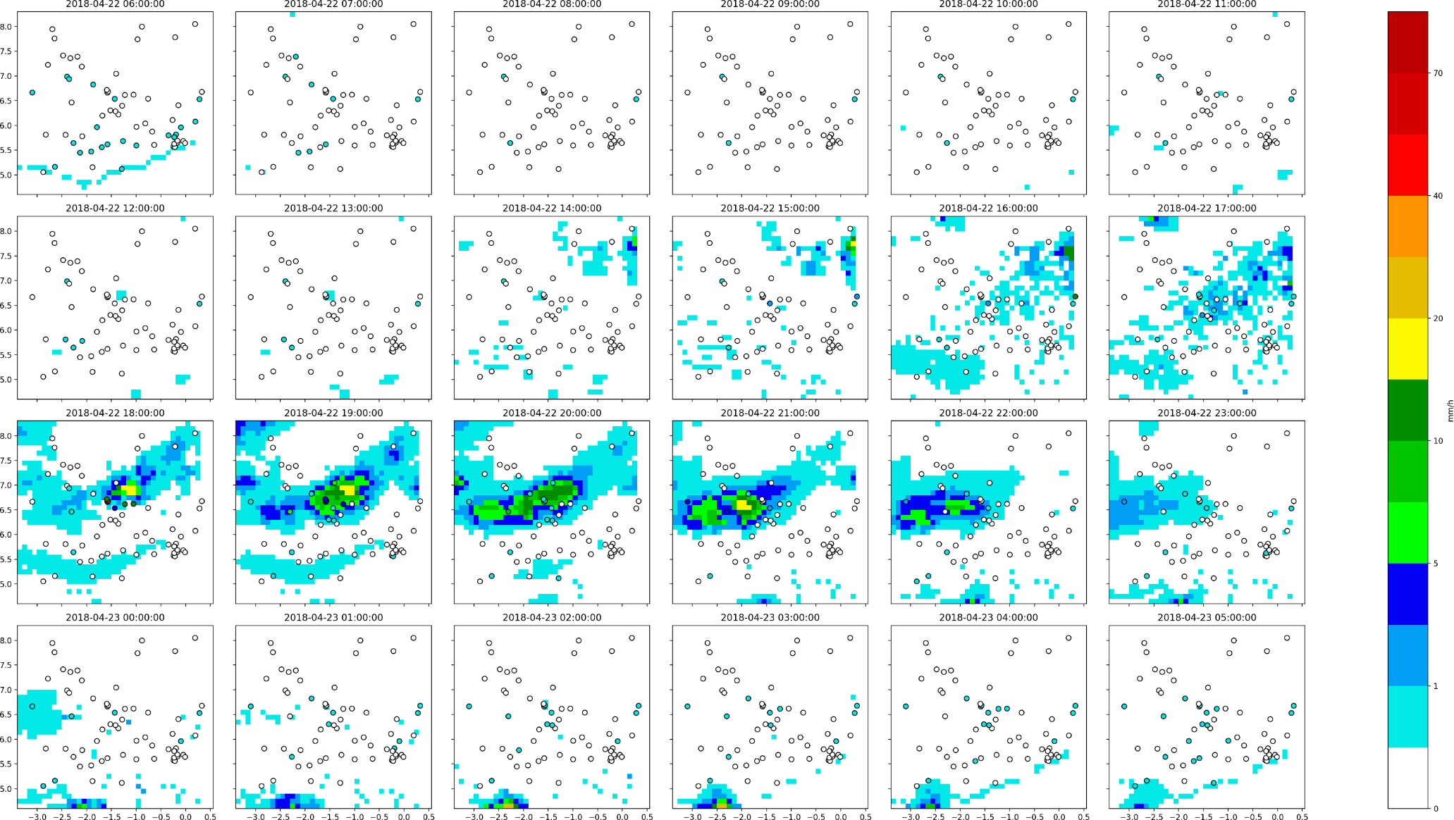
Precipitation data (1h accumulated):
IMERG-Late (background)
TAHMO measurement (circle)
Go to start
Case study

Slide 16
Precipitation data (1h accumulated):
IMERG-Late (background)
TAHMO measurement (circle)
Interpolated stations (contour line)
Go to start
Case study

Slide 17
Results
Go to start
The spatial and time warping are evaluated and compared using the Leave One Out Validation method, except for the position error.
Results

Slide 18
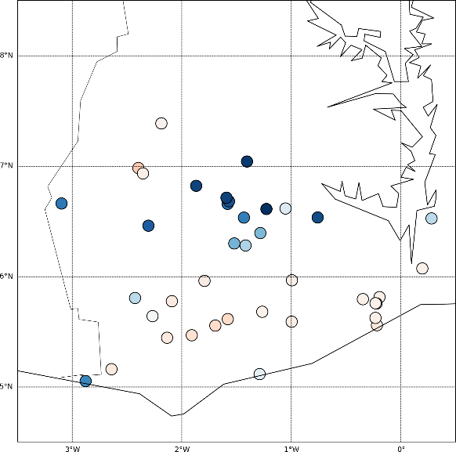
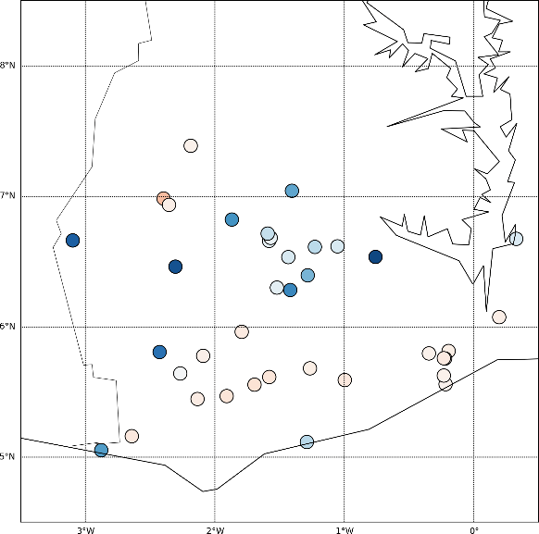
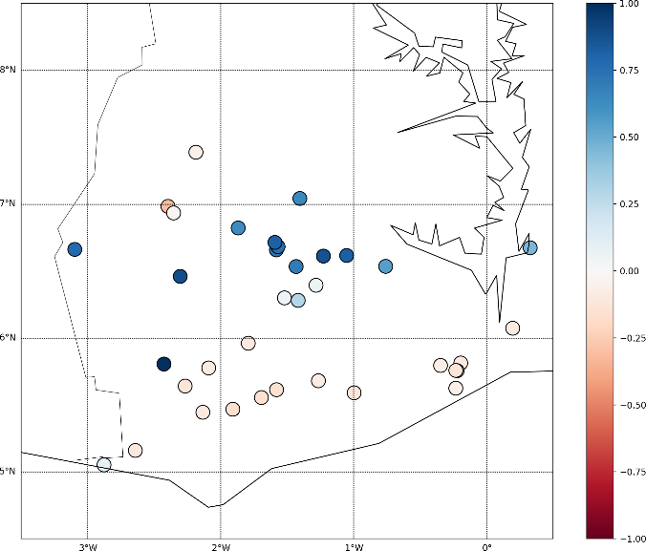
Results
Go to start
The spatial and time warping are evaluated and compared using the Leave One Out Validation method, except for the position error.
After spatial warping
Before
After time warping
Temporal correlation for each station.
Statistics before and after warping compared to the station measurements. The statistics are computed over all stations and all time steps.
 | Before | After space warping | After time warping
RMSE (mm/h) | 1,89 | 1,49 | 1,54
MAE (mm/h) | 0,20 | 0,14 | 0,15
Correlation | 0,18 | 0,62 | 0,59
Results

Slide 19
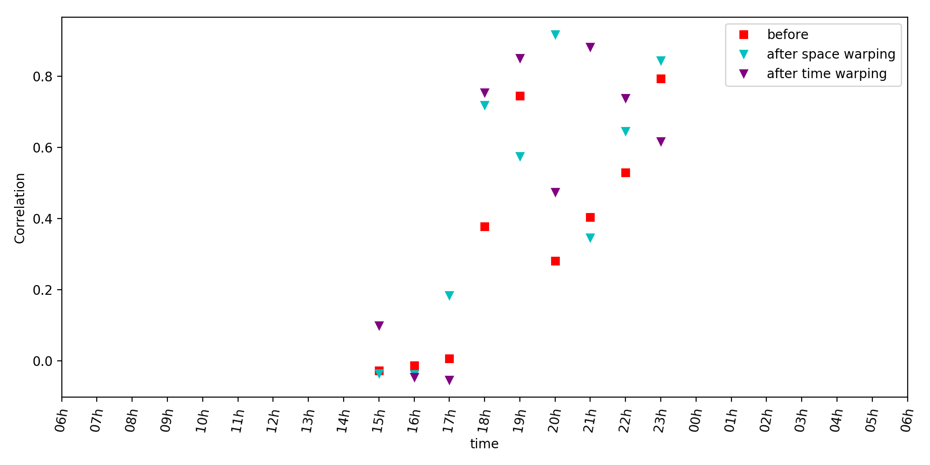
Results
Go to start
The spatial and time warping are evaluated and compared using the Leave One Out Validation method, except for the position error.
Spatial correlation at each time step at with more than 1mm/h recorded.
Statistics before and after warping compared to the station measurements. The statistics are computed over all stations and all time steps.
 | Before | After space warping | After time warping
RMSE (mm/h) | 1,89 | 1,49 | 1,54
MAE (mm/h) | 0,20 | 0,14 | 0,15
Correlation | 0,18 | 0,62 | 0,59
Results

Slide 20
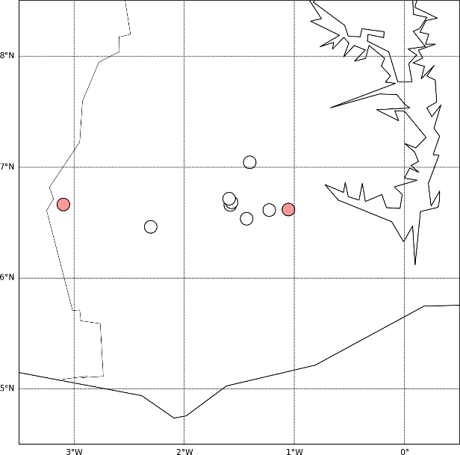
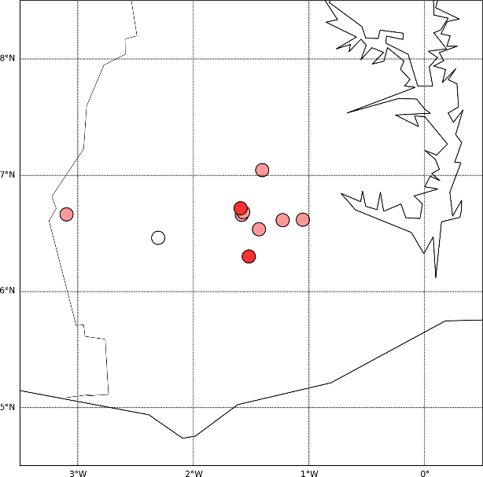
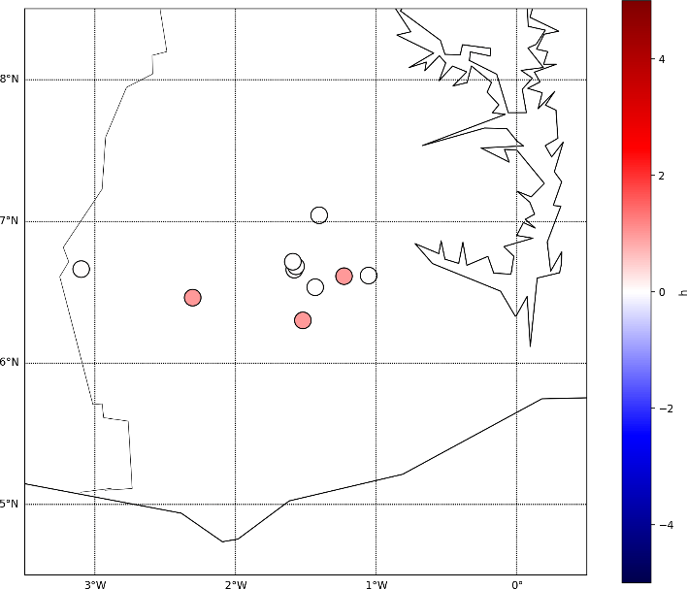
Results
Go to start
Time delay
After spatial warping
Before
After time warping
Time delay before and after warping at each station (with more than 1mm/h rainfall. In red, the peak in the estimated field is late (compared to the one in the station measurement). In blue, the peak is in advance.
Average absolute time delay before and after spatial warping. The average is done over all stations recording at least one time step with more rainfall than a certain threshold.
Threshold | Sample number | Before | After space warping | After time warping
1 mm/h | 10 | 1,10 h | 0,40 h | 0,30 h
5 mm/h | 7 | 1,00 h | 0,14 h | 0,29 h
10 mm/h | 5 | 1,20 h | 0,20 h | 0,20 h
Results

Slide 21
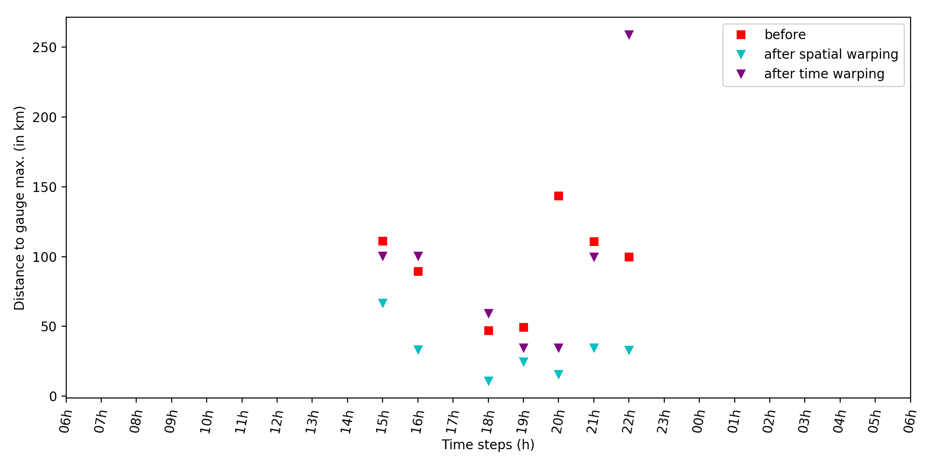
Results
Go to start
Position error
Distance between the ``true'' peak (in interpolated gauge) and the estimated ones before and after warping at each time step with more than 1mm/h recorded.
Average position error (km) before and after warping. The average is done over all time steps recording at least one pixel with more rainfall than a certain threshold.
Threshold | Sample number | Before | After space warping | After time warping
1 mm/h | 9 | 124,5 km | 76,9 km | 112,5 km
5 mm/h | 4 | 82,5 km | 21,2 km | 57,5 km
10 mm/h | 2 | 68,32 km | 22,2 km | 80,1 km
Results

Slide 22
Conclusion
Go to start
We applied the morphing approach applied to real (noisy) precipitation data. The spatial variability of IMERG ($u$) is preserved, while the position of the rainfall event is now matching the stations data.
Limitations:
Selection of the input data, the inputs $u$ and $v$ have to be similar enough (e.g. same number of rainfall events).
The method gives more weight to the high rainfall values.
Next steps:
Extension to other rainfall events.
Combining time and space warping.
Adding intensity correction .
Conclusion

Slide 23
Thank you
This study was built on
Le Coz, C., Heemink, A., Verlaan, M., ten Veldhuis, M.-C., van de Giesen, N. (2019). Correcting Position Error in Precipitation Data Using Image Morphing. Remote Sens., 11, 2557.
Bibliography:
Beezley, J. D., & Mandel, J. (2008). Morphing ensemble Kalman filters. Tellus A: Dynamic Meteorology and Oceanography, 60(1), 131–140.
Mandel, J., Beezley, J.D., Eben, K., Jurus, P., Kondratenko, V.Y., & Resler, J. (2010). Data Assimilation by Morphing Fast Fourier Transform Ensemble Kalman Filter for Precipitation Forecasts using Radar Images.
Ravela, S., Emanuel, K., & McLaughlin, D. (2007). Data assimilation by field alignment. Physica D: Nonlinear Phenomena, 230(1–2), 127–145.

