Slide 1






Soil Microbial Indicators of Alkane Flux around a Natural Gas Seep
Tom Bott
Simon Gregory, George Shaw, Barbara Palumbo-Roe
Acknowledgements:
BRGM: Frederick Gal, Eric Proust, Wolfram Kloppmann: for allowing the use of their gas data
How to Navigate:
On the next slide is the ‘home screen’ that sums up the work completed. Click a header to find out more about that section. A new slide, or slides, will appear. Once you’ve finished that section you’ll return to home screen by clicking to the next slide, or by hitting escape on your keyboard.
Notes:
My work focuses on…
Near surface microbiology changes

Slide 2
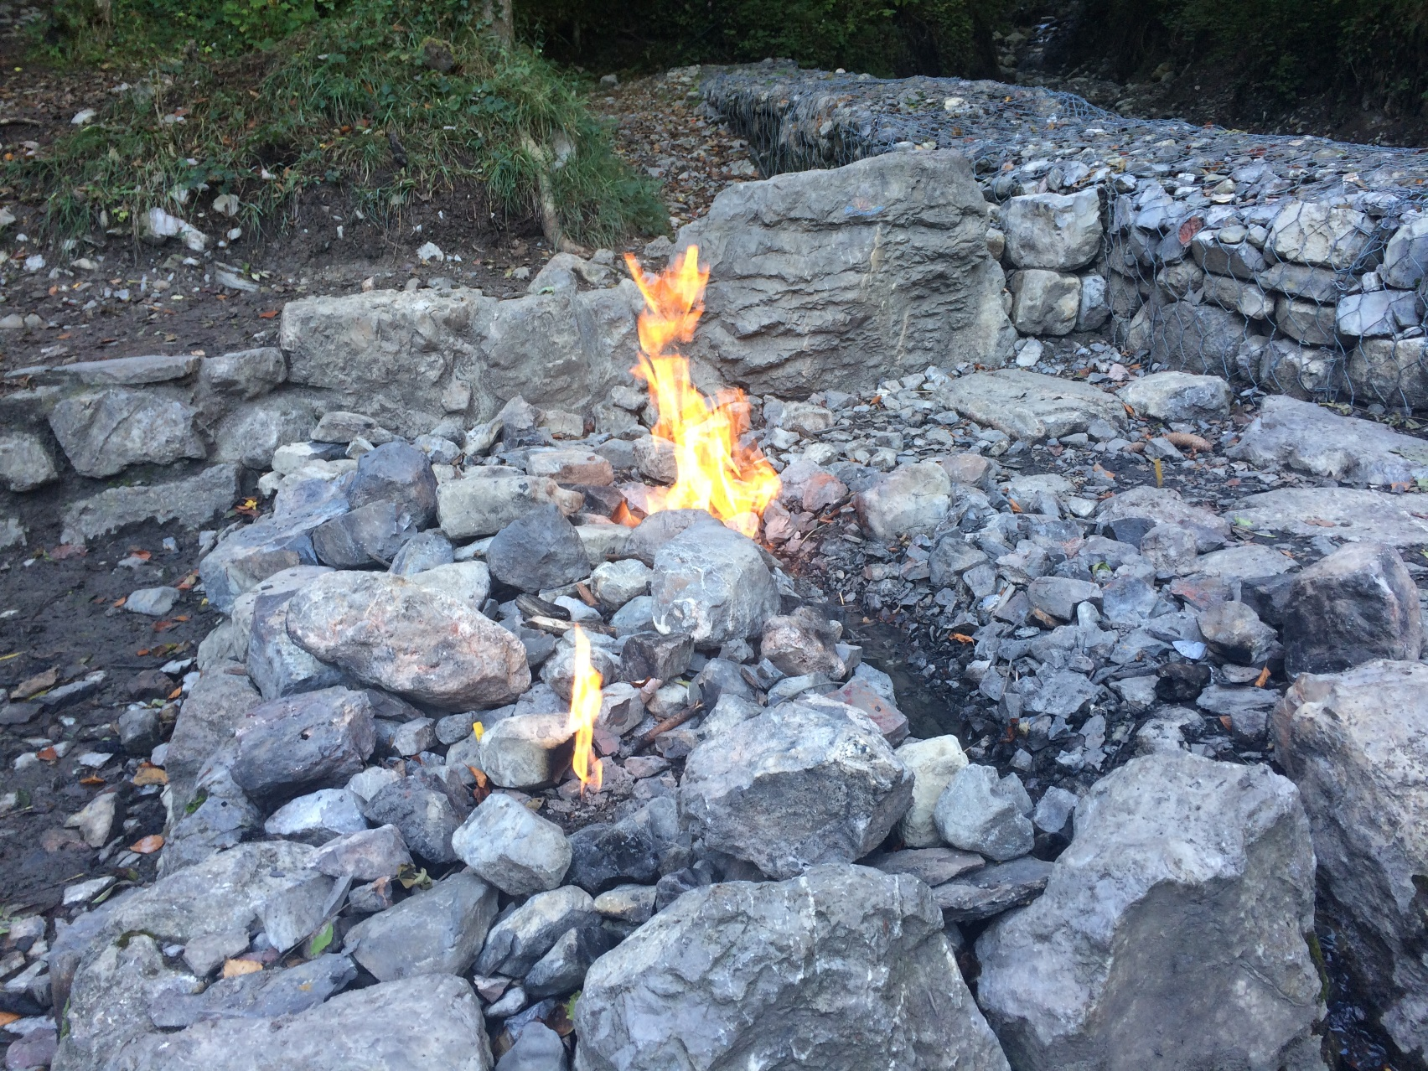


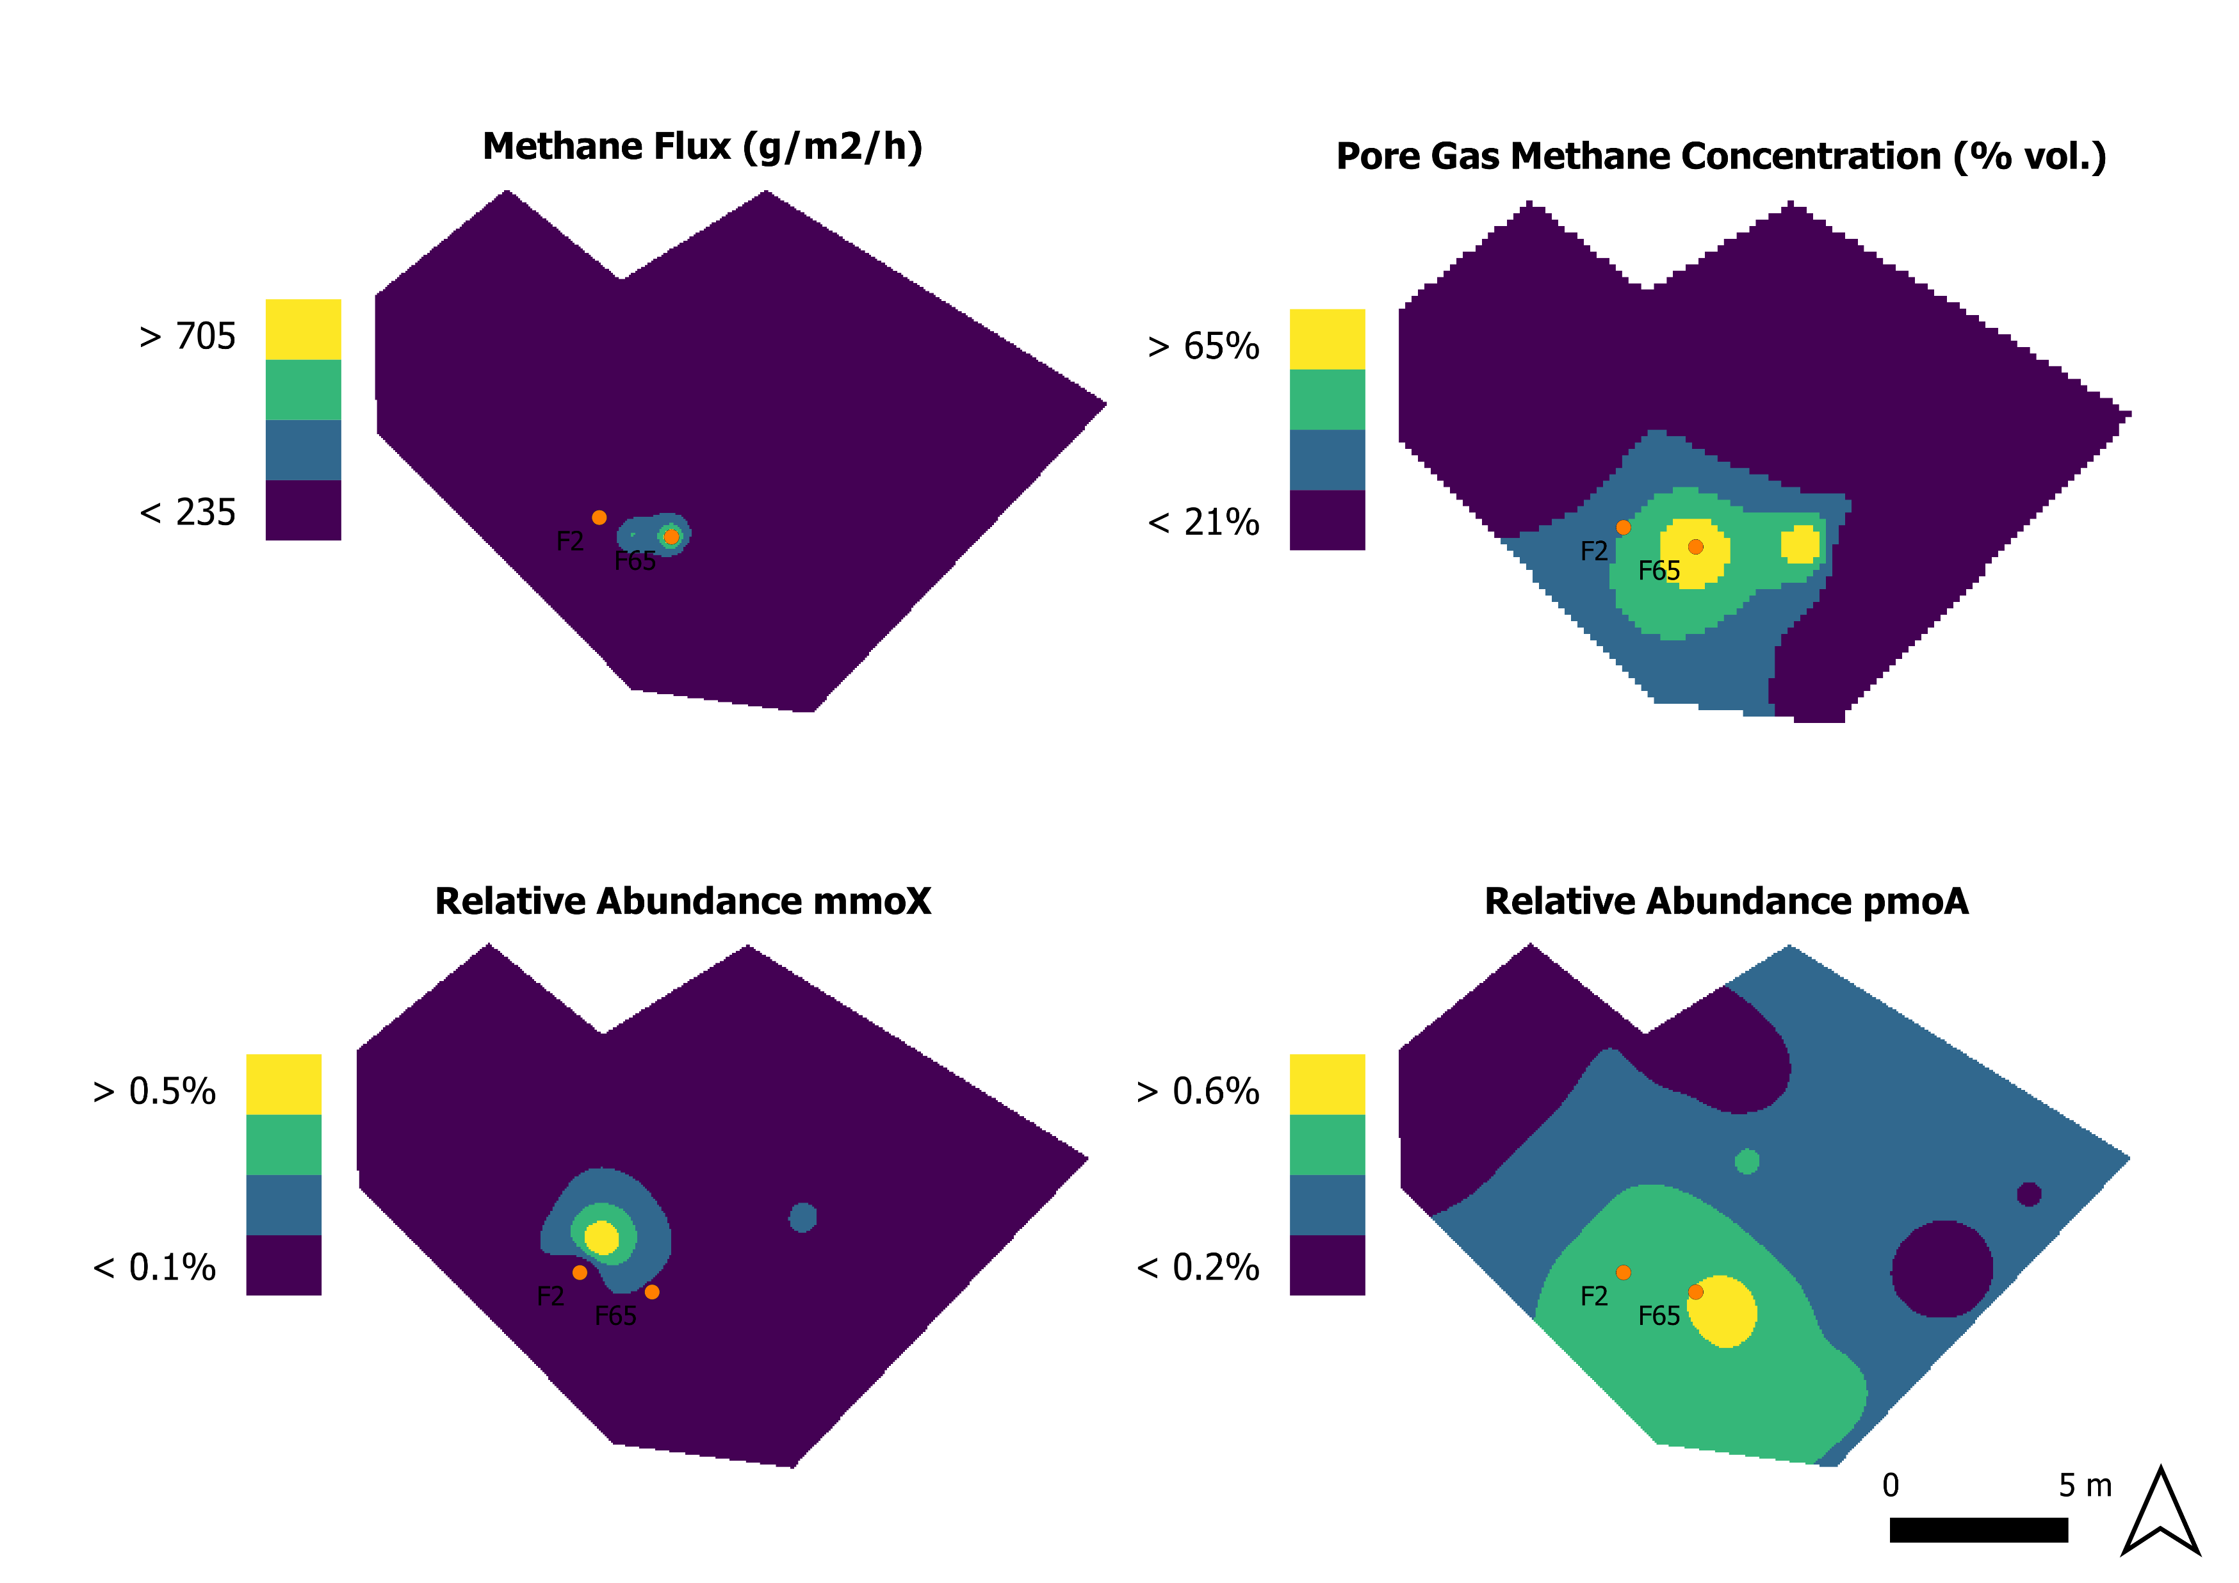
Soil Microbial Indicators of Alkane Flux around a Natural Gas Seep
Method
Test Site
Soil and Gas Sampling
  Using a regular grid
  Soil sampled at 20 cm depth
  Gas flux at surface and pore gas concentration measured
The Fontaine Ardent
France
Need
There is a legacy of oil and gas exploration. Abandoned wells can be emitters of gases from the subsurface, particularly methane. Tools are needed to monitor this.
Quantitative PCR
  Methanotrophs –pmoA & mmoX
  16S rRNA Gene
Why Use Bacteria?
Microbiology is slower to change than gas flux as a result can act as a average over time.
Analysis and IDW Interpolation
  Using ratio of 16S:Functional Gene.
Well characterised site.
Natural gas effusing to the surface at flammable concentrations.
Results, Discussion & Conclusion
Plot to the right shows methane and gene relative abundance. Warmer colours are higher concentrations and are discrete intervals showing 25% of total range.
Methane was detected at the surface and at 1 metre depth. The methane hotspots were close to the main seep (Point F2).
Both mmoX and pmoA also detected in soil. Hotspots of these appear related to methane flux and pore gas concentration.
Clear change in size of methane anomaly from 1 metre to surface. Possible relationship between pore gas methane concentration and methanotrophs relative abundance.
Presence of methanotrophs may explain differences in surface methane flux and pore gas concentrations.
Methanotrophs at this site appear to be an indicator of increased
methane concentrations.

Slide 3
Thanks for Reading!
If you have any questions, please join the EGU session Tom Bott will be there to take them. Alternatively the authors can be contacted at:
thb@bgs.ac.uk
Tom Bott
Simon Gregory, George Shaw, Barbara Palumbo-Roe
Acknowledgements:
BRGM: Frederick Gal, Eric Proust, Wolfram Kloppmann: for allowing the use of their gas data
Notes:
My work focuses on…
Near surface microbiology changes

Slide 4
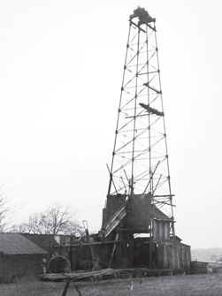
Need
There is a legacy of oil and gas exploration. Abandoned wells can be emitters of gases from the subsurface, particularly methane. Tools are needed to monitor this.
Legacy
Well Integrity
The UK alone has 2449 onshore oil and gas wells¹, with the majority decommissioned.
In the UK, once production stops the well is plugged, cut-off and buried. With the site returned to state of equal or better quality than before drilling began
There is currently no monitoring of decommission wells in the UK. Some wells have been decommissioned for several decades.
Wells are normally constructed with multiple layers of steel casing separated by cement. Their ability to stop material moving between the formations they pass through is the well integrity.
When a well’s integrity fails there is the potential for contamination between strata or for gases to rise to the surface.²
Methane is the main component of natural gas. It is also a potent greenhouse gas. Decommissioned wells may contribute to methane emissions to the atmosphere.³
Other components of natural gas included carbon dioxide and C₂-C₃ alkanes.
Future?
With continued interest in onshore oil and gas extraction, in particular with unconventional technologies, the number of decommissioned wells could increase.
Tools and systems to monitor these abandoned wells should be developed to mitigate methane release. Microbial indicators may be one such tool.
Inset Picture: Hardstoft One. The first oil well in the UK, sunk in 1915 and decommissioned in 1952.
References
UK OIL AND GAS AUTHORITY. 2019. Basic onshore well data [Online]. London, UK. Available: https://www.ogauthority.co.uk/media/6108/c-pdf-landwells-24-october-2019.xlsx [Accessed 03/2020].
WATSON, T. & BACHU, S. 2009. Evaluation of the Potential for Gas and CO2 Leakage Along Wellbores. SPE Drilling & Completion, 24, 115-126.
KANG, M., CHRISTIAN, S., CELIA, M. A., MAUZERALL, D. L., BILL, M., MILLER, A. R., CHEN, Y., CONRAD, M. E., DARRAH, T. H. & JACKSON, R. B. 2016. Identification and characterization of high methane-emitting abandoned oil and gas wells. Proceedings of the National Academy of Sciences, 113, 13636-13641.

Slide 5
Why Use Bacteria?
Microbiology is slower to change than gas flux as a result can act as a average over time.
Methanotrophs
Other Alkanotrophs
Vs. Gas Measurements?
Methanotrophs are bacteria that can only grow on methane. Oxidising it to carbon dioxide and water to produce energy.
There are two enzymes that oxidise methane to methanol in the first step of this process.
  Particulate Methane Mono-oxygenase (pMMO)
  Soluble Methane Mono-oxygenase (sMMO)
Each enzyme is encoded by a different gene. By quantifying the amount of that gene in an sample we can estimate how many methanotrophs are part of that bacterial community.
Sites with a greater methane concentration of flux should have a larger proportion of methanotrophs in their community.
There are also bacteria that can oxidise ethane, propane and butane using specialised proteins. The genes that encode for these proteins can also be detected.
This may enable a differentiation between a site with a strong thermogenic source of methane versus a site with a biological source.
Thermogenic sources have a larger proportion of C₂-C₄ alkanes which may impact the bacterial community’s composition.
Measuring flux or gas concentration is potentially faster. But, these can quickly change due factors like the weather. Microbiology should change much slower .
History
Oil and gas prospectors have used soil bacteria as indicators of reservoirs for decades ¹. Soils above a reservoir should receive a greater flux of alkanes with the gases rising due to pressure².
These approaches used culture based techniques over a large area to detect methanotrophs and other alkanotrophs
References
WAGNER, M., WAGNER, M., PISKE, J. & SMIT, R. 2002. Case Histories of Microbial Prospection for Oil and Gas Onshore and Offshore in northwest Europe, The American Association of Petroleum Geologists and the Society of Exploration Geophysicists.
TEDESCO, S. A. 1995. Surface Geochemistry in Petroleum Exploration, New York (US), Chapman and Hall.

Slide 6
Method
Gas Sampling
  Gas flux at surface measured across a 1 m grid
  Pore gas concentration measured at 1 m depth, fewer samples than flux due to difficulty measuring
Soil Sampling
  Using a regular grid
  Soil sampled at 20 cm depth
Quantitative PCR
  Methanotrophs –pmoA for pMMO & mmoX for sMMO
  16S rRNA Gene
Analysis and Inverse Distance Weighted Interpolation
  Ratio of 16S:Functional Gene producing an estimated relative abundance of the gene in the bacterial community
Genes
Quantitative PCR
mmoX and pmoA: Encodes for the catalytic subunit of soluble and particulate methane mono-oxygenase respectively.
16S rRNA is a gene that all bacteria have and is used in the production of proteins. Quantifying that gene enables an estimation of the total bacterial community.
qPCR enables the enumeration of a gene in a sample. Here it is set up to detect one gene, it replicates that gene until it is at a detectable concentration. The time it takes for detection to occur can be used to estimate the starting concentration. Compared to culturing techniques it should be quicker, more reliable and
more accurate

Slide 7
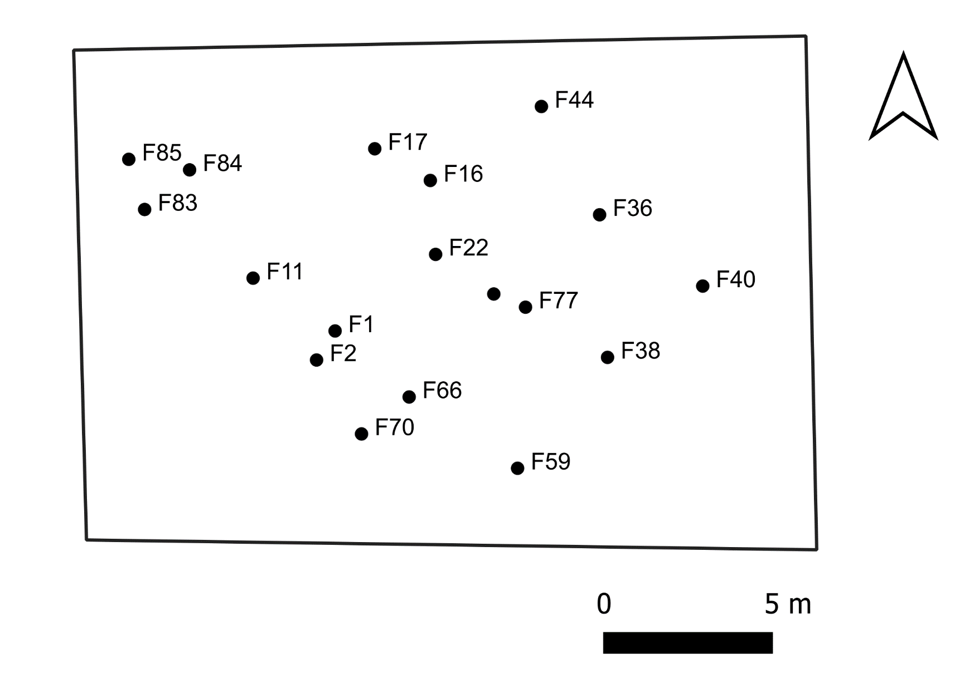
Test Site
The Fontaine Ardent
France
Well characterised site^{1,2,3}.
Natural gas effusing to the surface at flammable concentrations.
3 Background Samples
River/Stream
Description and Sampling
Selected as a proof of concept site for the methodology presented: i.e. can soil microbial indicators suggest the presence of a gas seep?
The site is in South-East France near Grenoble. There are records of a flammable seep for over a millennium.
The current main seep is the remains of a borehole sunk in the 1990s which is the center of a concrete pad, sketched onto the figure. The seep is predominately composed of methane (up to 84.4%¹)
Gas flux measurements took place over a 1 m spaced grid. Microbial sampling was spaced every 5 m (at 20 cm depth) and is shown on the figure.
Main Seep (F2), in the centre of a concrete pad
Gabion basket retaining wall
Points of soil sampling for microbial analysis
References
GAL, F., KLOPPMANN, W., PROUST, E., BENTIVEGNA, G., DEFOSSEZ, P., MAYER, B. & GAUCHER, E. C. 2017. Natural CH4 Gas Seeps in the French Alps: Characteristics, Typology and Contribution to CH4 Natural Emissions to the Atmosphere. Energy Procedia, 114, 3020-3032.
GAL, F., KLOPPMANN, W., PROUST, E. & HUMEZ, P. 2018. Gas concentration and flow rate measurements as part of methane baseline assessment: Case of the Fontaine Ardente gas seep, Isère, France. Applied Geochemistry, 95, 158-171.
GAL, F., PROUST, E. & KLOPPMANN, W. 2019. Towards a Better Knowledge of Natural Methane Releases in the French Alps: A Field Approach. Geofluids, 2019.

Slide 8
Results, Discussion & Conclusion
Recap
A total of, 86 flux measurements and 10 pore gas measurements were taken. 18 soil samples were taken for qPCR.
Surface Flux
Pore Gas
Methane flux from the soil was observed at points across the site.
One point, F65, appears anomalously high, until considered along with the pore gas concentration
At 1 m depth the soil pore gas was composed of up to 81.7% vol. (at F65) methane.
mmoX Abundance
pmoA Abundance
The particulate methane mono-oxygenase gene was detected all bar one point, a background sample.
Sample points around the seep had the greatest observed relative abundance.
The soluble methane mono-oxygenase gene was detected most strongly next to the main seep at the edge of the concrete pad.
Plot shows methane and functional gene relative abundance. Warmer colours represent areas with higher concentrations and are discrete intervals showing 25% of total range.

Slide 9
Results, Discussion & Conclusion
Methane
Clear change in size of methane anomaly from 1 metre to surface. This could be due to methane rising through areas of soil with greater permeability.
It could also be caused by methane being oxidised by methanotrophs in an aerobic zone between the two measurement points (1 m and the surface).
Methane Mono-Oxygenases
Currently unclear why the relative abundances of the two genes are not more similar. Almost all methanotrophs have pmoA, only some genera have mmoX. This could explain the greater spread of pmoA but not the separation of the two hotspots.
Possibly this is due to other factors that are providing the genera with mmoX an advantage, or disadvantage, to those with pmoA only.
Plot shows methane and functional gene relative abundance. Warmer colours represent areas with higher concentrations and are discrete intervals showing 25% of total range.

Slide 10
Results, Discussion & Conclusion
Key Point
Methanotrophs at this site appear to be an indicator of increased soil methane concentrations.
Preliminary Conclusions
Field scale changes in methanotroph abundance could be detected with this method.
Changes in methane signature between 1 m and the surface suggest that methanotrophs might obscure methane flux. This suggests using microbial indicators could other advantages to flux measurement
Future Work
Sequencing of samples to understand why pmoA and mmoX abundances do not align.
Method will need testing at more sites for further development.
Other alkanotroph genes need enumerating to further assess approach for detecting alkanes
Plot shows methane and functional gene relative abundance. Warmer colours represent areas with higher concentrations and are discrete intervals showing 25% of total range.

