Slide 1
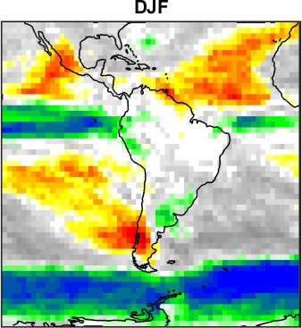
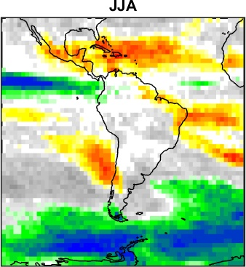
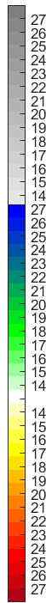
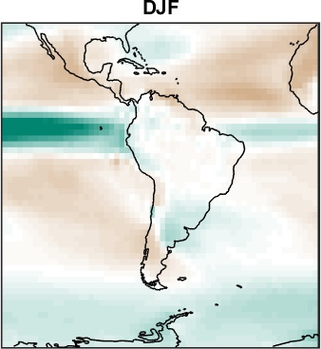
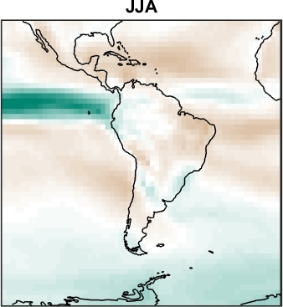
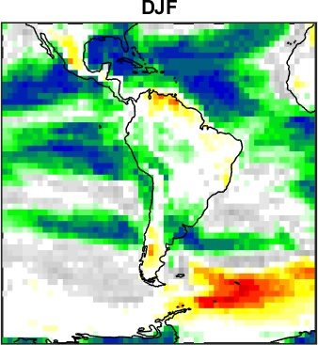
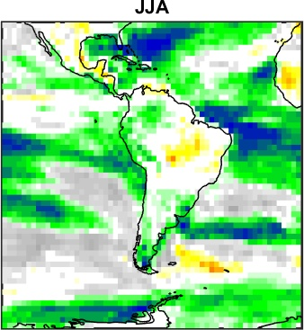
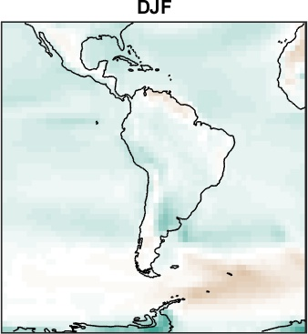
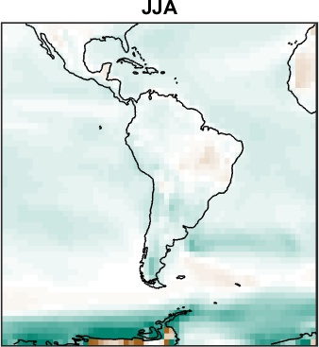
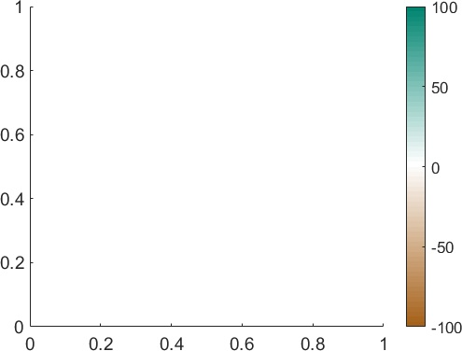
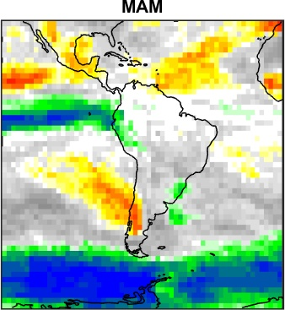
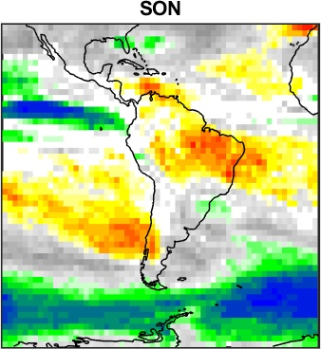
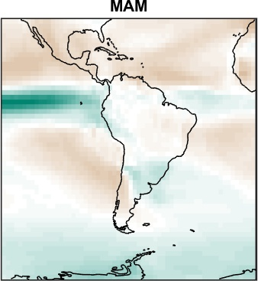
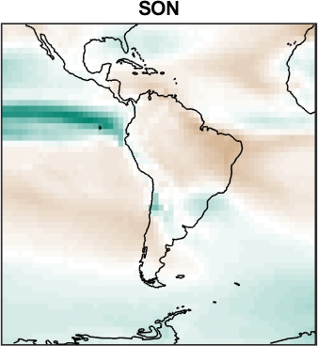
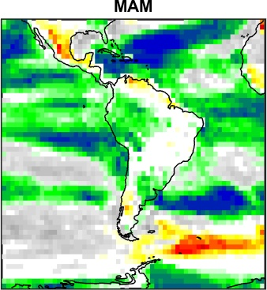
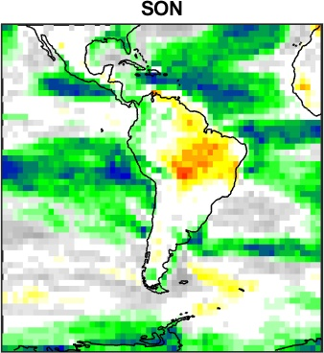
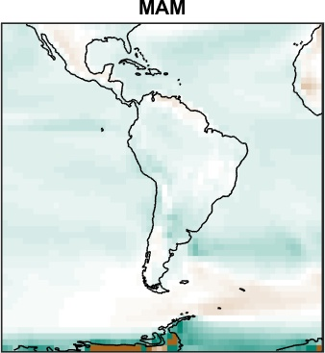
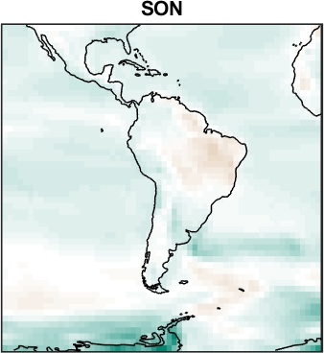
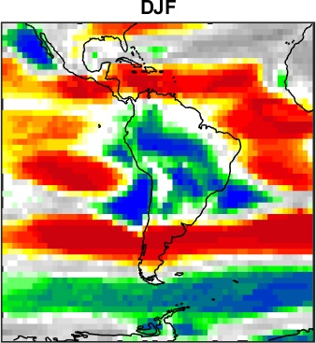
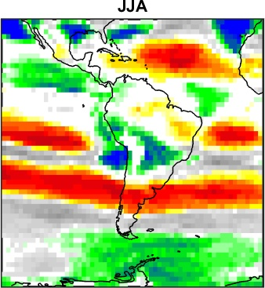
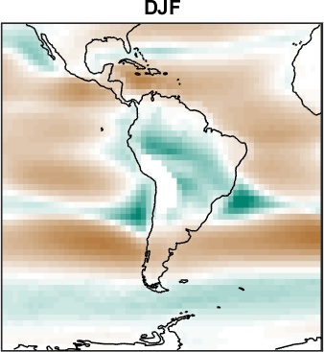
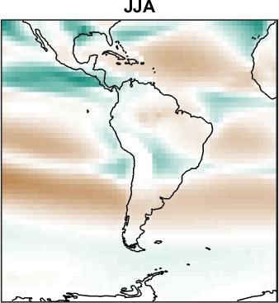
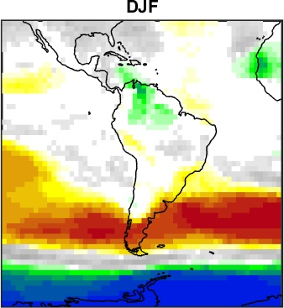
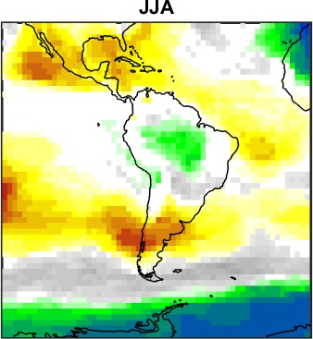
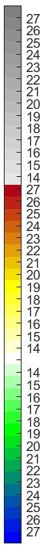
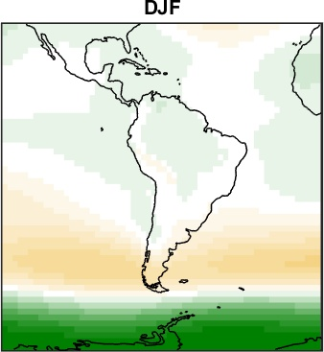
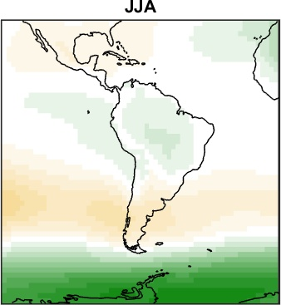
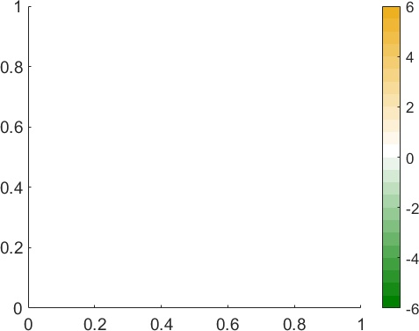
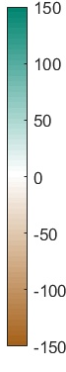
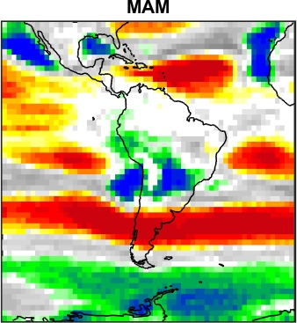
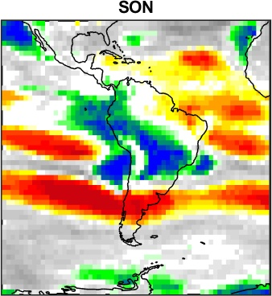
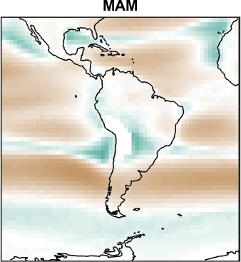
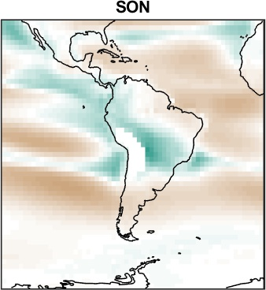
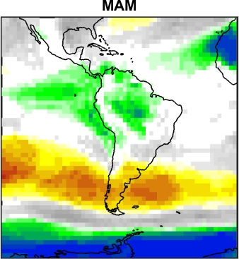
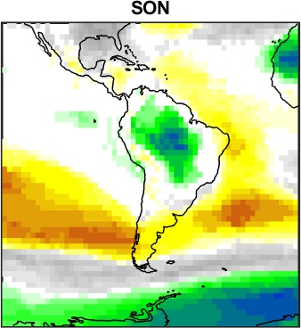
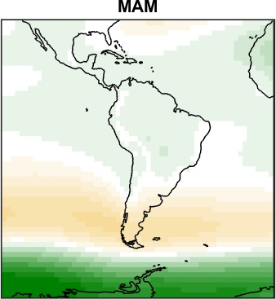
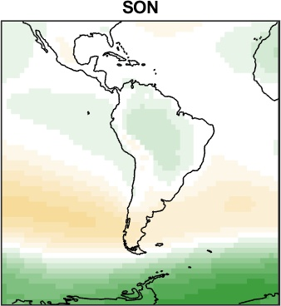
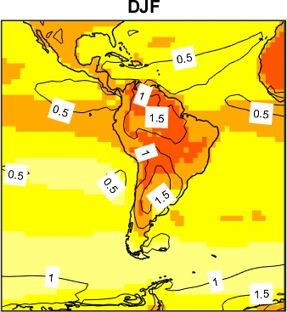
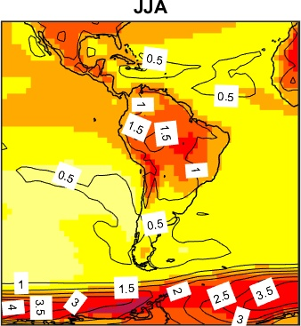
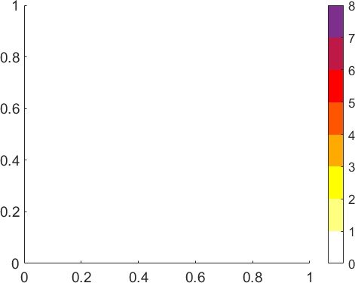
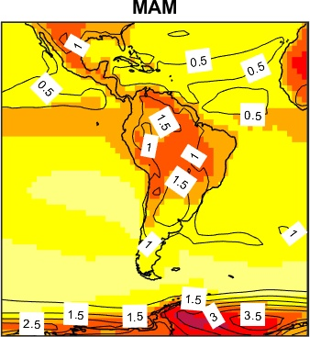
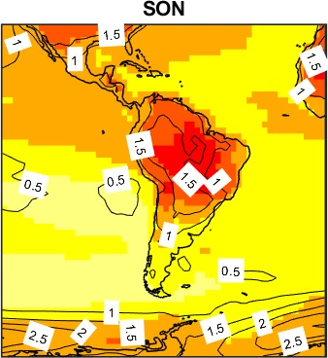
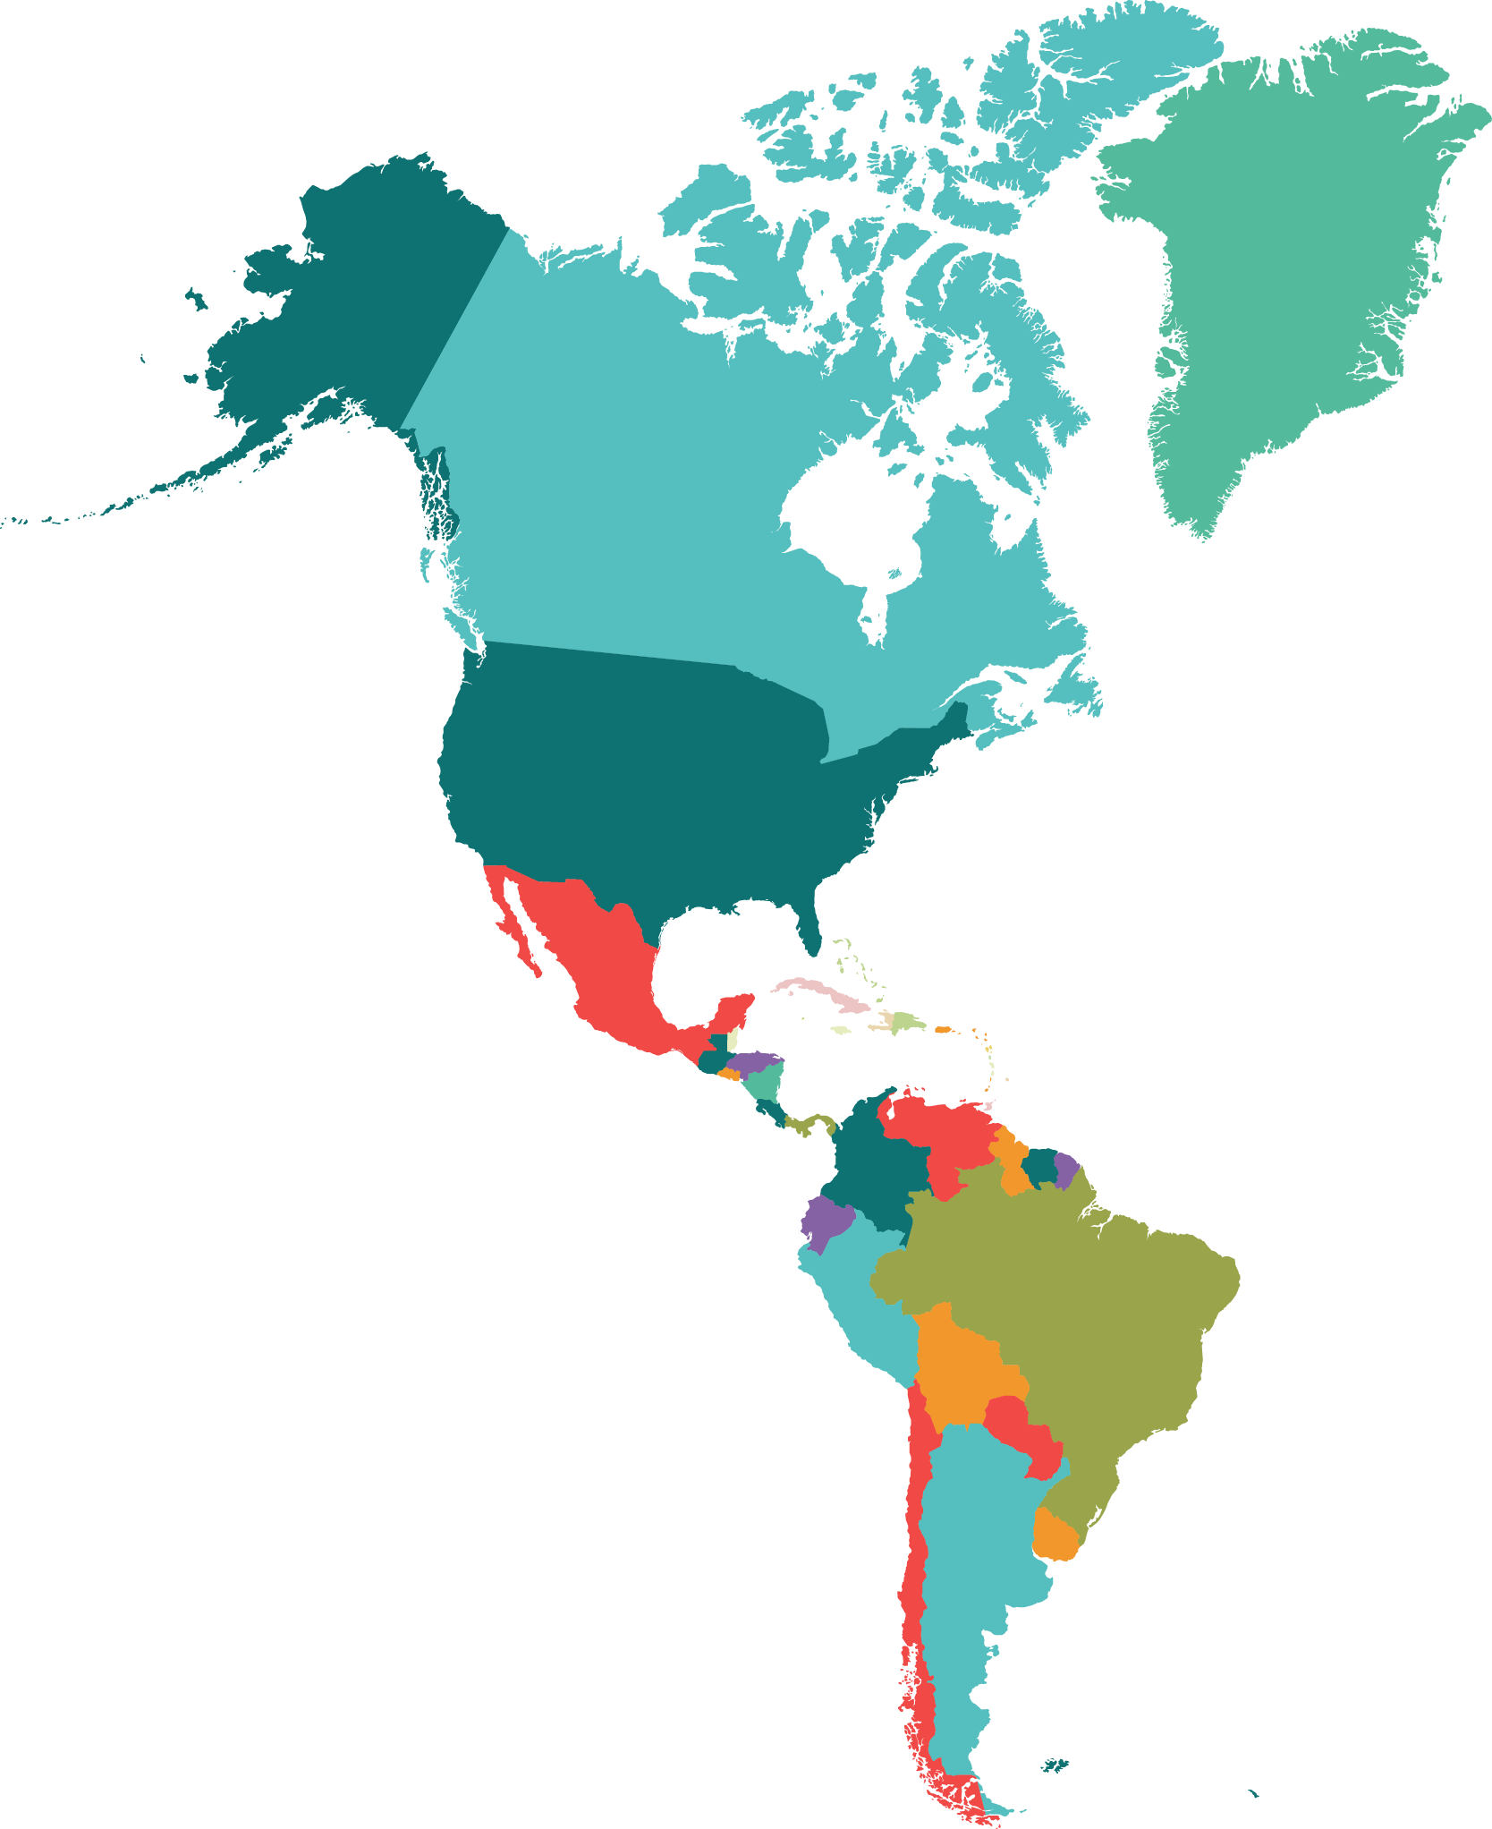
A Multivariate Assessment of Climate Change Projections over South America using CMIP5 Models
Valerie M. Thaler¹, Paul C. Loikith¹, Luana Albertani Pampuch², C Roberto Mechoso³
1. Department of Geography, Portland State University, Portland, OR 2. Instituto de Ciência e Tecnologia, UNESP – Univ. Estadual Paulista, Departamento de Engenharia Ambiental, SP, Brasil 3. UCLA, Department of Atmospheric and Oceanic Sciences, Los Angeles, CA
Introduction
Results
Projections of climate change have received relatively less attention over South America compared to other parts of the world.
Most existing studies focus on the multi-model mean and do not assess model ensemble uncertainty.
A comprehensive multi-model multi-variate assessment of future climate change over South America is presented.
Precipitation (PR)
Evapotranspiration (ET)
Objectives
Assess projections of change in a set of key variables for the end of the 21st century
Quantify model agreement and uncertainty between the models for each variable
Integrate findings into a comprehensive picture of projected climate change over South America
Figure 2: Left - number of models that agree on significant increases in PR (green-blues), significant decreases (yellow-reds), and non-significant changes (grays). Right - change in the MME of PR (%).
Figure 3: Left - number of models that agree on significant increases in ET (green-blues), significant decreases (yellow-reds), and non-significant changes (grays). Right - change in the MME of ET (%).
Data and Methods
Robust model agreement on a significant decrease in PR in extra-tropics for all seasons and most of Brazil for SON. Models also agree on an increase in PR in NW SA for DJF and MAM and SE SA for DJF, MAM, and SON.
Models agree on a significant increase in ET in NW SA for all seasons and on a significant decrease in ET in northern SA for DJF and MAM, central SA for JJA, and most of Brazil for SON.
27 models from the Coupled Model Intercomparison Project Phase 5 (CMIP5; Taylor et al. 2012)
Projected changes were calculated for the end of the 21st century (2071-2100) using a historical period of 1961-1990.
Model agreement quantification methodology is based on approach in Neelin et al. 2013.
Integrated Vapor Transport (IVT)
Sea Level Pressure (SLP)
Results
Temperature
Figure 4: Left - number of models that agree on significant increases in IVT (green-blues), significant decreases (yellow-reds), and non-significant changes (grays). Right - change in the MME of IVT (kg m⁻¹ s⁻²).
Figure 5: Left - number of models that agree on significant increases in SLP (yellow-reds), significant decreases (blue-greens), and non-significant changes (grays). Right - change in the MME of SLP (hPa).
Models agree on a significant decrease in IVT in southern SA for all seasons, a decrease in NE Brazil for JJA and SON, and an increase in central SA for all seasons.
Models show robust agreement on a significant increase in SLP in the sub/extra-tropics and a decrease in the tropics for all seasons. Clearly shows the poleward shift of extra-tropical storm track.
Summary
DJF
Wetter
Drier
JJA
MAM
Wetter
SON
Figure 1: Multi-model ensemble (MME) of projected change in temperature. Contours represent the standard deviation of the 27 projected temperature changes for all models used.
v
Drier
Drier + Warmer
All areas show warming for all seasons. The tropics show the largest spread in intra-ensemble warming magnitude. This suggests that the highest model uncertainty in warming magnitude is in the tropics.
Expansion of subtropical high pressure system
Expansion of subtropical high pressure system
Wetter
Wetter
Expansion of subtropical high pressure system
Expansion of subtropical high pressure system
Expansion of subtropical high pressure system
Expansion of subtropical high pressure system
Expansion of subtropical high pressure system
Drier
Wetter
Drier
Wetter
Drier
Drier
1. Neelin, J. D., B. Langenbrunner, J. E. Meyerson, A. Hall, and N. Berg, 2013: California Winter Precipitation Change under Global Warming in the Coupled Model Intercomparison Project Phase 5 Ensemble. J. Climate, 26, 6238–6256, https://doi.org/10.1175/JCLI-D-12-00514.1. 2. Taylor, Karl E., Ronald J. Stouffer, and Gerald A. Meehl, 2011: “An Overview of CMIP5 and the Experiment Design.” Bulletin of the American Meteorological Society, 93, 4, 485–98. https://doi.org/10.1175/BAMS-D-11-00094.1.
Support provided by the U.S. National Science Foundation AGS-1547899
Notes:
There will an overall warming over South America, with the tropics receiving the highest magnitude in warming with SON being the warmest. However, the tropics have the highest uncertainty in warming. The warming in the tropics during SON aligns with an overall decrease in evapotranspiration

