Slide 1
How Unusual are fires?
F.DiGiuseppe@ecmwf.int

Slide 2
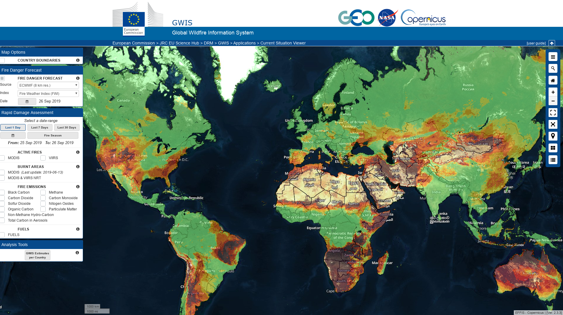
Context
ECMWF forecast for FWI is the modelling component for GWIS/EFFIS. At the moment the consolidated product displayed is the high resolution forecast up to 10 days. However there are some experimental products that are under evaluation and that might be released in the future

Slide 3
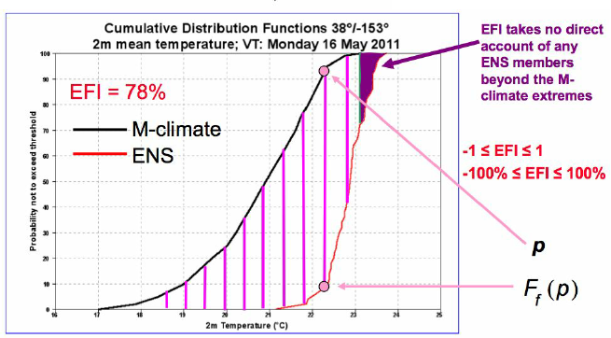
Comparing the model-climate with the forecast
(In terms of the whole ensemble)
Instead than the mean value consider climate as distribution
Also the forecast is not a fix value but a distribution of most likely event
Climatology
Forecast
Your forecast might be very extreme in your distribution

Slide 4
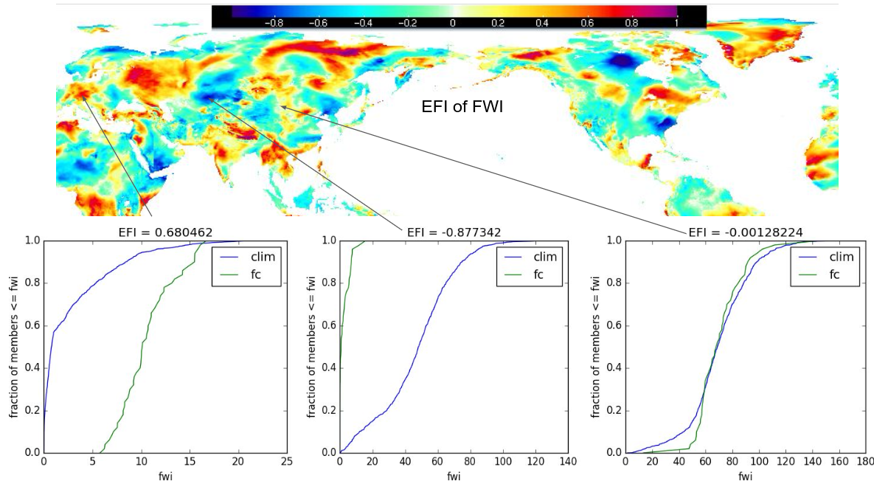
An extreme forecast index for the fire weather index

Slide 5
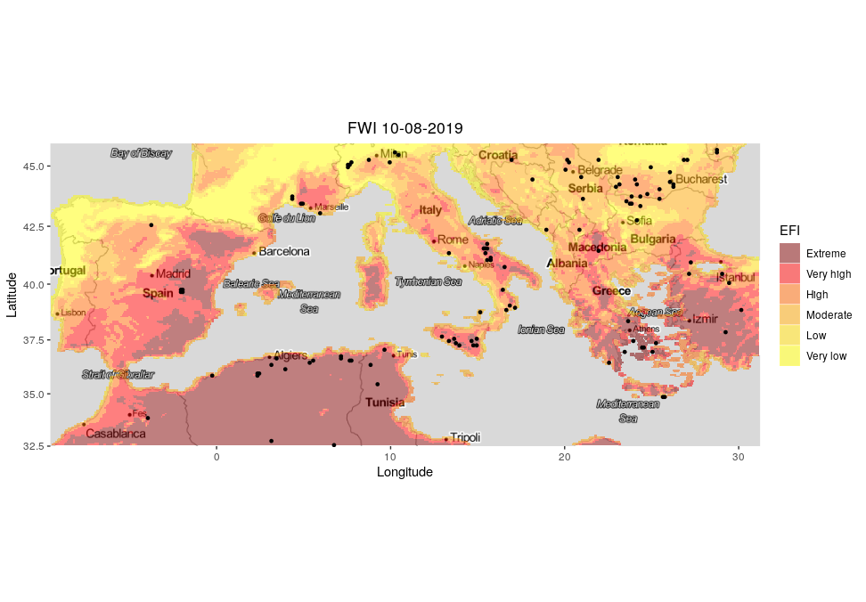
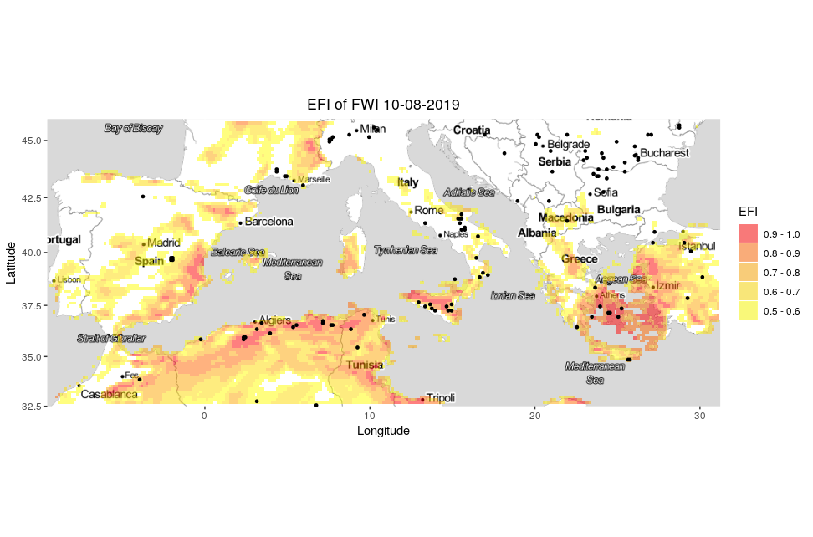
Applying probabilistic information to fire forecasting
Extreme Forecast Index
Model Climate
20 years of reforcast of FWI
Forecast
Distribution from ensemble prediction
Fire Hotspots from MODIS
Extreme forecast Index
The fire Weather index (FWI) is not a “sharp” index and extreme conditions might be “usual ” in some regions (e.g. Greece, Spain in August)
The extreme forecast Index helps identifying conditions that are also statistically unusual compared to the model climate

