Slide 1
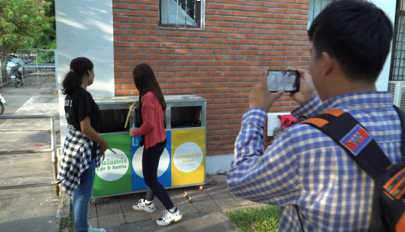
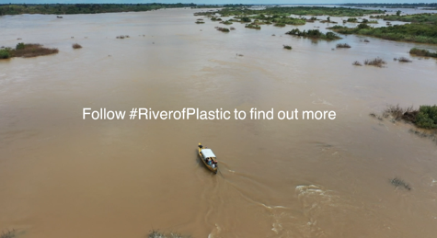
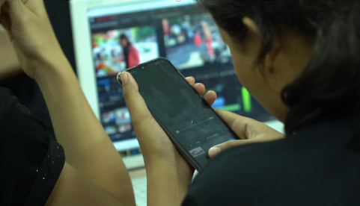
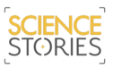
Environmental filmmaking workshops: Engaging university students on plastic pollution in Cambodia and Vietnam
Chris Hackney^{1,2}, Vivien Cumming³, Robin Waldman⁴
And the students of Phnom Penh, Cambodia and Hanoi, Vietnam
christopher.hackney@ncl.ac.uk
¹
²
³
⁴
All rights reserved, videos in this ppt ©VivienCumming

Slide 2
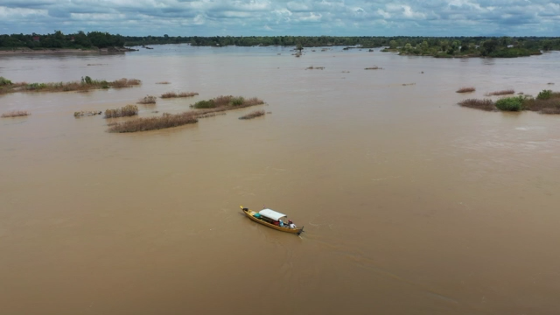
All rights reserved, videos in this ppt ©VivienCumming

Slide 3
AIM: to help students on environmental courses learn quick and easy ways to make impactful short films so as to communicate their science to the public and their peers on social media, which is widely used in the region.
Methods: The workshops lasted a day and taught students how to find a story, film it and edit it into a 1-minute video, with the videos shown at the end of the day in a mini ‘film festival’ and then shared by the students. The students were not given any brief of the content of the video.
Outcomes: Our research involves looking at plastic pollution in the Mekong River. In order to publicise the problem to the general public in the region the workshops with local students allowed us to tell environmental stories on social media from their perspective and streamlined the process of communication, providing content that could be shared widely.
Below is an example videos the groups created…
All rights reserved, videos in this ppt ©VivienCumming

Slide 4
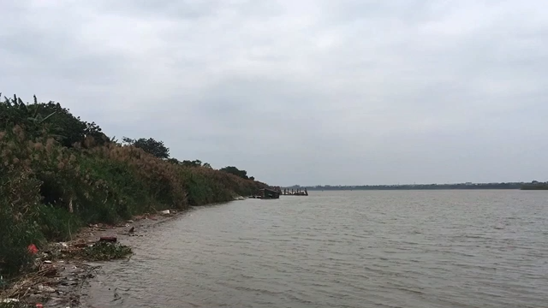
All rights reserved, videos in this ppt ©VivienCumming

