Slide 1
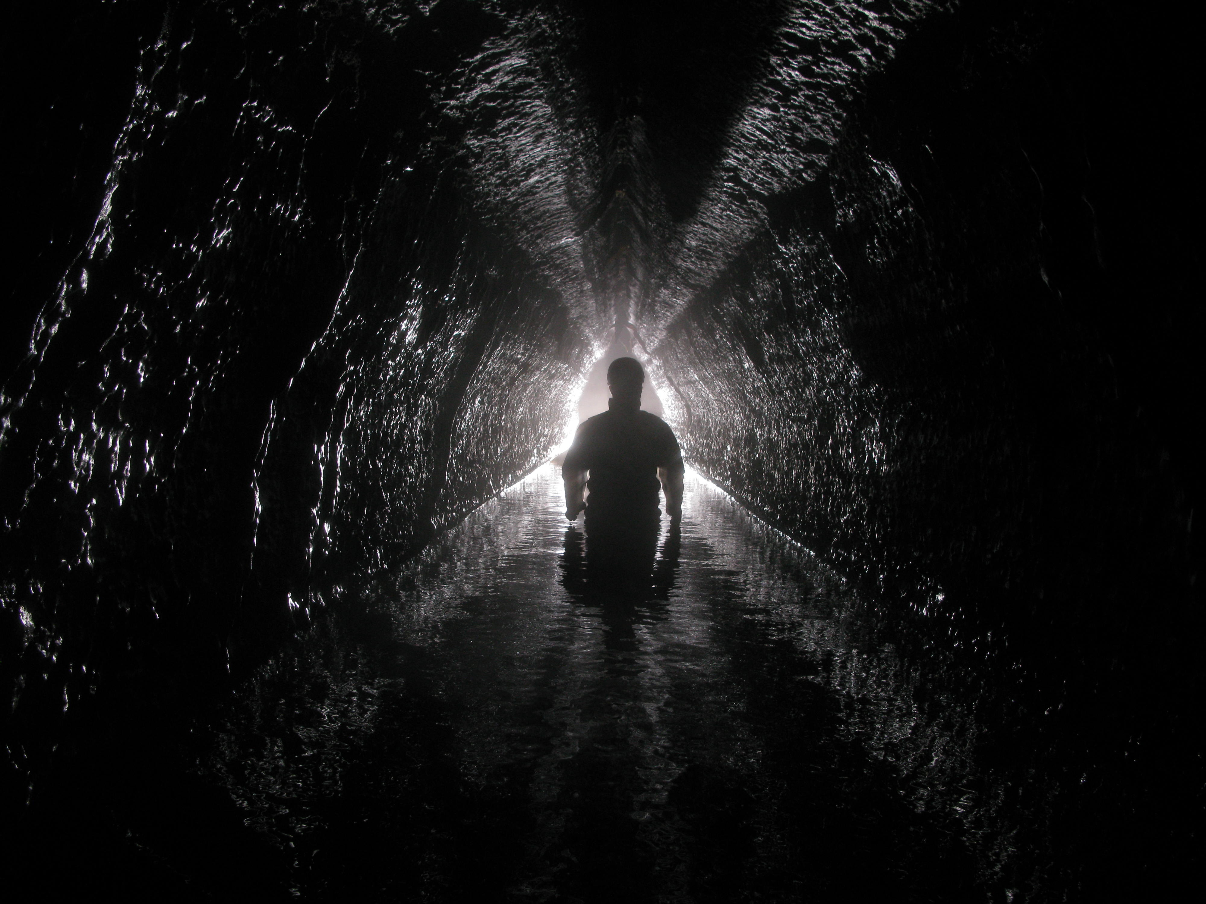

Modeling the impacts of cave ventilation and CO₂ dynamics on speleogenesis
Matt Covington – U. of Arkansas & Karst Research Institute, Slovenia
Max Cooper – Institute for Theoretical Physics, Warsaw
Franci Gabrovšek - Karst Research Institute, Slovenia

Slide 2
Approximately a decade of field-based research has demonstrated that CO₂ dynamics are a primary control on the spatial and temporal patterns of calcite dissolution within caves and streams incising carbonates
Conclusions from this work include:
1. Patterns of CO₂ degassing and production can control longitudinal changes in dissolution rates along karst streams (Covington et al. [2013]). These processes produce feedbacks between stream morphology and incision rate.
2. Variation of CO₂ within karst streams over time is the strongest control of time-variability in dissolution rates (Covington et al. [2015]).
3. Cave ventilation patterns can be a stronger control of dissolution rate variation over time within cave streams than storms (Covington et al. [in prep]).
4. The onset of ventilation within karst systems as they mature likely produces a strong reduction in the overall rates of dissolution as well as changes in the spatial patterns of dissolution (Covington and Vaughn [2019] and Covington et al. [in prep]).
Further bibliographic details are provided on the final slide for all cited manuscripts.
photo: Matt Covington
Notes:
We'll start with the first question …
But first, many of you are probably wondering who this mysterious figure is. I'm going to reveal that to you, and he will answer the question for me. But his answer is cryptic

Slide 3
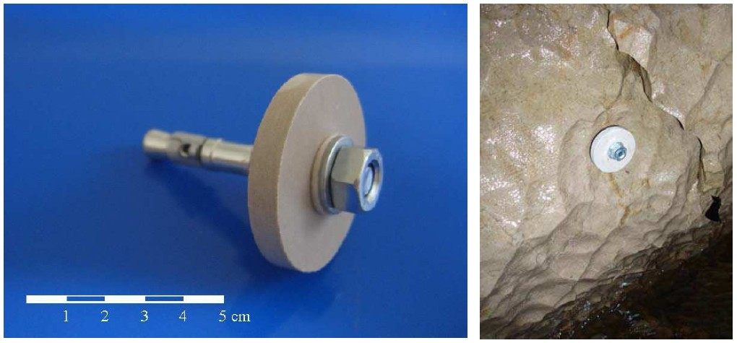
1. Longitudinal contrasts in dissolution rates
Limestone tablets used to estimate dissolution rates in the field
(Prelovšek, 2009)

Slide 4
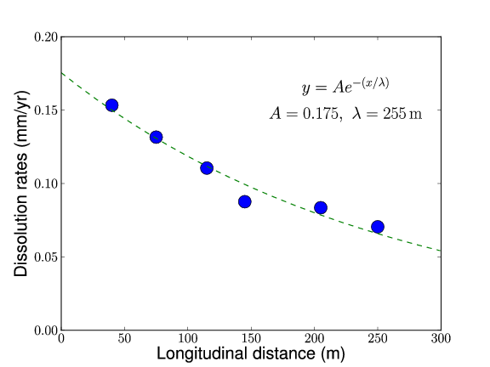
Why?
Measured dissolution rates decrease exponentially with
distance from entrance, with a length scale of ~250 m.
Rates are average rates from April 2007- April 2009.

Slide 5
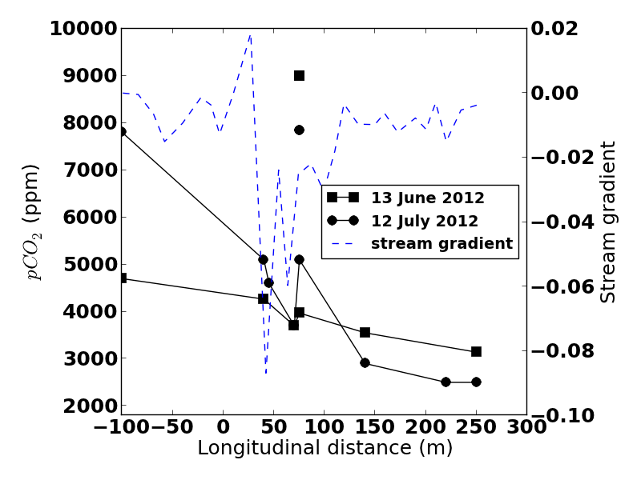
Longitudinal changes in dissolution caused by changes in CO2 induced by stream gradient
(For details see Covington et al. 2013, Geomorphology.)

Slide 6
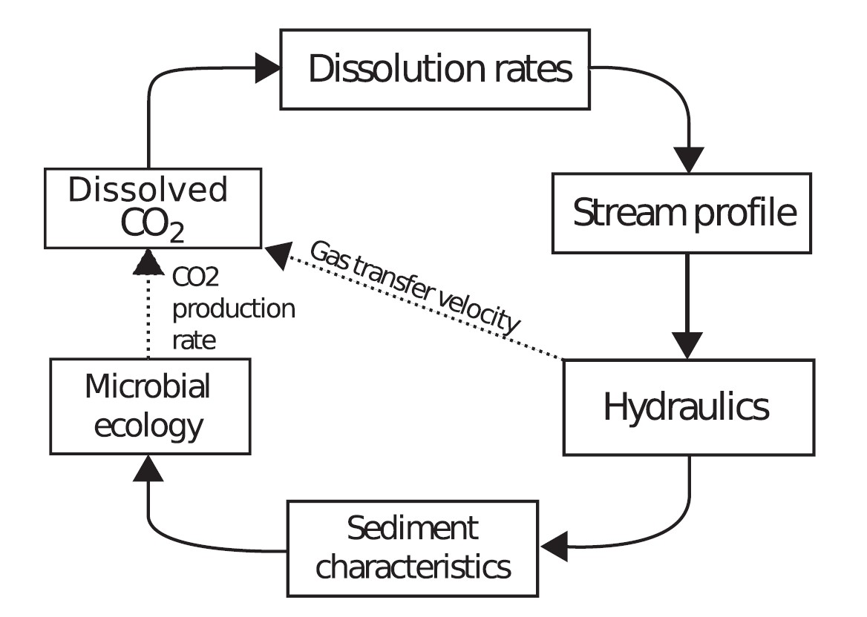
Geomorphological feedback mechanisms
(Covington et al. 2013, Geomorphology)

Slide 7
2. Time variability in dissolution rates.
(Covington et al. 2015, Geophys. Res. Lett.)

Slide 8
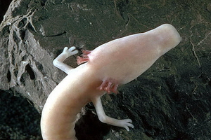
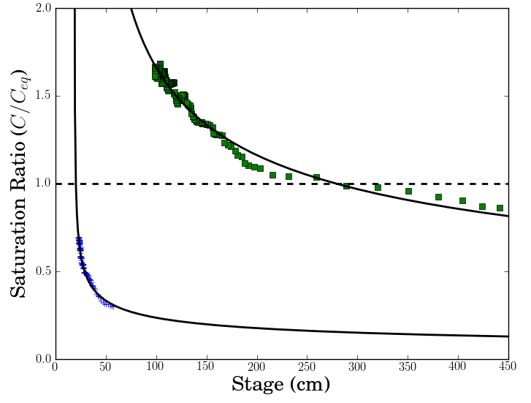
Olm
A python package for water chemistry
calculations and processing USGS
water quality data.
Automated download of USGS Water Quality data from
online database given a list of sites and desired data
Batch speciation calculations in PHREEQC for all
downloaded data
Functions for common water chemistry calculations and
estimation of calcite dissolution rates for a given chemistry
Automated production of plots and statistical calculations
Functionality for automated journal article production not yet
implemented...
Available on Github
Postojna Cave
(typically saturated)
Lekinka Cave
(typically undersaturated)

Slide 9
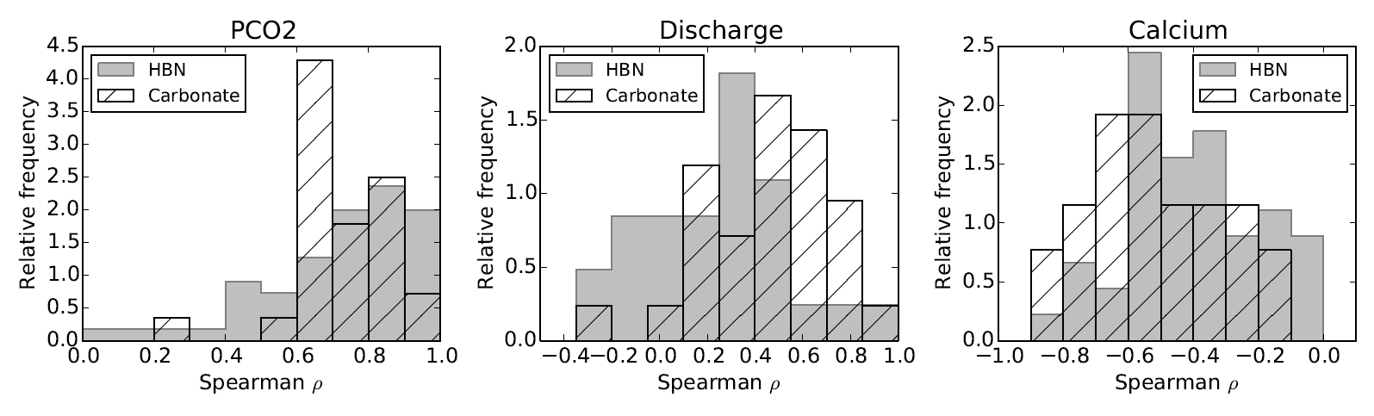
CO₂ is the strongest control on at-a-site variability in dissolution rate
Correlation coefficients calculated between dissolution rates and various potential controls to characterize at-a-site variability.
(Covington et al. 2015, Geophys. Res. Lett.)

Slide 10
3. Cave ventilation can control dissolution rates
Time series of dissolved and gaseous CO2 within a cave stream (Blowing Springs Cave, Arkansas, USA) and how they relate to the chimney-effect driven airflow patterns in the cave.
[Covington et al. (in prep)]

Slide 11
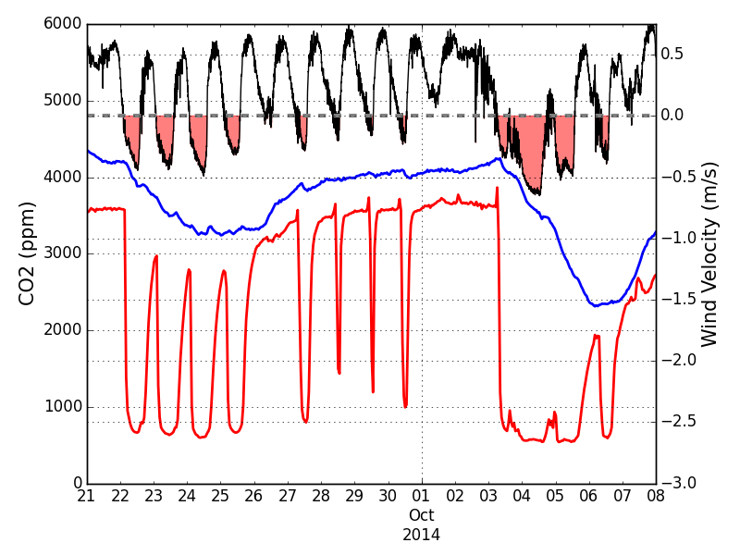
Airflow drives CO₂ dynamics in Blowing Spring Cave
Airflow velocity
Airflow reversals
CO2 water
CO2 air

Slide 12
Dissolution rates a strong function of airflow direction
Time variation in dissolution rates is more strongly controlled by airflow direction than storm events.
Airflow
Storms
Almost no dissolution occurs in winter!
[Covington et al. (in prep)]

Slide 13
Airflow Discharge
Short term
Day
Week
Month
Long term

Slide 14
Summer regime – stream connected to CO2 source
Arrows indicate direction of cave air flow. Two-way arrows indicate CO2 exchange between air and water, which is accentuated in winter.
CO2 Source

Slide 15
Winter regime – stream disconnected from CO2 source
Arrows indicate direction of cave air flow. Two-way arrows indicate CO2 exchange between air and water, which is accentuated in winter.
CO2 Source

Slide 16
4. Onset of ventilation reduces dissolution rates
Langle
Divergent flow
Sinking Stream
Here we studied an overflow-underflow system, where the unventilated underflow spring (Langle) represents earlier stages of karst conduit development and the overflow (Copperhead),which is intermittently ventilated, represents a more mature stage.
Copperhead
[Covington and Vaughn (2019), Chemical Geology]

Slide 17
CO₂ Dynamics at the Springs
Higher CO2 at Underflow
Overflow
Underflow
Onset of ventilation at overflow
[Covington and Vaughn (2019), Chemical Geology]

Slide 18
Calcite Saturation at the Springs
Overflow
Underflow
Overflow spring is only aggressive during
high CO2 and/or high flow
Underflow spring is always aggressive
[Covington and Vaughn (2019), Chemical Geology]

Slide 19
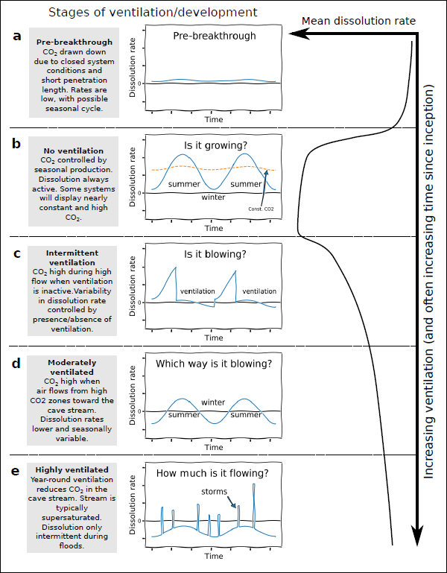
Conceptual model for how ventilation impacts cave development over the lifetime of a karst system. This framework is based on our work on CO2 from the sites presented here, as well as two other studies available in the literature (Groves and Meimann [2005] and Palmer [2007]). (a) Before breakthrough, closed system conditions limit dissolution rates. (b) After breakthrough but before onset of ventilation, dissolution rates are maximal. (c) With intermittent ventilation, the timing of ventilation is a strong control on dissolution rates, but average rates decrease. (d) With moderate ventilation, airflow direction controls rates. (d) For strongly ventilated systems, storms are a dominant control of variation.
Covington et al. [in prep]

Slide 20
Modeling the impacts of cave ventilation and CO2 dynamics on speleogenesis
While we have gained some general conceptual understanding of the impact of CO2 dynamics on karst evolution, it remains difficult to understand more precisely what the implications are for the morphology of karst conduits. Here we develop a new speleogenesis model to begin quantitative exploration of the impacts of these processes and present some initial results from this new model.
The model includes:
1. Calculations of CO2 transport within air and water phases and exchange between those phases.
2. Evolution of cave passage cross-sectional shape (based on Cooper and Covington [in press], ESPL).
3. Calculation of ventilation rate through air-filled portion of cave passage.
4. Calcite dissolution according to a transport-limited rate model, whereby dissolution rates scale with the square root of boundary shear stress.

Slide 21
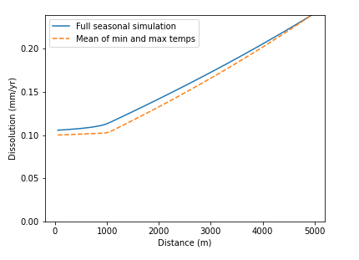
Seasonal ventilation cycles
One of the first challenges in simulating how ventilation impacts cave evolution is the strong separation of timescales involved (seasonal, or even daily, ventilation cycles versus the thousands of years timescales of cave evolution). Here we find that the dissolution rates calculated within a full seasonal temperature cycle are closely approximated by averaging the rates calculated on the days with the minimum and maximum temperatures.

Slide 22
Simulation setup
Simulations are 1D along a single conduit with multiple cross-sections.
We ran pairs of simulations with and without CO2 exchange and ventilation to examine the impact of CO2 dynamics.
Simulations with CO2 dynamics use a scheme where dissolution rates from minimum and maximum external temperature conditions are averaged (as in previous slide).
A rate of base-level fall is prescribed at the furthest downstream node, and morphology adjusts to accommodate incision at that rate (examples shown here use 0.25 mm/yr).
Upstream dissolved CO2 is fixed at 5000 ppm. The "upstream" boundary for gaseous CO2 switches with airflow direction and is set to 4000 ppm for summer conditions and 400 ppm for winter conditions. These values are all motivated by ranges observed at Blowing Springs Cave.
Upstream dissolved load is fixed at 80% of saturation.

Slide 23
What impact does CO2 exchange itself have on the evolution of a single channel?
Without CO2 exchange​
With CO2 exchange
The introduction of cave ventilation and CO2 exchange between air and water produces strong contrasts in both dynamics and equilibrium state. Black lines represent cave cross-sections and blue lines represent water levels.
Note that passage shape is distorted to enable clear visualization (all three axes have different scales). Numbers on axes denote meters.

Slide 24
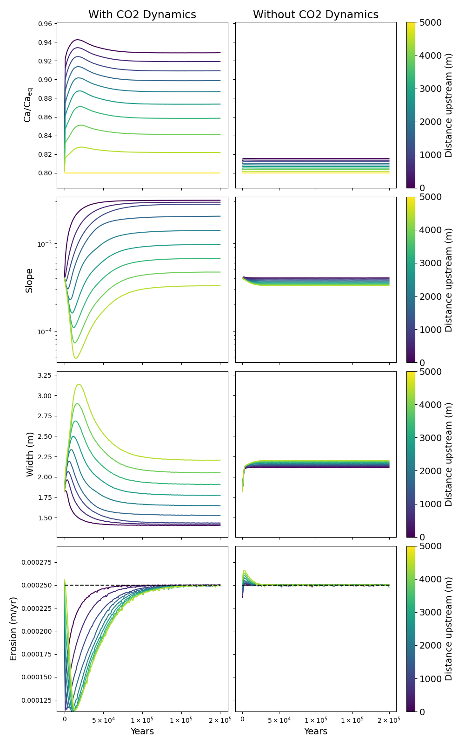
Evolution of chemistry, morphology and erosion rates over time, displayed for each cross-section from upstream (light colors) to downstream (darker colors).
The simulation without CO2 dynamics (right column) quickly adjusts to an equilibrium state where erosion rates for all cross-sections are equal to the rate of base-level fall (dashed line, lowest row).
For the simulation with CO2 dynamics (left column), downstream chemistry is substantially closer to saturation and initial erosion rates are consequently lower. Slope and width co-adjust until equilibrium is reached. In this equilibrium state, the channel is narrower and steeper downstream to compensate for the higher degree of saturation.

Slide 25
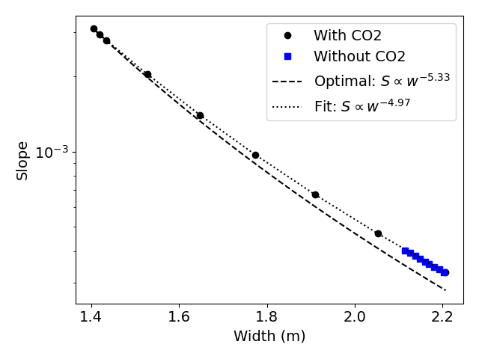
Co-adjustment of width and slope
Slope and width co-adjust in a way similar to that suggested previously in the bedrock channel literature (dashed line, Turowski [2007]). That is, slope is optimized to the minimum possible value that can produce the required rate of erosion.
This adjustment occurs for simulations both with and without CO2 dynamics. However, the CO2 dynamics create substantial constrasts in both width and slope along the channel.

Slide 26
Conclusions
The processes of CO₂ exchange, production, and transport within dissolved and gaseous phases are important drivers of spatial and temporal variation in calcite dissolution.
Cave ventilation itself can be a strong control on the timing and patterns of cave evolution.
CO₂ dynamics can produce adjustments to channel morphology, including zones of steepening and narrowing that compensate for reduced dissolutional capacity of the water.

Slide 27
Bibliography (1/2)
Cooper, M.P. and M.D. Covington (in press). Modeling cave cross-section evolution including sediment transport and paragenesis, Earth Surface Processes and Landforms. (online soon)
Covington, M. D., Prelovšek, M., & Gabrovšek, F. (2013). Influence of CO2 dynamics on the longitudinal variation of incision rates in soluble bedrock channels: Feedback mechanisms. Geomorphology, 186, 85-95.
Covington, M. D., Gulley, J. D., & Gabrovšek, F. (2015). Natural variations in calcite dissolution rates in streams: Controls, implications, and open questions. Geophysical Research Letters, 42(8), 2836-2843.
Covington, M. D., & Vaughn, K. A. (2019). Carbon dioxide and dissolution rate dynamics within a karst underflow-overflow system, Savoy Experimental Watershed, Arkansas, USA. Chemical Geology, 527, 118689.
Covington, M.D., Knierim, K., Young, Y., Rodriguez, J., and H. Gnoza (in prep). Cave airflow patterns control calcite dissolution rates within a cave stream: Blowing Springs Cave, Arkansas, USA. (will be on Earth ArXiv soon!)

Slide 28
Bibliography (2/2)
Groves, C., & Meiman, J. (2005). Weathering, geomorphic work, and karst landscape evolution in the Cave City groundwater basin, Mammoth Cave, Kentucky. Geomorphology, 67(1-2), 115-126.
Palmer, A. N. (2007). Variation in rates of karst processes. Acta Carsologica, 36(1).
Turowski, J. M., D. Lague, and N. Hovius (2007), Cover effect in bedrock abrasion: A new derivation and its implications for the modeling of bedrock channel morphology, J. Geophys. Res., 112, F04006.

