Slide 1

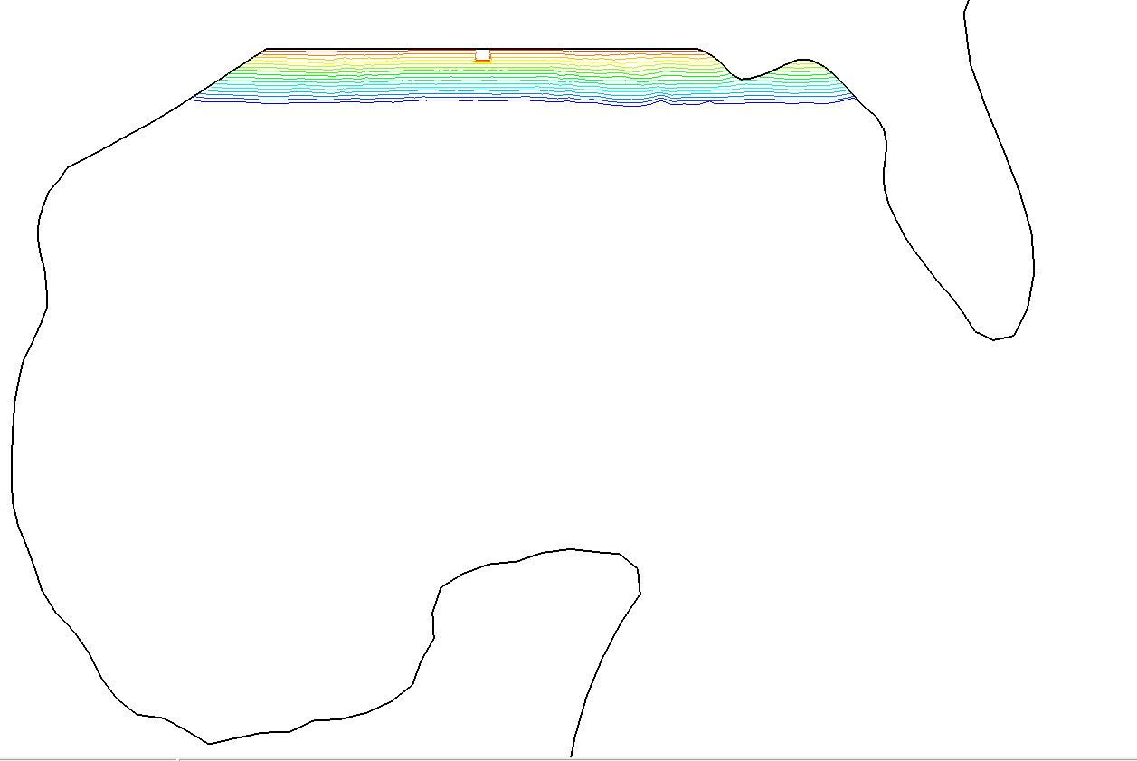

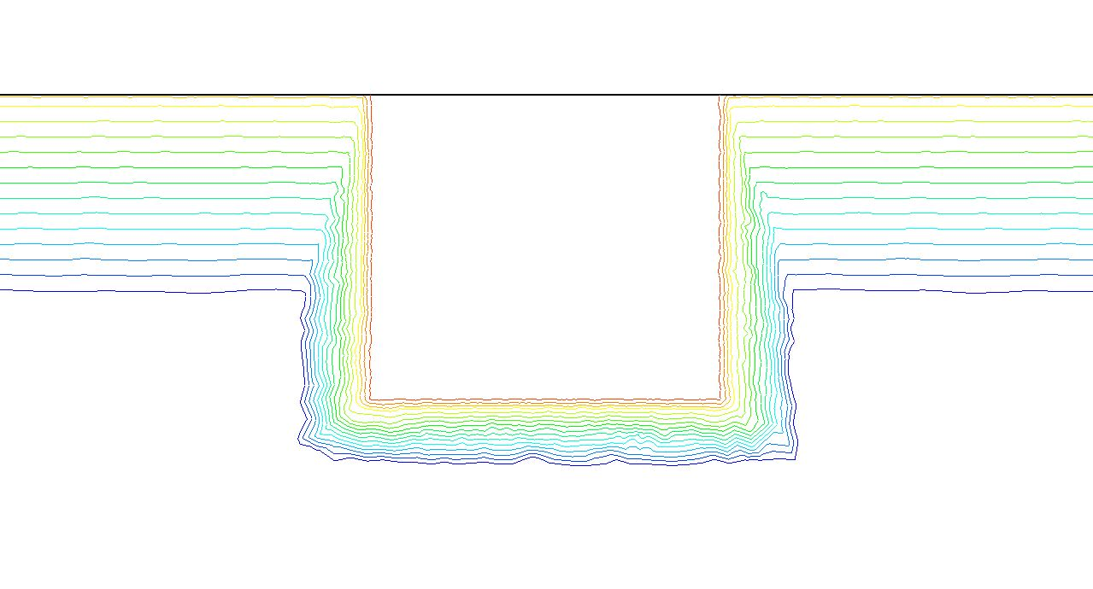



Parameterization of Coastal Wetlands and Their Role in Back Bay Hydrodynamics
Mary A. Cialone and Greg Slusarczyk
US Army Corps of Engineers (USACE) Engineer Research & Development Center (ERDC)
United States
Gulf of Mexico
European Geophysical Union Vienna, Austria 8 May 2020

Slide 2
Presentation Topics
Idealized Wetlands – Numerical Simulations and Analysis
  Elevation
  Vegetation type
  Continuity
New Jersey Bay Bay – Numerical Simulations and Analysis
  Restoration of Wetlands

Slide 3
Idealized Wetland – Elevation Variation
United States
Elevation, m
0.5 m (above MSL) - emergent
0.2 m (below MSL) - submerged
0.6 m (below MSL) - submerged
1.8 m (below MSL) - submerged
3.0 m (below MSL) - submerged
Gulf of Mexico
Coastal AND Inland Flooding
Potential for future flood hazards
Radius at Landfall (km) | Pressure at Landfall (mb) | Surge Potential (m)
20.4 | 975 | 1.8
38.9 | 975 | 2.2
38.9 | 941 | 3.5
20.4 | 900 | 4.4
38.9 | 900 | 5.2
74.1 | 900 | 6.0

Slide 4
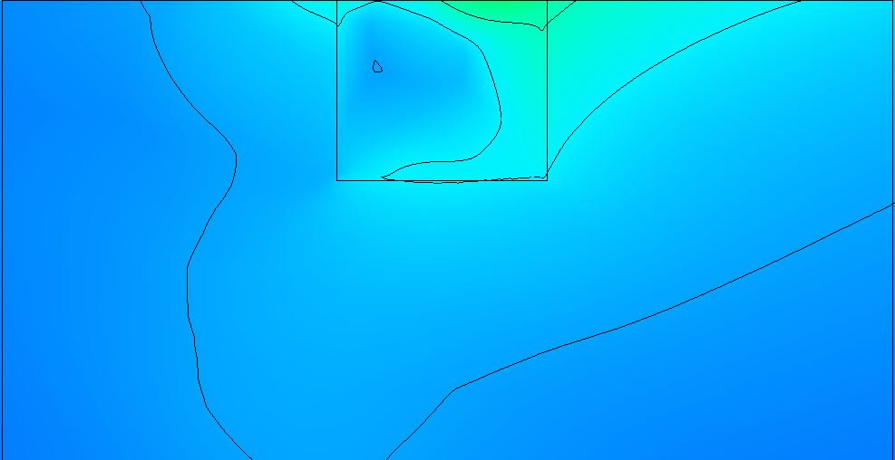
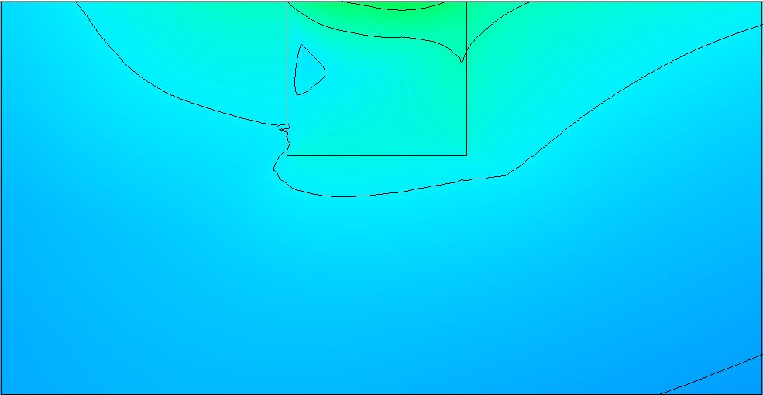
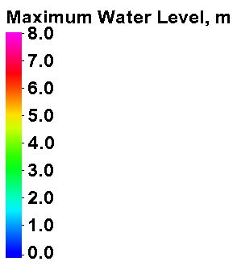
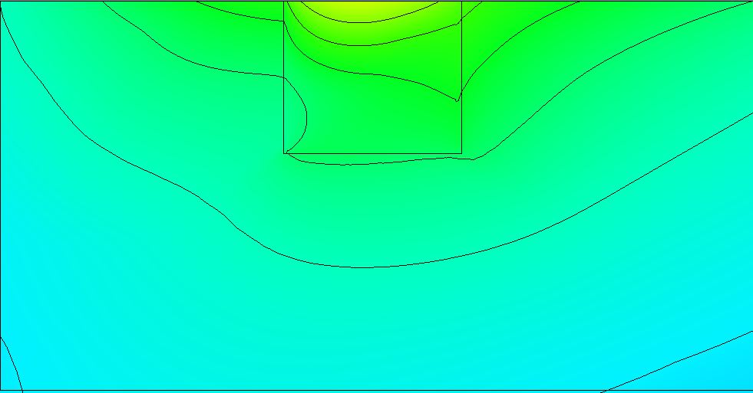
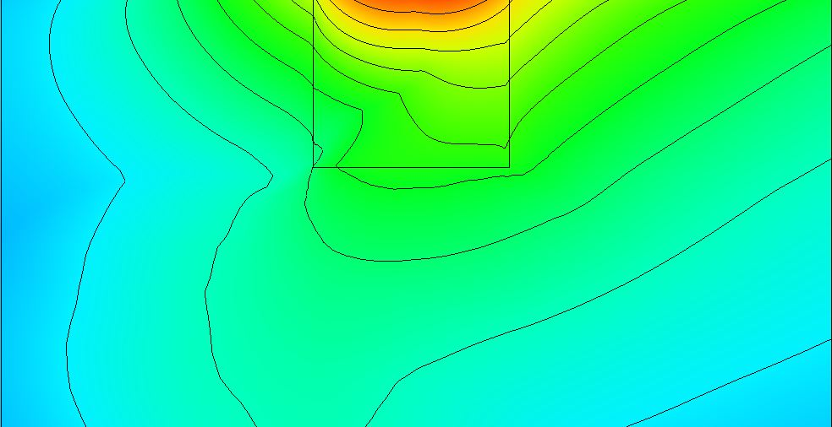
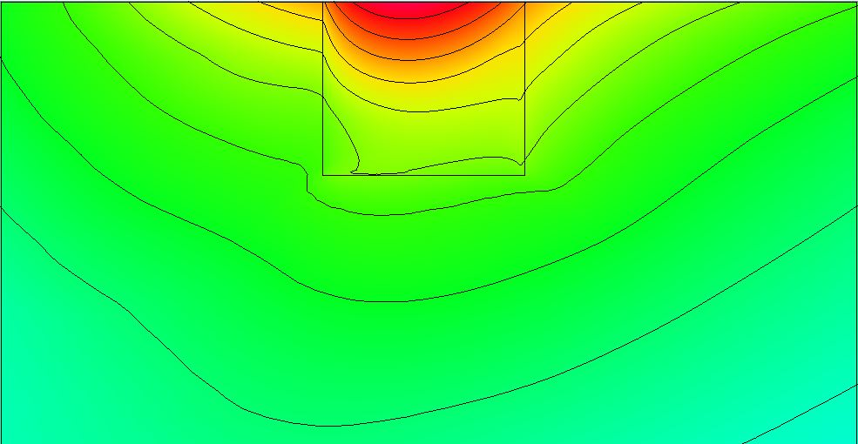
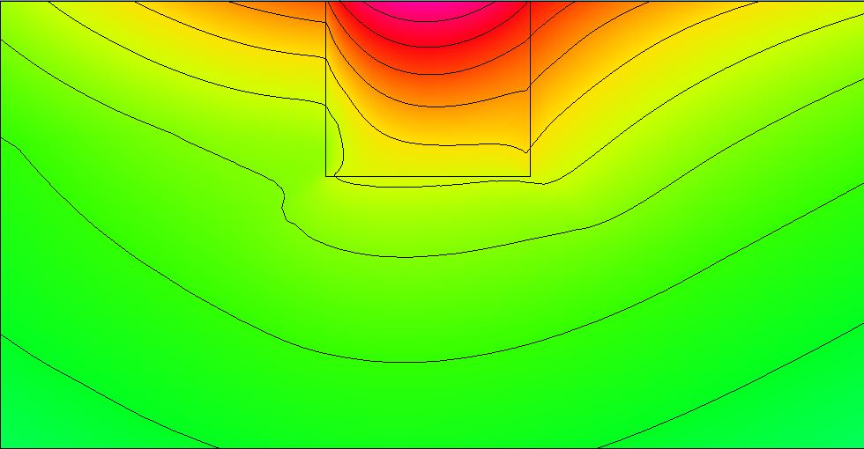
Idealized Wetland - Base Surge Response
1.8 m
2.2 m
Coastal AND Inland Flooding
Potential for future flood hazards
Surge Potential (m)
1.8
2.2
3.5
4.4
5.2
6.0
3.5 m
4.4 m
5.2 m
6.0 m

Slide 5
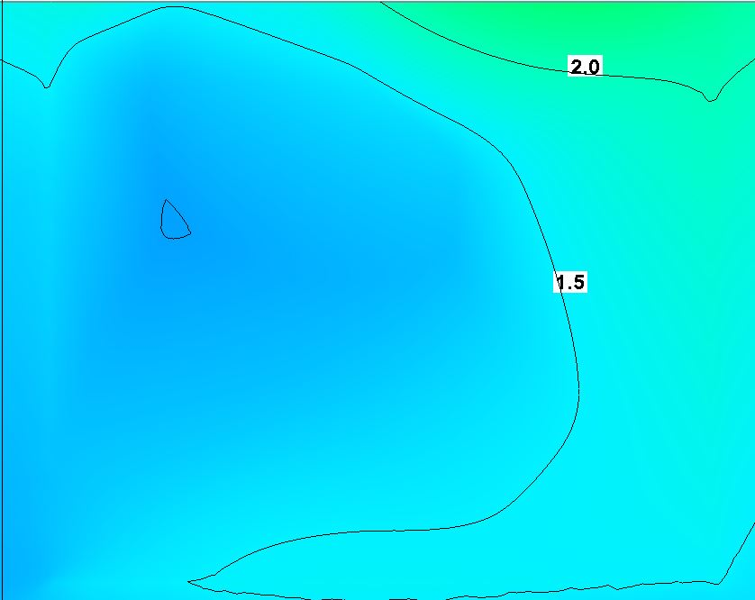
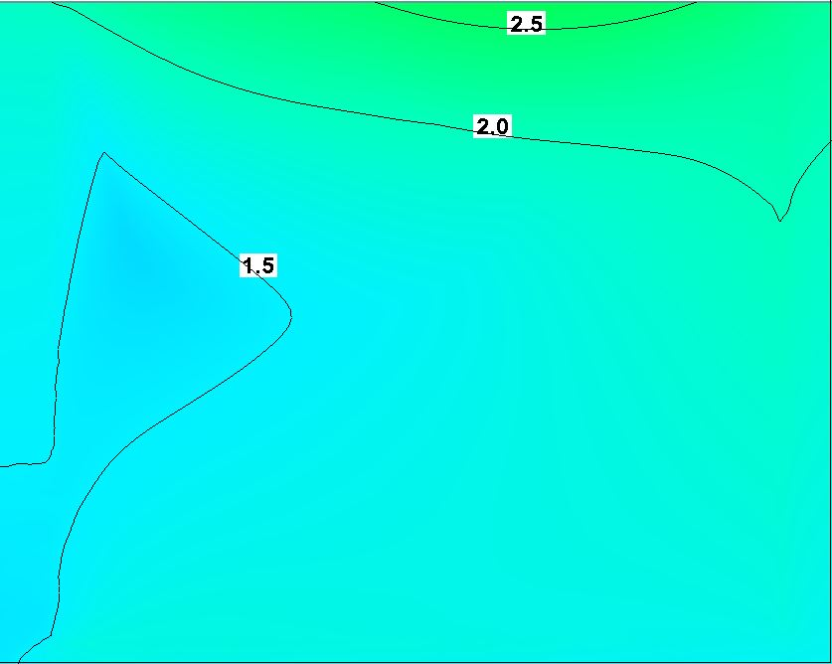
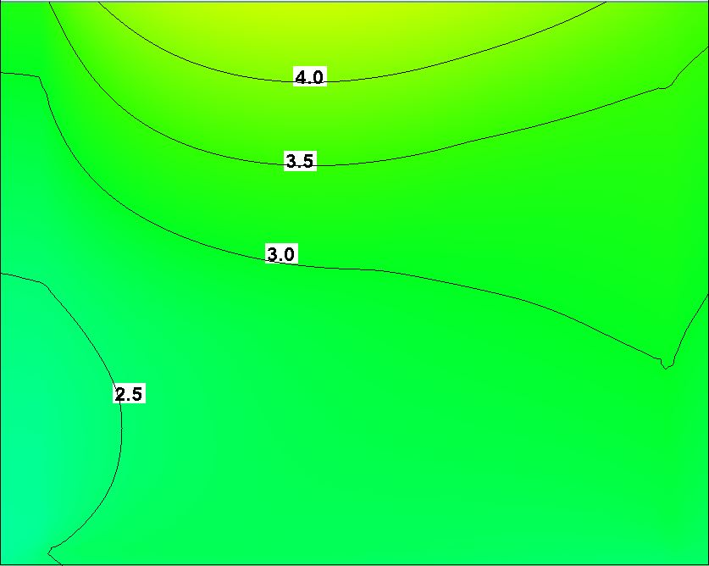
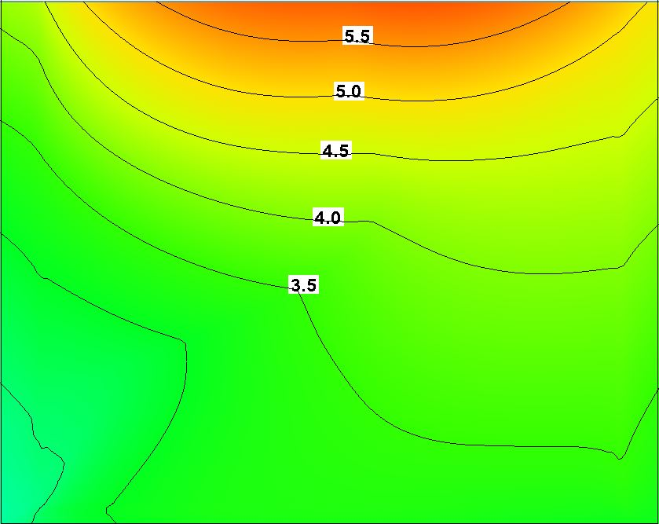
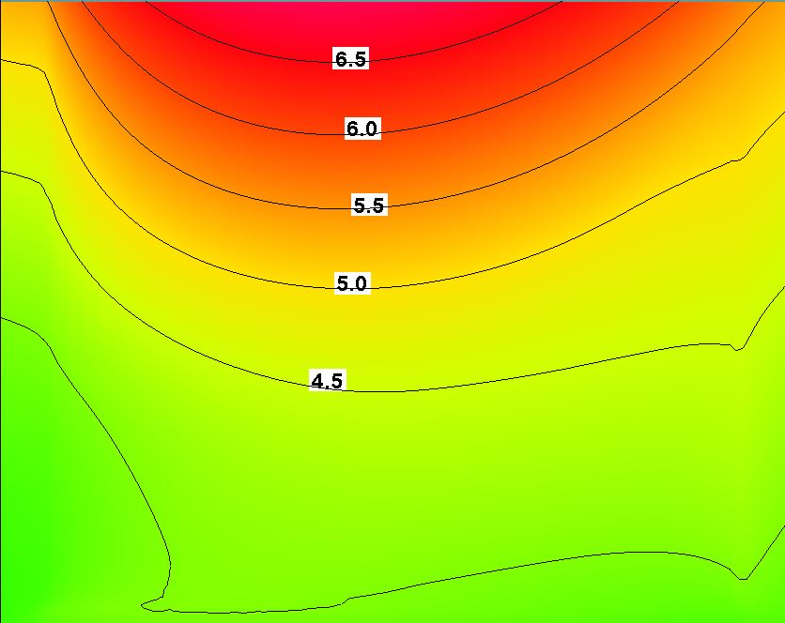
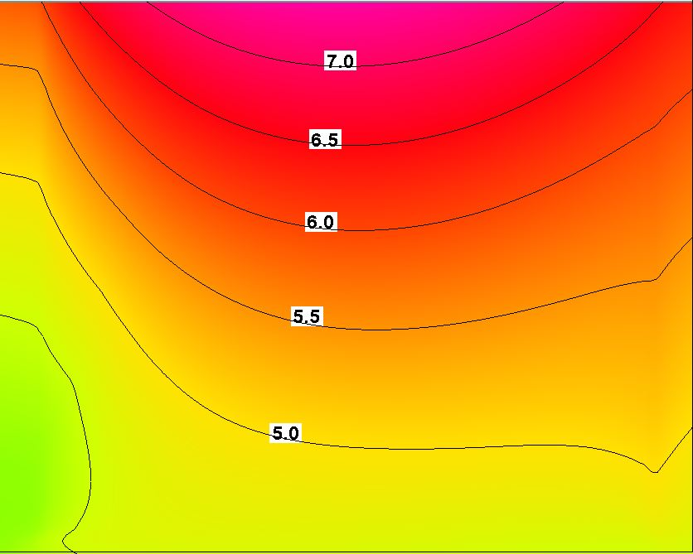
Idealized Wetland - Base Surge Response
1.8 m
2.2 m
Coastal AND Inland Flooding
Potential for future flood hazards
Surge Potential (m)
1.8
2.2
3.5
4.4
5.2
6.0
3.5 m
4.4 m
5.2 m
6.0 m

Slide 6
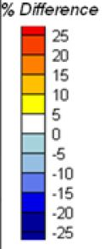
1.8
2.2
3.5
4.4
5.2
6.0
Wetland Elevation, m
-0.2 -0.6 -1.8 -3.0
Surge Potential
m
Difference in Peak Surge with Decreasing Wetland Elevation
Base = +0.5 m
(Emergent)
Coastal AND Inland Flooding
Potential for future flood hazards
Surge inversely proportional to depth, except for the storms with low surge potential
Generally, decrease in surge with decrease in bed elevation
Small storms – base case remains dry until water level is above 0.5 m, whereas for the lower elevation, the marsh is always inundated.

Slide 7
Idealized Wetland - Vegetation
United States
Gulf of Mexico
Coastal AND Inland Flooding
Potential for future flood hazards
Manning’s n
0.020
0.035
0.050
0.075
0.150
0.300
Radius at Landfall (km) | Pressure at Landfall (mb) | Surge Potential (m)
20.4 | 975 | 1.8
38.9 | 975 | 2.2
38.9 | 941 | 3.5
20.4 | 900 | 4.4
38.9 | 900 | 5.2
74.1 | 900 | 6.0

Slide 8
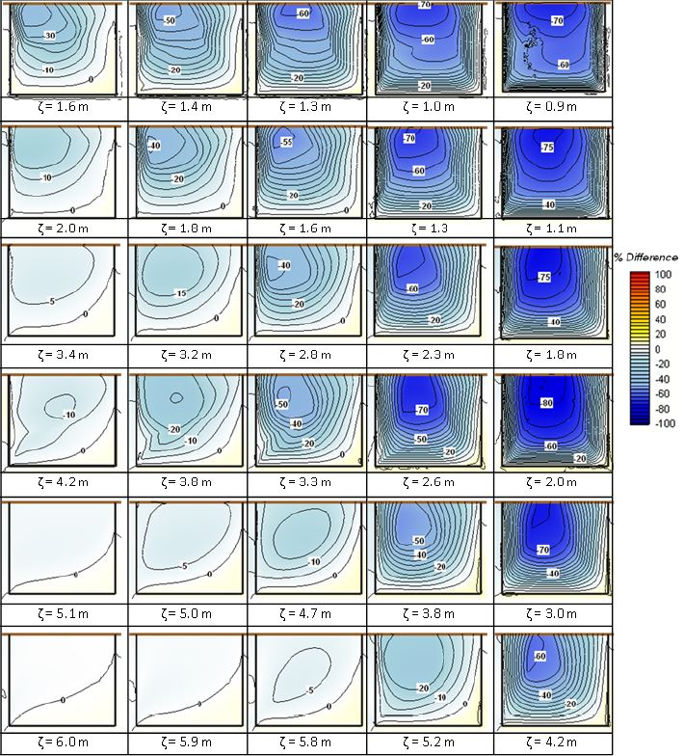
Surge Potential
m
Friction Coefficient
0.035 0.050 0.075 0.150 0.300
1.8
2.2
3.5
4.4
5.2
6.0
Difference in Peak Surge with Increasing Friction (Vegetation)
Base = 0.020
Surge reductions greater for higher friction/vegetation
Sensitivity of storm surge to bottom friction decreases with increased surge potential
Exception surge potential of 4.4 m due the storm characteristics and sensitivity to alongshore surge distribution
Coastal AND Inland Flooding
Potential for future flood hazards

Slide 9
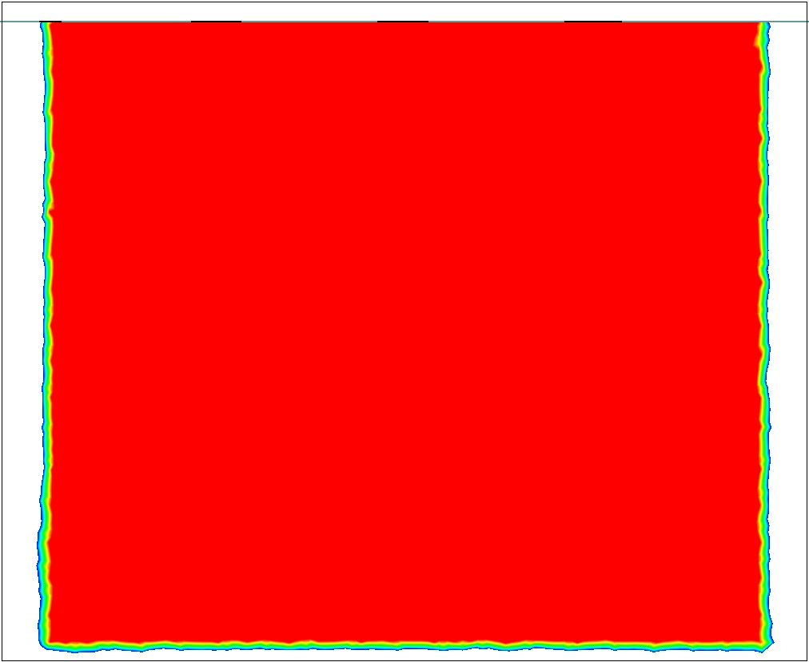
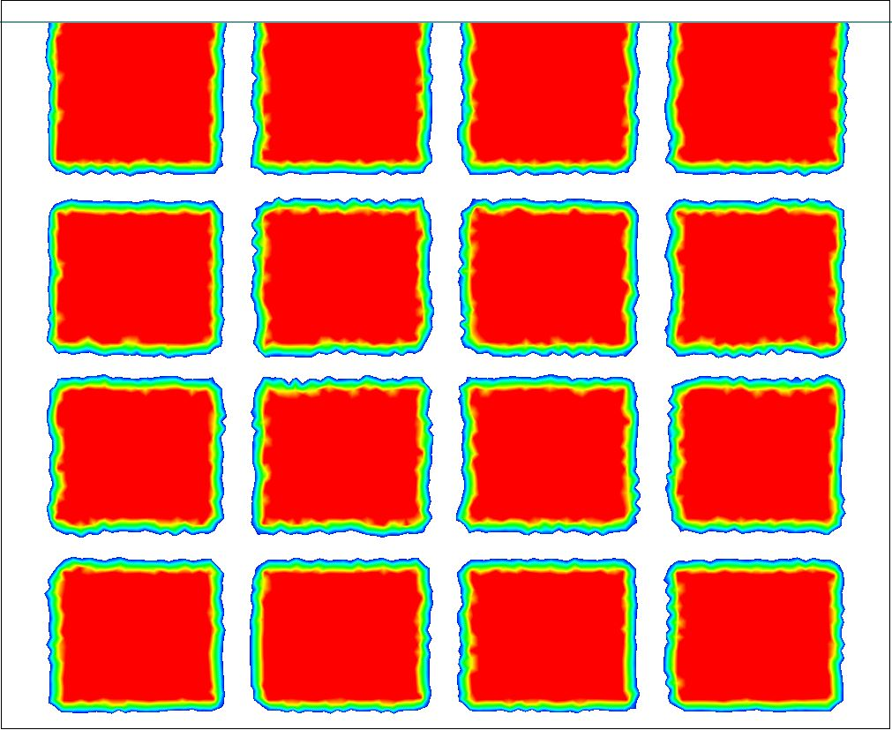
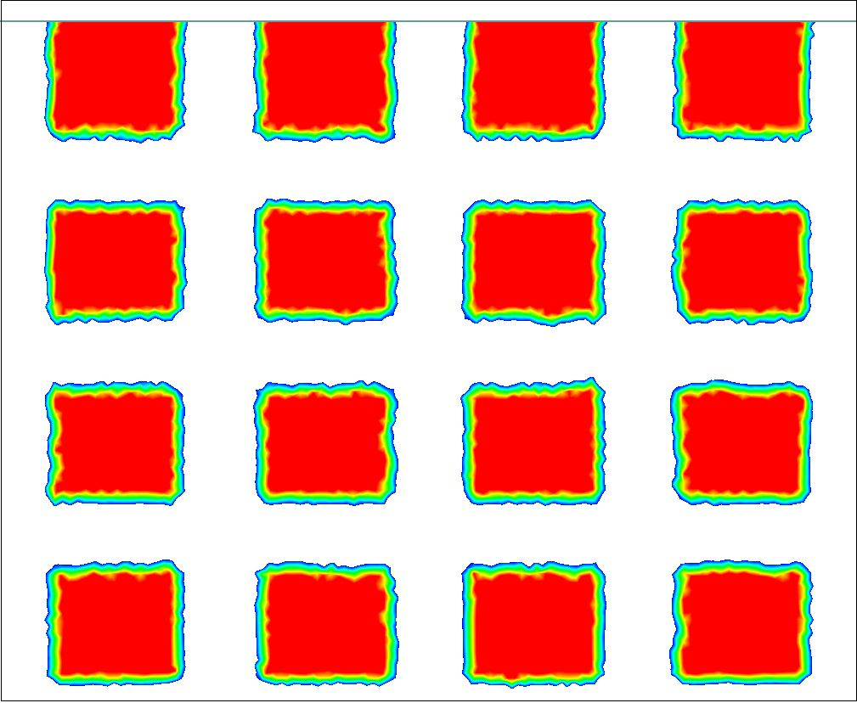
Idealized Continuity
United States
Gulf of Mexico
Potential for future flood hazards
n = 0 .035
Radius at Landfall (km) | Pressure at Landfall (mb) | Surge Potential (m)
20.4 | 975 | 1.6
38.9 | 975 | 2.0
38.9 | 941 | 3.4
20.4 | 900 | 4.2
38.9 | 900 | 5.1
74.1 | 900 | 6.0

Slide 10
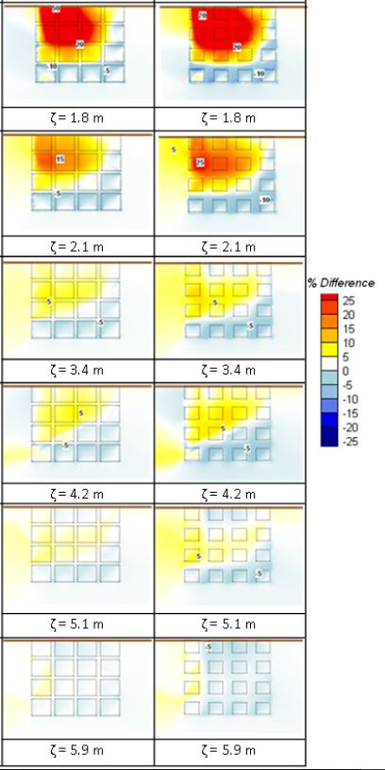
Continuity
75% 50%
Surge Potential
m
1.6
2.0
3.4
4.2
5.1
6.0
Difference in Peak Surge with Decreased Wetland Continuity
Base = 100%
(continuous)
Lowest four surge potential cases show an increase in surge as wetland become less continuous (channels allow surge to propagate through the wetland)
Large surge potential storms show a decrease as the channels convey water OUT of the marsh rather than piling up
Coastal AND Inland Flooding
Potential for future flood hazards

Slide 11
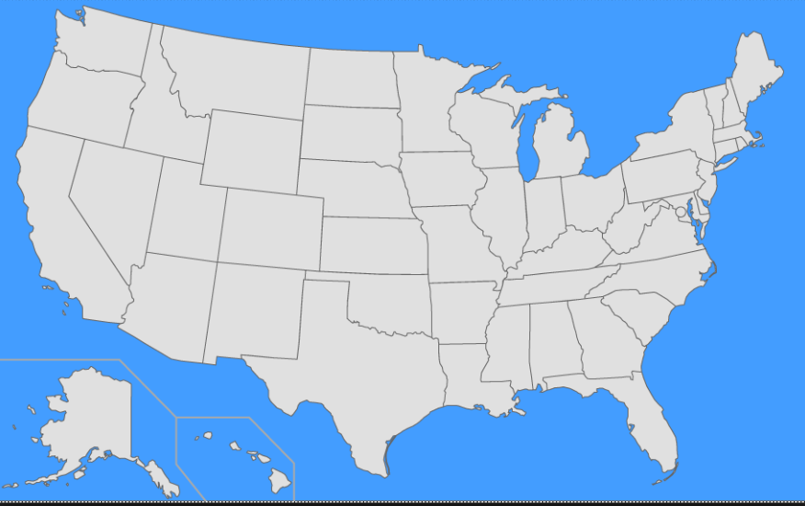
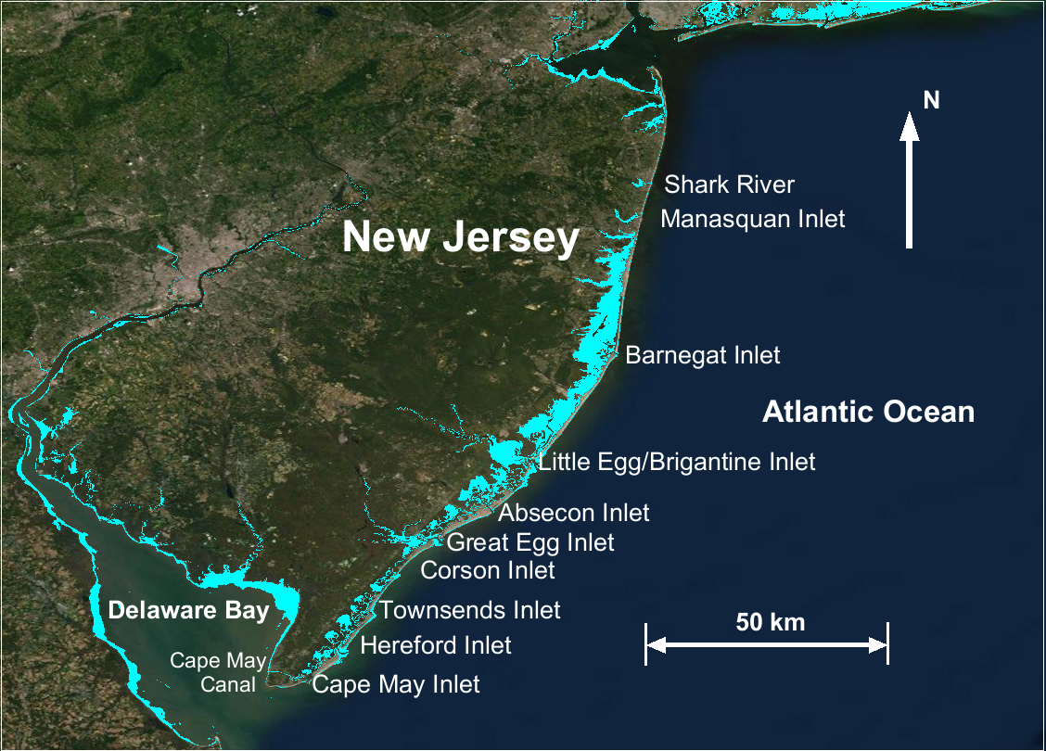
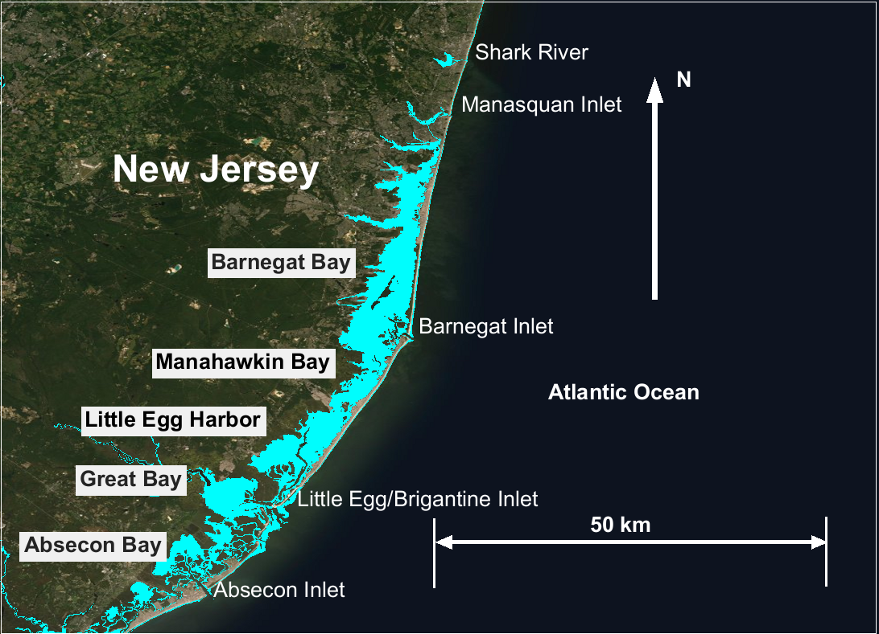
The Setting: New Jersey Back Bays, U.S.A.
United States
Inlet
Inlet
Two rivers: Shark and Manasquan
Barnegat Bay: largest 59 sq mi
3-Bays: 126 sq mi; 68%
Southern: closely spaced; connected; 1/3 of total bay area
Little Egg/Brigantine – widest opening

Slide 12
Wetland Restoration Research Plan
Numerical Evaluation of wetland restoration configurations
Purpose: potential flood risk reduction to:
Coastal population
Property
Infrastructure
Ecosystems
Two-dimensional, depth averaged ADCIRC hydrodynamic model to simulate surge propagation in response to forcing from synthetic tropical cyclone events
Synthetic tropical storms generated jointly by OceanWeather Inc. (OWI)/ERDC as part of the NACCS

Slide 13
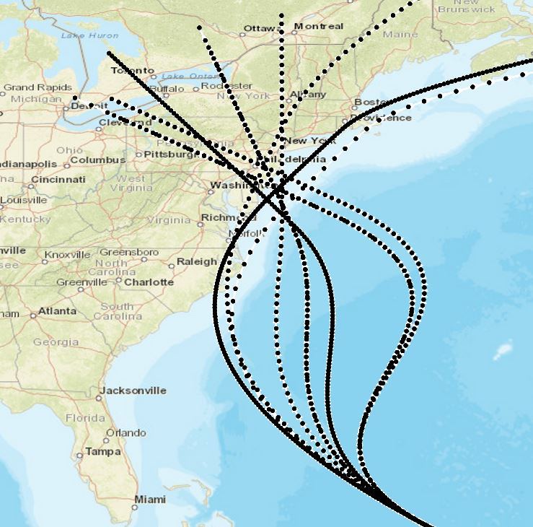
Selected Storms
4hra
ara
NJBB Storms | Landfall Angle (deg N) | Central Pressure Deficit (hPa) | Rmax (km) | Forward Speed (km/hr)
1 | -40 | 88 | 65 | 16
2 | -60 | 78 | 125 | 65
3=350 | -60 | 68 | 52 | 26
4 | -60 | 58 | 88 | 28
5 | -20 | 88 | 55 | 62
6 | -20 | 78 | 82 | 27
7 | 0 | 78 | 74 | 38
8 | 20 | 78 | 73 | 38
9=636 | 40 | 78 | 47 | 14
10 | 40 | 83 | 67 | 59
JPM-OS: requires MANY storms to cover forcing probability space
Design of Experiment (DoE): uses surrogate modeling and NACCS storm database
  Optimized storm selection capability
  Replicate full storm hazard curves

Slide 14
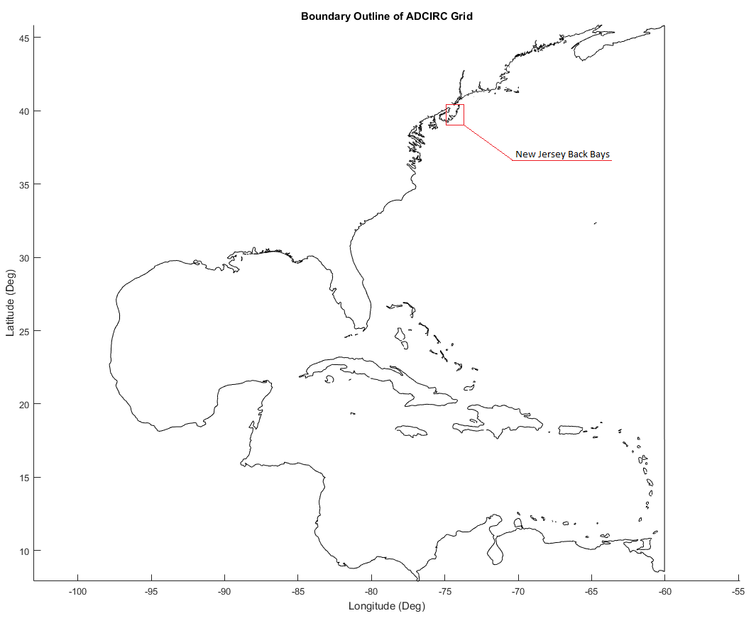
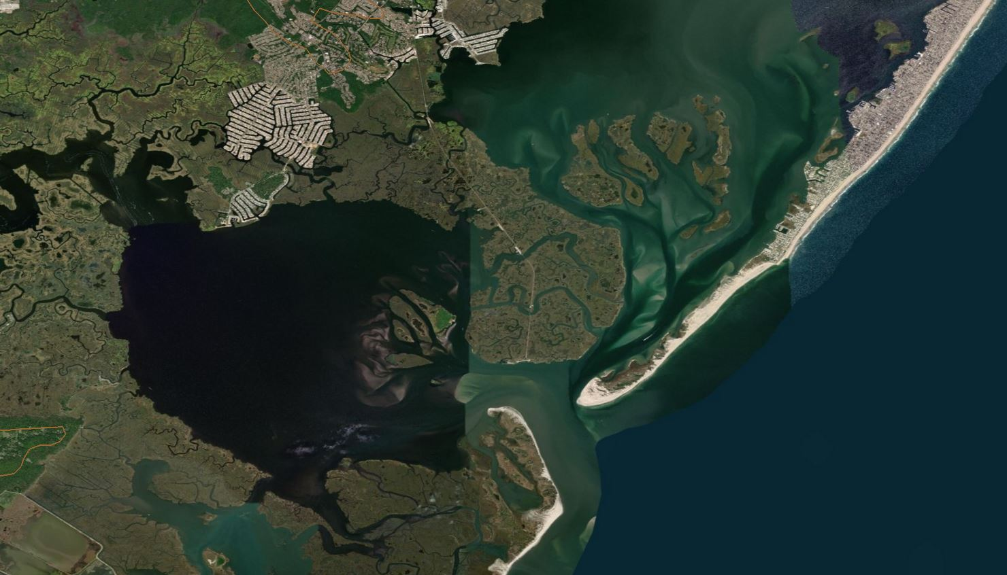
Numerical Mesh and Restored Wetlands at Holgate
Existing Wetlands
New Jersey Back Bays
U.S.A.
Atlantic Ocean
Gulf of Mexico
Numerically Restored Wetlands

Slide 15
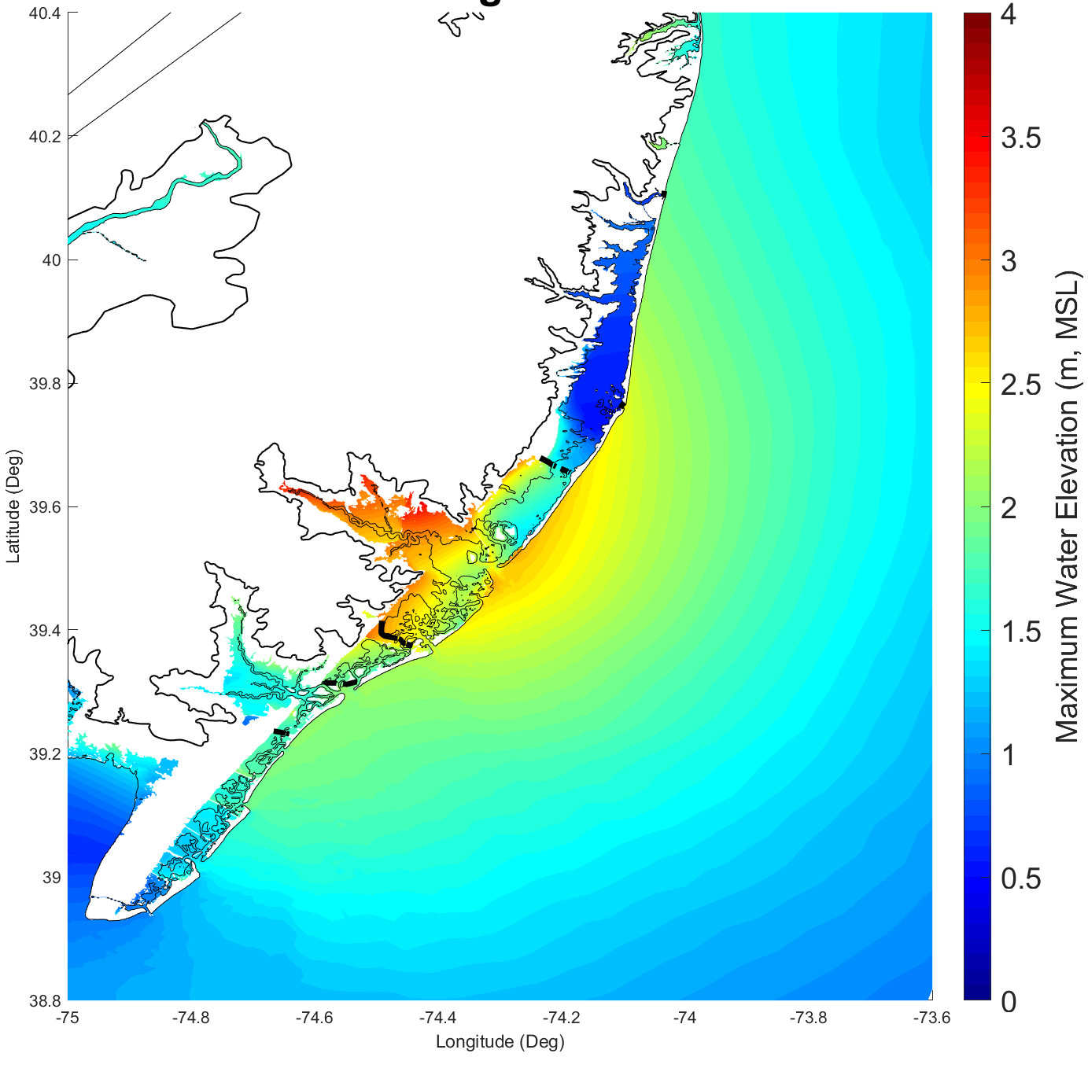
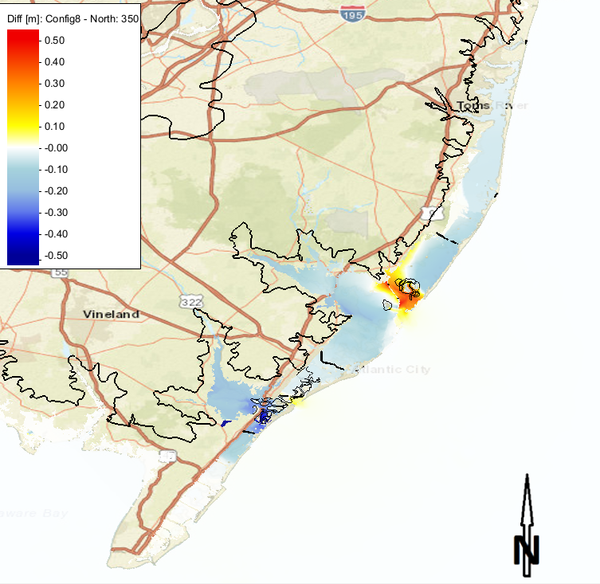
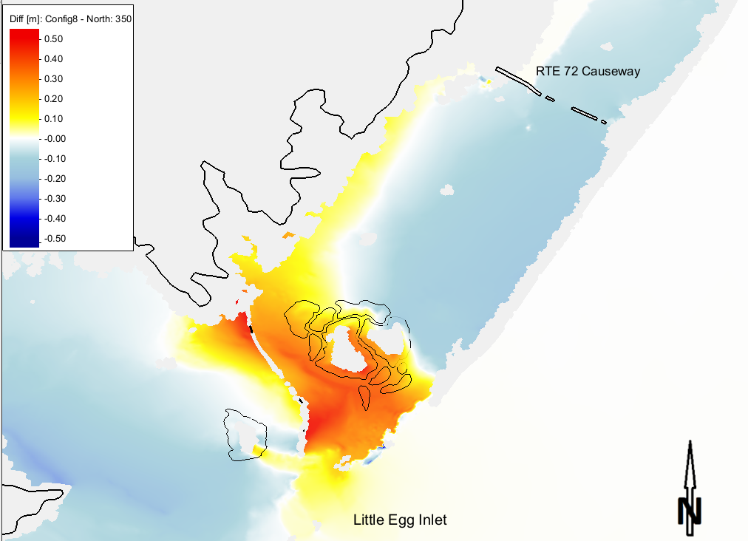
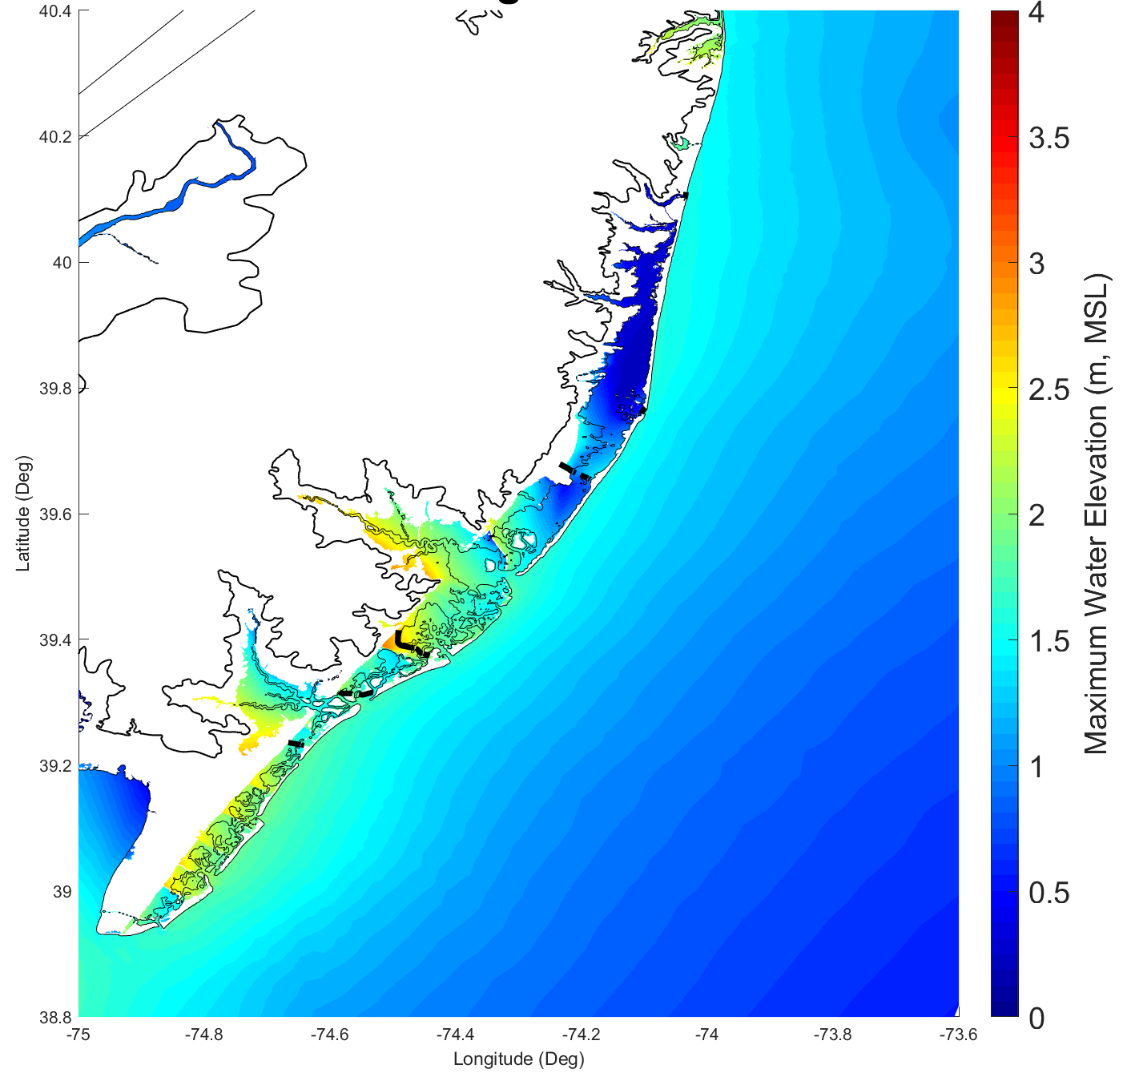
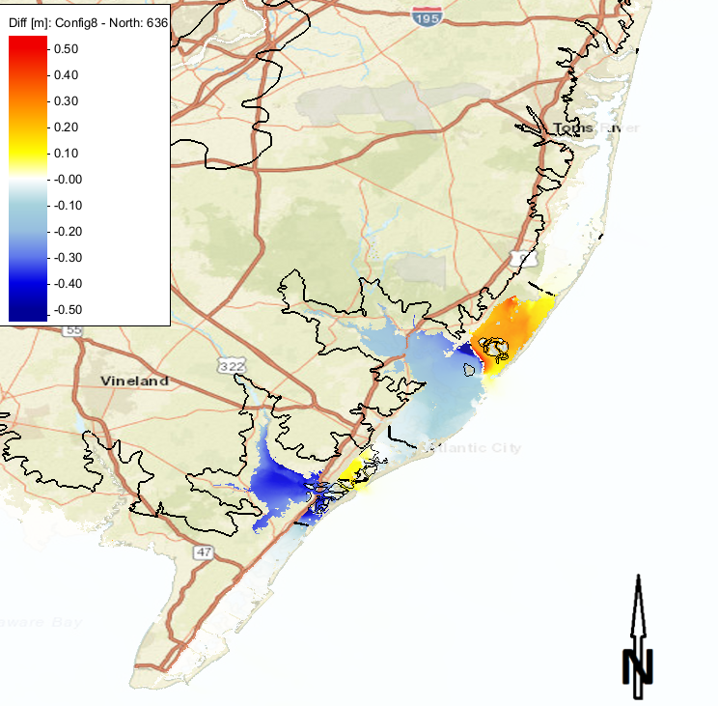
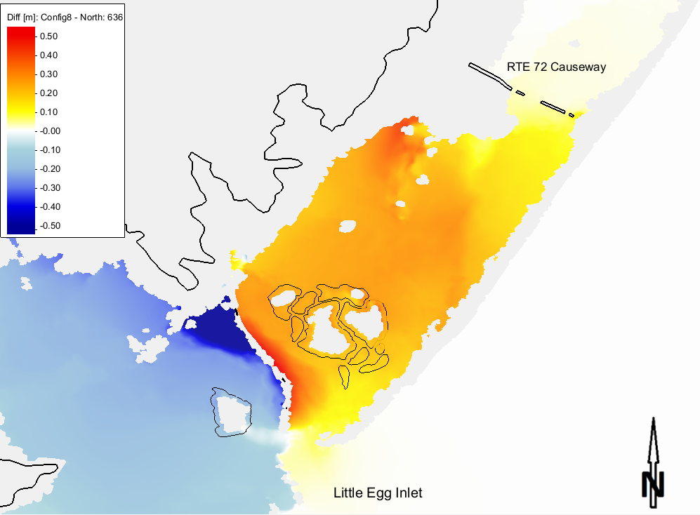
Holgate Wetlands
Maximum Surge Envelope
Difference (Restored Wetland – Base)
(m)
Storm 350
(m)
(m)
Storm 636

Slide 16
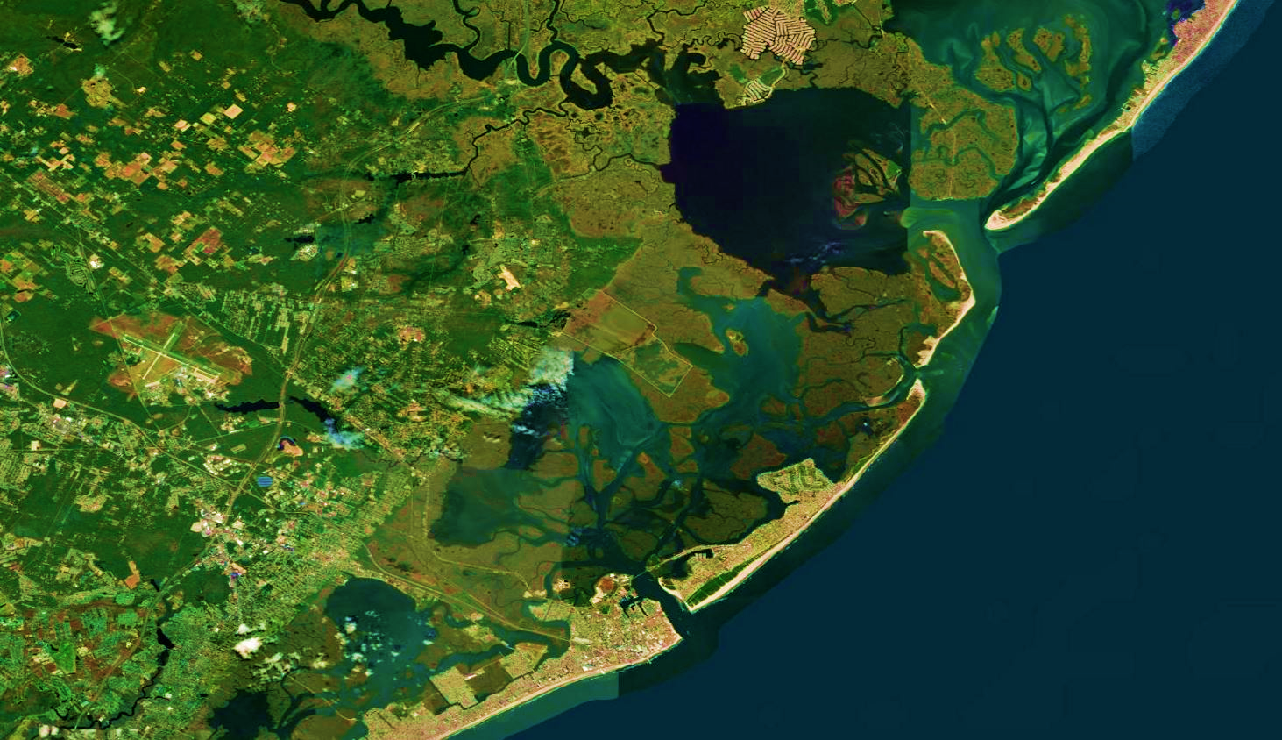
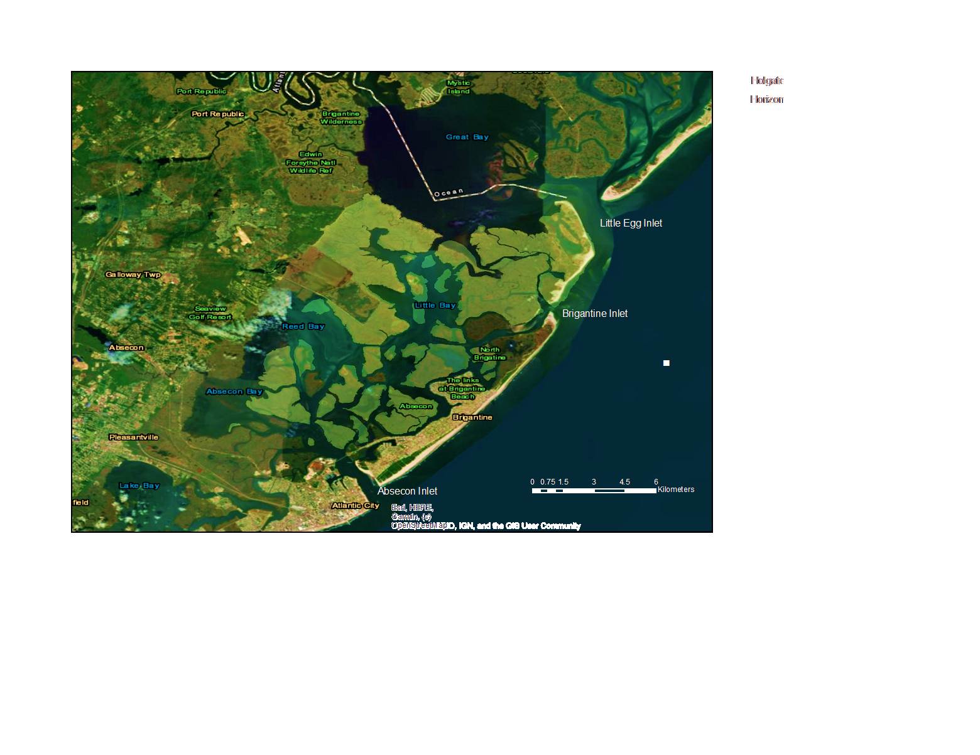
Numerical Mesh and Restored Wetlands at Brigantine
Existing Wetlands
New Jersey Back Bays
U.S.A.
Atlantic Ocean
Gulf of Mexico
Numerically Restored Wetlands

Slide 17
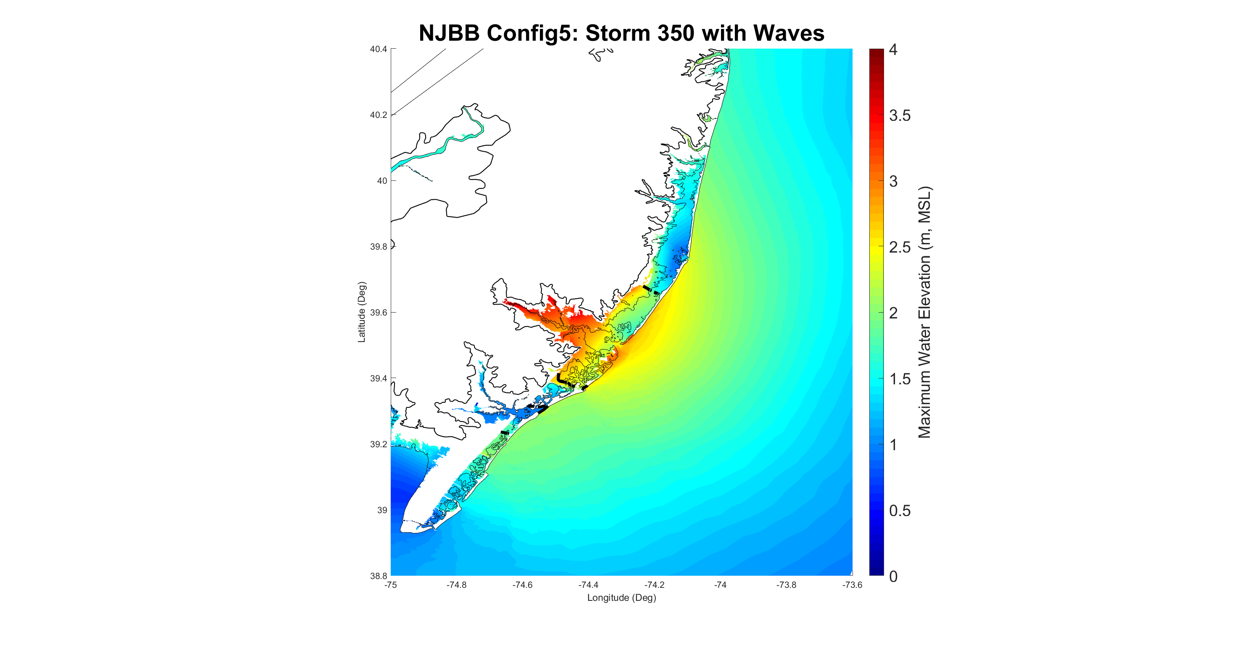
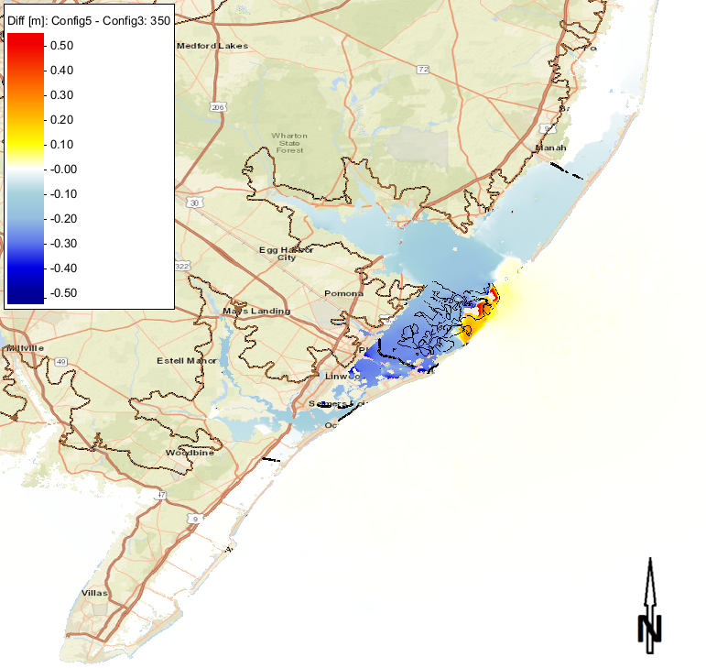
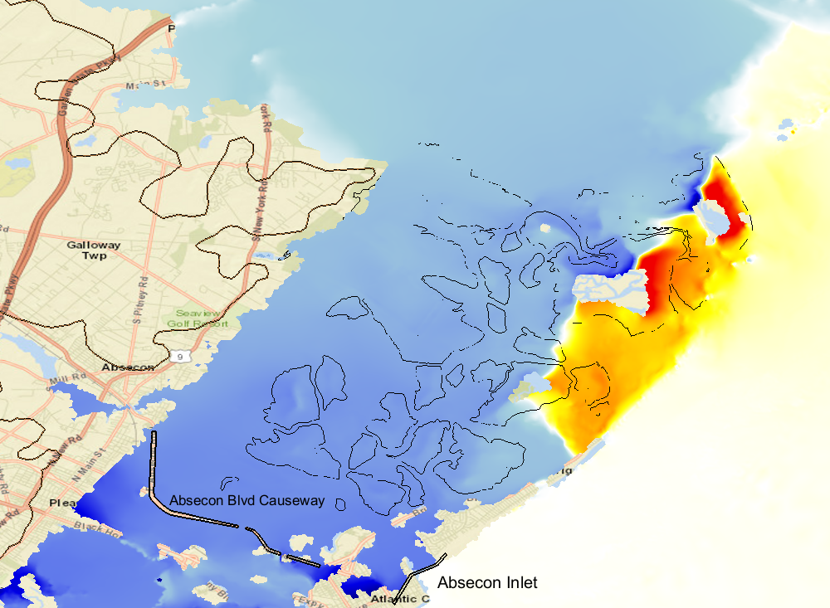
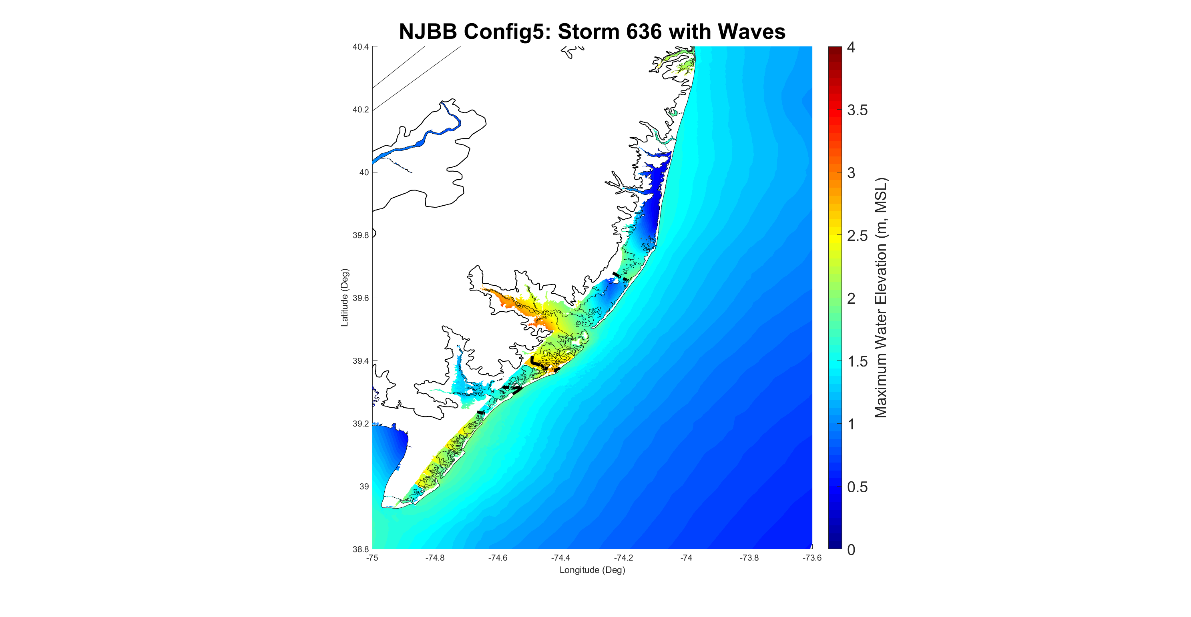
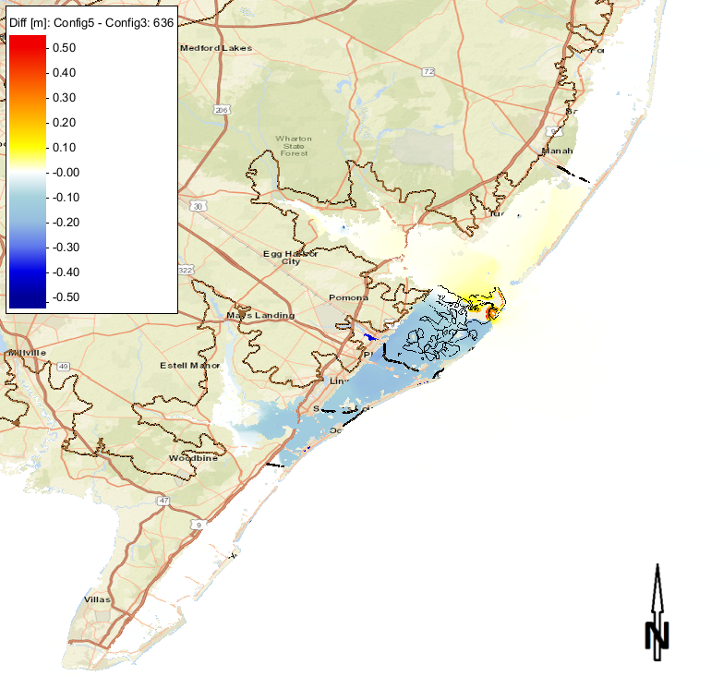
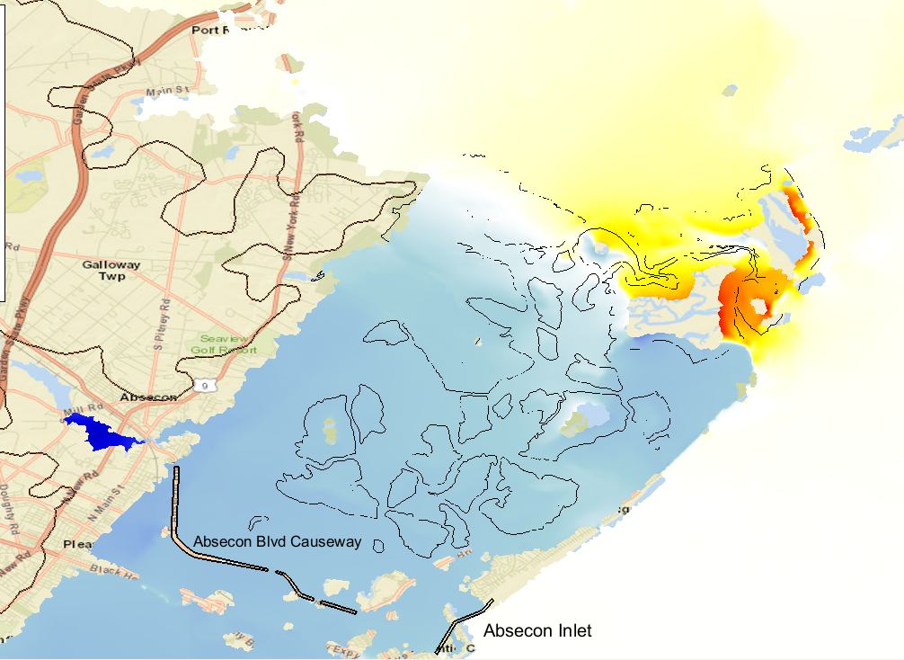
Brigantine Wetlands
Maximum Surge Envelope
Difference (Restored Wetland – Base)
(m)
Storm 350
(m)
Storm 636

Slide 18
Summary
Numerical modeling evaluation of the role of coastal wetlands in flood risk mediation by modifying wetland parameters (elevation, vegetation, continuity) in idealized setting and wetlands in New Jersey back bays
Unique study due to a combination of factors such as:
  Isolation of the effect of wetland parameters on storm surge (idealized cases)
  Varying geometric configurations of the wetlands in New Jersey cases
  Interconnectivity and hydraulic dependency of adjacent New Jersey bays
Wetland restoration may modify back bay surge levels, but should consider other mechanisms that may alter flow into and out of the bay:
  Other inlet openings, surge barriers, overwash, breaching, river inflow
  Prevention of return flow out of the bay
Wetland changes can modify the timing, duration, and magnitude of surge levels
Findings can be used to determine best future management practices for dredged material placement to maintain and restore wetlands considering: environmental pressures - climate change, subsidence, and storm-induced erosion
Notes:
In summary, Greg and I along with our partner Rob Hampson of the Philadelphia District of the Corps, evaluated the effectiveness of surge barriers in reducing back bay flooding with a numerical modeling study. From this we learned that there are a number of unique BAY factors and climate factors to consider when evaluating surge barriers – so even in this one state, north and south Jersey have very different geometric configurations of the inlets and bays and how they are connected.
We found that surge barrier CAN reduce back bay flooding, but you need to consider all mechanisms that can bring water into your region of interest that would potentially mitigate the benefits of a single surge barrier. Also – the surge barrier might trap flow and prevent draining of a bay. As in the case of Absecon Inlet, the surge barrier affected the timing, duration, and magnitude of elevated water levels in Absecon Bay.
In the future, we plan to look closer at the southern inlets and how they respond and possibly to include tides in our model simulations.

