Slide 1
Response of the QBO to a warming climate in global climate models
Jadwiga H. Richter
May 2019
F. Lott, N. Butchart, A. Bushell, S. Osprey, J. Anstey, Y. Kawatani, L. Holt
And other QBOi Participants

Slide 2
QBOi & Experiments
QBOi is a SPARC activity designed to improve our understanding of QBO generation and its impacts
Experiments:
Exp 1 (“AMIP”): Specified SSTs, sea-ice, external forcings, Jan 1 1979 – Feb 2009 (30 years, 1-3 ensembles)
Exp 2 (“Present-day timeslice”): repeating annual cycle SSTs, sea ice, and external forcings (100 years or 3 x 30yr ens)
Exp 3 (“2xCO₂ timeslice”): same as Exp 2, but 2xCO₂, SST+2K
Exp 4 (“2xCO₂ timeslice”): same as Exp 2, but 4xCO₂, SST+4K

Slide 3
Participating Models Exp 2, 3, 4
Model | GW Param | Source | Source Level
60LCAM5 | Lindzen | Richter et al. 2010 | Variable
AGCM3-CMAM | WM | Fixed | 90 hPa
CESM1(WACCM5-110L) | Lindzen | Richter et al. 2010 | Variable
ECHAM5sh | Hines | Fixed | 600 hPa
EMAC | Hines | Fixed | 643 hPa
LMDz6 | Lott et al | Lott and Guez 2013 | 500 hPa
MIROC-AGCM-LL | None | N/A | N/A
MIROC-ESM | Hines | Fixed | 657 hPa
MRI-ESM2 | Hines | Fixed | Surface
UMGA7 | WM | Fixed | 4 km
UMGA7gws | WM | Bushell et al. 2015 | 4 km

Slide 4
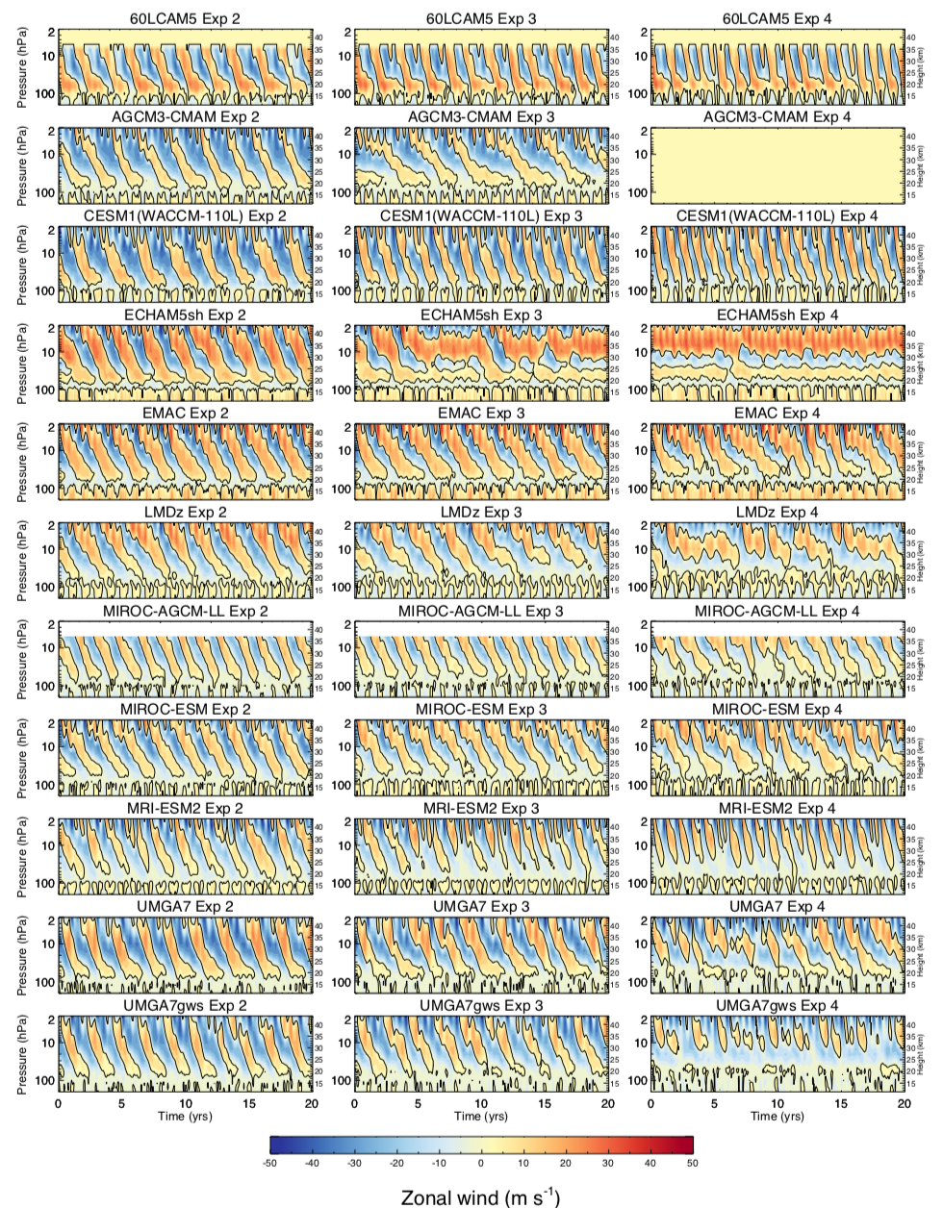
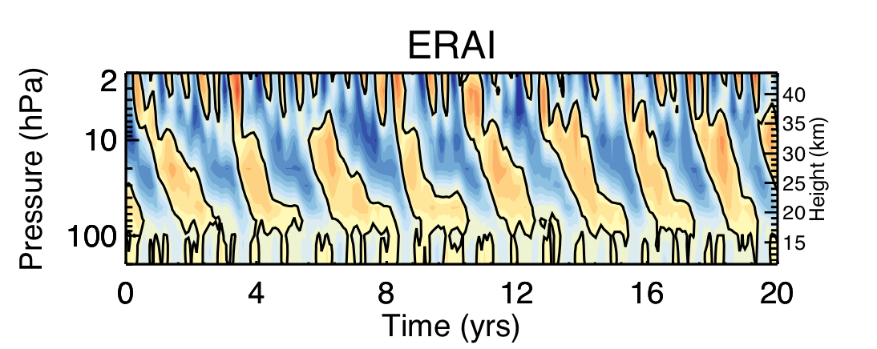
Exp, 2, 3, 4 QBOs
Zonal Mean U 5S to 5N
Exp 2
Exp 3
Exp 4
There is a wide range of responses of the QBO to a warming climate among climate models

Slide 5
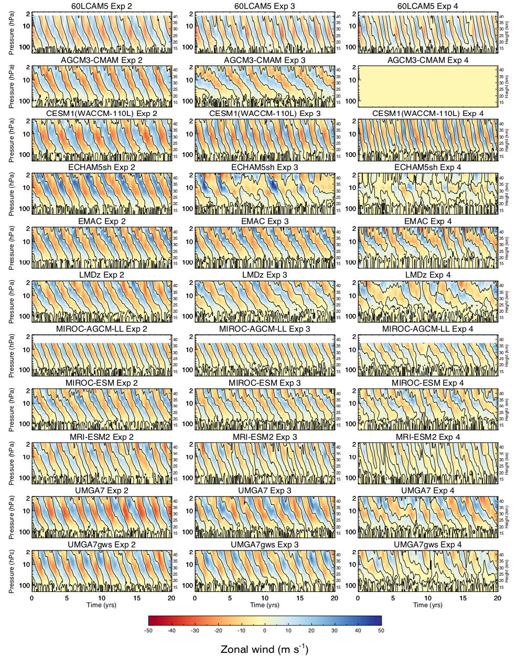
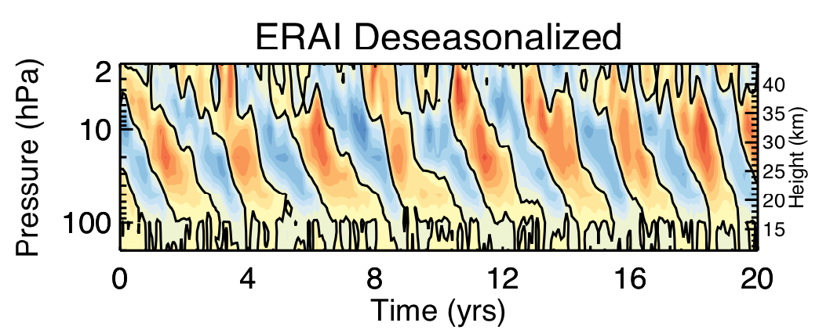
Exp, 2, 3, 4 QBOs
Deseasonalized Zonal Mean U 5S to 5N
Exp 2
Exp 3
Exp 4
Deseasonalized U shows a more coherent oscillation in some models in future climate

Slide 6
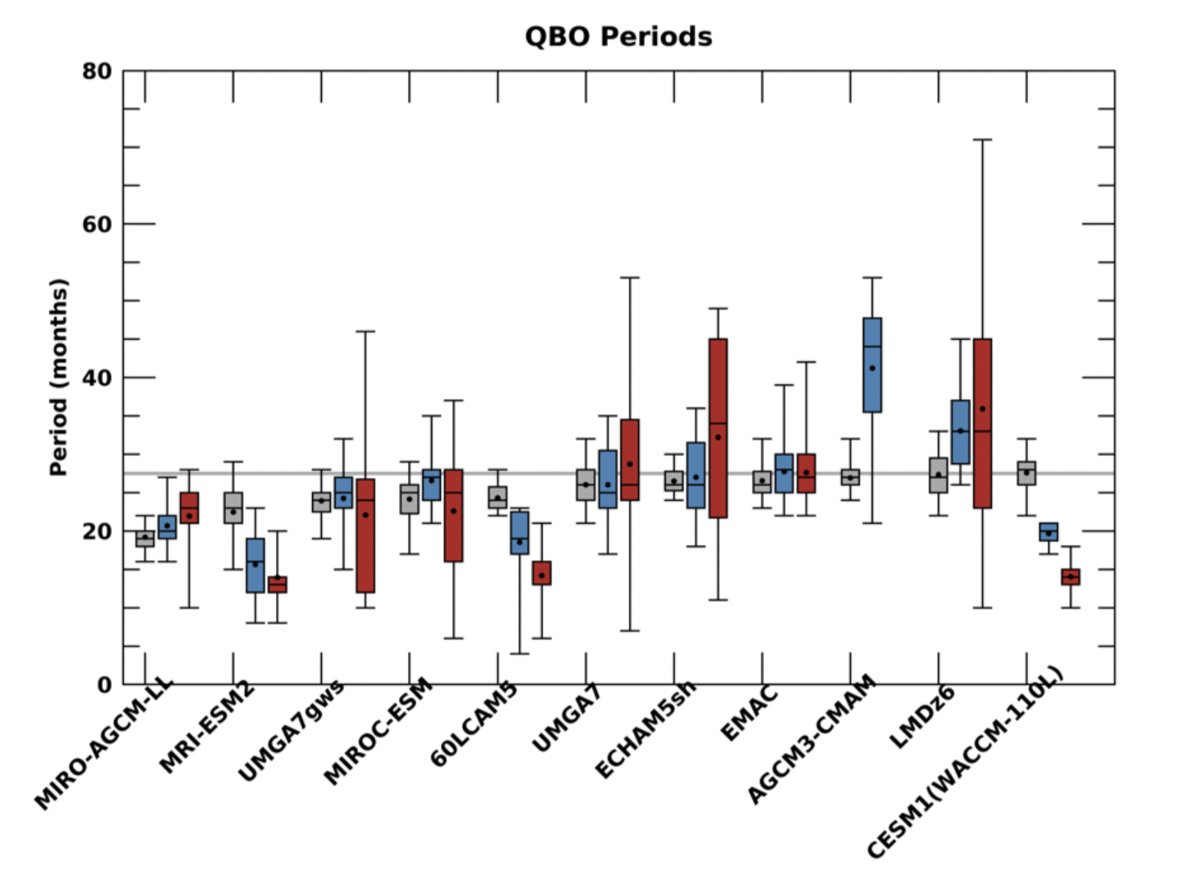
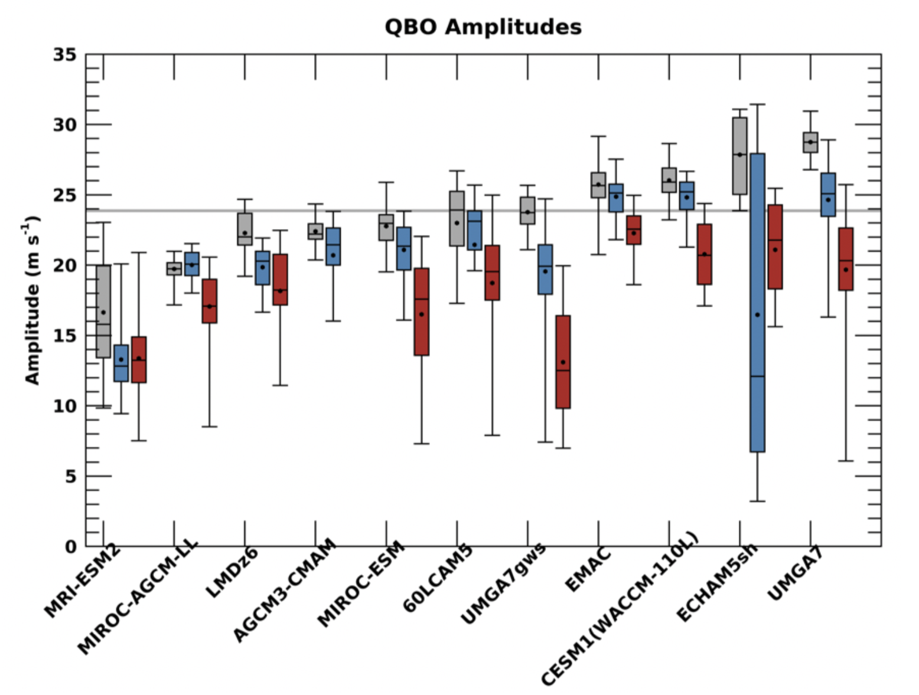
Exp 2, 3, 4 QBO Period & Amplitude
Exp 2
Exp 3
Exp 4
No Consistency in QBO Period Change among QBOi models
QBO Amplitude decreases in warming climate.

Slide 7
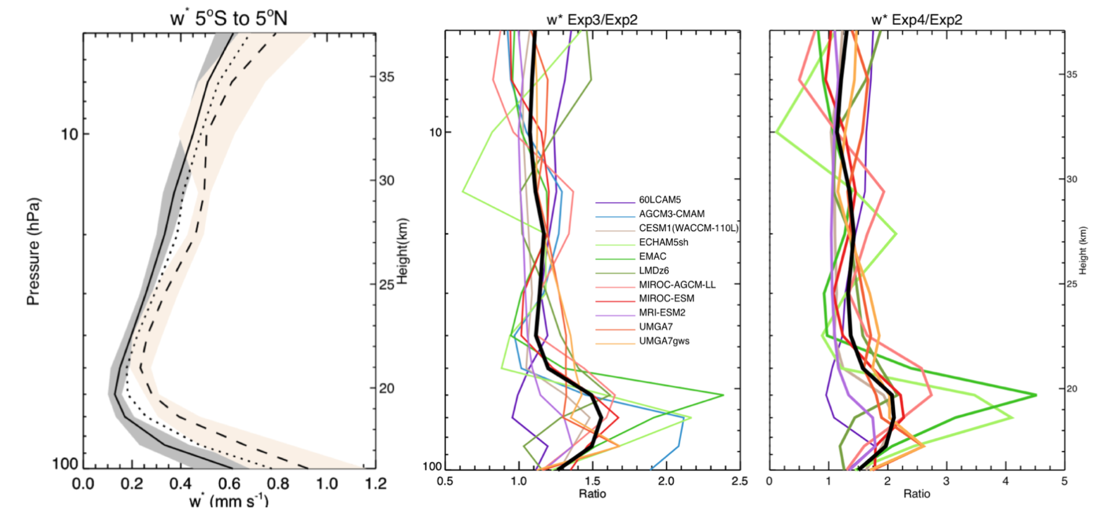
Residual Vertical Velocity: w*
W* increases in all models in the stratosphere
Largest Change: ECHAM5sh, MIROC-AGCM-LL, UMGA7, UMGA7gws

Slide 8
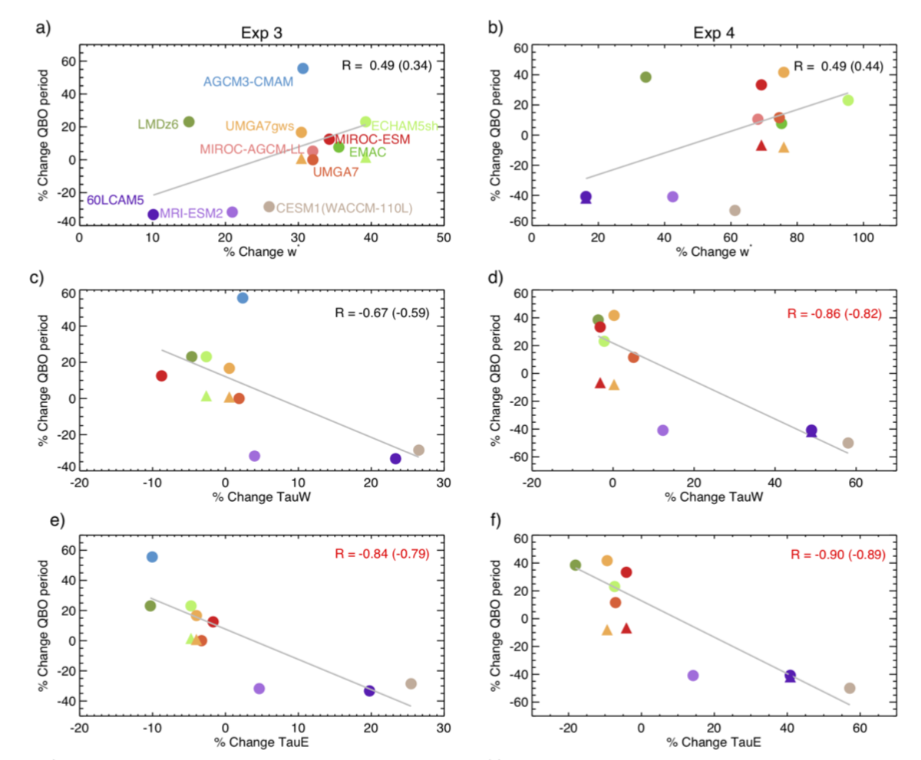
QBO Period Changes
W*
TauW: Westerly (eastward) momentum flux at 100 hPa
TauE: Easterly (westward) momentum flux at 100 hPa
QBO amplitude changes related to w* and GW Momentum Flux

Slide 9
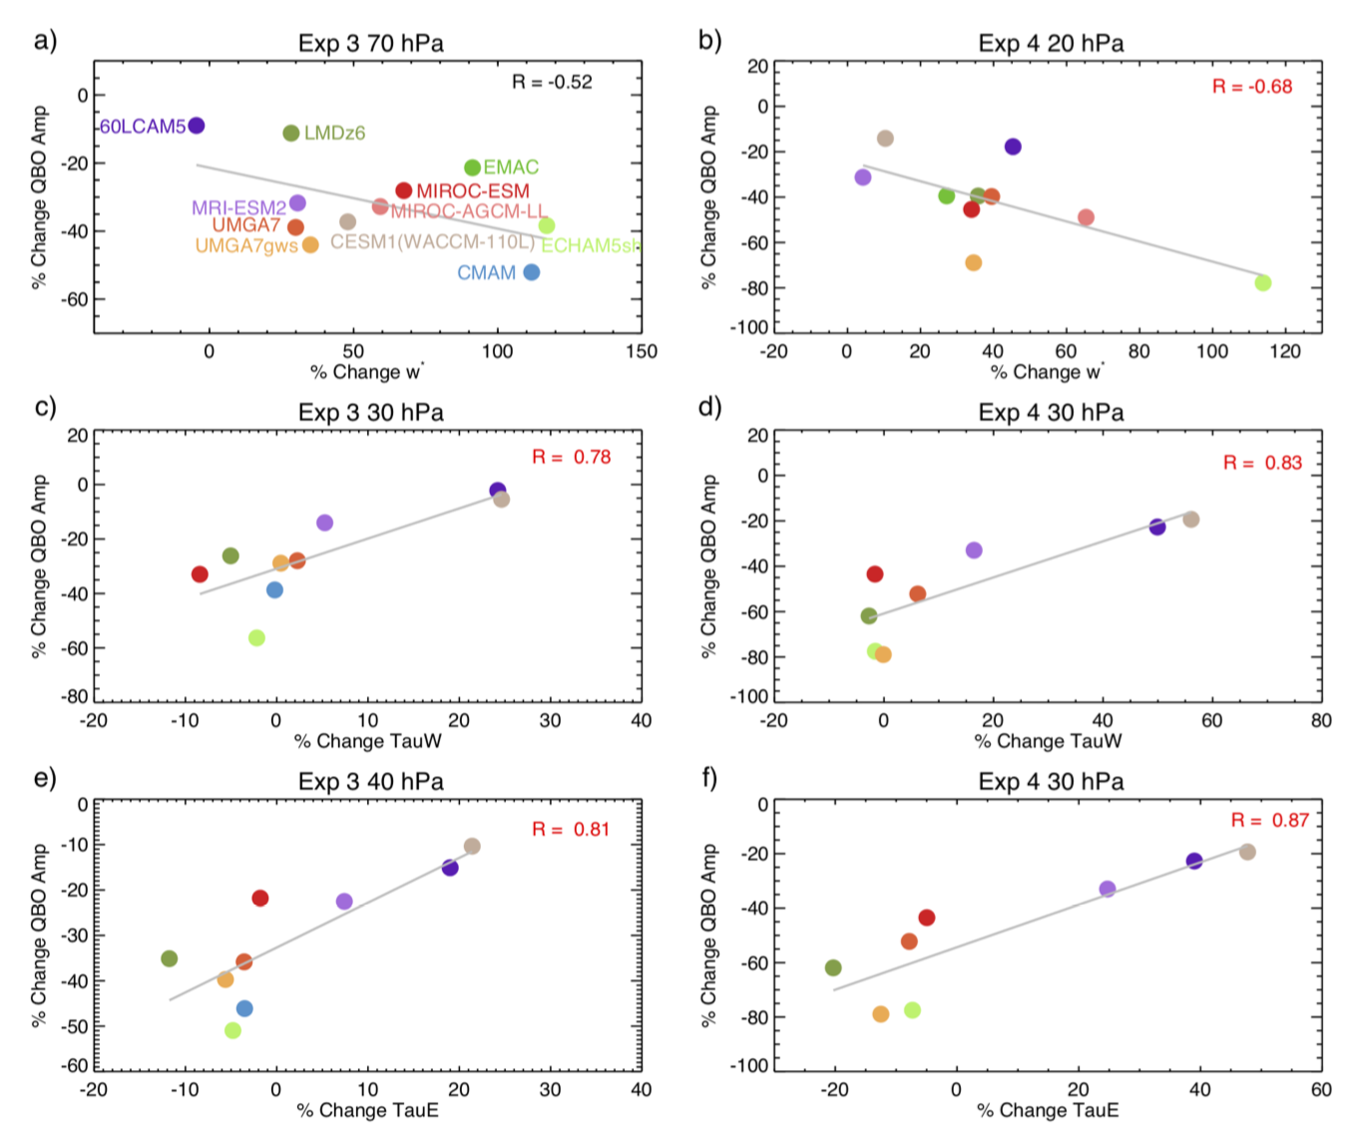
QBO Amplitude Changes
W*
TauW: Westerly (eastward) GW Momentum Flux at 30 hPa
TauE: Easterly (westward) momentum flux at 40/30 hPa
QBO amplitude changes related to w* and GW Momentum Flux

Slide 10
Summary and Conclusions:
11 GCMs participated in the QBOi warming climate experiments: 10 of them used a GW parameterization to obtain a QBO
There is no consistency among the QBOi models in how the QBO period will change in the future
QBO period change mostly depends on parameterized GWs
In all the models QBO amplitude is projected to decrease in warming climate
QBO amp decrease is correlated with an increase in residual vertical velocity and changes in GW momentum flux at 100 hPa
More can be found in Richter et al. (2020), QJRMS
Questions? Email jrichter@ucar.edu

