Slide 1
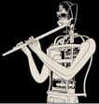
, IN Italian schools

Slide 2
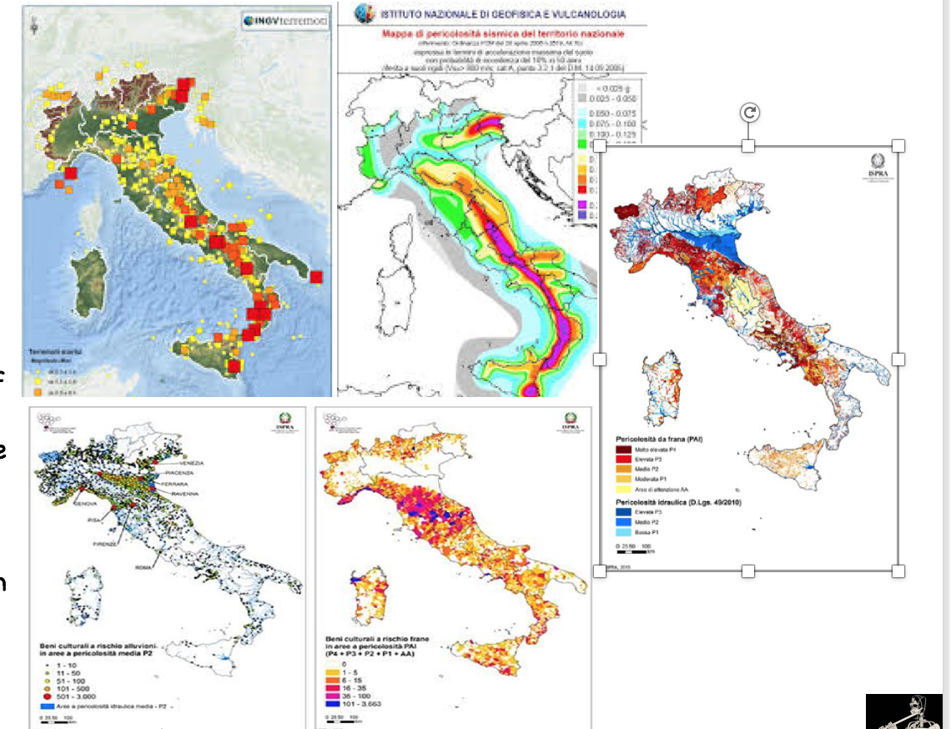
Italy is an “high risks “ country

Slide 3
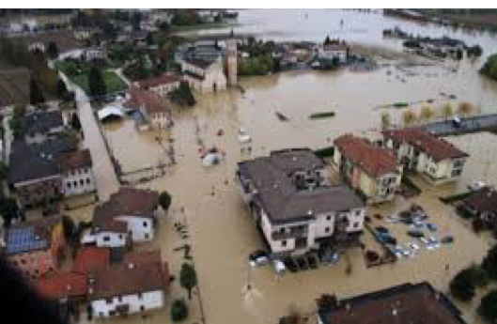
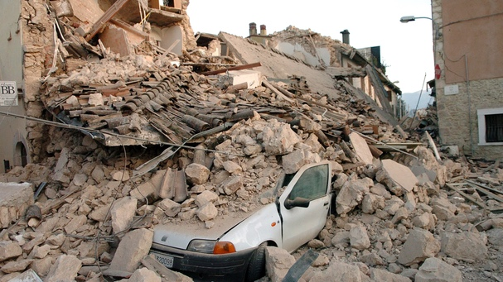
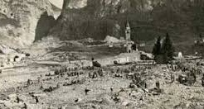
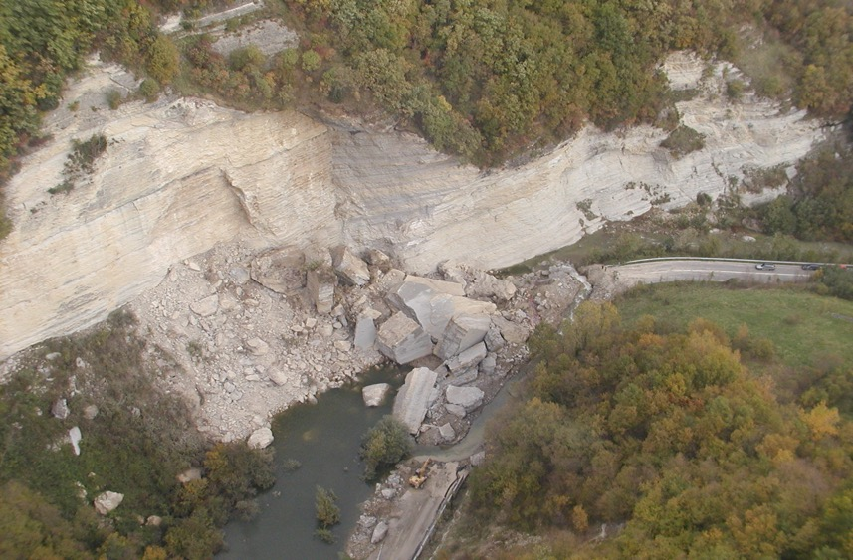
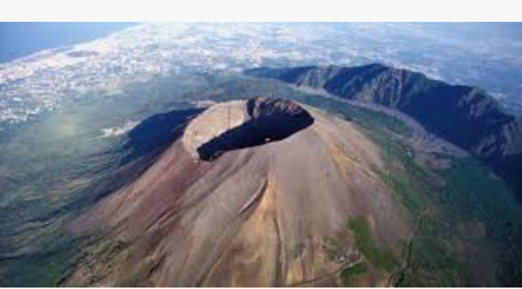
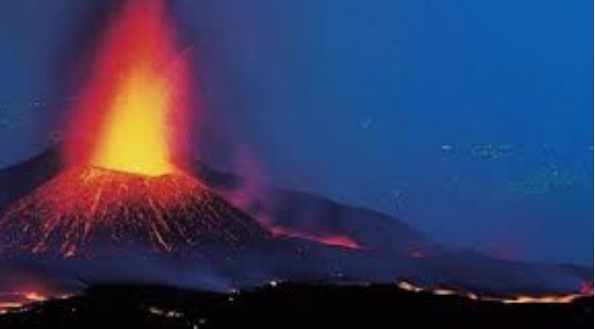
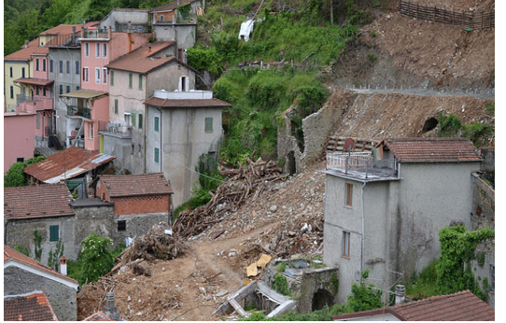
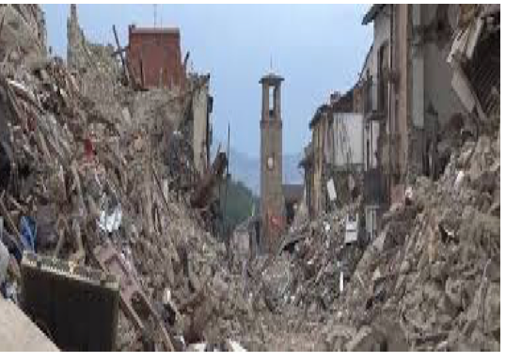
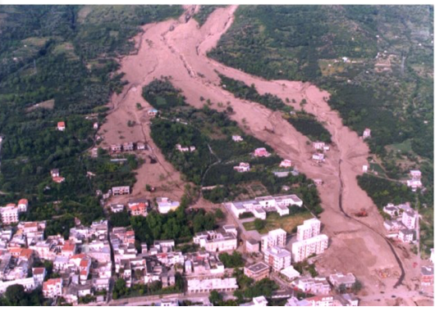
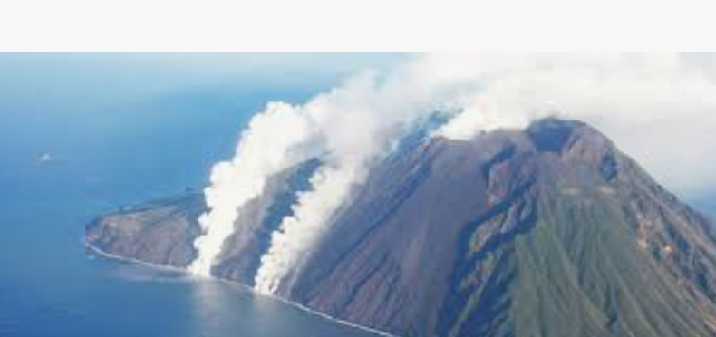
We do not miss anything!

Slide 4
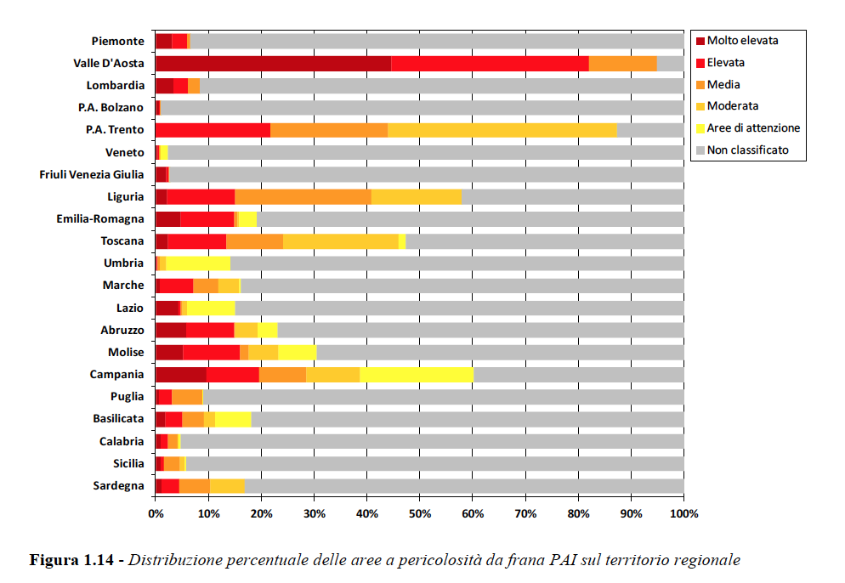
As tell us
history
and official scientific data

Slide 5
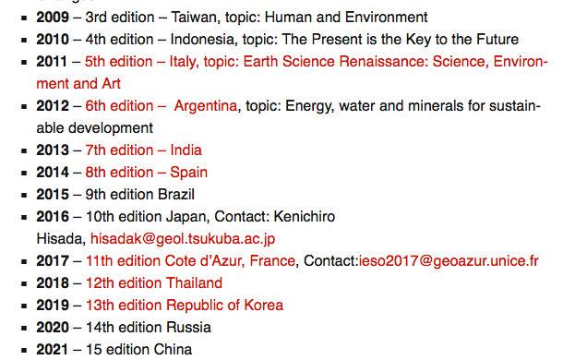
We need to improve awareness towards natural risks and hazards
in our students

Slide 6
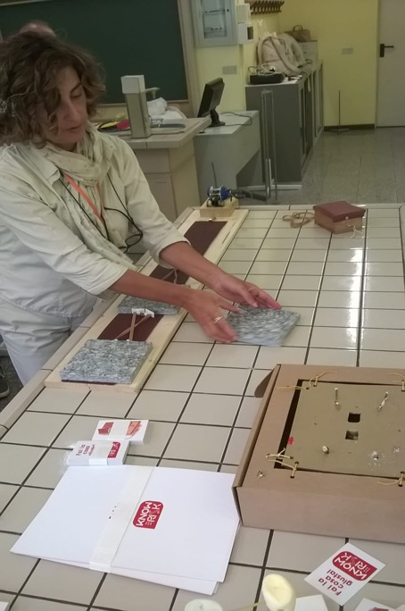
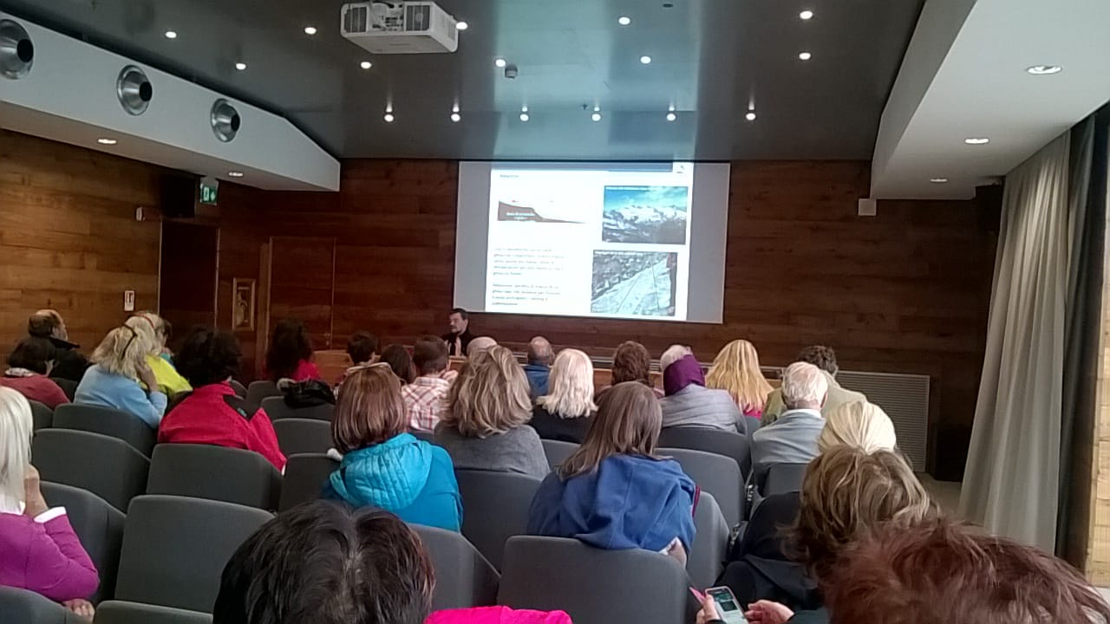
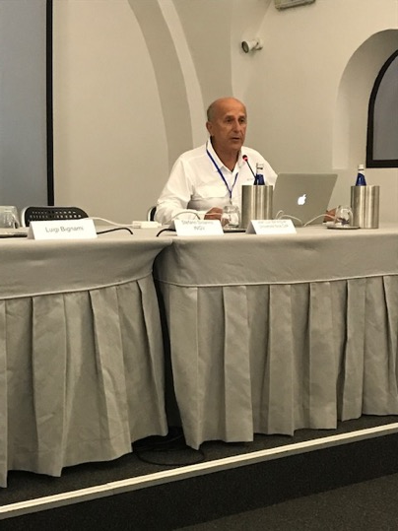
and in our teachers

Slide 7
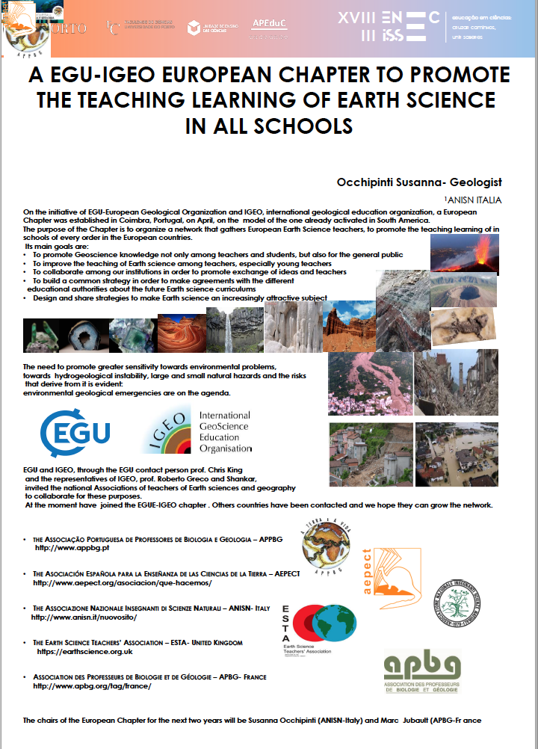
We try to cooperate
at all levels
and with partners
in Italy
and in Europe

Slide 8
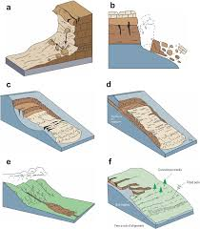
But traditional and formal educational tools, as
school texts
pictures
and official classifications
(as Varnes’ one)
are not always effective
to improve
awareness towards
natural risks and hazards
in our students

Slide 9
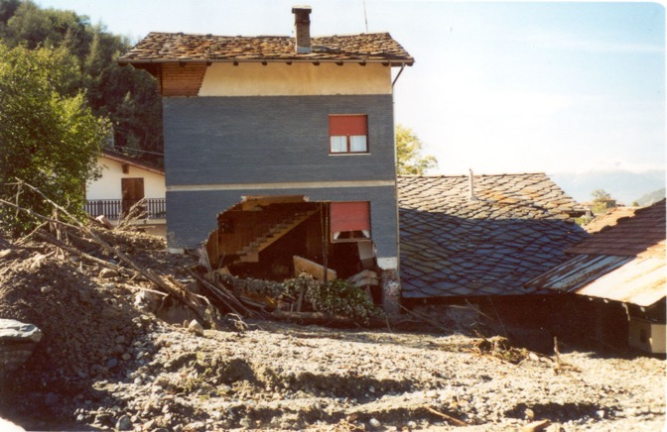
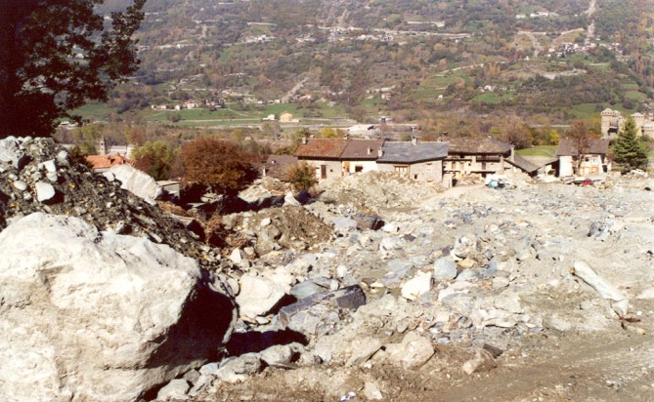
This educational path has the basic goals:
to recognise in the main elements,
the dynamics of the territory and the possible consequences :landslides, avalanches, floods, earthquakes...
to verify, when possibly experimentally,
in what conditions they may occur, what are the factors that trigger them, what are the limits of stability, what is the probability of occurrence.

Slide 10
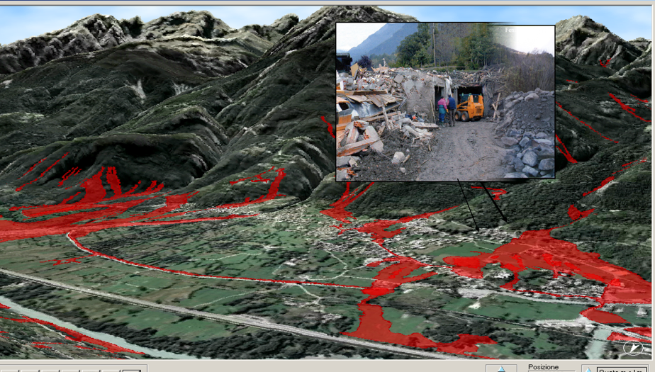
And, finally, the goal is to recognize that in our environment or in known and nearby areas,
these phenomenon even if different in nature, dimensions, consequences,
could directly affect them:
We ask to the students:
to be aware of the instability of their context,
to identify potentially involved areas and infrastructures,
to understand that the meaning of danger is different from that of vulnerability and of risk, to hypothesize
protective tools, limitations
relocation .

Slide 11
We decided to experiment a PBL approach, that, to be rigorous and effective requires:
critical thinking,
collaboration and various forms of communication; investigation as part of the process of learning
production of something new: an idea, a project, an interpretation;
This approach forces students
in interacting
in facing challenges
and solving problems.

Slide 12
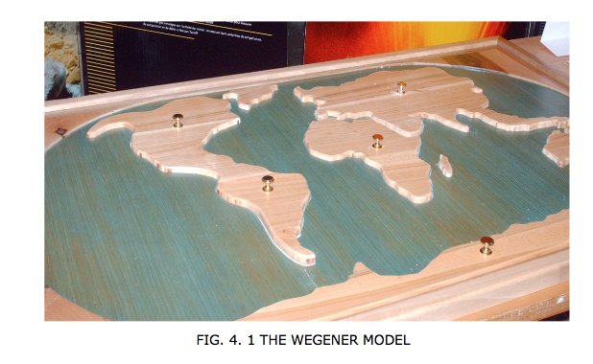
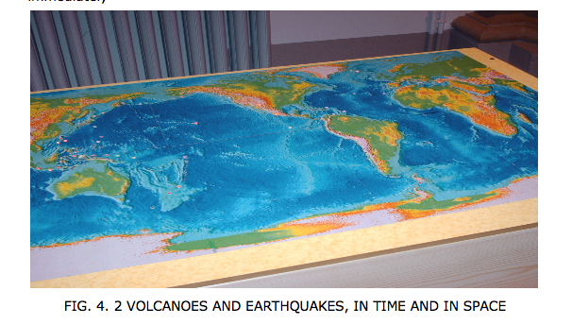
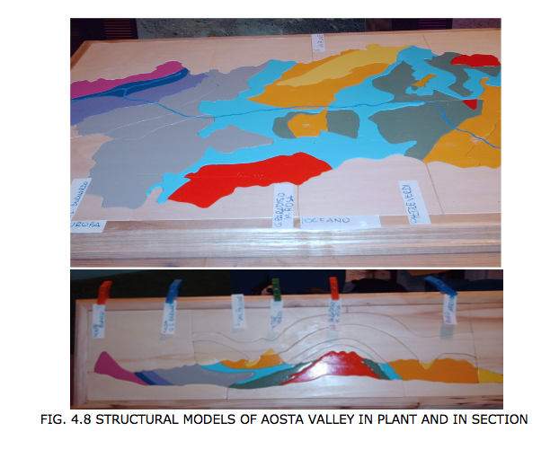
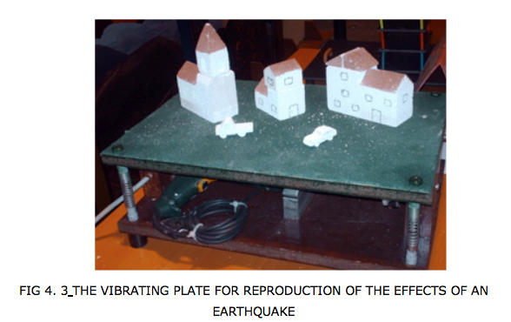
Over time, we have experimented
with laboratory activities,
we have built
sometimes rough and trivial
sometimes complex, models
to facilitate an experimental
hands-on approach,
using driving questions
and investigations

Slide 13
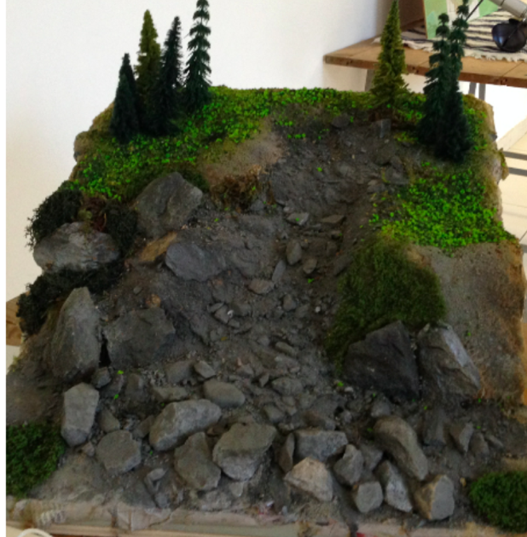
and to identify which causes can trigger a landslide and which factors can accelerate its movement
we have learned to recognize the different parts of a landslide:
the body, the sliding, the escarpment ...

Slide 14
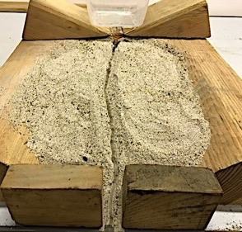
Experimenting different
materials humidity steepness of the slope roughness of the substrate anthropic actions

Slide 15
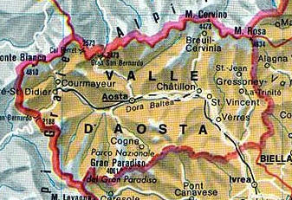
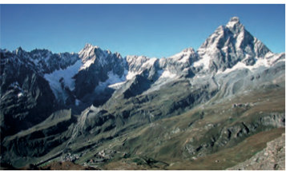
we proposed students to analyse three different cases,
A collapse A DGPV A complex landslide
in a known context
rich of technical documentation, images, cartographies
Valtournenche, is a left side valley of the Dora Baltea, in the Aosta Valley, famous because of the presence of the Matterhorn,
It is an area of great natural value for the beauty of the landscape, the mountains, the lakes and the presence of ski resorts , characterized by a significant influx of tourists and therefore
from widespread settlements

Slide 16
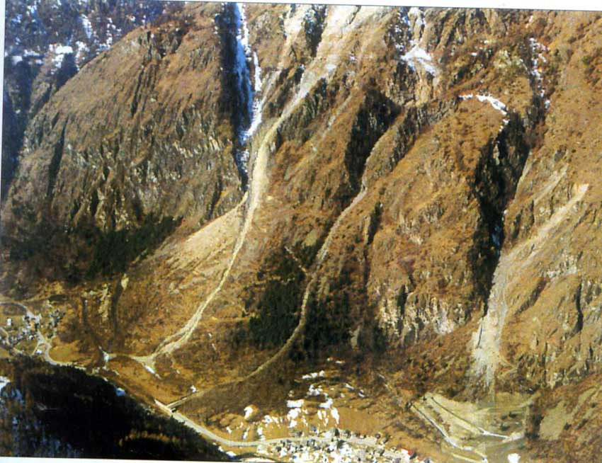
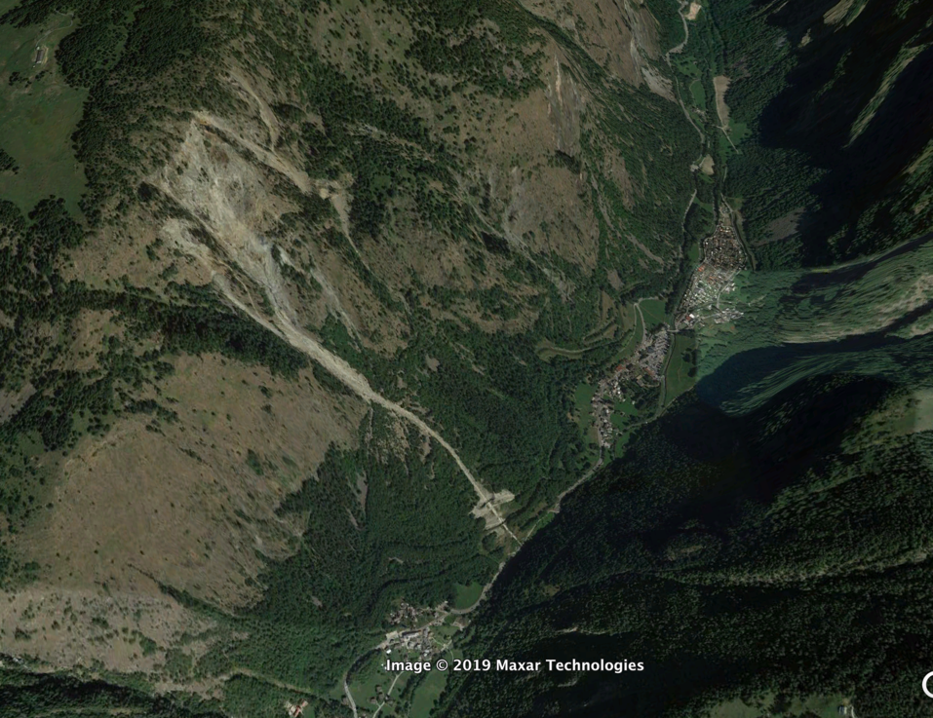
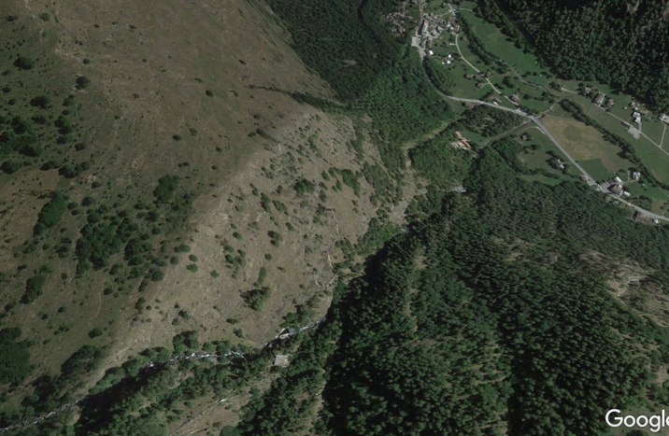
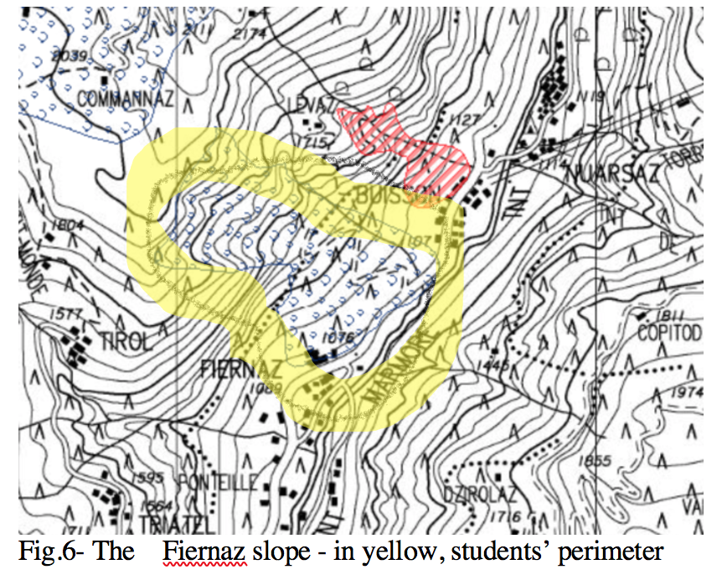
A collapse – località Fiernaz
Students were able
to make considerations about
the causes of the phenomenon,
the vulnerability of the village and the risk,
to determine the shapes of the slope
to formulate hypotheses of interventions,
as passive protections

Slide 17
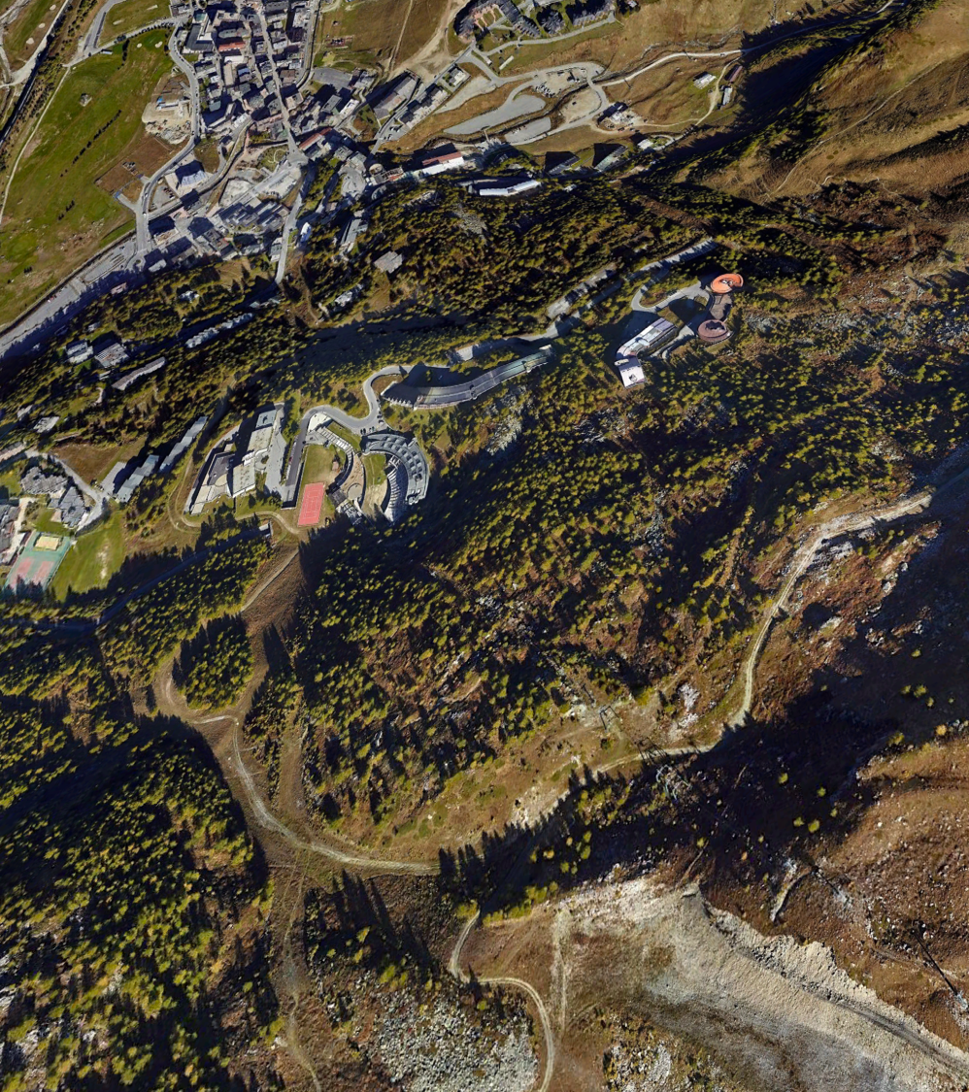
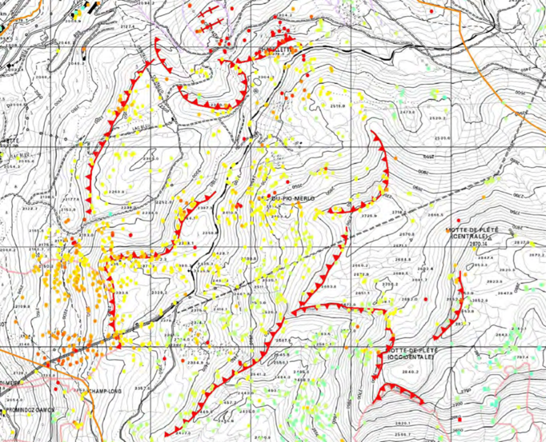
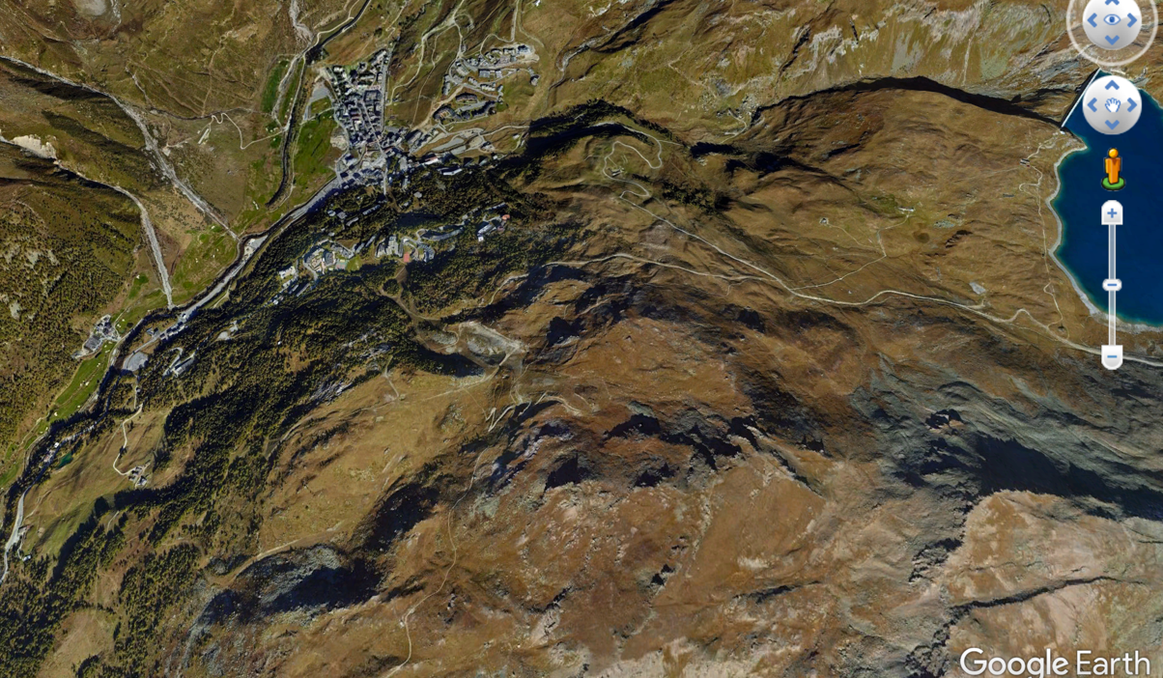
A DGPV- Loc Cielo Alto Cervinia Breuil
Students recognized some typical aspects of this great phenomenon
involving large areas and sometimes the whole slope:
the duplication of the ridge
the presence of ice glacier
the progressive and continuous movement of the landslide body that affected large built complexes

Slide 18
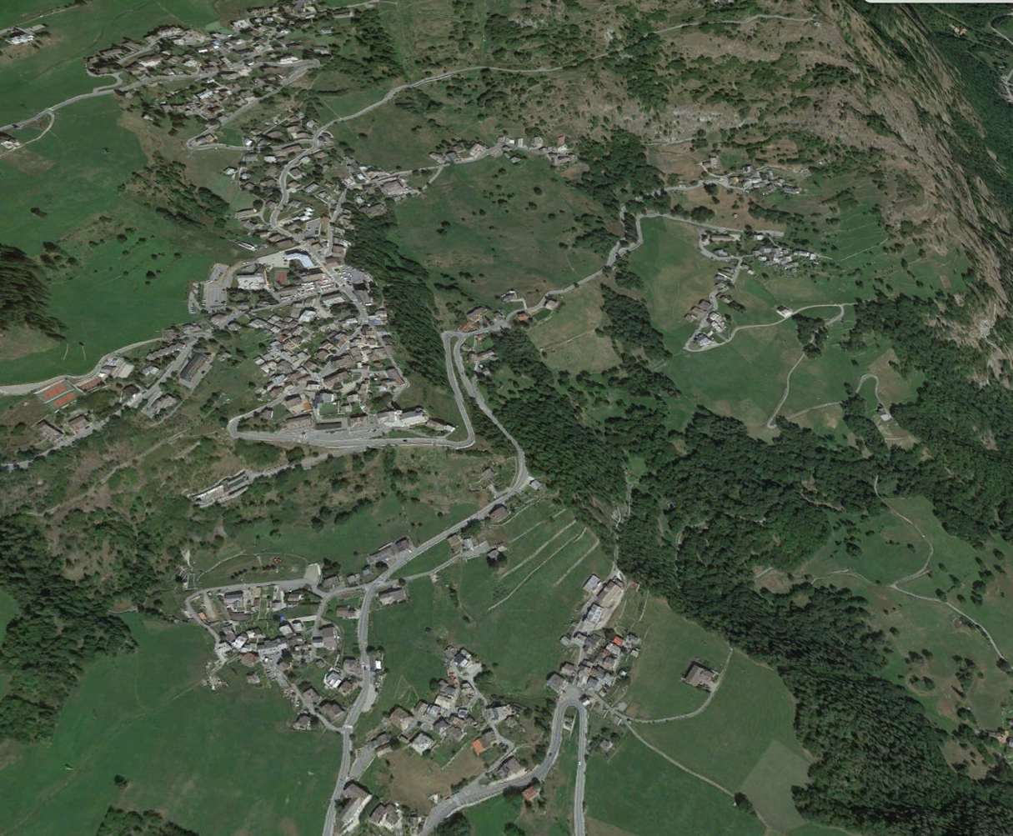
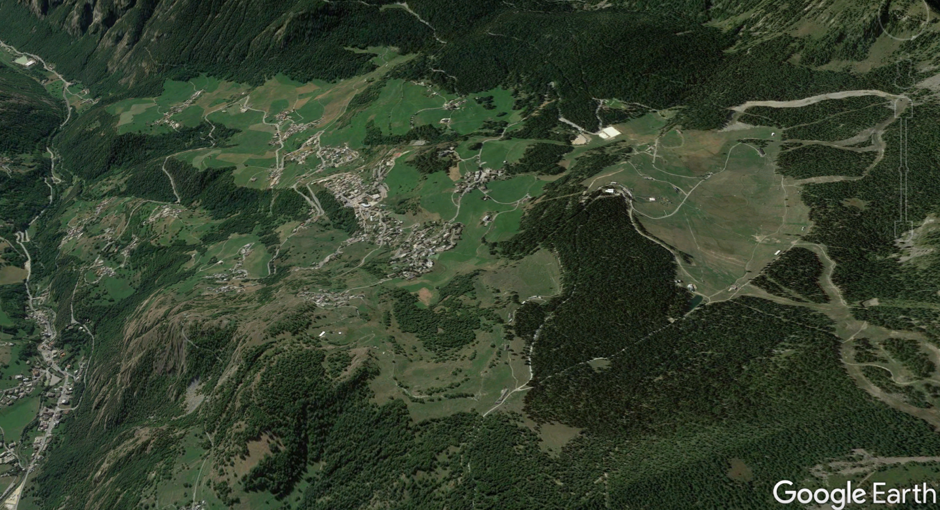
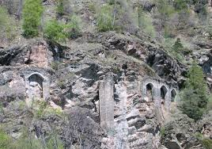
A complex landslide Loc. Torgnon
Students searched
to identify the phenomenon,
but it was particularly difficult
because of the amplitude of the involved area,
and, in this case,
they underestimated risk areas

Slide 19
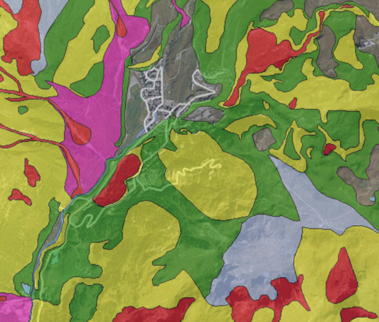
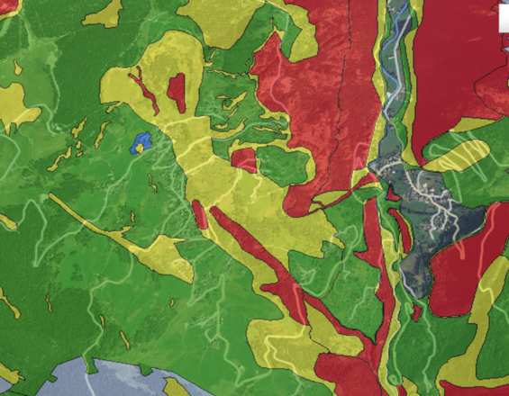
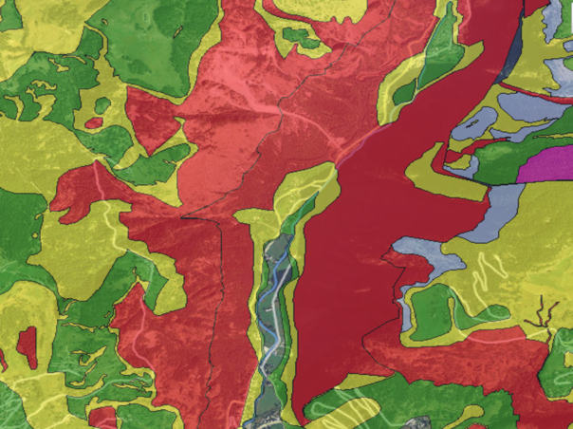
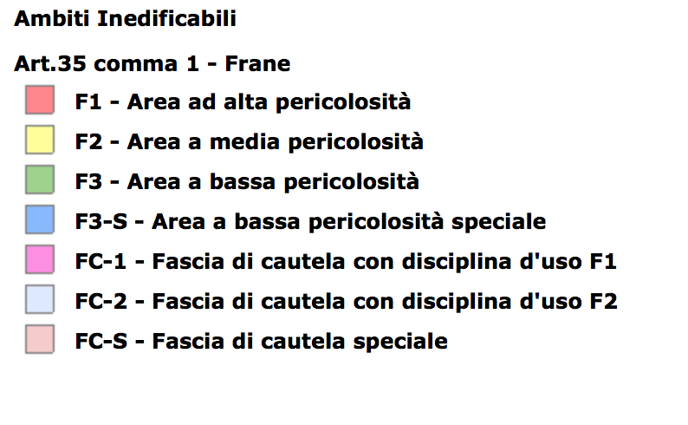
Students learnt that
it is possible to recognize, in photography or cartography, elements or shapes of the landscape, that allow to identify the presence of a landslide, a collapse, a DPGV; it is possible to recognize and to characterize the type of danger and the factors that may have triggered or reactivated the phenomenon , it is possible to understand what information is needed to correctly define the vulnerability of the area
and finally,
to cross-reference information from the geological-geomorphological analysis, that allows to highlight the danger,
the urban planning that allows to define the vulnerability,
in order to define the risk

Slide 20
And finally students were asked
to analyze different geological events, currently stabilized,
with different shape but similar dynamics
and to recognize consequences
They were asked to use the backward analysis:
as in a film shot backwards, it is possible to study
dynamics
triggering factors
and to prevent them,
considering that:
all the landslides affecting the valley have some common factors: the typology of the rocks, the shape and the high thicknesses, the action of the glaciers that occupied the valley for hundreds of meters thick, modelling the slopes and leaving discontinuity

Slide 21
This activity
has experienced a different educational approach, has improved their awareness towards environmental dynamics and risks,
has allowed to verify the skills students have acquired, such as to
recognize cause-and-effect relationships
Thank you for your attention. Any question?
s.occhipinti@mail.scuole.vda.it
susocchip@gmail.com

