Slide 1
Staying fair while being FAIR
Challenges with FAIR and Open data and services
for distributed community services in Seismology
Florian Haslinger & the EPOS Seismology Consortium
ORFEUS: Lars Ottemöller, Carlo Cauzzi, Susana Custodio
EMSC: Rèmy Bossu, Alberto Michelini
EFEHR: Fabrice Cotton, Helen Crowley, Laurentiu Danciu
and contributions from
A. Hübner & A. Strollo (GFZ), R. Sleeman (KNMI), dozens of colleagues, hundreds of websites

Slide 2

Where the title comes from …
(a) various personal discussions over the last years with colleagues, often with responsibilities in volcano or earthquake services in not so rich countries, who are seriously concerned – and sometimes have experienced – that the call for FAIR and Open data means that they shall make the data they collect available, while others (often from more resourceful countries) then ‘do the science’ and collect credit for it, faster than they could themselves, and with little if any benefit to them.
so it’s probably more ‘staying fair while being Open’
(b) our own difficulties in coming to terms with the implications of implementing FAIR and Open principles across our diverse, distributed, and federated services within EPOS Seismology, where we collect & disseminate data and products that are contributed to by 100+ academic and governmental institutions in 30+ countries (beyond EU…)

Slide 3
The case of the lowercase fair …
research ethics, community codes and best practices
fairness as a social / ethical concept (loosely defined)
- respectful
- just
- acknowledging and addressing needs of all involved entities
very human-centric (and perhaps depending on specific societal norms)
side note : FAIR was invented to support (automated / autonomous) machine-actionability ... (P. Wittenburg, pers. comm. 2019) - nothing to do with humans (?)

Slide 4
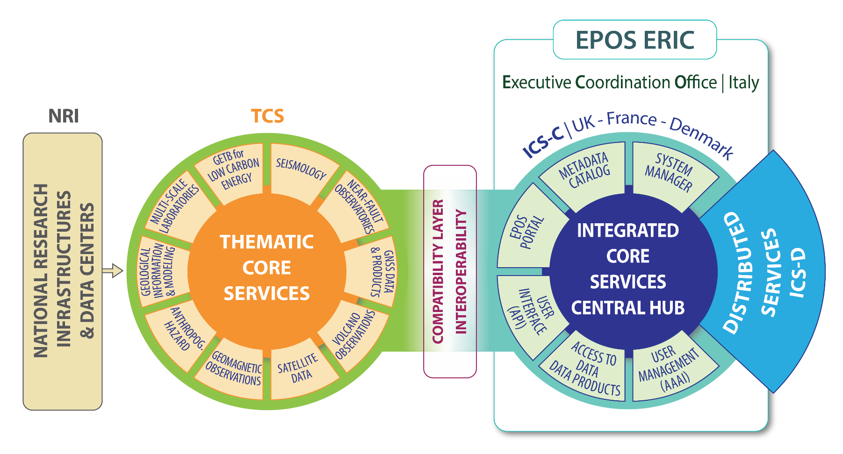
recap : the EPOS Architecture
www.epos-eu.org
Legal body &
core infrastructure:
EPOS ERIC
including
ECO & ICS
National RIs:
The foundation layer
Domain workhorses for the
implementation & coordination of data & service provisioning:
Thematic Core Services TCS
Notes:
Very briefly – the general EPOS architecture: …

Slide 5



EPOS TCS: community driven and governed services
Waveform Services
Waveform selection & access
Waveform metrics & Station Information
Strong Motion parameters
OBS data integration
Mobile Pool coordination & integration
Waveform modeling
Seismological Products
Earthquake Parameter Information
Macroseismic & Historical Event data
Seismological Products Platform
- rupture models / SiteCharTool / MT
- EventID / F-E-Region / …
Hazard and Risk Services
Seismic Hazard Models
Seismogenic Faults
Ground Shaking Models
Geotechnical Engineering Information
Strong Motion records in buildings
Earthquake Risk Services

Slide 6
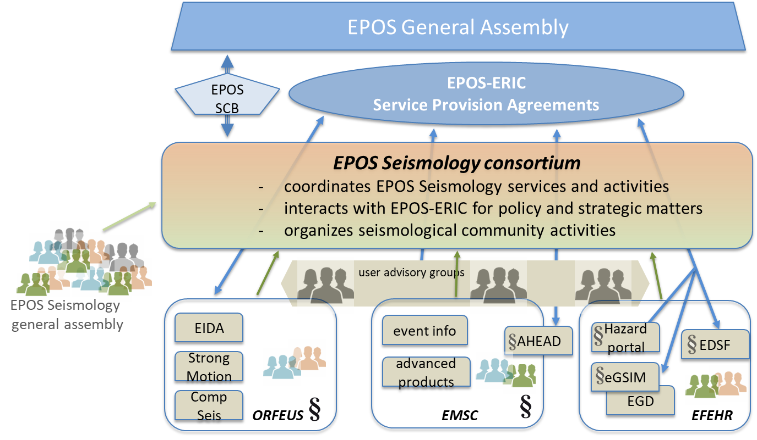
EPOS Seismology: our contribution to the EPOS Delivery Framework
Waveform Services
Waveform selection & access
Waveform metrics & Station Information
Strong Motion parameters
OBS data integration
Mobile Pool coordination & integration
Waveform modeling
October 2019:
EPOS Seismology established as consortium with members
ORFEUS, EMSC, EFEHR
Seismological Products
Earthquake Parameter Information
Macroseismic & Historical Event data
Seismological Products Platform
- rupture models / SiteCharTool / MT
- EventID / F-E-Region / …
Hazard and Risk Services
Seismic Hazard Models
Seismogenic Faults
Ground Shaking Models
Geotechnical Engineering Information
Strong Motion records in buildings
Earthquake Risk Services

Slide 7
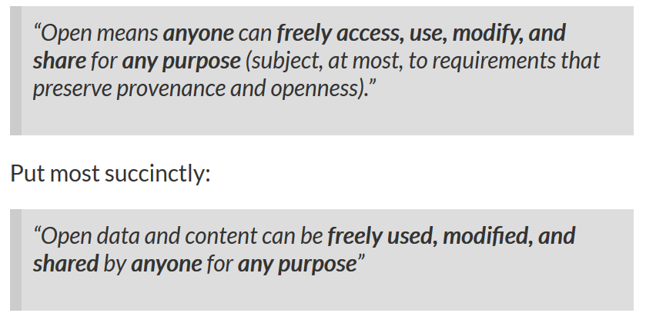
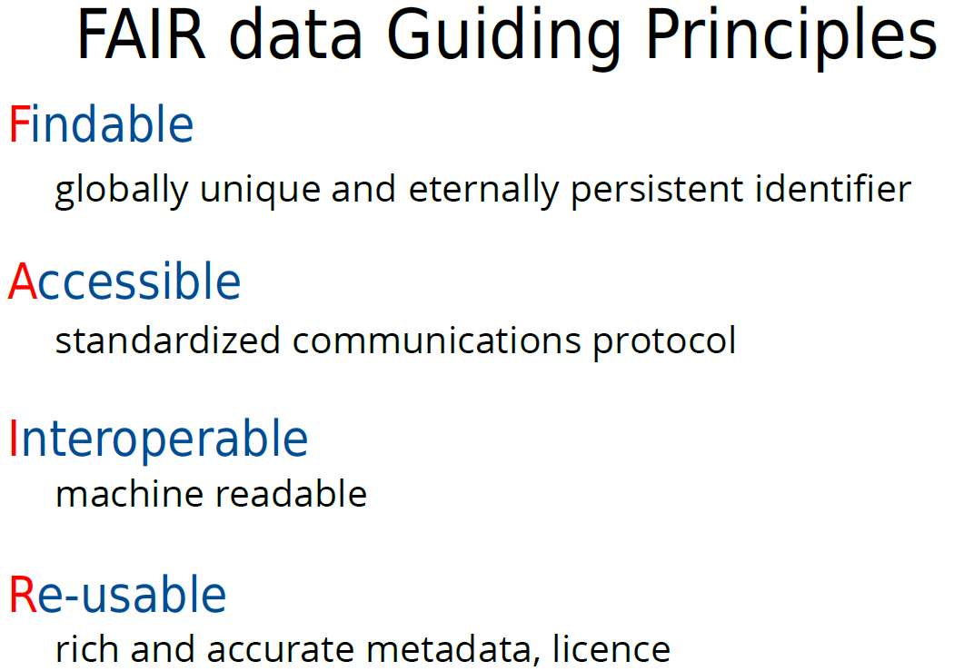
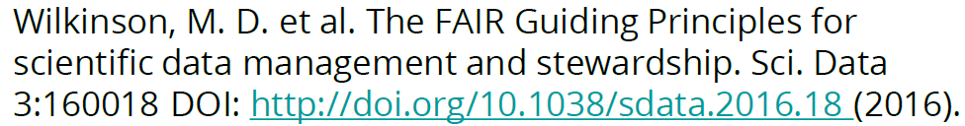
just to set the scene
Open Science
OPEN data
FAIR data
https://opendefinition.org
Open Access

Slide 8
in the following, let’s look at some specific issues and challenges
that we face at the moment
FAIR - devil in the details
  ‘implementation rules’ -> licenses, identifiers, metadata standards, repository requirements …
  FAIR was meant for machines… ?
Open – is open for interpretation
Open data, Open Access, … Open Science
Open for commercial use? Open for competitors (and if so, when)?
Open for unqualified comments (shitstorms)?

Slide 9
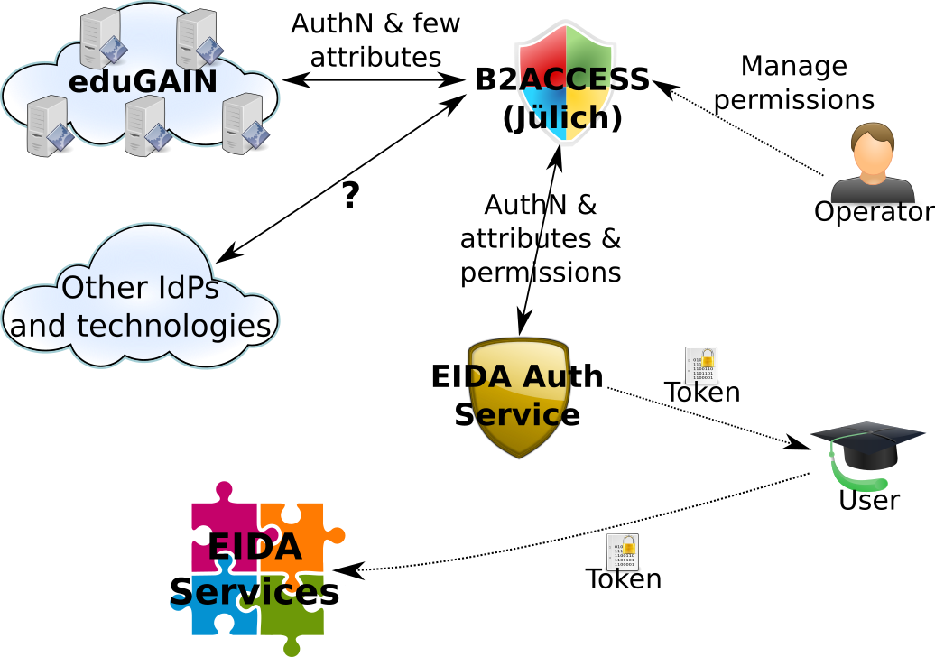
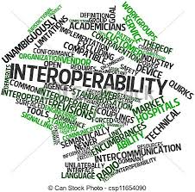
That’s where we left it last year…
EIDA federated authentication & authorization
FAIR and Open data
Do we need to control
access to achieve Open data & services?
of course! But – FAIR ≠ Open?
Licensing
CC-BY! … ah – can raw data be licensed?
Google wants to make a disaster info service !
… using my data ???
Attribution and provenance tracking
protect embargoed / restricted
data & services
comply with GDPR
Attribution
Attribution
Attribution
- dynamic data identification
- subset combination & remixing
- complex iterative processing
Attribution
Attribution
Metadata and vocabulary harmonization
Let’s go global! Who is in charge?
Notes:
A slide from last year… the challenges are all there… let’s have a closer look

Slide 10
Attribution –
Challenge: how to ensure (enforce?) appropriate attribution through the whole data life cycle (and what is appropriate)
Who should get acknowledged / referenced in your latest research work:
- the original ‘raw data’ collector (all of them…)
- the ones who generated the actual products that you then used (may have involved multiple steps)
- the institution operating the service that provided you with the products
… grandma? … any other sponsors of the above?
Metadata & identifiers can do it (really?)
  - but we need standardized automatic tools to extract ALL that information reliably
  (in particular to serve those bean-counters that want to count beans)
- and it looks like a bit of (meta)data collection work throughout – how expensive is it?
Can we start forgetting some levels after X years? And how big might X be?

Slide 11
Reproducibility –
Challenge: how to ensure end-to-end reproducibility and where are the (practical) limits
(e.g. in retaining previous versions of data(sets)… )
PByte of input data (collected from largeN sources) + complex workflows executed on specific systems with particular codes + visualized with that very special library
- a lost game from the start? in particular if you think about decades or centuries …
  - what are the basic information parameters to keep (and curate) to ensure a sufficient level of scientific reproducibility (i.e. a domain expert can properly interpret the results because she understands the input well enough)?
  - who is in charge? (yes, initially the original author… but she needs help with that… - and once she retires?)
Are today’s provenance tracking & capturing systems evolved enough (and sufficiently standardized)?
This is closely linked to the identifiers issue…

Slide 12
Licensing –
Challenge: where to go and what is actually allowed / meaningful
(among other considerations: will we ever legally respond to a breach?)
Many EU publications on Open (data / access / science) talk about ‘research data’ …
Licensing is closely linked to intellectual property (IP) rights – and that is governed by national law.
from the EPOS Data Policy (where we strongly encourage to adopt CC-BY):
Data and data products are grouped in 4 levels:
raw or basic data (level 0),
data products coming from (nearly)
automated procedures (level 1),
data products resulting from scientific investigations (level 2),
integrated data products resulting from
complex analysis (level 3).
no intellectual property (in many countries)
no copyright !
no license ?!
looks like research data

Slide 13
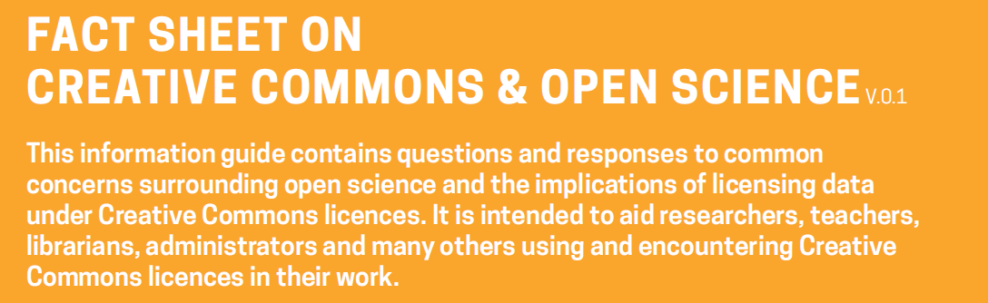
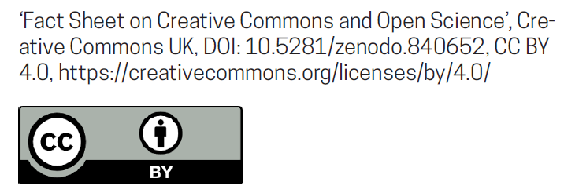
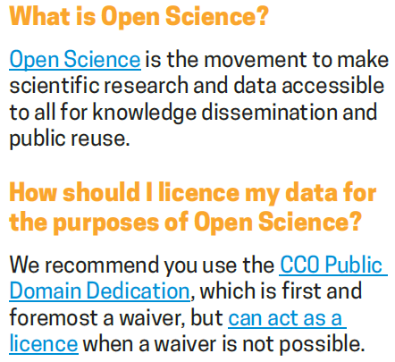
Licensing –
Challenge: where to go and what is actually allowed / meaningful
(among other considerations: will we ever legally respond to a breach?)
What the guys from Creative Commons say about it …
By applying CC0 to your data you enable everyone to freely reuse your data as they see fit by waiving (giving up) your copyright and related rights in that data.
You should keep in mind that there are many situations in which data is not protected as a matter of law. Such data can include facts, names, numbers – things that are considered ‘non-original’ and part of the public domain thus not subject to
copyright protections.
In these cases, using a Creative Commons license such as a CC BY could signal to users that you claim a copyright in the non-original data despite the law, and perhaps despite your real intention.

Slide 14
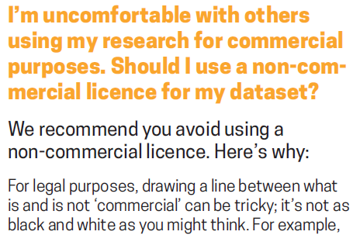
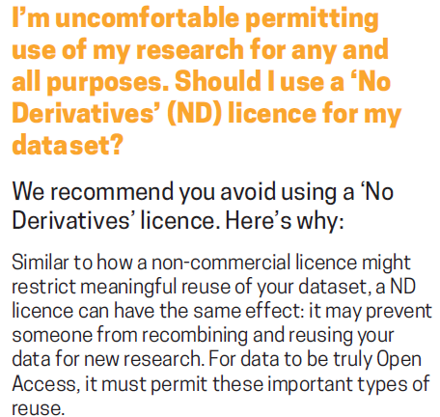
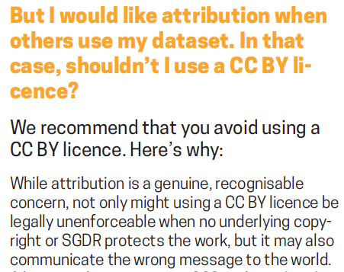
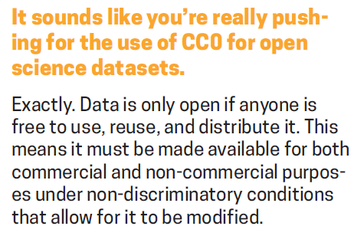

Slide 15
Identifiers –
Challenge: how to use them and which to use for what?
(granularity, machine-operability, global resolution)
Identifiers (persistent ones…) are key to almost everything here, it seems …
DOIs are great for attribution – also for datasets (see attribution slide for challenges…). (really?)
but maybe not so much for provenance tracking / workflow management?
and perhaps not for dynamic datasets / to capture subsets or selections? (work in progress… -> RDA)
It seems (to me) that we should use different identifiers in different contexts / for different purposes
(and then have a clever way to link between them)
technical solutions already exist (I am told… maybe too many different ones?)
– but we need to connect them to all our services and processign & curation workflows
do we need all identifiers to be globally unique and resolvable?
how much effort will it be to ensure that identifiers resolve correctly in 50 yrs from now?

Slide 16
So much for now… lots of open questions…
Thank You
Some further (almost random) stuff in the back… just because there is space for it in this format ☺

Slide 17
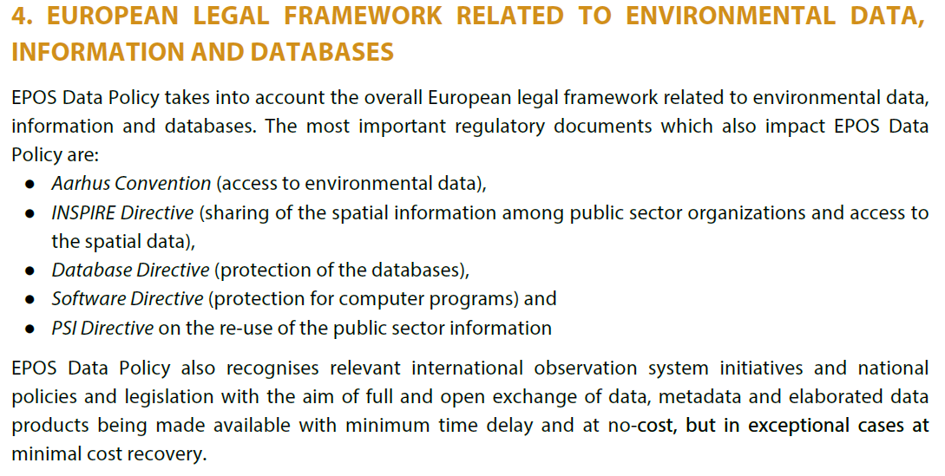

From the EPOS Data Policy

Slide 18
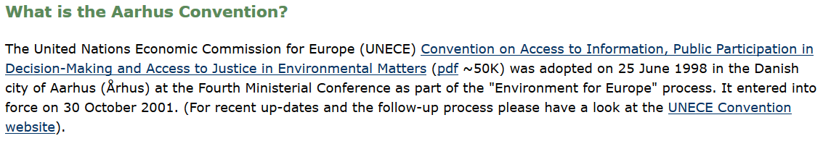
https://ec.europa.eu/environment/aarhus/
Right of everyone to have access to environmental information held by public authorities
Right to participate in environmental decision making
Right to review procedures to challenge public decisions that were made without
respecting the above

Slide 19
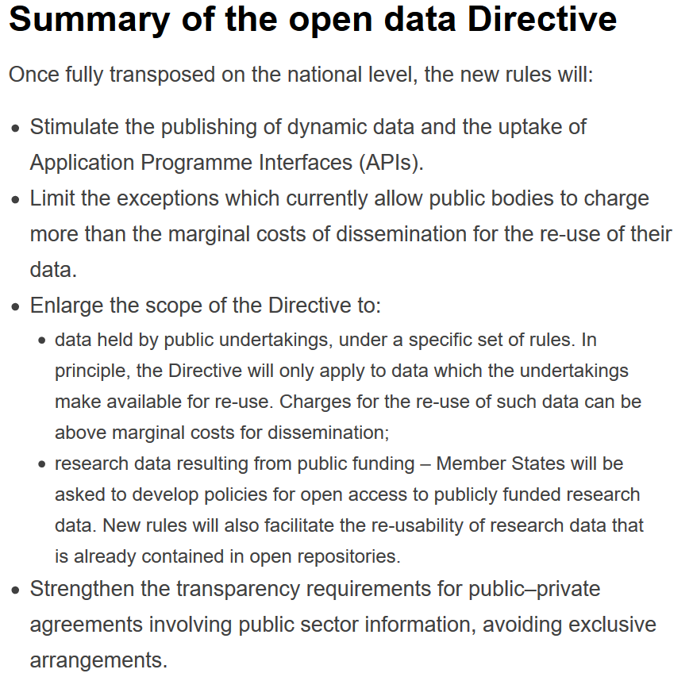
In July 2019 the PSI Directive (2003) was replaced by the Open Data Directive
https://ec.europa.eu/digital-single-market/en/european-legislation-reuse-public-sector-information

Slide 20
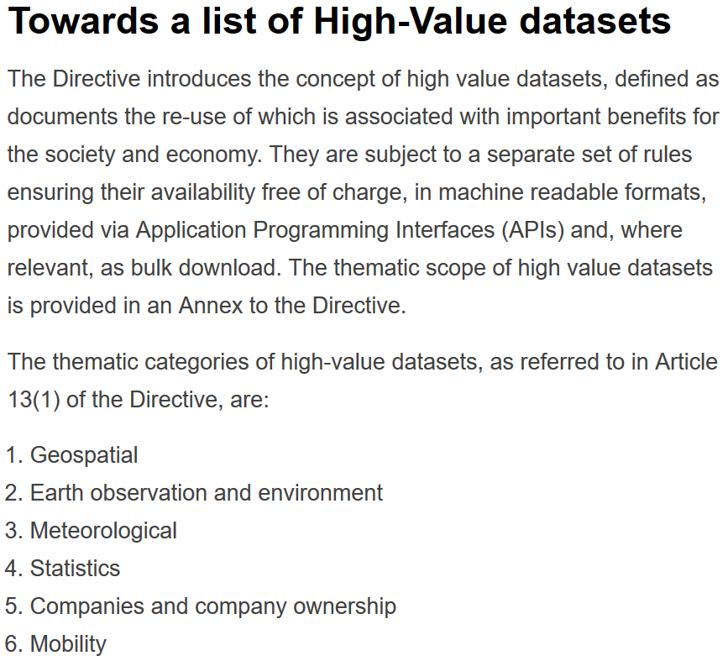
In July 2019 the PSI Directive (2003) was replaced by the Open Data Directive
https://ec.europa.eu/digital-single-market/en/european-legislation-reuse-public-sector-information

Slide 21
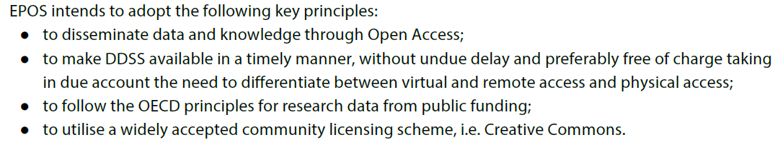
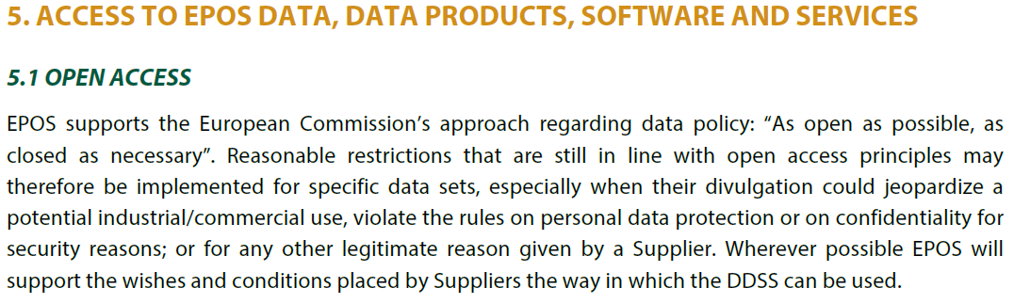
From the EPOS Data Policy

Slide 22
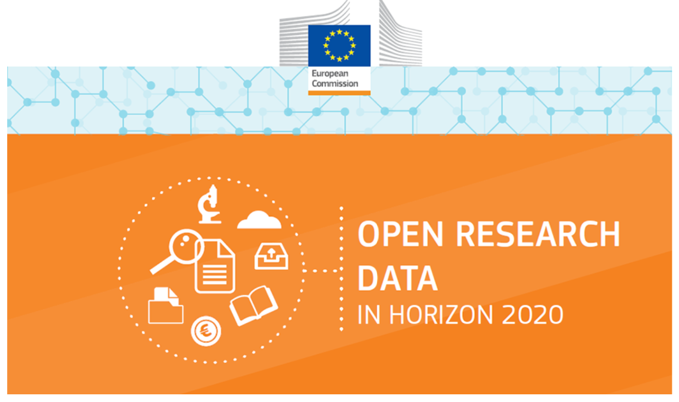
another EC brochure
https://ec.europa.eu/research/openscience/images/open-data-2016-w920.png

Slide 23
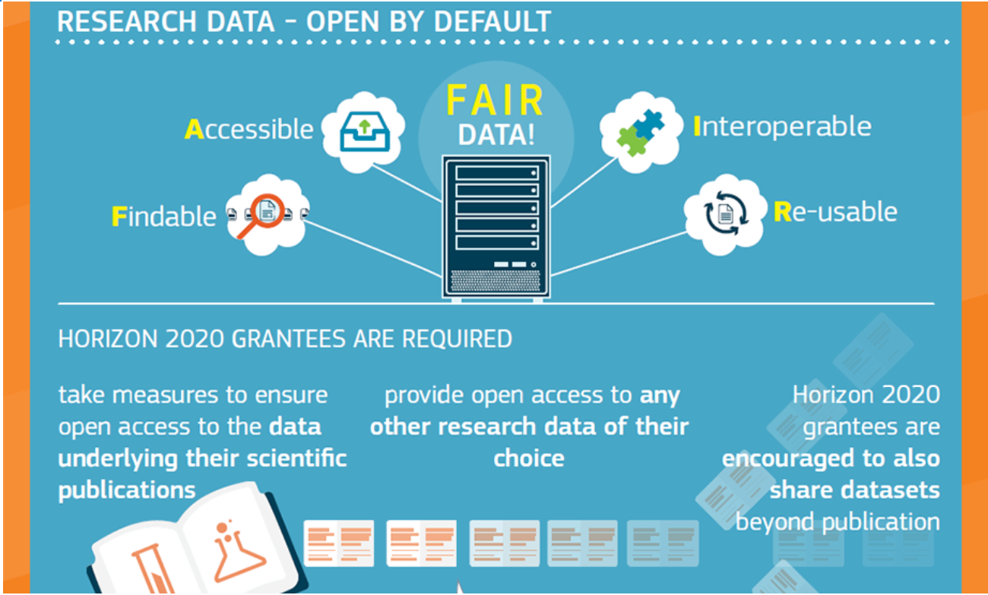
That’s not very committal?

Slide 24
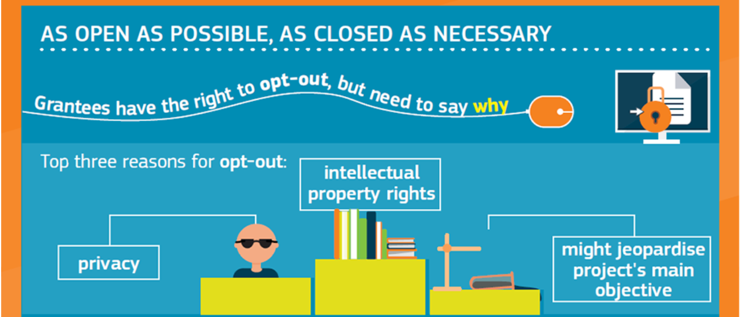
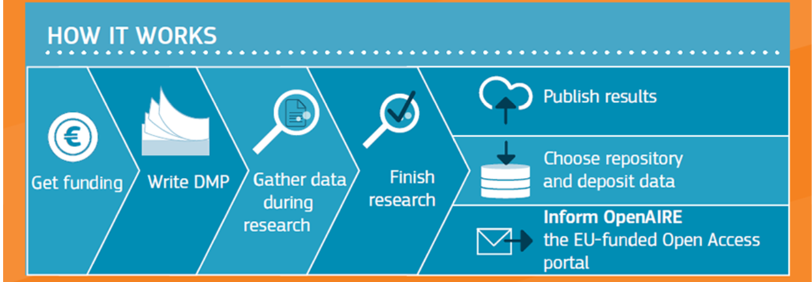
Looks like a way out for everybody who wants out…
The ‘research project’ approach falls short in many contexts…
But of course that’s what the brochure was written for…

Slide 25
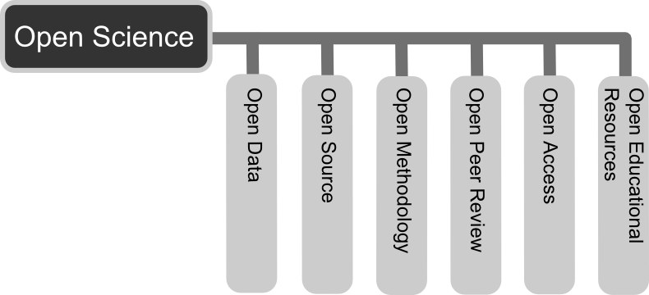
I guess we all know that by now …
https://ec.europa.eu/programmes/horizon2020/en/h2020-section/open-science-open-access
As other challenges need to be addressed such as infrastructure, intellectual property rights, content-mining and alternative metrics, but also inter-institutional, inter-disciplinary and international collaboration among all actors in research and innovation, the European Commission is now moving decisively from ‘Open access’ into the broader picture of ‘Open science’.
By Andreas E. Neuhold - Own work, CC BY 3.0, https://commons.wikimedia.org/w/index.php?curid=33542838

Slide 26
What we thought some time ago…
A closer look at ’access’ issues
The EC and many national governments encourage engagement with the private sector and want to use that engagement as a measure of success / relevance of science
potential commercial use cases:
insurance industry: earthquake catalogs,
hazard products, for portfolio assessment etc.
energy sector: waveforms (waveform modeling), strong motion parameters (for engineering safety)
social media providers: earthquake information for publicity and targeted services
potential issues:
for free or against charges?
(and if charged, how to enforce?)
loss of control over information
loss of visibility (-> funding?)
increased utilization of science
benefits to society
➡ Impact on access control, usage monitoring, licensing
Science is publicly funded:
results shall be free and open for all
maximizing access ensures optimal societal benefits
reward & recognition through attribution
Science is competitive:
reluctance to ’open’ data & products
embargo periods and usage restrictions
data (and products) as ’currency’

