Slide 1
Acceleration of cold ions in the process of symmetric magnetic reconnection.
Evgeny Gordeev¹, Andrey Divin^{1*}, Ivan Zaytsev¹, Vladimir Semenov¹, Yu. Khotyaintsev², S. Markidis³
¹Saint-Petersburg State University ²IRFU, Uppsala ³KTH, Stockholm
EGU 2020
Vienna
email: andrey.div@gmail.com
EGU2020-18886 ST2.4

Slide 2
Why magnetospheric cold ions are important ?
In addition to ~KeV range hot plasma sheet population, a significant fraction of cold ions (tens of eVs) of ionospheric origin (e.g. [Seki, 2003], [Engwall, 2009], [André, 2012] might be present there.
Observation studies (André [2012], Toledo-Redondo[2015-17], etc.) reported impact of the cold ion component on reconnection rate, kinetics and energy exchange.
Studies of the cold ions impact the reconnection process speculate on their possibility to drift inside the separatrix region due to the small thermal gyroradius André [2012], [Alm, 2018]
Might constitute >50% of total density.
Cold ions are magnetized on smaller scales than hot ions [Divin, 2016]
Cold ions modify Hall effect and might suppress Hall currents

Slide 3
Outline
Outline:
A) Motivation
B) Brief review on 2D kinetic reconnection physics
C) PIC simulations of hot and cold cases
D) On-going comparison with observations
E) Test particles model
Simulation setup
Hot ion case: Hall physics
Cold ion case: Hall physics
Insights from test particle calculations
Observations [Alm, 2018]

Slide 4
Simulation setup
iPIC3D code (2D version) [Markidis, 2010]
Initial condition: Harris CS, Ti/Te=5, no guide field, background density = 0.5 ^{x} peak Harris density
Run 1 (reference GEM-type run): background temperature = Harris CS temperature
Run 2 (cold ion run): background ion Ti(b)=0.01 ^{x} Ti(H)
Normalized units (ion inertial length, Alfvén velocity, ion cyclotron frequency)
Note: X is along B field; Y is normal to Harris CS.

Slide 5
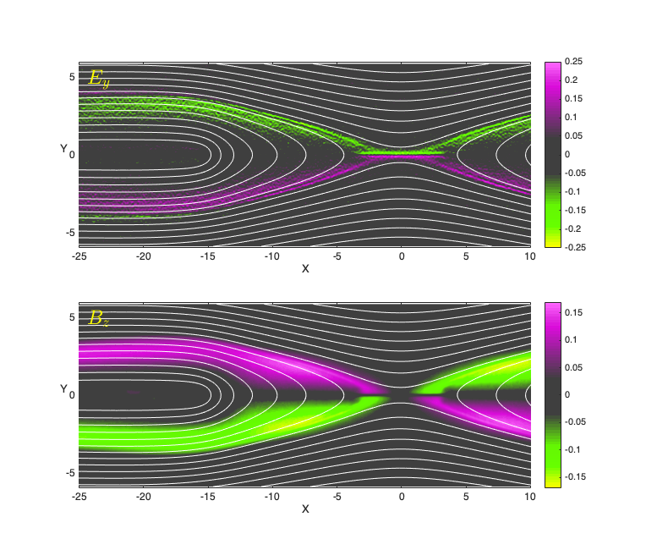
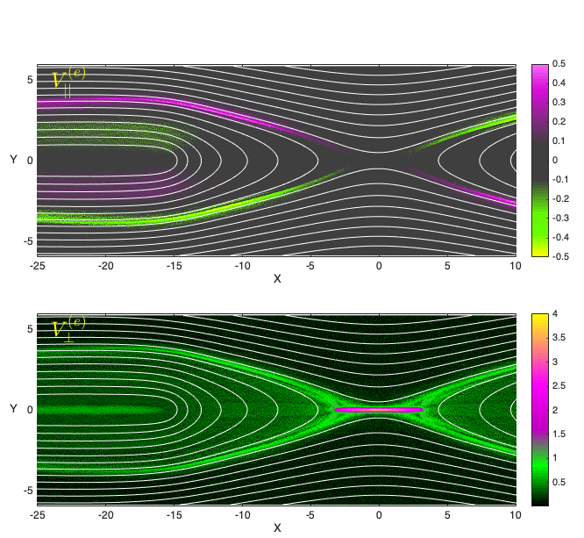
Run 1: conventional Hall physics, hot ion background
Inflow-outflow potential difference [Korovinskiy, 2008]
Parallel electron velocity
Ve
Va
Va
Ve
+
Perpendicular electron velocity
i
-
e
Ve
e
-
+
i

Slide 6
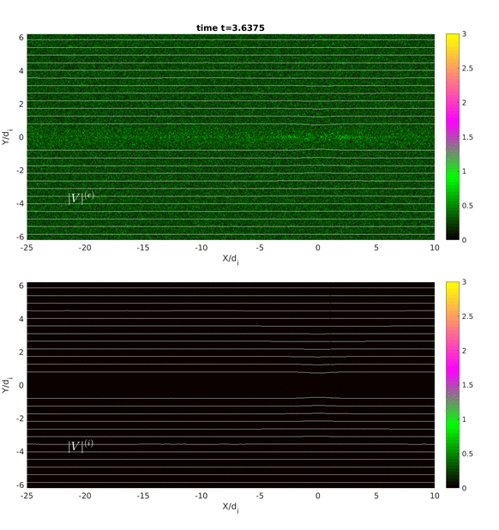
Run 2: movie
|Ve|
|Vi|

Slide 7
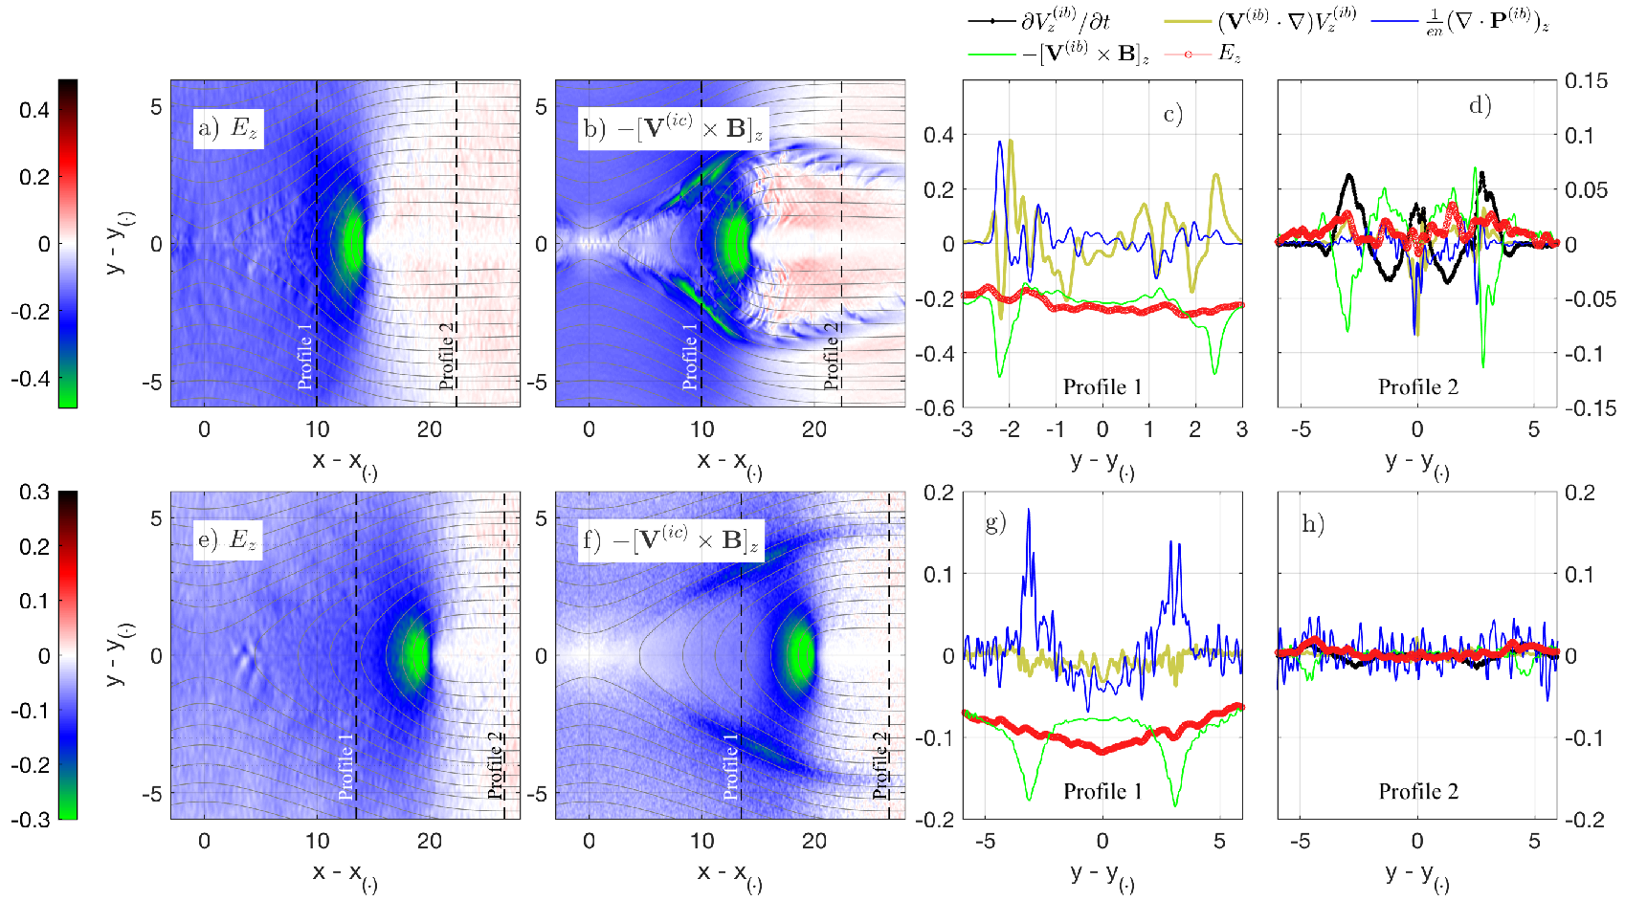
Ion momentum equation (z, reconnecting component)
Ahead of the front:
Ez perturbation, with
Ion [V x B]z balanced by dV/dt
separatrices:
{
{
Ion [V x B]z component
overshoot
Large ion inertia
close
(near)
distant
no Ez !
Cold run
no Ez !
Hot run
Weak ion inertia,
large ∇*Pi
Hot ion case:
very weak
perturbations
ahead of the front

Slide 8
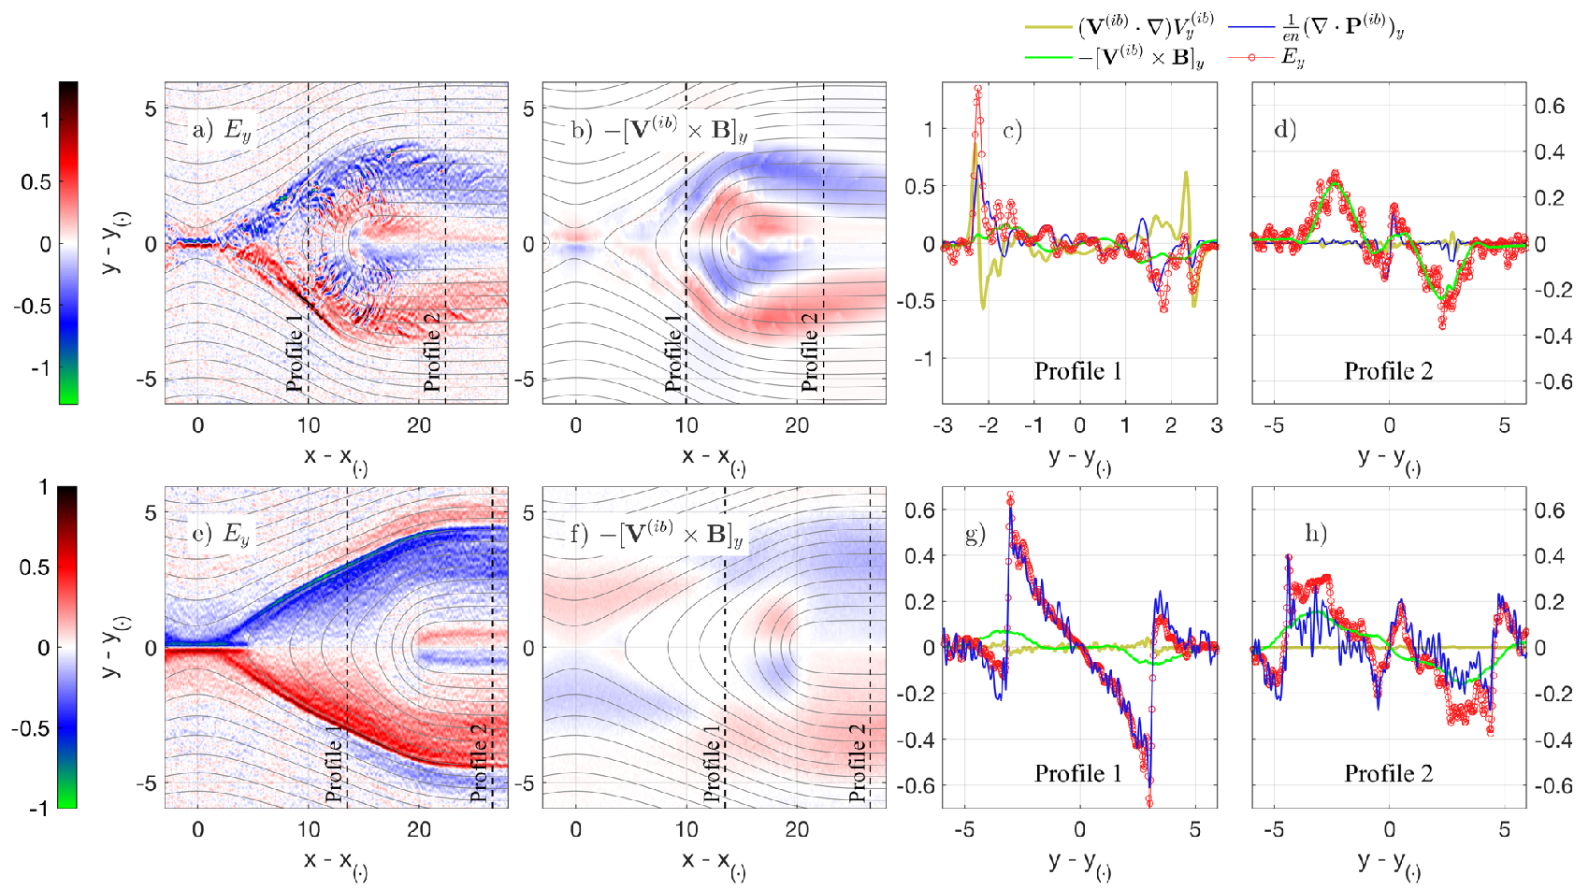
Ion momentum equation (y, ~Hall component)
separatrices:
Ion inertia (V∇)V
dominates at upstream side of the exhaust separatrix
Ey = Convective field
at distant separatrices
{
{
close
(near)
distant
Cold run
Hot run
Hot ion background:
Ey balanced by ∇*Pi
Ey is balanced by
∇*Pi and [V x B]z

Slide 9
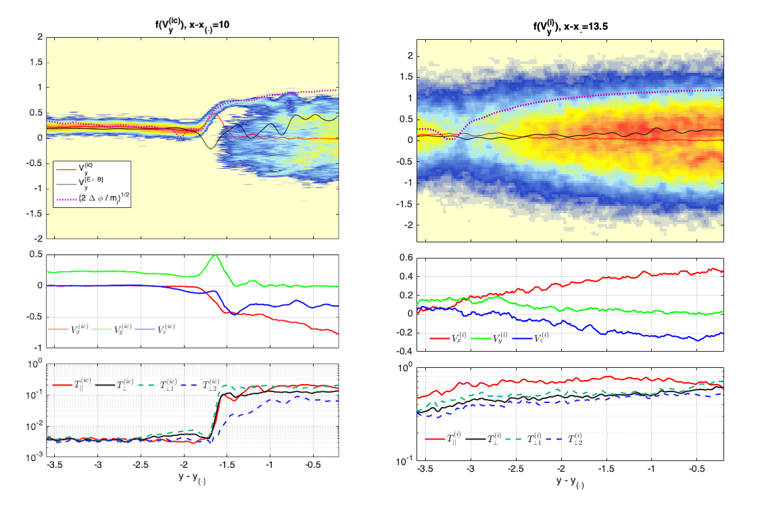
Cold ion beam accelerated up effective velocity
Cold ion simulation: perpendicular ion beam at separatrices
Perpendicular temperature dominates over parallel in a thin separatrix layer.
The accelerated beam persists inside the exhaust and mixes with warm (originally cold) outflow plasma moving from the diffusion region.
Cold case
Hot case

Slide 10
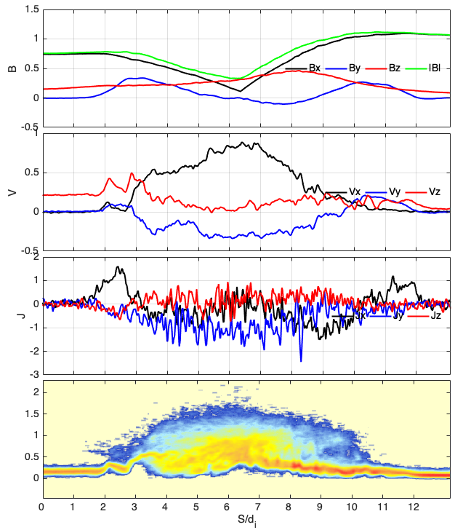
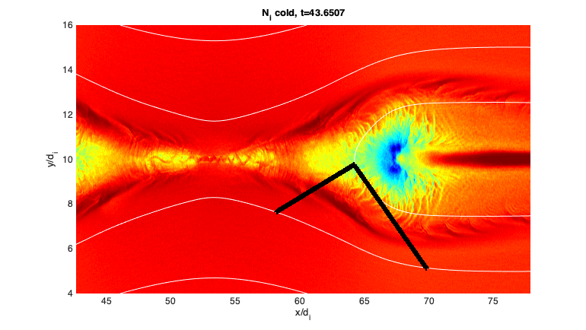
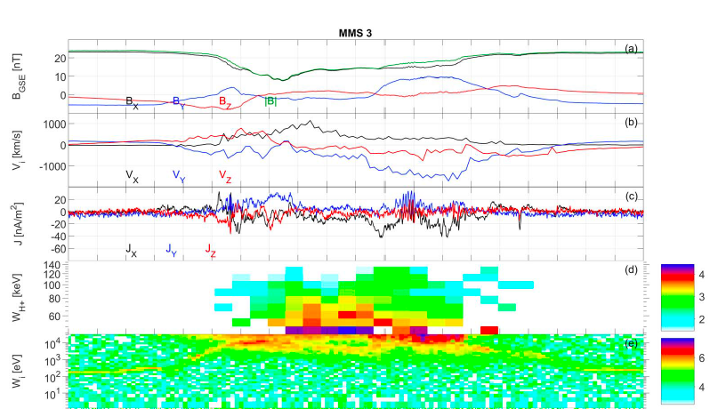
Interpretation cold ions in magnetotail
presented by [Alm GRL 2018].
Interpretation of cold ion reconnection exhaust crossing from [Alm, 2018, GRL 45(20), 2018, p. 10-941] (preliminary).
Possible trajectory
F(E)
Credit: [Alm, GRL 45(20), 2018, p. 10-941]

Slide 11
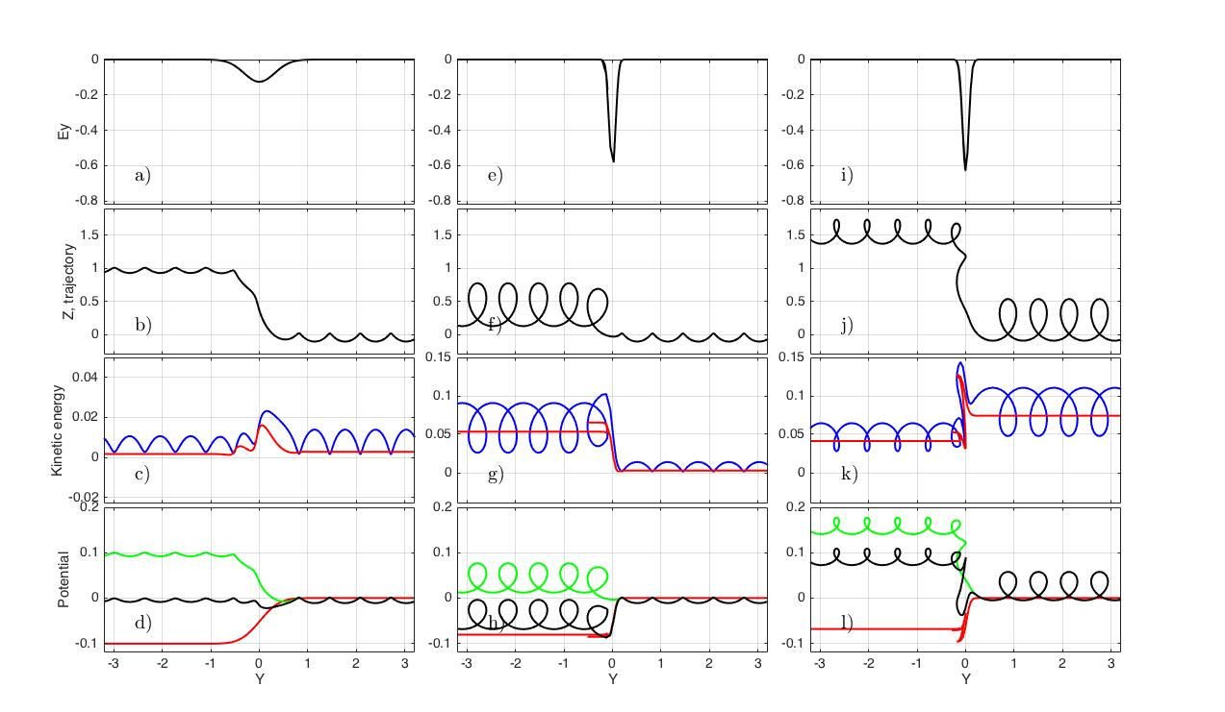
Test particle calculations
Wide potential drop -
Particle stay magnetized
Narrow potential drop
Cold ion
Hot ion
Ey
Trajectory
Ekin_total
Ekin in drifting frame
Ezdz
Eydy

Slide 12
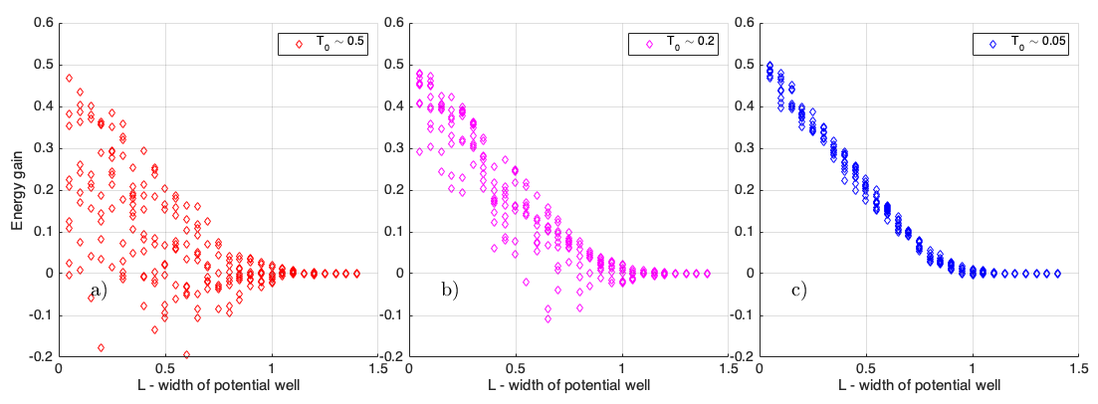
Energization of cold ions at separatrices.
Significant differences between the cold and hot ion dynamics at separatrices
Hot ions are scattered in energies by the electrostatic potential drop
Cold ions experience uniform perpendicular acceleration depending on the separatrix width.
For a wide layer: no acceleration at all in both cases.

Slide 13
Results
Cold ions are accelerated by the Hall electric field at separatrices. Cold ion acceleration occurs in the presence of both Hall and reconnection electric fields.
Peak cold ion energy matches well the value of the perpendicular electrostatic potential ~B²/ne across the separatrix.
The Hall electric field Ey is balanced only by the ion pressure term in hot ion simulation, in agreement with past studies. The cold ion run shows the presence of stronger ion inertia.
Hot ions experience very weak acceleration right at separatrices. Hot ions are scattered in energies by the narrow electrostatic potential.
(preliminary) Observations of cold ion-dominated reconnection [Alm, 2018] partially conform our picture.
RSCF 18-47-05001

