Slide 1
Modelling of airborne Full Tensor Magnetic Gradiometry using data from the INFACT project
- Synthetic Modelling
Jouni Nevalainen¹, Elena Kozlovskaya¹, Jukka-Pekka Ranta¹, Joan Marie Blanco², Moritz Kirsch², Richard Gloaguen², Michael Schneider³ & Jens Kobow³
1 Oulu Mining School, Faculty of Technology, University of Oulu, Oulu, Finland.
2 Helmholtz-Zentrum Dresden-Rossendorf, Helmholtz Institute Freiberg for Resource Technology, Freiberg, Germany.
3 Supracon AG, An der Lehmgrube 11, 07751 Jena, Germany.
EGU2020, 7.5.2020.
Online presentation

Slide 2
Content
INFACT project
Magnetics in mineral exploration
Full Tensor Magnetic Gradiometry
Synthetic modelling
Conclusions & future development

Slide 3
INFACT project
The Innovative, Non-invasive and Fully Acceptable Exploration Technologies (INFACT) project unites stakeholders of Europe’s future raw materials security in its consortium and activities.
INFACT is comprised of the following main components:
Development and test of innovative, non-invasive exploration technologies;
Foundation of 3 reference sites for exploration technology in the south, center and north of Europe;
Stakeholder engagement, education and policy reform.
These actions are combined to reach each of the main areas in which the EU has the power to influence changes in its raw materials security.

Slide 4
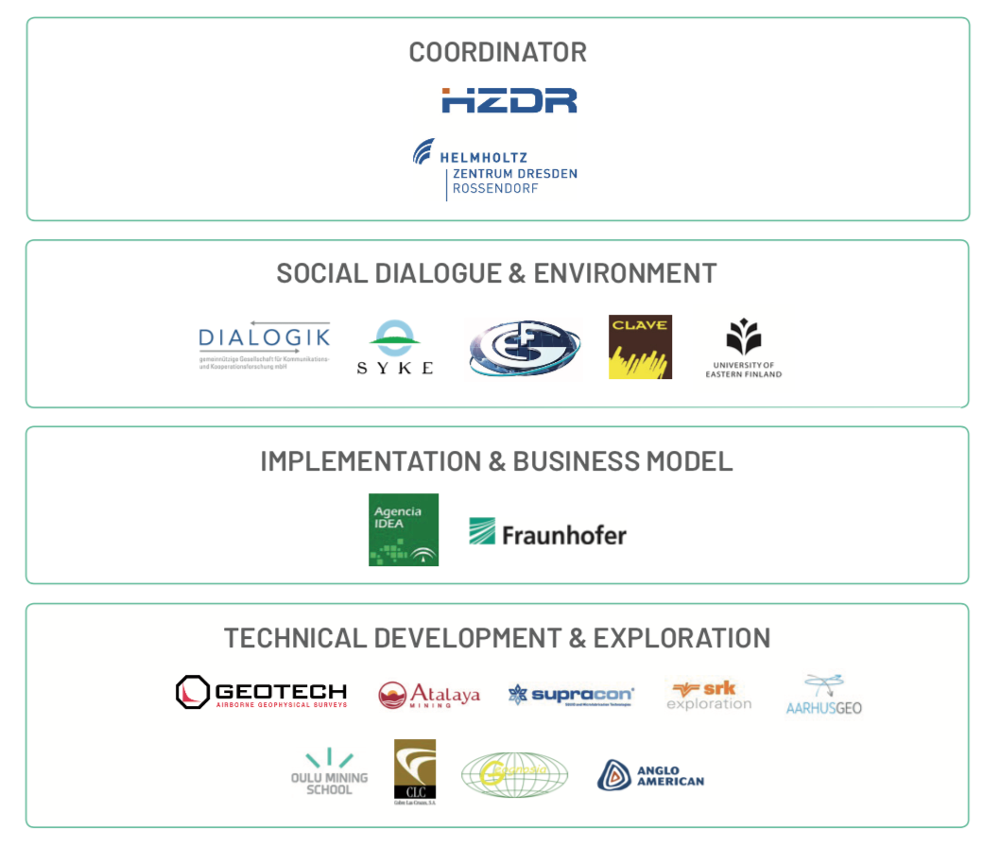
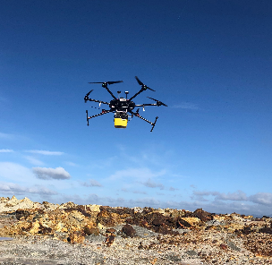
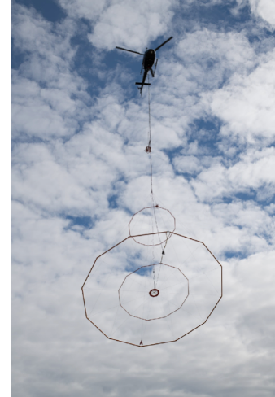
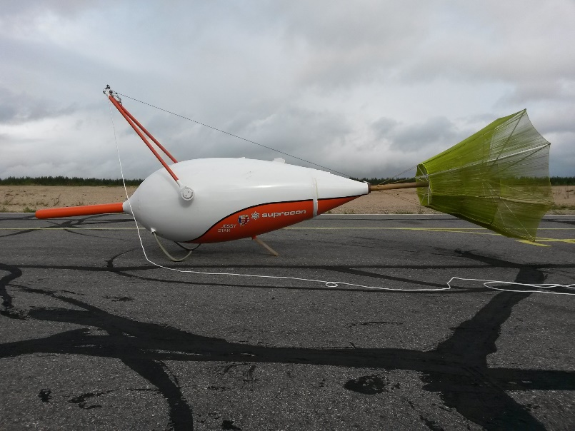
  INFACT – IN A NUT-SHELL
1
Support development of non-invasive exploration technologies
PARTNERS
2
Ensure that stakeholders’ voices are
heard
3
Look worldwide for best practices to apply in the EU
HZDR HIF
Supracon ®
Full Tensor Magnetic Gradiometry
System: JESSY STAR
Geotech, EM
Notes:
Helholtz zentrumn Dresden Rossendorf (HIF ) Helmholtz Institute Freiberg for Resource Technology

Slide 5
Magnetic method in mineral exploration
Magnetic Method is based on observing the variations in magnetic field due the geological (or other) content. Magnetic method is a “backbone” method in mineral exploration.
Although magnetic signature for any volume containing magnetic material is detectable using total field intensity instrumentation, its modelling can be difficult due the potential field nature of magnetic field (ambiguity).
In addition, presence of remanence magnetization and/or magnetic material in side rock can make accurate modelling challenging.
Notes:
Too trivial. No need for presentation in the end.

Slide 6
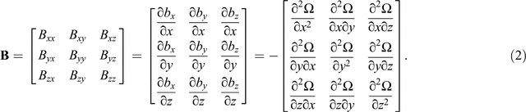
Full Tensor Magnetic Gradiometry, FTMG
In FTMG measurements the independent gradient components are observed for a single observation point.
This complete description of the magnetic field provide more information of the size, shape and material property of the magnetic rock mass.
This is due that a specific magnetic objects effect is observed in all magnetic field gradients at the observation point and thus constrain the number of possible magnetic models.
Can be measured directly or calculated from total magnetic intensity observations.
During past decade highly sensitive magnetometers based in SQUID (Superconducting QUantum Interference Devices) technology has been successfully adopted in Full Tensor Magnetic Gradiometry airborne measurements, which has made magnetic methods a “new coming”.
&
Bzz = -(Bxx +Byy)
Notes:
gradiometers are less sensitive to rotations in homogeneous magnetic field and thus reduce dramatically,
• gradiometers suppress the homogeneous magnetic field and do not suffer from geomagnetic noise,
• long wavelength regional trends in the gradient signals are removed,
• spatial resolution of gradient tensor data is in theory higher by a factor of two [24],
• the data provides additional information for the identification of magnetic remanence indicators,
• improved interpretation of gradient tensor data on irregular grids [25],
• gradient tensor data provide significant constraints to the solution of the inverse problem, e.g., the dipole-tracking algorithm [26] and have been successfully applied to estimate the location of block-shaped bodies.

Slide 7
Total magnetic intensity vs FTMG
TMI gives: just scalar total
magnetic intensity at the point
Obs. Point.
FTMG gives: complete behavior of
Magnetic field at the point.
Fligth lines

Slide 8
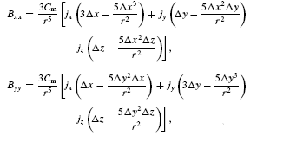

Synthetic modeling
Simple magnetic dipole with changing parameters.
Calculating effect to the magnetic field and its derivatives of the magnetized sphere.
parameters: XYZ (center) , radius, susceptibility, Earth inducing magnetic field (B0, I , D ).
Possibility to add remanent magnetization.
Hinze et al., 2013
B0
D
χ
I
r
J_{Rem}
J_{ind}
B0

Slide 9
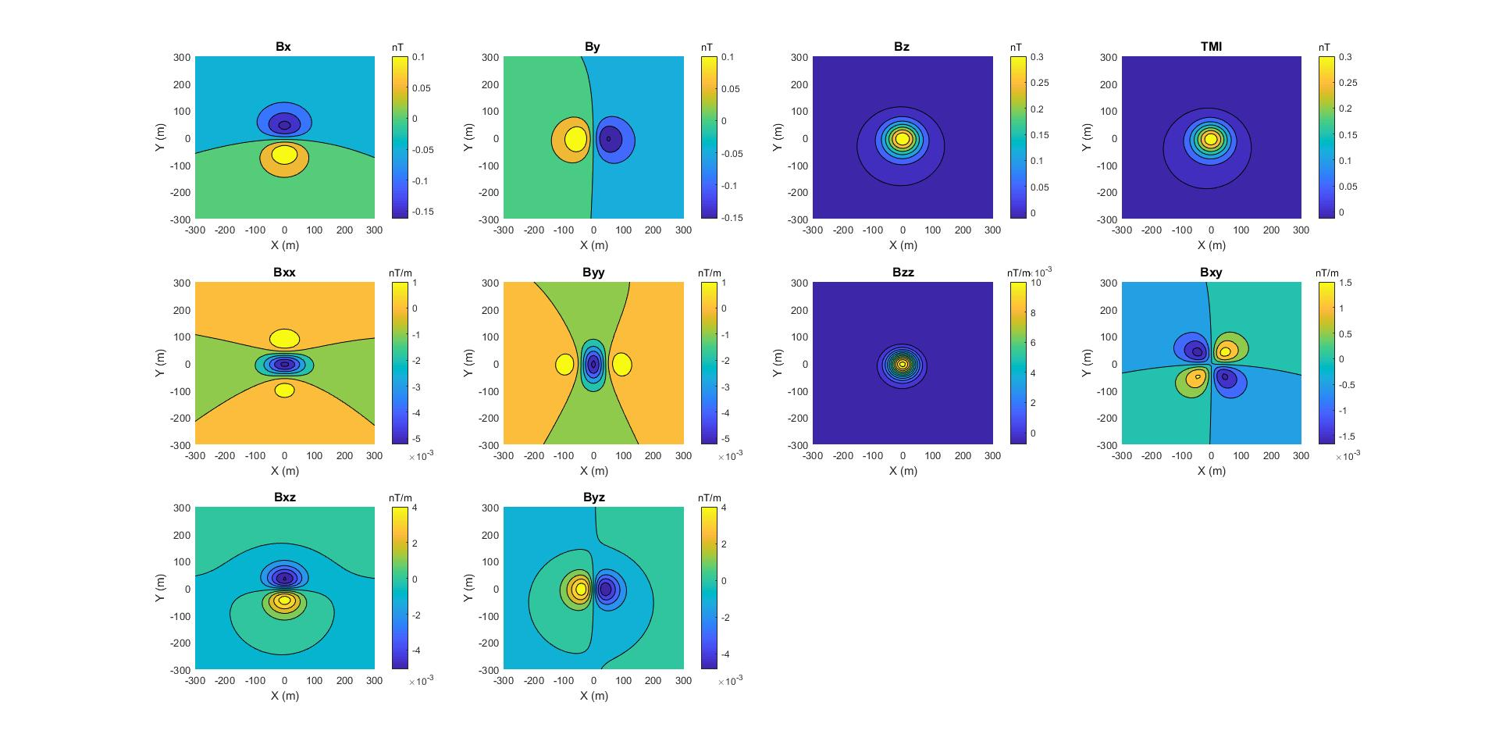
Single magnetic sphere, I=77.5 D = 12.1 B0 = 53557.5 nT (Northern Finland)
Response of sphere (dipole model)
r = 10, X0 =Y0 = 0 Z0 -50m, χ = (10*(10^(-3))
calculation Zc = 50 m
NOTE: NED coordinates!

Slide 10
Modeling with dipoles
Calculation heigth + points
Ground surface
Magnetic Object
Magnetic Object
10 m
To do: adding cuboid
elements in the algorithm
Notes:
Dipoles are used now for simplisity in coding.

Slide 11
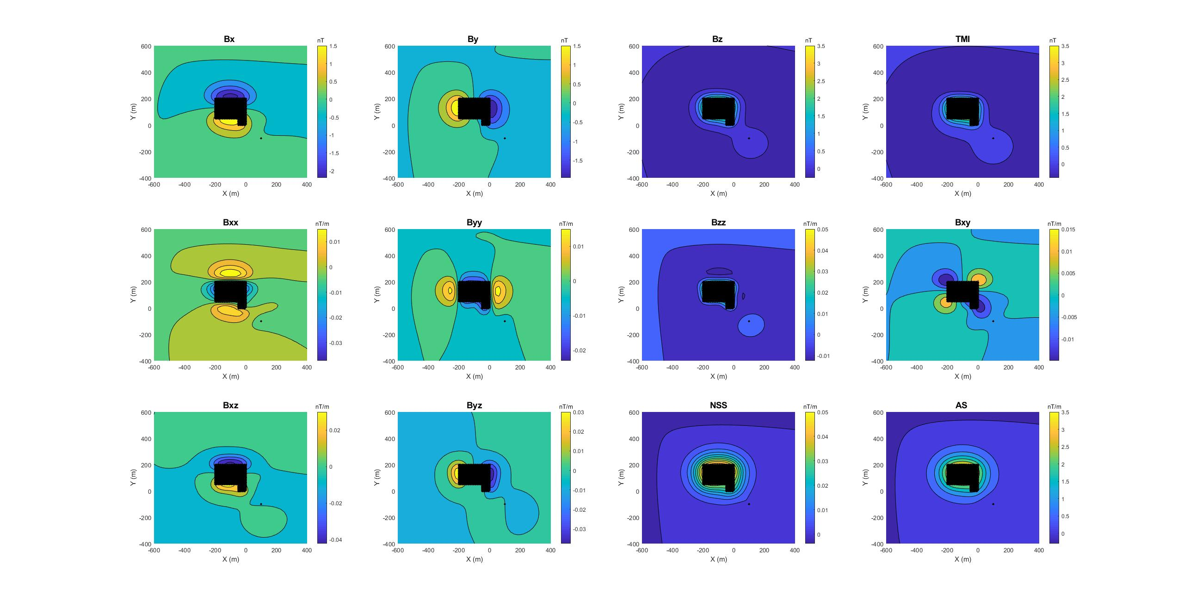
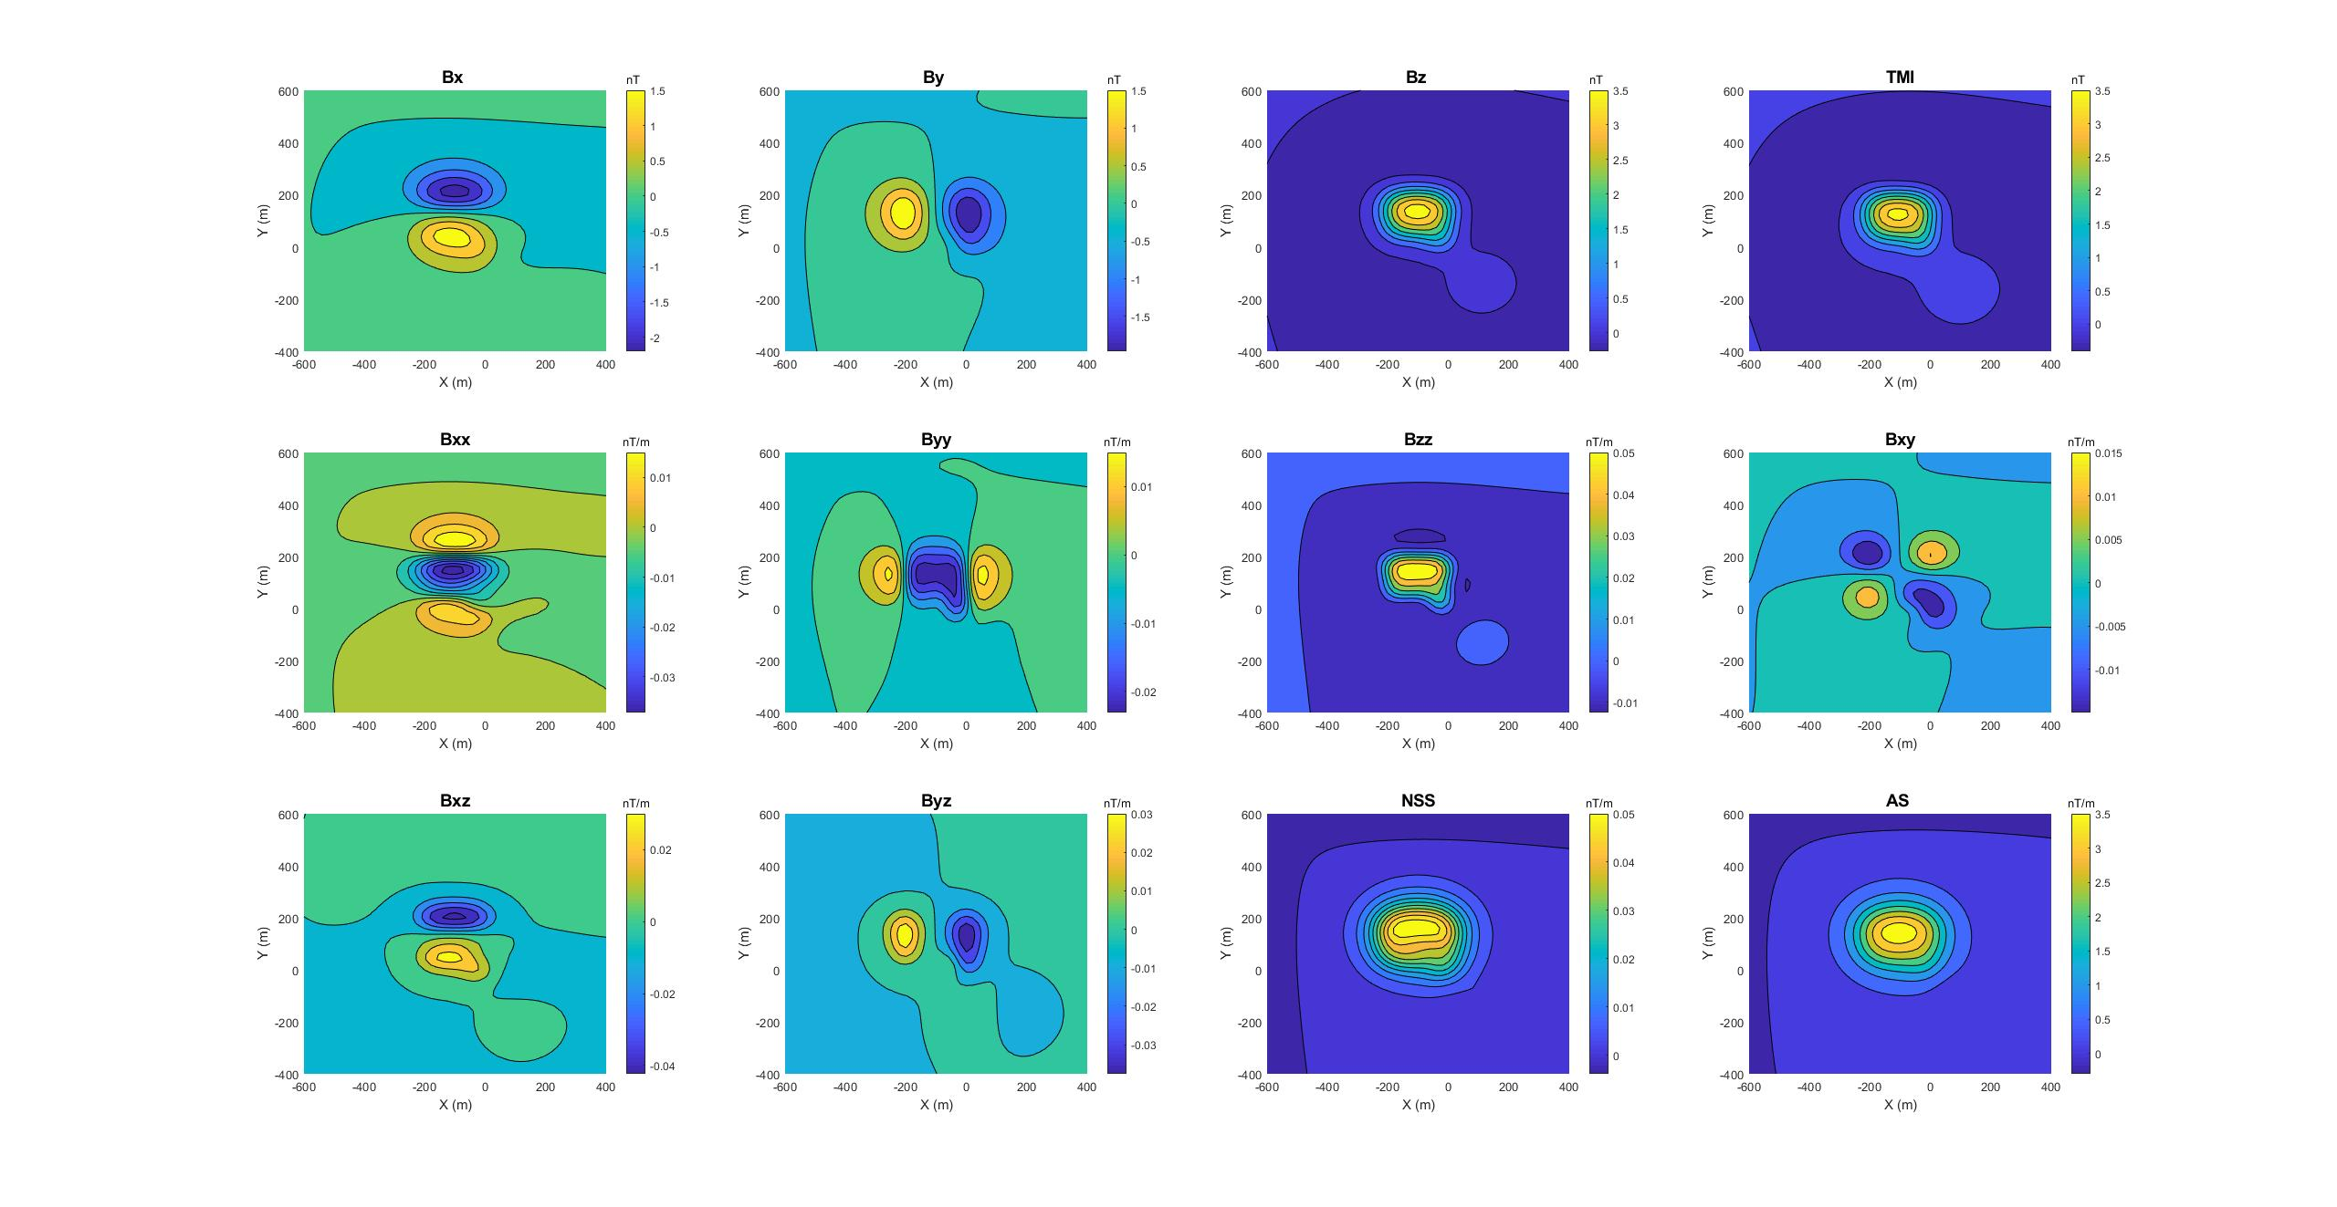
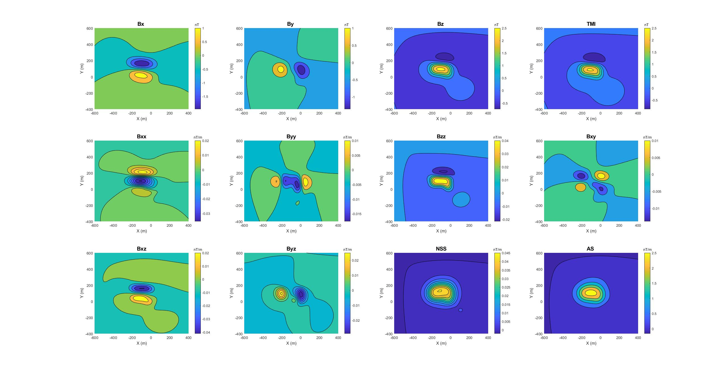
Remanent magnetization
I=77.5
D = 12.1
B0 = 53557.5 nT
View from east
Adding Remanent
Q = 1, I =-102.5
D = 45
200 m
Z = -40 ..-80
χ_rel = 3
TOP view
Z = -20 ..-60
χ_rel = 1
Z_center = -100
χ_rel = 10, r =15 m
Notes:
NSS many special characteristics, because it is semi independent of the source magnetisation direction. The NSS
parameter peaks over the centre of magnetisation for discrete bodies and along the central axis of elongate sources
A signal is good locating edges of magnetics objects.

Slide 12
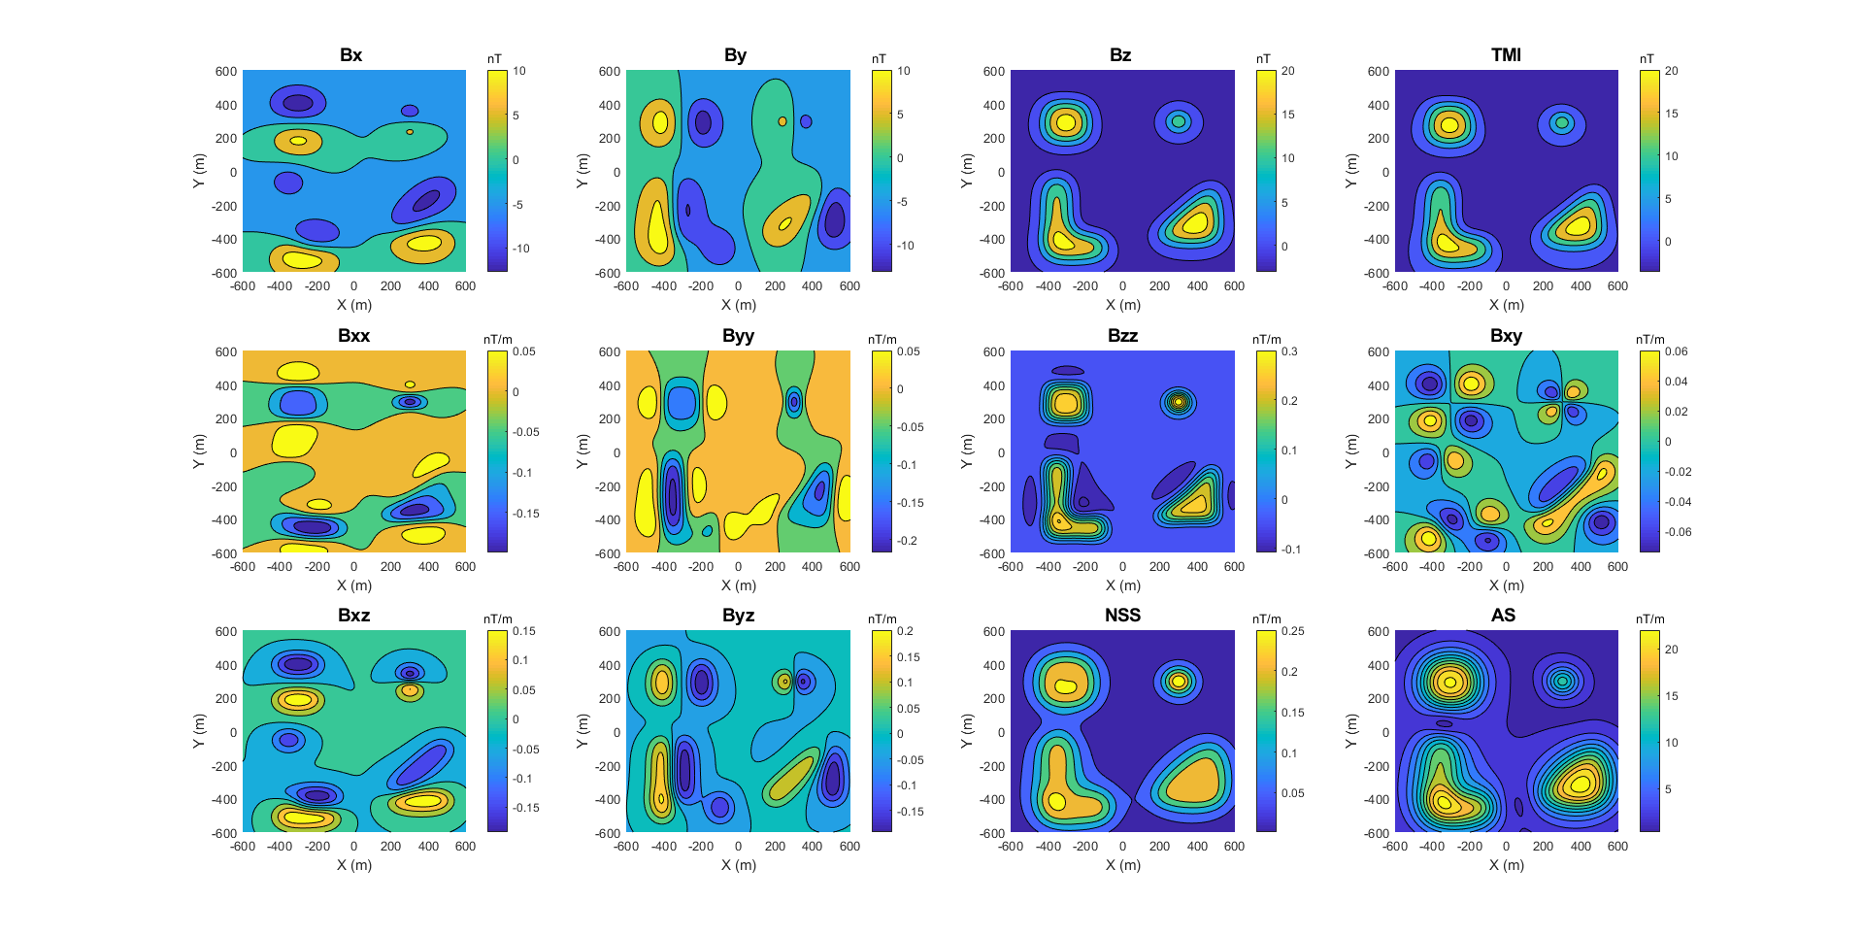
Anomaly shapes for Grid Search

Slide 13
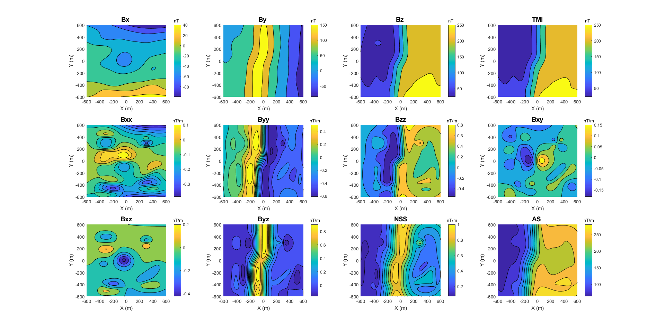
Anomaly shapes for Grid Search with contact
Notes:
Same than in slide 12 but with magnetic contact below the magnetic objects

Slide 14
Conclusions & future development
Modeling FTMG data gives clear advance versus TMI magnetic modeling due the stronger constrain from the data itself.
FTMG data has advantage in deriving information from space between flight lines.
Estimation of remanence magnetization component using the information derived from different magnetic gradient components.
Grid Search is used to find suitable model parameters to match the magnetic anomalies in the data. However, Grid Search is computationally very time consuming so we recommend constraining search parameters based on the data.
Further development:
Add cuboid elements in the forward modeling algorithm.
Adding optimization tools to adjust simple models and genetic algoritm multiobjective optimization for more complex models.

Slide 15
References
Geotech Ltd., 2019. Equipment photos from brochures + Project content.
Hinze, W.J, von Frese, R.R.B., Saad, A.H., 2013. Gravity and Magnetic Exploration, Principles, Practices and Applications. Cambridge University Press. (Chapters 8, 9).
INFACT, 2019. General information, more on http://infactproject.eu
Supracon, 2019. Equipment photos from personal contact.

