Slide 1
Dynamic And Interactive Scientific Posters: Visualising 3d Models And Simulation Data Using AR
Ryan L Payton
7th May 2020 – EGU2020: Sharing Geoscience Online

Slide 2
Allow static images from dynamic datasets to be visualised
Enable 3D data to be seen how it is supposed to be
Make your science interactive
Engage the audience
An extra dimension to capture the attention of observers
Excellent for younger generations

Slide 3
Production
Acquire 3D model converted
To OBJ or PLY format
Acquire MP4 video
Upload a target
image to Vuforia
Import 3D model or video
And targets from Vuforia into
Unity
Match targets & models/videos
and add interactive controls
Build the IPA file in
Xcode and open on an
iOS device to install
Open the APK file
on an Android
device to install
Export for Android or iOS

Slide 4
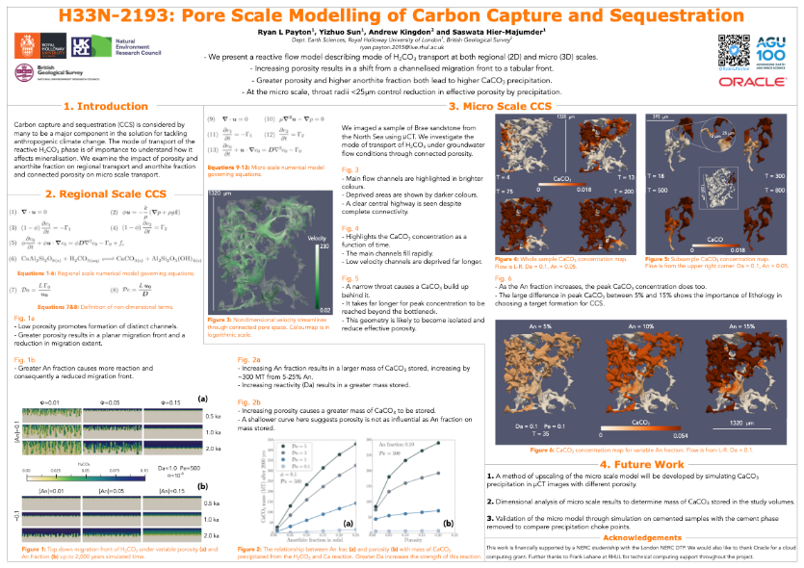
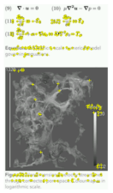
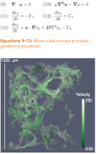
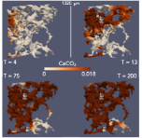
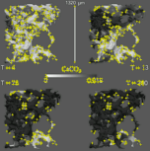
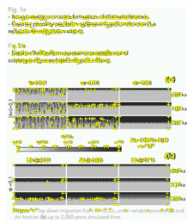
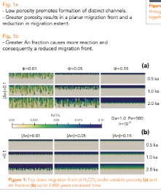
Posters
Reference
points as
yellow crosses
3 target
images

Slide 5
1 mm3 sandstone
from micro CT imaging
Numerical modelling
simulation result video
Numerical modelling
simulation result video

Slide 6
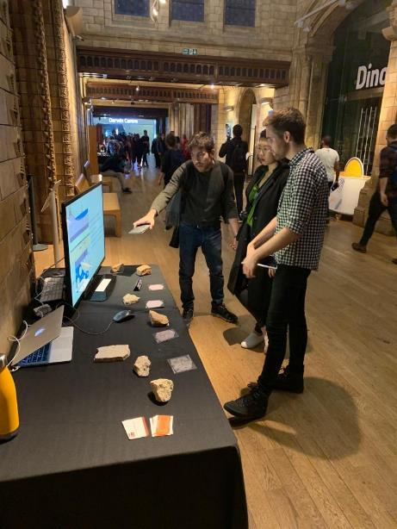
1 mm3 sandstone and limestone
from micro CT imaging
European Researchers
Night 2019
London Natural
History Museum

