Slide 1
Pressure Evolution Inside The High Voltage Modules Of Plasma Instrumentation When Exposed To Vacuum During Ground Test Campaigns Or After Launch To Space
P. Wittmann(1), M. Wieser(1), F. Trost(1), S.Barabash(1)
Swedish Institute of Space Physics
philipp.wittmann@irf.se
EGU 2020 online
2020-05-04

Slide 2
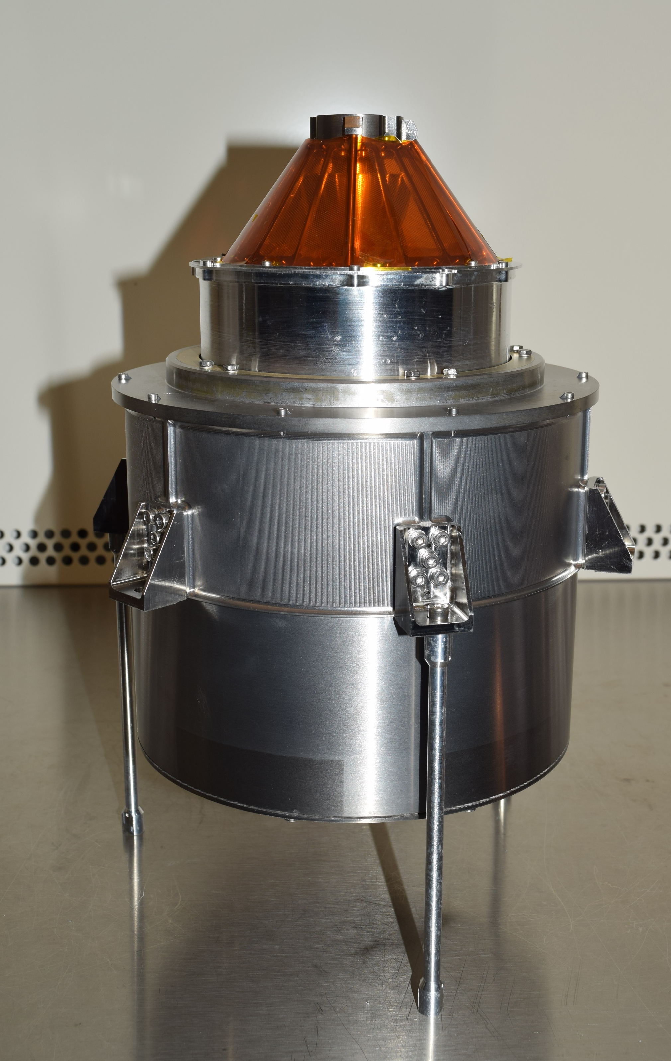
The Jovian Plasma Dynamics and Composition Analyzer (JDC)
A part of ESAs JUpiter ICy moons Explorer (JUICE) is the Particle Environment Package (PEP) [1]. PEP consists of six sensors with one of them being the Jovian plasma Dynamics and Composition analyzer (JDC)[2], built at the Swedish Institute of Space Physics.
JDC is a particle detector capable of detecting positive and negative ions as well as electrons with a mass range from 1amu to 70amu in an energy range from 1eV/q to 40keV/q. During these measurements in a hemispherical field of view, a mass resolution of 2 – 3 or up to 20, depending on channel, and an energy resolution of 12% can be achieved. For this high voltages up to 5.5kV and shielding against the harsh radiation environment (60% of the sensors 7.1kg) are needed.
~18cm
Notes:
Diameter of JDC

Slide 3
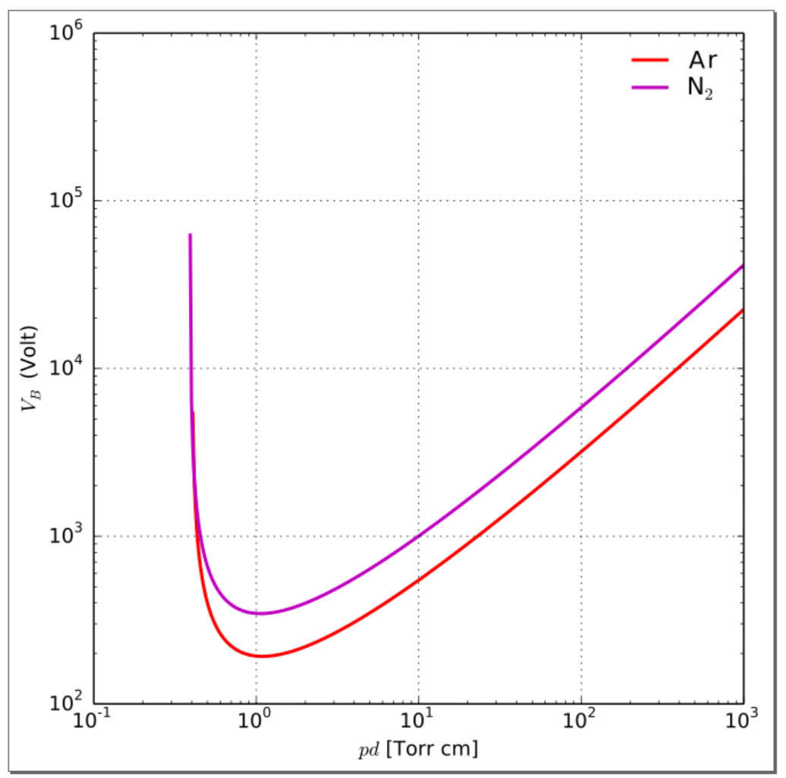
Pressure Inside a Particle Instrument
Dielectric strength for 2.5mm gap
High voltages (several kV) in particle instruments
→ large electric fields
⇒ discharges are more likely to happen
Discharge prevention:
Pressure inside our particle instrument must be below Paschen Minimum to have sufficient dielectric strength
Adapted from: https://en.wikipedia.org/
$${10}^{6}$$
$${10}^{5}$$
Dangerous pressure area
$${10}^{4}$$
$$V_{B}(Volt)$$
5.5kV
~2.5 mm
$${10}^{3}$$
$${10}^{2}$$
Paschen Minimum
0.52
5.2
52
520
5200
Pressure (mbar)
Notes:
Edit

Slide 4
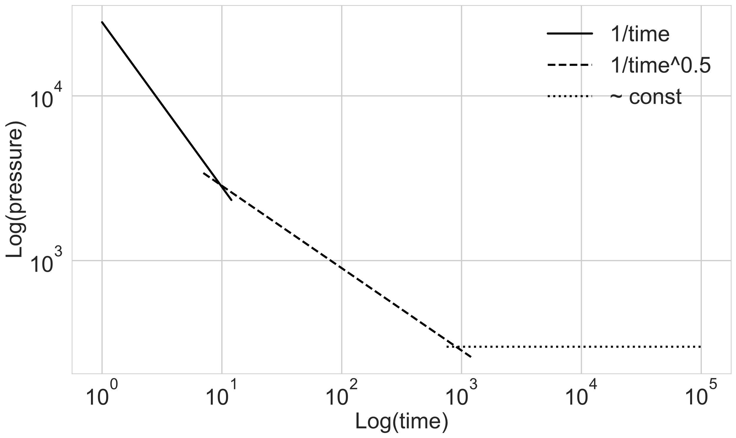
Pressure Evolution During Pump Down
Critical for Space instruments testing on ground; can be optimized
Adapted from M.J. Ernst et al. 1994 [3]
Three outgassing domains; $\frac{1}{t}$ dominant several minutes; $\frac{1}{t^{0.5}}$ dominant several days
Notes:
Constant part wirklich konstant

Slide 5
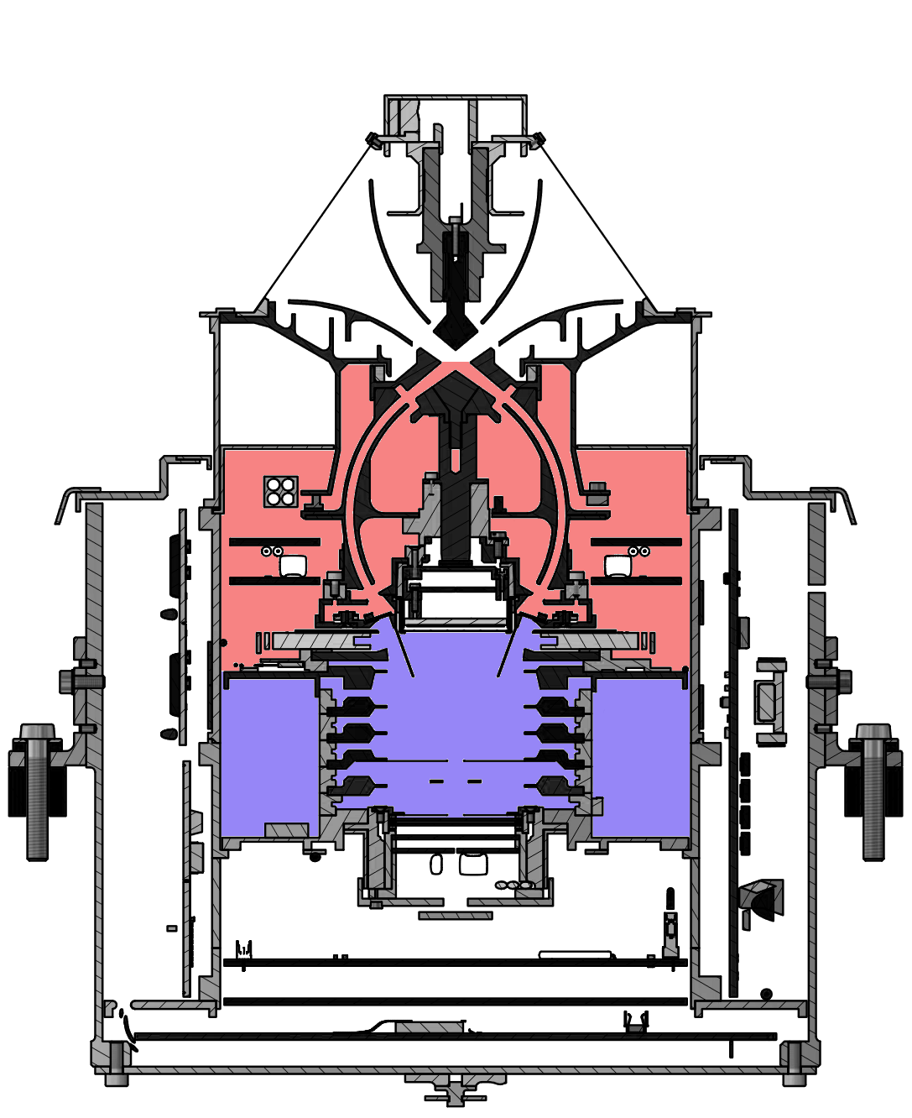
Critical Volumes of JDC
Two big volumes deep inside (red and blue)
Red has a volume of approximately 450cm³,
Blue 310cm³

Slide 6
Initial Outgassing Scheme of JDC
Two big volumes deep inside (red and blue)
Red has a volume of approximately 450cm³,
Blue 310cm³
The initial design had all volumes connected

Slide 7
Improved Outgassing Scheme of JDC
Two big volumes deep inside (red and blue)
Red has a volume of approximately 450cm³,
Blue 310cm³
The improved venting scheme tried to improve the connection between all volumes and to the outside.

Slide 8
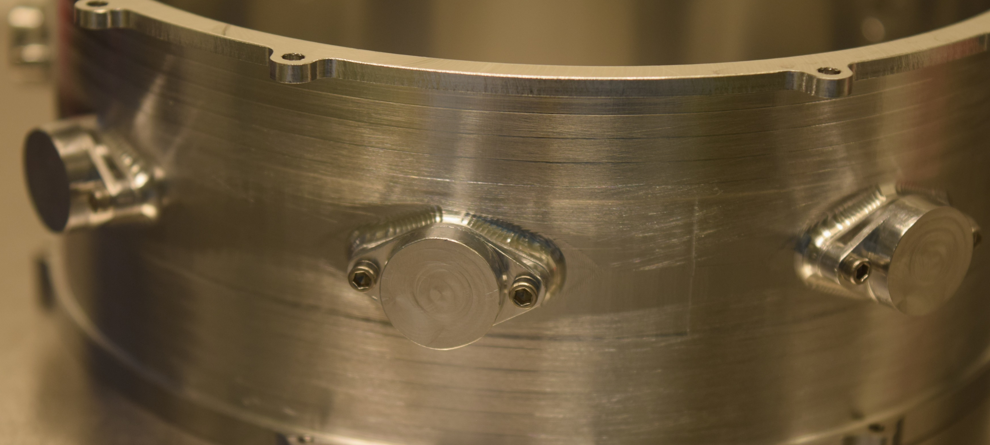
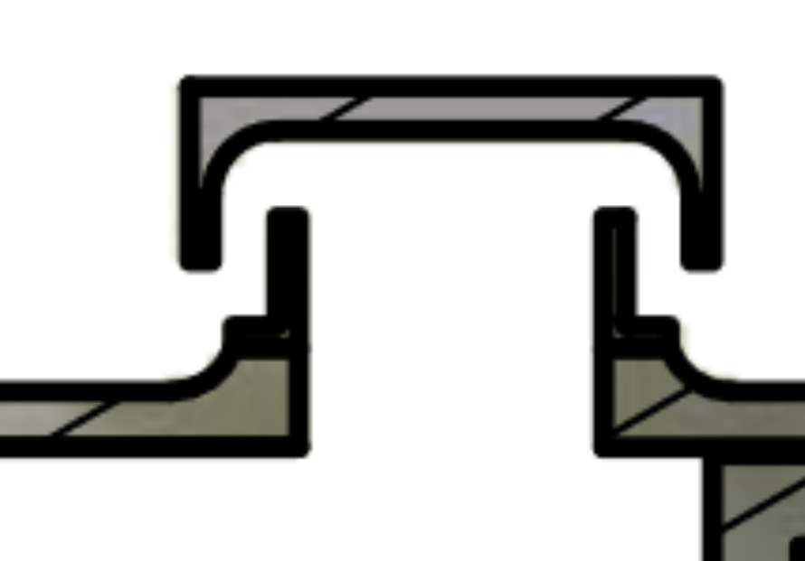
Old and New Venting of JDC
“Mushrooms” added to one of the pieces to improve venting and keep radiation shielding
Left high energy electron (blue) encountering a hole, right high energy electron (blue) encountering a “mushroom” with similar thickness of Al as rest of the wall (yellow). In red is a possible venting path.
 | Hole | Mushroom
Venting | ok | ok
Radiation shielding | insufficient | ok

Slide 9
Pressure Sensor Location Inside JDC
Sensor 1
Two big volumes deep inside (red and blue)
Red has a volume of approximately 450cm³,
Blue 310cm³
The improved venting scheme tried to improve the connection between all volumes and to the outside.
The pressure inside the instrument was measured with two micro pirani pressure sensors type “Heimann Sensor MEMS Type Pirani Vacuum Sensor HVS VAC03k”

Slide 10
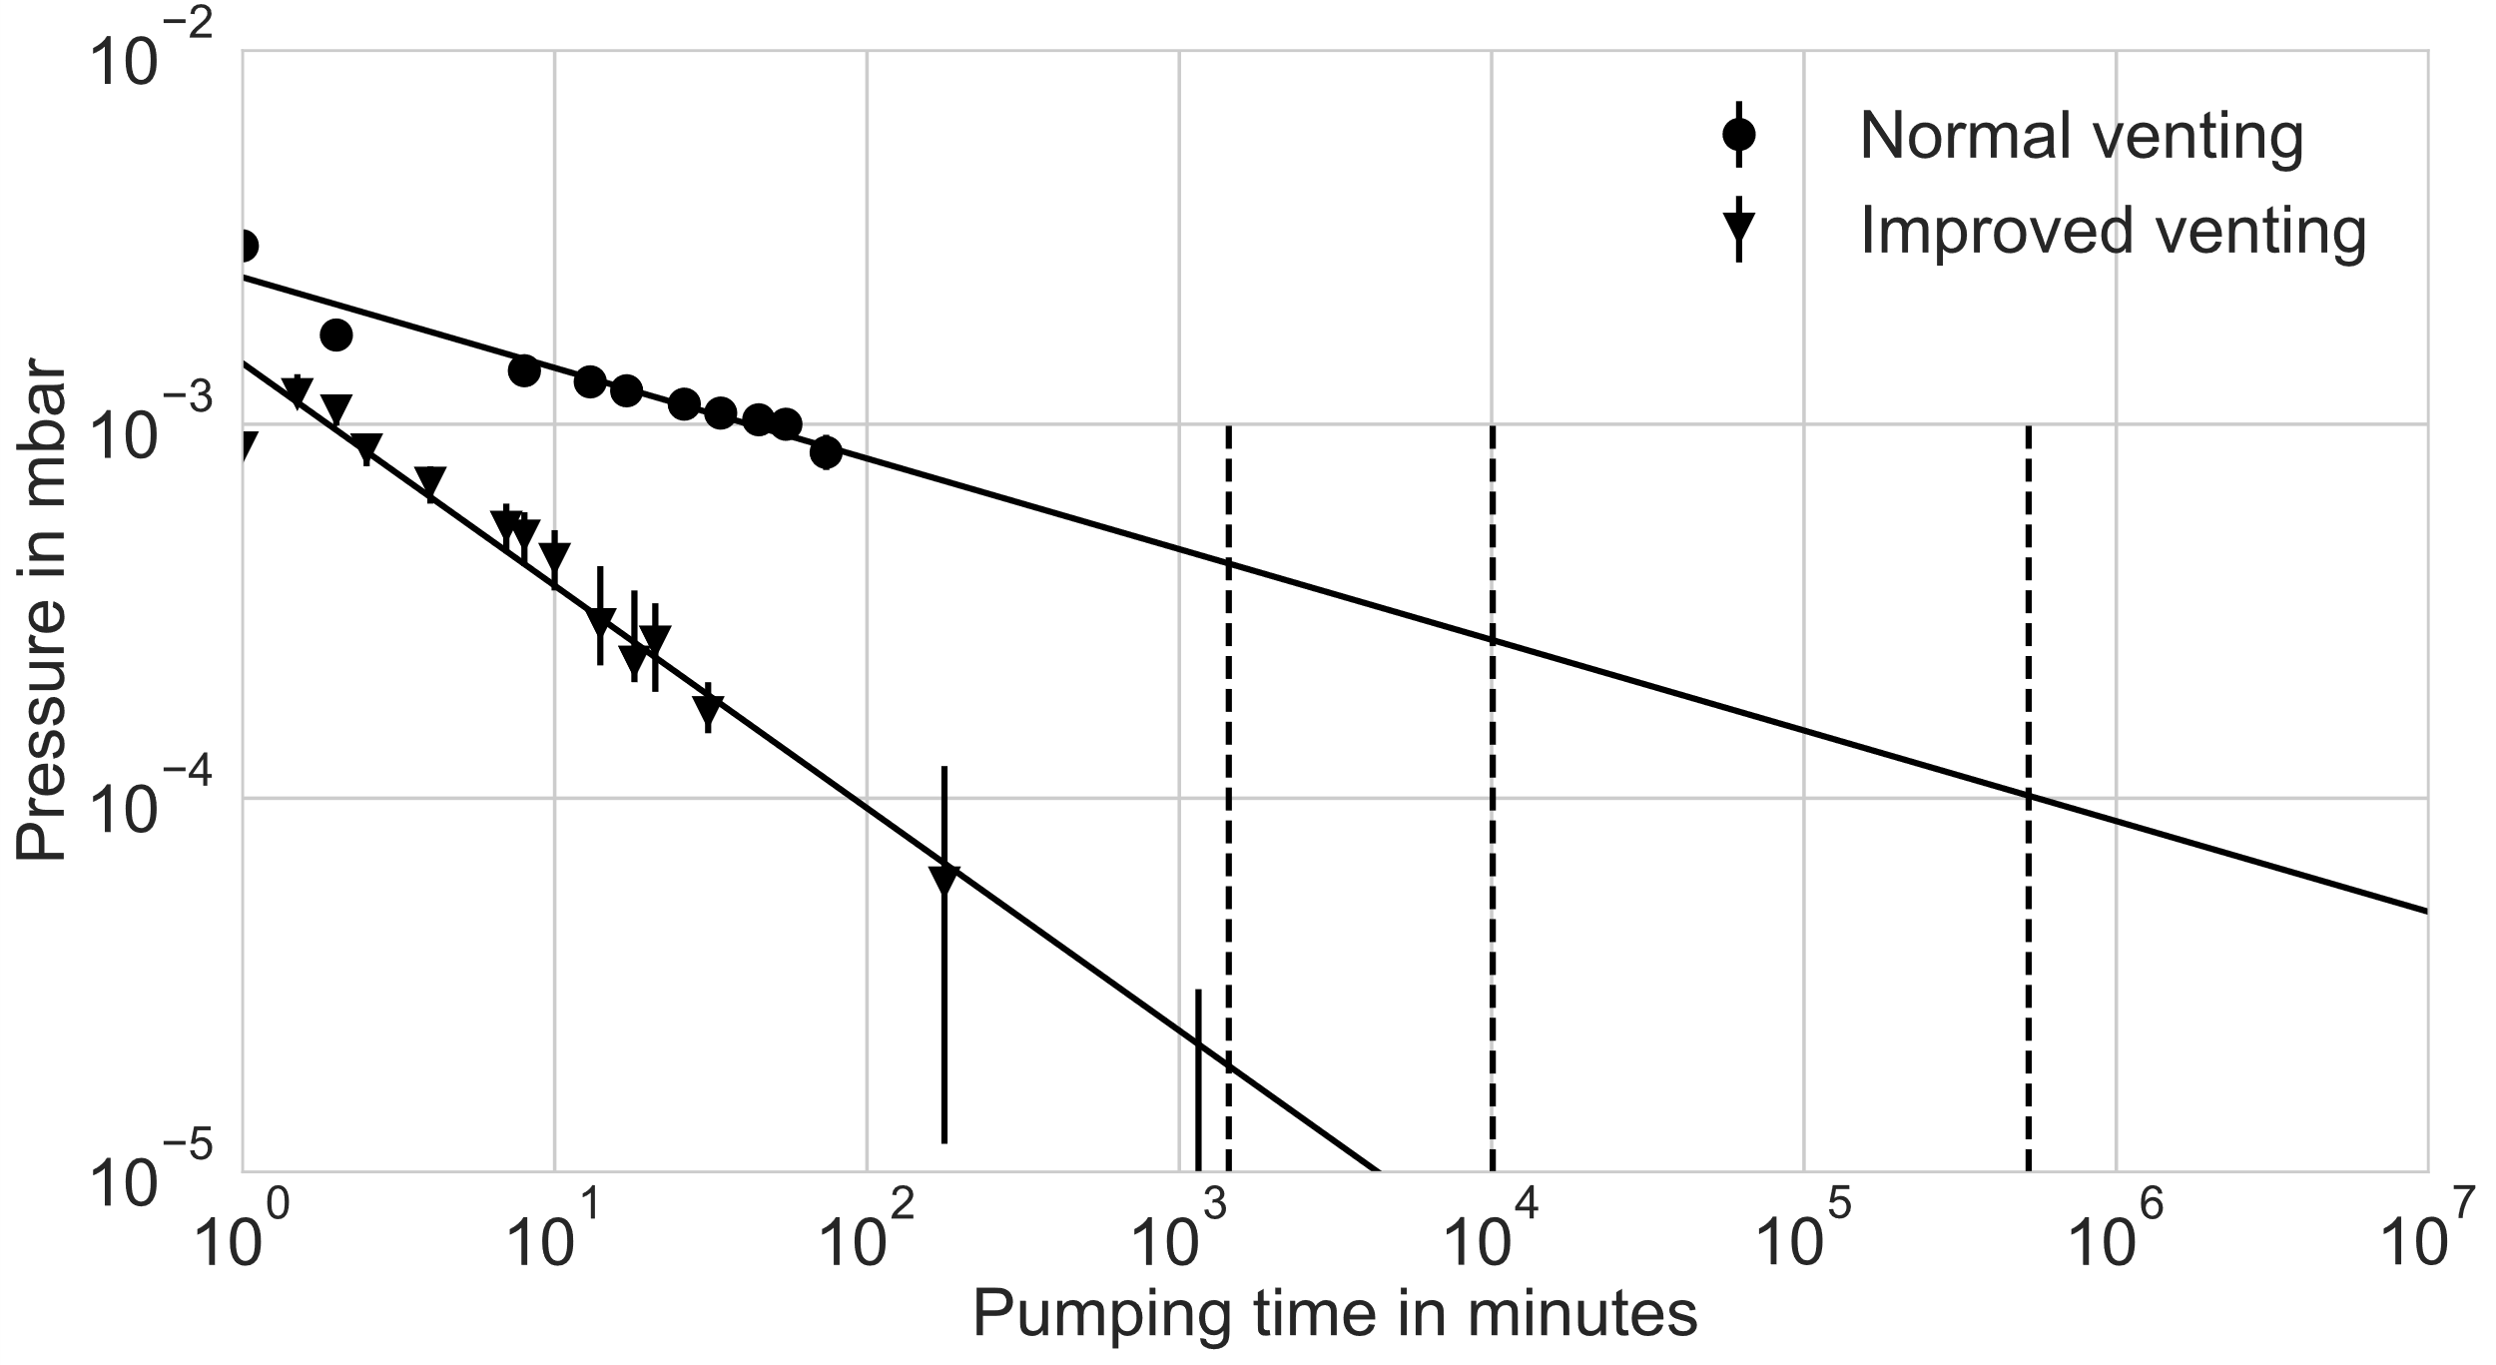
Effects of Improved Venting
1 day
1 week
1 year
Outgassing improvement helps: Normal case takes ~ 20 y to reach ${10}^{−4}$mbar
Improved case takes ~ 100 min to reach ${10}^{−4}$mbar
Wittmann et al. in preparation

Slide 11
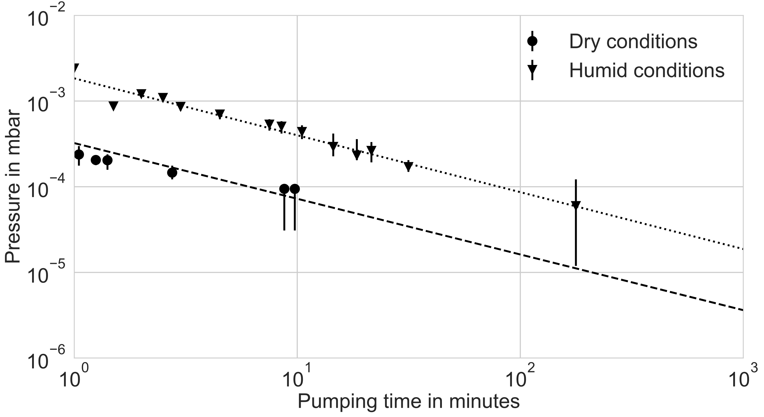
Dry vs Humid
If the instrument is stored in dry nitrogen or vacuum and only exposed shortly (~15min) to ambient air (humid), the removed water is not reappearing, resulting in a shorter pumping time.
Wittmann et al. in preparation

Slide 12
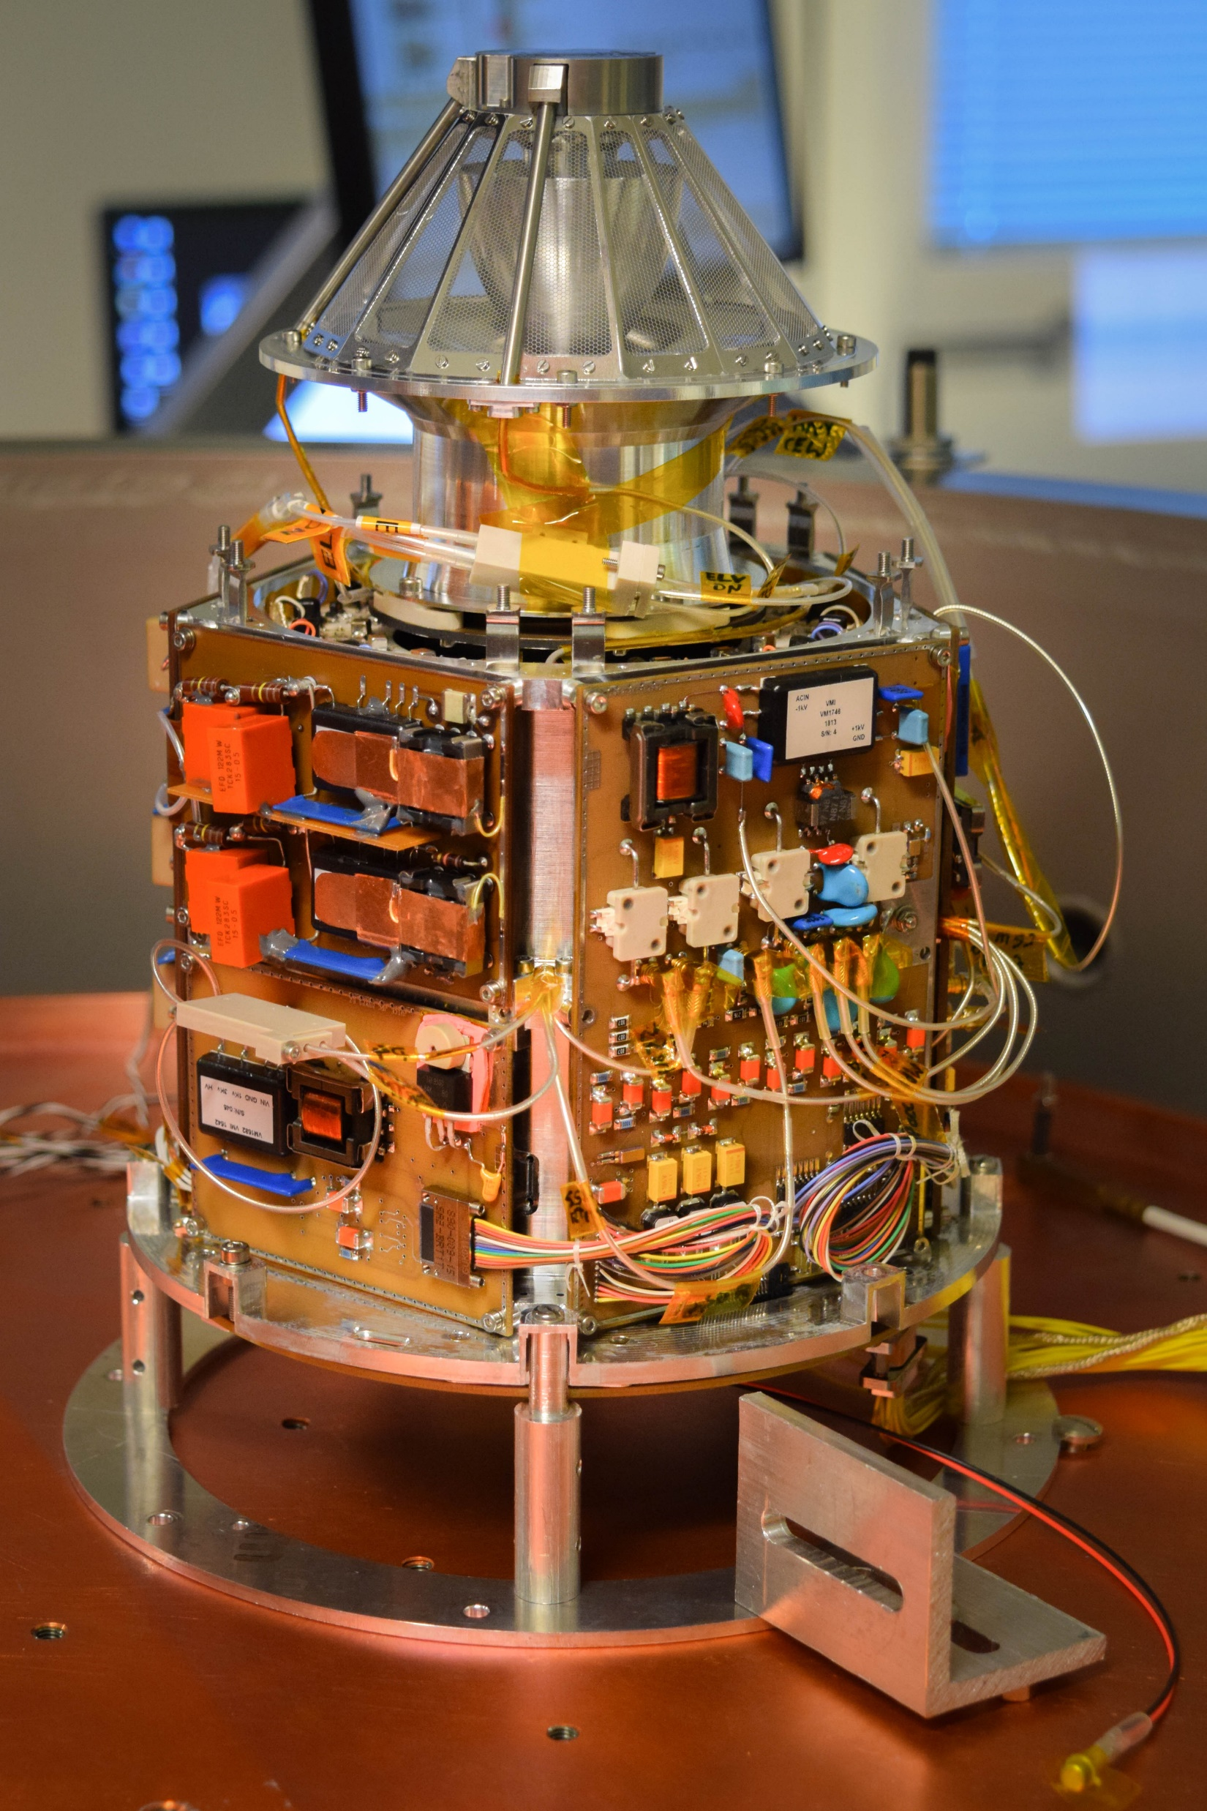
Conclusion
The improvement of the venting scheme inside JDC shortened the required outgassing time for safe high voltage operations from weeks to hours.
Previous outgassing and baking shortens the pumping time if the instrument has not been exposed to humid air for more than 15 minutes in-between individual pump-downs.
The next step in the evaluation of the data will be a comparison with data from tests of the Miniature Ion Precipitation Analyzer (MIPA), which is an instrument of Bepi-Colombo

Slide 13
References
[1] S. Barabash, P. Wurz, et al.: Particle Environment Pack-age (PEP), European Planetary Science Congress 2013,Vol. 8, EPSC2013-709, London, UK, 2013.
[2] J. Stude: Advanced Plasma Analyzer for Measurementsin the Magnetosphere of Jupiter, PhD dissertation, Umeåuniversitet, Umeå, 2016.
[3] M. J. Ernst, H. F. Hemond: Vacuum pumpdown model for long outgasing tubes, Journal of Vacuum Science & Technology A, Volume 12 Issue 2, 1994

