Slide 1
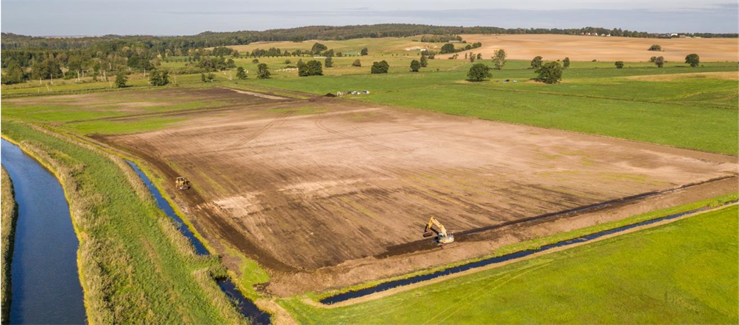
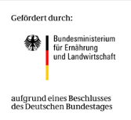
Putting Paludiculture into Practice – Experiences from field-scale Cattail paludiculture in NE Germany
Sabine Wichmann, Kerstin Haldan, Nora Köhn, Kristina Kuprina, Josephine Neubert, Franziska Tanneberger, Telse Vogel, Hans Joosten
Paludiculture → sustainable farming on wet peatland
practical experience is scarce
Paludi-PRIMA project (2019-2022)
→ up-scaling pilots
recommendations for large-scale implementation for farmers, authorities and policy makers
© AESA aerial
EGU2020
Sharing Geoscience Online

Slide 2
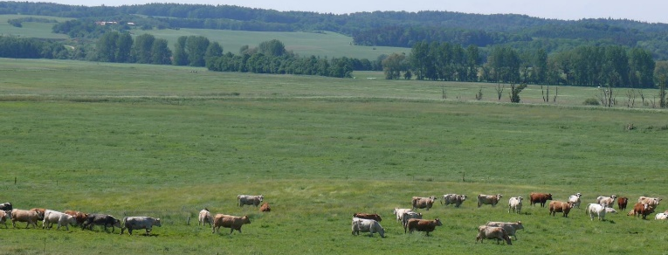
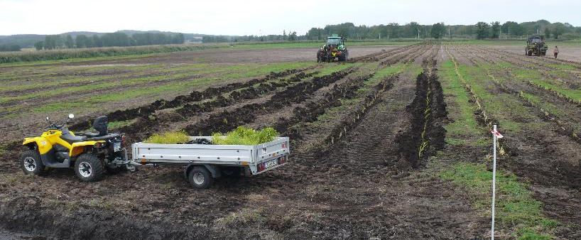
Establishment of Cattail field
~10 ha on a rewetted, formerly drained fen grassland
Site selection, planning and approval processes (water and nature conservation law)
Construction work: site preparation, water management
Planting Typha latifolia and T. angustifolia (0.5 and 1 plant m⁻²) using planting machines from forestry
Investigations on Cattail field
Working time measurements
Cost data of all implementation steps from site selection to harvest
Economic viability in dependence of biomass quality and utilisation
Monitoring of Cattail stand (vegetation survey, UAV, soil seed bank)
Water demand, nutrient retention and biodiversity
How to influence productivity and biomass quality?
Genetic analyses of natural Reed stands, partly harvested for thatching
Mesocosm experiments with 2 Cattail species and 5 Reed clones
Field trial with regional Reed Clone
→ Influence of species / genotype selection, site conditions and management

Slide 3
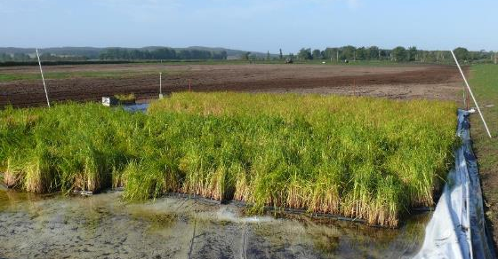
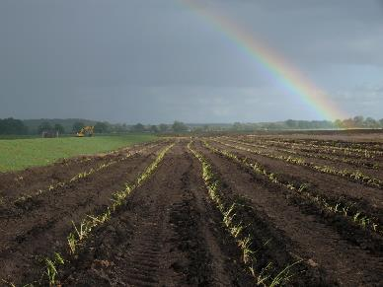
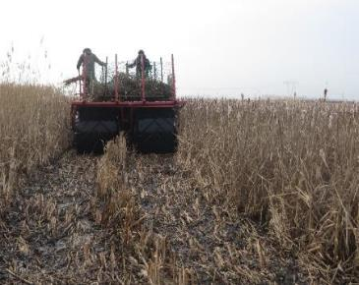
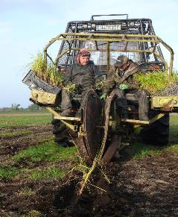
Preliminary messages
Framework
Current EU Common Agriculture Policy discourages farmers from keeping high water levels on peatlands
Insecurity: Are Cattail/Reed stands classified as protected habitats?
Complex planning and approval process needs to be standardised and simplified for farmers
Economics
High investment costs for shifting from drainage based agriculture to paludiculture
Need to optimise mechanical planting
Development needs for harvesting machines
Cultivation
Delayed planting (September 2019) + early and late frost (autumn, spring) hampered stand establishment
Large irrigation capacities needed after planting (first flooding) + in dry periods (April 2020: four week <1mm of rain)
Exchange on practical experiences and cost data from other field-scale pilots
→ elaborate general and specific recommendations
wichmann@uni-greifswald.de www.moorwissen.de/en/prima
© AESA aerial

