Slide 1

Comparison of model predictive control methods that can account for uncertainties in forecasts of flood discharge and storm surge
Case-study Volkerak-Zoommeer, the Netherlands
Acknowledgements:
Funded by the Rijkswaterstaat Corporate Innovation Programme 2019
Maarten Smoorenburg, Klaudia Horváth, Tjerk Vreeken, Ruben Sinnige, Stefan Nieuwenhuis, Rodolfo Alvarado-Montero, Teresa Piovesan, and Peter Gijsbers
Naam Achternaam

Slide 2
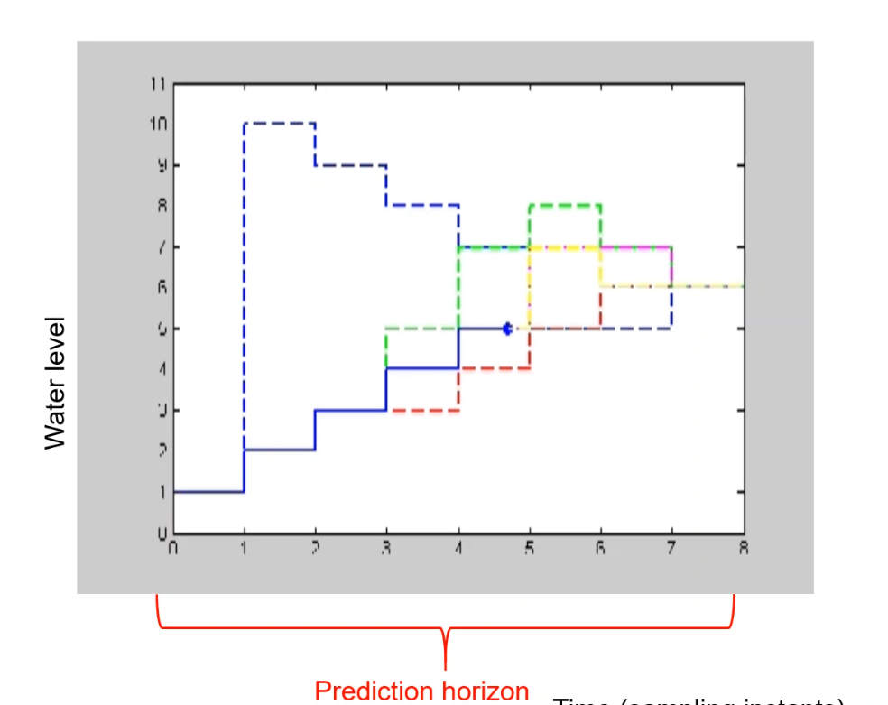
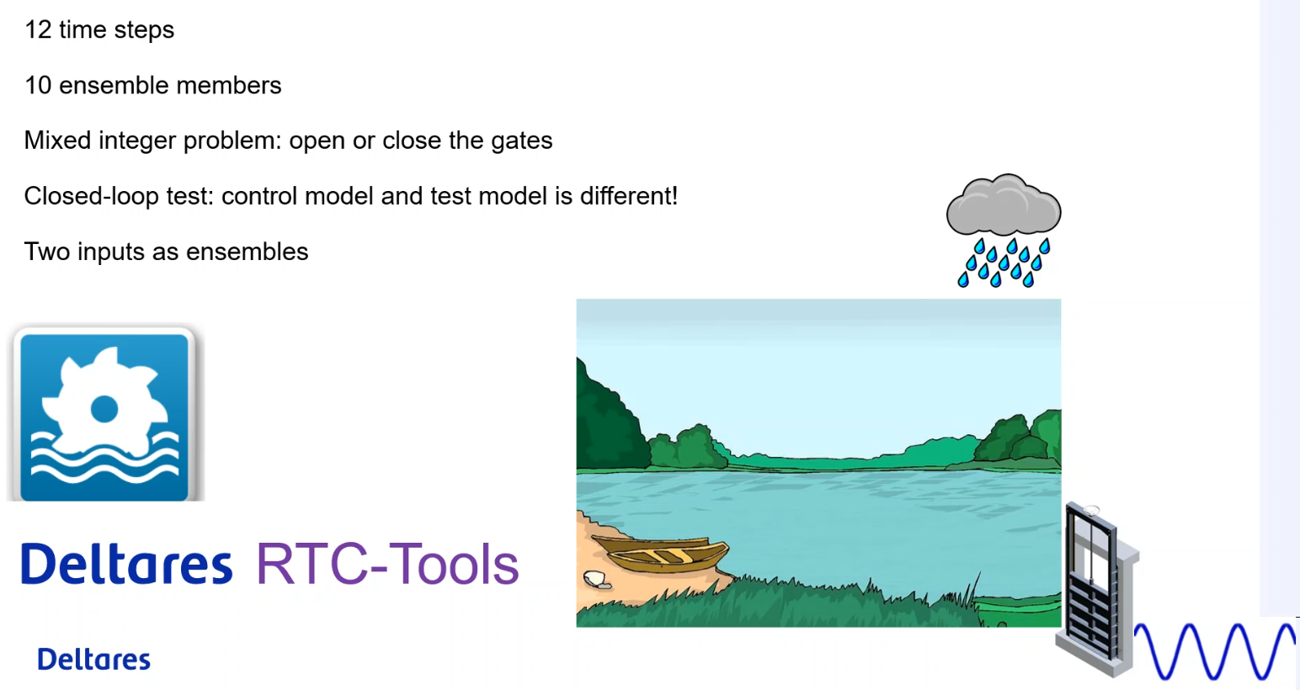
Want to know more,… already?
Please find more technical details in the EGU presentation of Klaudia Horváth
  Session HS3.3; presentation EGU2020-13342
  Horváth et al., 2020: Stochastic modelling and real-time control of complex environmental systems
  Live chat on Thursday 7 May 2020, 8:30 – 10:15
More information on the open source toolbox that was used for the optimization models can be found here:
https://www.deltares.nl/en/software/rtc-tools/

Slide 3
Content
Why use ensemble forecasts for operational water management?
Evaluating benefits of ensemble based MPC methods for the Volkerak-Zoommeer case study
Conclusions

Slide 4
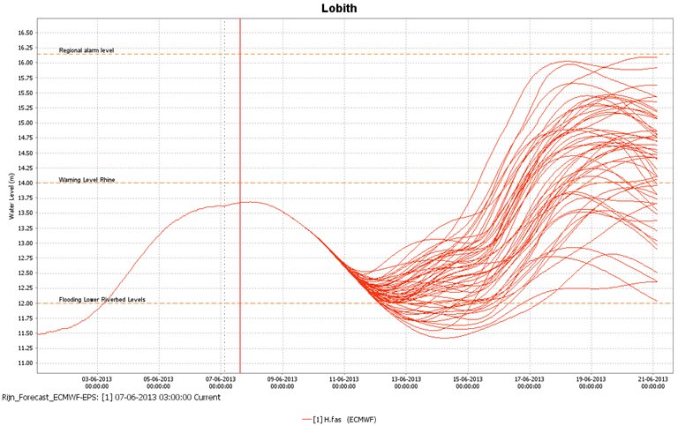
Why use ensemble forecast for decision making and control?
Ensemble forecasts help quantify uncertainty of future forcings
  Similarly, ensembles can be used to represent measurement and model uncertainties
Ensembles are samples taken from the uncertainty space, allowing computational evaluation with models
Ensembles aid anticipatory control that is save for ‘reasonable’ worst case scenario’s
Because of these benefits over deterministic forecasts, more and more ensemble products are developed and distributed

Slide 5
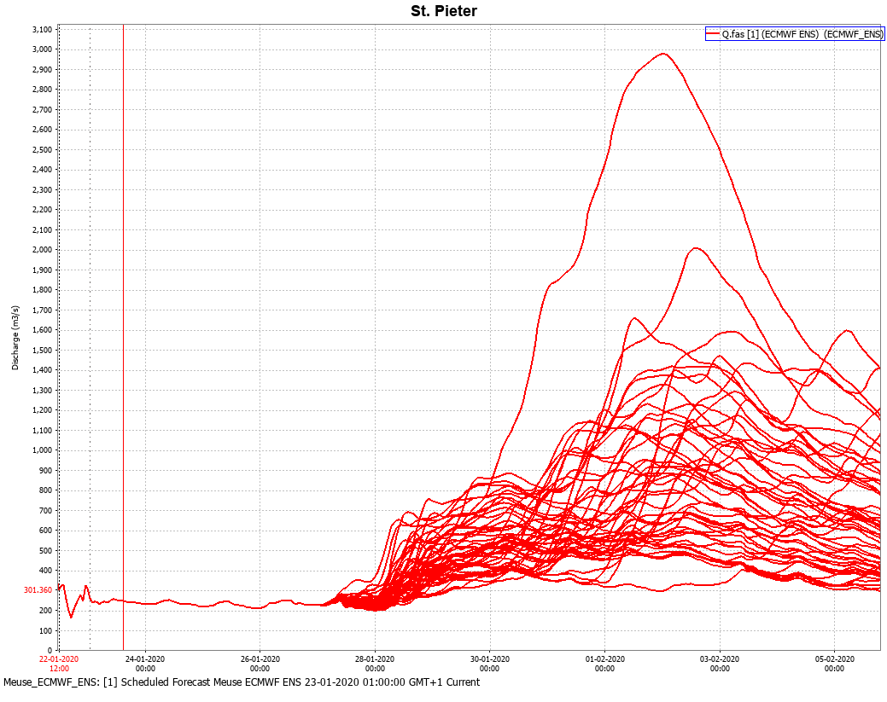
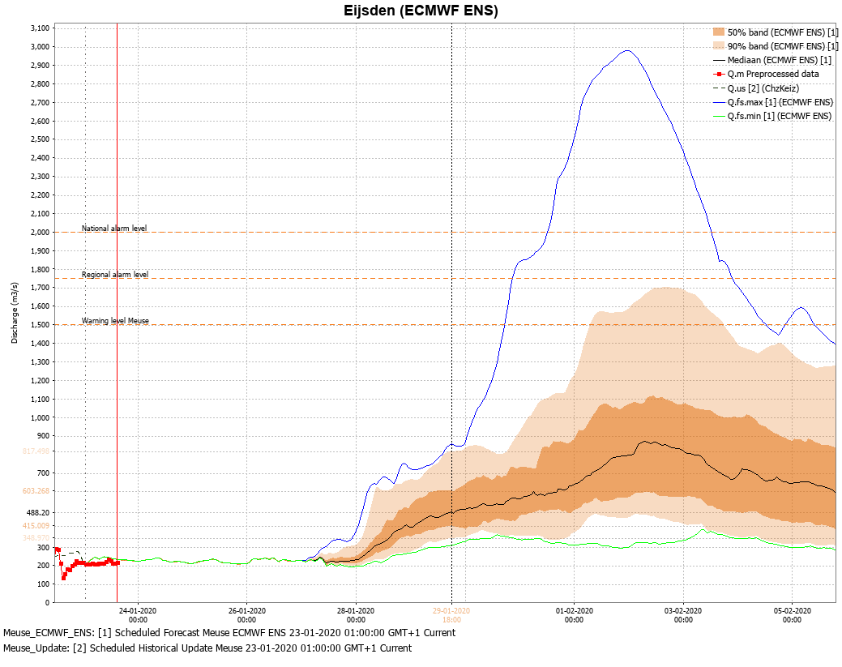
Why apply control on the basis of ensembles?
Ensemble forecasts can provide information about forecast uncertainty
With more knowledge of uncertainties,
in theory,
better decision can be made
Notes:
Usually extra efforts are needed to produce forecast with correct probability density functions from the ensemble forecasts, for example to correct for structural biases or uncertainties that are not sampled well by the ensemble product.
It helps to be certain about uncertainties and quantify them facilitate a risk based decision making (risk=probability x cost)

Slide 6
The challenge: make better decisions using uncertainty information
Decision rules (protocols) on probabilities are not yet made, or remain uncomfortable
More knowledge of uncertainties can make decision-making more complex
Timing is key: the better the timing, the more optimal is the control
  forecast do not directly tell you when a measure should be taken
Notes:
Still, even if we would know that the statistics are correct, e.g., there is a 10% probability that a flood volume of X m3/s will arrive in 3 days, operators often have no decision rules in place for the anticipation. And even if they have, what should be done when the percentage was 9%, or 8%?
Now that we have ensemble forecasts, we should also use them, but there maybe me much reluctance to do so since they can make the decision-making process more complex (ignorance is bliss?)
A key challenge is to apply mitigation strategies with correct timing: too late reactions cause extra damage, but too early responses might involve unnecessary costs when the event turn out to be less severe.

Slide 7
Particularly challenging decision making problem in the face of extreme events
Mitigation of extreme events like floods and droughts typically requires longer anticipation times
  Creating retention capacity to store flood water in water systems can take considerable time
  Storing extra water to use in dry periods can take considerable time
  Evacuation or barrier operations take considerable time
But: forecast uncertainty typically grows strongly with lead time
  Question may become: how long can we postpone taking action and wait for the forecast peak is more certain?
Mitigation for one extreme may compromise resilience for another extreme
  Lowering lake levels because of anticipated storm surge may results in too little stored water to cope with a drought
Mitigation measures are typically more costly for extremer events

Slide 8
How to apply control on the basis of ensembles?
There are several options; some pro’s and con’s:
Simulate all possible measures for all forecast ensemble members
  Pro: straightforward
  Con: computation time, lot of information and no advise for the end user

Slide 9
How to apply control on the basis of ensembles?
There are several options; some pro’s and con’s:
Simulate all possible measures for all forecast ensemble members
  Pro: straightforward
  Con: computation time, lot of information and no advise for the end user
Simulate one measure for all forecast ensemble members
  Pro: useful scenario analysis if one knows what kind of measure it to be taken
  Con: limited help on what measure to take, and no final advise for the end user

Slide 10

How to apply control on the basis of ensembles?
There are several options; some pro’s and con’s:
Simulate all possible measures for all forecast ensemble members
  Pro: straightforward
  Con: computation time, lot of information and no advise for the end user
Simulate one measure for all forecast ensemble members
  Pro: useful scenario analysis if one knows what kind of measure it to be taken
  Con: limited help on what measure to take, and no final advise for the end user
Let computer determine what is the best measure for the given ensemble forecast(s)
  Pro: transparent evaluation of objectives, with single advise for end user
  Con: Difficult? Computation time? Requires developments.
MPC?
www.clipart-library.com

Slide 11
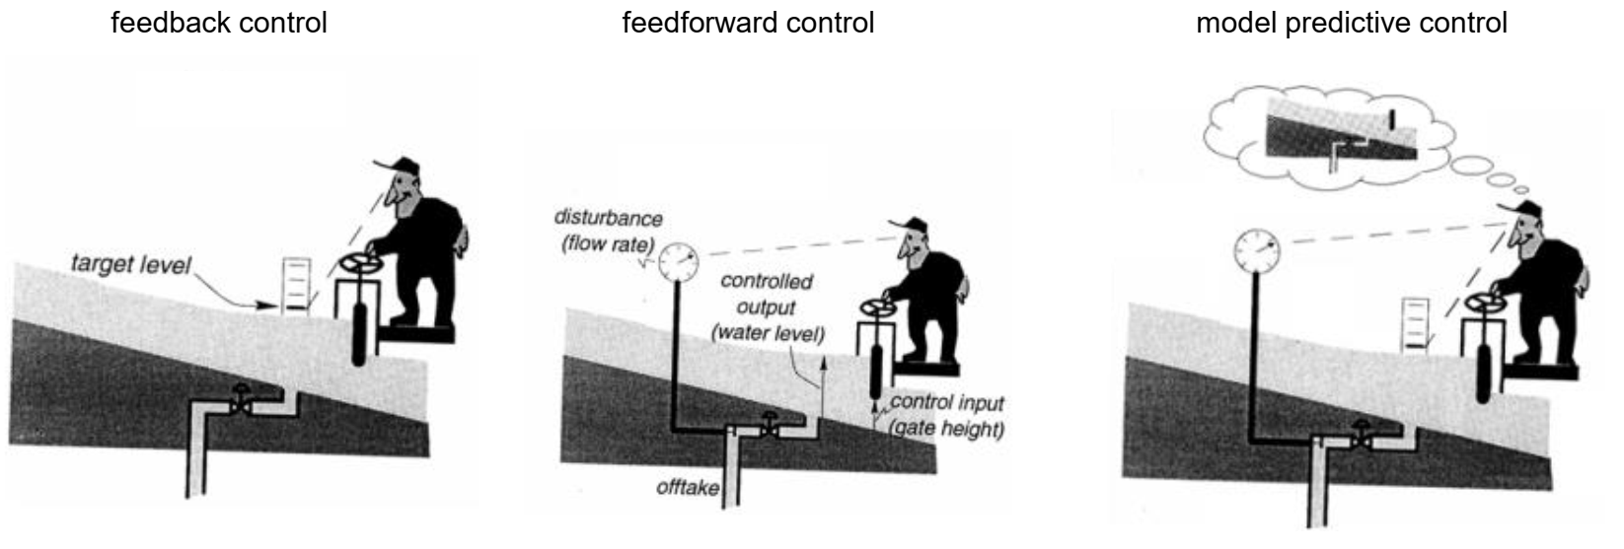
What is Model Predictive Control?
User Manual of RTC Tools 1
Notes:
MPC is a technique where a model of the control system, for example a lake, is used to exploit the effects of control actions in response to a predicted future to determine the optimal control strategy
One could even use ensemble forecasts, or ensembles of initial states, or model parameters to account for different sources of uncertainty.

Slide 12
Using Model Predictive Control with ensemble forcing
Complicated, but feasible (e.g., Tree Based MPC; Raso et al., 2014,),
…..and ‘getting more and more feasible?’
Our main research question:
How useful is MPC with ensemble forecasts for
water management control involving discrete decision variables?
Discrete decision variables (yes/no; on/off) are often needed in operational control of water systems; e.g., gates, sluices, turbines, pumps.
….Optimization of the resulting mixed integer problem is was computationally challenging
Raso, L., D. Schwanenberg, N. C. van de Giesen, and P. J. van Overloop. 2014. “Short-Term Optimal Operation of Water Systems Using Ensemble Forecasts.” Advances in Water Resources 71 (September): 200–208
Notes:
Techniques to use ensemble forecast already existed, but with limited scope in terms of model complexity, optimization techniques, and/or feasibility to use in practice
New implementations in RTC Tools 2 allow coupling of different solvers, advanced linearization techniques and generally more practical way of setting up models and using them in a live operational forecasting system.
Binary (discrete) decision variables are needed in the control model, but as this means we have to solve a mixed integer problem, the involved computational burden used to be too much to allow use in real world applications.

Slide 13
Approach
Explore the added value of full ensemble and ensemble tree MPC for different levels of uncertainty through comparison with MPC on deterministic forecasts with different biases
  Synthetic forecast to have controllable forecasts uncertainty or and errors
Running 4 closed-loop experiments:
  2 flood events,
  ensemble inflow forecasts, combined with deterministic or ensemble forecasts of storm surge
For each experiment, we ran
  2 methods for MPC with ensemble forecasts
  10 setups with deterministic forecasts whereby forcings where structurally over or underestimated

Slide 14
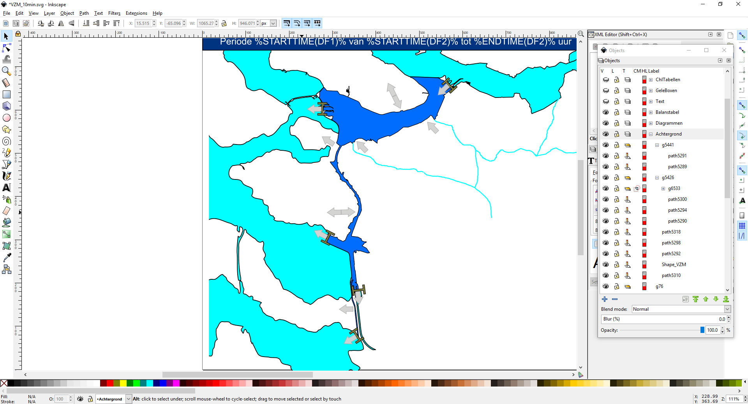

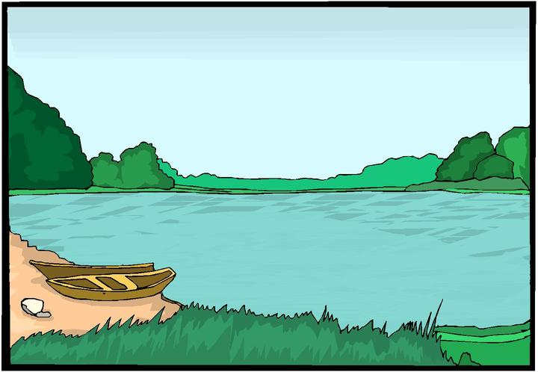
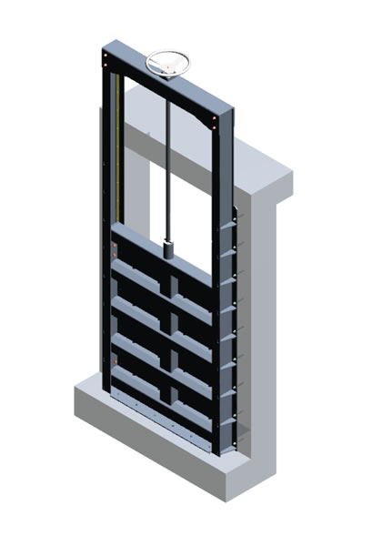

Control problem ‘flood mitigation’ in Volkerak-Zoommeer (VZM)
“Natural” inflow from surrounding areas
3 sluices separate VZM from tidal waters
→ Spill discharge (Q) dependent on head difference (∆H)
Volkerak-
Zoommeer
Q_{in}
Q_{out} (∆H)
Bathse Spuisluis

Slide 15
Control problem ‘flood mitigation’ in Volkerak-Zoommeer (VZM)
‘‘Natural” inflow from surrounding areas
3 sluices separate VZM from tidal waters
→ Spill discharge (Q) dependent on head difference (∆H)
Water excess challenge:
→ Maintain lake level through spill gate at Bathse Spuisluis
Prevent using emergency spill through sluices
Uncontrolable infow (Q_{in})
Volkerak-
Zoommeer
Q_{in}
Q_{out} (∆H)
Bathse Spuisluis

Slide 16
Model Volkerak-Zoommeer
Q_{in, forecast}
V(H)
Nonlinear relation volume – lake level
Nonlinear relation discharge - head difference
Discrete decision variables for flow direction
Main goal:
Maintain lake level between NAP -0.10m and NAP+0.15m (quadratic penalty on target exceedance)
→ Extra release prior to the event to create retention capacity to buffer the inflow flood wave is needed
Ensemble forecast?
  inflow from rivers (Brabantse Rivieren)
  ‘outside’ waterlevel at Westerschelde Estuary
Q_{out}(∆H_{forecast})
Notes:
Rijkswaterstaat already uses an RTC-Tools advisory model in their operational decision support system to control the lake level (and flushing operations to manage salinity). This model uses only deterministic forecasts and works with nonlinear equations.
As combination of nonlinear equations and discrete decision variables requires much computation time, this model was linearized to allow MPC with ensemble forcing.

Slide 17
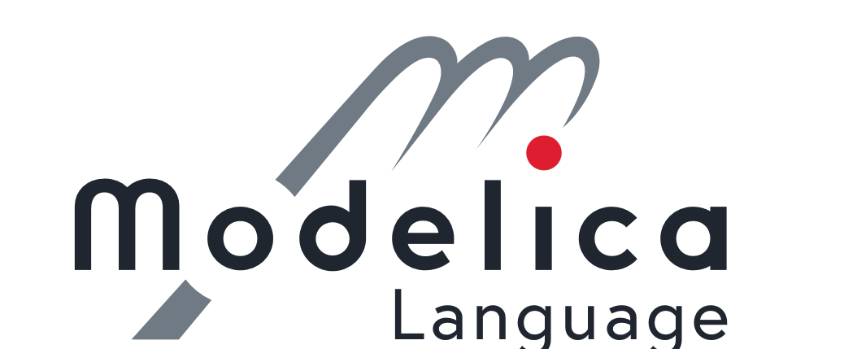





Model setup
Optimization model for MPC with:
  Discrete decision variables (booleans: open/close, yes/no, etc.)
  Smart linearization techniques to reduce to Mixed Integer Linear Problem (MILP)
  Convex optimization
Optimization and simulation models were implemented in RTC Tools 2
  Open source framework for using a combination of Python, Modelica an CasADi tooling
  Convex optimization possible with a variety of solvers
  The commercial CPLEX solver was used to have sufficiently fast computations
The closed-loop experiment was facilitated by integration in Delft-FEWS for managing modeling workflows and analysis.
RTC-Tools
Delft-FEWS
Notes:
Open source solvers can be coupled, but commercial solvers like CPLEX were found to be more efficient for MILP problems
https://www.deltares.nl/en/software/rtc-tools/
https://oss.deltares.nl/web/delft-fews/home

Slide 18
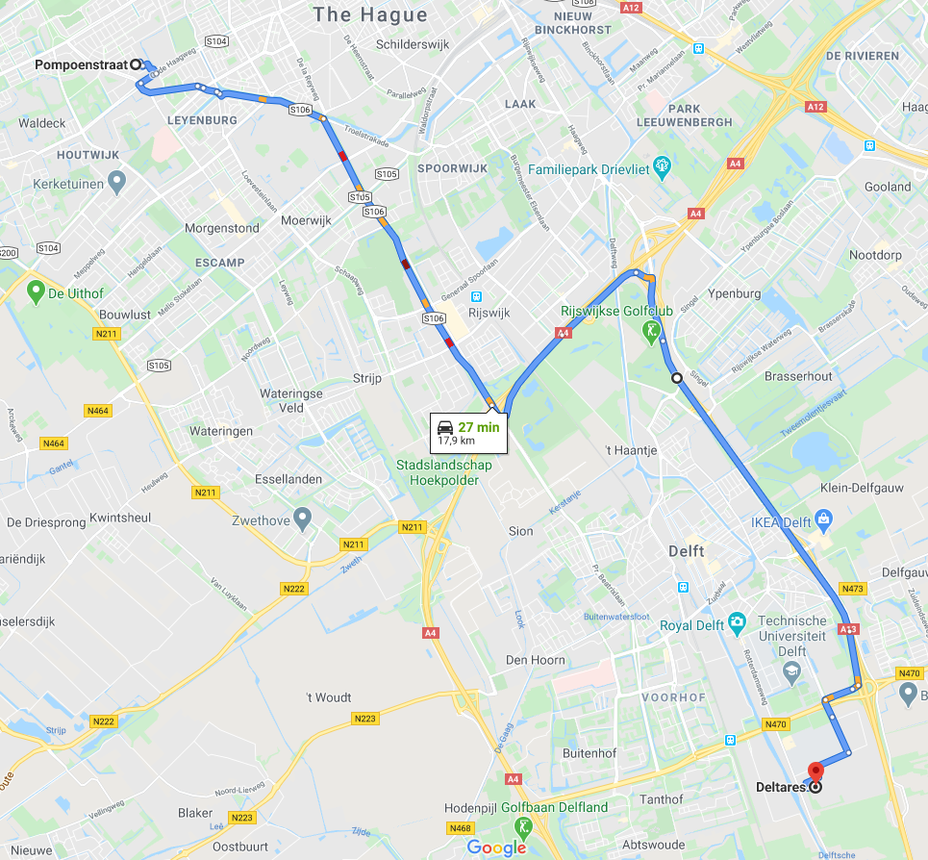
Use of ensembles in model predictive control
Two methods for using ensembles in MPC
Ensemble MPC: Solve for all ensembles without taking into account that new information will become available
Tree Based MPC (Raso et al., 2014): Solve for all clusters of similar ensembles and take into account that new information will become available
Tree Based MPC can be compared to a route problem where one uses an ‘intermediate’ path to allow switching to different highways depending on traffic forecasts
Raso, L., D. Schwanenberg, N. C. van de Giesen, and P. J. van Overloop. 2014. “Short-Term Optimal Operation of Water Systems Using Ensemble Forecasts.” Advances in Water Resources 71 (September): 200–208
Notes:
Ensemble MPC tries to find the optimal solution for all forecasts, essentially overestimating the uncertainty of the distant future by not allowing the situation to become more certain when time passes. The method is therefore known to be too conservative, but this can still be desirable for some cases. Also, finding a solution for all ensembles for the full forecast horizon typically requires more computation time.
Tree Based MPC allows splitting the ensemble in branches at different control points and therewith some mimicking of how new information can be used in the future to adapt control further. MORE INFORMATION ON TB-MPC on the next slide

Slide 19
More on Tree Based MPC
Split ensembles at control points in clusters or bundles
Compute optimal control per bundle (branch)
Difference between Tree Based and Ensemble MPC are explained in more detail in presentation by Klaudia Horváth; Session HS3.3 - presentation EGU2020-13342
Raso, L., D. Schwanenberg, N. C. van de Giesen, and P. J. van Overloop. 2014. “Short-Term Optimal Operation of Water Systems Using Ensemble Forecasts.” Advances in Water Resources 71 (September): 200–208
Notes:
Control points are moments in time where new decision are to be made, based on new information; new measurements and new forecasts
First clustering occurs after the first control point. Further clustering of the ensembles occurs after each new control point.
Clustering is done by determining the two outermost members and the grouping the remaining members on the basis of closest distance

Slide 20
Evaluating added value of MPC with ensembles
Compare ensemble MPC methods to deterministic MPC
160 closed-loop experiments with synthetic observations and forecasts of inflow and storm surge
  2 events with synchronous wave of storm surge and inflow
  2 variants; deterministic or ensemble forecasts of storm surge (combined with ensemble inflow forecasts)
  4 different degrees of uncertainty
  10 MPC setups (E-MPC, TB-MPC, and 8 deterministic MPC with varying error magnitudes)
Difference between observations and forecasts is known (i.e., are controlled in the experiments)
Optimization with 2 goals; in order of priority:
  Keep lake level between NAP -0.10m and NAP +0.15m
  Try to keep lake level between NAP +0.02m and NAP +0.03m (target = average of range)
Notes:
2x2x4x10=160
This was a lab experiment where the uncertainty and the errors of the forecasts were set by the experimenters
For flood events, only these 2 goals matter. For day-to-day operations and/or salinity management more goals are used in practice

Slide 21
Setup of closed-loop experiments
Setup
each 12 a new T0,
lead time of 5 days
event of 29 days
Ensemble Tree MPC with control points at 12h, 24h and 48h
Ensemble MPC is same, but without control points
Procedure
Advice optimal control for given initial conditions and forecasts
Simulate effect of following the advice until next T0
Compute new optimal control advice with latest system state and new forecasts
Etc. etc.
-1 0 1 2 3 t→
-1 0 1 2 3 t→
-1 0 1 2 3 t→
Optimize (measured state + forecast)
Simulate new state from observed forcing
Notes:
Implementation was done with all real-world requirements, like post-processing needed to obtain detailed structure settings (like discrete nr of gates to open).
The simulation model used the full nonlinear equations, yielding best estimate of the real-world response to the controls

Slide 22
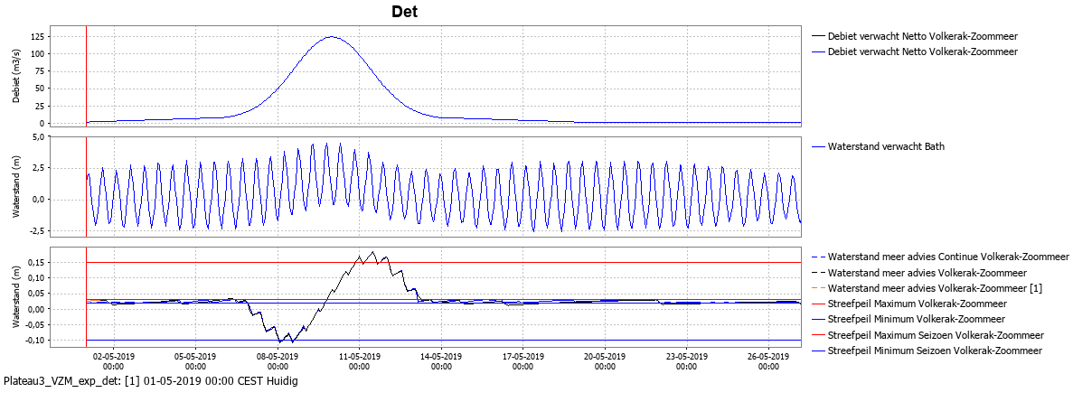
Synthetic event definition
Results of the closed-loop experiment with perfect forecasts
Notes:
The synthetic observation series could be used to produce perfect forecast every 12h with 5 day lead times
The resulting control is our benchmark to compare the different MPC solutions against. Note that the level cannot be kept within the target range at all times
The experimental forecast are either ensemble forecasts surrounding the perfect forecast with some spread

Slide 23
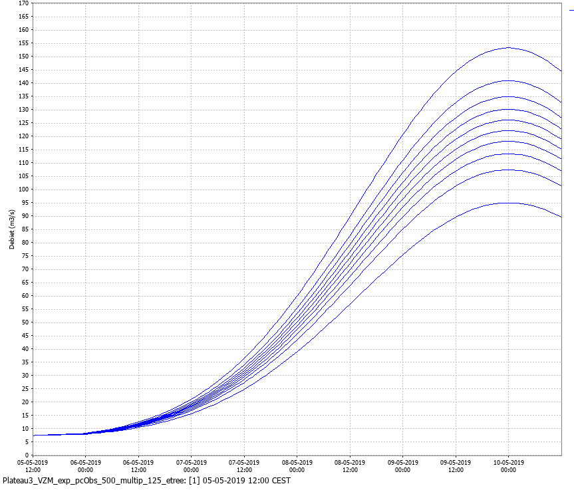
Synthetic forecasts
Difference between forecasts and observations is known
At each T0 a normal distribution of the ‘error’ is put around the observed forcing (mean = median = observation)
Ensemble forecast are sampled from that normal distribution
  Width of ensemble was varied with factors for multiplication with the median; factors 1.1, 1.25, 1.5 and 2.0
  10 members, at equal percentile distance between the 2.5e and 97.5th percentile
Deterministic forecasts have known bias
  They are within the ensemble forecast’s uncertainty ‘space’
  Percentiles: 2.5, 10, 25, 45, 50, 55, 75, 90 and 97.5

Slide 24
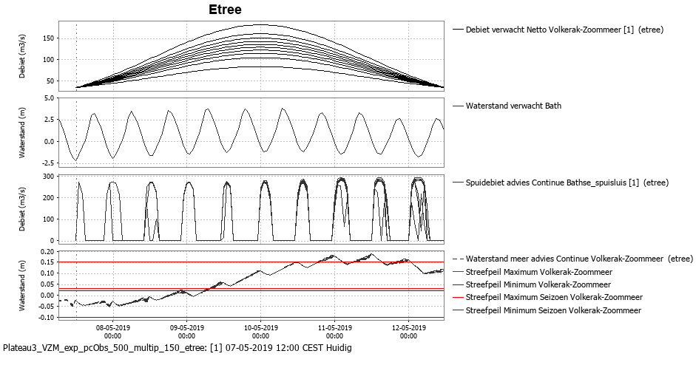
Example of the Tree Based MPC advice
Up to 8 ‘branches’ in advice
Expected effect is shown per ensemble member (trace)
Notes:
Graph 1 shows ensemble inflow forecast just before the flood peak
Graph 2 shows a deterministic storm surge forecast (astronomical tide series with effect of wind updraw superimposed)
Graph 3 show the advised outflow; one advise until the first control point after 12h, then two optimal control strategies until the next control corresponding to 2 different forecast branches, and up to 4 or 8 strategies for the periods after subsequent control points.
Graph 4 shows the effect on the lake level for each advise in combination with the corresponding forecasts. Note the ‘positive feedback’ that more water can be released when lake levels are higher, resulting in similar lake levels after each spill period.

Slide 25
Results
Example results table of Experiment 1: maximum exceedance (in cm) of the upper target (NAP +0.15m)
Percentile/method | 2.5 | 10 | 25 | 45 | 50 | 55 | 75 | 90 | 97.5 | TB-MPC | E-MPC
multiplication factor
1.1 | 4.7 | 5.0 | 4.6 | 4.6 | 4.6 | 4.1 | 4.3 | 3.4 | 2.8 | 4.5 | 2.6
1.25 | 5.3 | 5.3 | 5.0 | 4.6 | 4.6 | 4.3 | 3.0 | 1.3 | 0.0 | 4.0 | 0.1
1.5 | 6.3 | 6.3 | 5.3 | 4.3 | 4.6 | 4.3 | 1.2 | 0.0 | 0.0 | 3.8 | 0.1
2.0 | 8.1 | 8.0 | 6.3 | 5.0 | 4.6 | 3.4 | 0.0 | 0.0 | 0.0 | 3.7 | 1.0
Notes:
For each of the 4 experiments (2 events, with or without ensemble storm surge forecast), this matrix can be drawn to present the relation between forecast uncertainty (rows; i.e., the multiplication factor used to determine the ensemble spread) and the different deterministic and ensemble MPC setups.
For reference, the deterministic MPC with perfect forecasts (50th percentile) is presented in the center.
We here see that the Tree Based MPC method results in lesser exceedance of the upper target level, and that this benefit grows with increasing forecast uncertainty. Even a mild underestimation (percentile 25-45) in the deterministic forecast results in substantially worse control (6.3cm of exceedance for the p25 test compared to 3.7cm exceedance with the TB MPC for the high uncertainty forecasts in the bottom row)
The Ensemble MPC method produces even lesser exceedance, but the behavior of that solution is less structural. Also its more (over)conservative control produces less exceedance here, but resulted in drawdowns below the lower target in some other experiments.

Slide 26
What have we seen in these experiments?
Maximum exceedance and duration of exceedance are coupled
Lake levels could get below NAP- 0.10m for some E-MPC or overestimated det. forecasts
Post-processing affects final outcome substantially
E-MPC is more conservative than TB-MPC
Integrating ensembles in control seems more useful when the future is more uncertain
Notes:
Comment per bullet: point:
Different metrics to measure goodness of control give similar conclusions
Lake level could get below the lower target level for Ensemble MPC since it is very conservative.
As in operational practice, the optimal strategy is continuous and should be discretized to obtain usable structure control settings. This post-processing can results in a less optimal control than the model ‘thought’, causing a relative late response to the forecasted problem for all models. It is important to know this, as one could deal with this by reducing this mismatch between model and practice, or amending the objectives to direct the solution a bit (make the model target band narrow to match this ‘unaccounted volume error with’
As expected, the Ensemble MPC proved to result in very conservative control, sometimes leading to lake levels below the lower target. Although this level of conservativeness can be desirable, we would argue that this should be achieved by a matching control problem definition and not by overestimating the uncertainty. See also the comment in the previous slide.
As expected, use of uncertainty information is more useful when there is more uncertainty. This probably does not hold when uncertainty grows to infinity (where one should not use MPC for anyway) but we did not test that. For the reasonable use case of up to a factor 2 difference between the median and the worst member in a flood forecast, the benefits of using ensembles instead of deterministic forecasts seems evident.

Slide 27
Conclusions
Safer control with Tree Based MPC, particularly when forecast uncertainty is relatively high
  More conservative anticipation
  Less chance of erroneous control
AND …
MPC with ensemble forcing runs stable and fast enough for use in real-world operational decision support systems
Notes:
For CONCLUSION 1 see the explanation in the previous slides
For CONCLUSION 2: The closed-loop experiments ran stably, with computation times in the order of 1-2 minutes (hourly timesteps, 10 ensemble members, lead time of 5 days). The experiments provided an extensive test with a challenging optimization problems and a real world operational setup: i.e.: the only ‘fake’ thing were the forecasts.

Slide 28
Want to know more,… still?
Contact us!
Please find more technical details in the EGU presentation of Klaudia Horváth
  Session HS3.3; presentation EGU2020-13342
  Horváth et al., 2020: Stochastic modelling and real-time control of complex environmental systems
  Live chat on Thursday 7 May 2020, 8:30 – 10:15
More information on the open source toolbox that was used for the optimization models can be found here:
https://www.deltares.nl/en/software/rtc-tools/
Maarten.Smoorenburg@Deltares.nl
Klaudia.Horvath@Deltares.nl

Slide 29
Thank you for your attention!
Looking forward to hearing
your questions and feedback
Maarten.Smoorenburg@Deltares.nl
Klaudia.Horvath@Deltares.nl

