Slide 1
The impact of climate change on agriculture in sub-Saharan Africa
Sarah Chapman¹, Cathryn Birch¹, Edward Pope², Susannah Sallu¹, Catherine Bradshaw², Jemma Davie², John Marsham¹
¹University of Leeds, Leeds, UK
² Met Office Hadley Centre, Exeter, UK

Slide 2
Aims
How will climate change (RCP8.5) impact on the agricultural suitability of maize, soy and cassava in sub-Saharan Africa at the end of the century?
How does agricultural suitability differ in a convection permitting model (CP4A) and its parameterized counterpart (P25)?
Use 4 focus countries (Tanzania, Malawi, Zambia and South Africa) to look at model spread in more detail

Slide 3
Climate models
CP4A and P25 (Kendon et al., 2019; Stratton et al., 2018)
Historical = 1997 – 2006, Future = 2097 – 2106
CP4A = convection permitting, 4.5 x 4.5km
P25 = parameterized counterpart to CP4A, 26 x 39km
CORDEX (Coordinated Regional Downscaling Experiment)
Historical = 1971 – 1999, Future = 2071 - 2099
0.44° x 0.44°
6 RCMs driven by 11 GCMS over Africa domain
28 Bias corrected CMIP5 models (Famien et al., 2018; Taylor et al., 2012)
Historical = 1971 – 1999, Future = 2071 - 2099
0.5° x 0.5°
Bias-corrected as part of AMMA2050, using ISIMIP2b method and EWEMBI dataset
All models regridded to 0.5° x 0.5° resolution

Slide 4
CORDEX models
GCM/RCM | RCA4 | CCLM | REMO2009 | RACMO22T | HIRHAM5 | CanRCM4
HadGEM*
ICHEC-EC-EARTH
MPI-ESM-LR*
CNRM-CM5*
MIROC5*
CSIRO Mk3.6.0*
IPSL-CM5A-MR*
IPSL-CM5A-LR*
CanESM2*
NOAA-GFDL-ESM2M*
NorESM1-M*
* Part of bias corrected CMIP5 set also

Slide 5
Methods
Bias corrected CP4A, P25 and CORDEX models
Calculated rainy season in all models for use in agricultural suitability analysis (Dunning et al., 2016)
Calculated agricultural suitability of maize, soy and cassava in all models

Slide 6
Bias correction
Temperature
Linear scaling method (Teutschbein & Seibert, 2012)
Reference dataset = Climatic Research Unit (CRU) TS4.03 (Harris, 2019; University of East Anglia Climatic Research Unit, 2019)
Precipitation
Local Intensity Scaling using a 0.1mm/day minimum threshold (Fang et al., 2015)
Reference dataset = CHIRPS v2.0 dataset (Funk et al., 2015)

Slide 7
Agricultural Suitability Analysis
Calculated using EcoCrop method (Ramirez-Villegas et al., 2013)
Calculates suitability based on temperature and rainfall thresholds during the growing season
Gives a score between 0 (unsuitable) and 1 (highly suitable)
For maize and soy, growing season = rainy season
Cassava is an annual crop, so annual data was used
For maize, also considered the impact of extreme temperatures

Slide 8
Suitability equation
$Total Suitability=T_{suit}∗ R_{Suit}$
Temperature and rainfall suitability use same equation, temperature uses mean growing season temperature, rainfall uses total growing season rainfall
$$T_{suit}=\left\{\begin{matrix}0 & T_{mean}<T_{abs_min} \\ 0 & T_{mean}>T_{abs_max} \\ 1 & T_{opt_min}≤T_{mean}≤T_{opt_max} \\ 1− \frac{T_{opt_min}+ T_{mean}}{T_{opt_min}− T_{abs_min}} & T_{abs_min}≤T_{mean}<T_{opt_min} \\ 1− \frac{T_{opt_max}+ T_{mean}}{T_{opt_max}− T_{abs_max}} & T_{opt_max}<T_{mean}≤T_{abs_max}\end{matrix}\right.$$
For maize:
$$Total Suitability={MIN(T}_{suit}, Textremessuit)∗ R_{Suit}$$
$$T_{extremesuit}=100−\% of growing season with daily T_{mean}>30°C$$

Slide 9
Thresholds
Thresholds based on FAO EcoCrop Database (2007)
Crop | Temperature (°C) |  |  |  | Rainfall (mm/growing period)
 | Optimal |  | Absolute |  | Optimal |  | Absolute
 | Min | Max | Min | Max | Min | Max | Min | Max
Soybean | 20 | 33 | 10 | 38 | 600 | 1500 | 450 | 1800
Cassava | 20 | 29 | 10 | 35 | 1000 | 1500 | 500 | 5000
Maize | 18 | 30 | 10 | 47 | 600 | 1200 | 400 | 1800

Slide 10
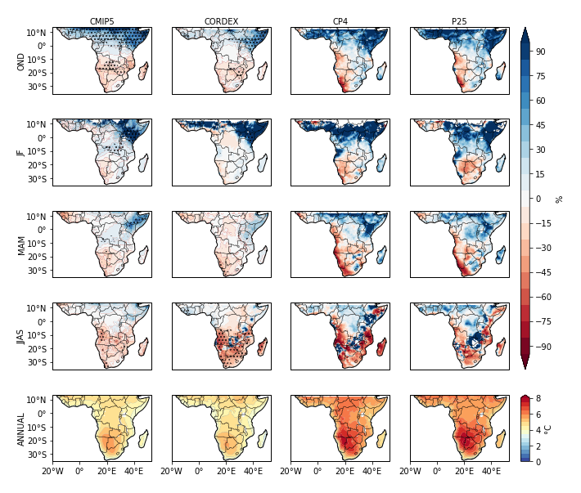
Results – climate impact (RCP8.5) on end of century rainfall and temperature
Dots = 2/3rds of models agree on sign of change
CMIP5 and CORDEX multi model ensemble mean similar
CP4A and P25 similar to each other and warmer than CORDEX and CMIP5

Slide 11
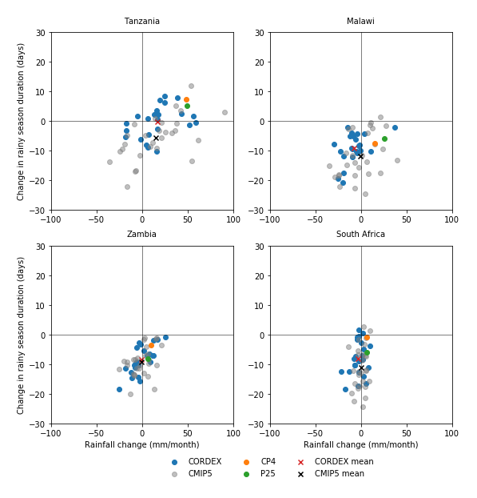
Model variation
End of century change in rainy season duration and rainfall with RCP8.5
Tanzania = Oct – Dec and March – May
Other countries = Nov – April
Large ensemble spread
Mean and spread similar CORDEX and CMIP5
CP4A and P25 similar to each other compared to ensemble spread

Slide 12
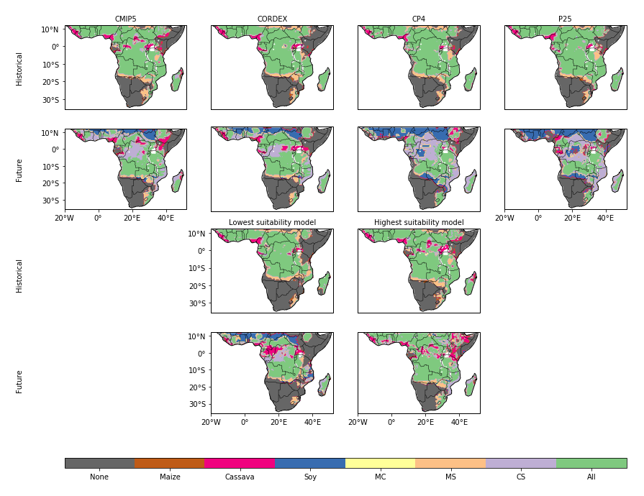
Agricultural suitability
Historical period – most areas except Horn of Africa suitable for all crops
Mostly within optimal temperature range = some temperature change can occur before suitability is impacted
Maize and cassava declined near equator in the future. For maize, this was mostly due to inclusion of extremes.
MC = maize and cassava, MS = maize and soy, CS = Cassava and soy
Highest future suitability model = BNU-ESM, lowest future suitability model = HadGEM2-ES CCLM4.

Slide 13
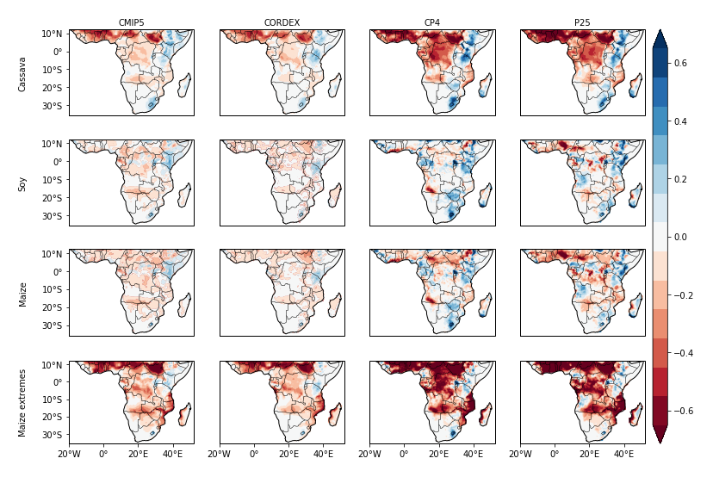
Change in suitability with climate change
CMIP5 and CORDEX similar to each other
Inclusion of extremes had large negative impact on maize suitability
Maize declines larger in P25 than CP4A due to more widespread declines in rainfall

Slide 14
Model variation in suitability change - soy
Tanzania – soy declines related to declines in rainfall
Zambia and Malawi – interannual variation in rainfall important, and suitability declined in some models where rainfall increased
CanESM2 CanRCM4 had highest rainfall increases for Malawi. However, frequent low rainfall years, particularly in southern Malawi, led to lower average crop suitability.
Background contours = suitability change based on CORDEX ensemble mean, annual data (same colour scale as points)

Slide 15
Model variation in suitability change - cassava
Declines in cassava suitability related to declines in rainfall
Interannual variability in rainfall less important than for soy
Higher required rainfall threshold than soy, however uses all rain throughout the year and not dependent on rainy season rainfall
Background contours = suitability change based on CORDEX ensemble mean, annual data (same colour scale as points)

Slide 16
Key messages
Large variation in rainfall responses with climate change in ensemble
Rainfall declines led to crop suitability declines in Tanzania
Malawi and Zambia – interannual variability in rainfall also important, and suitability declined in some models where overall rainfall increased
CMIP5 and CORDEX ensemble mean and spread similar for temperature and rainfall
CP4A and P25 similar to each other, compared to ensemble spread
GCM uncertainty, rather than convection parameterizations, still a large part of uncertainty in agricultural suitability results

Slide 17
Key messages
Maize very sensitive to inclusion of extreme temperatures
Unable to include this for cassava and soy due to lack of information
CP4A differs from P25 more so when it comes to extremes (Kendon et al., 2019)
Convection permitting models generally improve on regional climate models more so when it comes to extremes (Prein et al., 2015)
If we were able to include extremes more comprehensively, CP4A results may have differed more from P25

Slide 18
References
Dunning, C. M., Black, E. C. L., & Allan, R. P. (2016). The onset and cessation of seasonal rainfall over Africa. Journal of Geophysical Research: Atmospheres, 121(19), 11,405-11,424. https://doi.org/10.1002/2016JD025428
Famien, A. M., Janicot, S., Ochou, A. D., Vrac, M., Defrance, D., Sultan, B., & Noel, T. (2018). A bias-corrected CMIP5 dataset for Africa using the CDF-t method - A contribution to agricultural impact studies. Earth System Dynamics, 9(December), 313–338. https://doi.org/10.5194/esd-2017-111
Fang, G. H., Yang, J., Chen, Y. N., & Zammit, C. (2015). Comparing bias correction methods in downscaling meteorological variables for a hydrologic impact study in an arid area in China. Hydrology and Earth System Sciences, 19(6), 2547–2559. https://doi.org/10.5194/hess-19-2547-2015
Food and Agriculture Organization of the United Nations. (2007). EcoCrop. http://ecocrop.fao.org/ecocrop/srv/en/cropFindForm
Funk, C., Peterson, P., Landsfeld, M., Pedreros, D., Verdin, J., Shukla, S., Husak, G., Rowland, J., Harrison, L., Hoell, A., & Michaelsen, J. (2015). The climate hazards infrared precipitation with stations - A new environmental record for monitoring extremes. Scientific Data, 2, 1–21. https://doi.org/10.1038/sdata.2015.66
Harris, I. (2019). Release Notes for CRU TS v4.03: 15 May 2019. https://crudata.uea.ac.uk/cru/data/hrg/cru_ts_4.03/Release_Notes_CRU_TS4.03.txt
Kendon, E. J., Office, M., Centre, H., Stratton, R. A., Office, M., Office, M., Centre, H., Marsham, J. H., Rowell, D. P., Office, M., Centre, H., Senior, C. A., Office, M., & Centre, H. (2019). Enhanced future changes in wet and dry extremes over Africa at convection-permitting scale. Nat. Comm., 2019, 1–18. https://doi.org/10.1038/s41467-019-09776-9
Prein, A. F., Langhans, W., Fosser, G., Ferrone, A., Ban, N., Goergen, K., Keller, M., Tölle, M., Gutjahr, O., Feser, F., Brisson, E., Kollet, S., Schmidli, J., Van Lipzig, N. P. M., & Leung, R. (2015). A review on regional convection-permitting climate modeling: Demonstrations, prospects, and challenges. Reviews of Geophysics, 53(2), 323–361. https://doi.org/10.1002/2014RG000475
Ramirez-Villegas, J., Jarvis, A., & Läderach, P. (2013). Empirical approaches for assessing impacts of climate change on agriculture: The EcoCrop model and a case study with grain sorghum. Agricultural and Forest Meteorology, 170, 67–78. https://doi.org/10.1016/j.agrformet.2011.09.005
Stratton, R. A., Senior, C. A., Vosper, S. B., Folwell, S. S., Boutle, I. A., Earnshaw, P. D., Kendon, E., Lock, A. P., Malcolm, A., Manners, J., Morcrette, C. J., Short, C., Stirling, A. J., Taylor, C. M., Tucker, S., Webster, S., & Wilkinson, J. M. (2018). A Pan-African Convection-Permitting Regional Climate Simulation with the Met Office Unified Model: CP4-Africa. Journal of Climate, 31(9), 3485–3508. https://doi.org/10.1175/JCLI-D-17-0503.1
Taylor, K. E., Stouffer, R. J., & Meehl, G. A. (2012). An overview of CMIP5 and the experiment design. Bulletin of the American Meteorological Society, 93(4), 485–498. https://doi.org/10.1175/BAMS-D-11-00094.1
Teutschbein, C., & Seibert, J. (2012). Bias correction of regional climate model simulations for hydrological climate-change impact studies: Review and evaluation of different methods. Journal of Hydrology, 456–457, 12–29. https://doi.org/10.1016/j.jhydrol.2012.05.052
University of East Anglia Climatic Research Unit. (2019). CRU TS Version 4.03. https://crudata.uea.ac.uk/cru/data/hrg/cru_ts_4.03/

