Slide 1
Study of mountain-wave-induced stratospheric cooling over the Antarctic Peninsula using a parameterisation scheme in the UM-UKCA chemistry climate model
Andrew Orr, Scott Hosking, Aymeric Delon, Tracy Moffat-Griffin, Lars Hoffman, Reinhold Spang, Luke Abrahams, James Keeble, and Peter Braesicke
Introduction / background
An important source of polar stratospheric clouds (PSCs) is from the temperature fluctuations induced by mountain waves.
This formation mechanism is usually missing in chemistry–climate models because these temperature fluctuations are neither resolved nor parameterised.
Here, we investigate in detail the localised wintertime stratospheric cooling produced by a parameterisation scheme describing stratospheric mountain-wave-induced temperature fluctuations into the UM-UKCA global chemistry-climate model.
We focus on the Antarctic Peninsula, which is a hot spot for mountain waves.
See Orr et al. (2015 for details of the scheme.
Orr, A., Hosking, J. S., Hoffmann, L., Keeble, J., Dean, S. M., Roscoe, H. K., Abraham, L., Vosper, S., and Phillips, T.: Inclusion of mountain wave-induced cooling for the formation of PSCs over the Antarctic Peninsula in a chemistry-climate model, Atmos. Chem. Phys., 15, 1071-1086, doi:10.5194/acp-15-1071-2015, 2015.

Slide 2
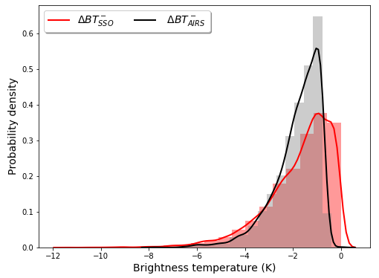
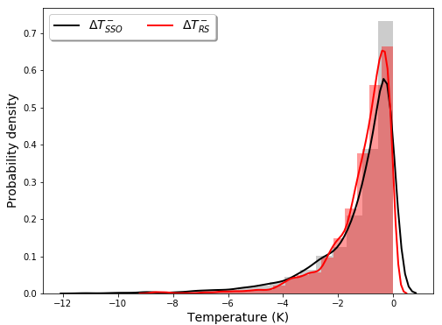
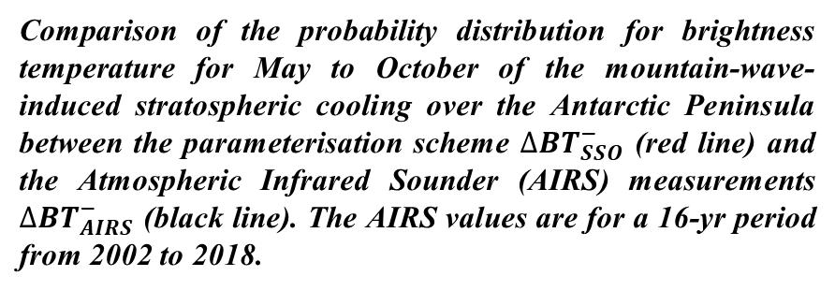
Comparison of results from the scheme with AIRS (left) and radiosonde (right) measurements
Comparison of the probability distribution for brightness temperature for May to October of the mountain-wave-induced stratospheric cooling over the Antarctic Peninsula between the parameterisation scheme $∆{BT}_{SSO}^{−}$ (red line) and the Atmospheric Infrared Sounder (AIRS) measurements $∆{BT}_{AIRS}^{−}$ (black line). The AIRS values are for a 16-yr period from 2002 to 2018.
Comparison of the probability distribution of temperature for May to October at an altitude of 22 km of the mountain-wave-induced cooling over the Antarctic Peninsula between the parameterisation scheme $∆T_{SSO}^{−}$ (black line) and the radiosonde observations $∆T_{RS}^{−}$ (red line). The radiosondes are launched daily for a 14-yr period from 2002 to 2015.

Slide 3
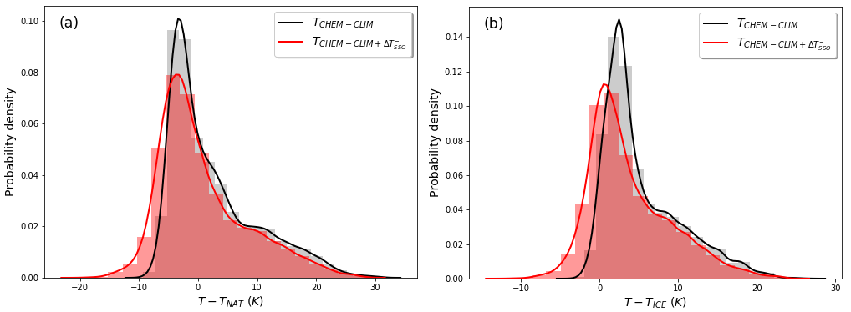
Influence of the scheme on how often PSC formation temperatures are exceeded in the model
Probability distributions of the temperature differences between the model temperature T and the formation temperature of type Ia (T_{NAT}) and type II (T_{ice}) PSCs over the Antarctic Peninsula at an altitude of 20.4 km for the combined months of May to October, , i.e. $T−T_{NAT}$ (a) and $T−T_{ice}$ (b). Here $T$ is equal to either $T_{CHEM−CLIM}+{∆T}_{SSO}^{−}$ (red line) and $T_{CHEM−CLIM}$ (black line), i.e. when the parameterisation scheme is switched on and off.

