Slide 1
Understanding distributed data – a semantic web approach for data based analysis of NDT data in civil engineering
D666 | EGU2020-19332
further explanations are available in the slide notes
Christoph Völker¹, Benjamin Moreno-Torres¹, Sabine Kruschwitz^{1,2}
1 Bundesanstalt für Materialforschung und –prüfung 2 Technische Universität Berlin

Slide 2
Many practical task can be solved
Rebar
Localization of built-in
components
Tendons
Anchors
Grain structure
Pipes
Structural exploration
Structure
Layer
Micro structure
NDT in
Civil Engineering
Interfaces
Geometry
Material
characterisation
Migration monitoring
Sulphate attack
Fatigue
Corrosion
Chemical reaction
Moisture
Ions
Cracking
ASR
Delamination
Determination
Damage
analysis
Chlorides
Poor construction
Sulphates
Alkaline
Honeycombing
Homogeneity
Grouting defect
Notes:
Geophysical methods are typically used to study the geological situation of the near subsurface or the physical structure of the Earth. However, they have also become very popular for the non-destructive investigation of concrete infrastructure buildings.
Ground penetrating radar (GPR) is, e.g., commonly used for locating rebars and other steel built-in parts in reinforced concrete. Ultrasonic techniques—which are the high-frequency equivalent to seismic methods in geophysical applications—are applied for structural inspections such as thickness measurements, the localization of voids, delaminations or other types of flaws. NDTCE delivers valuable information that support the engineer in decision making.
Testing tasks are based on the information required from the stakeholders.
Generally speaking, we distinguish between three fields:
the determination of material parameters by material characterization;
the localization of EBT and the determination of the geometry in the structural exploration;
the detection of the material properties of the material. Damage in the damage analysis.
Many tasks cannot be considered separately:
The characterization of moisture and ion content is of course often related to chemical reactions that damage the concrete.
The detection of cracks and the detection of interfaces are related topics: Cracks are interfaces.
The quality with which we can locate built-in parts also depends on the material properties of the concrete - for example on its microstructure.
The tasks in NDT in the building industry are therefore often highly multivariate and overlapping – so is the data.

Slide 3
Is it possible to create value from existing data? The fourth paradigm of science*
Empirical
Science
Theory
Driven
Science
Computational
Science
Data
Driven
Science
*Hey, T. et al. (2009) ISBN: 978-0-9825442-0-4
Notes:
Data driven science has developed out of the growing demand for open science combined with the meteoric rise of AI and machine learning. As these innovative technologies allow ever-larger datasets to be processed and hidden correlations to be unveiled, data-driven science is emerging as the fourth scientific paradigm following the first three eras of experimentally, theoretically, and computationally propelled scientific discoveries. Often connected to the fourth industrial revolution or the second machine age, such data-driven approaches permeate science, business, politics, and even social life.
The underlying objective of data driven science is to significantly reduce the time and cost of discovering new knowledge. Creating the data is often seen as the critical factor in this process. Data driven science seeks therefore to reuse existing data. In contrast to conventional empirical science, it is interdisciplinary in scope and utilizes modern statistical methods as a common basis for cross domain data analysis. This opens new avenues of acquiring knowledge in science.

Slide 4
Creating value from data in NDTCE What questions can we answer with data?
Which NDT method has the best performance for the detection of cracks in 20 cm depth?
Querying (distributed) data (NDT-Google)
Knowledge extraction (analysis of hidden correlations)
Improvement of engineering and physical models
Which factor influences the quality of a specific testing task the most?
Based on similar cases, when is the next production step feasible?
Notes:
In this context non-destructive testing (NDT) offers various opportunities to use data-driven technologies for profit. In the field of materials science (MS) and especially in NDT knowledge is usually derived experimentally. Many measurement data sets are naturally generated. This data holds great potential, e.g. for automated information extraction, for quantifying measurement uncertainties and for extracting new relations among data with knowledge extraction. This could benefit engineering models which are based on real measurement data, where the safety margins for a given scenario could be reduced if large amounts of real measurement data are factored into the estimates.

Slide 5
Research data management status quo in the dpt. for NDTCE
Large amounts of data available at BAM
GPR
830 GB, 285 k Files Ultrasonic
420 GB, 10 Mio. Files
Reconstruction
860 GB, 10 k Files
>20 Years
~15 TB
~30 Mio.
Problem: Data stored in Windows file system -> reuse not practically
Notes:
At the department “NDT for Civil Engineering” at the Federal Institute for Materials Research and Testing (BAM), ~15 terabytes and ~30 million files have been created over the past few decades. This data contains test sets from various test methods in many test scenarios that are unique in the world. This is potentially a great asset in the data age. Nevertheless, information from measurement data is generated, analyzed and disseminated in so many different ways that it is difficult even for colleagues to reuse data without further information. The underlying data, in turn, are weakly structured in the sense that it is not readily apparent what the specific content of a particular measurement is. Additionally the data is typically stored in weakly structured file systems. Whilst it is in many cases possible to interpret and classify data sets by taking into account signal patterns and information fragments contained in file headers, file paths and file names, this representation is unsuitable for subsequent use in terms of (interoperable) information exchange. Although it is not a specific issue of the organization, it exemplifies what occurs in similar research institutions with similar research fields and goals. The current status quo of NDT data is fundamentally incompatible with modern methods for the computational extraction of knowledge from data. Moreover, modern data analysis methods are based on systematic computational access to large data sets, preferably via application programming interfaces (API).

Slide 6
Ontology based data management
Automated data source
management
Platform based
Data Analysis
Semantic-Web
Semantic Data Analysis
Data Pipeline
Data Space
Ontology
SemDB
Data
Analyst
*
NDT-Expert
BIM-Parser
Engineer
IFC
Export
*e.g. as in: Adnan, K. et al. 2019; https://doi.org/10.1186/s40537-019-0254-8
Enabling seamless communication between stakeholders
Notes:
The scope of our work is to provide an accessible representation of knowledge that describes the test sets using an ontology based approach. This is intended to facilitate the scientific exploitation of distributed data sources in the domain of NDT. Furthermore, it aims to achieve interoperability in materials research, thus creating the possibility of expanding the knowledge through interdisciplinary exchange with other domains. More specifically, the NDT ontology provides the basis for an information exchange between NDT experts and BIM, e.g. by extending the IFC scheme.
The core of the presented work is the development of an NDT-ontology, which formalizes the domain knowledge associated with (advanced) NDT methods, such as radar and ultrasound.

Slide 7
Ontologies Overview
Ontologies are the “core” of the semantic web.
"The Semantic Web is an extension of the current web in which information is given well-defined meaning, better enabling computers and people to work in cooperation.“*
Ontologies are knowledge graphs that provide a machine readable data-description-framework which can be highly expressive.
*Berners-Lee et al. (2001) "The Semantic Web"
Notes:
Ontologies are closely related to the concept of the Semantic Web (SW). As an extension of the Internet, SW pursues the goal that through "a uniform framework [...] data can be exchanged and reused across application, company and community boundaries" (Berners-Lee 1999). The ontology is the central logic unit of the SW.
This creates the essential prerequisites for data structuring using an ontology-based approach. Ontologies describe the knowledge of a domain (like NDT) with a mathematical model. Information is described semantically - i.e. the relationships of relevant terms to each other are also mapped. If necessary, incomplete information can be derived from the respective context. The dilemma of explicit description - the later purpose of use is usually unknown at the time of its creation - and the associated loss of information can thus be minimized. For NDT in civil engineering, ontologies can be used specifically to sort and analyze measurement data with the help of computers and to recognize correlations.

Slide 8
Onologies
Ontologies describe data on three levels:
-
-
-
-
-
-
-
-
Vocabulary A-Z
Specifying a controlled vocabulary for relevant entities & phenomena
Defining relationships between entities
Defining rules for the interpretation of relationships (reasoning)
Notes:
Phenomena of the "real" world (e.g. an inspection task) are represented in a ontology by the specification of relevant terms (controlled vocabulary). The use of a common vocabulary, e.g. based on DIN EN 1330-4 (2010), could ensure a broader acceptance of an ontology.
In addition, relationships between entities are described by logical functions, such as a transitive or inverse relationship.
This is accompanied with rules for the interpretation of the relationships. This is because the same relation could have completely different meaning depending on the respective domain. The relationship “runs on” for example could mean two things, depending on whether (1) a “car” “runs on” “petrol” or (2) a “spider” “runs on” the “desk”.

Slide 9
Ontologies Enhanced expressivity
NDT in
Civil Engineering
1) map data on ontology (explicit information)
2) infer additional (implicit) information through axioms.
3) store information in database:
implicit
information
Testing tasks
Testing task 1
Testing task 2
Material property
low
high
has result
File XY:
-performs „Testing task 2“
-relates to „Material property“
File XY
Notes:
Measurement data are assigned (mapped) to appropriate concepts of the ontology and are thus automatically placed in a context.
In this simple example “File XY” is mapped to “Testing Task 2” of the “NDT in Civil Engineering” ontology. An axiom defines the relation between “Testing task 2” and “Material property” as “has result”. Consequently “File XY” relates in some way to “Material property”. This implicit information can be made explicit by serializing the available information in a database with a reasoning engine.
In contrast to classical database schemata, which explicitly describe data sources by means of defined metadata, ontologies can be used to query implicit knowledge.
If, for example, a measurement file is assigned to the term "roadway slab (bridge)", other highly probable properties can be derived automatically if “relates to some” axioms define a connection to other properties (such as field measurement, reinforced concrete, dynamically loaded component, exposed to moisture and chloride, increased concrete compressive strength, increased concrete cover, horizontal slab, etc.)

Slide 10
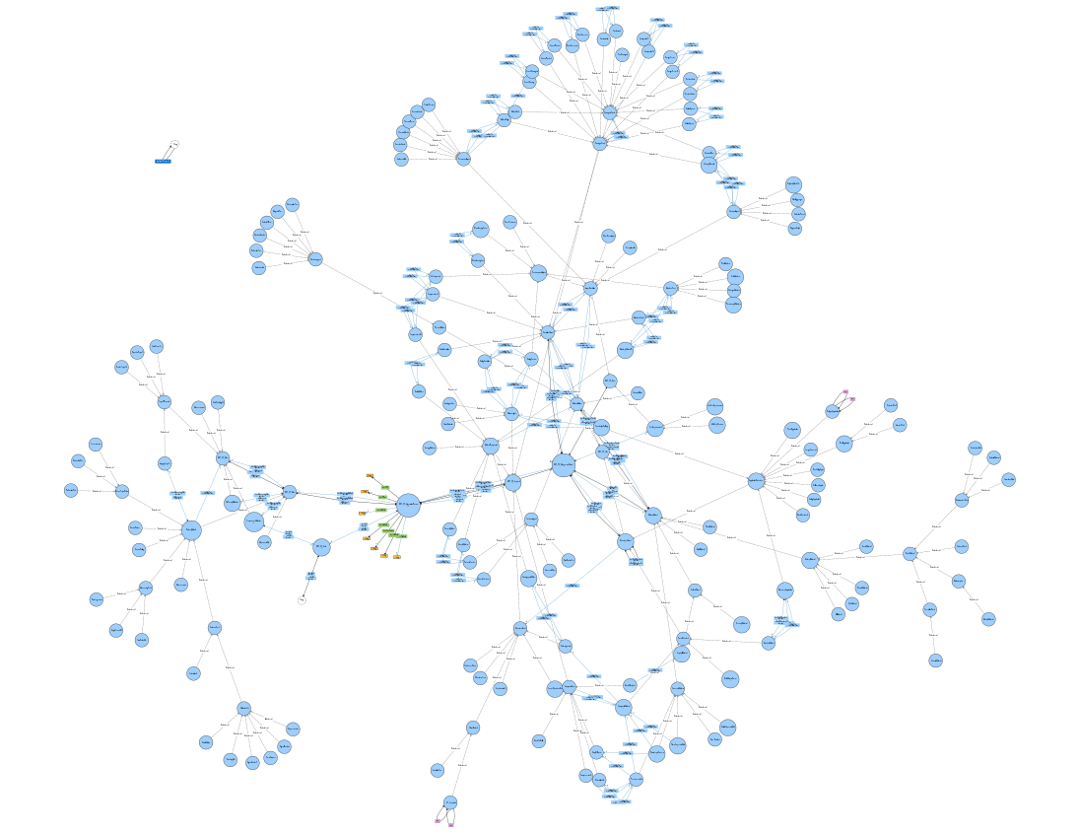
Ontologies Practical example
Ontology describing GPR in NDT-CE*
Created to describe 50 randomly selected data sets (~1500 axioms)
415 explicit data properties specified
471 additional implicit properties were derived
*Zscherper, E. (2020) Bachelor Thesis Technische Universität-Berlin
Notes:
In a first implementation 50 randomly selected measurements from BAMs internal research data repository from the GPR method were chosen. Based on these data, the specific requirements for a data integration concept are identified which have to be fulfilled. The ontology represents the knowledge that can be gained from test data. Ultimately, this aims at an optimal use of the measurement data.
Which questions can be answered by the ontology?
Which research question can be solved with a specific information resource? Which measurement method provides the optimal results for certain test tasks? Which measurement methods are used to investigate certain object structures and materials? Which problems may occur in which constellations? What are the relationships between material properties and the required inspection tasks?
The ontology consist of ~1500 axioms.

Slide 11
Conclusion
Many research questions related to distributed information cannot be answered to date
Answering these questions requires powerful meta data frameworks
Diverse domains (such as NDT-CE) benefit from semantic data description
Ontologies enable seamless information exchange between stakeholders (e.g. via data platforms)
*Berners-Lee et al. (2001) "The Semantic Web"
Notes:
Data-driven research in MS generally and in NDTCE specifically suffers from the quality of metadata. This quality of metadata is highly dependent on a precise specification of each aspect of the data collection process chain. Not only is there a requirement for a precise description of these aspects, but the underlying contextual information should also be taken into account in data management. This is particularly important when trying to analyze data beyond the specific purpose for which they were collected. To achieve a certain degree of compatibility between different data, a consistent semantic description of the collected data is essential.
For this purpose the data and measurement descriptions can be used from the NDT CE ontology. This in turn allows a direct integration of the ontology and the restructured data into the existing mechanisms for data acquisition during an NDT investigation. This not only creates an ontology for the NDT, but also demonstrates the seamless integration into existing MS tools/infrastructures with all their added value in terms of comparability of the collected data. Furthermore, the existing NDT data will be significantly improved by establishing a link between the different MS initiatives. At the very least, the collected data will become comparable and integratable across different MS domains. This allows the development of a new support system and further statistical analysis of such structured MS data. Furthermore, existing data sets can be integrated into a uniform data representation and thus enable further analyses.

Slide 12
Thank you very much for your interest.
Christoph.Voelker@BAM.de

