Slide 1
Dynamics of the 1989 fracture system and relations with the Etna eruptive activity of the last 30 years
G. Aiesi¹, A. Bonforte¹, G. Brandi², F. Calvagna¹, S. Consoli¹, G. Distefano³, G. Falzone¹, A. Ferro¹, S. Gambino¹, F. Guglielmino¹, G. Laudani¹, G. Marsala³, F. Obrizzo², L. Privitera³, G. Puglisi¹, S. Russo³, B. Saraceno¹, R. Velardita¹
1 INGV - Osservatorio Etneo, Piazza Roma, 2 Catania
2 INGV - Osservatorio Vesuviano, via Diocleziano, 238 Napoli
3 Dip. Scienze Biologiche, Geologiche e Ambientali, Università di Catania, Corso Italia 57, Catania

Slide 2
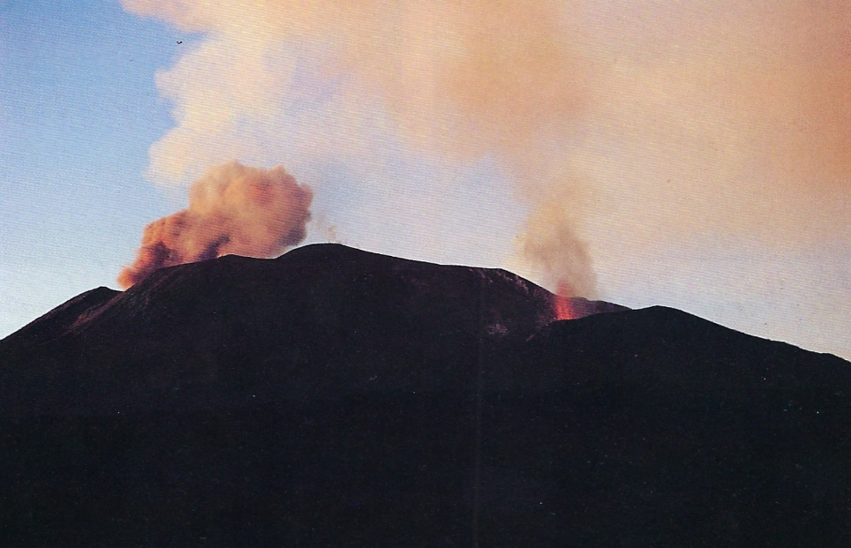
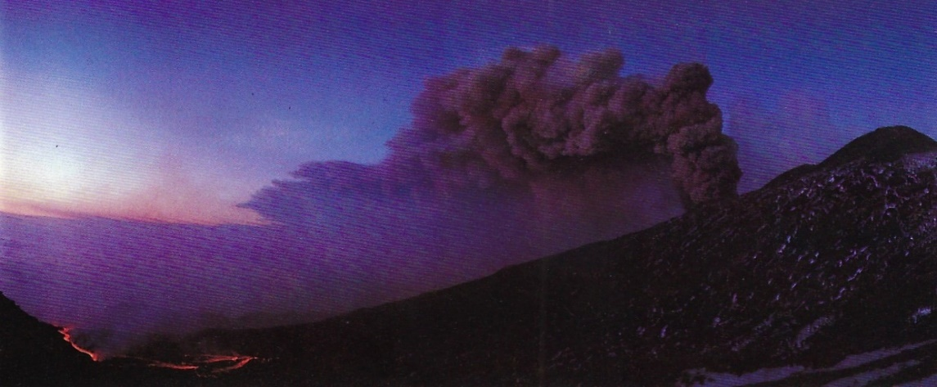
The 1989 eruption
The 1989 eruption of Mount Etna lasted from 1989 September 11 to October 9 and was characterized by intermittent Strombolian lava fountaining and effusive activity, which was limited to the volcano summit, in the first phase.
On September 23–24, two different fracture systems began to open at the foot of the SE Crater and propagated at a rate of 1 km day⁻¹ downhill, trending c. NE and SE, respectively. On September 27, while at the edges of the NE fracture system flank magma effusion started, the SE fracture extended by a further 5 km in five days, propagating downhill as a dry, non-effusive system.

Slide 3
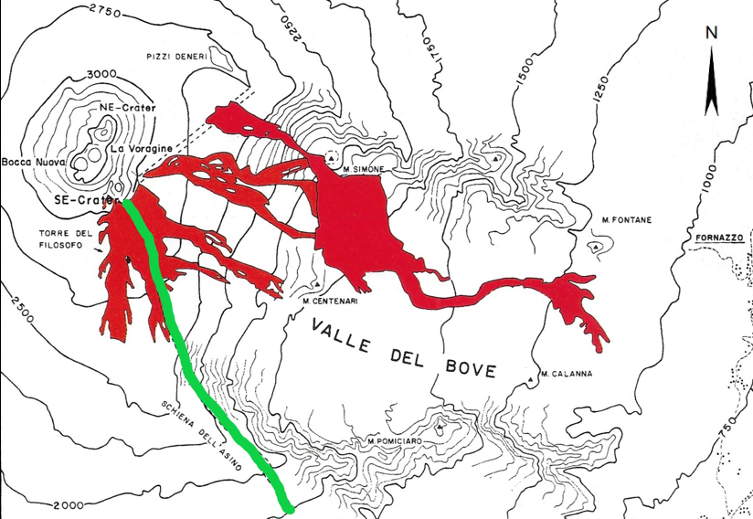
The SE fracture (in green) was formed between September 27 and October 3, during the eruptive sequence of 1989.
It extends from the base of the Southeast Crater to an altitude of 1500 m above sea level, with an NNW-SSE orientation.
Its width varies from 30 to 300 m, while it has a total length of approximately 6.5 km.
Map of the lava flows emitted during the 1989 eruption. The green line indicates the SE fracture, the orange box indicates the terminal part of the fracture studied (from "Mt. Etna: the 1989 eruption" Giardini Editore, modified).

Slide 4
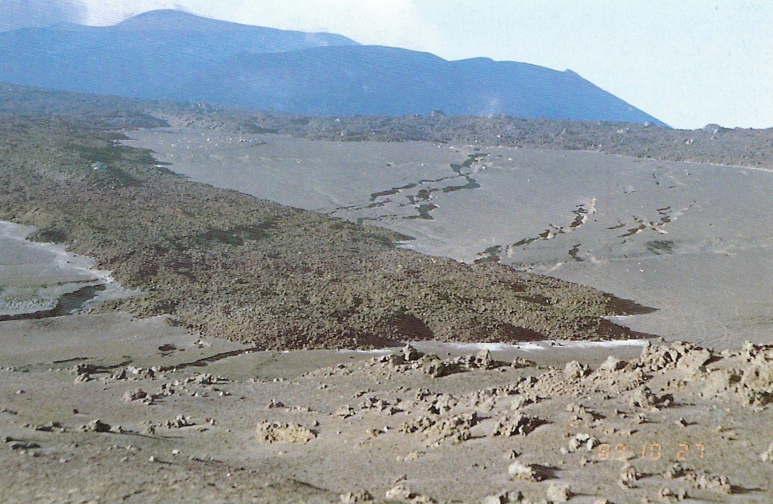
The SE fracture system initially evolved extremely rapidly, then progressively slowed down: it all began on the evening of September 27, when, in less than 24 hours, the fractures travelled 2.3 km, reaching the Cisternazza area.
On 30 September, they arrived at the Schiena dell'Asino, while on 2 October, they cutted the SP 92 road, which connects Zafferana Etnea to the Rifugio Sapienza; at 17:00 on the same day, the fractures still moved, until they reached Casa dello Sciatore. In the night between 2 and 3 October, the fracture system reached 1500 m a.s.l., where it stopped.

Slide 5
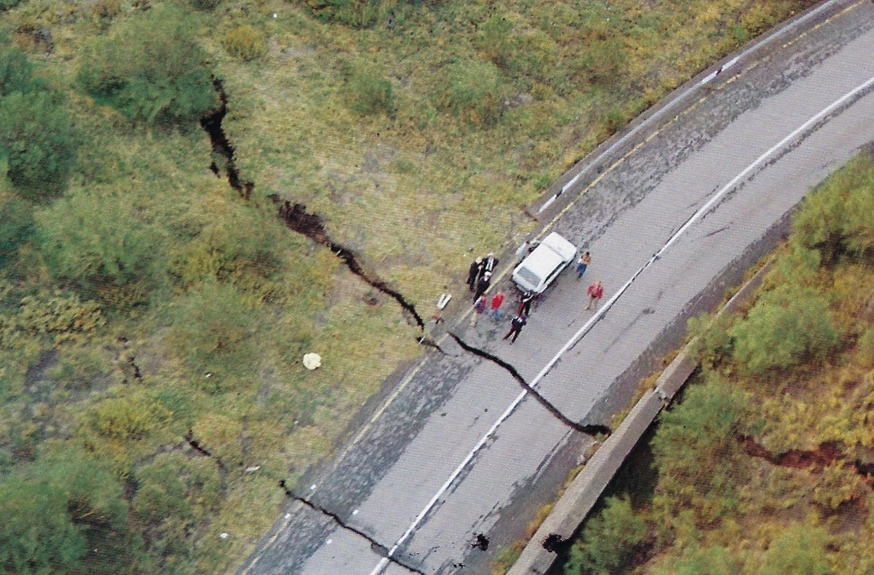
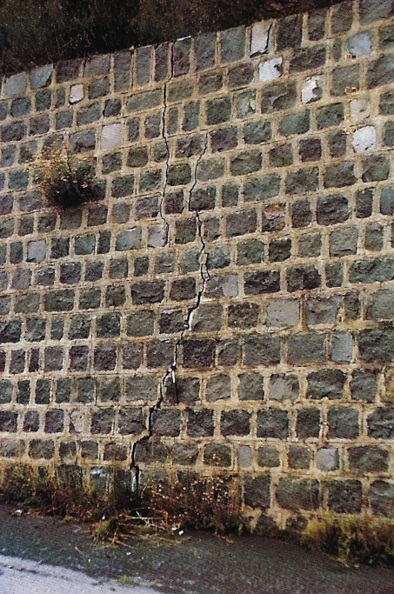
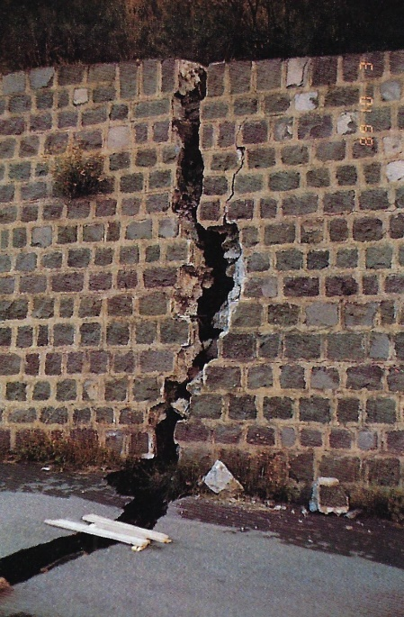
The effects of the fracture
The tensile deformation affected an area of 167 m wide, with a N150 direction and consisted of two fracture systems: the western system, which formed a graben that was 9 m wide and the eastern system, which affected an area 91 m wide.
Progressive opening of the fault that delimits to the west the graben, formed on 2 October, along the SP 92 road. (From "Mt. Etna: the 1989 eruption" Giardini Editore).

Slide 6
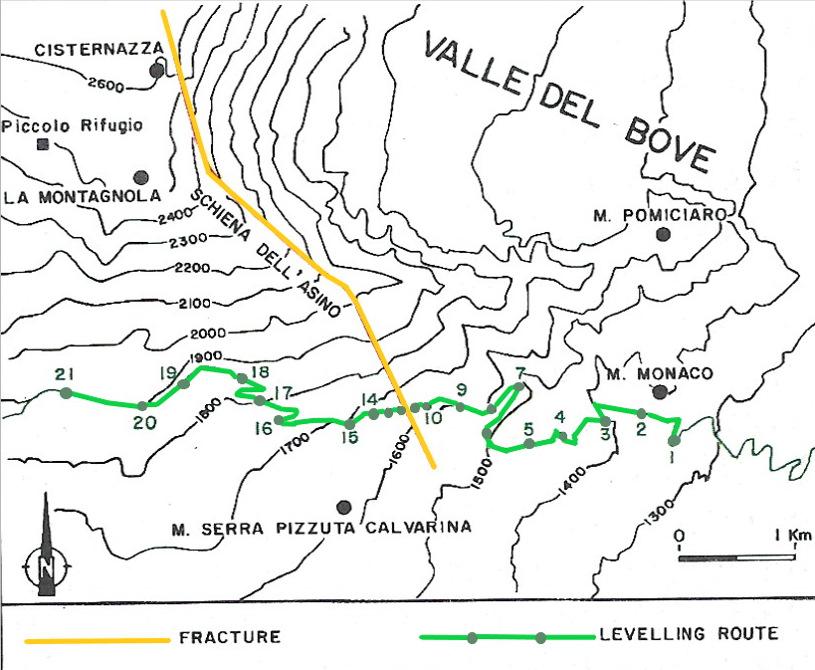
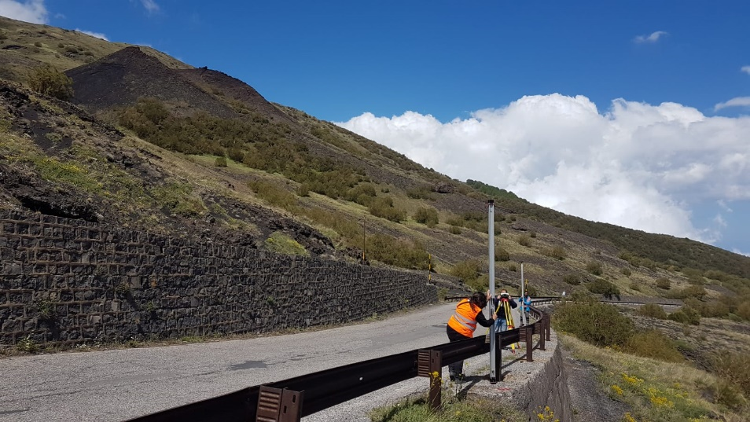
Monitoring systems
Levelling
Since 1980, a levelling network has operated on Mount Etna. It is composed by about 100 benchmarks, distributed along a 60 km route, for a total height difference of 500 m.
During 1989 eruption, the network was extended in the zone affected by the opening of the fractures, adding 21 benchmarks along the SP92.
Levelling measures – May 2019

Slide 7
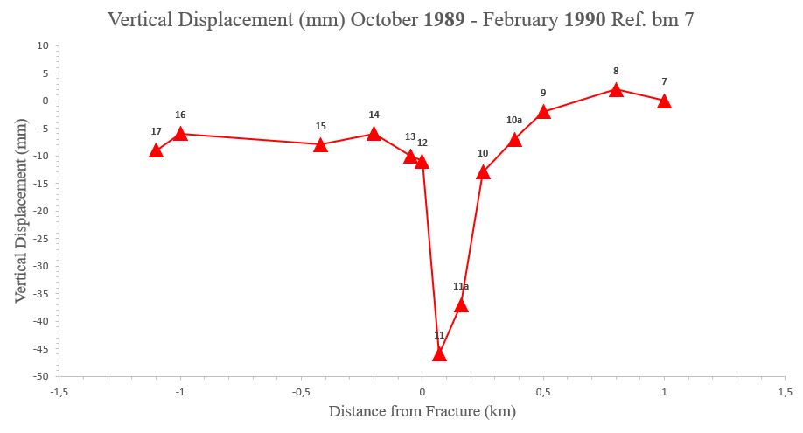
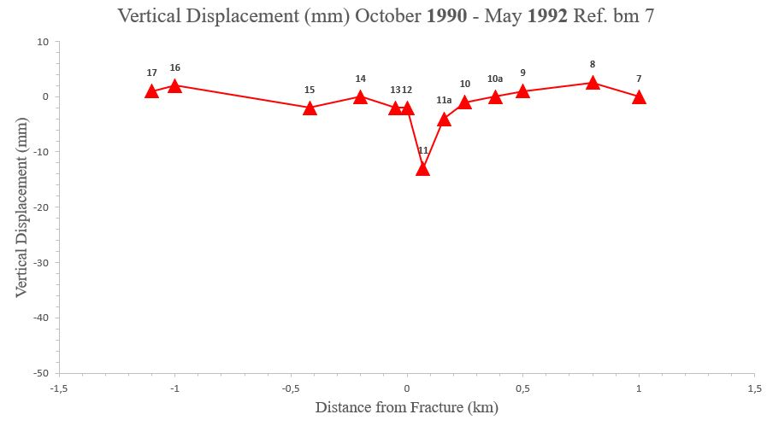
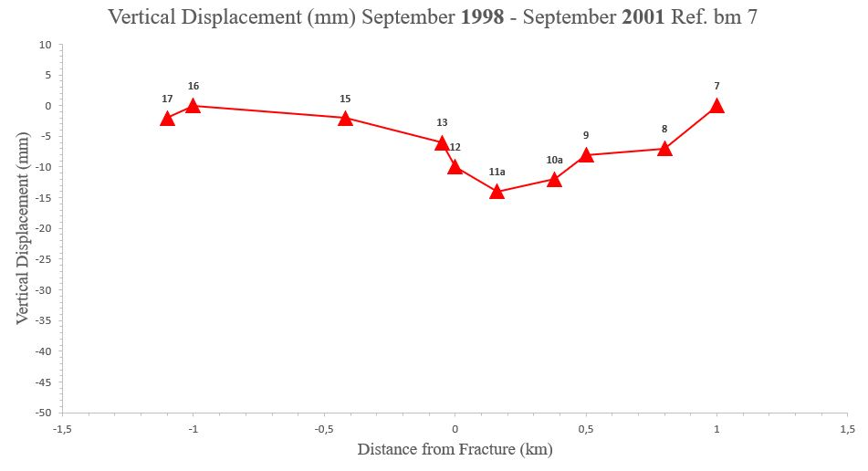
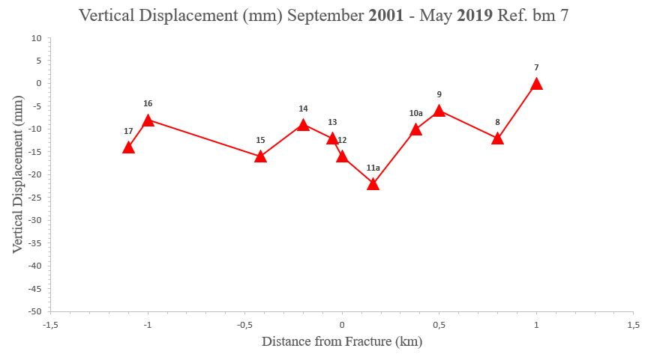
Levelling
Vertical Displacements, recorded in 4 different periods

Slide 8
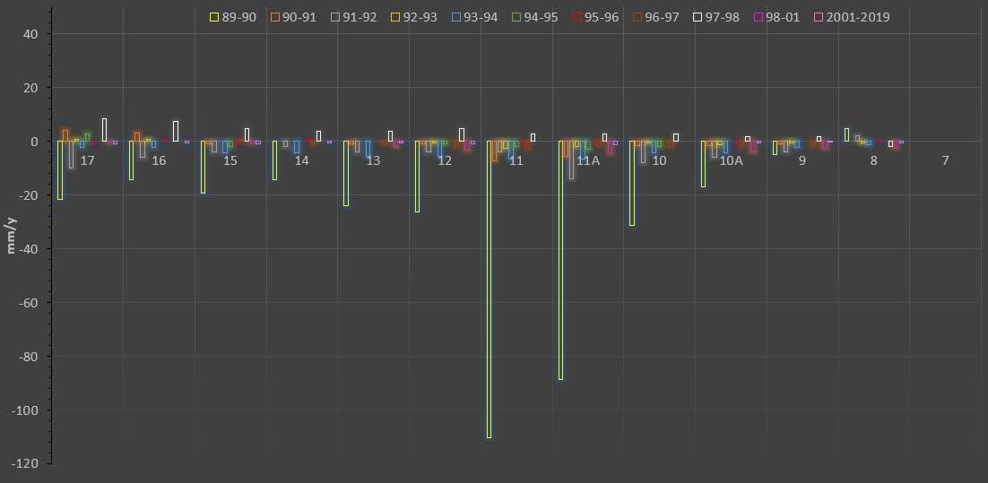
Levelling
Annual deformation rates calculated from the data collected during the levelling measures (from 1989 to 2019), which indicate that, after the 1989 eruption, the vertical deformations, albeit in sharp decrease, however, continued.

Slide 9
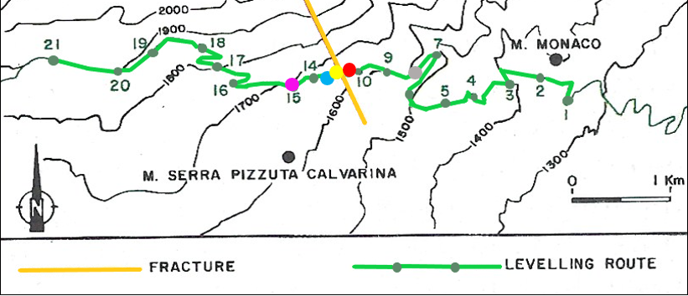
Levelling
Temporal reconstruction of vertical deformations, relating to 5 benchmarks (15, 13, 11a, 10a, 8): these are the points along which the deformations are greatest. Therefore, they allow to clearly highlight the magnitude of the movements in the last 30 years.
11A
13

Slide 10
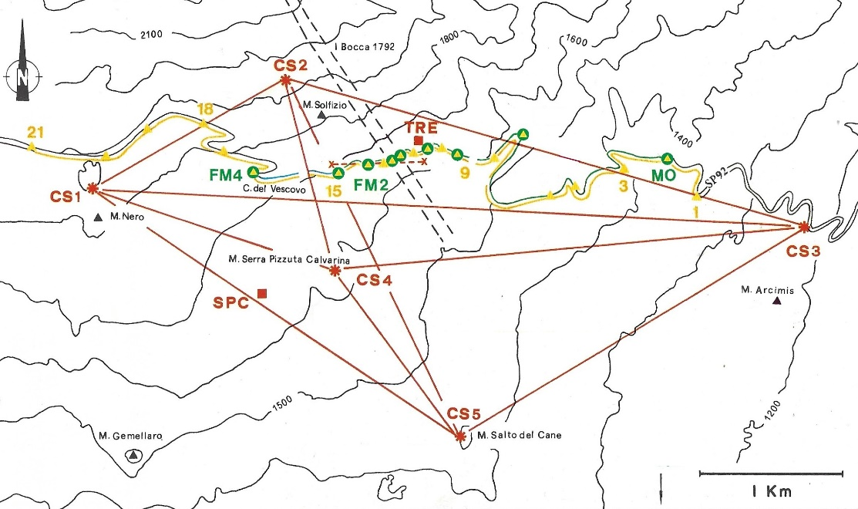
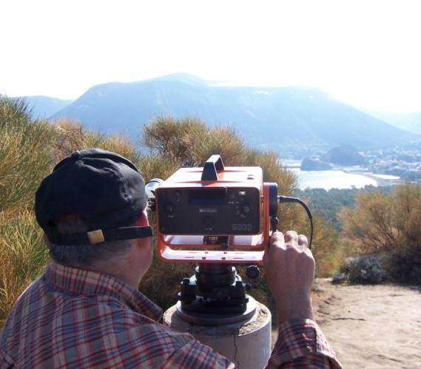
EDM (Electromagnetic Distance Meter)
Starting from 1978, a benchmark network was realized on Mount Etna, in order to measure the horizontal ground deformations by using geodimeters (or distance meters).
Monitoring systems present in 1989 along the southern termination of the SE Fracture System (hatched). The red lines indicate the baseline of the EDM geodimetric network, the green lines the microgravimetric lines, the yellow lines the levelling lines. The red squares indicate the tiltmetric stations (from Mt. Etna: the 1989 eruption, Giardini Editore, modified)
Geodimetric measurements (with Geodimeter).

Slide 11
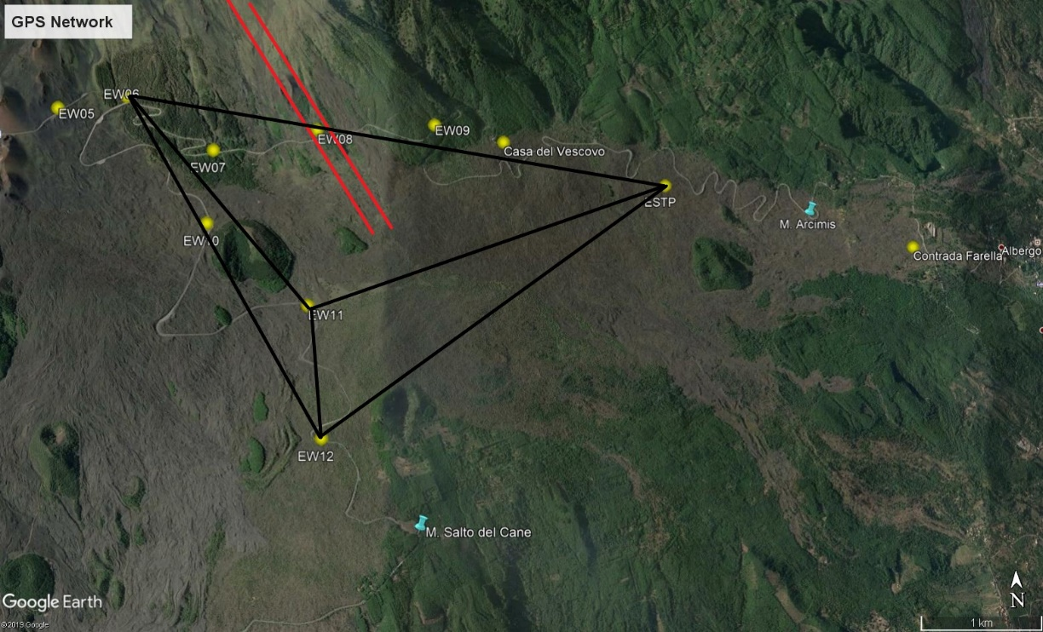
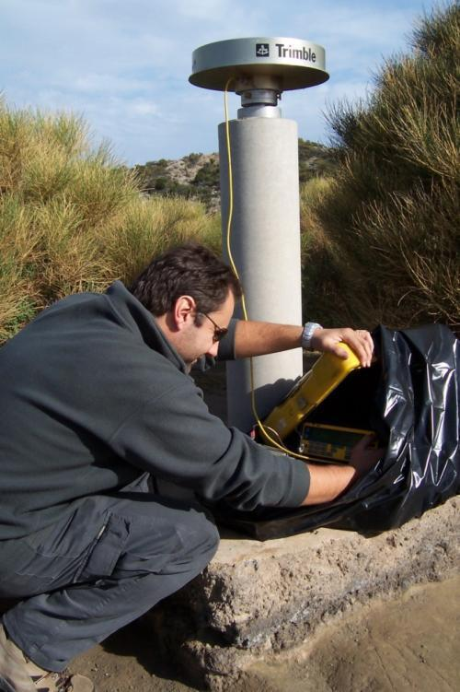
Since 2003, the EDM geodimetric network has been replaced by GPS measurements.
Trilateration network, built by joining the GPS stations EW06, EW11, EW12, ESTP. The red lines indicate the 1989 fracture. (Data SIO, NOAA, U.S. Navy, NGA, GEBCO © 2019 Google).
GPS measurements.

Slide 12
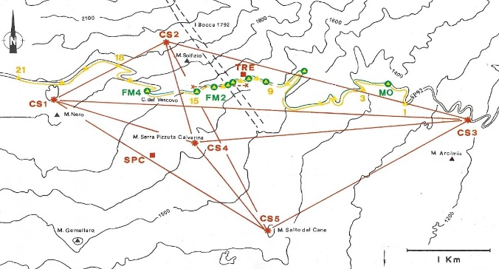
EDM + GPS
Extension
Seaward sliding
of the eastern flank

Slide 13
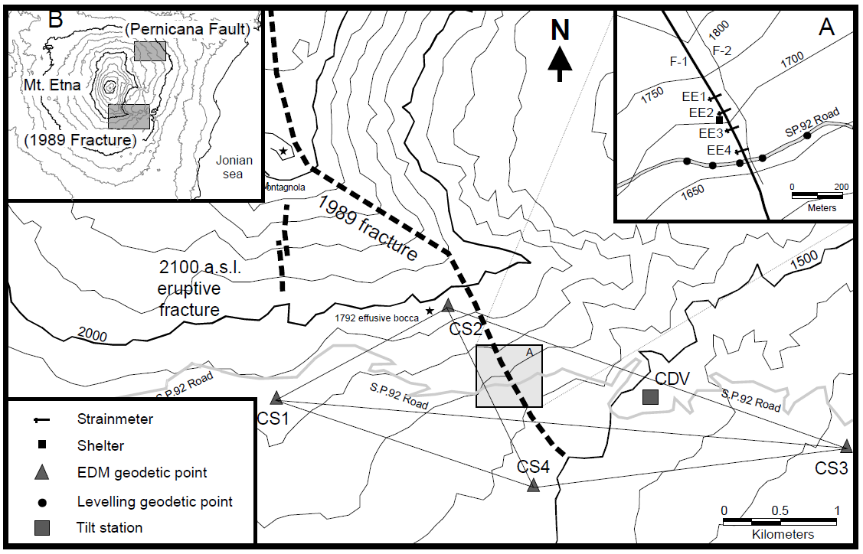
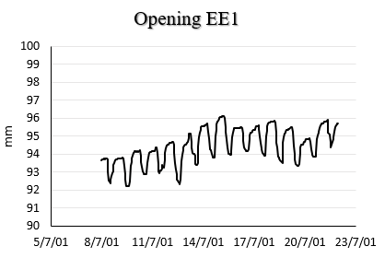
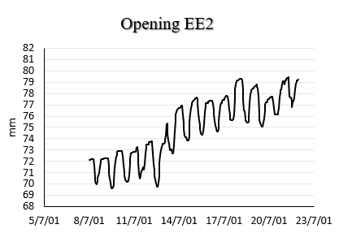
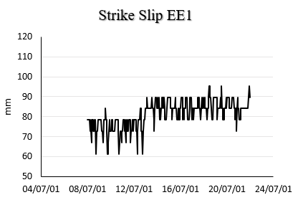
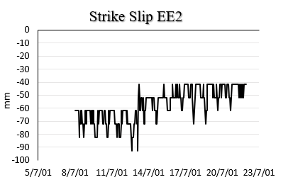
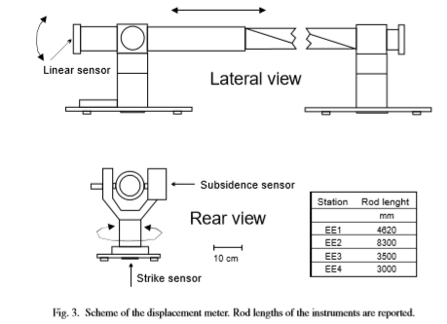
Extensometers
Map of the southern end of the 1989 fracture. The insert (A) shows the rod-strainmeter network and levelling points near the fractures (Gambino S., 2004).
Graphs relating to the rod-strainmeter EE1
Graphs relating to the rod-strainmeter EE2
Left-lateral displacement

Slide 14
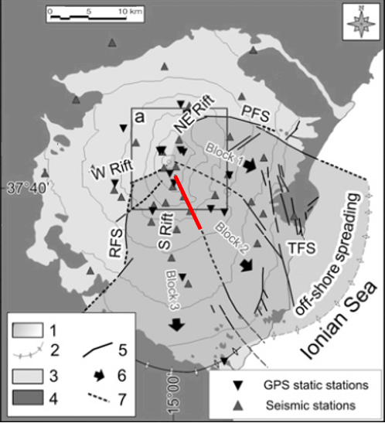
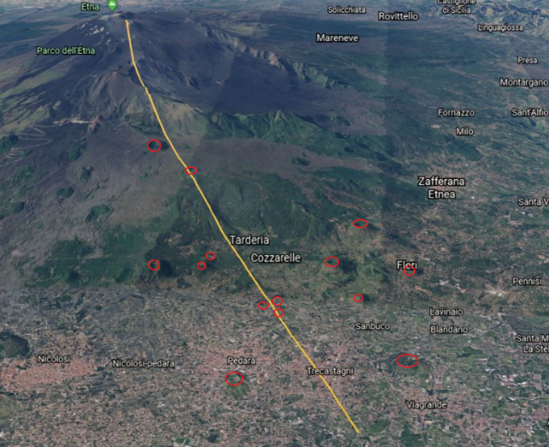
Concluding remarks
The 1989 fracture in these 30 years has shown a subsidence and a shear dynamics, especially during the intrusive phases.
The 1989 fracture can be considered a part of a more important junction structure. During intrusions it generally shows a left strike slip dynamics, even if, in the long term, it shows a right lateral component, due to seaward sliding of the eastern flank (the higher speed of Block 2 than Block 3).
Finally, the 1989 fracture is a potential danger for the population because it could represent a preferential path for the ascent of magma, as evidenced by the cones (highlighted by red circles), aligned along the same structure; therefore, monitoring over time in the future is recommended.

