Slide 1
Impact of tropical cyclone storm surges on groundwater salinity in southwest regions of Bangladesh
Chi San Tsai, Prof. Adrian P. Butler and Dr.Mo A. Hoque
EGU General Assembly 2020
Online 7th May 2020

Slide 2
Outline
Bangladesh: vast river deltas & Land reclamation
Drinking water in coastal Bangladesh /Impacts of storm surges
To investigate how storm surges affect the salinity of coastal water resources in Bangladesh
The study area/Model development
Representation of subsurface geology
Model calibration
2D storm surge model (model setup & Results)
Summaries

Slide 3
Bangladesh : vast delta rivers
Deltaic coastal plains
vulnerable to storm surges,
tidal surges &flooding
Salinity is a widespread problem
Asia coastline
11 mega deltas
Bangladesh locates at the Ganges-Brahmaputra-Meghna which is the world largest river system delta. These low-lying delta plains are subject to tropical cyclones associated with storm surges.

Slide 4
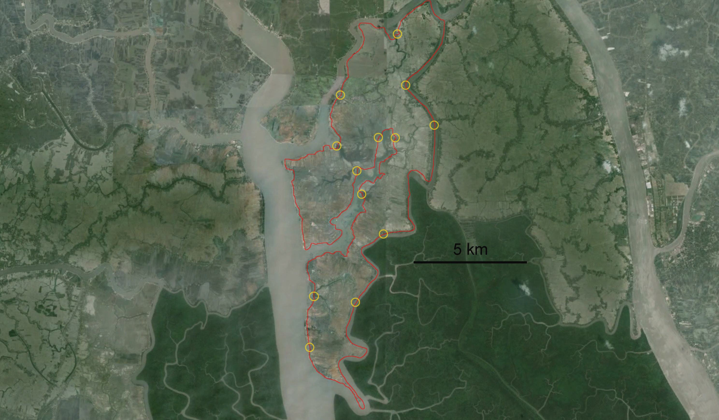
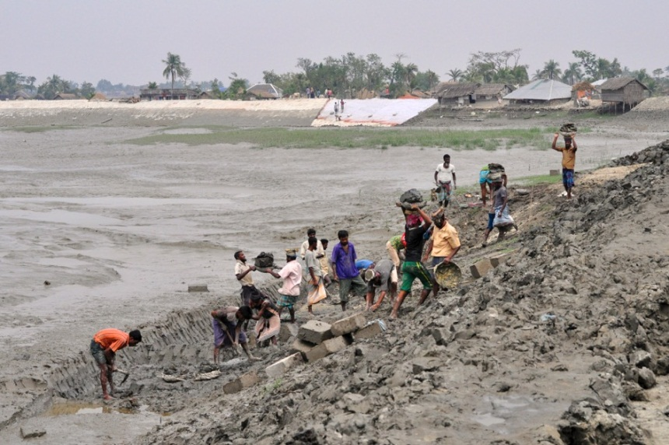
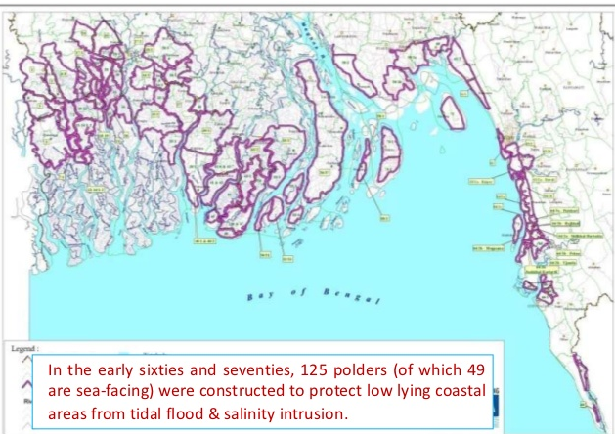
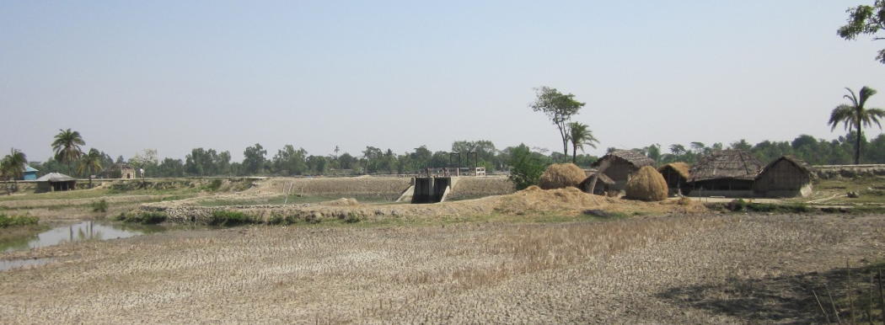
Coastal Bangladesh: Land Reclamation / Polders
http://news.vanderbilt.edu/
These embankments provided protection against tidal and surge inundations since the 1960s.
Embankment
World Bank 2010

Slide 5
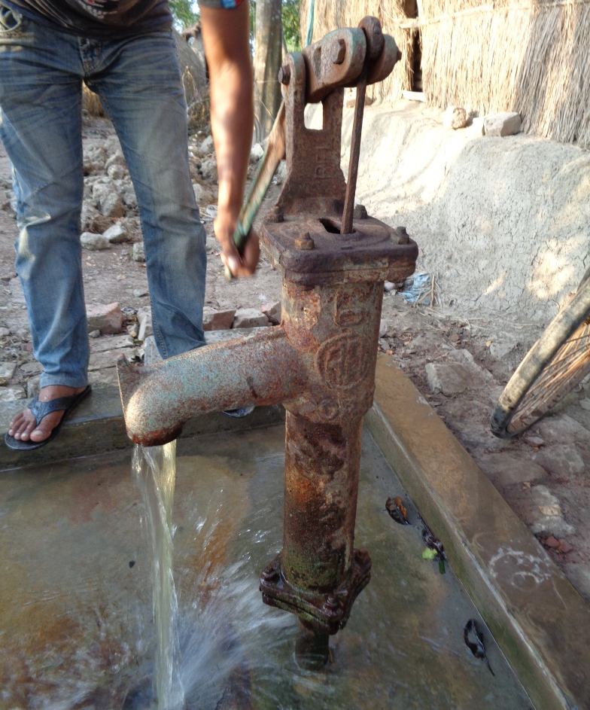
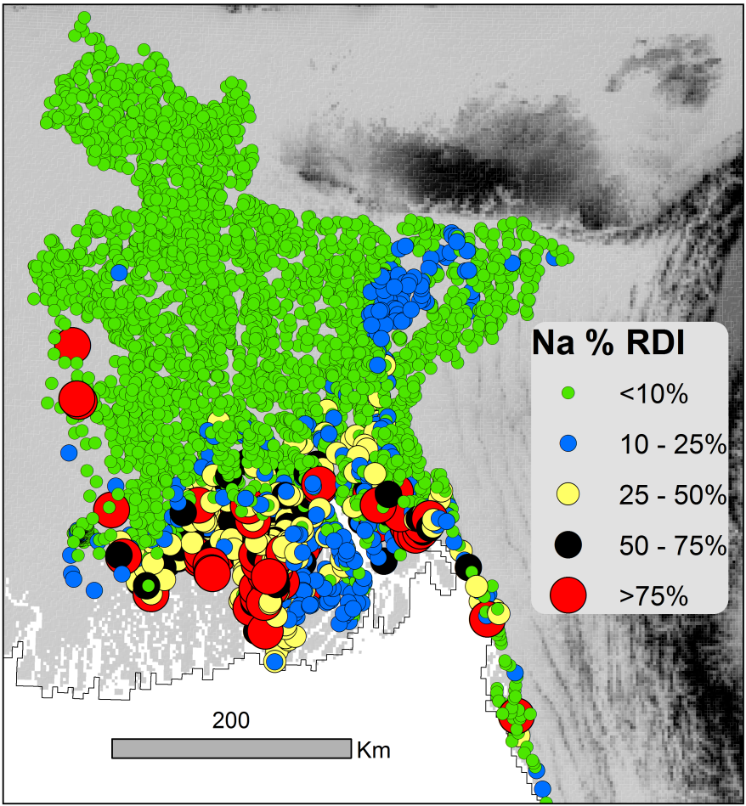
Drinking water in coastal Bangladesh
(Complied from various sources)
GROUNDWATER provides potable water to >94% of Bangladesh but in coastal areas this resource is pervasively saline, and hence people avoid it.

Slide 6
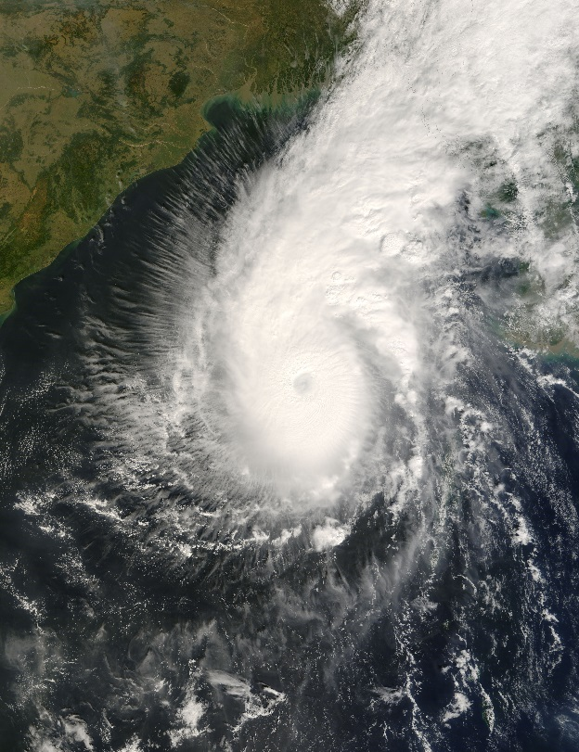
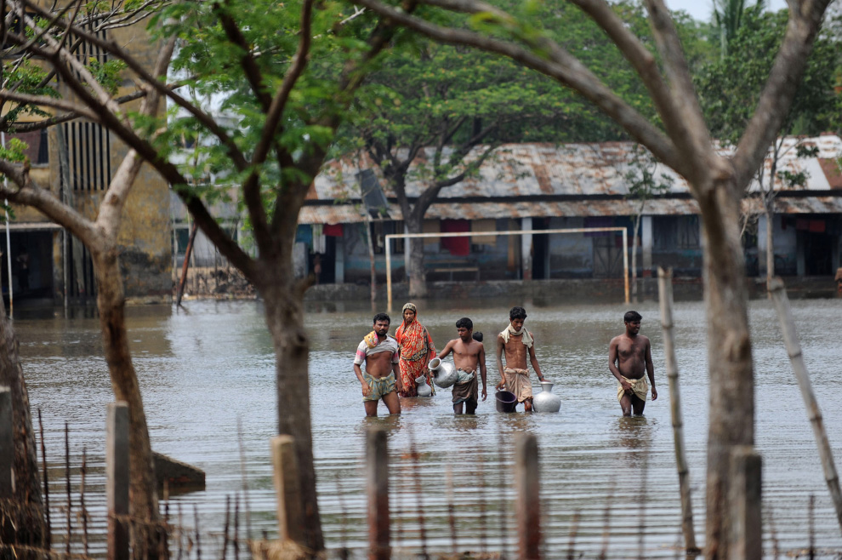
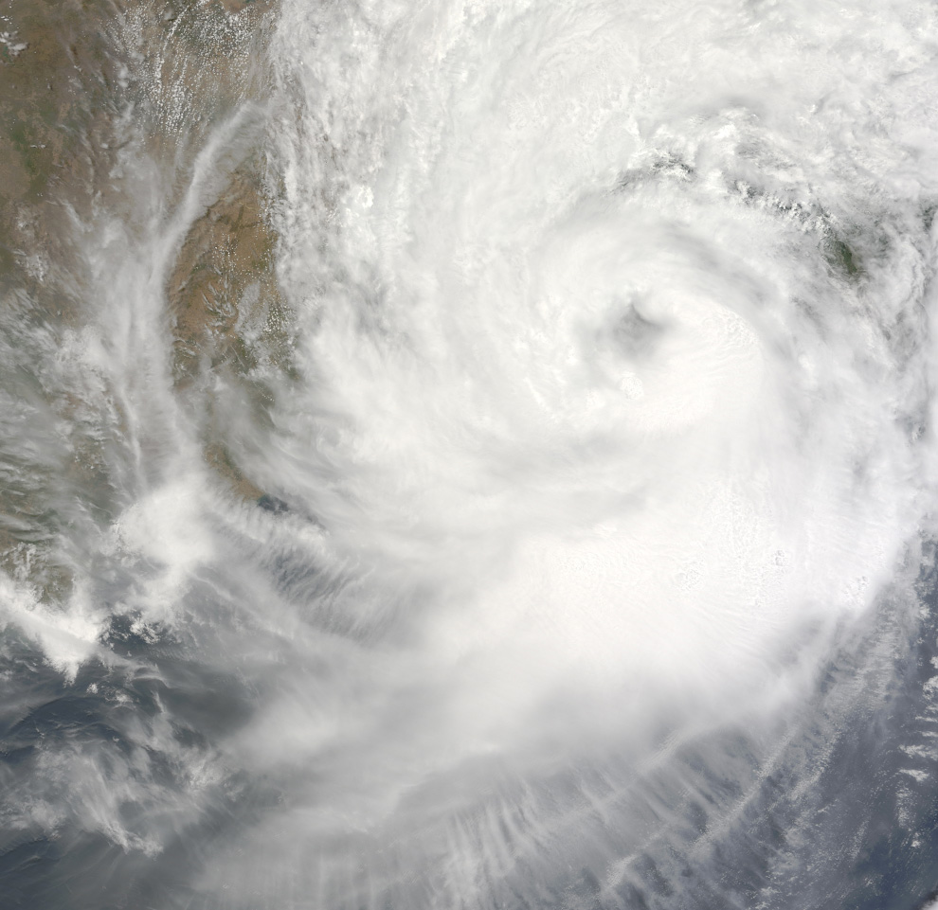
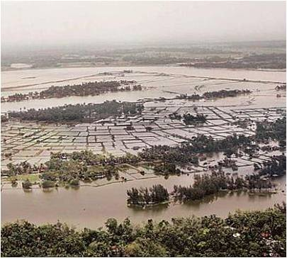
Impacts of storm surge – Cyclone Aila (May 2009)
Source : http://archive.boston.com/bigpicture/2009/06/cyclone_aila.html
Source : NASA's satellite image
Bangladesh
Extensive flooding
> 247deaths
~ destroyed homes of 1million people
[Source: European commission]
During 2007-2015, Bangladesh was hit by 4 cyclones, Sidr (2007), Aila (2009), Mahasen (2013), and Koman (2015).
Source: https://ejatlas.org/conflict/aila-affected-people-need-protection-bangladesh​

Slide 7
The study area
2D cross section
A₀
B₀
The southwest coastal region of Bangladesh
It has a climate consisting of dry winters (November-April) and a tropical monsoon (May-October) characterised by wide variation of rainfall.

Slide 8
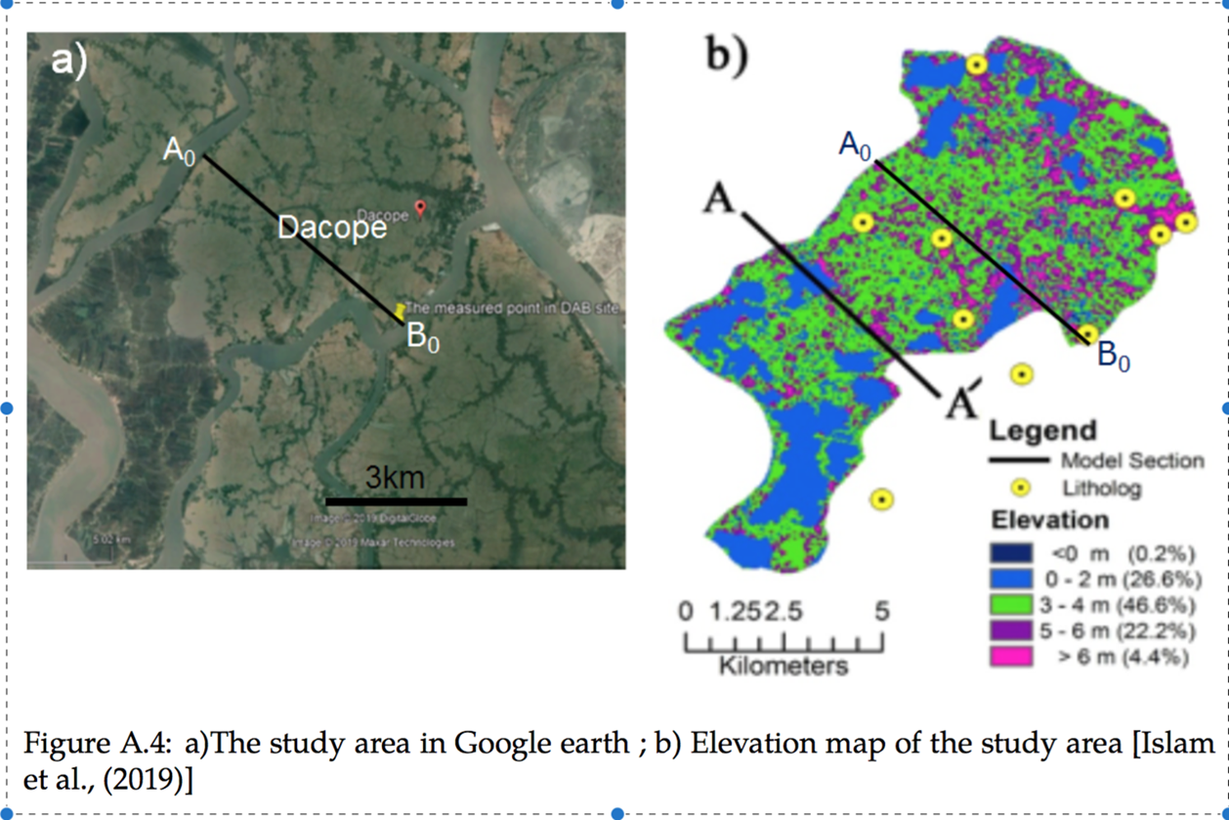
Representation of subsurface geology
Macro-scale
Micro-scale
3 km
B₀
pond
Rahman et al.,2018
Islam et al.,2019
B₀

Slide 9
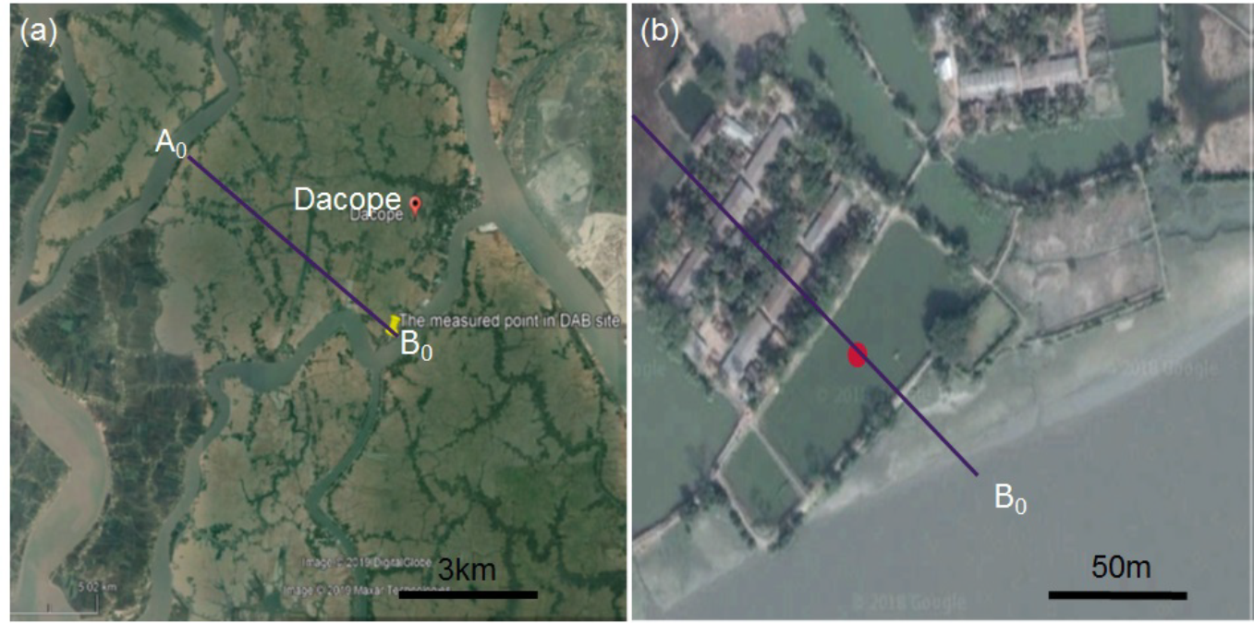
Model development
Boundary conditions
pond
canal
canal
canal
B₀
C_{saltriver}=12000mg/l
h^{f}=ρ_{s}/ρ₀*[SRL(t)-z]+z
C_{saltriver}=12000mg/l
h^{f}=ρ_{s}/ρ₀*[SRL(t)-z]+z
pond
E
HydroGeoSphere, a fully coupled surface & subsurface domains approach, is used to simulate investigate the role of tropical cyclonic storm on long-term salinity (Therrien et al.,2010).

Slide 10
Surface features & land use along A₀-B₀
Source: Google earth

Slide 11
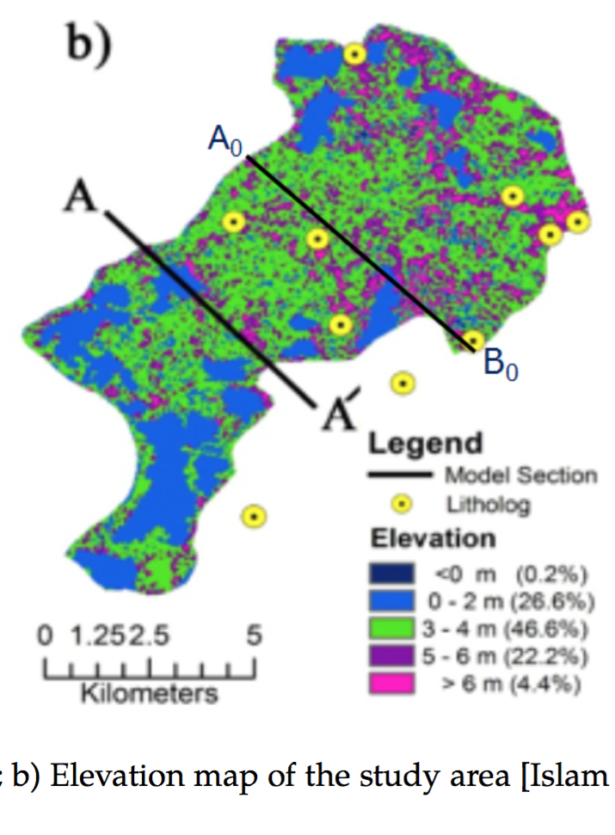
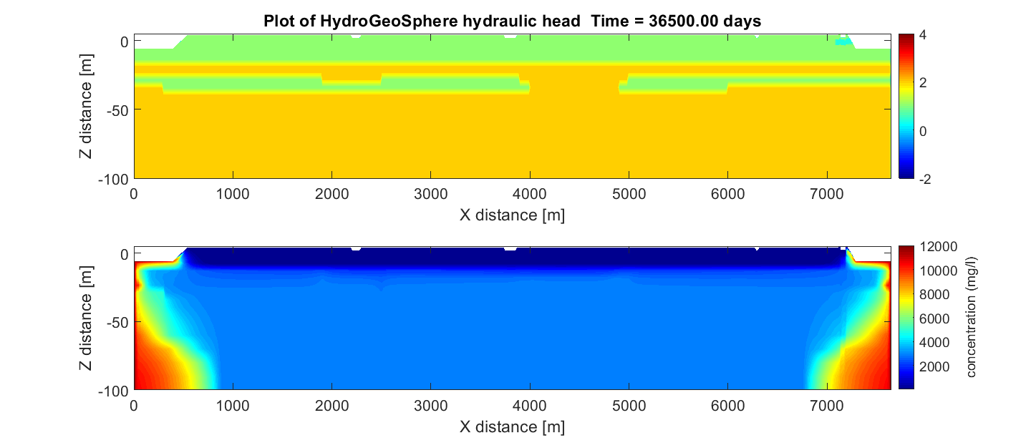
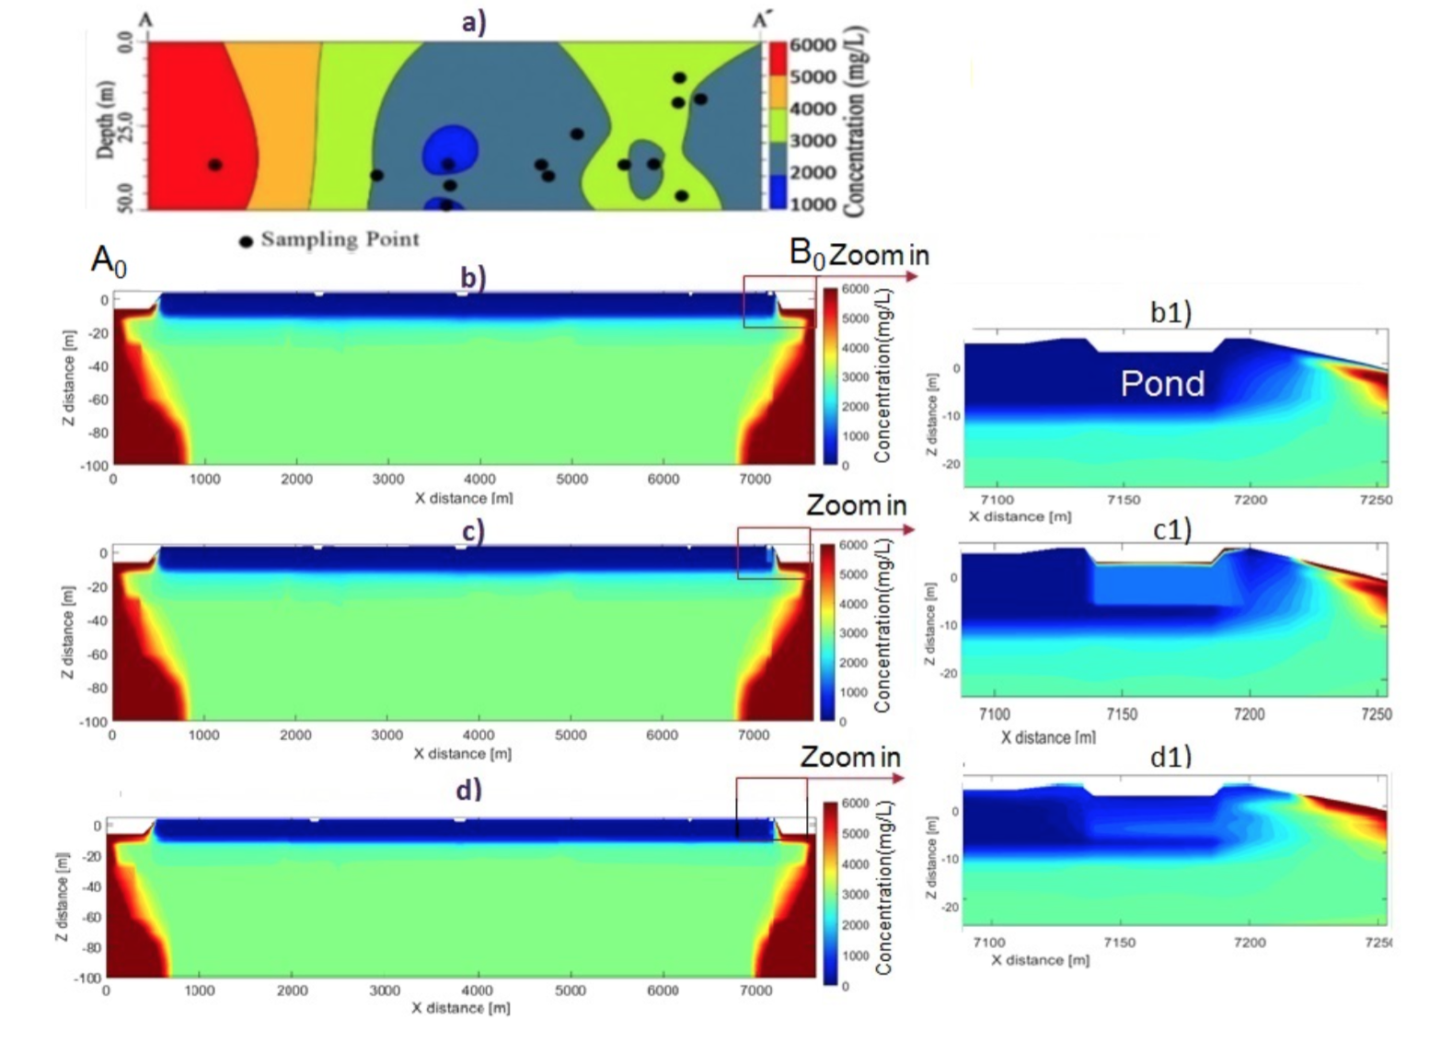

Measured GW salinity & modelled GW salinity
(a)
A₀
(b)
B₀
3 km
(c)
Elevation map of the study area (Islam et al., 2019)
Uncalibrated GW salinity along cross section A₀-B₀
GW salinity along cross section A-A’ (Islam et al., 2019)

Slide 12
Simulated parameters land use & lithology

Slide 13
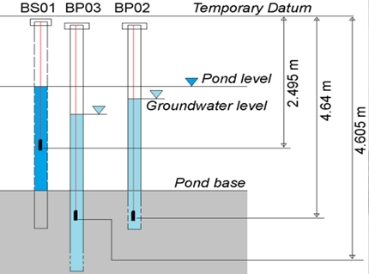
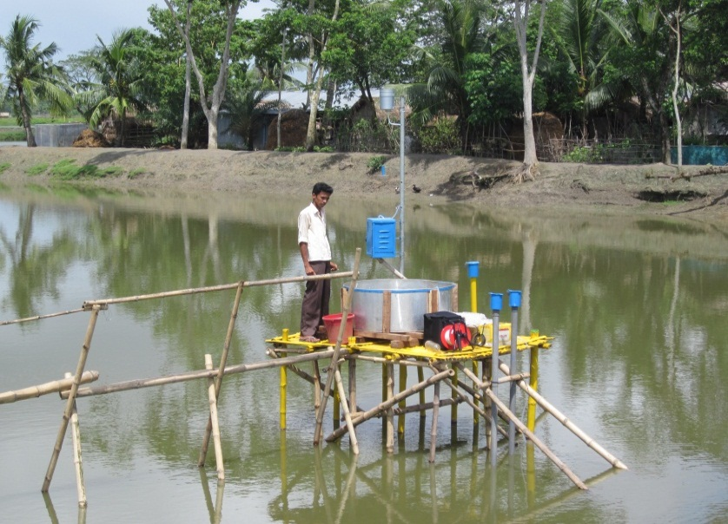
Pond monitoring
Study area
Field survey
BS01
A monitoring system was used to observe the interaction between the pond and underlying groundwater. Rainfall, evaporation, pond and groundwater level, abstraction, and solute concentration were monitored. Two piezometers (BP03&BP02 were also set-up around the pond (BS01).

Slide 14
Model calibration
Hydraulic heads of pond &GW
Hydraulic head of pond
Hydraulic head of GW
at 1m depth
Hydraulic head of GW
at 3m depth
Pond &GW salinities
Pond salinity
GW salinity at 1m depth
Pond &GW salinities below the pond
GW salinity at 3m depth

Slide 15
2D storm surge model (model setup)
Before
After
Observed surge level from Chittagong station where is about 235KM far from the study area. These surge levels were picked from mid-day of May 25-May 26 2009 Although surge level data is not from the nearest river level, it is used for a severe cyclonic storm case. These surge levels were applied to B₀
Surge water level data is from University of Hawaii

Slide 16
2D storm surge model (Results)
Surge (river) level of surface domain of the surge model
Day 1
Day 7
Year 1
canal
canal
canal
Pond
canal
canal
canal
Pond
canal
canal
canal
Pond
Storm surges introduced into the same model and repeatedly used evaporation & rainfall data of 2014 for 5 years to see how pond & GW salinities recover to their original state by monsoonal flushing. Here are surge levels of surface domain at day1 day7 and year1.

Slide 17
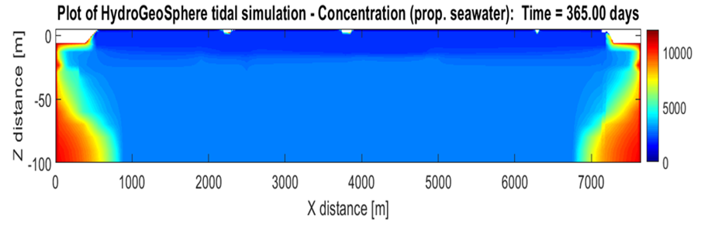
2D storm surge model (Results)
Pond & GW salinity
(1)
(2)
After 1year GW salinity at 4.3m deep below pond begins to increase.
GW salinity at T=1 year
4.3m
Figure (1) shows a profile of groundwater salinity (from pond to 4.3m deep) at 7 different times From day1 to year1. When Storm surge hit at 1st day pond salinity was rising to 12000mg/l and dropped gradually but it was still higher than 6000mg/l.
Figure (2) shows groundwater salinity of the 2D model at year1.

Slide 18
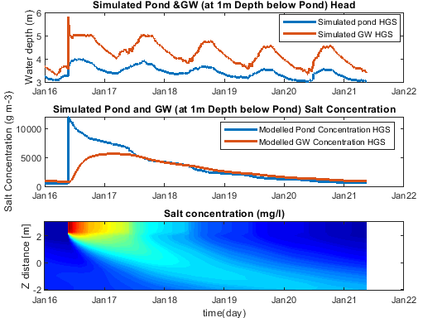
Repeatedly used
2014 evaporation
and rainfall data
Salinity dynamics in DAB site
Storm surge
Storm surge
600mg/l
pond
Salt-built-up
GW
Here are the pond & GW heads & salinities changes during 2016 to 2021.The model shows a salt built-up in the underlying sediment below the pond. After 5 years monsoonal flushing, pond &GW salinities are still higher than drinking water standards (500mg/l). (Cmax=12000mg/l)

Slide 19
Summaries
High salinity in drinking water is a serious issue along the southwest coastal of Bangladesh.
A fully coupled surface-subsurface model is used to investigate the role of tropical cyclone on salinity of water resources in Bangladesh
In this study
Pond & GW salinities take 4-6 years to be freshened to pre-surge levels by monsoon.
The model shows a salt built-up in the underlying sediment below the pond.
What we learned from this study
Periodic seasonal flooding during the monsoon may help to reduce salinity in the soil and water in coastal areas.
The episodic surge event is likely one source of near-surface GW salinity.

Slide 20
Thank you
Reference
Collaborators:
Professor Adrian P. Butler
Dr.Mo A. Hoque
Technique support:
Dr. Steven Berg
HydroGeoSphere community
Islam, M.A., Hoque, M.A., Ahmed, K.M. and Butler, A.P., 2019. Impact of Climate Change and Land Use on Groundwater Salinization in Southern Bangladesh—Implications for Other Asian Deltas. Environmental management, 64(5), pp.640-649.
Rahman, A. K. M. M., Ahmed, K. M., Butler, A. P., and Hoque, M. A. (2018). Influence of surface geology and micro-scale land use on the shallow subsurface salinity in deltaic coastal areas: a case from southwest Bangladesh. Environmental Earth Sciences, 77(12).
Therrien, R., McLaren, R. G., Sudicky, E. A., and Panday, S. M. (2010). A Three-dimensional Numerical Model Describing Fully-integrated Subsurface and Surface Flow and Solute Transport. page 456.
World Health Organization (2017). Guidelines for drinking-water quality. OCLC: 975491910
Schaap, M. G., Leij, F. J., and van Genuchten, M. T. (2001). rosetta : a computer program for estimating soil hydraulic parameters with hierarchical pedotransfer functions. Journal of Hydrology, 251(3-4):163–176. Schwartz, F. W. (2003). Fundamentals of ground water /. Wiley, Chichester :.
Gelhar, L. W., Welty, C., and Rehfeldt, K. R. (1992). A critical review of data on fieldscale dispersion in aquifers. Water Resources Research, 28(7):1955–1974. tex.eprint: https://agupubs.onlinelibrary.wiley.com/doi/pdf/10.1029/92WR00607.
Shammi M, Rahman MM, Bondad SE, Bodrud-Doza M. Impacts of Salinity Intrusion in Community Health: A Review of Experiences on Drinking Water Sodium from Coastal Areas of Bangladesh. Healthcare (Basel). 2019;7(1):50.
Harun, M. A. Y. A. and Kabir, G. M. M. (2013). Evaluating pond sand filter as sustainable drinking water supplier in the Southwest coastal region of Bangladesh. Applied Water Science, 3(1):161–166.
Scheelbeek, P. F., Chowdhury, M. A., Haines, A., Alam, D. S., Hoque, M. A., Butler, A. P., ... & Vineis, P. (2017). Drinking water salinity and raised blood pressure: evidence from a cohort study in coastal Bangladesh. Environmental health perspectives, 125(5), 057007.

