Slide 1
Borehole
Data Management System
a web interface for borehole data acquisition and management
Cannata Massimiliano, Hoffmann Marcus, Antonovic P. Milan @SUPSI Nils Oesterling, Sabine Brodhag @Swisstopo

Slide 2
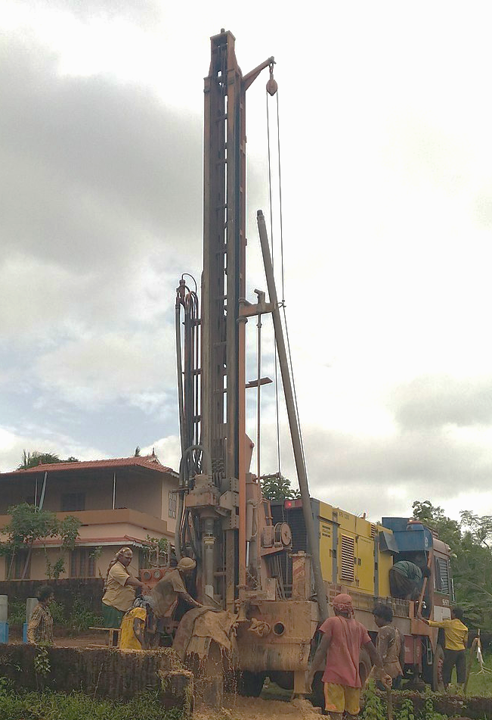
The importance of shallow underground
The uppermost 500 metres below the ground that are the most widely used today.
Approximately 90 percent of all underground activities.
Borehole data reveal the sequence of the geological layers at a specific location.
Thanks to the available comprehensive geological data from the surface, it is possible to obtain an overview of the geological conditions throughout the entire country.
construction
extraction of drinking water
mineral resources
installation of geothermal probes
etc.
https://www.swisstopo.admin.ch
Notes:
construction work, extraction of drinking water and mineral resources, installation of geothermal probes, etc.

Slide 3
Data handling: common practices
Most used approach:
Geologist produces static data reports that describe the stratigraphy and the related characteristics
Sometimes data are integrated into database
Rarely borehole data are stored following standards
Static data
Databases
Standards

Slide 4
The Federal Borehole Data Model
Benefits:
The focus is on the exchange, the usage and quality of the data
Data harmonization
level of detail
precise definitions
relationships and dependencies among the data
Common language between stakeholders
https://www.geologieportal.ch/en/

Slide 5
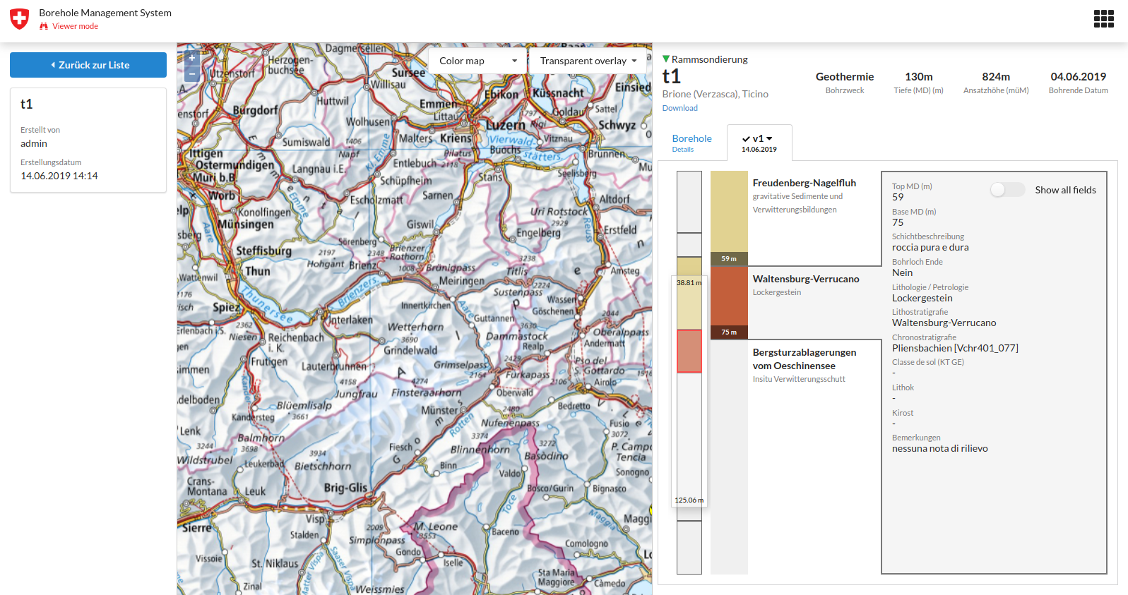
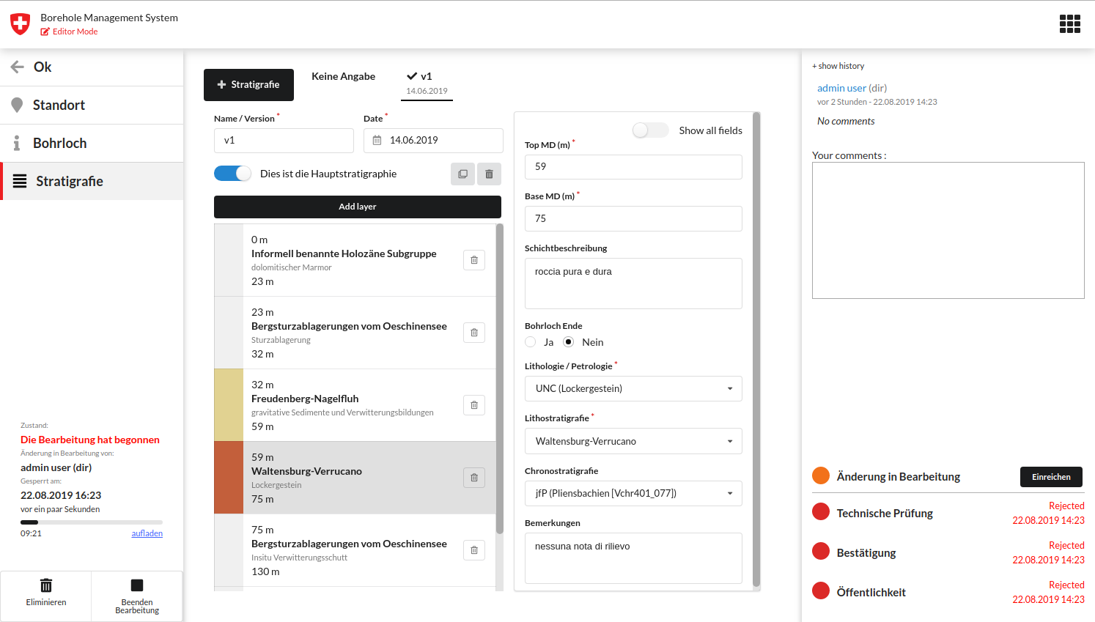
The first web application standard compliant
In 2018 Swisstopo financed SUPSI the development of a new Web Application to manage and exchange Borehole data with an Open Source License.

Slide 6
Borehole Data Management System
~ A modular architecture ~

Slide 7
There are three main modules
3
2
1

Slide 8
System Architecture: Web Service
Python Shapefile Library
PyShp
BDMS Web Service
- Python 3.7 - User authentication and authorization - JSON API: modify, search and display - Reusable as a Python module - Multilanguage
1

Slide 9
System Architecture: JavaScript API
BDMS JavaScript API
A JavaScript Library implementing the communication with BDMS Server API
Packaged as NPM package
2
BDMS Web Service
- Python 3.7 - User authentication and authorization - JSON API: modify, search and display - Reusable as a Python module - Multilanguage
1

Slide 10
System Architecture: User Interface
BDMS User Interface
ReactJS single page user interface
3
BDMS JavaScript API
A JavaScript Library implementing the BDMS Server API
Packaged as NPM package
2
BDMS Web Service
- Python 3.7 - User authentication and authorization - JSON API: modify, search and display - Reusable as a Python module - Multilanguage
1

Slide 11
System Architecture: ready for the cloud
BDMS User Interface
ReactJS single page user interface
3
3
BDMS JavaScript API
A JavaScript Library implementing the BDMS Server API
Packaged as NPM package
2
BDMS Web Service
- Python 3.7 - User authentication and authorization - JSON API: modify, search and display - Reusable as a Python module - Multilanguage
1

Slide 12
Borehole Data Management System
~ How it works ~

Slide 13
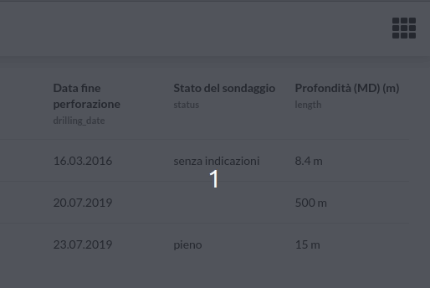
Two modes
VIEWER MODE
Explore with an interactive map,
Search data with attributes filtering
Export selected borehole data & metadata in PDF, CSV and/or Shapefile
Viewer mode (read only)
Offering access to all the published data
Editor mode
Create new borehole metadata through the quality control process
EDITOR MODE
Insert new borehole metadata
Validate and check the quality
Publish to viewers

Slide 14
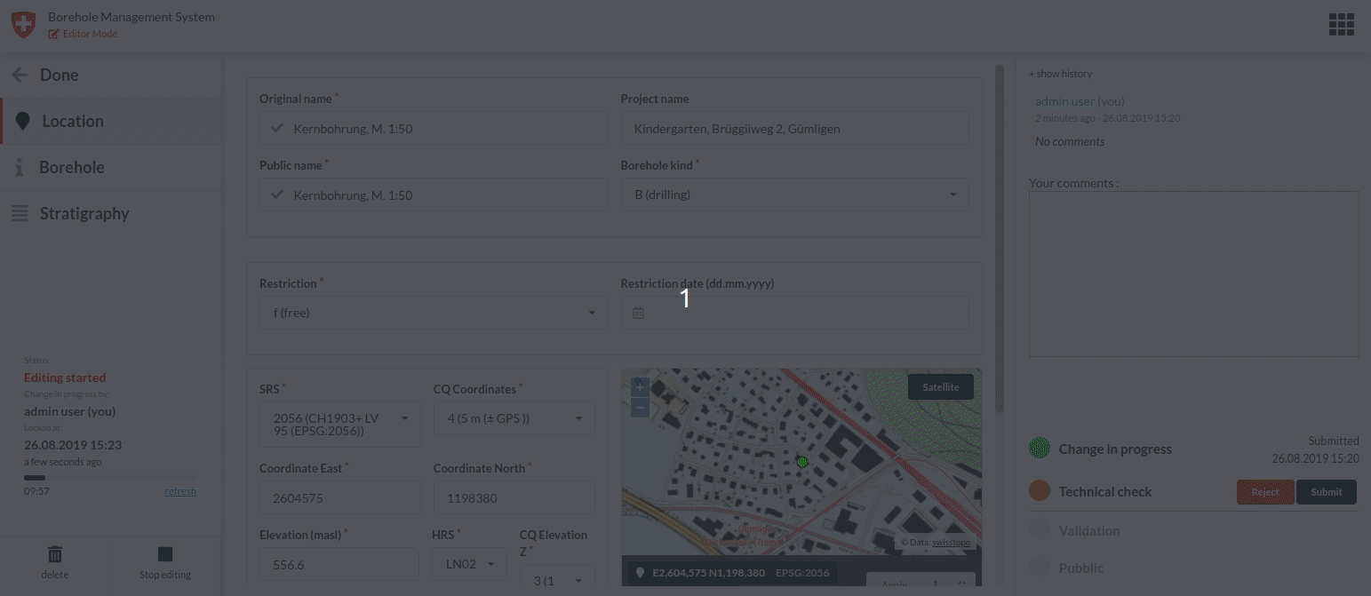
Quality control process
Data production
Request for a verification
Data control
Roles:
Data producer (EDITOR)
Data controller (CONTROLLER)
Data validator (VALIDATOR)
System administrator (PUBLISHER)
Request for a verification
Data validation
Publication

Slide 15
Data status
Data production
Three different statuses:
Data production: borehole data that are inside of the quality control process.
Validated: all the data that are valid but not yet published (or will not be published).
Published: all the borehole data that have passed the quality control process and are available to the viewers.
Validated
Published

Slide 16
Workgroups
PUBLISHER
PUBLISHER
W2
A user can belong to one or more workgroups.
A user can have different roles in different workgroups
Users from one workgroup cannot interact with data belonging to other workgroups
VALIDATOR
EDITOR
W1
CONTROLLER
VALIDATOR
EDITOR
CONTROLLER

Slide 17
Data Access Control
Workgroup 1
workspace
Workgroup 2
workspace
Workgroup N
workspace
Editing
Editing
Editing
Validated
Validated
Validated
Published

Slide 18
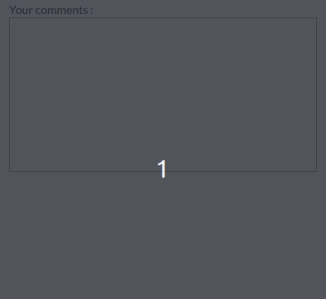
Validation and comments
Please check the @Restriction date
EDITOR
During the quality check process, users can add comments, nominating form fields so that editors can visually see which fields are wrong.
I’ve checked, set it to 2019-08-30
CONTROLLER
Thanks, done!
EDITOR
Publication

Slide 19
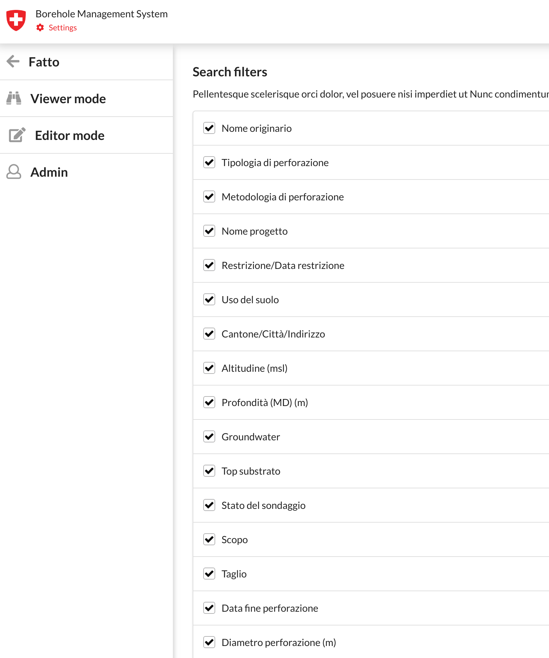
High Degree of Customization
Select field to be used as filters
Define visible fields
Select search filters
Choose between 6 display modes
Add external WMS overlays

Slide 20
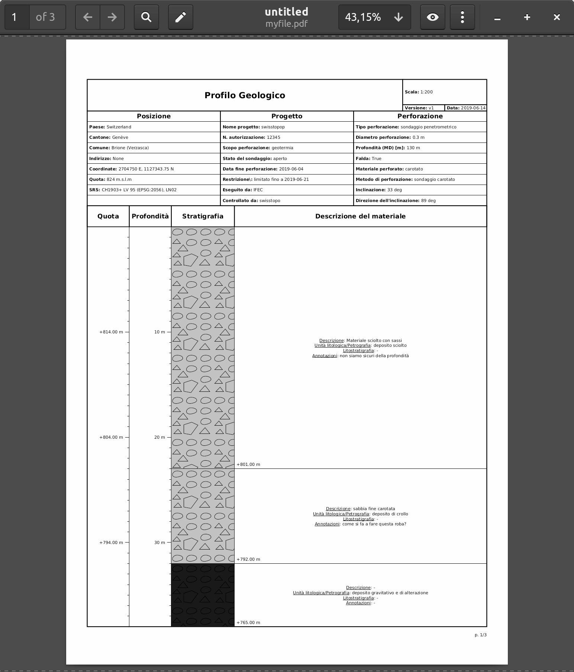
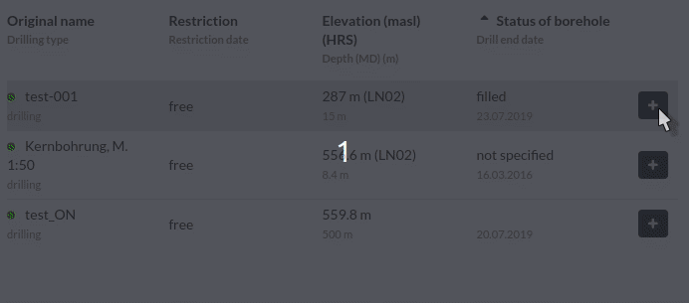
Export data as:
Select Boreholes and download:
ShapeFile
CSV
PDF

Slide 21
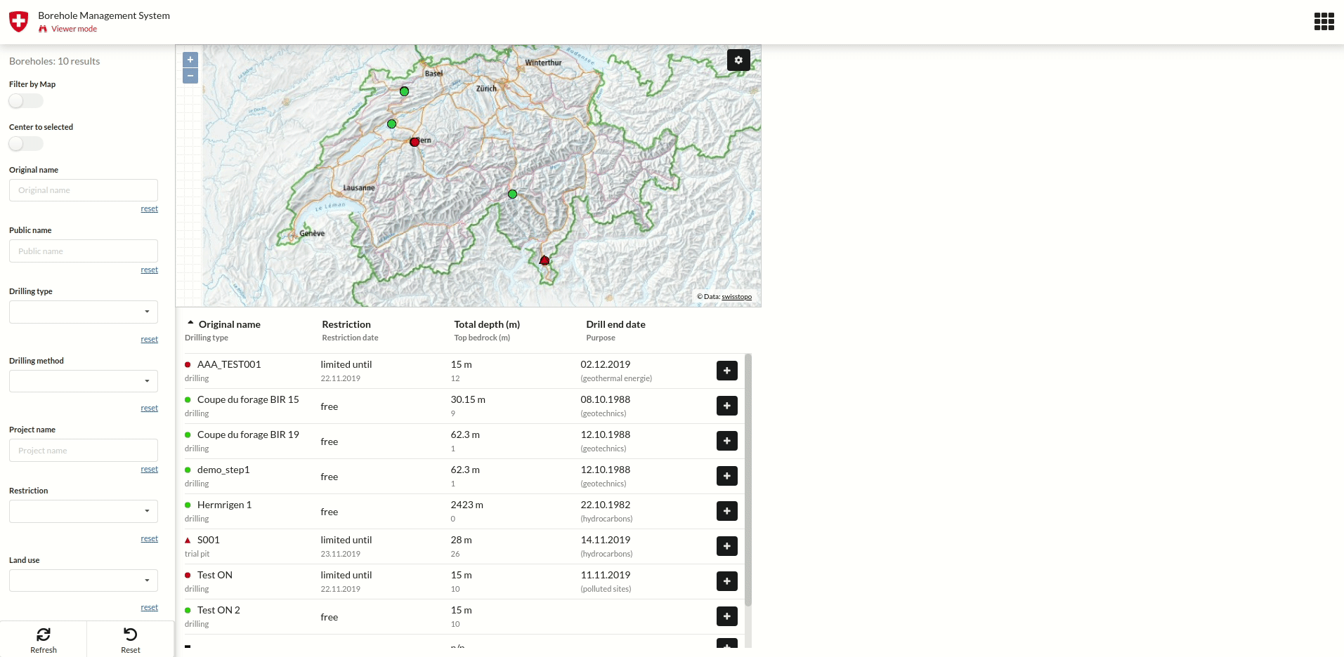
Thanks for your attention
Special thanks to Swisstopo for financing this project
Source code:
BDMS Service https://github.com/geoadmin/service-bdms BDMS JS API https://github.com/geoadmin/js-bdms BDMS UI https://github.com/geoadmin/web-bdms
Documentation and DEMO: https://geoservice.ist.supsi.ch/docs/bdms

Slide 22
Thanks for your attention
Special thanks to Swisstopo for financing this project
Source code:
BDMS Service https://github.com/geoadmin/service-bdms BDMS JS API https://github.com/geoadmin/js-bdms BDMS UI https://github.com/geoadmin/web-bdms
Documentation and DEMO: https://geoservice.ist.supsi.ch/docs/bdms

