Slide 1





Energetic electron acceleration during magnetic reconnection
Huishan Fu
(符慧山)
Beihang University
huishanf@gmail.com
1
1

Slide 2
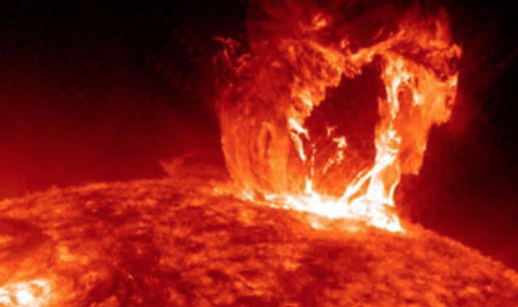
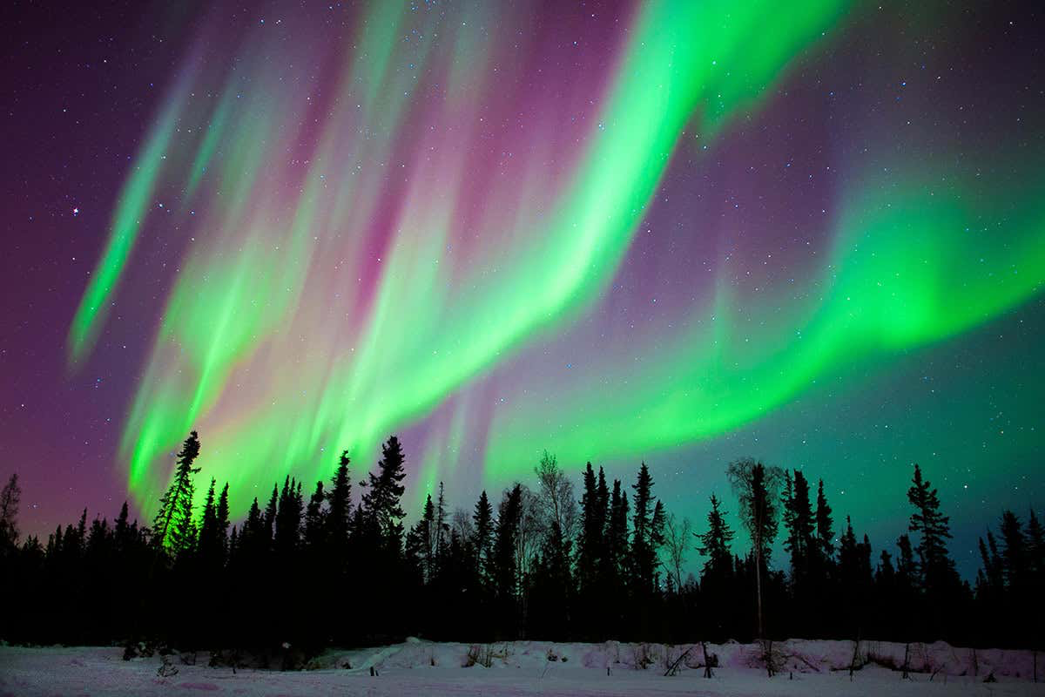
Energetic electrons in solar system
Energetic electrons during solar eruption
Energetic electrons during substorm

Slide 3
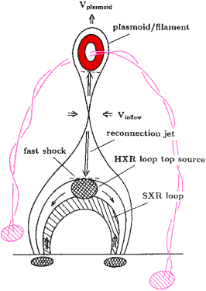
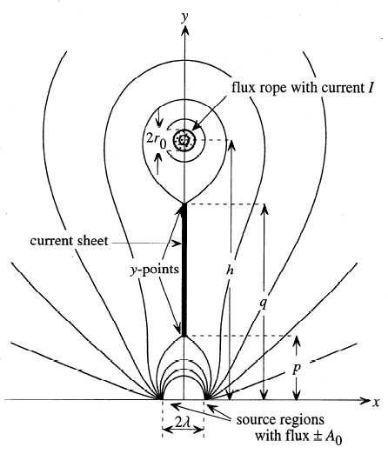
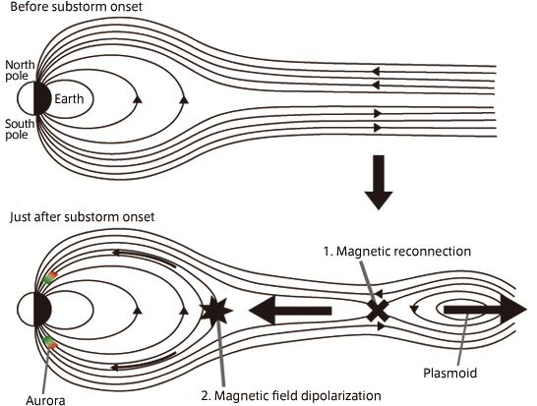
Magnetic reconnection as the driver
Solar Flare
CME
Substorm
reconnection
reconnection
reconnection
Shibata+, 1995APJL
Lin+Forbes, 2000JGR
Nakamura, 2011JGR

Slide 4
How the acceleration happens?
Parallel acceleration at separatrix
Fermi acceleration inside island
Fermi acceleration outside island
Betatron acceleration in pileup region
Nonadiabatic acceleration by waves
Acceleration in thin current sheet
Acceleration at reconnection fronts
Acceleration in unconfined reconnection jets
Acceleration at reconnecting magnetopause

Slide 5
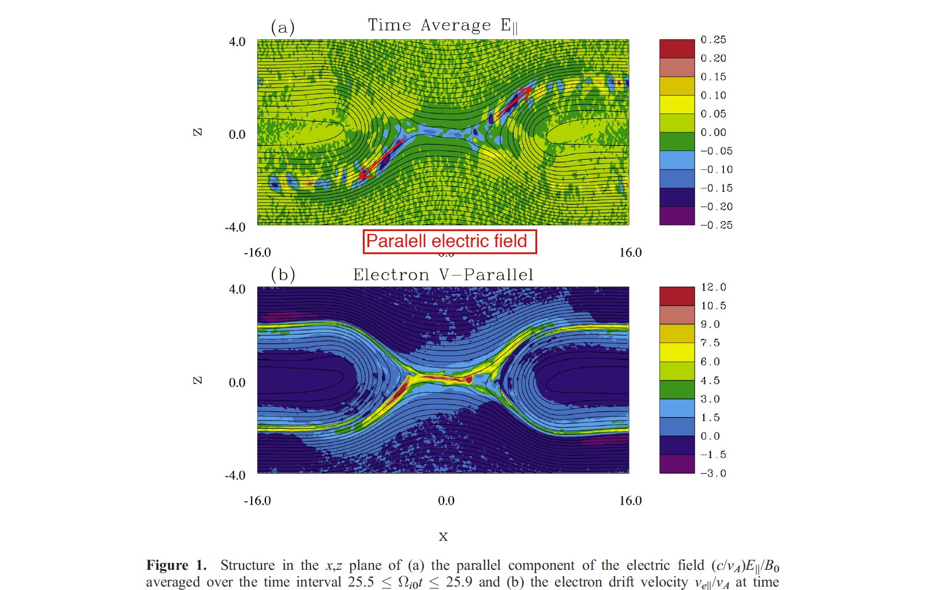
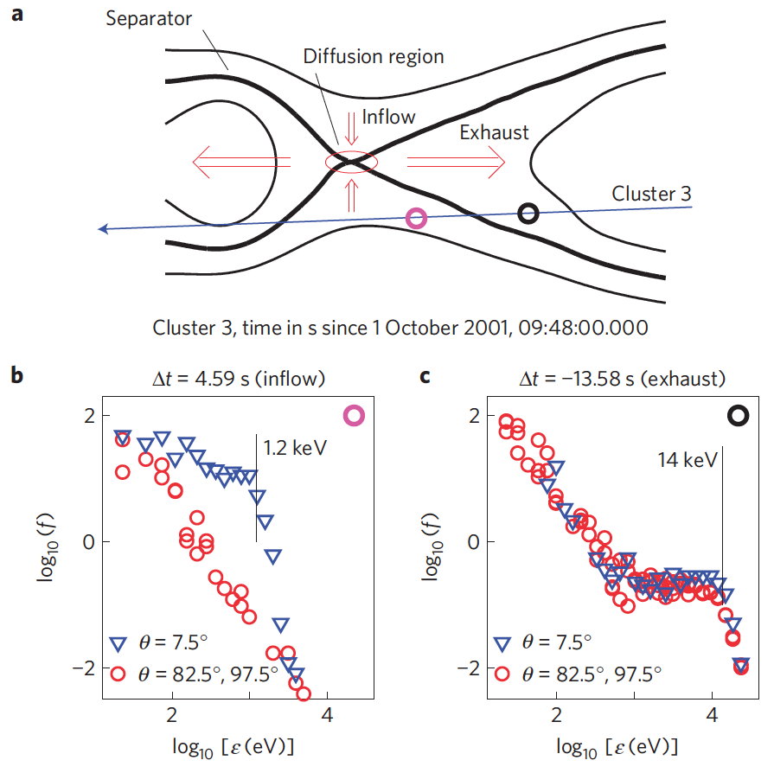
How the acceleration happens?
1. Parallel acceleration at separatrix
PIC simulation
Observation
Pritchett, 2006JGR
Egedal+, 2012 Nature Phys.
Parallel electric fields
Electron parallel velocity
large V// related to large E//
Effective in guide-field reconn.
PSD in parallel direction is enhanced significantly

Slide 6
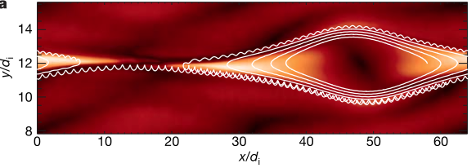
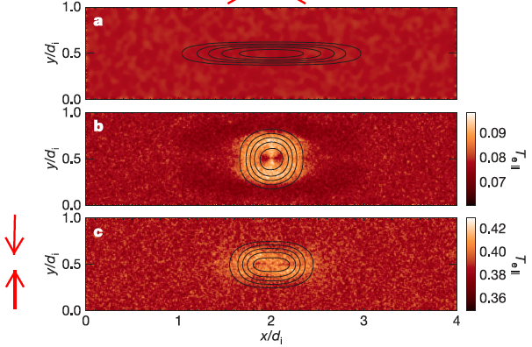
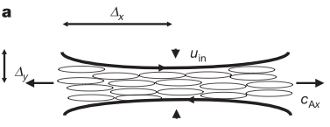
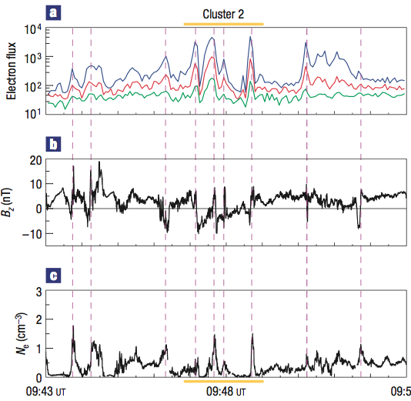
How the acceleration happens?
2. Fermi acceleration inside island
Drake+ 2006Nature
Drake+ 2006Nature
Magnetic island is contracting, leading to shrink of magnetic field line, and then first-order Fermi acceleration
Multiple-island assumption
Observation evidence: energetic electrons associated with islands
Chen+ 2008, Nature Phys.

Slide 7
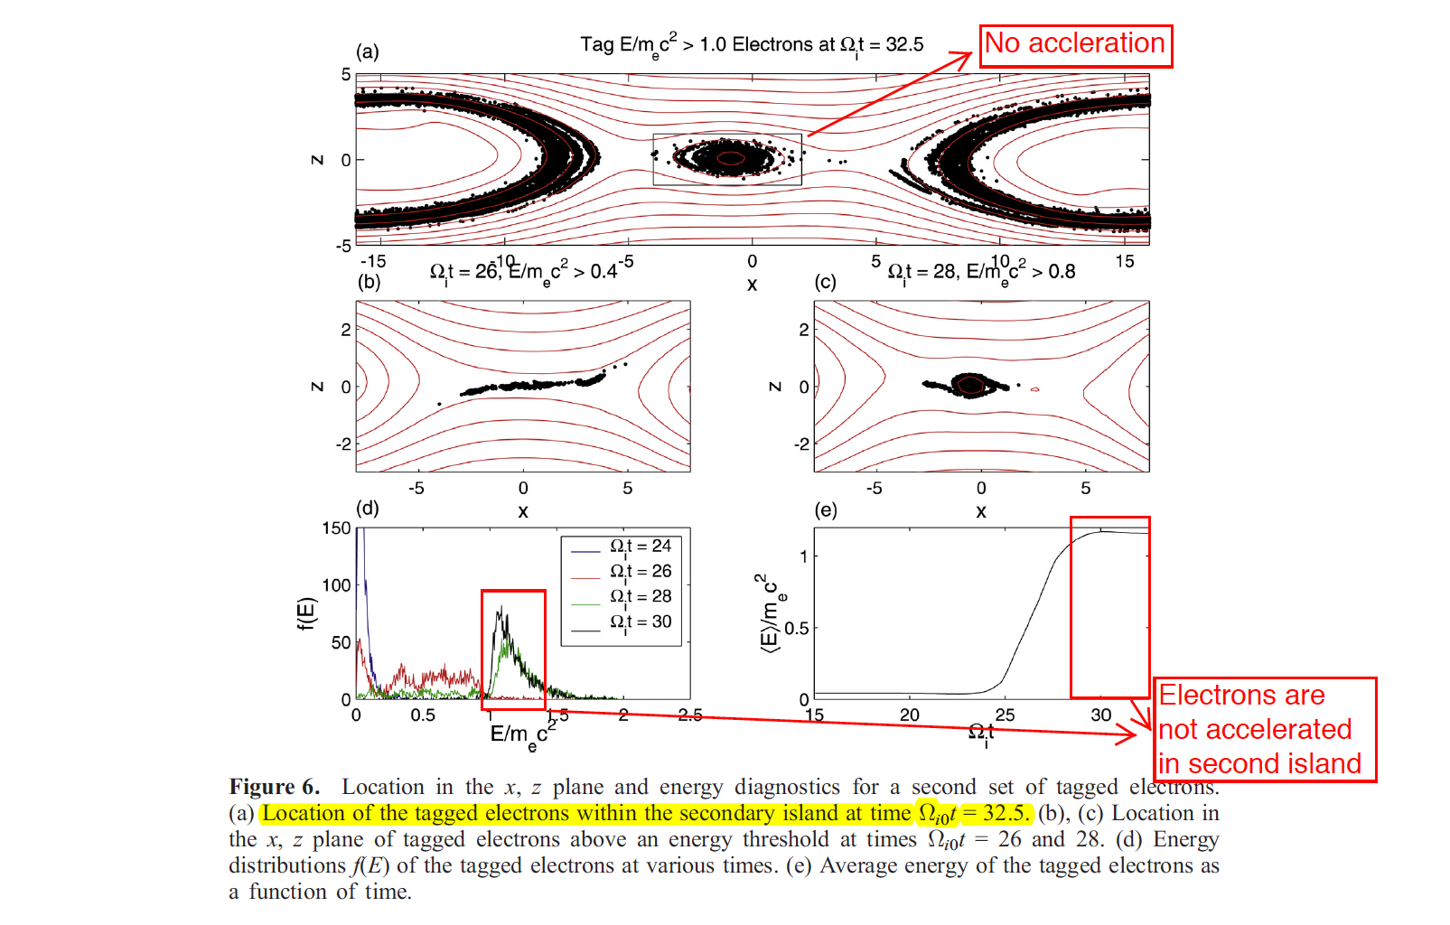
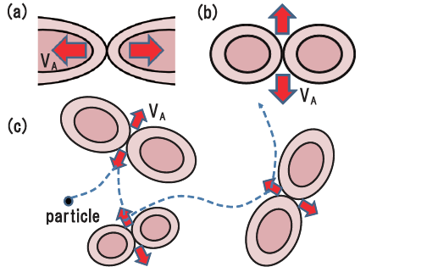
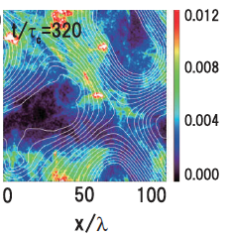
How the acceleration happens?
3. Fermi acceleration outside island
No electron acceleration in secondary island
No electron
Pritchett, 2006JGR
Pritchett, 2006JGR
Hoshino+, 2012PRL
No acceleration inside island
electron acceleration outside island (first-order Fermi)

Slide 8
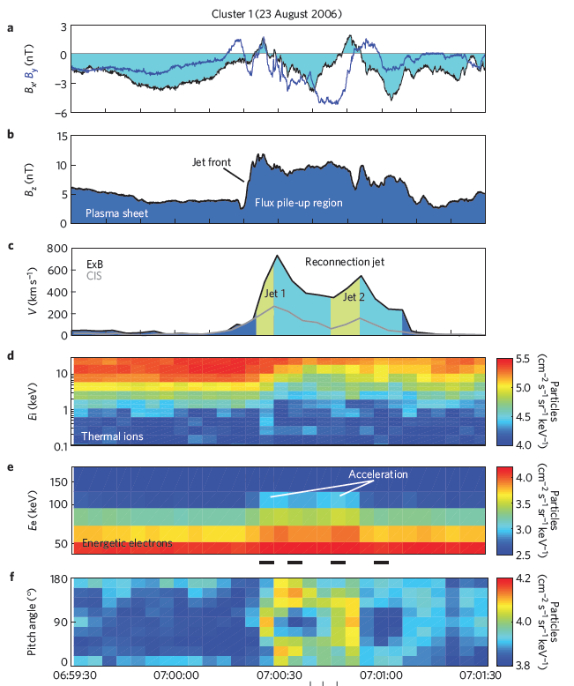
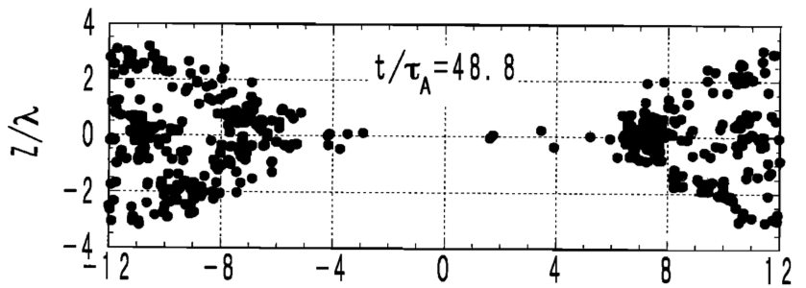
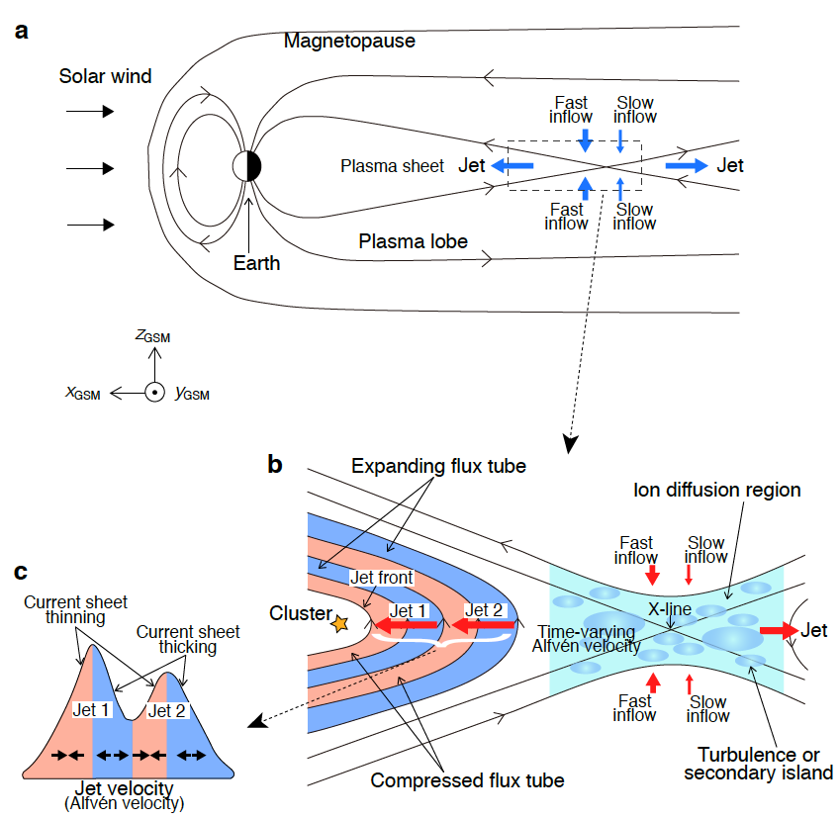
How the acceleration happens?
4. Betatron acceleration in pileup region
Hoshino+ 2001, JGR
Adiabatic acceleration
Fu+ 2013, Nature Physics
Fu+ 2013, Nature Physics

Slide 9
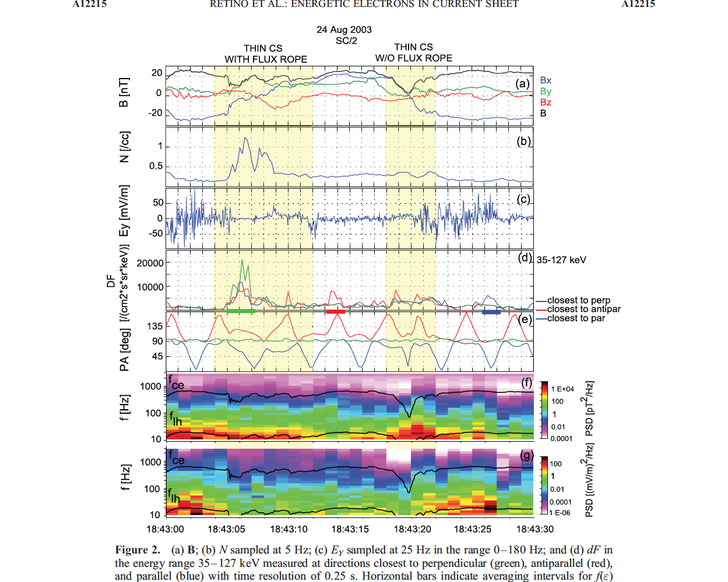
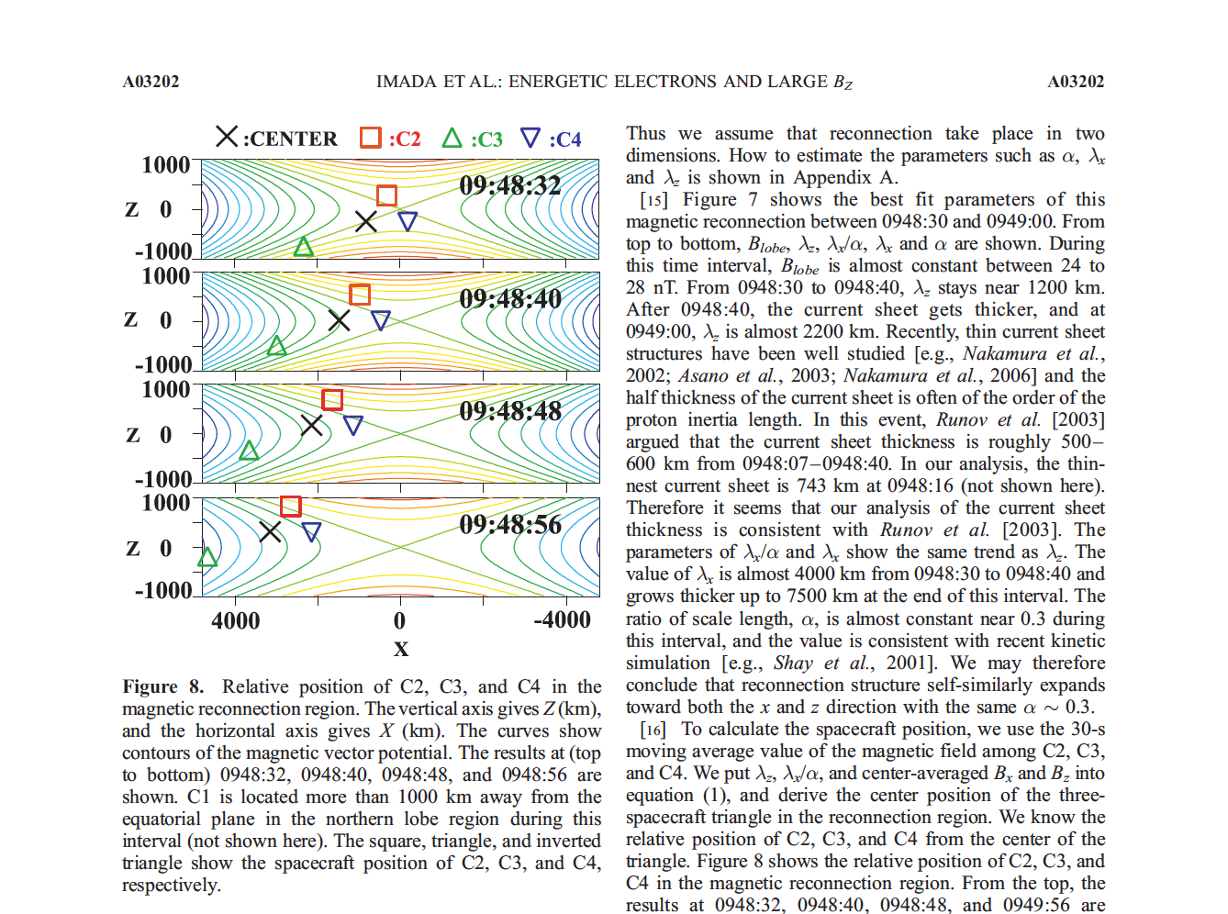
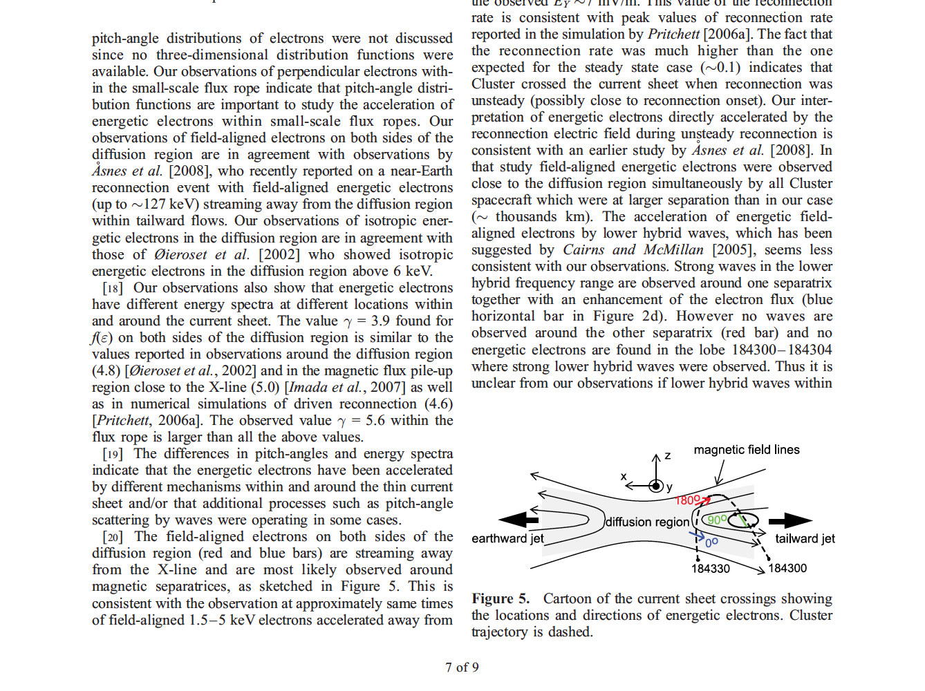
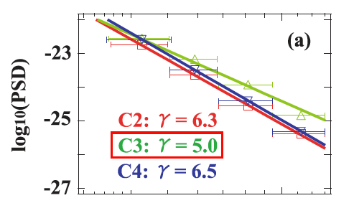
How the acceleration happens?
5. Nonadiabatic acceleration by waves
Retino+, 2008JGR
Power-law index does not change => adiabatic acceleration
Power-law index changes => nonadiabatic acceleration
Imada+, 2007JGR
nonadiabatic acceleration inside island
nonadiabatic acceleration in outflow region

Slide 10
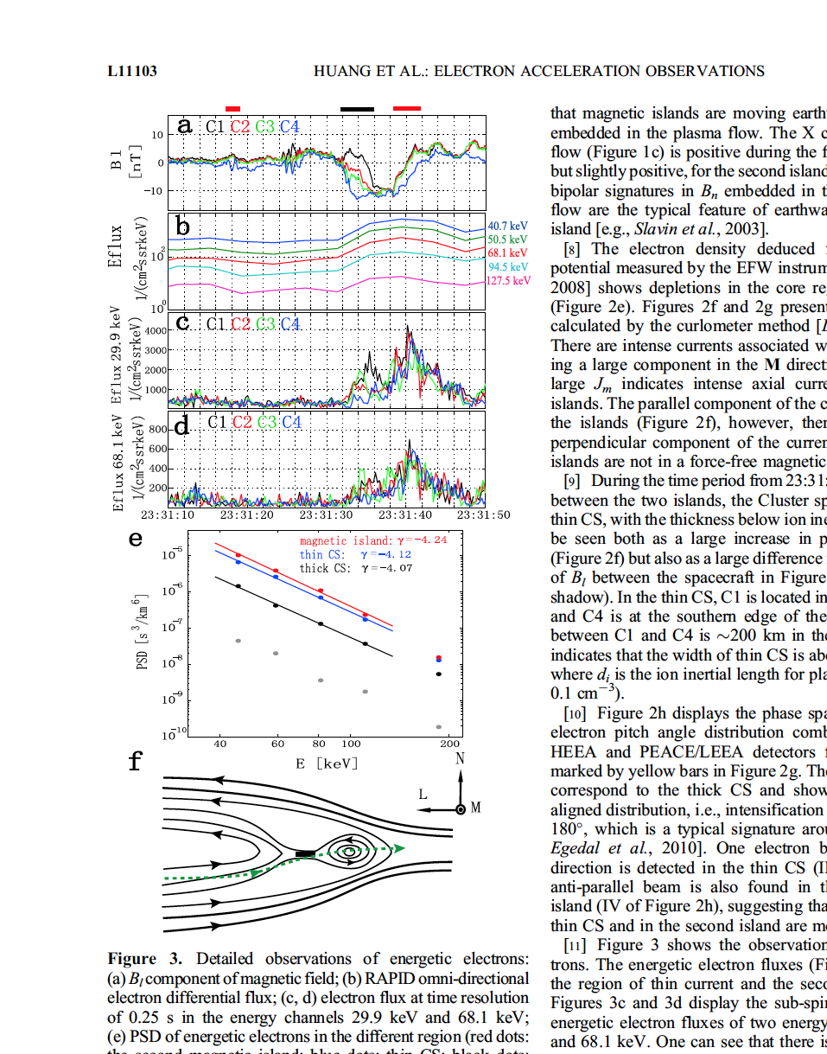
How the acceleration happens?
6. Acceleration in thin current sheet
Huang+, 2012, GRL

Slide 11
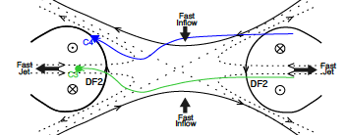
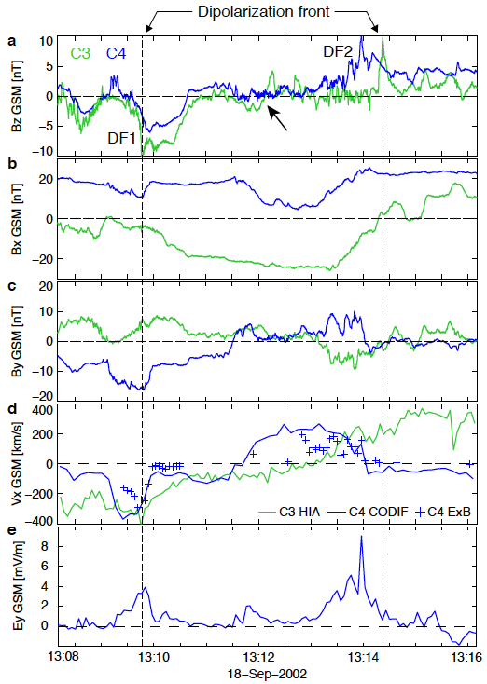
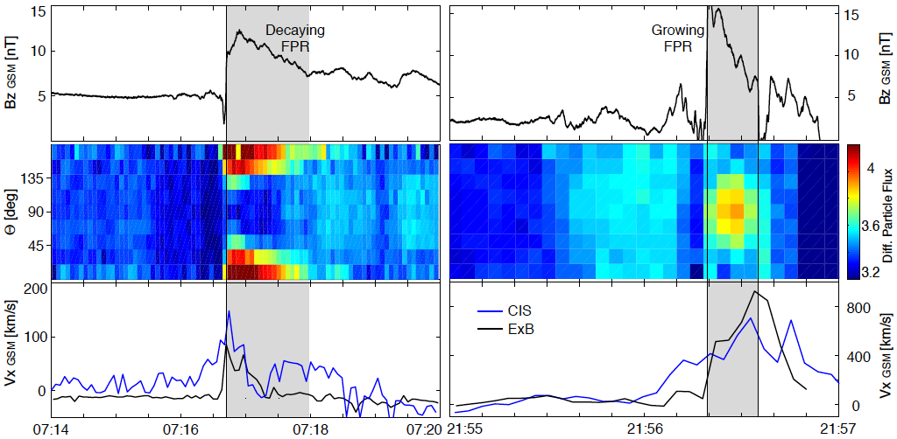
How the acceleration happens?
7. Acceleration at reconnection fronts
Fu+ 2013, GRL
Fu+ 2013, GRL
Fu+, 2011GRL
Fermi acceleration
Betatron
acceleration

Slide 12
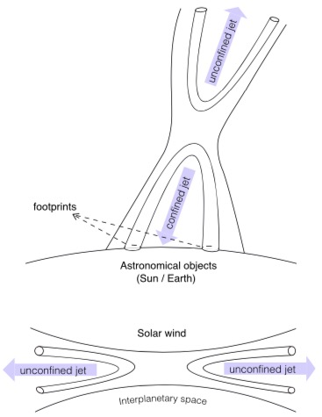
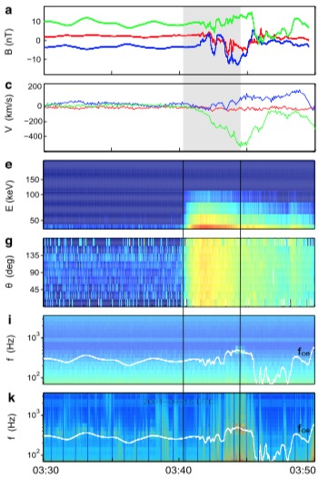
How the acceleration happens?
8. Acceleration in unconfined reconnection jets
Chen & Fu+, 2019APJL
Chen & Fu+, 2019APJL
unconfined reconnection jets

Slide 13
How the acceleration happens?
9. Acceleration at reconnecting magnetopause
Fu+, 2019GRL
Acceleration
Enhancement of the 1-4 keV electrons
Fu+, 2019GRL
Wave-particle acceleration

Slide 14
How efficient is acceleration?
Typical situation: F2/F1<100

Slide 15
How efficient is acceleration?
Extreme situation:
10000 times enhancement within 30 s
Fu+, 2019APJL
Fu+, 2019APJL
10000 times of flux enhancement
5 times of energy increase
7.5 times of energy increase
More efficient than radiation belt!!!

Slide 16

Summary
9 processes/mechanisms for electron acceleration
Acceleration efficiency: 10000 times enhancement
Fu et al. (2019), Astrophys. J. Lett., 870, L22, https://doi.org/10.3847/2041-8213/aafa75
Fu et al. (2019), Geophys. Res. Lett., 46, https://doi.org/10.1029/2019GL083032
Chen & Fu et al. (2019), Astrophys. J. Lett., 881, L8, doi:10.3847/2041-8213/ab3041

