Slide 1
Pressure conditions in coupled magma bodies and their evolution during eruptions and caldera collapse: Piton de la Fournaise 2007
Freysteinn (1) , Aline Peltier (2,3), Siqi Li (1), Valérie Ferrazzini (2,3), Andrea Di Muro (2,3)
(1) Nordic Volcanological Center, Institute of Earth Sciences, University of Iceland.
(2) Université de Paris, Institut de Physique du Globe de Paris, CNRS, F-75005, Paris, France
(3) Observatoire Volcanologique du Piton de la Fournaise, IPGP Paris, La Plaine des Cafres, France
Understanding the interplay between pressure evolution in magma bodies in volcano roots and caldera collapses is important to for the general understanding of volcanoes and how calderas form.
We use lessons-learned regarding caldera collapse dynamics and inferred 2014-2015 pressure evolution in a magma body under the Bardarbunga caldera, Iceland, to revisit the dynamics of the 2007 caldera collapse at Piton de La Fournaise volcano, La Reunion: WORK IN PROGRESS
Project supported by EUROVOLC trans-national access:
Access to data bases and all information on 2007 events provided
by Observatoire Volcanologique du Piton de la Fournaise.

Slide 2
Piton de la Fournaise La Reunion, caldera collapse in 2007
From table of recent caldera collapses in: Gudmundsson et al., Gradual caldera collapse at Bárdarbunga volcano, Iceland, regulated by lateral magma outflow, Science

Slide 3
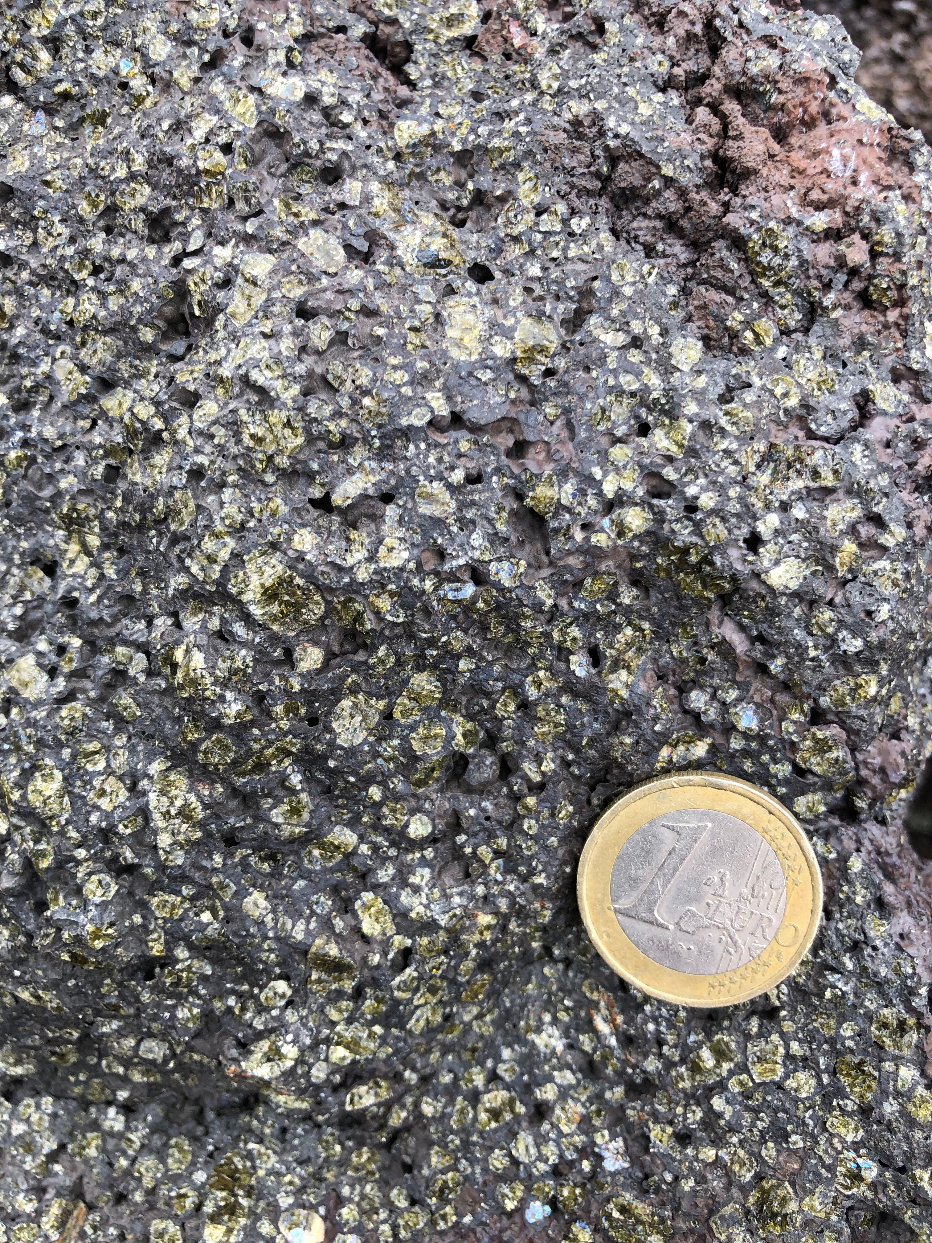
Piton de la Fournaise 2007
Scenario of events
The site of the lateral flank eruption occurred at an elevation of about 500 m, much lower than the summit. This elevation difference is inferred to a key factor for creating high driving pressure for magma flow.
In addition to “conventional geodetic models”, consider also constraints provided by the pressure difference between the magma body and surface vents
18-19 Feb
km
30 March
2
Piston
Collapse
6 April
1
2 April – 1 May
0
Shallow magma domain
-1
Not to scale
Deep source?
-8

Slide 4
General relation between magma flow and pressure drop Mass conservation: Magma body + magma channel
Expansion of magma remaining in the body drives out magma
OR
Piston collapse into
the magma body
Channel
Compressible
magma
Magma body: Oblate ellipsoid

Slide 5
Theories to test
Caldera collapse occurs because of combined effects of weak caldera faults and development of under-pressure (relative to lithostatic) under collapsing piston.
Magma can flow in sustained magma channels despite development of under-pressure because of inelastic effects, e.g. erosion of a crystal mush layer
During sudden outflow of magma from a magma body, the volume contraction of the shallow magma domain can be described by a contraction of ellipsoid in elastic halfspace.

