Slide 1






Attributing Chinese Hydrological Extreme Events
The CSSP China Event Attribution Team
Simon Tett, Buwen Dong, Fraser Lott, Ying Sun, Ruidan Chen, Yang Chen, Siyan Dong , Xuewei Fan, Jie Jiang, Chunxiang Li, Wei Li, Chunhui Lu, Yuanyuan Ma, Rouke Li, Delei Li, Nergui Nanding, Safi Ullah, Fangxing Tian, Xuan Wang, Linyun Yang, Rong Yu, Wenxia Zhang, Lianhua Zhu
Author’s Rights Reserved

Slide 2
Introduction
Examined three hydrological events in 2018 & 2019
Heavy rainfall in Central China during summer 2018
Heavy March-June rainfall in south eastern China during 2019.
Severe drought in Yunnan in May/June of 2019
All studied with HadGEM-GA6 based system – found reduction in heavy rain prob.; increase in drought prob.

Slide 3
HadGEM-GA6 Attribution System
Model resolution is N216 (approx. 60 km)
Four ensembles all forced with sea-surface temperature & sea ice
historical – 15 Members 1960-2013
historicalNat 15 Members naturalised 1960-2013
HistoricalExt – 525 members 2018 & 19
historicalNatExt – 525 members naturalised 2018 & 19

Slide 4
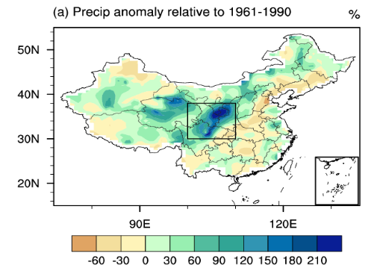
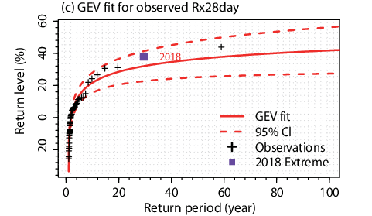
Heavy rainfall and flooding in Central China in June/July 2018
Observed Events: Rain -- 2018

Slide 5
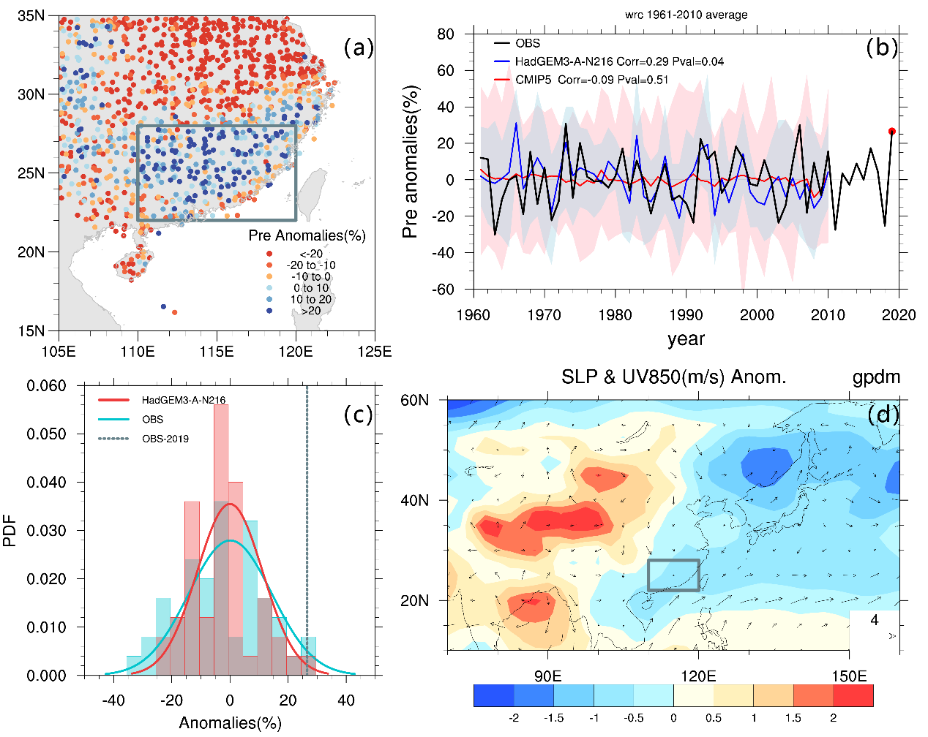
March to June 2019 rain in Southern China
Observed Events: Rain -- 2019
Extraordinarily long & 3rd wettest rainy season.
27% larger than 1961-2010 normal
Rain gauge precipitation anomalies
NCEP circulation anomalies

Slide 6
May & June 2019 Drought in Yunnan
Observed Events: Drought -- 2019
Precipitation about 40% (~2 σ) below normal in Yunnan
Driest on record (for this region)
Yunnan % Precip. Anom
historical
historicalNat
obs
Station Precip
Return Period
2019 Drought

Slide 7
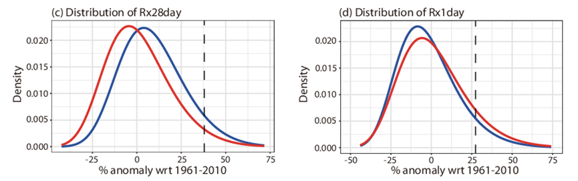
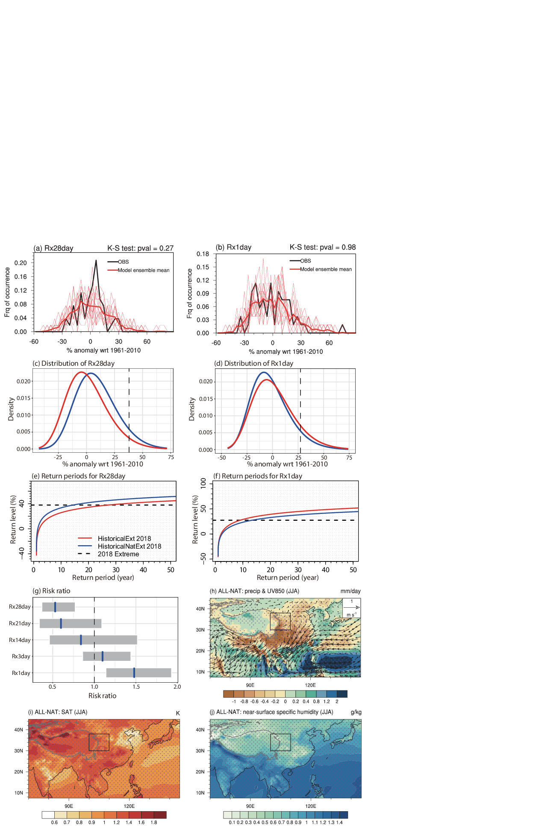
Heavy Rainfall and Flooding – summer 2018
Event Attribution – rain 2018
Risk ratio about ½ suggesting anthropogenic forcing reduced risk by about ½.

Slide 8
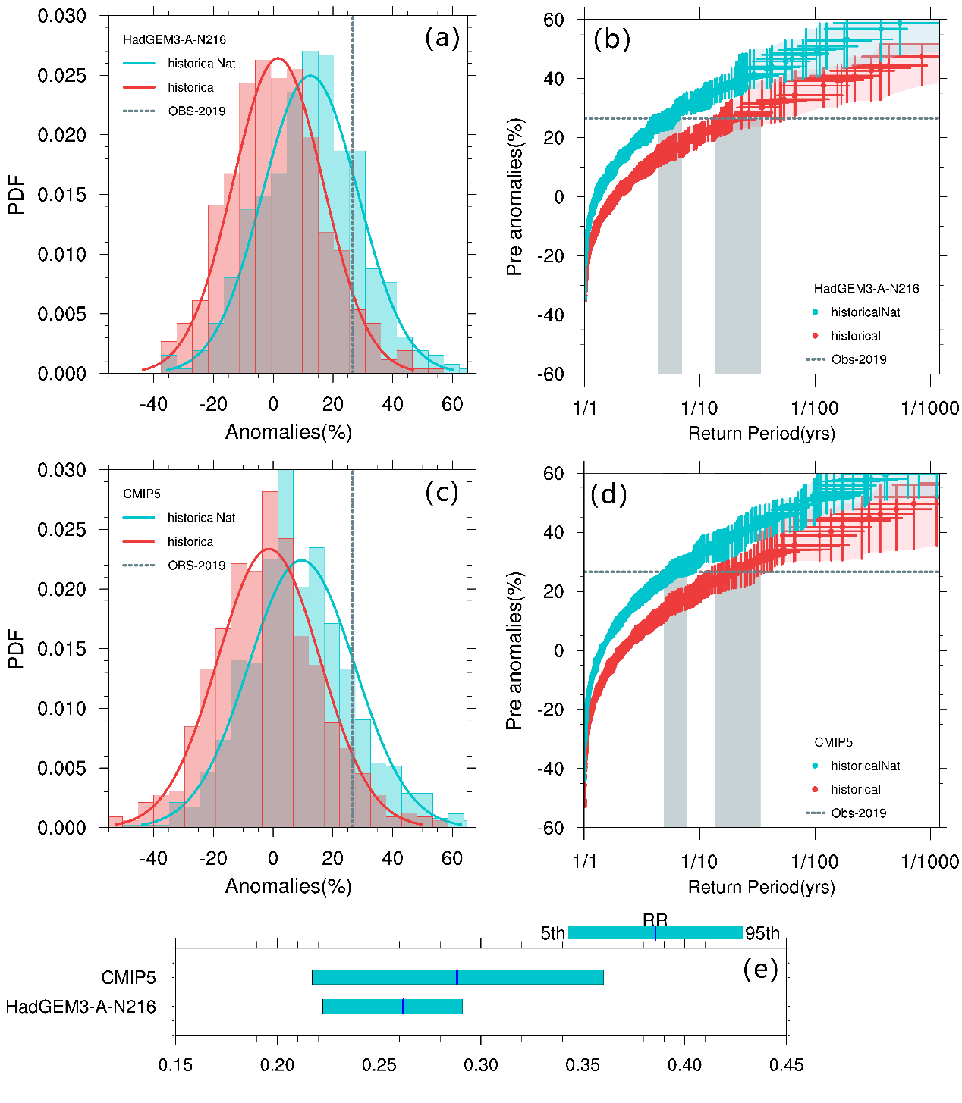
Heavy Rainfall– March to June 2019
Event Attribution – rain 2019
HadGEM-GA6
CMIP5
Risk Ratio
Risk Ratio of such events reduced by about 2/3 - 3/4

Slide 9
May/June 2019 Yunnan Drough
Event Attribution – drought 2019
Anthropogenic forcings have increased risk of 2019 like drought by about 14.

Slide 10
CMIP6 analysis
Event Attribution – drought 2019
Shift to drier conditions in CMIP6 ensemble but not as strong as in HadGEM-GA6 ensemble. RR about 2 (1.3-3.3)

Slide 11
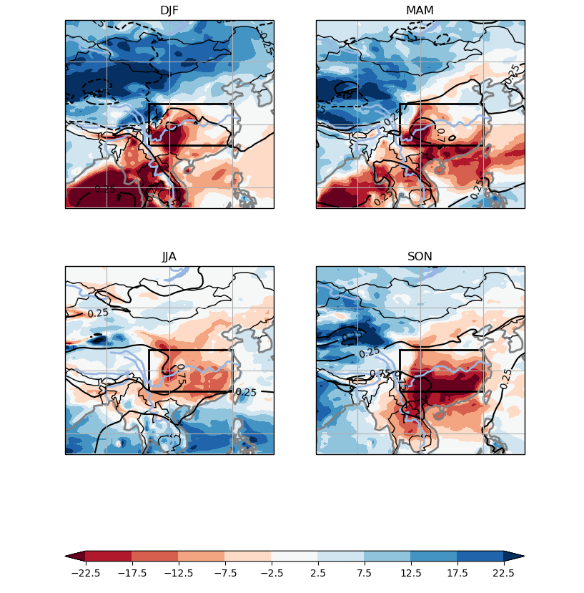
How is SE China’s rainfall changing?
Simulated by HadGEM-GA6 ensemble for 2017-2019. When ensemble size is 525 members. Focus on region in box
Relative drying throughout the year. Most rain in MAM & DJF so these seasons matter most.

Slide 12
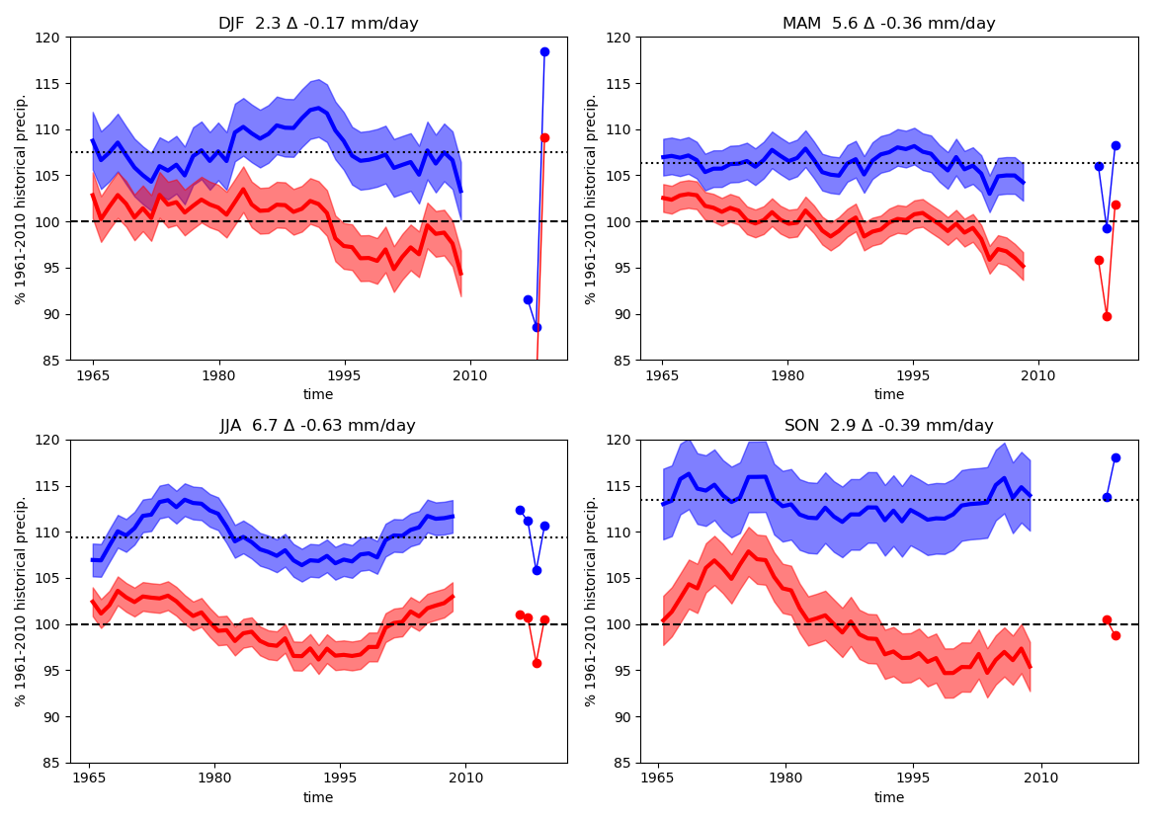
Time series of Precipiation % 1961-2010
historicalNat
Each season shown separately with 11-year running mean. 14 member ensembles show average +/- 2 std. err. Individual seasons shown for 525 member ensemble.
Some inter-dec var in natural. But also drying in historical
historical

Slide 13
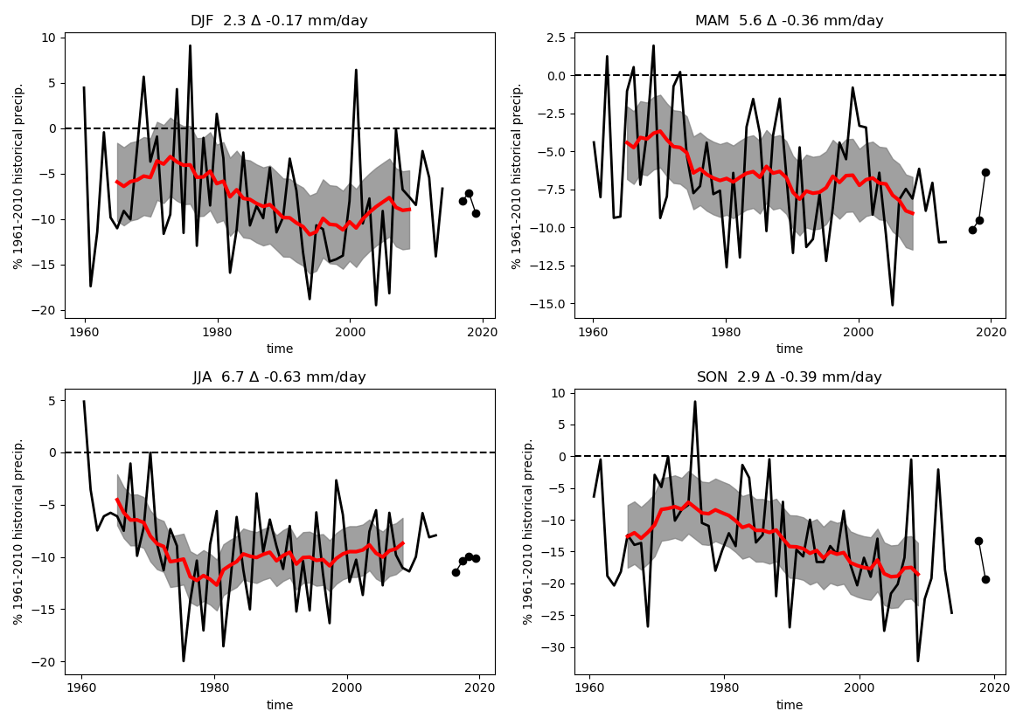
Time series of Difference
Shows difference from natural as % of 1961-2010 historical precipitation. Each season shown separately. Drying in MAM & SON about 10% “now” but about 5% in early 1960’s.
14-member mean
11-year running mean
525-ensemble mean

Slide 14
Conclusions
General drying in monsoon over SE China…
Leading to enhanced risk of drought and reduced risk of seasonal heavy rain.
Appears to be part of a longer term change of which ~ ½ happened prior to 1960.
Is this a model artefact or is it real?

