Slide 1
Potential of a Multimodal Orbital Radar Mission for the Exploration of Enceladus
Andreas Benedikter^{1,2}, Marc Rodriguez-Cassola¹, Gerhard Krieger¹, Rolf Scheiber¹, Gustavo Martin del Campo Becerra¹, Ralf Horn¹, Alberto Moreira¹, Michael Stelzig² and Martin Vossiek²
(1) German Aerospace Center (DLR), Microwaves and Radar Institute; (2) FAU Erlangen-Nürnberg, Institute of Microwaves and Photonics (LHFT)
EGU 2020

Slide 2
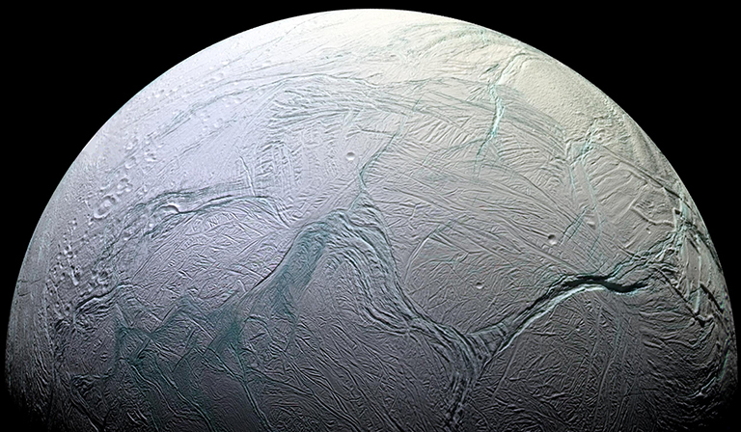
Potential of a Multimodal Orbital Radar Mission for the Exploration of Enceladus
Andreas Benedikter^{1,2}, Marc Rodriguez-Cassola¹, Gerhard Krieger¹, Rolf Scheiber¹, Gustavo Martin del Campo Becerra¹, Ralf Horn¹, Alberto Moreira¹, Michael Stelzig² and Martin Vossiek²
(1) German Aerospace Center (DLR), Microwaves and Radar Institute; (2) ) FAU Erlangen-Nürnberg, Institute of Microwaves and Photonics (LHFT)
EGU 2020
Knowledge for Tomorrow
image credit: NASA/JPL

Slide 3
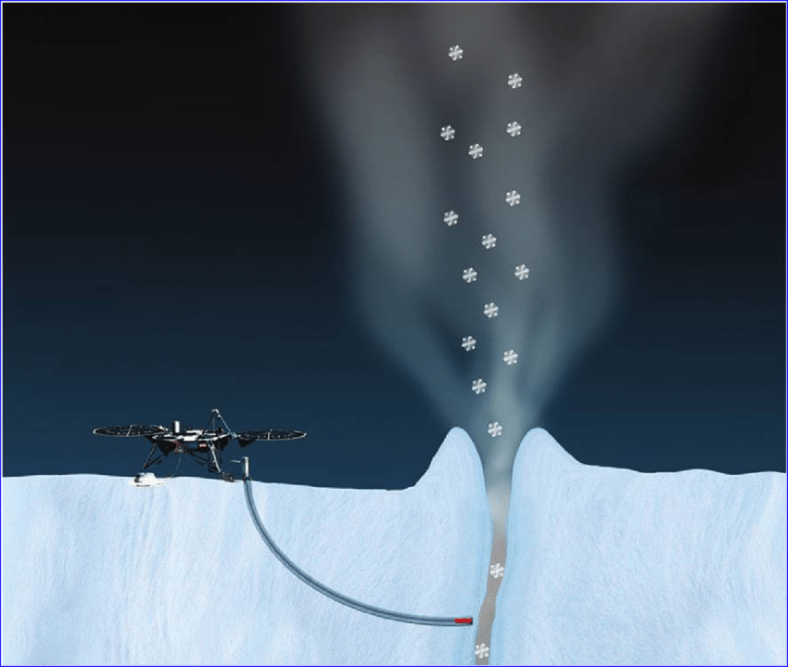
Enceladus Explorer Initiative (EnEx)
Initiative of the German Space Administration for the development of concepts for the future exploration of Enceladus and its subglacial water
Crucial information for landing site selection and landing performance:
Imaging of surface structure (crevasses, obstacles, roughness)
Surface topography
Surface composition (snow or ice, density, grain size)
Subsurface structure (near-surface aquifers, crevasses structure, obstacles)
Lander with IceMole

Slide 4
Enceladus Explorer Initiative (EnEx)
Why a radar instrument?
15 years of winter darkness at Enceladus south pole (~ from year 2038 - 2053) → Radar imaging independent of sunlight illumination
Penetration capability in snow and ice → Only modality offering wide-area, high-resolution subsurface exploration
Topographic mapping capability over wide areas with metric or sub-metric accuracy
Capability of high spatial resolution independent of distance
High sensitivity to spatial deformation
Radar orbiter
image credit: NASA/JPL

Slide 5
Enceladus Explorer Initiative (EnEx)
Radar orbiter
Not only a sensor for the lander mission:
Contribute in the understanding of the surface and internal structure, geology and geophysical processes on Enceladus (e.g., surface structure/composition, structure of tiger stripes, ice layering, tidal effects)
image credit: NASA/JPL

Slide 6
Multimodal, Multi-Frequency Radar Orbiter
Mode | Measurement
Multi-frequency SAR | imaging, characterization surface + subsurface
SAR interferometry | topography; deformation
Bistatic sounding Orbiter ↔ IceMole | IceMole localization; ice composition estimation
Ice Sounder | subsurface interfaces; tiger stripes structure
Altimeter | elevation; deformation
Radiometer | south polar activity, temperature profile
Operating in several active and passive modes to maximize information diversity (similar to the Cassini Radar instrument)
Operating in different frequency bands for surface and subsurface ice exploration:
  Relatively high frequency (Ka-band, approx. 35 GHz) → sensitivity to surface features
  Lower frequency (P-band, approx. 435 MHz) → partial penetration of radar echoes into snow/ice → sensitivity to subsurface features

Slide 7
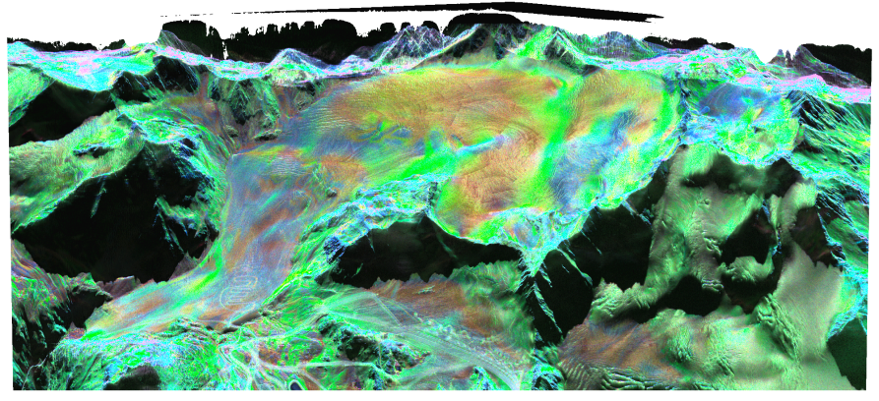
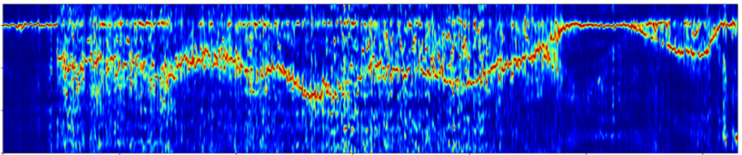
Multimodal, Multi-Frequency Radar Orbiter
Synthetic Aperture Radar (SAR)
Technique to obtain 2-D or 3-D high resolution imaging of the terrain
Mode | Measurement
Multi-frequency SAR | imaging, characterization surface + subsurface
SAR interferometry | topography; deformation
Bistatic sounding Orbiter ↔ IceMole | IceMole localization; ice composition estimation
Ice Sounder | subsurface interfaces; tiger stripes structure
Altimeter | elevation; deformation
Radiometer | south polar activity, temperature profile
Exemplary data from DLR‘s airborne SAR sensor (F-SAR) over the Mittelbergferner (Alpine glacier):
high-frequency subsurface exploration
Red color indicates scattering mechanisms connected to fresh snow accumulation
Crevasses in the glacier
vertical slice
low-frequency subsurface exploration
0
-20
depth (m)
-40
internal ice reflections
-60
bed rock under glacier

Slide 8
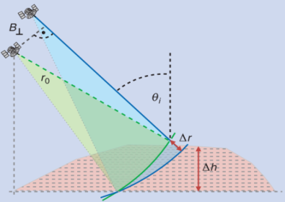
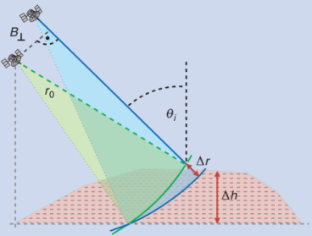
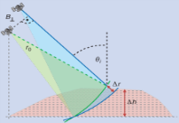
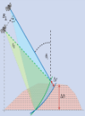


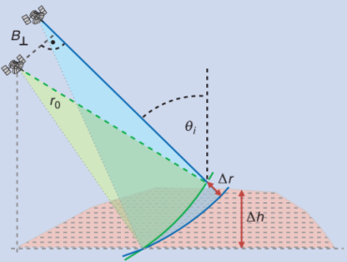
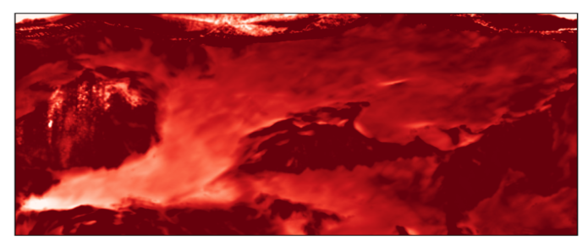


Multimodal, Multi-Frequency Radar Orbiter
SAR intereferometry (InSAR)
Combination of multiple SAR images to generate digital elevation maps (DEM) or deformation maps
Mode | Measurement
Multi-frequency SAR | imaging, characterization surface + subsurface
SAR interferometry | topography; deformation
Bistatic sounding Orbiter ↔ IceMole | IceMole localization; ice composition estimation
Ice Sounder | subsurface interfaces; tiger stripes structure
Altimeter | elevation; deformation
Radiometer | south polar activity, temperature profile
Two approaches for an Enceladus orbiter:
single-pass
repeat-pass
$$Δt$$
Exemplary data showing the DEM difference of the Mittelbergferner between year 2019 and year 2000:
Similar measurements feasible for Enceladus topography and deformation

Slide 9


Multimodal, Multi-Frequency Radar Orbiter
Bistatic transmission measurements between the orbiter and the IceMole equipped with a transponder (similarities to the CONCERT experiment of the Rosetta mission)
Mode | Measurement
Multi-frequency SAR | imaging, characterization surface + subsurface
SAR interferometry | topography; deformation
Bistatic sounding Orbiter ↔ IceMole | IceMole localization; ice composition estimation
Ice Sounder | subsurface interfaces; tiger stripes structure
Altimeter | elevation; deformation
Radiometer | south polar activity, temperature profile
IceMole + Transponder
delay and attenuation of radar signals through ice
esitimate of dielectric ice parameters
geophysical ice parameters (density, grain size, temperature, salinity)
Terrestrial analog experiment planned for spring 2021 in the Alps

Slide 10
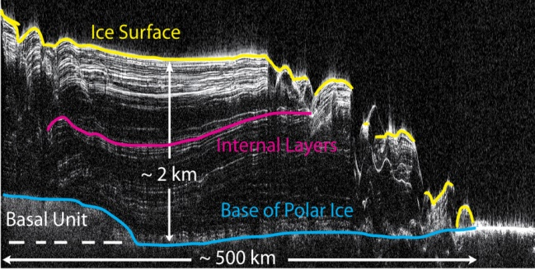
Multimodal, Multi-Frequency Radar Orbiter
Operating the radar in nadir-looking configuration:
Mode | Measurement
Multi-frequency SAR | imaging, characterization surface + subsurface
SAR interferometry | topography; deformation
Bistatic sounding Orbiter ↔ IceMole | IceMole localization; ice composition estimation
Ice Sounder | subsurface interfaces; tiger stripes structure
Altimeter | elevation; deformation
Radiometer | south polar activity, temperature profile
Low-frequency radar ice sounder
Example: North polar cap cross section of Mars imaged by SHARAD
image credit: NASA/JPL
Great penetration capability
High sensitivity to ice layers
High-frequency radar altimeter
Elevation/deformation measurements
Information for orbit determination
Reduced complexity (power, data rate) compared to SAR interferometry, but lower spatial resolution and coverage capability

Slide 11
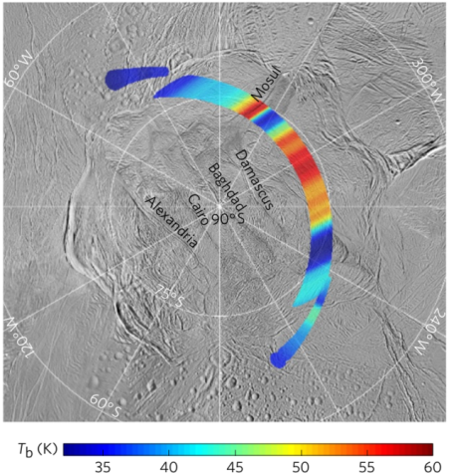
Multimodal, Multi-Frequency Radar Orbiter
Passive operation of the radar as microwave radiometer:
Mode | Measurement
Multi-frequency SAR | imaging, characterization surface + subsurface
SAR interferometry | topography; deformation
Bistatic sounding Orbiter ↔ IceMole | IceMole localization; ice composition estimation
Ice Sounder | subsurface interfaces; tiger stripes structure
Altimeter | elevation; deformation
Radiometer | south polar activity, temperature profile
Surface brightness temperature map of Enceladus South pole measured with the Cassini RADAR (2.2 cm wavelength) [1]
Only microwave radiometry observation of Enceladus during the Cassini mission
Temperature anomalies coincide with large fractures in the ice
A future Enceladus mission would allow an extended spatial and temporal coverage
Using additionally a low frequency may allow for inverting vertical temperature profiles through the ice crust
[1] Le Gall, A., Leyrat, C., Janssen, M. et al. Thermally anomalous features in the subsurface of Enceladus’s south polar terrain. Nat Astron 1, 0063 (2017)

Slide 12
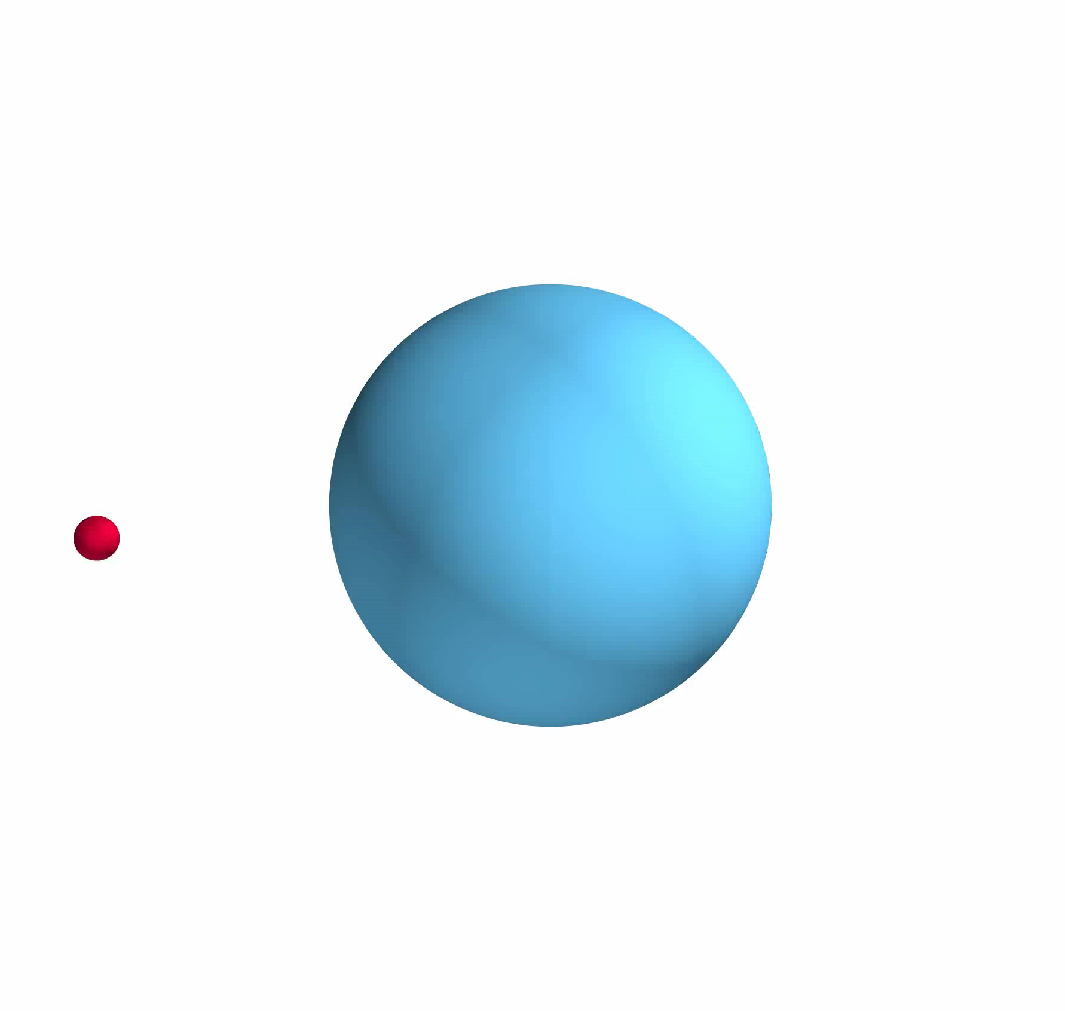
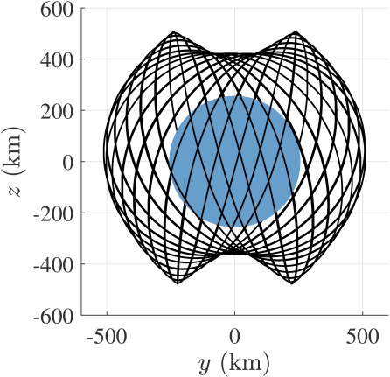
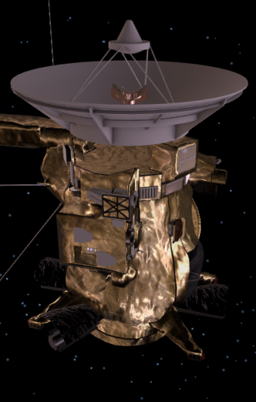
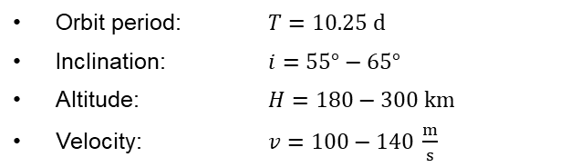
Multimodal, Multi-Frequency Radar Orbiter
Orbit Considerations
Architecture Considerations
multimodal, multi-frequency architecture
Cassini spacecraft as reference for mass and space limitations
P-band feed
Ka-band sub-reflector, transparent at P-band
Orbit period: $T=10.25 d$
Inclination: $i=55°−65°$
Altitude: $H=180−300 km$
Velocity: $v=100−140 \frac{m}{s}$
Ka-band feed array
3 m main reflector
image credit: NASA/JPL
Ka-band (35 GHz) multi channel: surface imaging, single-pass interferometry, downlink
P-band (435 MHz) single channel: subsurface imaging, sounding
4 m reflector antenna
R. P. Russell and M. Lara, “On the design of an Enceladus science orbit”, Acta Astronautica, vol. 65, no. 1, pp. 27 – 39, 2009.

Slide 13
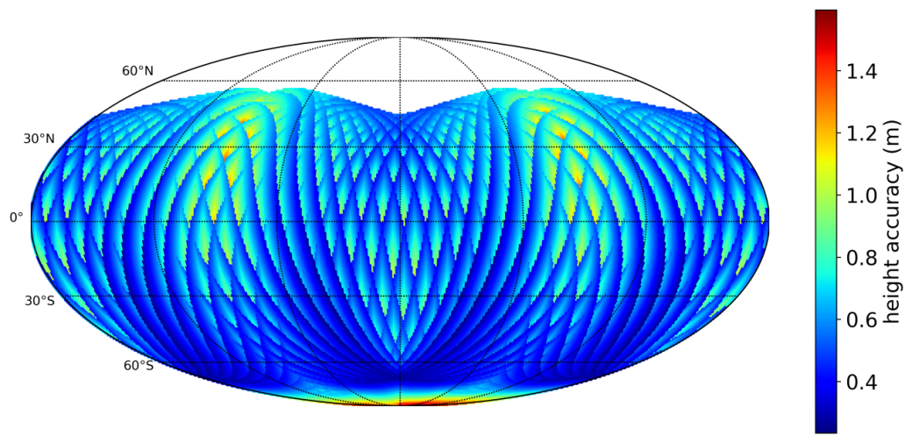
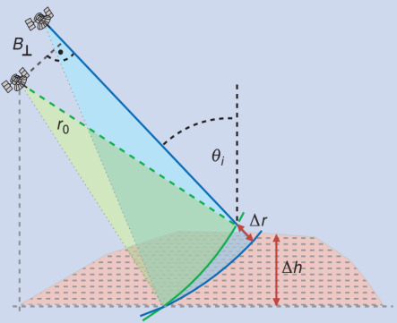


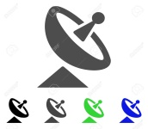
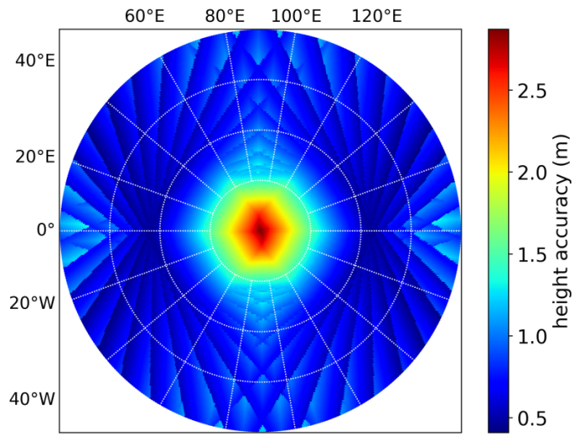
Topographic Mapping Performance
single-pass interferometry
Parameter | Value
center frequency | 35 GHz
average transmit power | 50 W
bandwidth | 150 MHz
antenna size | 0.3 x 0.3 m²
baseline | 1.5 m
product resolution | 8 x 8 m²
-80˚S
-70˚S
-60˚S

Slide 14
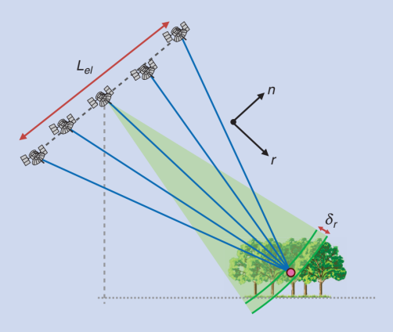
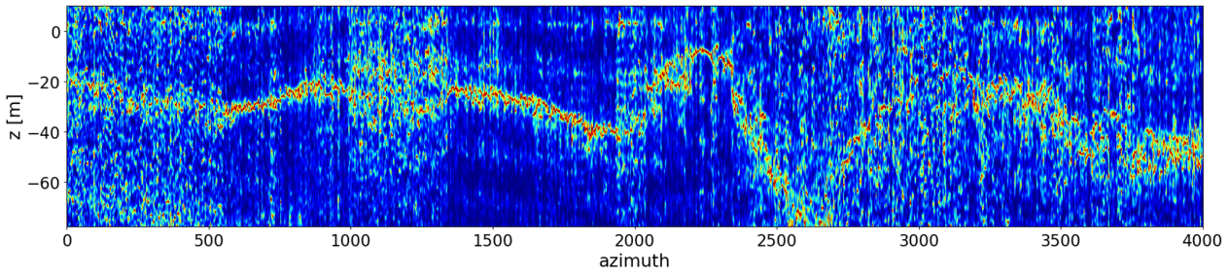
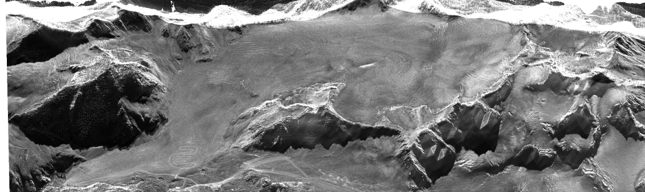
Subsurface Imaging Concept
Unique capability of tomographic SAR imaging for the global exploration of ice sheets
Vertical slices through the glacier
azimuth [samples]
vertical slices
Data of airborne campaign for EnEx at Mittelbergferner glacier
Notes:
Nice simulation of 3D resolution

Slide 15
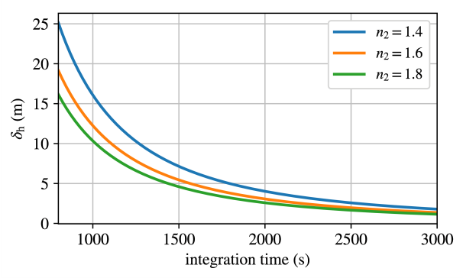
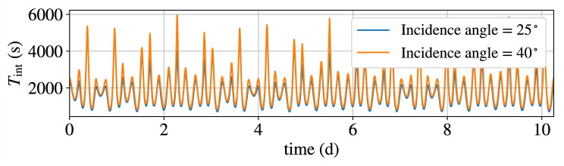

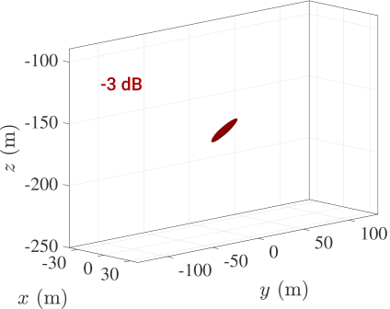
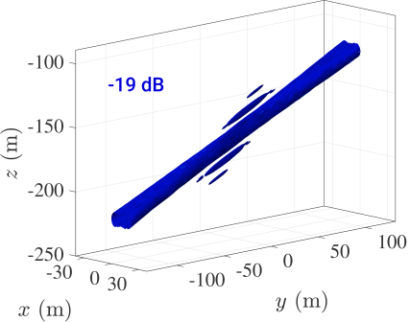



Subsurface Imaging Concept
Unique capability of tomographic SAR imaging for the global exploration of ice sheets
Tomographic repeat pass orbits about Enceladus are highly questionable
Single-pass volumetric imaging concept based on:
Wide angular extent of the surveys
→ Long integration times
Vertical resolution for two-layered model
$n_{2}$: refractive index of ice layer
Sensitivity of the surveys to the refractive index profile of the ice
$$T_{int}$$
3-D impulse response for given orbit geometry and realistic permittivity profile
Notes:
Nice simulation of 3D resolution

Slide 16
Conclusion
Winter darkness at Enceladus south pole from year 2038 – 2053 drives the need for a radar instrument enabling the imaging, mapping and characterization of the moon
A single architecture radar instrument can be operated in several active and passive modes to obtain a wide spectrum of information
The multi-frequency architecture allows for the simultaneous exploration of surface and subsurface features of the ice crust
A conservative system regarding power, mass, and space may allow for metric-resolution imaging and topographic mapping with metric accuracy
The unique orbit geometry can be exploited in a subsurface imaging concept to obtain volumetric imaging of the ice crust complementary to tomographic repeat-orbit imaging

