Slide 1
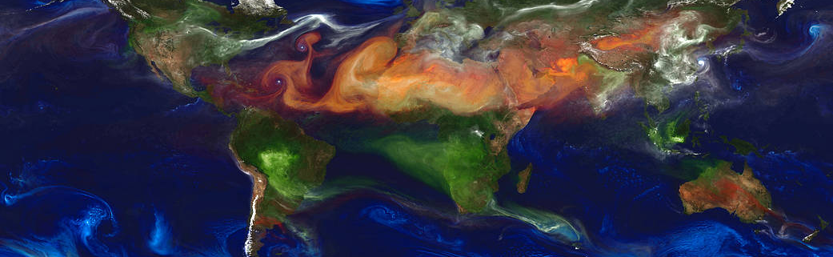
Climate forcing and committed global warming:
GHGs, aerosols and ozone 1970-2010
Alcide ZHAO, David Stevenson and Massimo Bollasina
School of GeoSciences, The University of Edinburgh
NASA | GEOS-5

Slide 2
alcide.zhao@ed.ac.uk​
Take-home message
Present day climate in response to the past few decades of emission changes are out of equilibrium
Once in equilibrium, the global mean temperature responses are twice as large as the transient 1970-2010 changes
ERF may only work at global scale for well-mixed GHGs, and needs to be used carefully for short-lived climate forcers

Slide 3
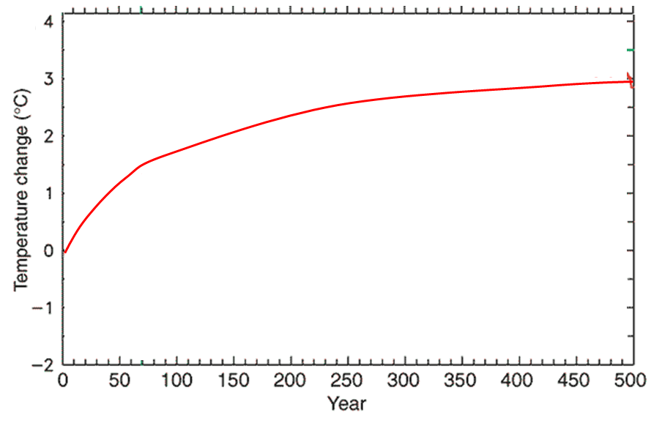
Why equilibrium? Steady-state
alcide.zhao@ed.ac.uk​
Equilibrium state
Timing of
CO2 doubling
Committed warming
Equilibrium
climate response
Realized climate response
Constant double CO2 conc./ forcing
Transient state
The climate system is currently not fully-responded to past changes in emissions/forcigs
Takes hundreds of years to realise the slow response component of the oceans

Slide 4
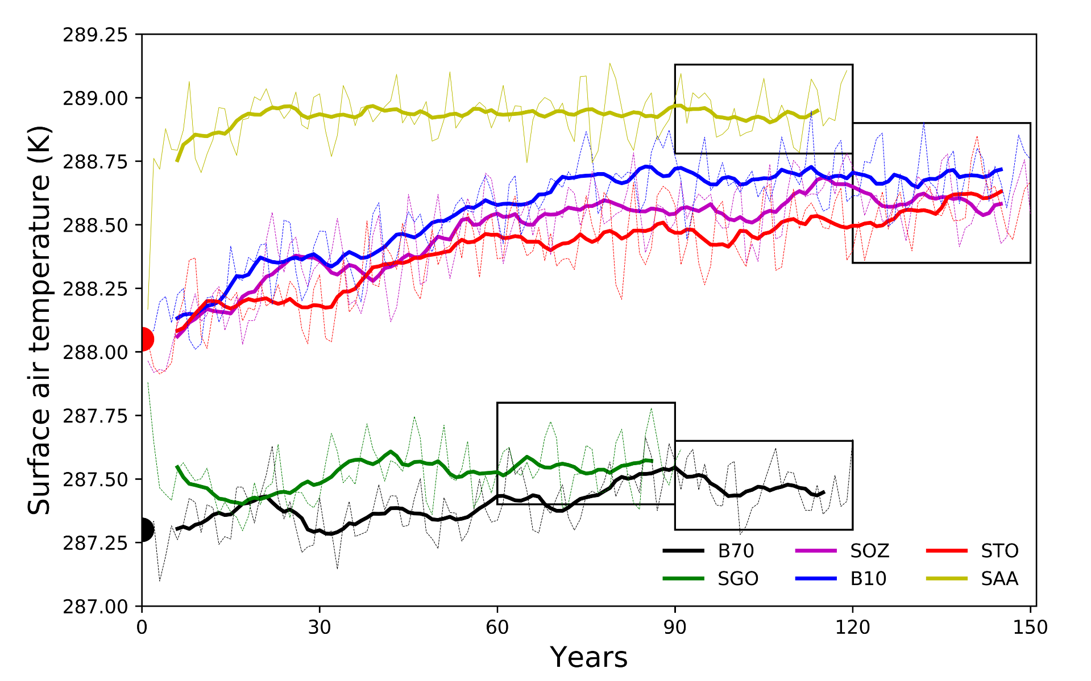
Time-slice runs to climate equilibrium
alcide.zhao@ed.ac.uk​
Aerosols 1970
Baseline 2010
Trop O₃ 1970
Start runs from CESM-LE dumps for 2010, 1970
All O₃ 1970
Last 30-yrs for analysis
WMGHG 1970
Baseline 1970
Differences between baseline runs and sensitivity runs tell the effects of changes in individual forcings

Slide 5
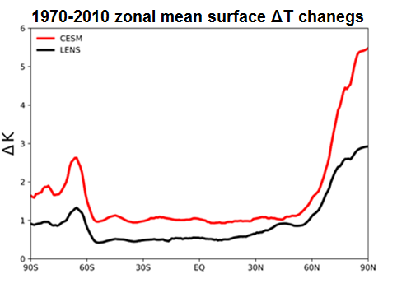
alcide.zhao@ed.ac.uk​
Equilibrium vs. transient response
Once the present-day climate has fully-responded to 1970-2010 emission changes, the global mean temperature change will be doubled
There might be more long-term climatic impacts/risks.

Slide 6
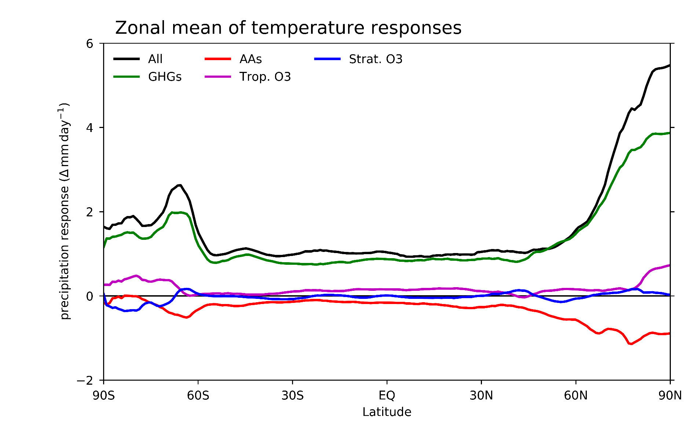
alcide.zhao@ed.ac.uk​
Temperature change attribution
Global mean
All forcing: +1.23 K
GHGs: +1.03 K
Trop. O3: +0.24 K
Strat. O3: -0.07 K
Aerosols: -0.26 K

Slide 7
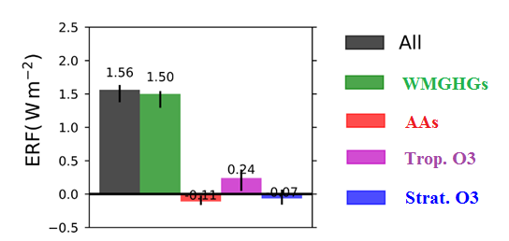
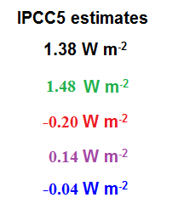
alcide.zhao@ed.ac.uk​
1970-2010 effective radiative forcing (ERF)
ERF is though to be a useful indicator of temperature change, and appealing for quick climate change projections, as well as climate strategy development

Slide 8
alcide.zhao@ed.ac.uk​
Does ERF behave? Not necessarily
May behave for GHGs, but not for SLCFs
May behave when globally averaged, but not at regional scale
Not useful to show spatial distribution of ERF and regional mean values
$$S\text{ensitivity}\text{ =}\frac{\text{△}\text{T}}{\text{△}\text{ERF}}$$

Slide 9
alcide.zhao@ed.ac.uk​
Key points
Present day climate in response to the past few decades of emission changes are out of equilibrium
Once in equilibrium, the global mean temperature responses are twice as large as the transient 1970-2010 changes
ERF may only work at global scale for well-mixed GHGs, and needs to be used carefully for short-lived climate forcers
Zhao, et. al (2019). Climate forcing and response to greenhouse gases, aerosols and ozone in CESM1. J. Geophys. Res. https://doi.org/10.1029/2019JD030769

