Slide 1
C3S beyond 2020

Slide 2
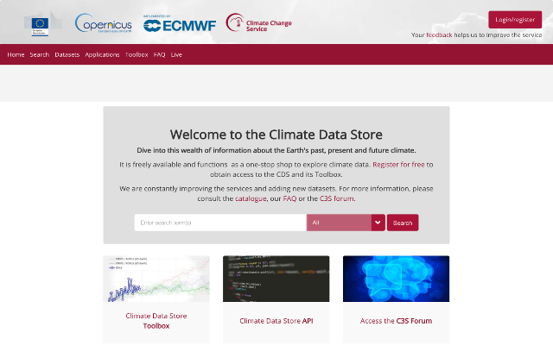
The Climate Data Store
Registered users: 41 751+
TB/day: ~50 (30-60)
Datasets: 64
23000+
registered users
Status on 4th May 2020 at 06h00 CET
The number of users increased by 5000+ in the last couple of months.
Notes:
2

Slide 3
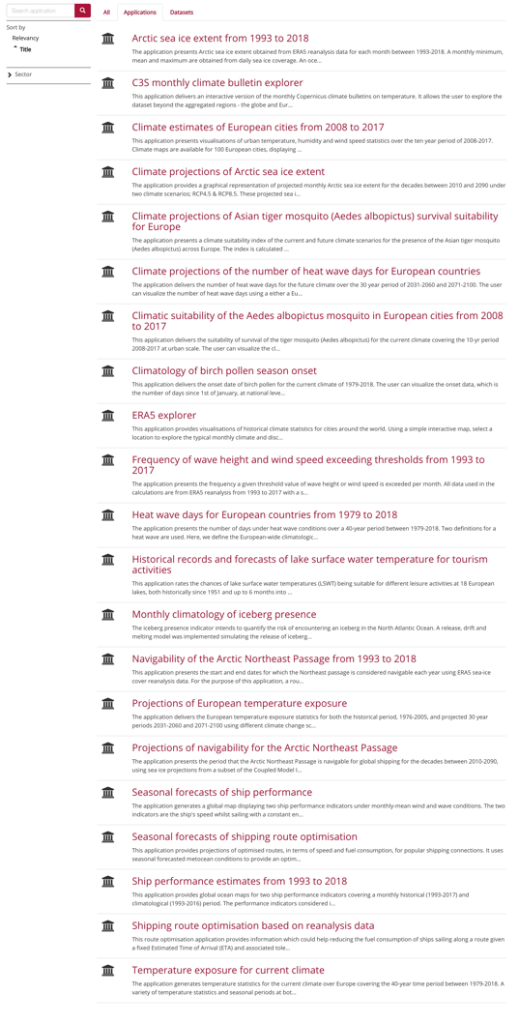
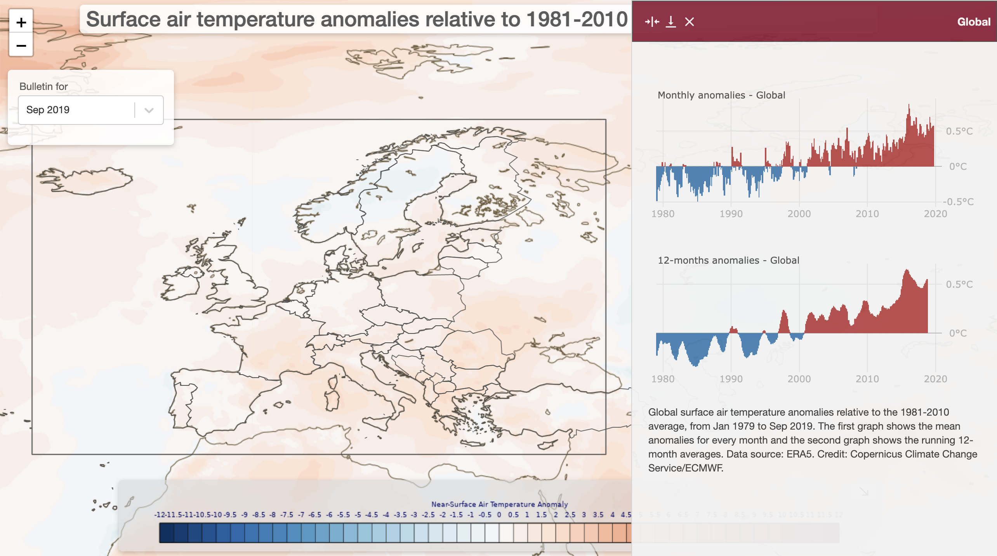
The Climate Data Store
… and more than 20 applications
(Health, tourism, transport, …)
Status on 28th Oct. 2019 at 9h30 CET

Slide 4
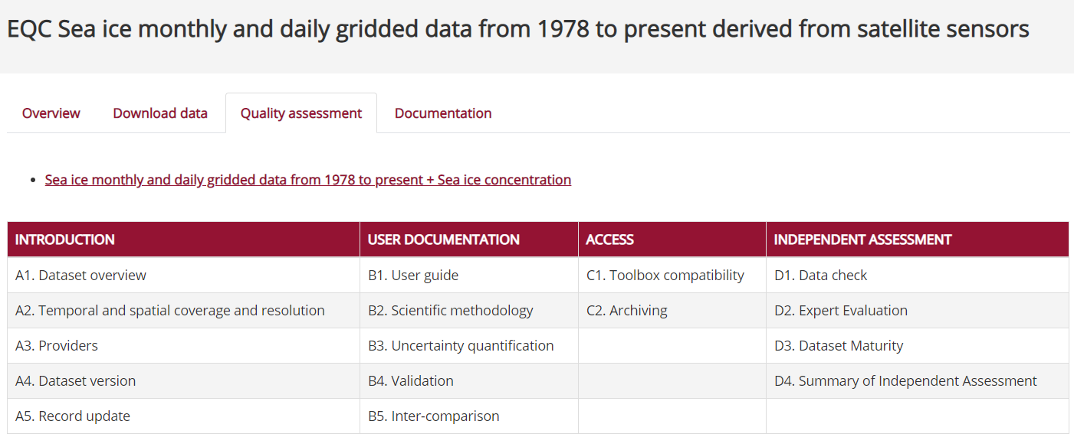
Evaluation and Quality Control
EQC function is pre-operational
Content Management System integrated into the CDS
100+ Quality Assurance Reports produced
EQC tab with synthesis table in CDS-test
Ready to go live in Q2 2020
Analysis of User Requirements underway
Operational URDB holding 3000+ requirements
First URADs on data, toolbox and sectors produced
Internal EQC Review Board established to address issues reported by EQC
Mechanism put in place to inform service evolution

Slide 5
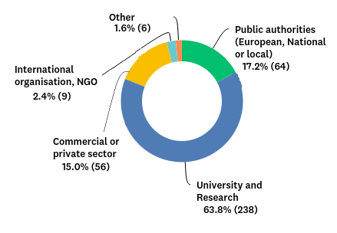
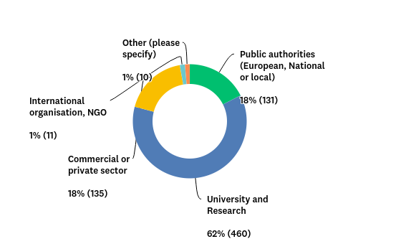
User profile
2018
2019
A significant majority of survey participants (70%) works in academia and research, followed by 14% in the public sector, and 11% in the commercial sector.
Within the EU-based responses we see a more even distribution than elsewhere (see plots above), with public sector and commercial entities having 18% each.
The sectoral distribution shows how C3S products continue to find significant uptake among commercial and public-sector users. The fraction of users from these sectors is increasing both in absolute and relative terms.

Slide 6
Key message
C3S has achieved most (if not all) its original objectives and successfully positioned itself as a key global player in the world of climate services.
The original vision is still largely valid.
The keyword for the next phase is enhanced continuity

Slide 7
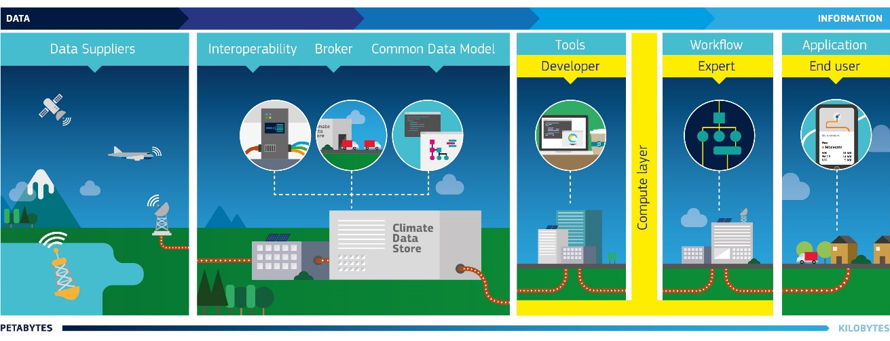
C3S : Current Vision Still Valid
Authoritative voice for Europe
Subsidiarity
Stimulate the market for climate services

Slide 8
C3S : Current Vision Still Valid
Authoritative Voice for Europe
Operational provision of critical climate information:
European State of Climate
Develop an attribution function; identified targets: media & planner
Monitoring tool for COP21 Paris agreement (“we will help you improve your reporting”), UNFCCC, WMO
Increase support to policy/decision making process by addressing more sectoral oriented issues
Enhanced reference reanalysis datasets
Including more ECVs/indicators as needed

Slide 9
C3S : Current Vision Still Valid
Subsidiarity
Take stock of European infrastructure and complement national climate services at European level.
Involve closely national expertise (Met services, universities, governments) and increase outreach and capacity building in Central/Eastern Europe (training, dedicated use cases, etc.).
Subsidiarity expands to outside Europe. More direct contribution to GFCS agenda, support developing countries (via DG Dev Co, World Bank), and SDGs at large

Slide 10
C3S Current Vision Still Valid
Stimulate the market for climate services
Expand capabilities of CDS/CDS toolbox and expert training
Direct approach with communities of practice (in concertation with European DGs).
Develop decadal predictions service to address a strong demand (~10 years) from the market.
Including a verification service

Slide 11
C3S beyond 2020
Three priorities:
Service consolidation at large
Enhancement of the CDS and operationalisation of SIS offer
Promotion of user uptake (i.e. EU policies, downstream service providers, media, academia..)

Slide 12
C3S 2.0 portfolio
Portfolio | Product high level description
A: CDS core products | Climate observations
 | More Observational gridded products (ECVs)
 | Global and regional climate reanalyses
 | Multi-model seasonal forecasts
 | Initialised climate predictions (decadal)
 | Global and regional climate projections
B: SIS indicators | Climate Impact Indicators, either generic or sector-specific, covering the economic sectors of water, energy, agriculture, insurance, health, infrastructure, tourism, biodiversity, etc.
 | Use cases and demo cases for various sectors
 | Sectoral workflows and applications
C: Evaluation and Quality Control | Quality Assurance for CDS: quality assurance, traceability, product quality, quality of service, verification service
 | Quality Assurance for SIS: quality assurance, fitness for purpose, User Requirement Data Base (URDB), User Requirement Analysis Document (URAD)
D: Outreach and Communication | Web content provision and management
 | Monthly and Annual Statement of Climate
 | Marketing, fact sheets, success stories, etc.
 | Attribution Service component
 | Events: Workshops, Assemblies, conferences
 | Training

Slide 13
C3S reanalysis – proposal for next phase
2016 - 2020: ERA5 from 1950
ERA5T: preliminary data at short delay (<5 days)
ERA5L: 9km global land products
2021 - 2023: Centennial reanalysis ??
From 1851, coupled ocean, moderate resolution
Benchmarks: CERA-20C, 20CRv3
Input data from C3S in situ databases
2023 - 2025: Production ERA6
Coupled ocean, high resolution
EUMETSAT reprocessed data, C3S satellite data rescue
ERA6L with enhanced land data assimilation
2024 - 2026: Joint CAMS/C3S reanalysis
Coupled chemistry
From 1979, updated at short delay
User requirements:
‘Climate quality'
High resolution
As far back as possible
Uncertainties
Additional products
Latest ECMWF model
Timely delivery
Easy access
Great user support
2021-2025: Regional reanalyses
Outsourced
Pan-Arctic, Europe
Extension to centennial

Slide 14
C3S Seasonal Forecast – 10-year outlook
User requirements:
Multi-model products
High resolution
Uncertainties
Use cases
Additional products
Latest model developments
Timely delivery
Easy access
Great user guidance and support
Context: Multi-model Seasonal forecast system based on inputs from:
ECMWF, UKMO, MF, DWD, CMCC
NCEP, JMA, ECCC, BoM, more?
Authoritative multi-model products
Links with RCCs/RCOFs, other multi-model approaches, etc.
Improved timeliness, ensemble size, resolution?

Slide 15
C3S beyond 2020, main elements
CDS:
Target ~ 35+ ECVs/Climate Indicators
Step-up with sentinel reprocessing (will feed into the above)
Ambitious reanalysis programme (global + regional)
New service on decadal prediction
SIS:
Operational production, CIIs feeding into State of Climate, EEA Climate-Adapt platform, JRC, …
Focus on use cases to showcase applications
Closer link with EU DG needs
EQC:
Quality Assurance for all (CDS, SIS, OUTREACH)
Continual user requirement management, usability and quality of service assessment

Slide 16
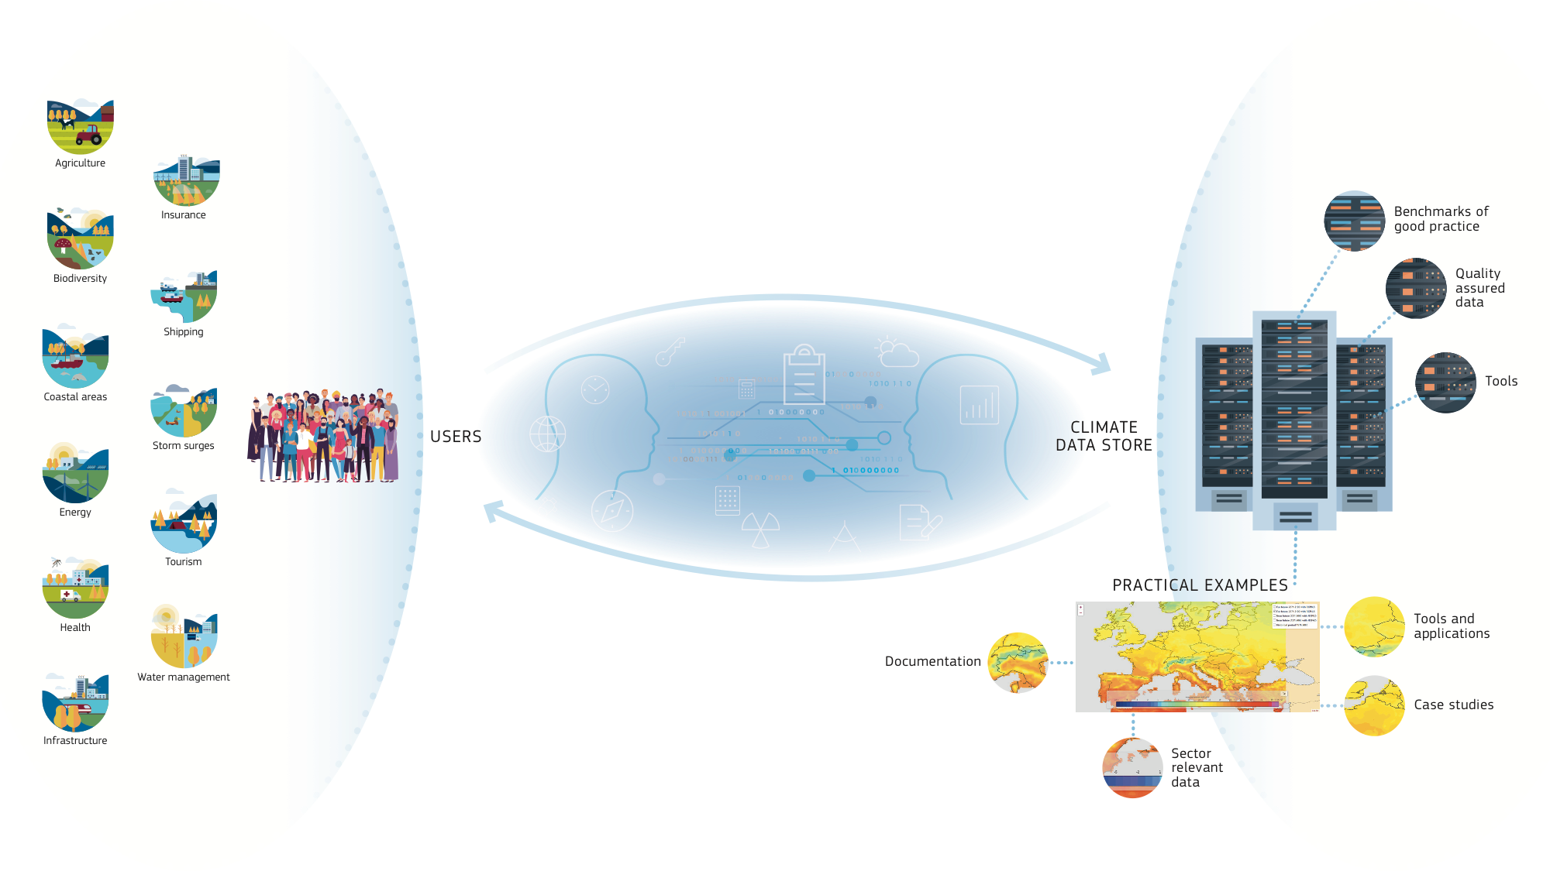
All sectors addressed
Notes:
To provide practical examples of how C3S in general and CDS in particular could deliver information of relevance to specific sectors.
To act as benchmarks of good practice.
To document users needs, and whenever possible address those.
In particular SIS contracts should develop and make available
sector-relevant indicators and tools that were either unavailable or inaccessible before.

Slide 17
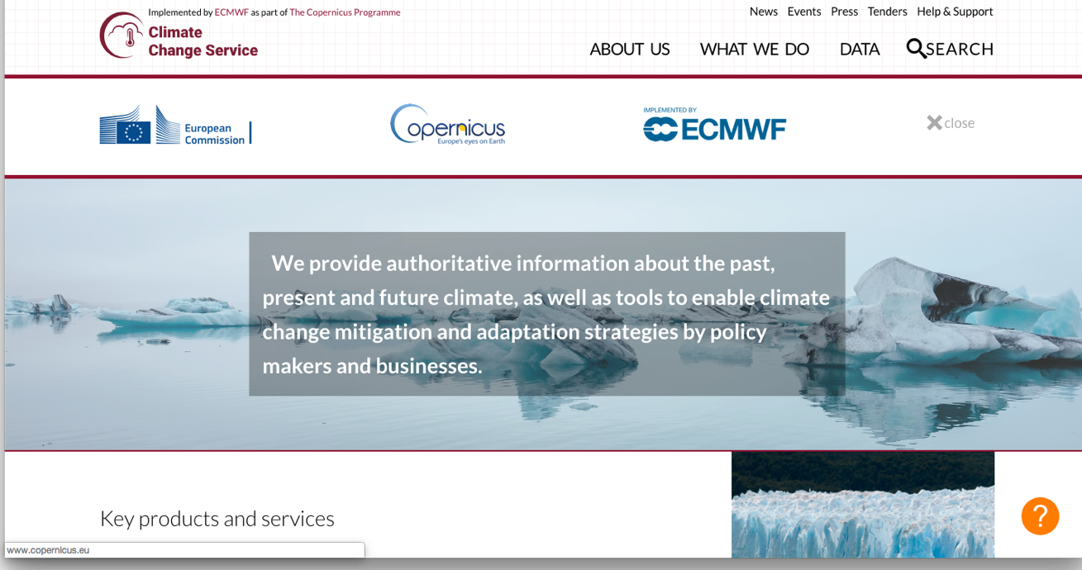
Thank you !
climate.copernicus.eu
For more info:
copernicus-support@ecmwf.int
Carlo.Buontempo@ecmwf.int
Twitter: @carlo_tuitter

