Slide 1
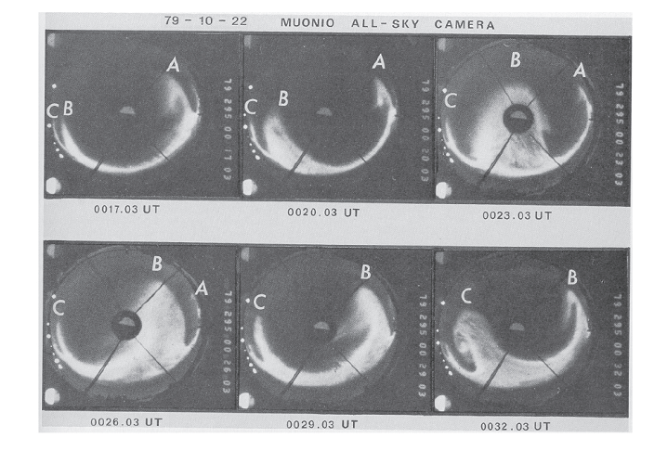
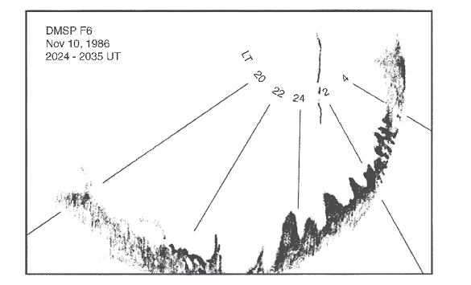
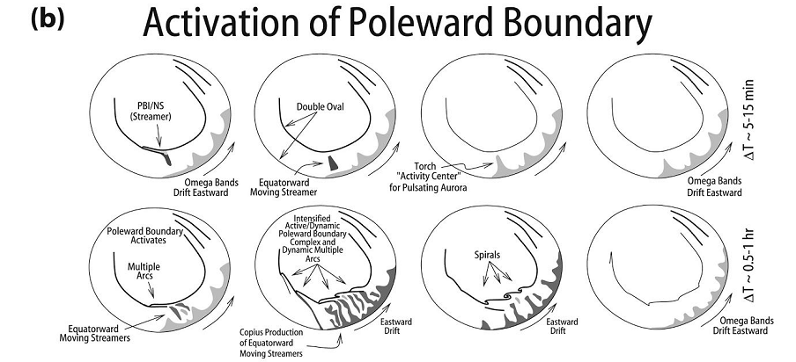
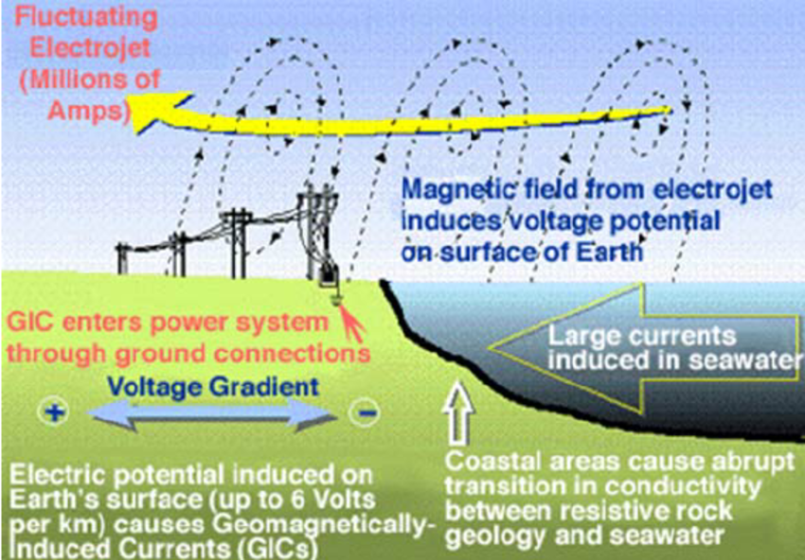
Auroral omega bands are a significant cause of large geomagnetically induced currents
RSF project # 19-77-10016
S. V. Apatenkov, V. A. Pilipenko, E. I. Gordeev, A. Viljanen, L. Juusola, V. B. Belakhovsky, Ya. A. Sakharov, V. Selivanov

Slide 2
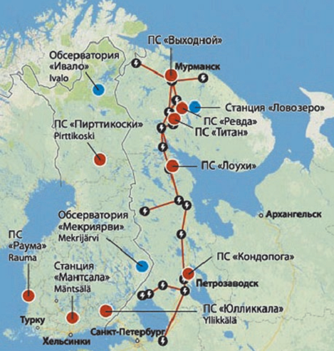
Instrumentation and data. GIC
120A at VKH transformer

Slide 3
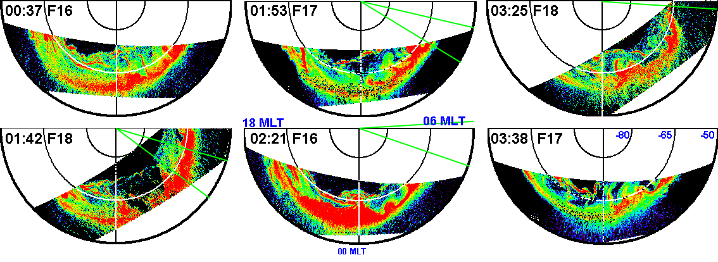
DMSP UV data
Streamers -> torch like / omega bands

Slide 4
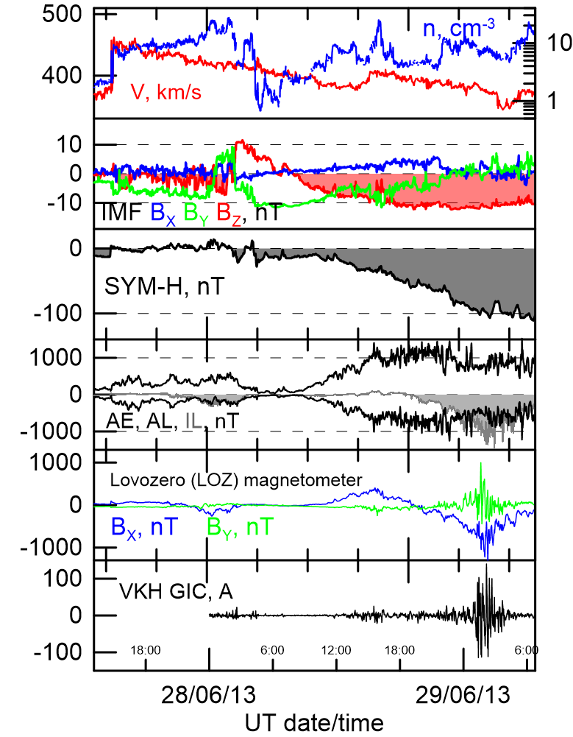
Storm overview

Slide 5
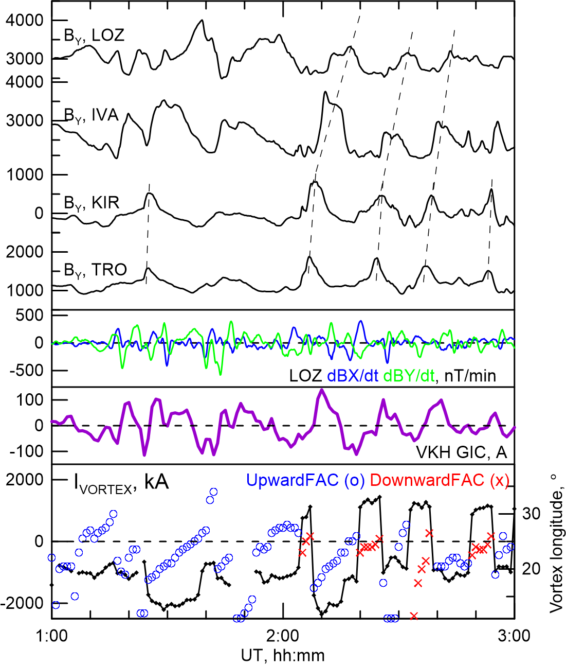
IMAGE local observations

Slide 6
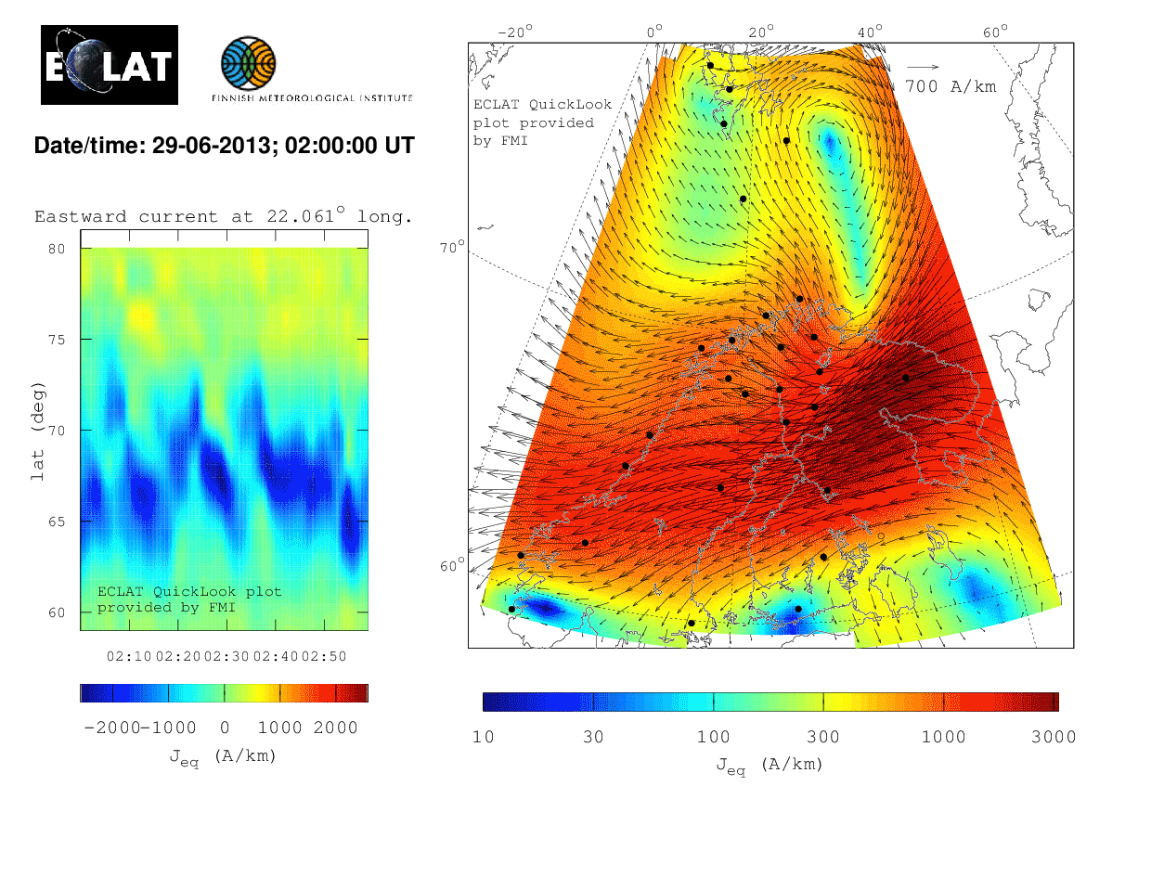
2D equivalent currents applying Amm & Vilanen 1999
2D rather than 1D AEJ
Eastward moving vortices

Slide 7
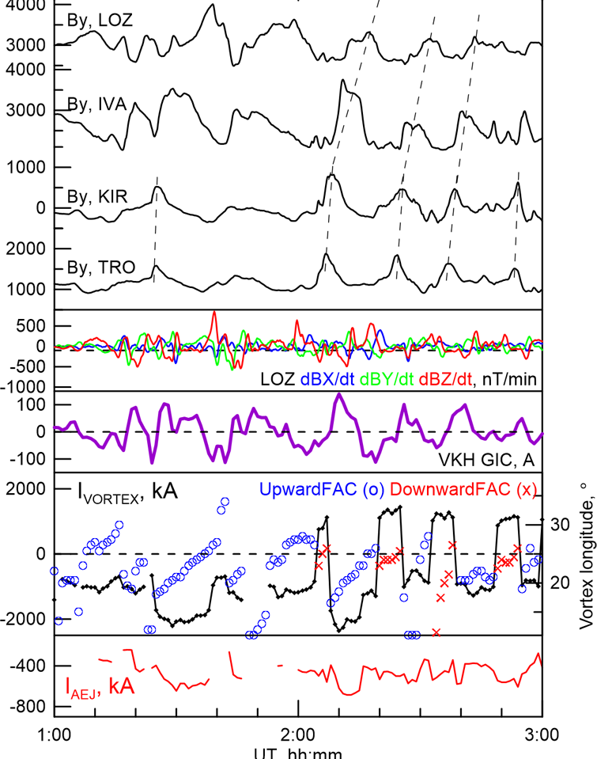
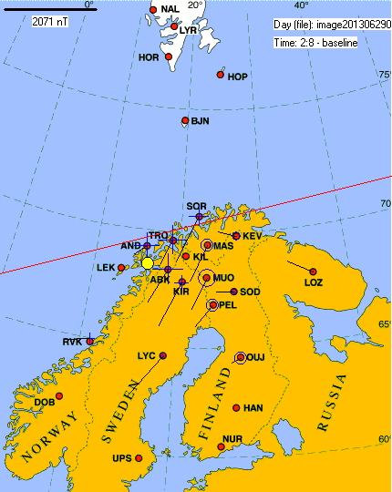
Vortex center & amplitude
FAC changes its sing and conserves amplitude
Eastward motion 1-2.5 km/s

Slide 8
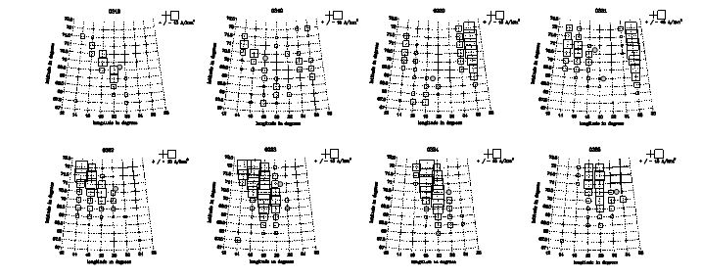
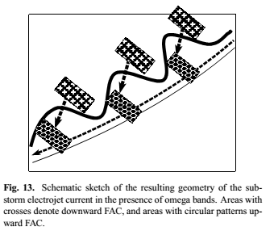
Omega bands and FACs
Pairs of FAC upward + downward
Attached to every drifting omega Amm et al. 2005

Slide 9
Temporal vs spatial derivative
Total dB/dt up to 15nT/s directly from KIR,IVA,LOZ recordings
(Vgrad)B ~ 1.5-10 nT/s obtain as V~0.5-2 km/s gradB 3-5nT/km
Both terms are comparable!

Slide 10
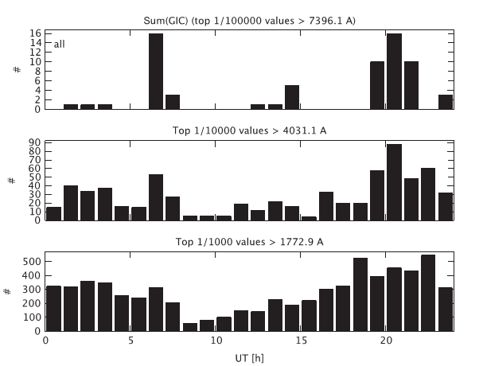
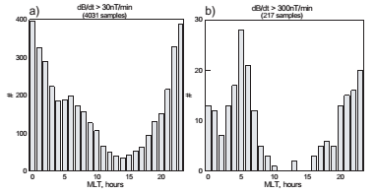
Large GIC and dB/dt occurrence
Apatenkov et al 2004
Morning maxima
Pulsations?
1 substorm –> 5-10 Ωs
Viljanen et al. 2014, Vorobjev et al. 2019

Slide 11
Conclusions
The largest GIC at VKH related to auroral omega bands
Ionospheric currents include eastward moving vortices with alternate signs
Spatial term ≥ temporal term in total time derivative

Slide 12
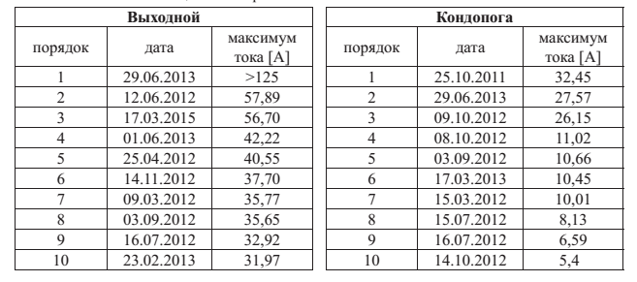
Largest GIC at VKH and KND
> 50% in morning MLT
Streamers or omegas can be found in DMSP SSUSI
Rest 50% is pre-midnight and dayside. During huge oval intervals

Slide 13
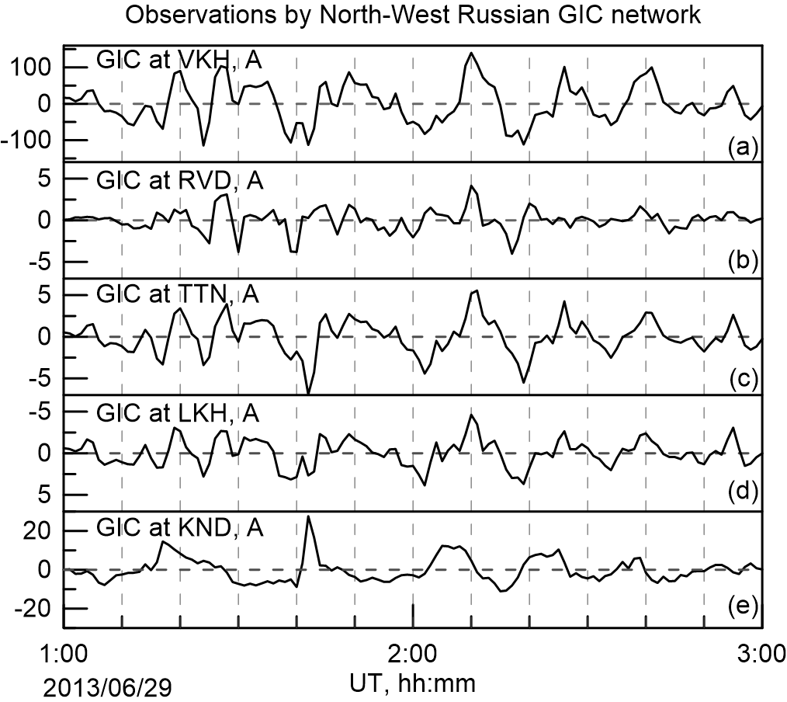
GIC at other stations

Slide 14
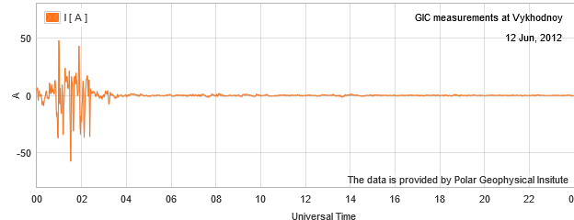
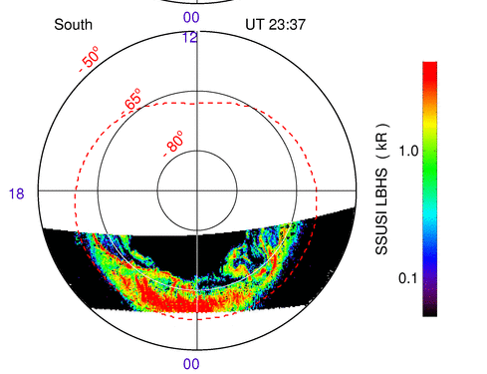
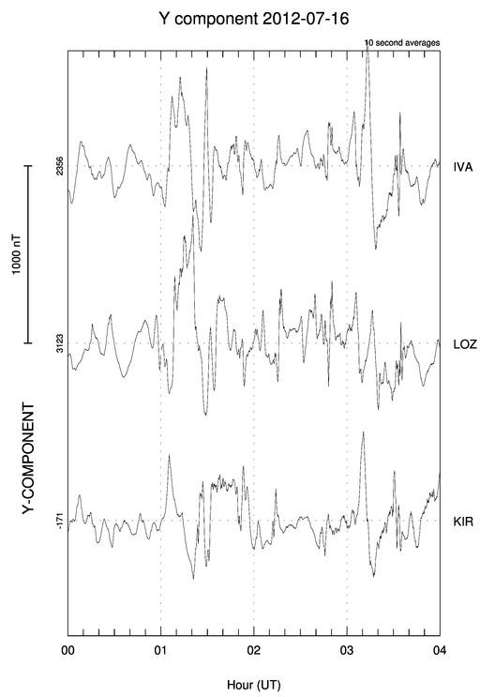
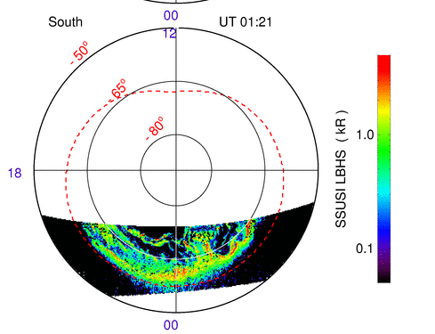
DMSP and IMAGE

Slide 15
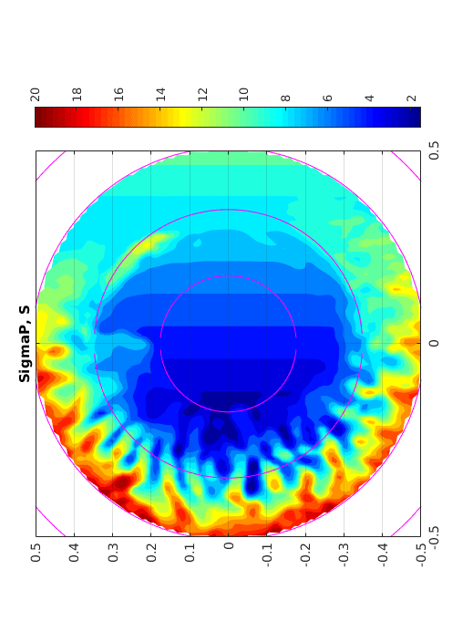
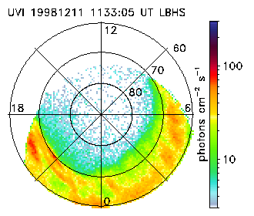
25 minutes of convection

Slide 17
