Slide 1
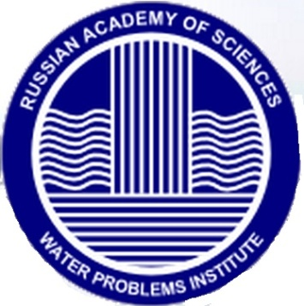
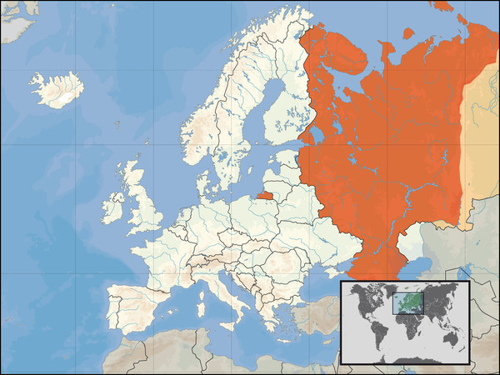
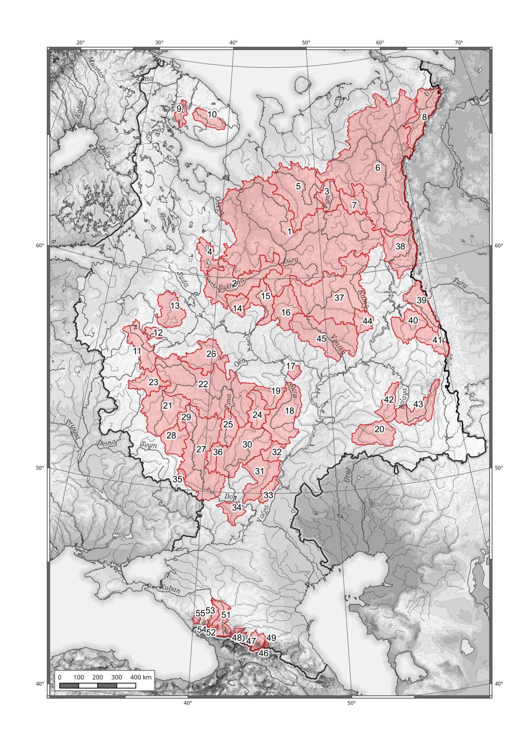
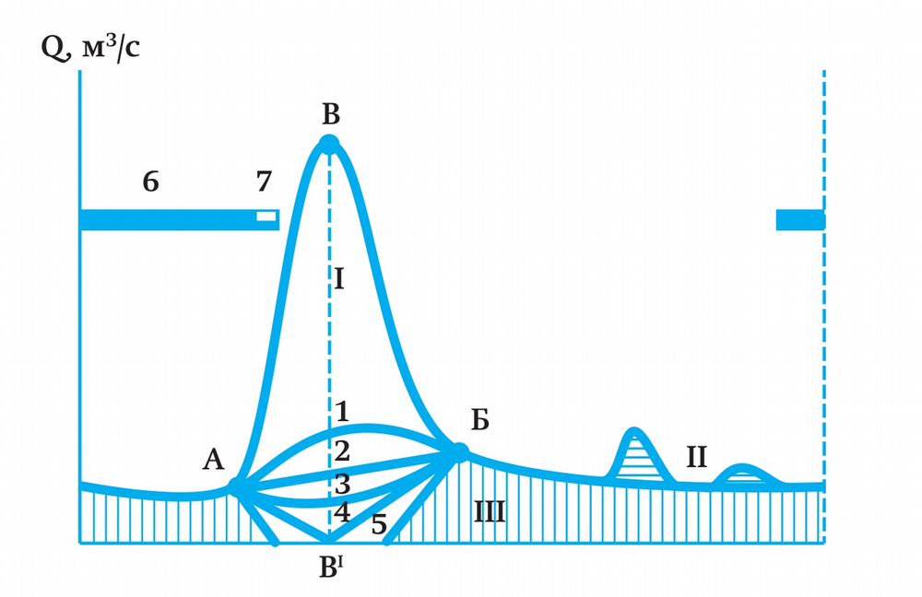
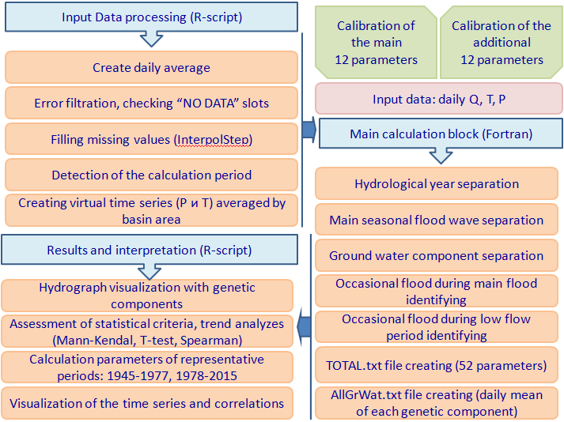
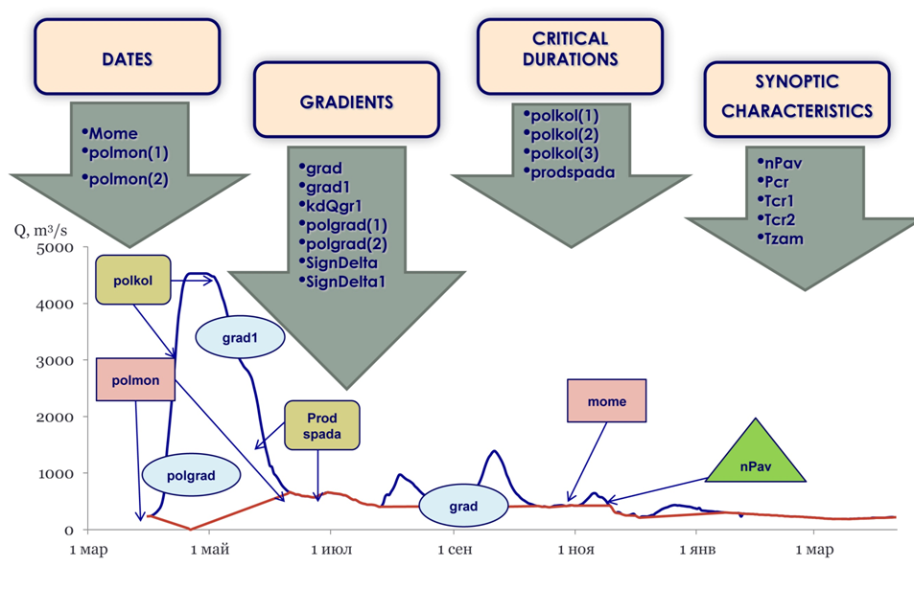
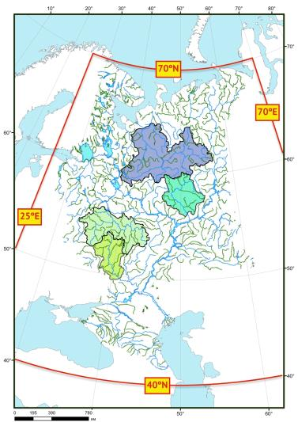
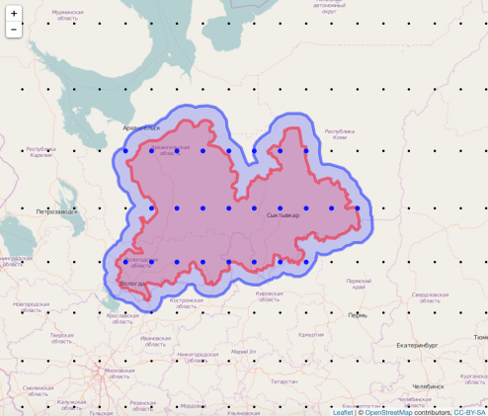
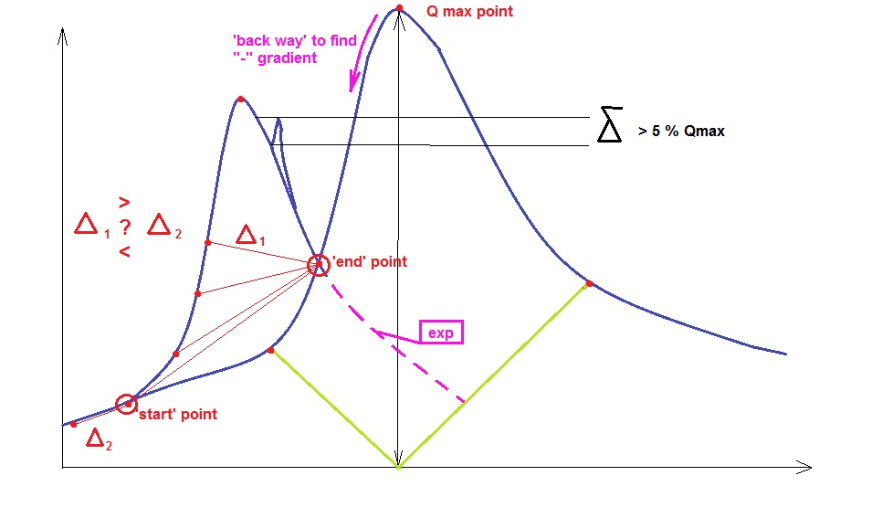
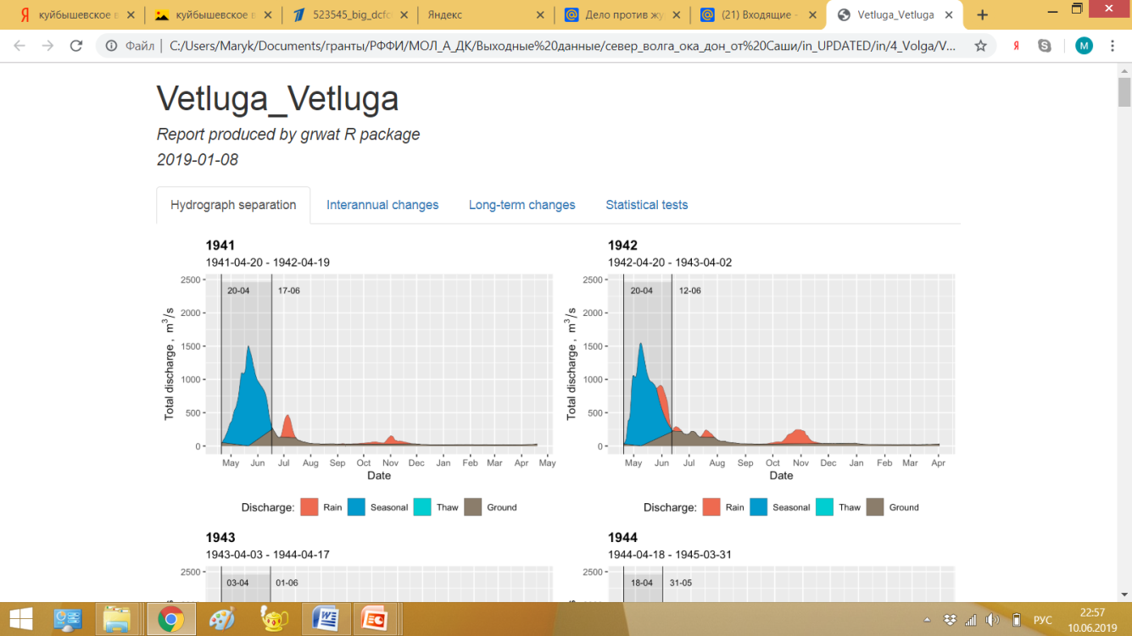
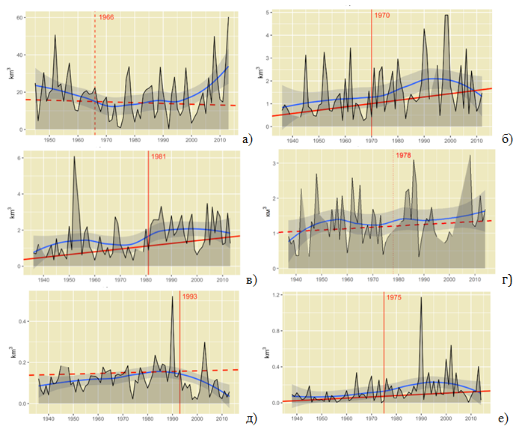
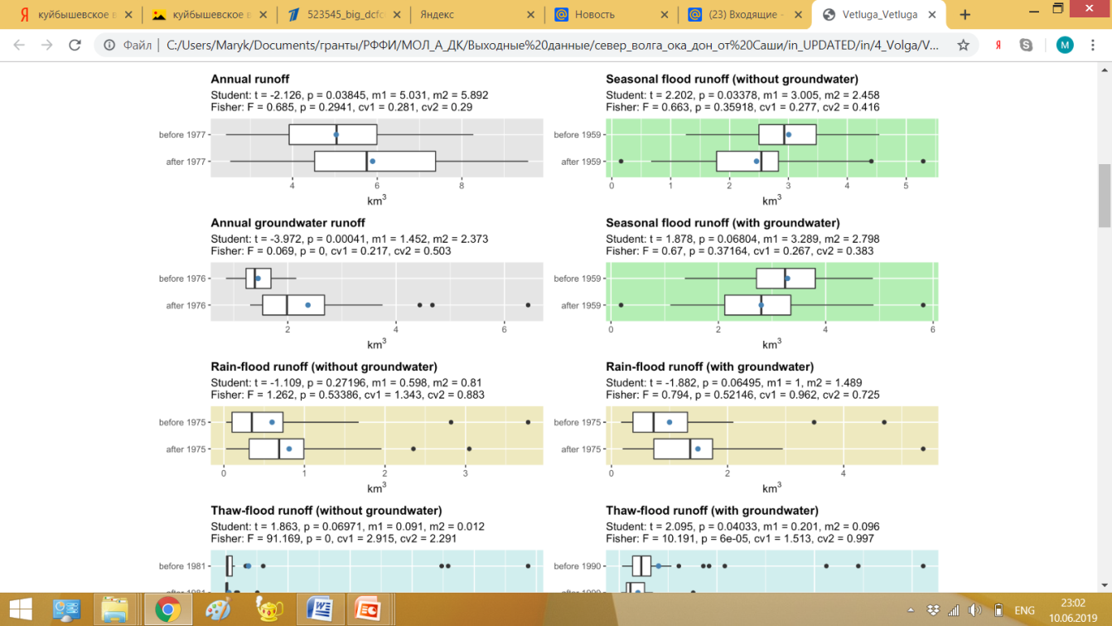
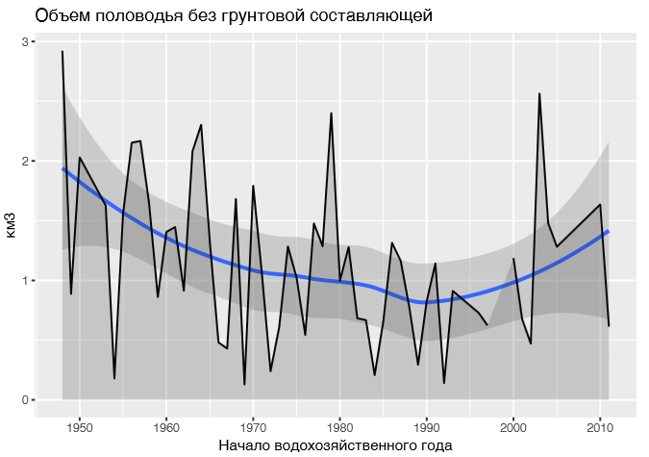
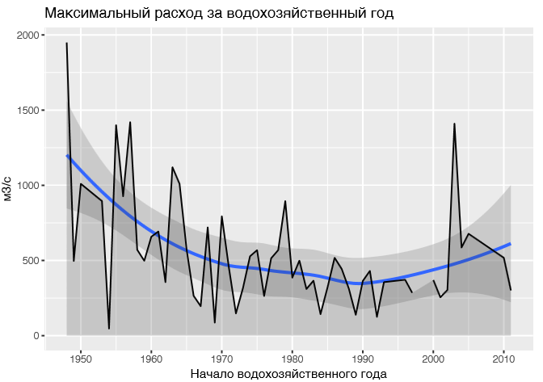
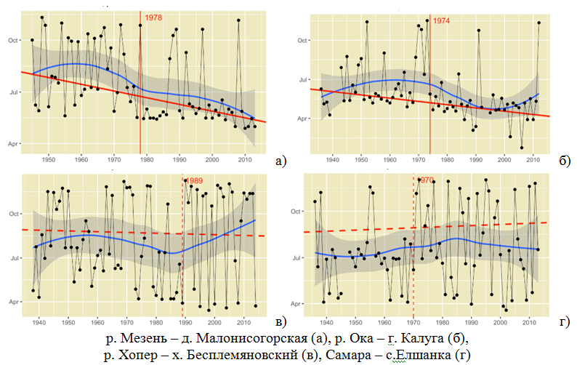
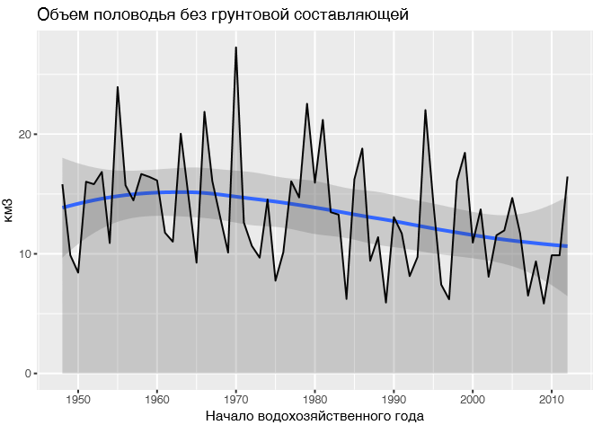
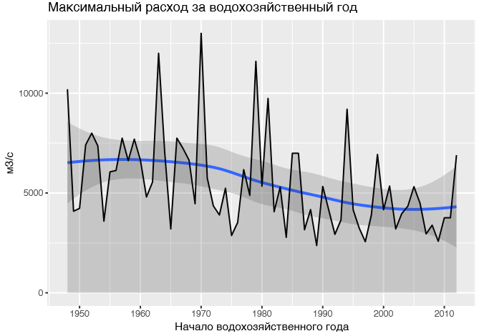
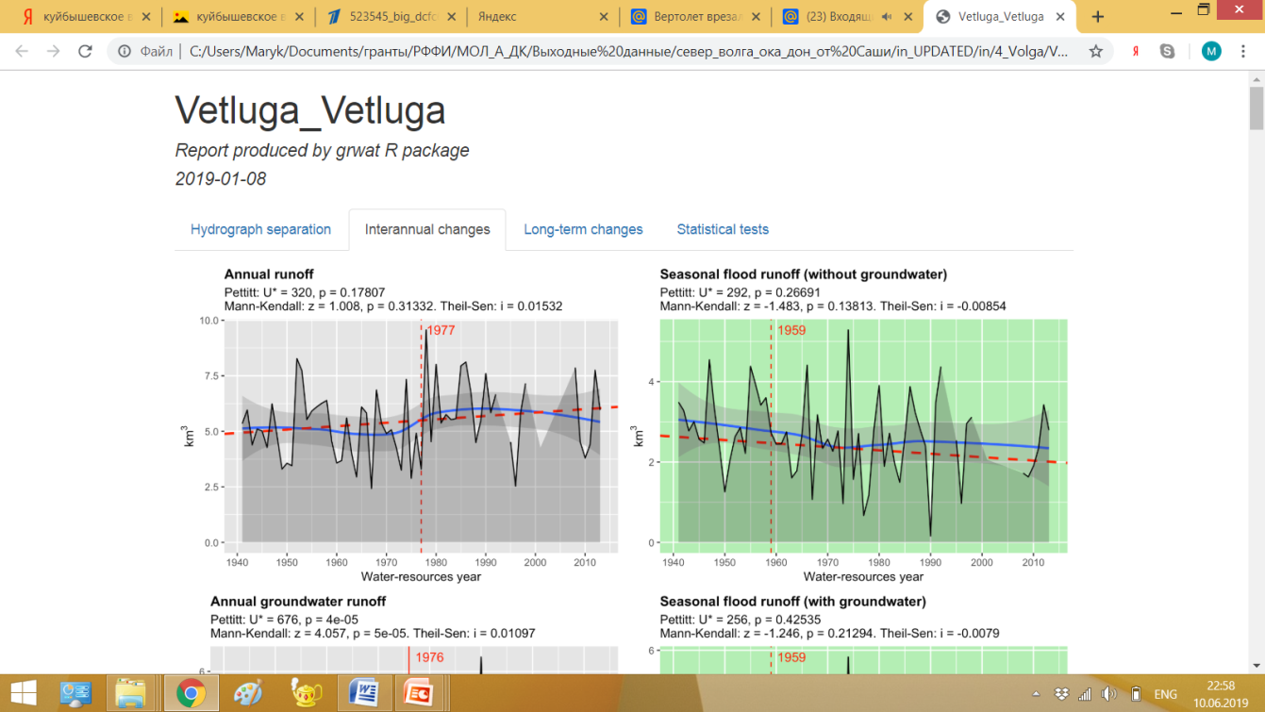
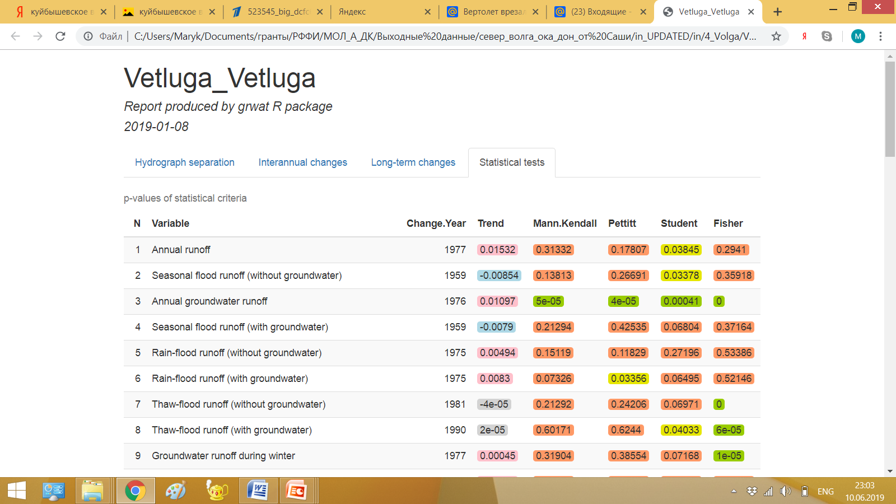
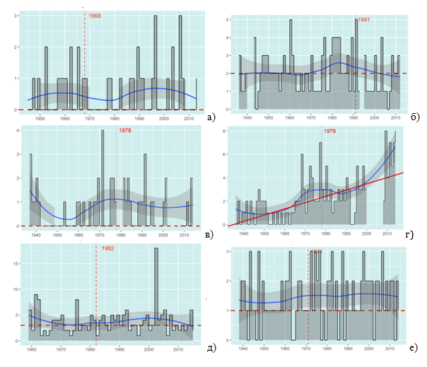
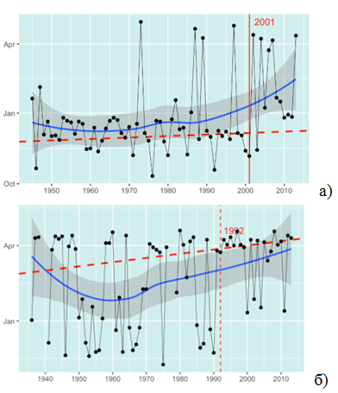
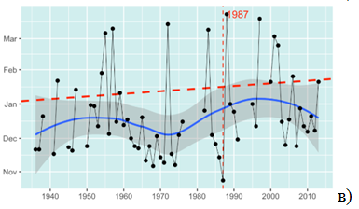
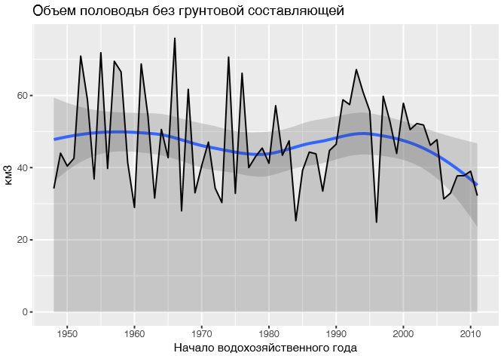
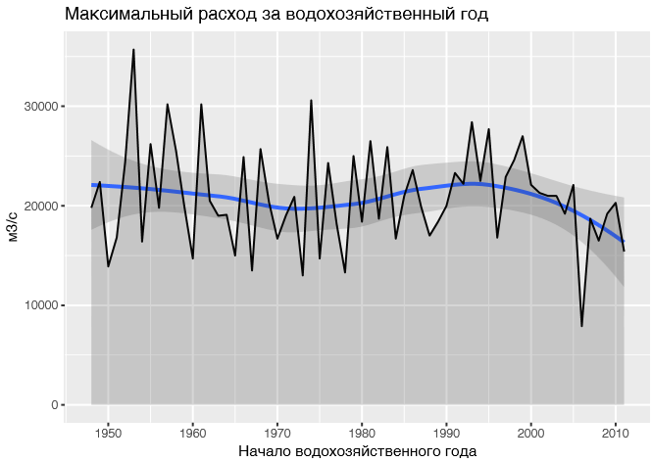
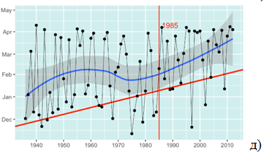
Lomonosov Moscow state university, Faculty of Geography, Hydrology Department
Water Problems Institute, Russian Academy of Science
Using automatic hydrograph separation approach to widen the amount of river runoff
characteristics for water regime transformation analysis
by Ekaterina Rets, Maria Kireeva and Timofey Samsonov
MAIN GOAL: to estimate contribution of different nourishment sources and phases of water regime to river hydrograph formation and maximum runoff in particular
OBJECTIVES:
To investigate different hydrograph separation methods for the plain rivers on European part of Russia
To create a universal algorithm, based on graph analytics and complex hydro-meteorological analyses
To verify the separation algorithm for 35 watersheds and to analyze changes of main hydrological parameters in recent hydro climate conditions
DATA:
Daily discharge for 55 representative watersheds for 1945 - 2017
Daily NOAA-CIRES 20th Century Reanalysis V2 (1945-1978) and ERA-Interim Reanalysis data for temperature and precipitation
Similar algorithms, realized in international practice (software: BFI+, FlowComp, WHAT, RC)
1
Principal scheme of hydrograph separation
2
Created algorithm of automatic hydrograph separation (GrWat)
Assumed mechanisms
Zero ground water input during the day of the Q max
Linear interpolation of ground water discharge from start to the
end of seasonal flood wave
Well-pronounced seasonal flood wave (> 50 % of the runoff)
Uncertain form of seasonal flood wave with overlapping rain
Stable summer-autumn low flow period
Autumn occasional flood period
Principal scheme of GrWat algorithm with 3 main blocks
Main blocks Main groups of calibrated parameters
The use of the reanalyze data to identify rain and snow melt peaks
Theoretical approach
East-European type of water regime and
hydrograph separation according to Kudelin (1973)
The study has been carried out with the support of the Russian Science Foundation [Project No. 19-77-10032]
Ground water
Rain water
1-4: different types of connection between surface water and ground water layers
(Kudelin, 1967)
Melt water
Assumed classification of occasional floods:
Separation of thaw peaks overlapped on the main seasonal-flood wave
Thaw floods during cold period
Thaw floods overlapping on main seasonal flood wave
Well-pronounced seasonal flood wave
Stable summer-autumn low flow period
Autumn occasional flood period
Snow melt
> 50 %
Rain floods overlapping on main seasonal flood wave
Rain
<20 %
ground
<20 %
Rain floods during warm period
3
Visualization of the results: .html report file
4
Intra annual and long-term changes of main hydrological parameters
5
Conclusions
4 main chapters in .html report file (example for riv.Vetluga – station Vetluga)
Seasonal flood wave
Seasonal flood wave
Decrease in Seasonal flood volume and increase in occasional flood volume
In recent hydro climate conditions it is very difficult to create universal algorithm for hydrograph separation
Drops in the rate of maximum annual discharge to maximum discharge during winter
Increase in duration of the deficit period
Increase in number of the flood waves
Obvious hydrograph transformation
Medveditsa – Archedinskaya (South part of study area)
Annual volume of rain occasional flood s Date of maximum discharge of rain occasional floods
Volume of seasonal flood Maximum discharge of seasonal flood
Oka – Murom (Central part of study area)
Volume of seasonal flood Maximum discharge of seasonal flood
Number of thaw occasional floods Date of maximum discharge of thaw occasional floods
North Dvina – Ust-Pinega (North part of study area)
Volume of seasonal flood Maximum discharge of seasonal flood
Basically for all station volume of seasonal flood decreased as well as snow melt maximum
Mezen (North) б) Oka (Central)
в) Khoper (South) г) Samara (East)
Volume all of occasional rain floods rise mostly and the dates of rain flood maximum in last 40 years have tendency to observed in all seasons. Number of thaw floods rise as well as their dates switch to later period
The study has been carried out with the support of the Russian Science Foundation [Project No. 19-77-10032]

