Slide 1
Assessing geo-hydrological hazards with Remote sensing data in Antananarivo (Madagascar) historical center
Ciampalini A., Frodella W., Spizzichino D., Margottini C., Casagli N.

Slide 2
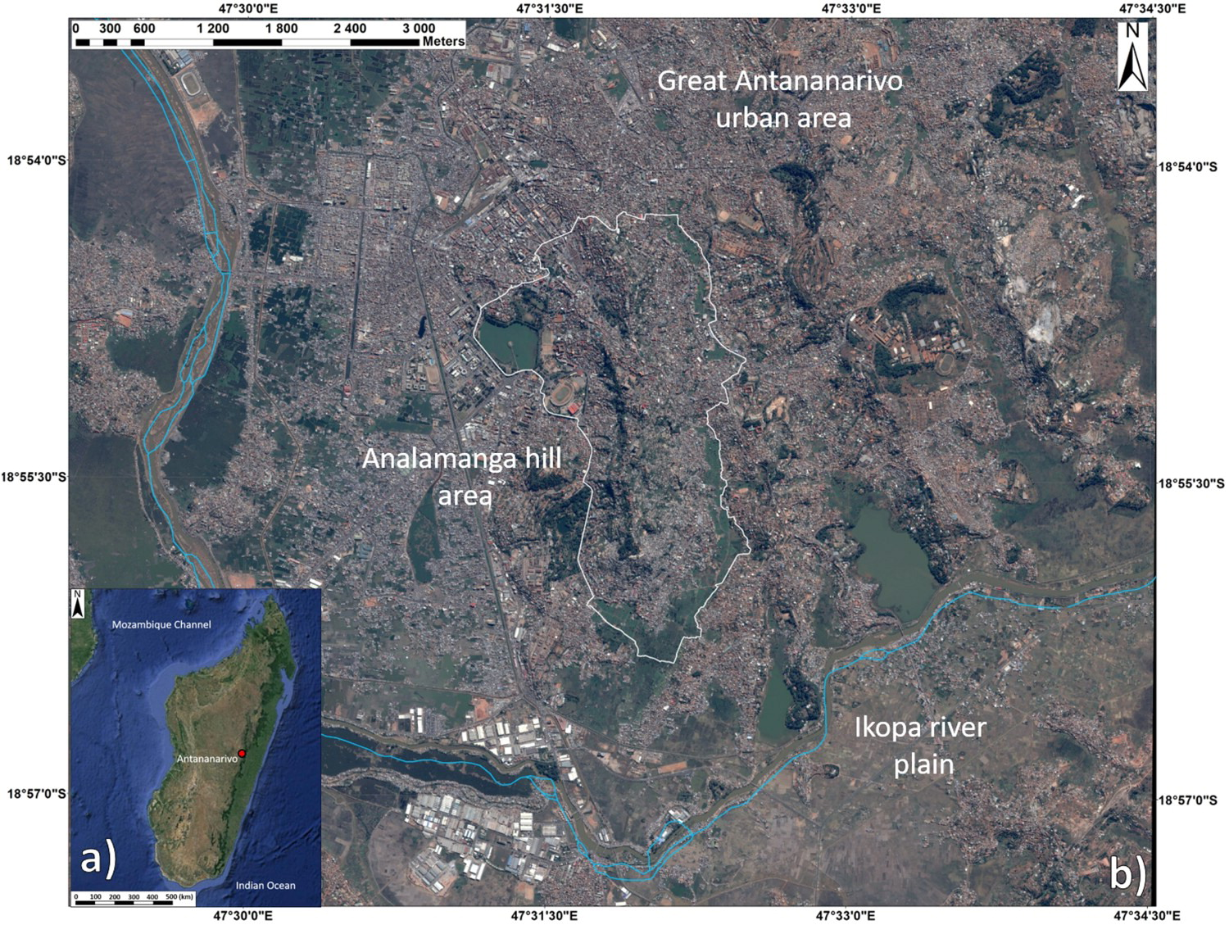
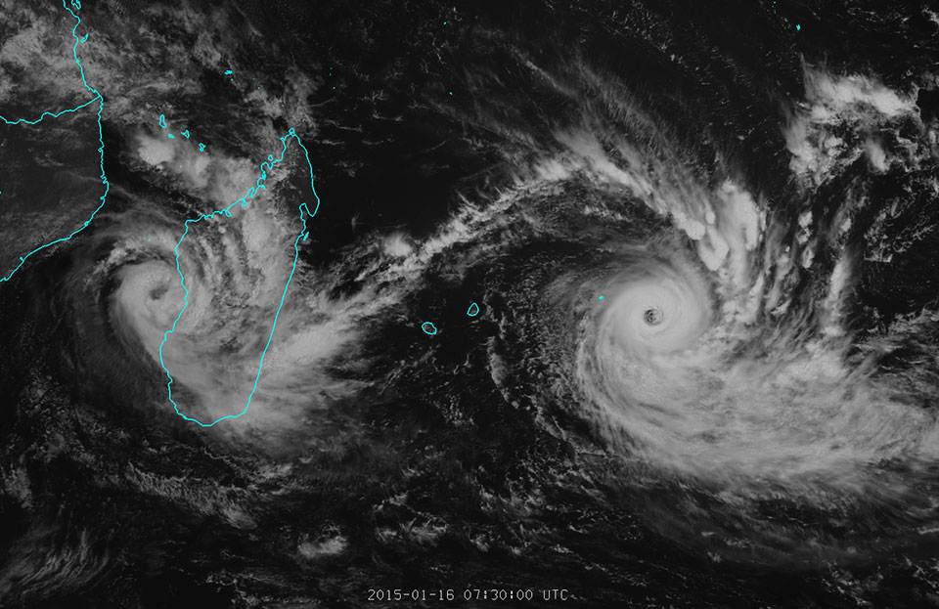
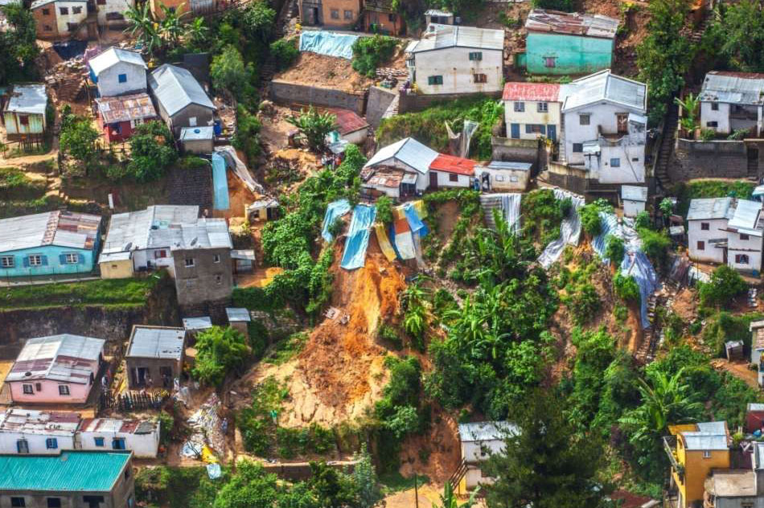
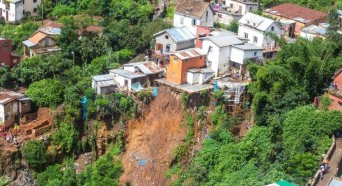
Location & Event
Study area location: regional setting (a), the city urban setting (b).
Antananarivo
b
a
c
Twin cyclones Bansi and Chedza hitting Madagascar East coast on 16 January 2015 (a) (www.eumetsat.int); aerial pictures of the triggered shallow landslides within the city on March 5th event (b, c) (BNGRC - Bureau National de Gestion des Risques et des Catastrophes).

Slide 3
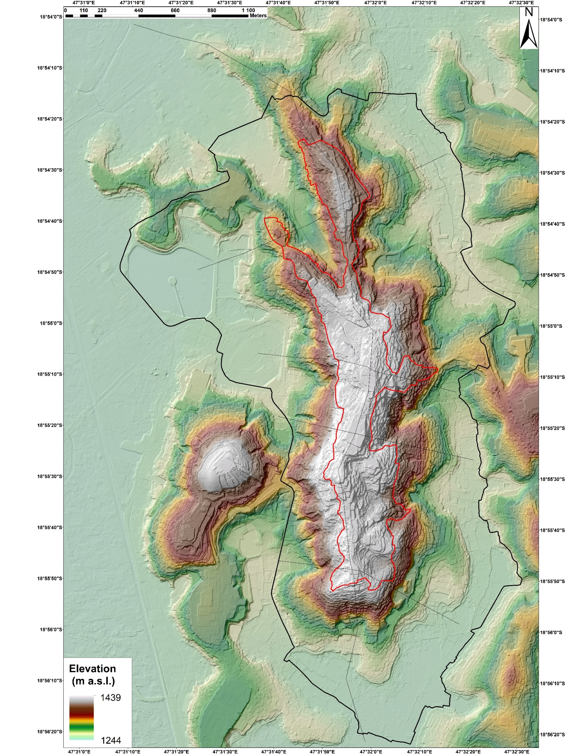
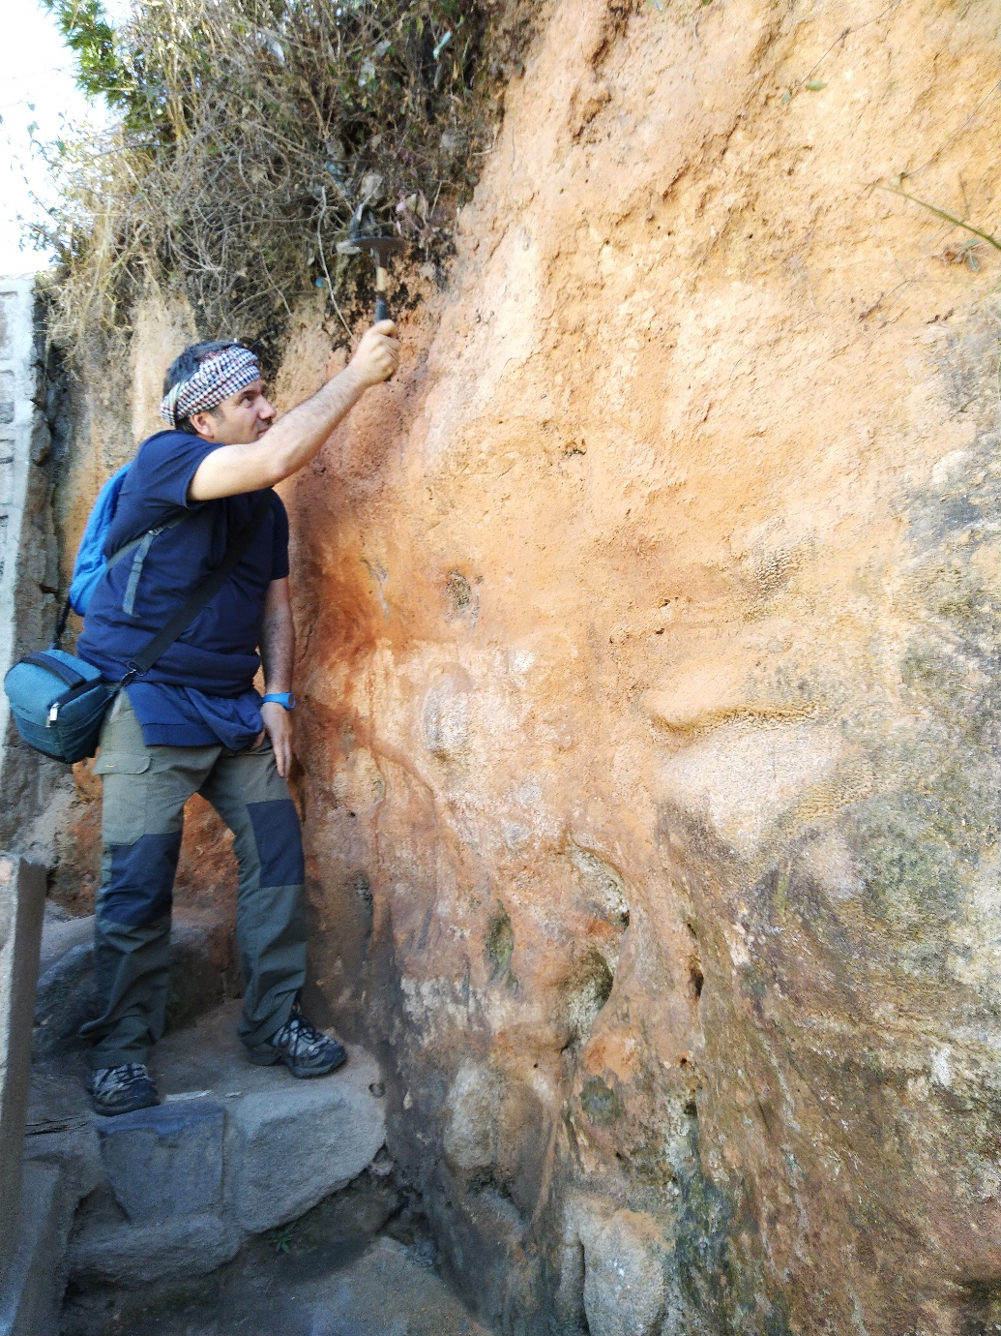
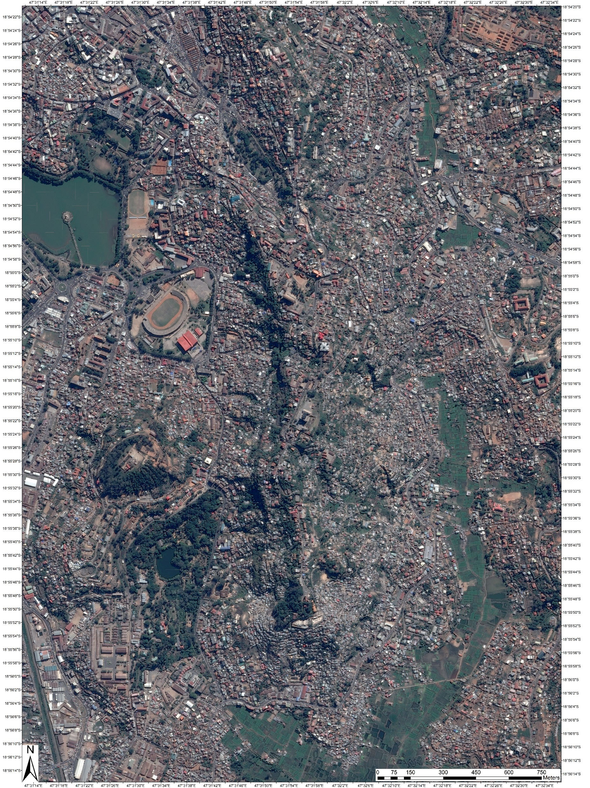
Heuristic approach: field surveys+RS
Geological surveys
Aerial lidar (1 m res.)
Pleiade-1 satellite orthofoto
(0.5 m res)

Slide 4
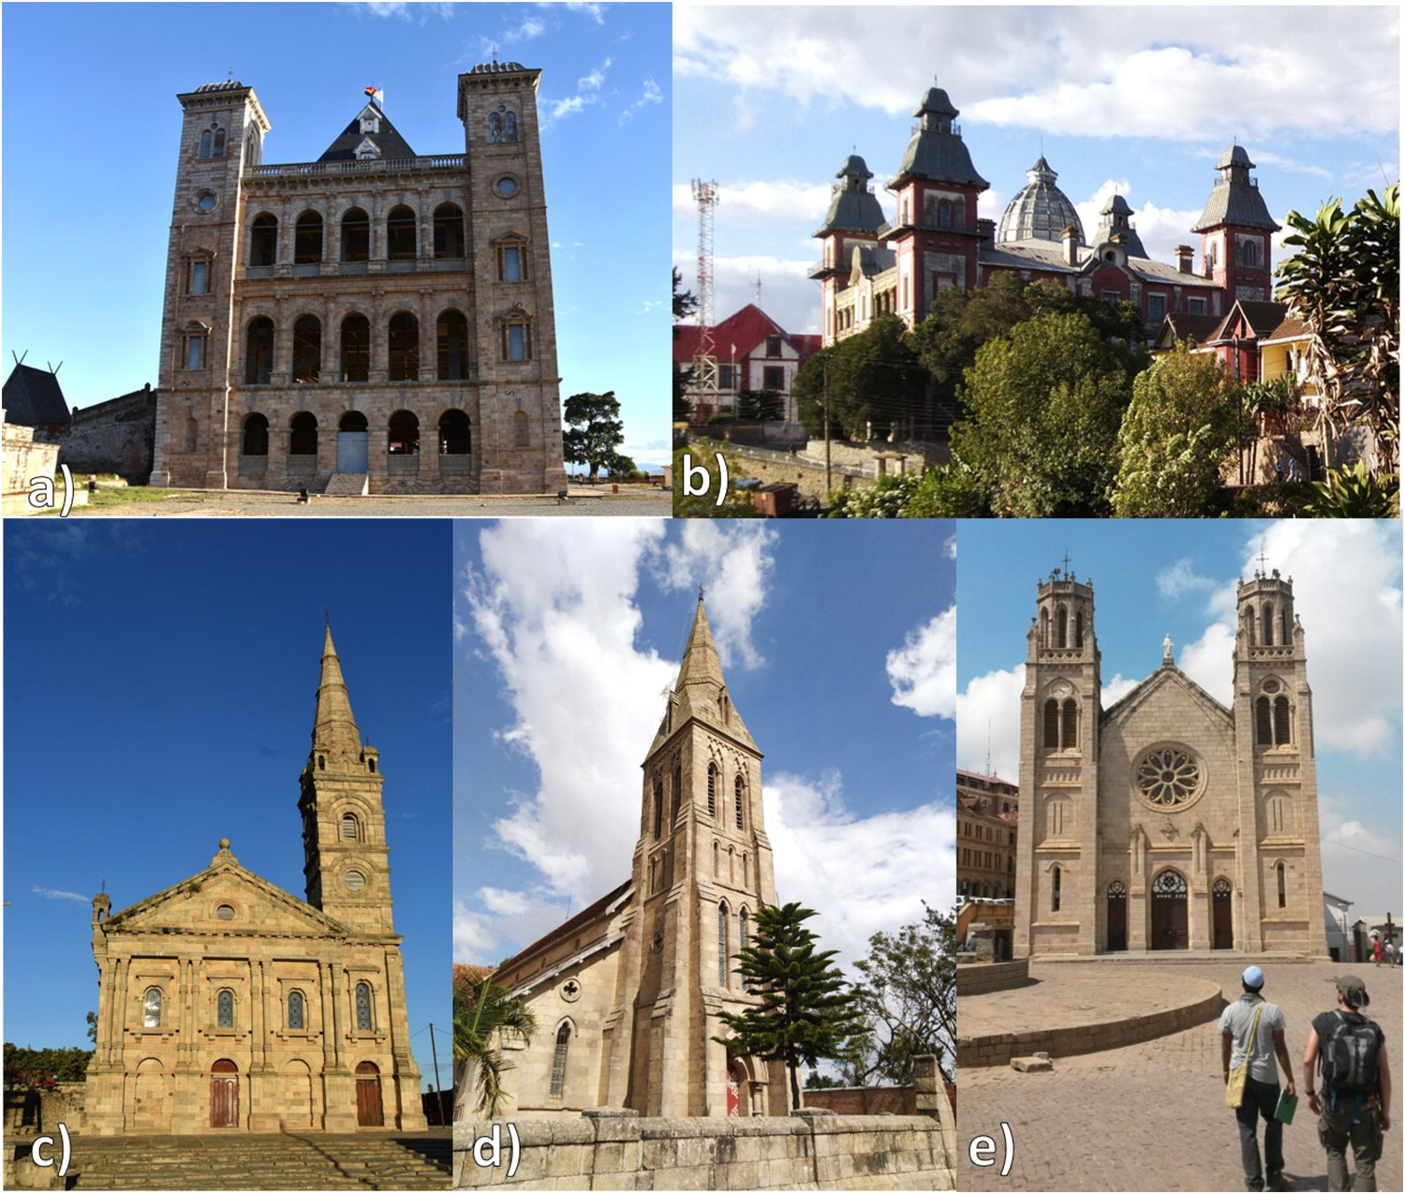
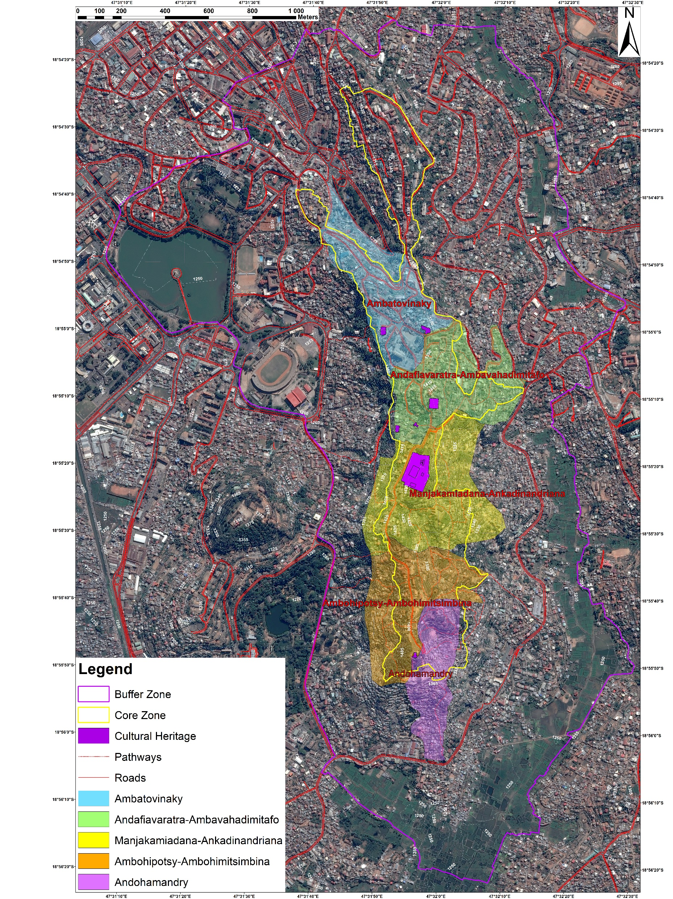
Cultural heritage of the High City
(Tentative List UNESCO)
Antananarivo historical center quarter areas, including the possible new UNESCO Core and Buffer zones. The High City cultural heritage: (a) The Rova Palace; (b) Andafiavaratra Palace; (c) The Royal Chapel; (d) Ambohipotsy Cathedral; (e) Andohalo Cathedral.

Slide 5
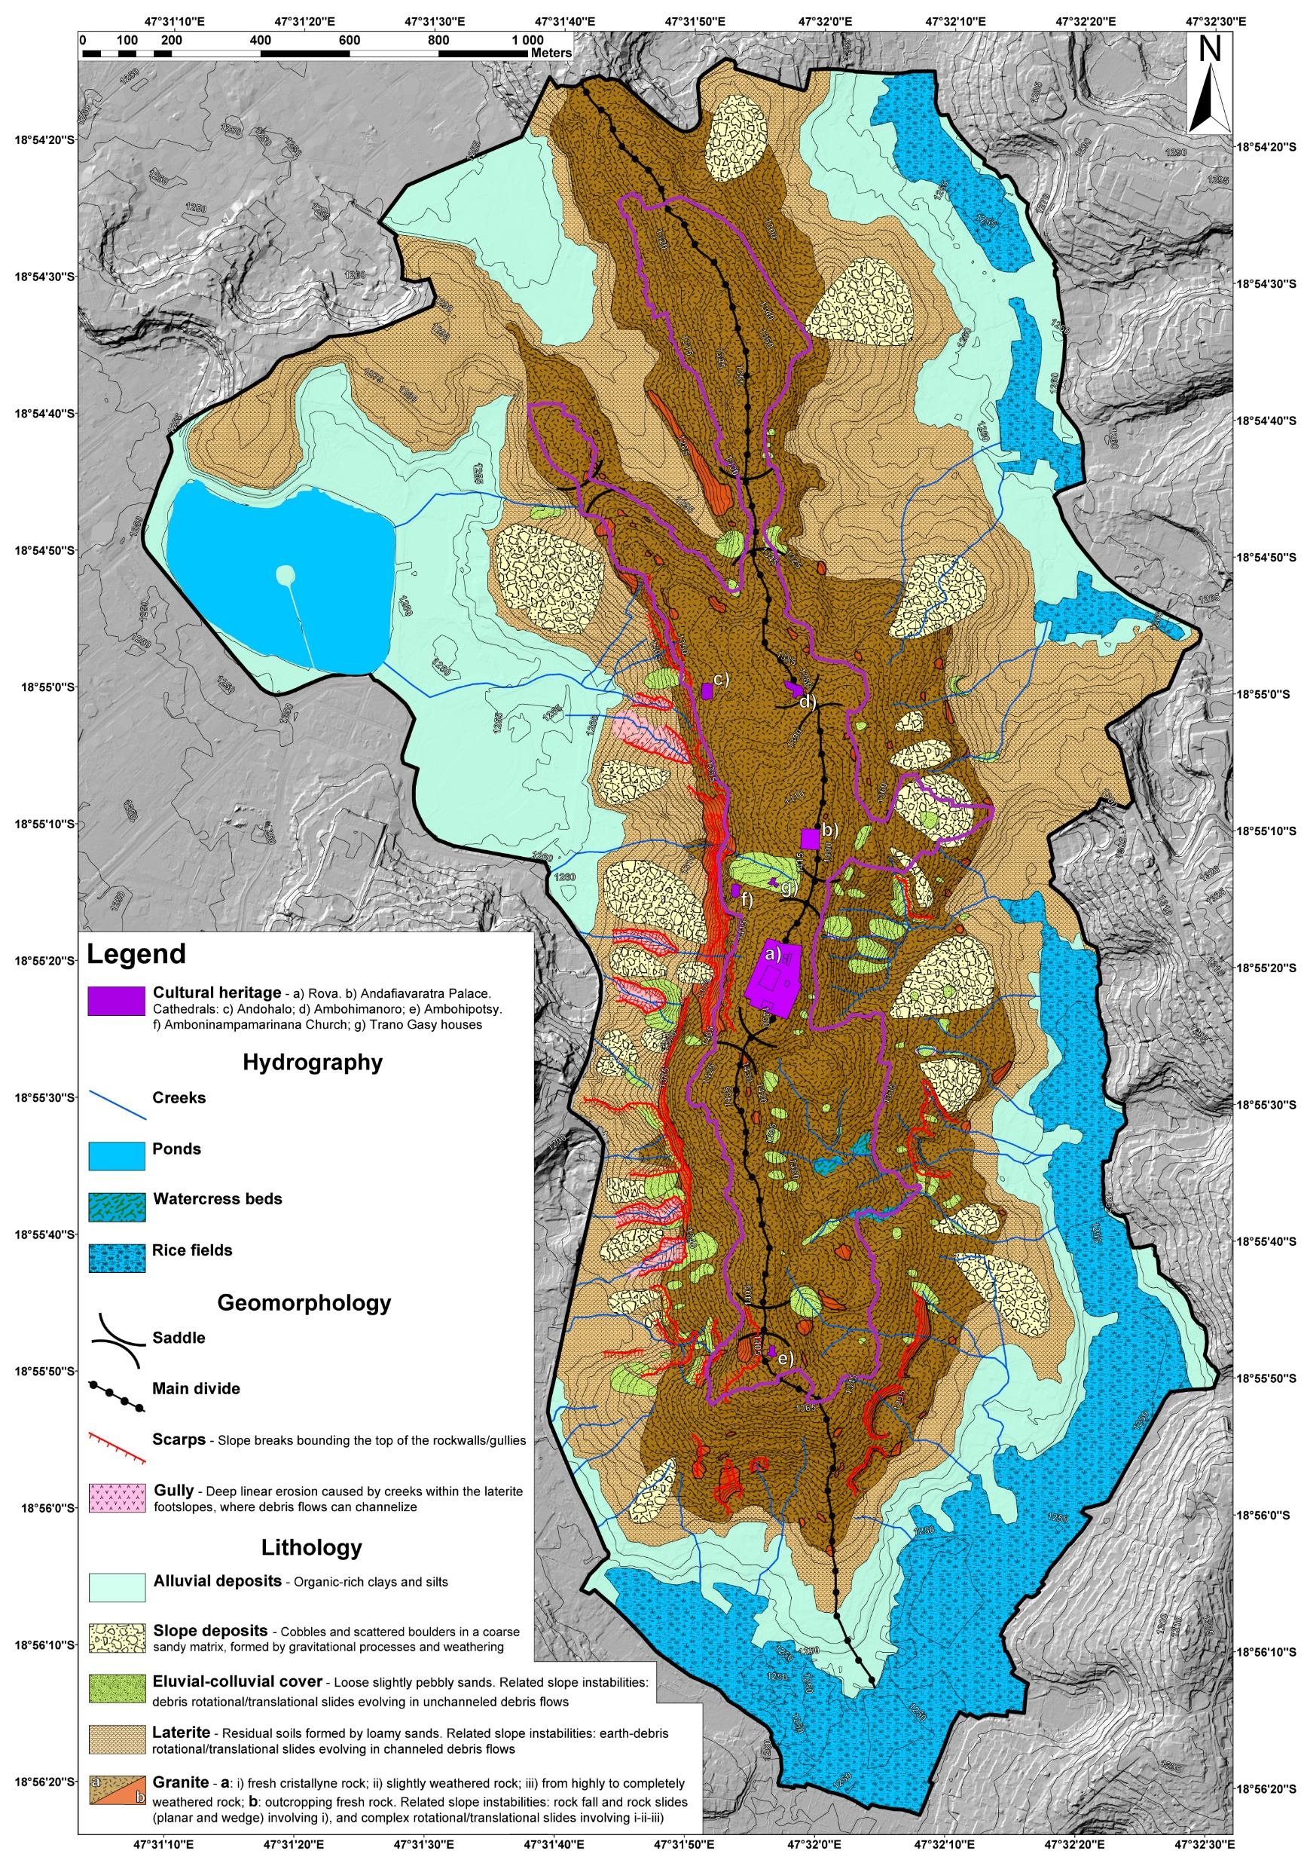
Geological and geotechnical data
Geological features of the study area: road cut showing an example of different granite weathering products (a); fresh granite (on the bottom) and limited granite (on the top) (b); laterite terrace slope cut for housing (c); eluvial–colluvial cover mixed with rubbish on vegetated slope (d); detail of heterogeneous slope deposits (e).

Slide 6
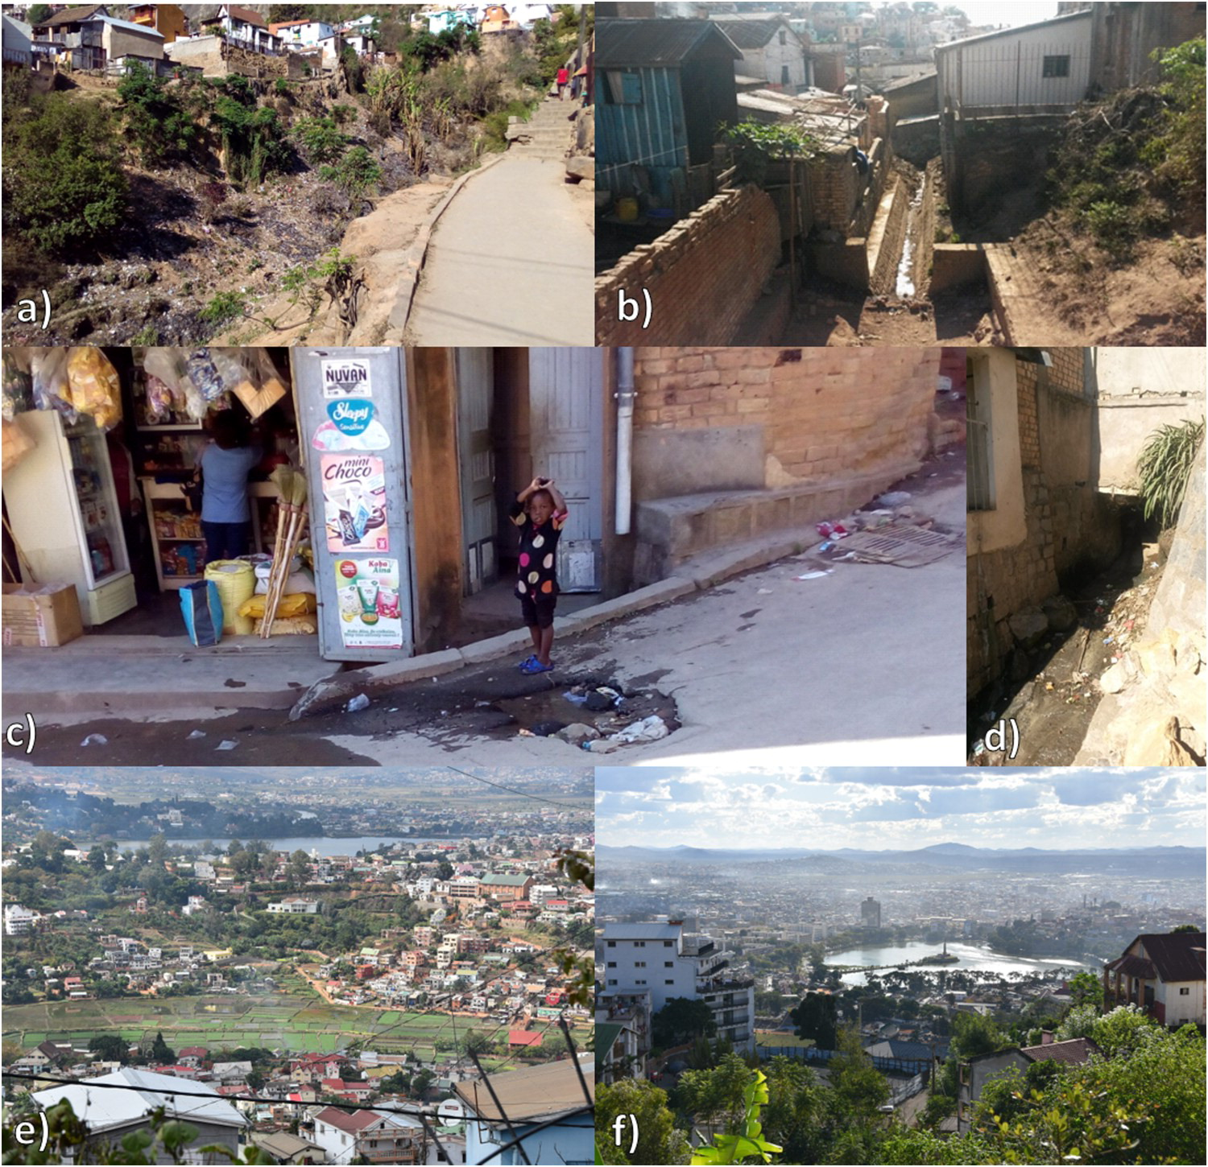
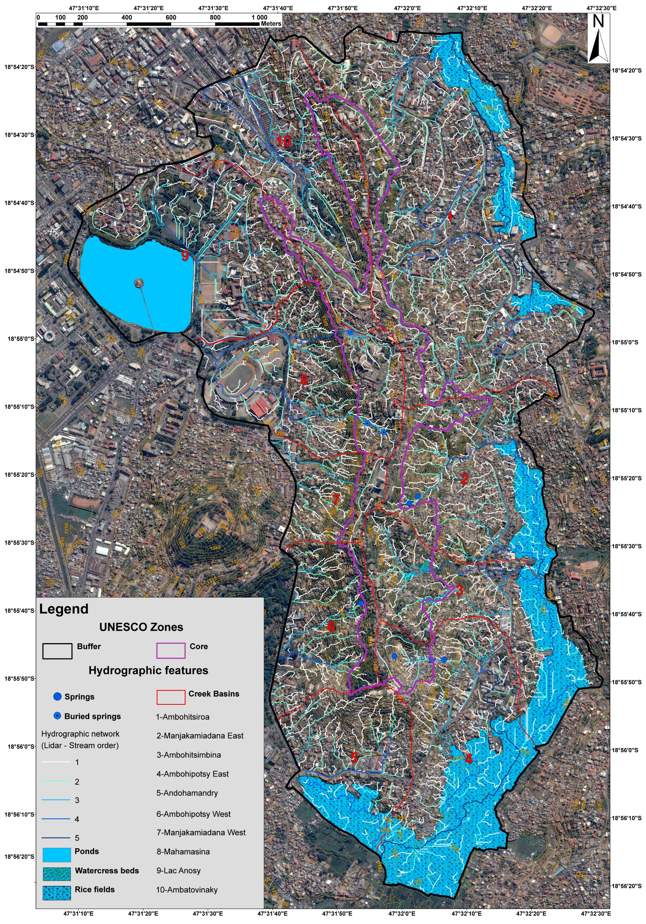
Hydrography
Natural and Urbanized features of the study area hydrographic network: Lavakas in the western footslope (Basin 7; a); narrowing by concrete buildings (Basins 6; b); Culverting causing road pavement erosion, and garage dumping filling culvert (Basin 8; c, d); Rice fields in Basin 1 (e); Lac Anosy, Basin 9; f).

Slide 7
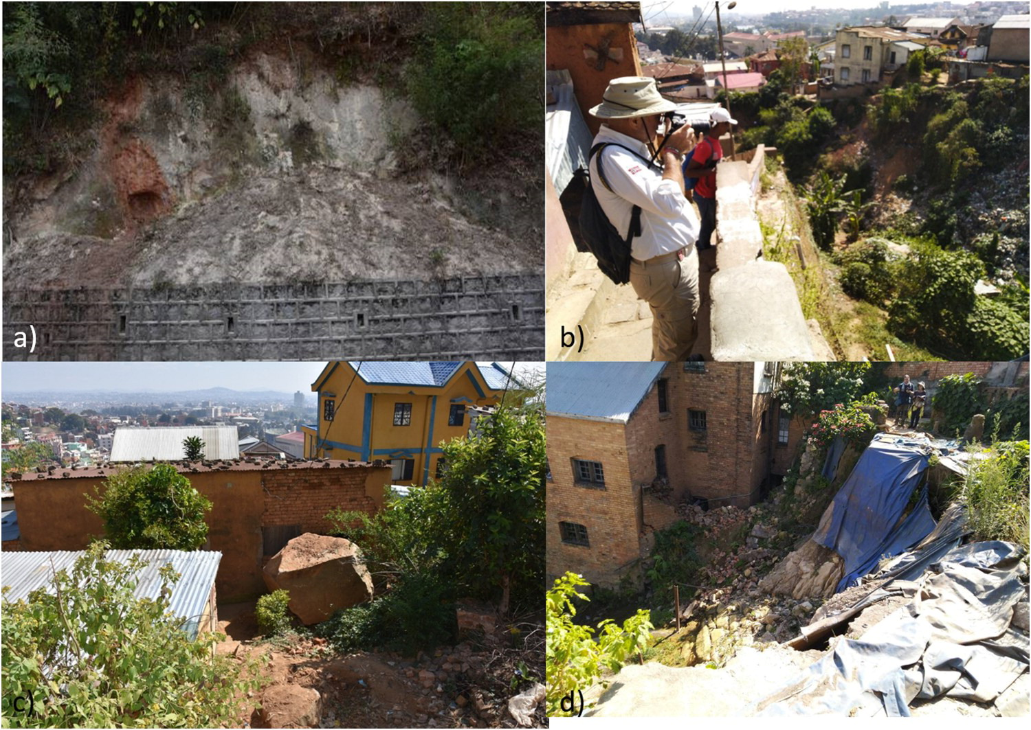
Landslide slope-scale inventory
Examples of the detected instability phenomena: (a) Debris rotational/translational slides; (b); Earth-debris rotational/translational slides; (c) Rock fall and rockslides; (d) Complex rotational/translational slide.

Slide 8
Acknoledgements
References
Ciampalini, A., Frodella, W., Margottini, C., & Casagli, N. (2019). Rapid assessment of geo-hydrological hazards in Antananarivo (Madagascar) historical centre for damage prevention. Geomatics, Natural Hazards and Risk, 10(1), 1102-1124.
Frodella, W., Spizzichino, D., Ciampalini, A., Margottini, C., & Casagli, N. (2020). Hydrography and geomorphology of Antananarivo High City (Madagascar). Journal of Maps, 1-12.

