Slide 1
Modeled based analysis of fish farm emissions impact on the fjord biogeochemistry
Anfisa Berezina^{1,2}, Evgeniy Yakushev^{2,3}, Phil Wallhead³
¹Institute of Earth Sciences, St. Petersburg State University, St. Petersburg, Russia
²Laboratory of land-ocean interactions and the anthropogenic impact, Shirshov Institute of Oceanology, Russian Academy of Sciences, Moscow, Russia
³Section of oceanography and biogeochemistry, Norwegian Institute for Water Research, Oslo, Norway

Slide 2
Introduction
Fish farming industry faces challenges connected with environmental management of aquaculture sites. It is important to investigate the potential impacts of increased concentrations of nutrients, pharmaceuticals and waste products on the coastal marine environment.
Models are a cost-effective method to evaluate impacts of site selection and production levels on the environment and can be used in Environmental Impact Assessments (EIAs).
We used the Bottom RedOx Model model (BROM, Yakushev et al., 2017) with detailed treatment of redox biogeochemistry coupled with the 2-Dimensional Benthic-Pelagic transport model (2DBP). We argue that the simplified 2D spatial setting is potentially useful for exploring mechanisms of biogeochemical impacts and for helping to guide general policy on fish farm emissions.
In this work, the model is calibrated using field data collected in Hardangerfjord, one of the largest salmon farming areas in Norway, in August 2016.

Slide 3
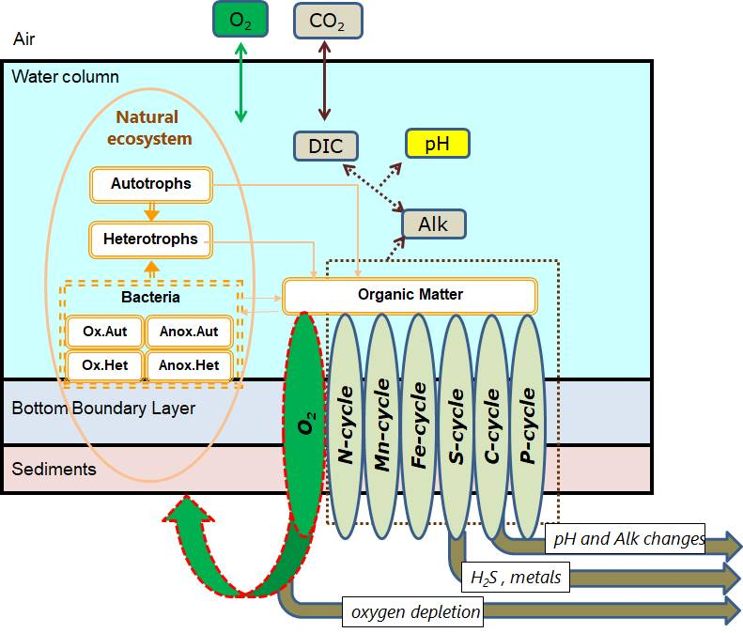
BROM
The benthic–pelagic biogeochemical model BROM combines a relatively simple ecosystem model with a detailed biogeochemical model for the water column, benthic boundary layer, and sediments, with a focus on oxygen and redox state.
BROM considers interconnected transformations of chemical species (N, P, Si, C, O, S, Mn, Fe) and resolves organic matter (OM) in nitrogen currency following Redfield ratios between the main nutrients.
Schematic representation of the Benthic RedOx Model (BROM) biogeochemical processes considered and the model’ domain.

Slide 4
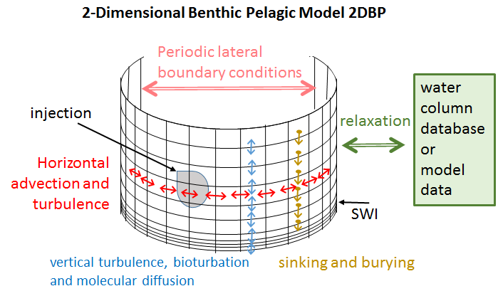
2DBP transport model
The 2-Dimensional Benthic-Pelagic model (2DBP) simulates vertical and horizontal transport of particulate and dissolved matter in the water column and upper sediments at small horizontal scales (10-1000 m).
Vertical grid resolution varies from meters in the water column to several cm in the BBL and increases from less than 1 mm below the sediment-water interface (SWI) to several cm deeper in the sediments.
Horizontal resolution: from 25 at the center of the transect to 250 m in its periphery.
Scheme of the 2-Dimensional Benthic-Pelagic model (2DBP).

Slide 5
Hardangerfjord. Fish farm location
Hardangerfjord is a sill fjord (depth of sill 150 m) located on the southern-western coast of Norway. 179 km long, maximum depth = 860 m. The fjord system is well aerated and bottom water is in oxic conditions.
Field surveys to assess the biogeochemical structure of the water column and the sediments potentially affected by cage aquaculture were performed.
Water samples were taken near five fish farm installations (at 20 m, 200 m and 500 m distance) and in the middle of the fjord, whereas sediment samples were collected from the southernmost station only.
Position of stations during the cruise to the Hardangerfjord 25-26.08.2016

Slide 6
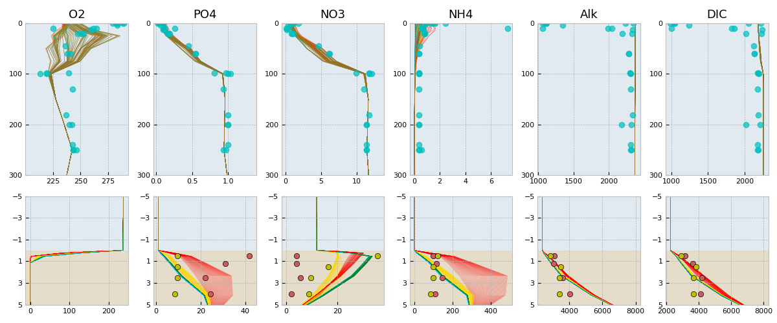
Modelled and observed vertical distribution
А
B
C
D
E
F
Modelled and observed vertical distribution of dissolved oxygen (A), phosphate (B), nitrate (C), ammonium (D), total alkalinity (E), and dissolved inorganic carbon (F), in the water column and porewater. Light blue circles show concentrations observed at 300-1000 m distance from a farm in the water column. Red and yellow circles show sediment porewater concentrations observed at 100 and 500 m from a farm (stations 200 and 199 respectively). All samples were taken in August. Coloured lines show the distributions of modelled concentrations in the time interval +/-1 month relative to observations (bottom) for different distances from a farm: 100 m (red), 500 m (yellow), 900 m (green) and 1400 m (blue).

Slide 7
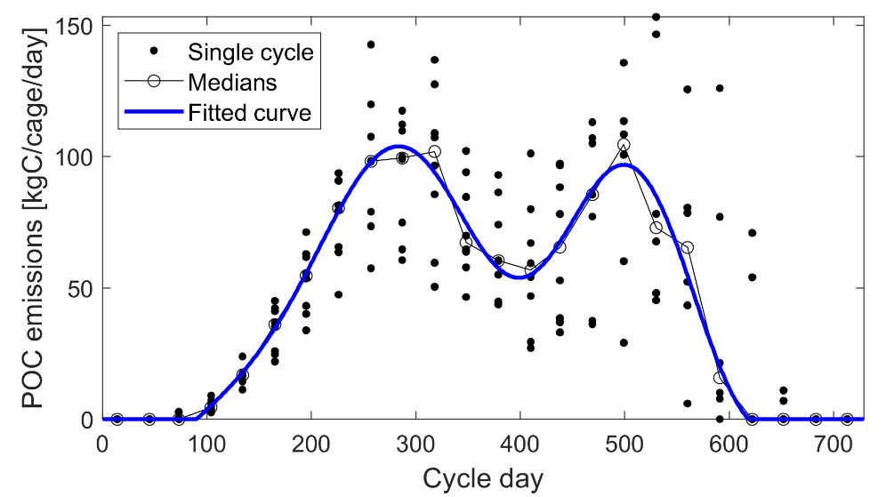
Fish farm
We modeled a single fish farm comprising 3 cages positioned in adjacent grid cells of width 25 m.
The biogeochemical fate of the fish farm waste was simulated in a specifically written FABM compatible module.
The vertical sinking speed of Waste was taken as 1000 m d⁻¹ for the dominant size class of Atlantic salmon waste particles (1-5 cm s⁻¹).
To parameterize the effect of respiration of living fish we introduced a dependence between amount of injected Waste and consumed oxygen.
A scheme of the fish farm feed fate and the Waste emission during typical 2-year long fish farm installation scenario assumed in the model.

Slide 8
Waste emission results in reduction of oxygen penetration depth
Animation of temporal variability of waste emission and oxygen concentration along the transect from the start to the end + 3 months of fish farm operation

Slide 9
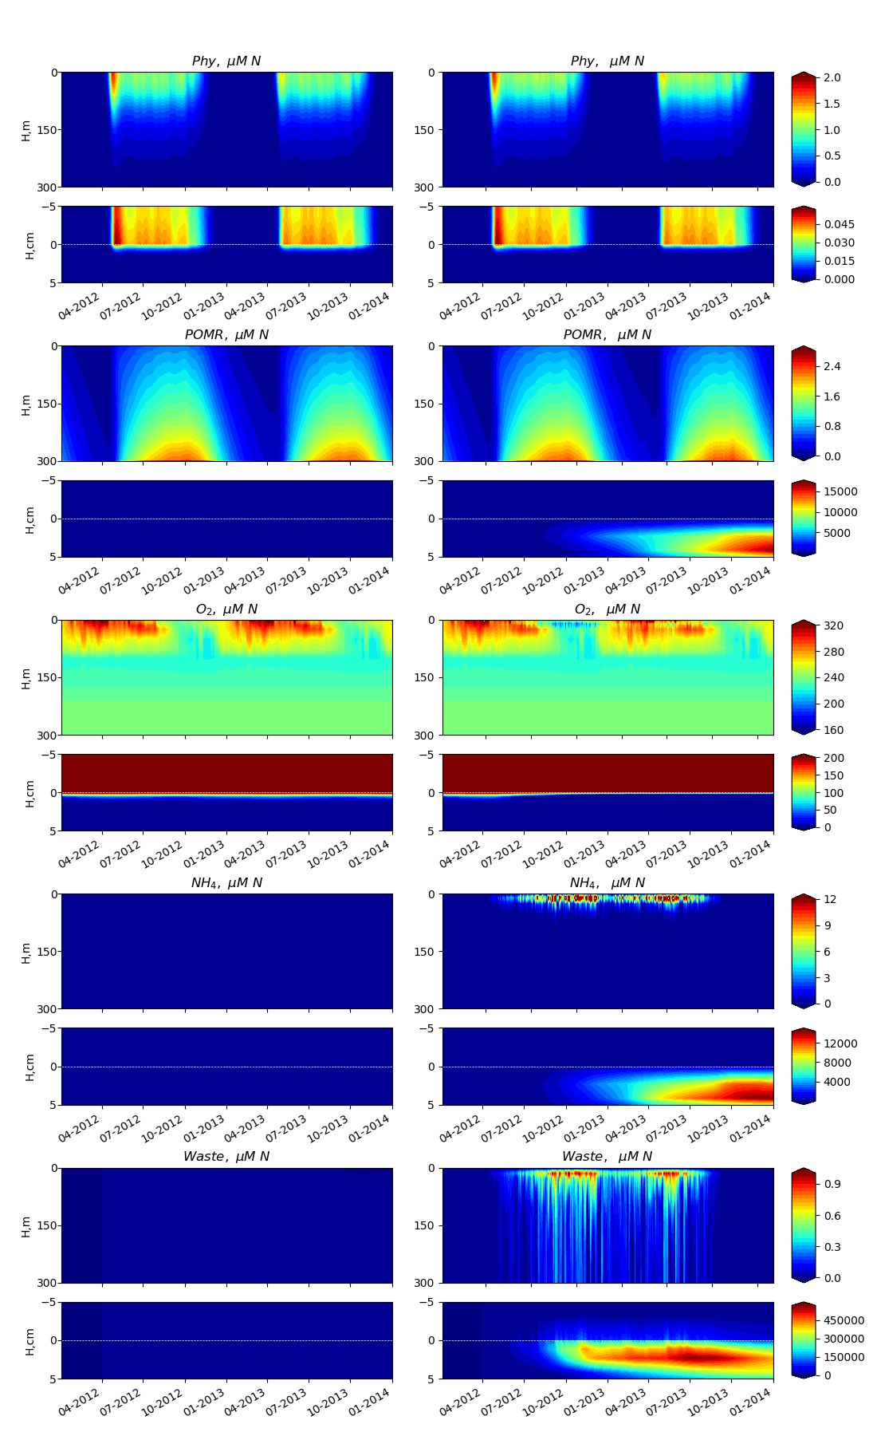
Baseline region and the fish farm variability
Baseline | Fish Farm
Baseline | Fish Farm
Variability of parameters during a 2-year period with a typical fish farm installation scenario (from April 1st first year to November 1st second year) in the baseline region and at the fish farm installation.

Slide 10
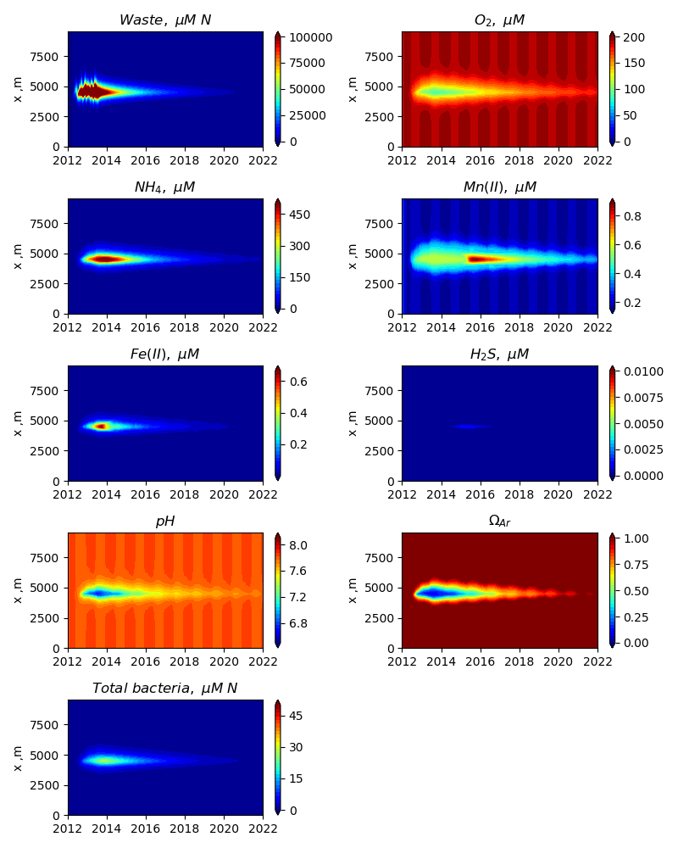
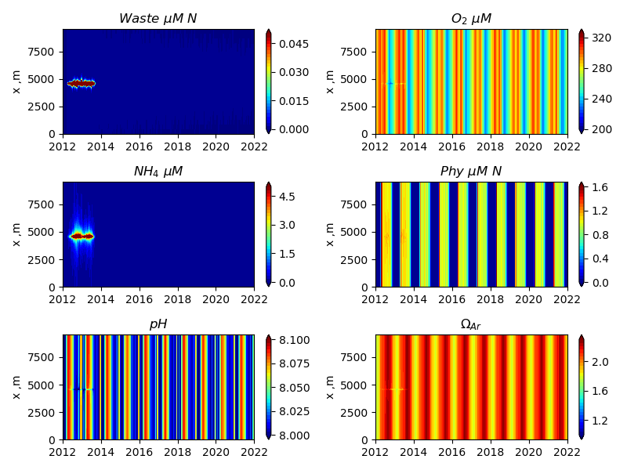
Temporal variability of model parameters at the transect through the fish farm.
10 m depth
Bottom layer

Slide 11
Temporal variability of parameters below the fish farm
Temporal variability of the model parameters during the 10 years below the fish farm operated in first 2 years.

Slide 12
Conclusions
The model describes in detail the processes of organic matter mineralization in oxygen depleted conditions that are vitally important for the prediction of the oxygen levels (i.e. denitrification, metal reduction, sulphate reduction).
The model produced profiles of oxygen, nutrients, and carbonate chemistry that were in reasonable agreement with observations. Although, further observations and modelling work is needed to rigorously define boundary conditions and to provide a strong test of the model.
We also showed how the model can be used to investigate critical levels of aquaculture-derived organic loading that can cause the formation of hypoxic and anoxic conditions in the bottom water. The 2DBP-BROM model is thus a promising tool for managing the impacts of aquaculture on local water quality and for assessing the carrying capacity of water bodies.
At present this model can not be used for licensing, but this work is a step forward to develop a component of a system for licensing first regarding the biogeochemical processes in the bottom layer.

Slide 13
Thank you!

