Slide 1

This presentation (pptx file) has been prepared for the ‘virtual’ EGU 2020 conference,
session GMPV1.1, ‘Advances in measuring and applying triple oxygen isotopes’
The presentation is based on a recent publication by the authors: Chemical Geology 532 (2020), 119332 https://doi.org/10.1016/j.chemgeo.2019.119332
Details of references cited in the presentation are given in the paper. The exception is to Wostbrock et al. (2020), which was published later:
Chemical Geology 533 (2020), 119432
https://doi.org/10.1016/j.chemgeo.2019.119332

Slide 2
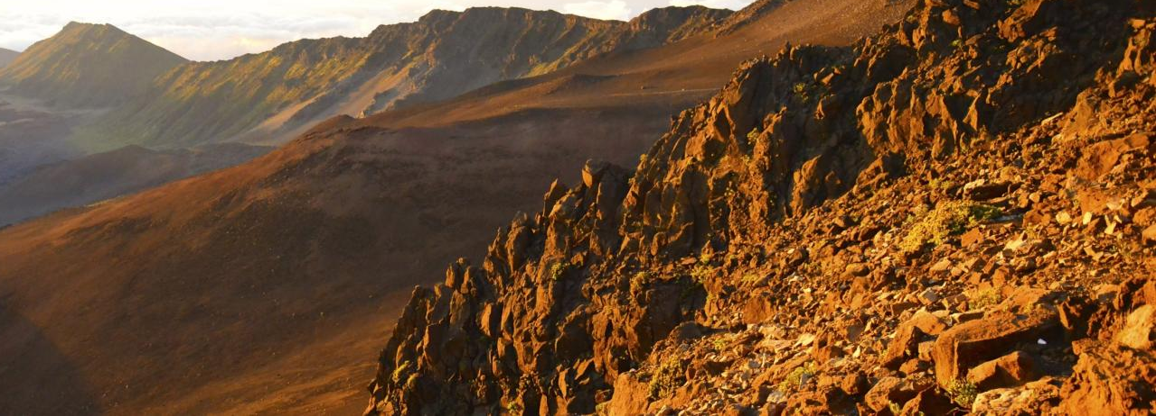



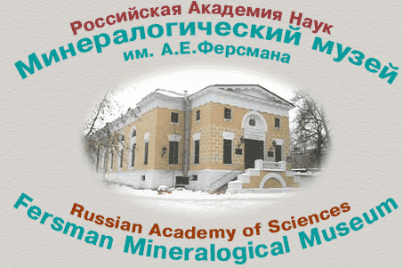
Standardizing high precision Δʹ¹⁷O data from silicate rocks and minerals
Martin F. Miller¹, Andreas Pack², Ilya N. Bindeman^{3,4} and Richard C. Greenwood¹
¹ Planetary and Space Sciences, School of Physical Sciences, The Open University, Walton Hall, Milton Keynes, MK7 6AA, UK
² Georg-August-Universität, Geowissenschaftliches Zentrum, Abteilung Isotopengeologie, Goldschmidtstraβe 1, 37077 Göttingen, Germany
³ Department of Earth Sciences, University of Oregon, Eugene, Oregon, 97403, USA
⁴ Fersman State Mineralogical Museum, Moscow 115162, Russia
Martin Miller
Planetary and Space Sciences
School of Physical Sciences
The Open University
Walton Hall
Milton Keynes MK7 6AA
United Kingdom

Slide 3
RELATIONSHIP BETWEEN ¹⁷O/¹⁶O AND ¹⁸O/¹⁶O
Δʹ¹⁷O
Quantifies deviations from an assigned reference line of slope λ_{RL} and ordinate axis intercept γ_{RL} on a ln(1 + δ¹⁷O) versus ln(1 + δ¹⁸O) plot:
Δʹ¹⁷O = ln(1 + δ¹⁷O) – λ_{RL}ln(1 + δ¹⁸O) – ln(1 + γ_{RL})
= δʹ¹⁷O – λ_{RL}δʹ¹⁸O – γʹ_{RL}
10³ln(1+ δ¹⁷O)
∆ʹ¹⁷O
Reference line (slope λ_{RL} )
γʹ_{RL} is the ordinate axis intercept of the reference line
γʹ_{RL} = 0
10³ln(1 + δ¹⁸O)
Even with λ_{RL} assigned (as 0.528 or 0.5305 or some other number), the accuracy of ∆ʹ¹⁷O data depends critically on the accuracy of calibrating the δ¹⁸O and δ¹⁷O values of the ‘working standard’ O₂ to VSMOW and correcting for any instrument-related compression of the δ¹⁷O and δ¹⁸O scales
Accurate and precise Δʹ¹⁷O data – reproducible by inter-laboratory comparison – are important for quantifying and understanding processes responsible for oxygen triple-isotope ratio variations in nature

Slide 4
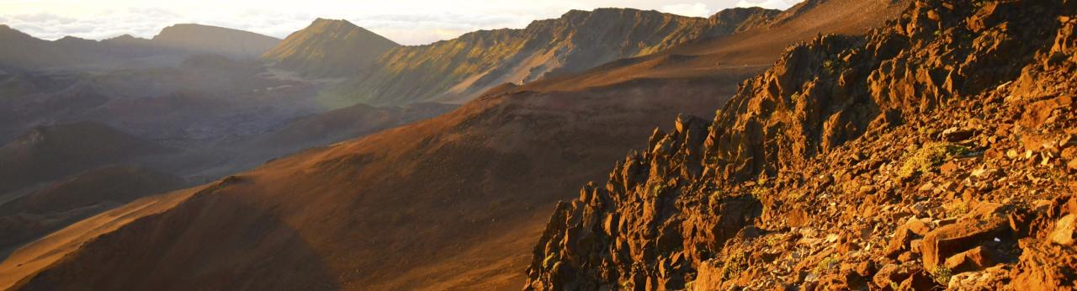
Quantifying oxygen triple-isotope ratios in silicate rocks and minerals
Recently reported Δʹ¹⁷O values (±1σ) of San Carlos olivine (a mantle silicate proxy) on the VSMOW–SLAP scale, with direct measurement of VSMOW and SLAP reference waters for calibration:
Pack et al. (2016):
–36 ± 9 ppm (Georg-August Universität Göttingen, Germany); –40 ± 7 ppm (Okayama University, Japan)
Sharp et al. (2016):
–54 ± 8 ppm (University of New Mexico, USA)
Wostbrock et al. (2020):
–58 ± 5 ppm (University of New Mexico, USA)
No consensus yet on Δʹ¹⁷O value of San Carlos olivine on the VSMOW-SLAP scale
Similarly, no consensus on Δʹ¹⁷O values of other silicate standards

Slide 5
Quantifying oxygen triple-isotope ratios in silicate rocks and minerals
Because δ¹⁷O and δ¹⁸O measurements and their respective errors are correlated (a result of the ‘mass dependent’ fractionation relationship), Δʹ¹⁷O values can be determined to higher precision (5–10 ppm, best case) than the associated δ¹⁷O and δ¹⁸O data
The next slide shows reported variations of the measured δ¹⁸O and δ¹⁷O values of commonly-used silicate standards UWG-2 garnet and San Carlos olivine. In some case (as identified), VSMOW and SLAP reference waters were also measured, for calibration

Slide 6
Variations in reported δ¹⁸O and δ¹⁷O values of UWG-2 garnet and San Carlos olivine
(error bars represent ±1σ, standard deviation)
Wostbrock et al. (2020)
N
Kim et al. (2019)
9
Ali et al. (2016)
24
Young et al. (2016)
50
UWG-2
garnet
Levin et al. (2014)
2
Pack & Herwartz (2014)
5
Tanaka & Nakamura (2013)
31
Ahn et al. (2012)
17
Kusakabe & Matsuhisa (2008)
20
94
δ¹⁸O_{VSMOW} (‰)
δ¹⁷O_{VSMOW} (‰)
N
Wostbrock et al. (2020)
18
Kim et al. (2019)
9
Greenwood et al. (2018)
28
Ali et al. (2016)
5
Pack et al. (2016)ª
30
San Carlos olivine
Pack et al. (2016)^{b}
5
Sharp et al. (2016)
19
Starkey et al. (2016)^{c}
12
Starkey et al. (2016)^{d}
9
Young et al. (2016)
17
Levin et al. (2014)
35
Pack & Herwartz (2014)
9
Tanaka & Nakamura (2013)
20
Ahn et al. (2012)
21
Kusakabe & Matsuhisa (2008)
7
Key:
δ¹⁸O_{VSMOW} (‰)
δ¹⁷O_{VSMOW} (‰)
Filled circles: fluorination by BrF₅
‘Working standard’ O₂ calibrated directly
to VSMOW and SLAP measurements
ª Measurements at Georg-August-Universität Göttingen
Open circles: fluorination by F₂
^{b} Measurements at Okayama University, Japan
^{c} Type (I) San Carlos olivine ^{d} Type (II) San Carlos olivine

Slide 7
Oxygen triple-isotope ratio measurements of silicate rocks and minerals – standardization challenges
Silicate Δʹ¹⁷O data are commonly reported on the VSMOW-SLAP scale (λ_{RL}= 0.528, γ_{RL}= 0, with Δʹ¹⁷O of SLAP defined to be zero as proposed by Schoenemann et al., 2013)
Isotopic measurements of SLAP and VSMOW enables instrument-related compression of the δ¹⁸O and δ¹⁷O scales to be determined
Even with agreement on the numerical values of λ_{RL} and γ_{RL} in the definition
Δʹ¹⁷O = ln(1 + δ¹⁷O) – λ_{RL} ln(1 + δ¹⁸O) – γ_{RL}
silicate Δʹ¹⁷O data may not be directly comparable, if the isotopic data cannot be calibrated accurately
(using water references VSMOW and SLAP)
Alternatively: a two-point line defined by silicates of very different δ¹⁸O values (similar to the VSMOW–SLAP difference) can be used for Δʹ¹⁷O reporting. The resulting data can subsequently be converted to the VSMOW–SLAP (or other) scale, when the empirical slope value (λ_{RL}) of the two-point silicate line is agreed and consensus obtained on the corresponding empirical γ_{RL} value given when the silicate δ¹⁷O and δ¹⁸O data are reported relative to VSMOW

Slide 8
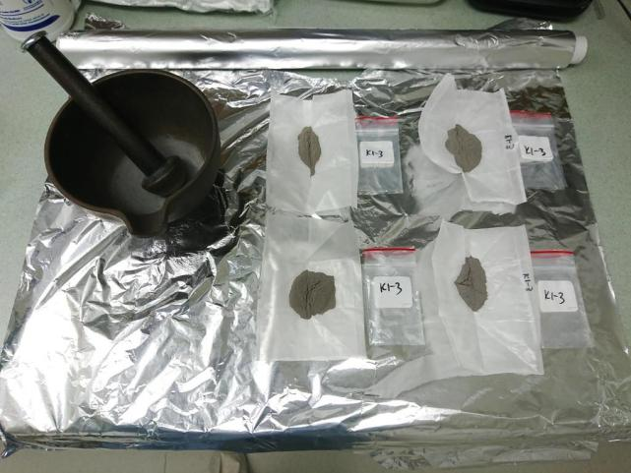
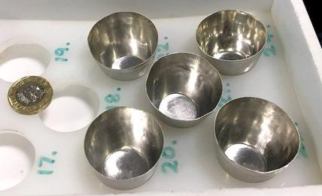
Khitostrov Rock Standard, KRS (low δ¹⁸O)
Prepared from an amphibolite-grade Palaeoproterozoic rock from Khitostrov, Karelia, Russia (sample K1-3 from Bindeman et al., 2010; Bindeman et al., 2014). This region hosts the lowest recorded δ¹⁸O of silicate rocks on Earth, –27∙3 ‰.
After removal of metamict zircon, plagioclase and biotite, residue consisted of ~90% garnet, together with rutile, amphibole, ilmenite and corundum. These minerals are resistant to secondary alteration.
Crushed to a fine powder then sintered to fused block at 1100°C in (Pt + 5% Au crucibles), in a constant flow of dry nitrogen.
Sintered material crushed and sieved to 0∙25–0∙5 mm grain size.
δ¹⁸O = –25∙20 ± 0∙09 ‰ (1σ)

Slide 9
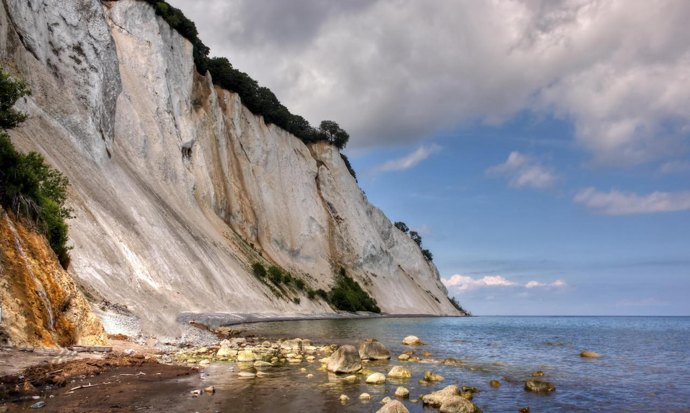
Stevns Klint Flint Standard, SKFS (high δ¹⁸O)
Stevns Klint, south-east Zealand Island, Denmark (exposed Cretaceous–Palaeogene boundary)

Slide 10
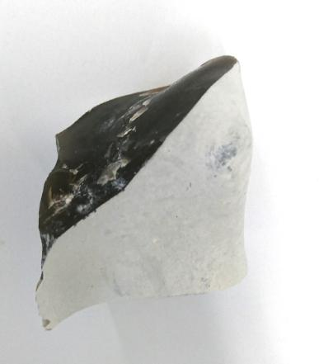
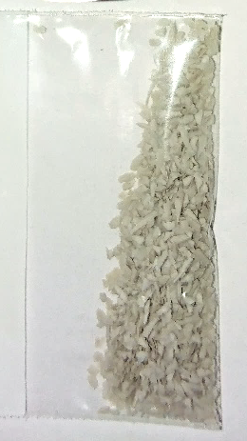

Stevns Klint Flint Standard (SKFS)
Prepared from a flint nodule collected
(by Richard Greenwood) just below the exposed Cretaceous–Palaeogene boundary at Stevns Klint.
δ¹⁸O = 33.93 ± 0.24 ‰ (1σ)
Heated at 1000°C (in air) to remove aqueous micro-inclusions.
Nodule originally contained 0∙83 weight % water, as determined by University of Oregon TC/EA measurements.
Acid treated (0∙1M HCl, 60°C), washed, dried, crushed and sieved to 0∙25–0∙5 mm grain size.

Slide 11
Data comparison: δ¹⁷O, δ¹⁸O and Δʹ¹⁷O of proposed and established silicate standards
measurements normalised to UWG-2 garnet: δ¹⁸O = 5.75 ‰ and Δʹ¹⁷O_{0.528, γ = 0} = –46 ppm
based on Pack et al. (2016) calibration of San Carlos olivine Δʹ¹⁷O = –38 ppm on the VSMOW-SLAP scale

Slide 12
Using KRS and SKFS measurements to form a reference line
Data comparison: Δʹ¹⁷O_{KRS-SKFS} of established silicate standards UWG-2, San Carlos olivine, NBS 28
SKFS
10³ln(1+ δ¹⁷O_{VSMOW})
In contrast to γ, the λ value of the two-point line is independent of whether the δ¹⁷O and δ¹⁷O data are calibrated to VSMOW or are reported relative to the ‘working standard’ O₂.
KRS
With δ¹⁷O and δ¹⁷O data reported relative to VSMOW:
(95% confidence interval)
For Open University and Georg-August Universität Göttingen data, calibration to VSMOW was based on Pack et al. (2016)
For University of Oregon data, calibration of the ‘working standard’ O₂ to VSMOW was performed at Δ*IsoLab, University of Washington, Seattle, USA

Slide 13
Data comparison: Δʹ¹⁷O_{KRS-SKFS} of established silicate standards San Carlos olivine and UWG-2
Open University data (circles)
Georg-August-Universität data (diamonds)
SKFS
Error bars indicate standard error of the mean
10³ln(1+ δ¹⁷O_{VSMOW})
KRS
(standard error of the mean)
Δʹ¹⁷O_{KRS–SKFS} is unchanged by reporting all δ¹⁷O and δ¹⁸O data (including for KRS and SKFS) relative to the ‘working standard’ O₂ instead of to VSMOW

Slide 14
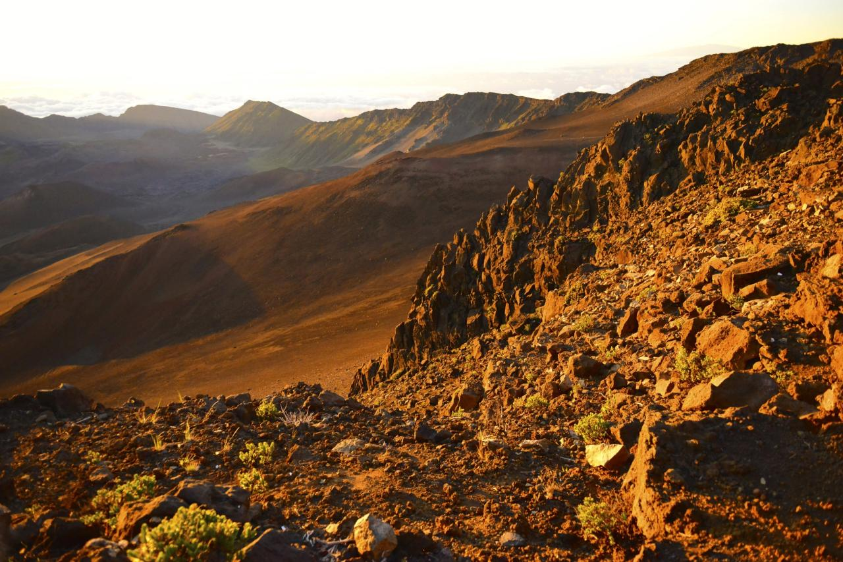
CONCLUSIONS
Calibration of silicate δ¹⁷O and δ¹⁸O data to a water reference scale (VSMOW-SLAP) is challenging
Two silicate standards (KRS and SKFS), differing in δ¹⁸O by more than 59 ‰, have been prepared and are available on request
With δ¹⁷O and δ¹⁸O calibrated to VSMOW, measurements of λ and γ for the two-point KRS–SKFS line at the Open University, Georg-August-Universität Göttingen and the University of Oregon, are in good agreement
Δʹ¹⁷O_{KRS-SKFS} measurements of established standards San Carlos olivine and UWG-2 at the Open University,
Georg-August-Universität Göttingen and the University of Oregon are also in good agreement
Δʹ¹⁷O_{KRS-SKFS} values are independent of the calibration of the ‘working standard’ O₂
(facilitating silicate Δʹ¹⁷O_{KRS-SKFS} measurement reproducibility between laboratories)
For accurate conversion between Δʹ¹⁷O_{KRS-SKFS} and Δʹ¹⁷O_{0.528} or another Δʹ¹⁷O definition,
direct calibration of δ¹⁸O and Δʹ¹⁷O_{0.528} values of KRS and SKFS to the VSMOW–SLAP scale are needed

