Slide 1
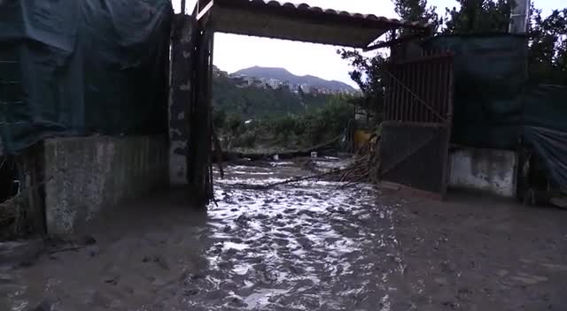
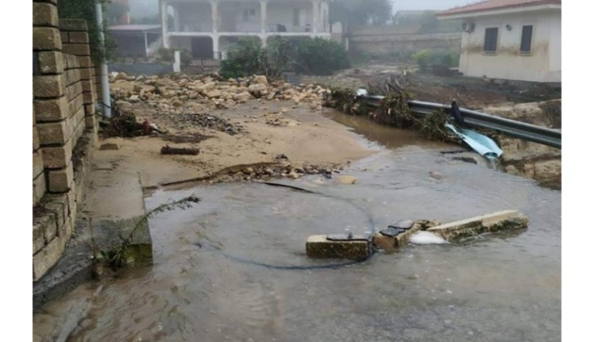
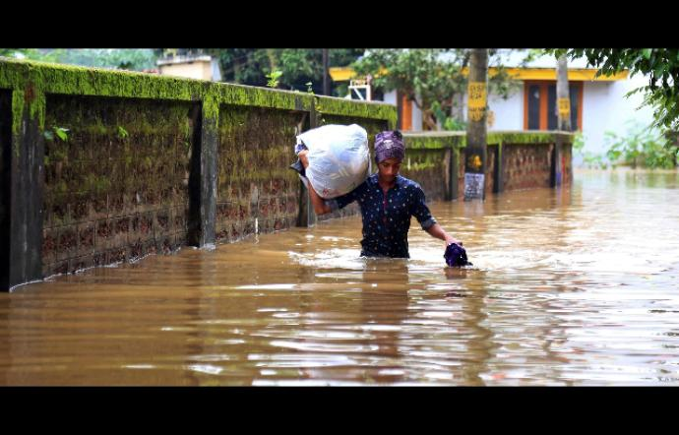
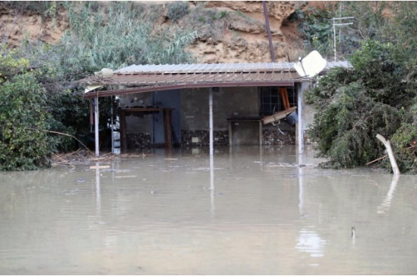
WEATHER CIRCULATION PATTERNS AS PRECURSOR OF HEAVY RAINFALL EVENTS: AN APPLICATION TO SICILY, ITALY
Giuseppe Cipolla^{1,*}, Antonio Francipane¹, Leonardo Valerio Noto¹
^{1.} Dipartimento di Ingegneria - Università degli Studi di Palermo, Viale delle Scienze, Ed.8, 90128, Palermo (Italy)
*corresponding author contact: giuseppe.cipolla04@unipa.it

Slide 2
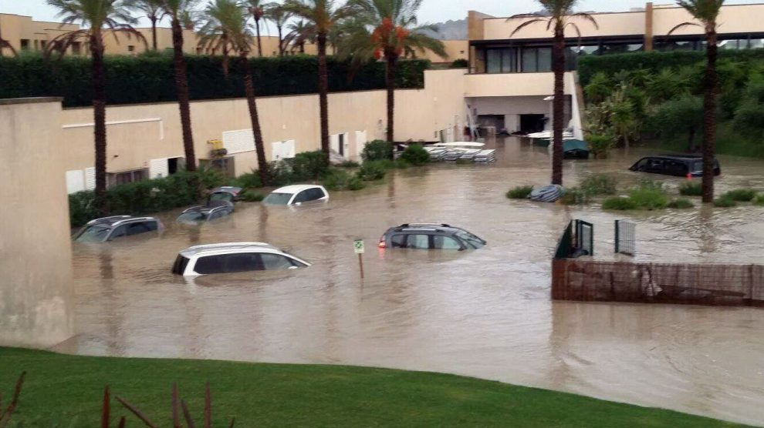
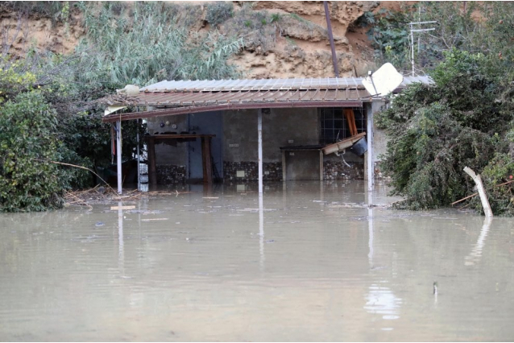
Weather circulation patterns as precursor of heavy rainfall events: an application to Sicily, Italy
Giuseppe Cipolla^{1,*}, Antonio Francipane¹, Leonardo Valerio Noto¹
^{1.} Dipartimento di Ingegneria - Università degli Studi di Palermo, Viale delle Scienze, Ed.8, 90128, Palermo (Italy)
*corresponding author contact: giuseppe.cipolla04@unipa.it
Motivations
Increasing occurrence of heavy rainfall events (high intensity and short duration) in the Mediterranean area, where Sicily is located.
Increase of floods occurrence and consequent damages.
Sciacca (AG)
February 2017
Casteldaccia (PA)
November 2018
Palermo (PA)
September 2019

Slide 3
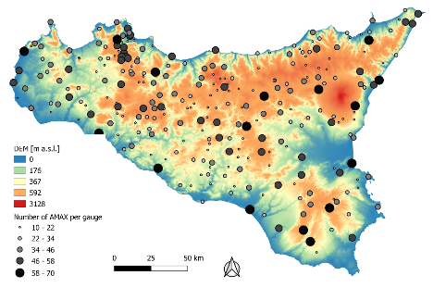
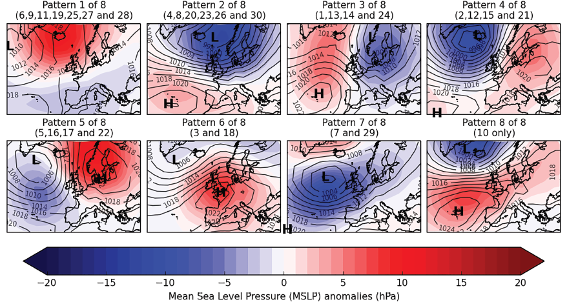
Weather circulation patterns as precursor of heavy rainfall events: an application to Sicily, Italy
Giuseppe Cipolla^{1,*}, Antonio Francipane¹, Leonardo Valerio Noto¹
^{1.} Dipartimento di Ingegneria - Università degli Studi di Palermo, Viale delle Scienze, Ed.8, 90128, Palermo (Italy)
*corresponding author contact: giuseppe.cipolla04@unipa.it
Case study and data
Rainfall AMAX of 280 Sicilian gaugesª
European WPs of atmospheric circulation^{b}
Reanalysis data of CAPE (Convective Available Potential Energy) and VIDMF (Vertical Integral of Divergence of Moisture Flux), ERA-Interim Archive^{c}
a) Autorità di bacino – Regione Siciliana;
b) Neal R., Fereday D, Crocker R, Comer RE (2016). A flexible approach to defining weather patterns and their application in weather forecasting over Europe. Meteorological application 23: 389-400;
c) European Centre for Medium-Range Weather Forecast (ECMWF, https://www.ecmwf.int/).

Slide 4
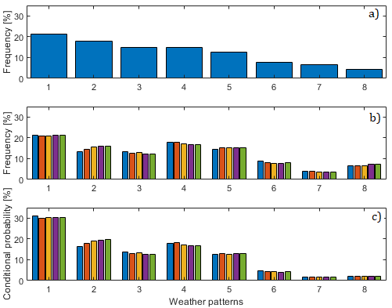
Weather circulation patterns as precursor of heavy rainfall events: an application to Sicily, Italy
Giuseppe Cipolla^{1,*}, Antonio Francipane¹, Leonardo Valerio Noto¹
^{1.} Dipartimento di Ingegneria - Università degli Studi di Palermo, Viale delle Scienze, Ed.8, 90128, Palermo (Italy)
*corresponding author contact: giuseppe.cipolla04@unipa.it
WPs as precursors of AMAX
AMAX (from 1928 to 2016)
WPs (from 1850 to 2016)
Association AMAX-WPs on the base of the day of occurrence
a) Frequency of occurrence of each WP
b) Frequency of occurrence of AMAX under each WP
Bayesian approach
Input
Method
c) Conditional probability of the cause (WP) given the effect (AMAX)
Output

Slide 5
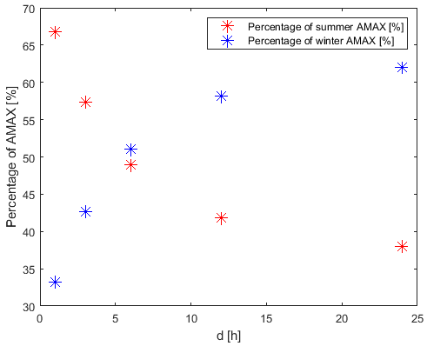
Weather circulation patterns as precursor of heavy rainfall events: an application to Sicily, Italy
Giuseppe Cipolla^{1,*}, Antonio Francipane¹, Leonardo Valerio Noto¹
^{1.} Dipartimento di Ingegneria - Università degli Studi di Palermo, Viale delle Scienze, Ed.8, 90128, Palermo (Italy)
*corresponding author contact: giuseppe.cipolla04@unipa.it
WPs as precursors of AMAX: summer and winter periods
The percentage of AMAX occurred during the summer period (from May to October) decreases as the duration increases, while a opposite pattern is recognizable under the winter period (from November to April);
At 6-hour duration the percentage of occurred AMAX, during summer and winter periods, is almost the same.

Slide 6
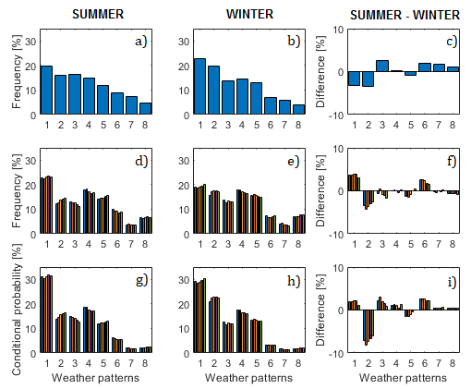
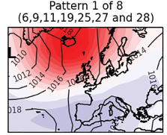
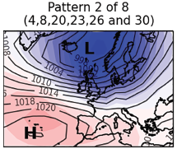
Weather circulation patterns as precursor of heavy rainfall events: an application to Sicily, Italy
Giuseppe Cipolla^{1,*}, Antonio Francipane¹, Leonardo Valerio Noto¹
^{1.} Dipartimento di Ingegneria - Università degli Studi di Palermo, Viale delle Scienze, Ed.8, 90128, Palermo (Italy)
*corresponding author contact: giuseppe.cipolla04@unipa.it
WPs as precursors of AMAX: summer and winter periods
In summer period there is a net prevalence of WP1 (NAO-) on the other WPs in the occurrence of rainfall AMAX, at all durations;
Despite in winter period WP1 is always the main WP leading to the occurrence of rainfall AMAX, the contribution of WP2 (NAO+) becomes relevant as well.
NAO-
NAO+

Slide 7
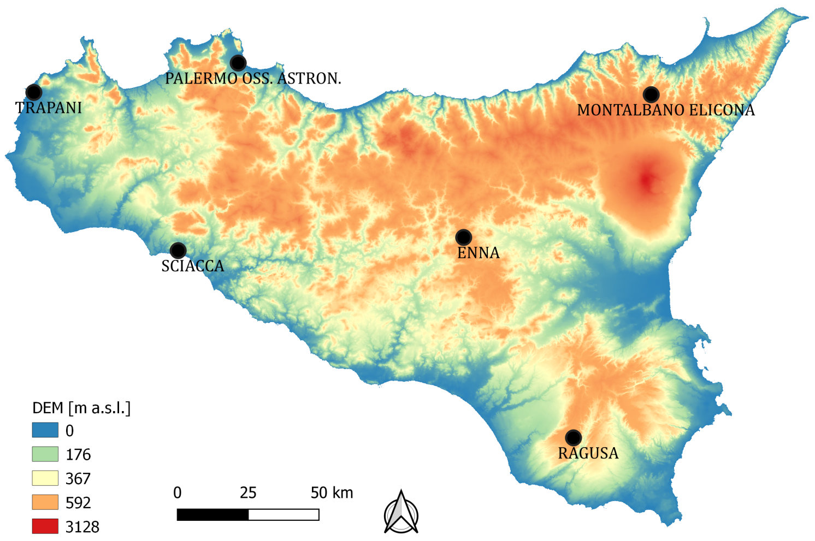
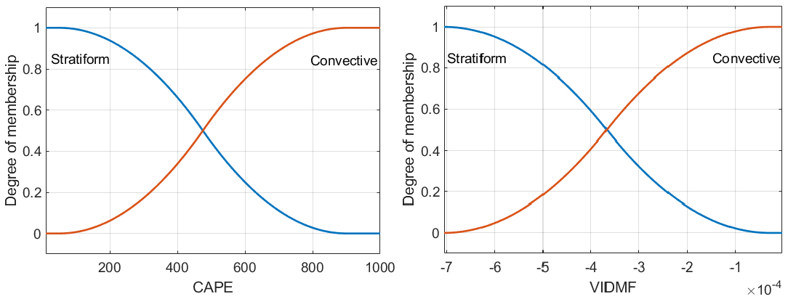
Weather circulation patterns as precursor of heavy rainfall events: an application to Sicily, Italy
Giuseppe Cipolla^{1,*}, Antonio Francipane¹, Leonardo Valerio Noto¹
^{1.} Dipartimento di Ingegneria - Università degli Studi di Palermo, Viale delle Scienze, Ed.8, 90128, Palermo (Italy)
*corresponding author contact: giuseppe.cipolla04@unipa.it
AMAX classification
Membership functions of CAPE
Convective (stratiform) AMAX
Max of CAPE at each day for each pixel covering Sicily
Degree of membership (DM) of CAPE at each AMAX to the class convective (stratiform)
CAPE at each day of AMAX occurrence
DM ≥ 0.6
Days of occurrence of AMAX
Lat/Lon of the considered gauge
Minimum DM (logical AND)
DM of each AMAX to the class convective (stratiform)
VIDMF at each day of AMAX occurrence
Min of VIDMF at each day for each pixel covering Sicily
Degree of membership (DM) of VIDMF at each AMAX to the class convective (stratiform)
DM < 0.6
Membership functions of VIDMF
Mixed/unresolved AMAX
Input
Method
Output

Slide 8
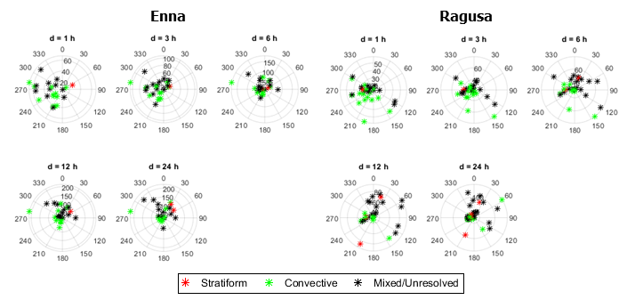
Weather circulation patterns as precursor of heavy rainfall events: an application to Sicily, Italy
Giuseppe Cipolla^{1,*}, Antonio Francipane¹, Leonardo Valerio Noto¹
^{1.} Dipartimento di Ingegneria - Università degli Studi di Palermo, Viale delle Scienze, Ed.8, 90128, Palermo (Italy)
*corresponding author contact: giuseppe.cipolla04@unipa.it
AMAX classification

Slide 9
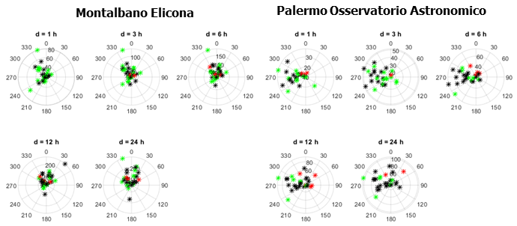
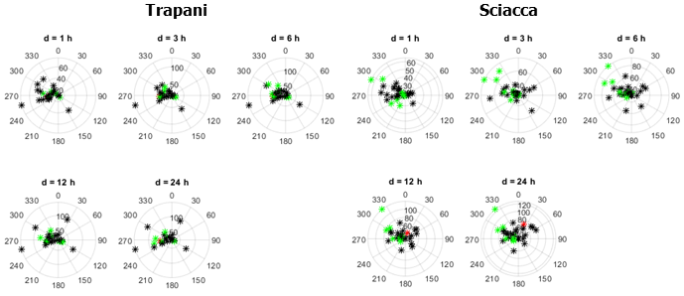
Weather circulation patterns as precursor of heavy rainfall events: an application to Sicily, Italy
Giuseppe Cipolla^{1,*}, Antonio Francipane¹, Leonardo Valerio Noto¹
^{1.} Dipartimento di Ingegneria - Università degli Studi di Palermo, Viale delle Scienze, Ed.8, 90128, Palermo (Italy)
*corresponding author contact: giuseppe.cipolla04@unipa.it
AMAX classification
At 1-hour duration there is a prevalence of convective over stratiform AMAX at all gauges, especially during the summer period (polar plots between ~120° and ~300°);
At 24-hour duration the percentage of stratiform events tend to increase, respect to the 1-hour duration, even though it remains low. Mixed/unresolved AMAX tend to prevail at this duration and they are mostly concentrated in the winter period.

Slide 10
Weather circulation patterns as precursor of heavy rainfall events: an application to Sicily, Italy
Giuseppe Cipolla^{1,*}, Antonio Francipane¹, Leonardo Valerio Noto¹
^{1.} Dipartimento di Ingegneria - Università degli Studi di Palermo, Viale delle Scienze, Ed.8, 90128, Palermo (Italy)
*corresponding author contact: giuseppe.cipolla04@unipa.it
Conclusions
The analyses carried out with WPs highlighted that the greatest part of rainfall AMAX is caused by the occurrence of WP1, which is the NAO- pattern. In this condition, Sicily is situated within an area characterized by a low MSLP (Mean Sea Level Pressure) and, considering the dynamics caused by this weather pattern, the region is interested in a warm and humid airflow that probably results in the occurrence of high intensity and short duration rainfall events.
The Fuzzy approach used to distinguish rainfall AMAX into convective, stratiform and mixed/unresolved events, on the base of their CAPE and VIDMF, highlighted a predominance of convective over the stratiform AMAX related to the summer period, at 1-hour duration. The percentage of mixed/unresolved AMAX is almost the same of the convective one. At the 24-hour duration, a slight increase in the percentage of stratiform AMAX is recorded, even though the mixed/unresolved events seem to predominate and to be concentrated in the winter period.

