Slide 1
Biochar from different feedstocks as catalysts for the conversion of algal lipid into biodiesel
EGU2020-19912
Vassiliki D. Tsavatopoulou (1), Andriana F. Aravantinou (1), John Vakros (2), and Ioannis D. Manariotis (1) (1) University of Patras, Department of Civil Engineering, 26504 Patras, Greece (idman@upatras.gr), (2) University of Patras, Department of Chemistry, 26504 Patras, Greece
Microalgae are a group of microorganisms capable to accumulate up to 80% triacylglycerol w/w, making them as one of the most promising renewable sources for biofuels. Biodiesel derived from algal oil is produced via transesterification process, where the oil is mixed with alcohol and a suitable catalyst at an elevated temperature. Recently, research has been focused on catalysts from renewable sources, like biomass and residues generated in households, in the form of biochar. The aim of this work is to investigate the use of biochar as a heterogeneous catalyst and compared to common homogeneous catalysts (H₂SO₄ and NaOH) for the conversion of algal lipid into biodiesel. The effect of feedstock and pyrolysis temperature were investigated. More specifically, biochar was produced from malt spent rootlets (MSR), coffee spent grains (CSG) and olive kernels (OK) at pyrolysis temperatures ranging from 400 to 850ºC. The preliminary results showed that biochar from malt spent rootlets achieved about 50% conversion of lipids to fatty acid methyl esters during transesterification.
Biochar
Transesterification Results
Materials & Methods
Biochar Characterization
Conclusions

Slide 2
Biochar
Biochar from different feedstocks as catalysts for the conversion of algal lipid into biodiesel Vassiliki D. Tsavatopoulou (1), Andriana F. Aravantinou (1), John Vakros (2), and Ioannis D. Manariotis (1) (1) University of Patras, Department of Civil Engineering, 26504 Patras, Greece (idman@upatras.gr), (2) University of Patras, Department of Chemistry, 26504 Patras, Greece
Biochar is obtained from the incomplete combustion of carbon-rich biomass under oxygen-limited conditions.
Raw materials (coal, wood, peat) and residue materials (used coffee, seeds from brewery) are converted to activated carbon by thermal decomposition in a furnace under controlled atmosphere and heat by physical or chemical activation.
Biochar recyclable catalysts perform a better catalytic activity for simultaneous esterification and transesterification of non edible oils.
X

Slide 3
Materials & Methods
Biochar from different feedstocks as catalysts for the conversion of algal lipid into biodiesel Vassiliki D. Tsavatopoulou (1), Andriana F. Aravantinou (1), John Vakros (2), and Ioannis D. Manariotis (1) (1) University of Patras, Department of Civil Engineering, 26504 Patras, Greece (idman@upatras.gr), (2) University of Patras, Department of Chemistry, 26504 Patras, Greece
Microalgae Cultivation
Biochar Preparation
Lipid Extraction
Transesterification of algal lipids
X

Slide 4
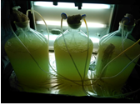
Microalgae cultivation
Biochar from different feedstocks as catalysts for the conversion of algal lipid into biodiesel Vassiliki D. Tsavatopoulou (1), Andriana F. Aravantinou (1), John Vakros (2), and Ioannis D. Manariotis (1) (1) University of Patras, Department of Civil Engineering, 26504 Patras, Greece (idman@upatras.gr), (2) University of Patras, Department of Chemistry, 26504 Patras, Greece
Scenedesmus sp. were used, which was obtained from the SAG Culture Collection of the University of Göttingen.
Algal precultures were prepared with 10 L of modified 1/3 N BG-11 medium in a glass bottle. The bottle was under lights with constant aeration (3,5 lt/min) and was placed in a walk-in incubator room under controlled environmental conditions at 20º C.
X

Slide 5
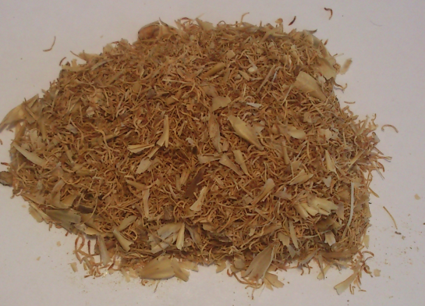
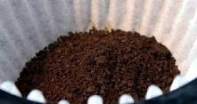
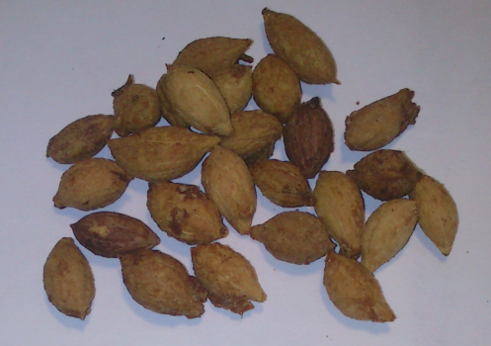
Biochar preparation
Biochar from different feedstocks as catalysts for the conversion of algal lipid into biodiesel Vassiliki D. Tsavatopoulou (1), Andriana F. Aravantinou (1), John Vakros (2), and Ioannis D. Manariotis (1) (1) University of Patras, Department of Civil Engineering, 26504 Patras, Greece (idman@upatras.gr), (2) University of Patras, Department of Chemistry, 26504 Patras, Greece
Malt spent rootlets (MSR) were obtained from the Athenian Brewery S.A. (Patras, Greece). Its chemical composition includes 32% protein, 11% fibre, 8.7% ash, 2.5% reducing sugars, 0.9% non-reducing sugars, 27% starch, 0.02% phytic acid, 0.4% polyphenols, 2% Ca, 1%P, 0.2% K, 0.1% Na, 0.01%, Fe, 0.01% Mg, and 0.01% Zn (Salama et al. 1979; Bekatorou et al. 2010).
Coffee spent grains (CSG) and olive kernels (OK) were obtained from local businesses of the region.
The vessels were placed in a gradient temperature furnace (LH 60/12, Nabertherm GmbH, Germany) at 400 or 850 ºC for 3 hours.
MSR
Coffee
X
Olive stones

Slide 6
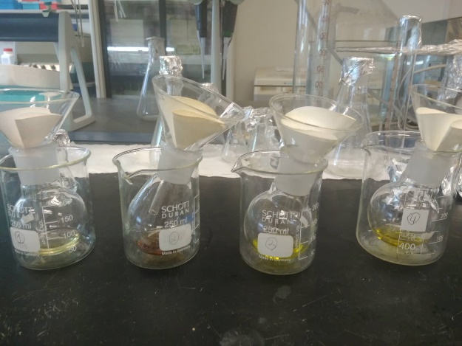
Lipid Extraction
Biochar from different feedstocks as catalysts for the conversion of algal lipid into biodiesel Vassiliki D. Tsavatopoulou (1), Andriana F. Aravantinou (1), John Vakros (2), and Ioannis D. Manariotis (1) (1) University of Patras, Department of Civil Engineering, 26504 Patras, Greece (idman@upatras.gr), (2) University of Patras, Department of Chemistry, 26504 Patras, Greece
Selected algal strains were cultivated and lipids were extracted.
The procedure of Folch et al. (1957) was followed for the extraction of lipids. The biomass was dried at 90º C and then extracted three times with a mixture of chloroform:methanol (2:1). The biomass was removed by filtration through a filter paper and the extracted lipids transferred quantitatively to a tared Erlenmeyer flask. The procedure was repeated three times in order to extract all the lipids.
The flask was fitted to a rotary evaporator, where the FOLCH reagent was removed under vacuum conditions. The flask was allowed to cool to ambient temperature in a desiccator and then was weighed. The weight difference corresponded to intracellular lipids.
X

Slide 7
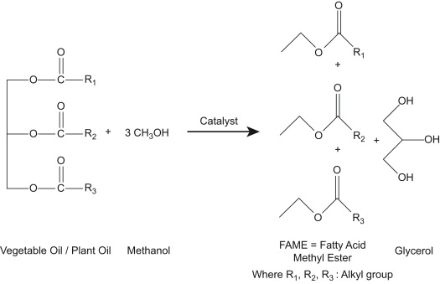
Transesterification of algal lipids
Biochar from different feedstocks as catalysts for the conversion of algal lipid into biodiesel Vassiliki D. Tsavatopoulou (1), Andriana F. Aravantinou (1), John Vakros (2), and Ioannis D. Manariotis (1) (1) University of Patras, Department of Civil Engineering, 26504 Patras, Greece (idman@upatras.gr), (2) University of Patras, Department of Chemistry, 26504 Patras, Greece
The molar ratio of catalyst: lipid was 0.35:1 and the methanol:lipid ratio was 600:1. The molecular weight of microalgae was considered to be 845 g/mol.
Reactions were done at 60°C and the samples were centrifuged on a shaking agitator for 20 h and a stirring speed of 200 rpm.
The microalgal residues were then separated from the solutions by centrifugation at 5000U/min for 5 min in a centrifuge.
Finally, analysis and the concentration of FAMEs were performed using a gas chromatograph.
X

Slide 8
Biochar Characterization
Biochar from different feedstocks as catalysts for the conversion of algal lipid into biodiesel Vassiliki D. Tsavatopoulou (1), Andriana F. Aravantinou (1), John Vakros (2), and Ioannis D. Manariotis (1) (1) University of Patras, Department of Civil Engineering, 26504 Patras, Greece (idman@upatras.gr), (2) University of Patras, Department of Chemistry, 26504 Patras, Greece
Element | % weight
 | BC
C | 74
O | 12
K | 7
P | 2
Si | 2
Cl | 2
S | 0.5
Others | 0.5
SEM images and EDS analysis of the biochar MRS
EDS results for the untreated biochar MRS.
PZC of biochar MRS: pH=6,9
X

Slide 9
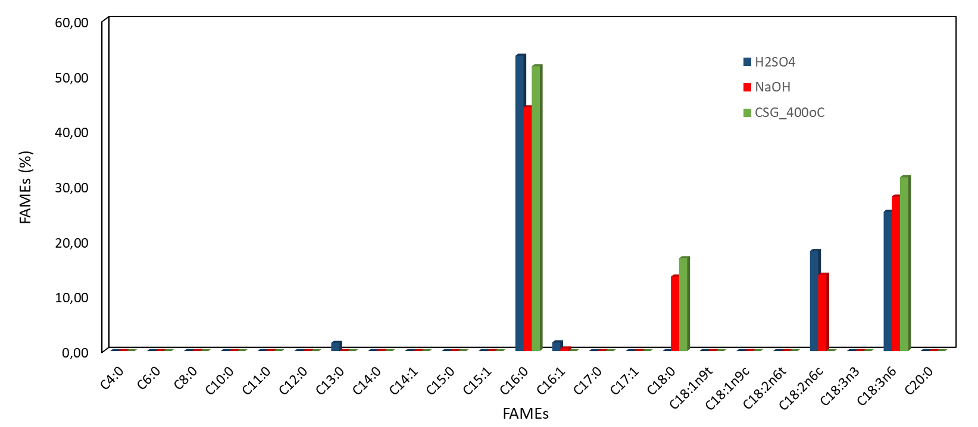
Transesterification results
Biochar from different feedstocks as catalysts for the conversion of algal lipid into biodiesel Vassiliki D. Tsavatopoulou (1), Andriana F. Aravantinou (1), John Vakros (2), and Ioannis D. Manariotis (1) (1) University of Patras, Department of Civil Engineering, 26504 Patras, Greece (idman@upatras.gr), (2) University of Patras, Department of Chemistry, 26504 Patras, Greece
Homogeneous catalysts (H₂SO₄ and NaOH) compared to the biochar CSG at 400ºC (the most productive tested biochar).
The main methyl ester in all cases was the Methyl palmitate (C16:0).
Methyl palmitate (C16:0), methyl stereate (C18:0), methyl oleate(C18:1), methyl linoleate (C18:2) and methyl linolenate (C18:3) are suitable candidates for biodiesel production.
1/3

Slide 10
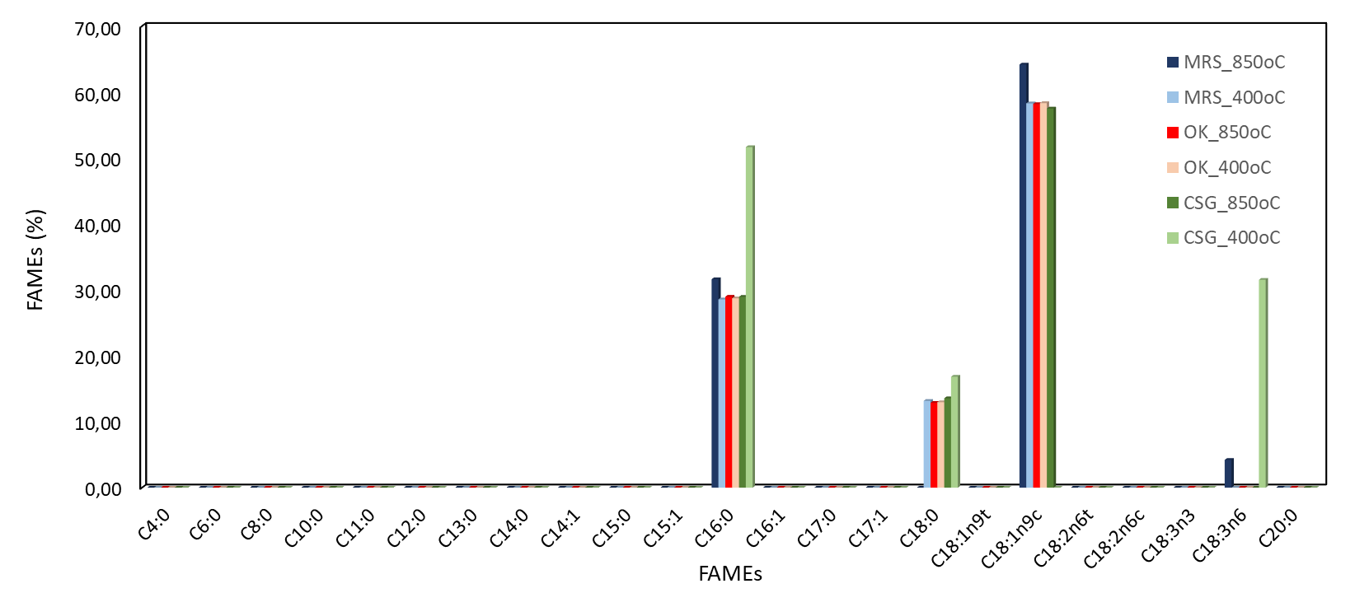
Transesterification results
Biochar from different feedstocks as catalysts for the conversion of algal lipid into biodiesel Vassiliki D. Tsavatopoulou (1), Andriana F. Aravantinou (1), John Vakros (2), and Ioannis D. Manariotis (1) (1) University of Patras, Department of Civil Engineering, 26504 Patras, Greece (idman@upatras.gr), (2) University of Patras, Department of Chemistry, 26504 Patras, Greece
The main methyl ester in all biochar cases with the exception of CSG_400ºC was the Methyl oleate (C18:1n9c).
In the biochar OK results were similar regardless of their temperature treatment, however this was not shown in the other two biochars (MRS and CSG).
2/3

Slide 11
Transesterification results
Biochar from different feedstocks as catalysts for the conversion of algal lipid into biodiesel Vassiliki D. Tsavatopoulou (1), Andriana F. Aravantinou (1), John Vakros (2), and Ioannis D. Manariotis (1) (1) University of Patras, Department of Civil Engineering, 26504 Patras, Greece (idman@upatras.gr), (2) University of Patras, Department of Chemistry, 26504 Patras, Greece
Catalyst
 | H₂SO₄ | NaOH | MRS 850ºC | MRS 400ºC | OK 850ºC | OK 400ºC | CSG 850ºC | CSG 400ºC
Methyl Esters | (%)
C13:0 | 1.48
C16:0 | 53.55 | 44.20 | 31.61 | 28.56 | 28.96 | 28.72 | 28.94 | 51.56
C16:1 | 1.55 | 0.46
C18:0 |  | 13.49 |  | 13.16 | 12.87 | 12.96 | 13.56 | 16.83
C18:1n9c |  |  | 64.17 | 58.28 | 58.18 | 58.32 | 57.50
C18:2n6c | 18.14 | 13.83 | 4.22 |  |  |  |  | 31.52
C18:3n6 | 25.27 | 28.02
Catalysts | Total FAMEs (mg)
H₂SO₄ | 27.55
NaOH | 29.04
MRS_850ºC | 21.34
MRS_400ºC | 16.78
OK_850ºC | 16.35
OK_400ºC | 19.12
CSG_850ºC | 18.96
CSG_400ºC | 25.70
3/3
X

Slide 12
Conclusions
Biochar from different feedstocks as catalysts for the conversion of algal lipid into biodiesel Vassiliki D. Tsavatopoulou (1), Andriana F. Aravantinou (1), John Vakros (2), and Ioannis D. Manariotis (1) (1) University of Patras, Department of Civil Engineering, 26504 Patras, Greece (idman@upatras.gr), (2) University of Patras, Department of Chemistry, 26504 Patras, Greece
Biochars are environmental friendly cheap and reusable catalysts.
The transesterification process is influenced mainly by the type of selected catalyst.
Homogeneous catalysts (H₂SO₄ and NaOH) had similar results to the biochar CSG at 400ºC (the most productive tested biochar).
In the OK and CSG biochar as catalyst showed that the treatment temperatures effect the FAMEs recovery.
CSG biochar treated at 400ºC showed similar results to homogeneous catalysts.

Slide 13
Thank you for your attention
X

