Slide 1
Detection of rhododendron in a
deciduous woodland using airborne
hyperspectral remote sensing
Gary Llewellyn, Loreena Jaouen, Jennifer Killeen, Chloe Barnes,
Luke Platts, Steve Case and David Mothersdill
gary.llewellyn@2excel.uk
D696 | EGU2020-19931

Slide 2
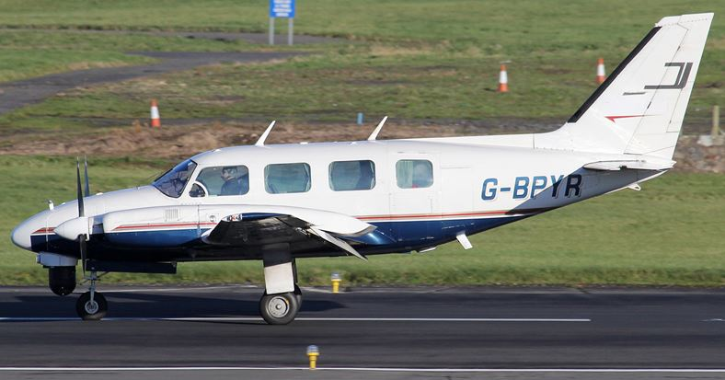
NEO HySPEX VNIR sensor
Spectral range: 400 – 1000nm
Spatial bands: 1800
Spectral channels: 186
Spectral sampling: 3.26nm
Bit resolution: 16 bit
Flight height (above ground level): 1000m

Slide 3
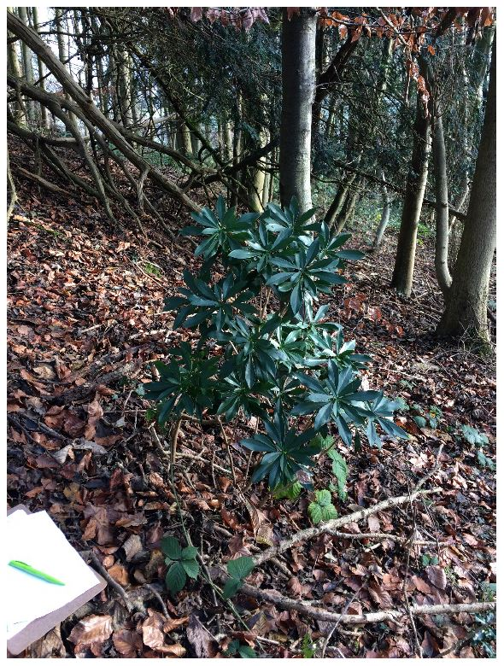
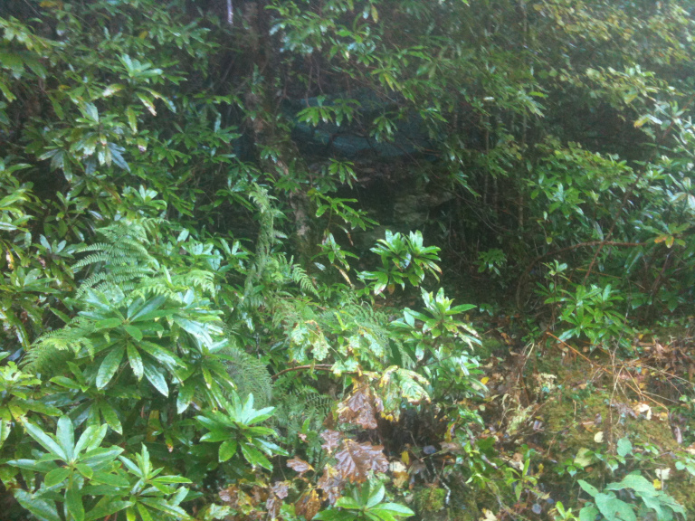
Rhododendron (Rhododendron ponticum) has been identified as an invasive non-native species (INNS) in the UK and a potential carrier of plant pathogen Phytophthora ramorum.

Slide 4
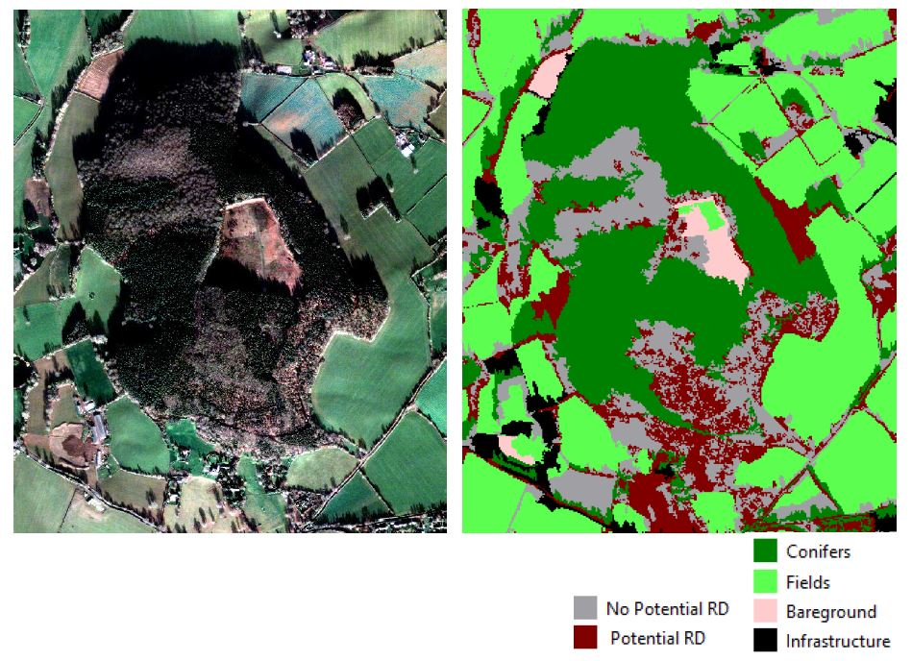
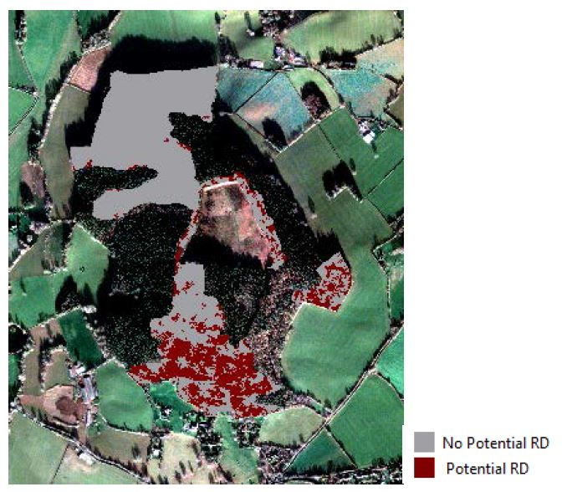
High resolution satellite solutions

Slide 5
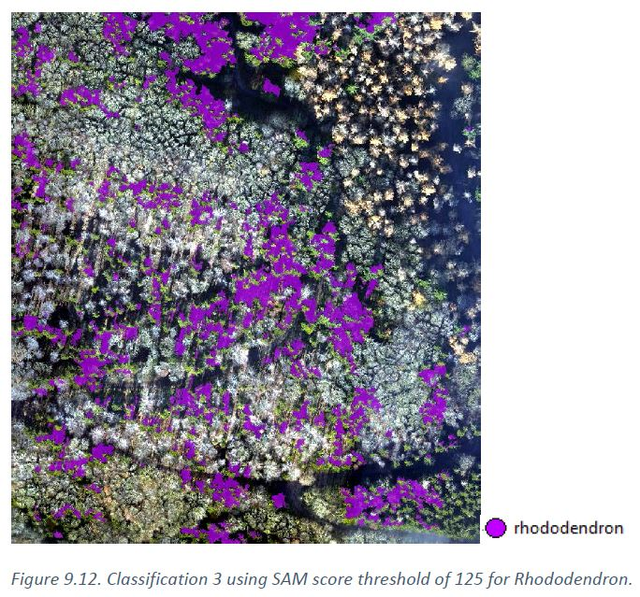
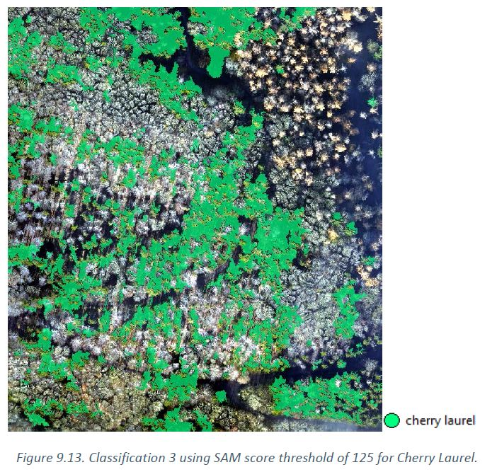
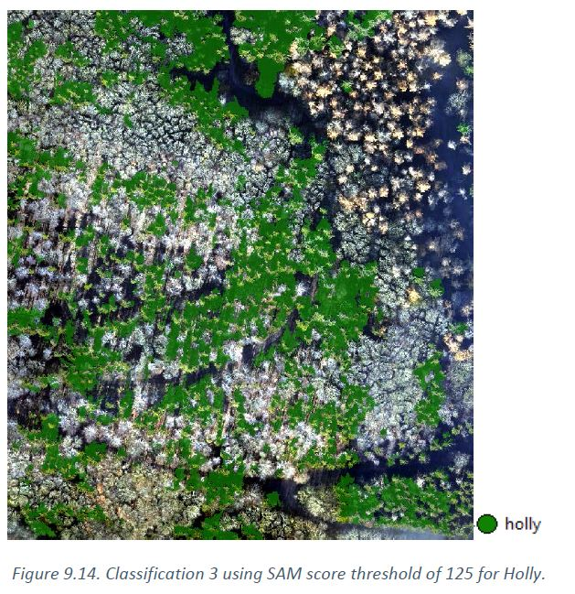
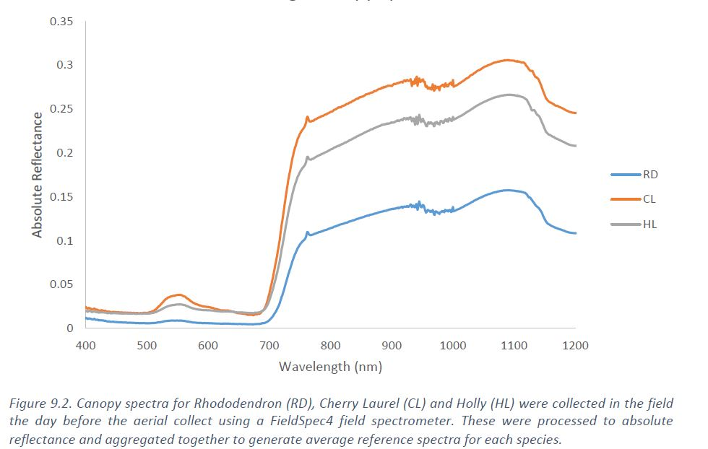
Airborne hyperspectral data allows for the detection of specific understorey species rather than the general identification of similar under-storey species, i.e. Potential Rhododendron.
In this example, spectral angle mapper (SAM) values are used to separate three understorey species.

Slide 6
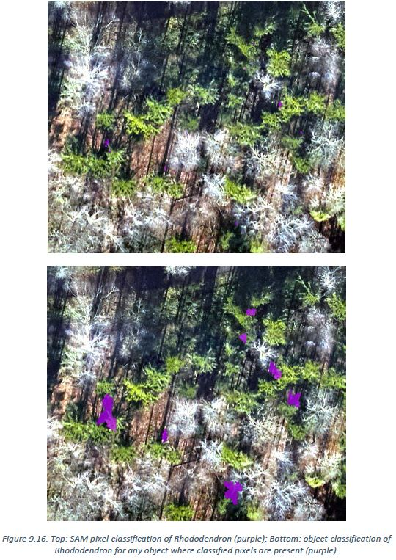
Although ‘high’ spatial resolution satellite data could identify areas of ‘potential rhododendron’, the discrimination of rhododendron from other understorey woodland vegetation was not possible.
Only hyperspectral systems could specifically identify rhododendron in the understorey and only airborne hyperspectral systems could provide both the spatial and spectral resolution required to identify and map rhododendron coverage.

