Slide 1
Data Fusion on the CANDELA Cloud Platform
German Aerospace Center
Data Intelligence and Knowledge Discovery team

Slide 2
Contents
About CANDELA
Insight Machine Learning
What is Data Mining?
Data Mining in action
5. Data Mining demo

Slide 3
With the advent of the Copernicus program with its wealth of open data, the Earth Observation application and service development domain is increasingly adopting big data technologies.
CANDELA R&D step proposes the deployment of efficient Access, Discovery, Processing and Delivery modules.
Efficient data retrieval, mining augmented with machine learning techniques and interoperability is key in order to fully benefit from the available assets, create more value and subsequently economic growth and development of European members states.
A special attention is given to re-use and openness.

Slide 4
CANDELA main objective
CANDELA project main objective is to allow the creation of value from Copernicus data through the provisioning of modelling and analytics tools given that the tasks of data collection, processing, storage and access will be provided by the Copernicus Data and Information Access Service (DIAS).
Concept: Data Science to enable the successful integration of heterogeneous datasets, to support the definition and design of the data transformation to information, the use of taxonomies and elements of ontology and semantics, learning, KDD, annotation, data analytics.

Slide 5
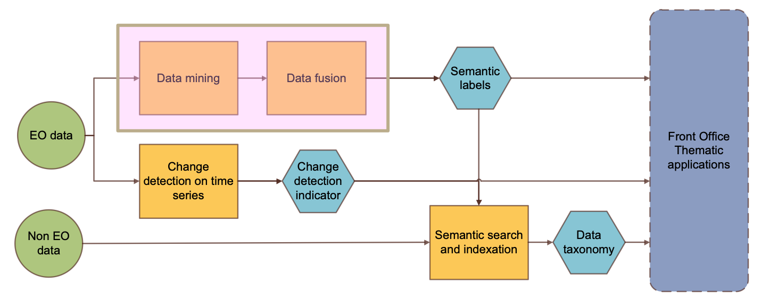
The analytics modules

Slide 6
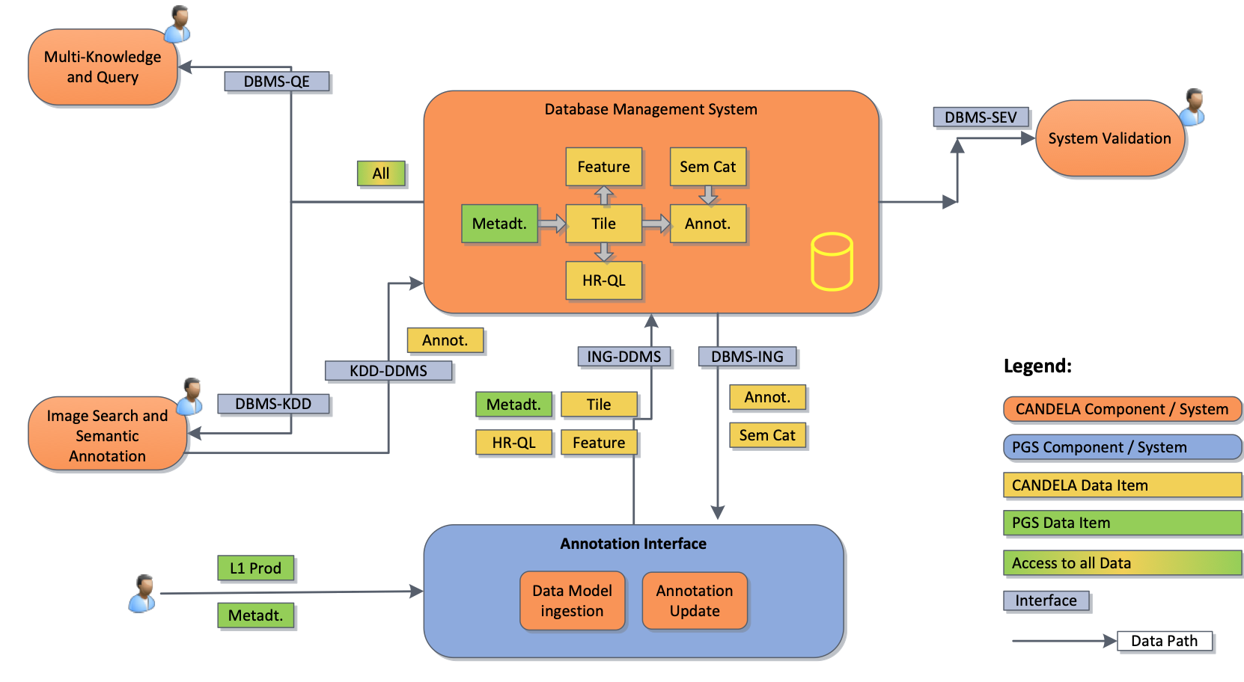
Data Mining and Fusion in CANDELA

Slide 7
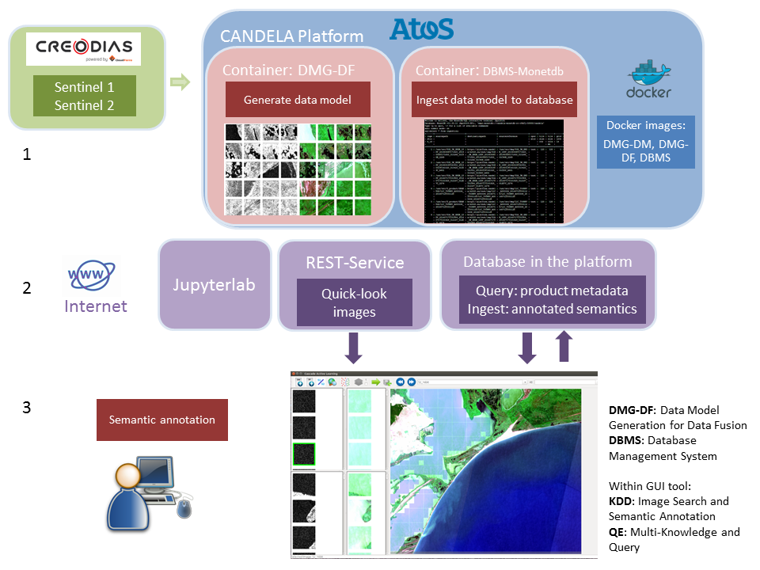
Data Fusion Architecture
Source: CANDELA D2.8 Data Fusion v2 v1.0
Notes:
Similarly, data fusion module in candela differs in:
1 layer, data model generation for data fusion which processes 1 s-1 and 1 s-2 products simultaneously, under the premise that they are co-registered and cover the same area.
3 layer, the front end is able to extend the quick-look columns, and show the paired s-1 and s-2 patches. Which means, each row the patches are registered.

Slide 8
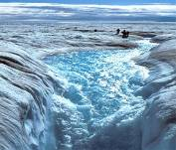
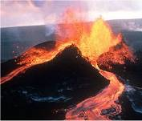
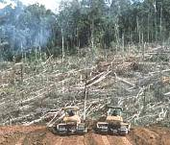
Supervised machine learning
Supervised machine learning for classification is a mapping of an input data to an output set of labels based on a training data set of examples.
Step 1 TRAINING
Step 2 CLASSIFICATION
Machine uses the model to map unknown data to trained classes
Machine is learning the data model
…
Training data set
Unknown data
Labeled data
…

Slide 9
Active learning
Active learning is when machine is interactively interrogating a user (information source) to label new data points with the desired outputs.
User selected training data
…
Machine is learning
incremental
Unknown data
…
User relevance feedback

Slide 10
Supervised machine learning
An assessment
KPI | Shallow ML | Deep Learning | Active Learning
Training data volume | Medium (GB) | Very high (PB) | Very small (0.1KB)
Trained data volume | Large (GB-TB) | Very high (PB) | Large (GB-TB)
No. of classes | Up 100 | Up 100 | Any, user defined
Classification accuracy | Avg. 85% | Avg. 90% | Avg. 85%
Training speed | Medium (hour) | Slow (days) | Fast (minutes)

Slide 11
Data Fusion
We analysed the complementarity between SAR and multispectral sensors
Developed new data fusion components
Developed components have been validated
Fusion by concatenating the features computed from each kind of image provide better accuracy
The fused images discriminate the retrieved categories more accurately by complementing the characteristics of each single image
For the second version of the deliverable, we are planning to test Data Fusion on the Sentinel-1 and Sentinel-2 data that will be in relation with the use cases from WP1.

Slide 12
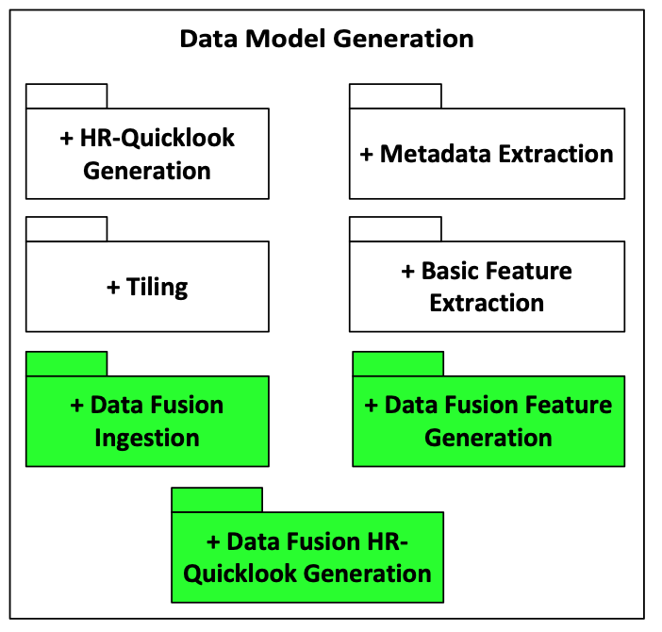
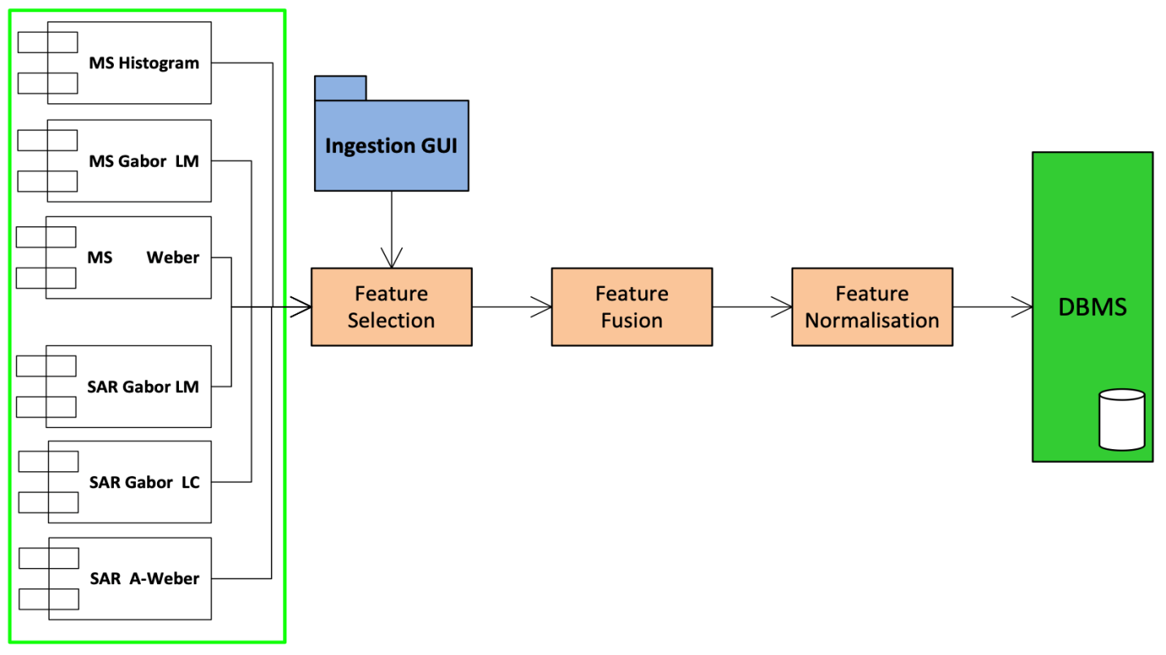
Data Fusion in CANDELA
CANDELA Data Model Generation (DMG) Component: new modules

Slide 13
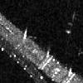
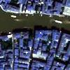
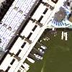
Data Fusion: SAR vs. MS EO
TerraSAR-X vs. WordView
The clouds
Complementary features

Slide 14
Data Fusion: The Validation Data Sets

Slide 15
Data Fusion: Selected Results

Slide 16
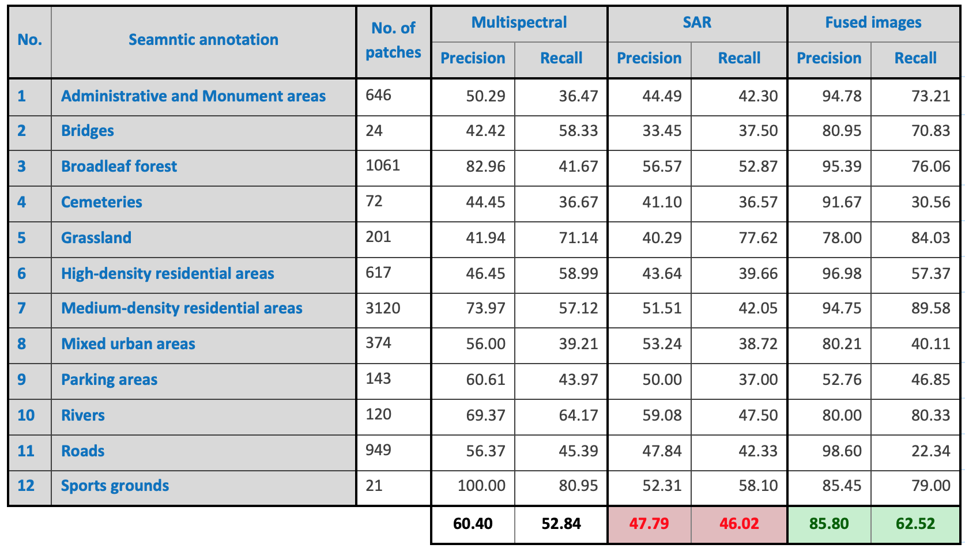
Data Fusion: Selected Results

Slide 17
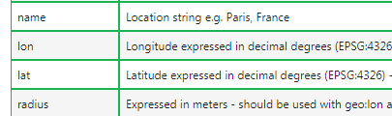
CreoDIAS: data connector
CreoDIAS provides access to metadata through a Data Finder API, to discover data:
name
platform
instrument
resolution
productType
cloudCover
snowCover
cultivatedCover
… etc.
Notes:
Before were talking about modules, and architectures.
Now is a detailed processing pipeline for data mining and data fusion:
Creodias provides a data finder api, which provides abundant options to discover Copernicus data:
Location name, mission, resolution, cloudcover…

Slide 18
CANDELA platform: Jupyterlab
Launch_datafusion.jynb: launch data fusion dmg process on the platform
Monetdb.jynb: Search and query in database
Notes:
The user interface of candela platform is via jupyterlab.
Each user has his/her own account, for example, I used my account to developed:
Launch_dmg_s1 and s2 notebooks, launch data fusion notebook, and monetdb notebook which enables users query in the database.

Slide 19
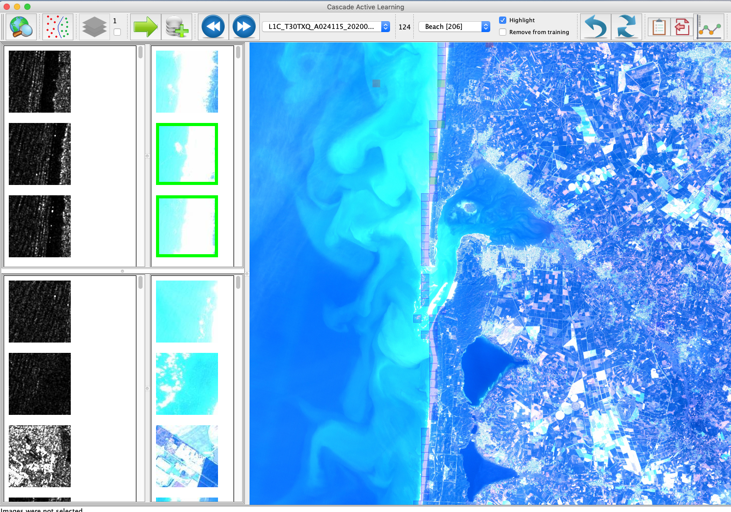
Data Fusion: Selected Results

Slide 20
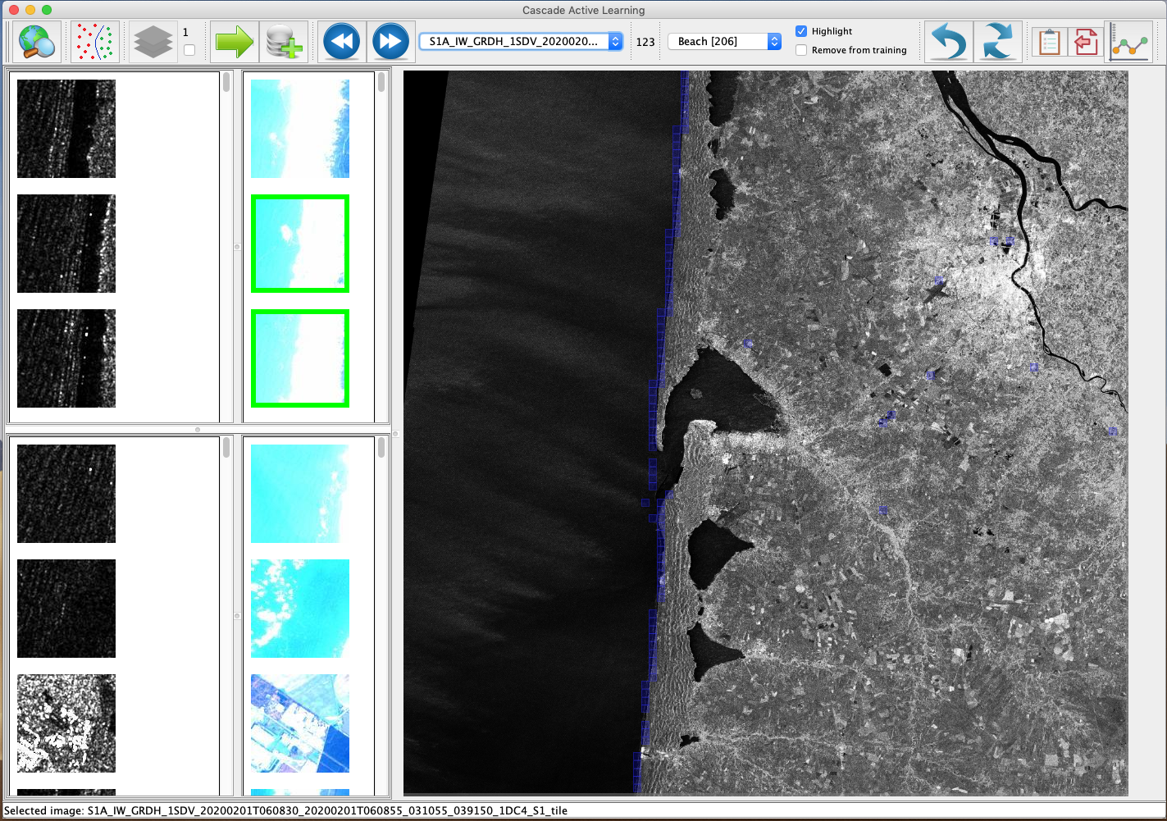
Data Fusion: Selected Results

Slide 21
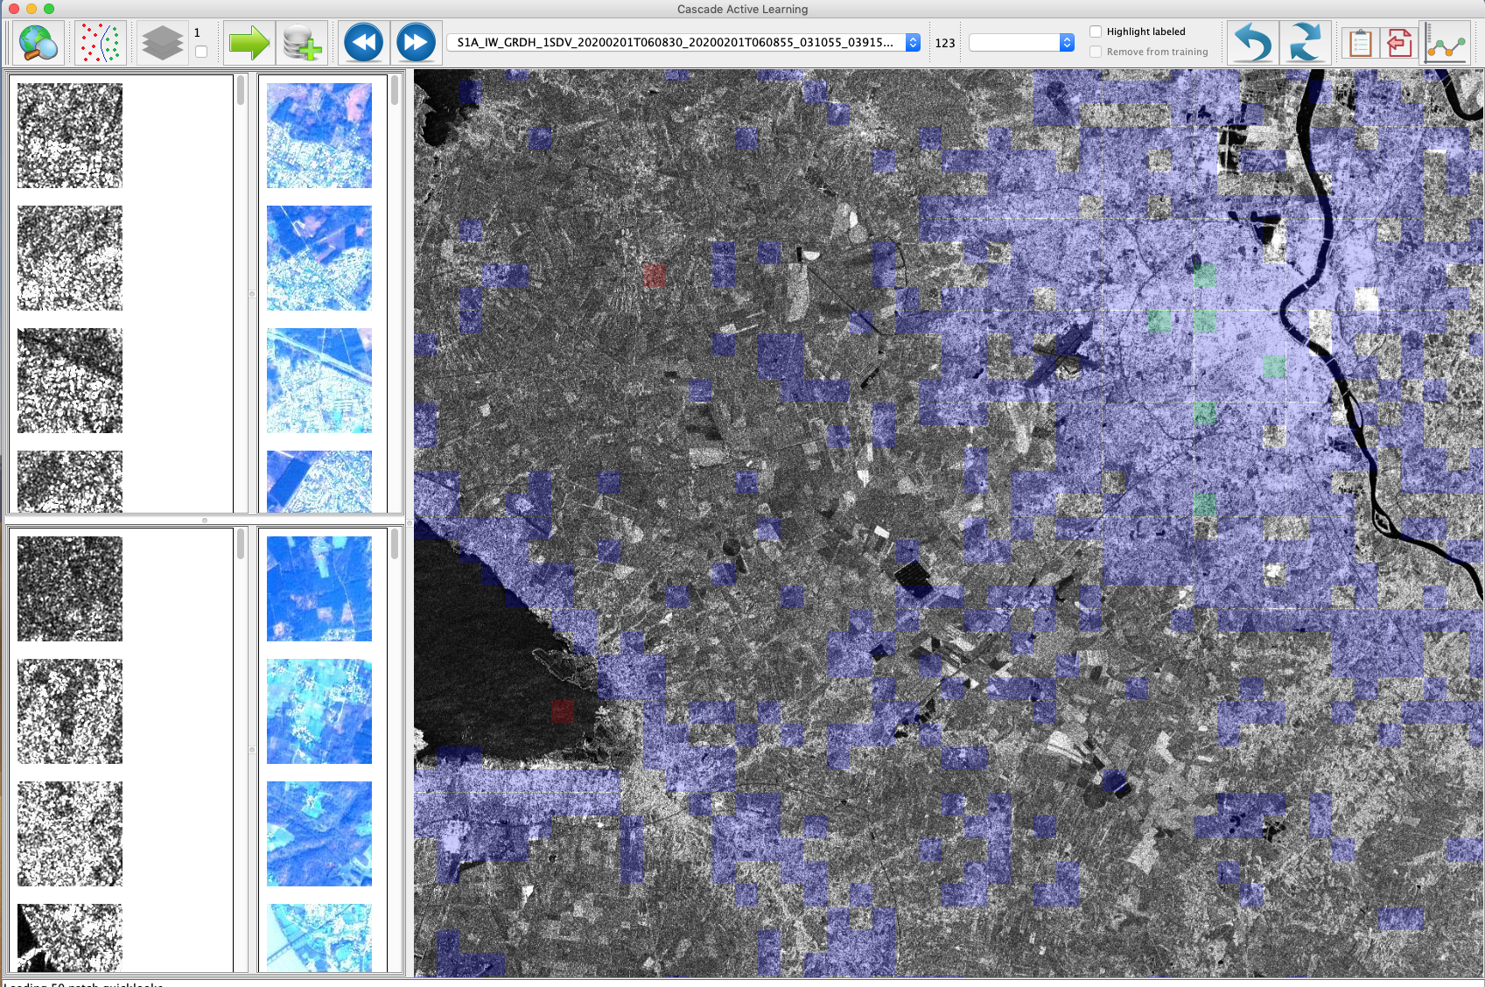
Data Fusion: Selected Results

Slide 22
Acknowledgement
This presentation was prepared by the Data Intelligence and Knowledge Discovery team at DLR: Dr. Wei Yao, Dr. Corneliu Octavian Dumitru and Prof. Dr. Mihai Datcu.
Special thanks to Perre Blanchart, LivingPlanet 19
Contact: mihai.datcu@dlr.de

