Slide 1
Collisional growth in a Lagrangian cloud model: Findings from column model simulations
S. Unterstrasser (DLR Oberpfaffenhofen), F. Hoffmann (NOAA/CIRES),
M. Lerch (DLR)
Contribution D3622 | EGU2020-1997
in session AS5.9

Slide 2
Introduction
Terminology:
Collisional growth: aggregation, coalescence, coagulation, riming. The technical implementation of those processes is similar in Lagrangian cloud model (LCM).
LCM = particle-based microphysics = superdroplet method.
Simulation particle (SIP) = computational droplet = super droplet. Usually, each SIP represent a certain number of identical hydrometeors.
Weighting factor = multiplicity
Introduction:
LCMs are considered the future of cloud microphysical modeling, though they are computationally expensive.
Several algorithms exist for treating collisional growth in an LCM (Shima et al, 2009; Sölch & Kärcher, 2010; Andrejczuk et al, 2010; Riechelmann et al, 2012).
Three different algorithms have been rigorously tested in a box model setup with a clear indication which algorithm is superior (Unterstrasser et al, 2017).
This superior algorithm is now tested in column-model framework.

Slide 3
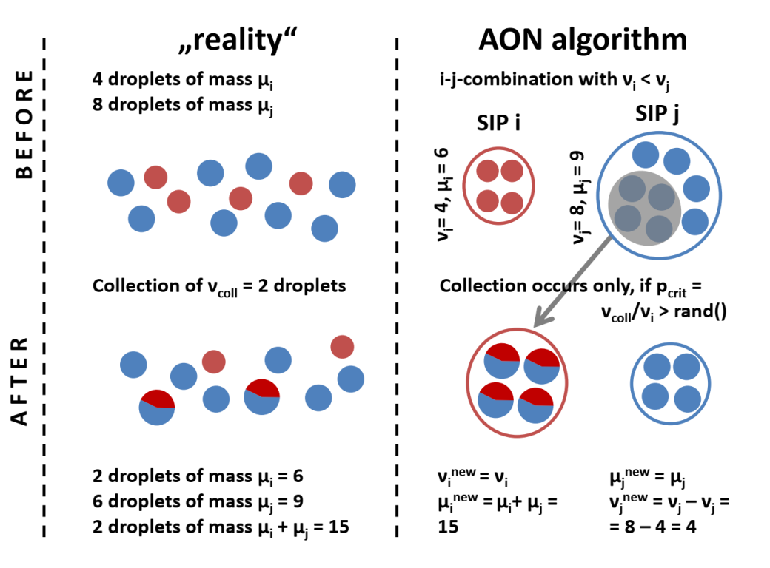
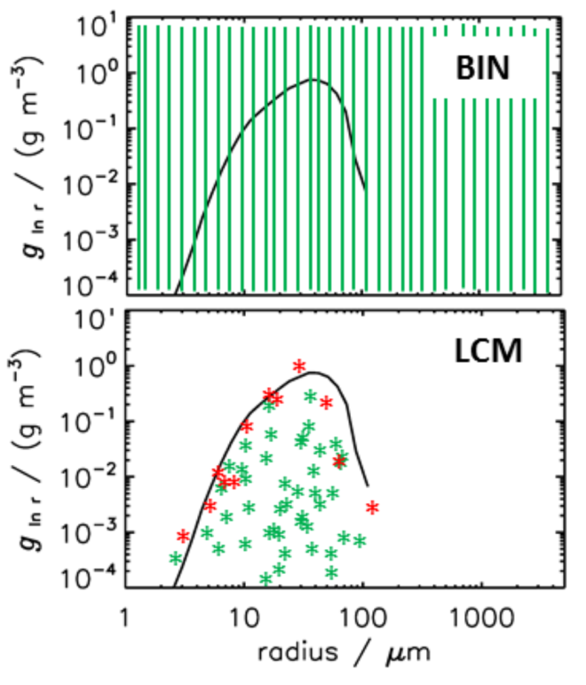
Background: Collisional growth in LCMs
Challenges of a collision implementation in LCMs are:
It is not feasible to create a new SIP for each collision , as N_{SIP} would explode.
Computational cost: Quadratic in N_{SIP} if all SIP combinations are tested.
Compared to bin models, LCM do not have a unique representation of a given hydrometeor size distribution. Unterstrasser et al, 2017 showed that the performance of the various collision algorithms depends crucially on how the SIP ensemble looks like. Using a ensemble with many equally-weighted SIPs drastically deteriorates the algorithm performance.
SIP i
SIP j
New SIP k
Bin model analogon:
Bin i Bin j Bin k (and k+1)

Slide 4
All-Or-Nothing (AON) Algorithm
The AON algorithm had the best performance in Unterstrasser et al. 2017. (The term AON was introduced in that paper. Others call the algorithm simply super-droplet method)
First described independently in Shima et al, 2009 and Sölch & Kärcher, 2010. The basic idea is the same in both papers, but a few aspects differ.
Probabilistic Monte Carlo method.
Smoluchowski equation valid only for an infinite, well-mixed volume and neglects fluctuations; for finite volumes a superior description (the so called master equation) exists (Gillespie, 1972; Bayewitz et al, 1974), which is much harder to solve (e.g. Alfonso, 2015).
In the limit of all weighting factors approaching unity, the AON algorithm solves the master equation, not the Smoluchowski equation (Dziekan & Pawlowska, 2017) => relevant for small cloud volumes where fluctuations cannot be neglected.

Slide 5
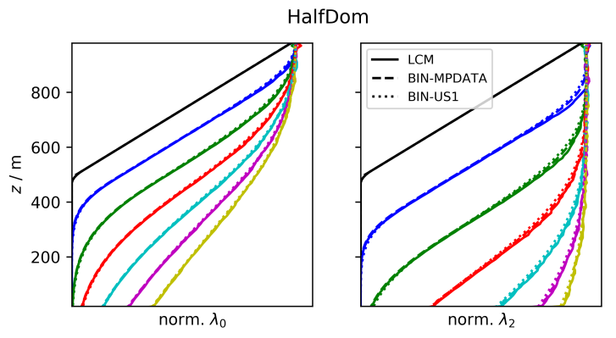
Column model setup
Column model with sedimentation and collisional growth; prescribe an initial droplet size distribution.
Eulerian model with MPDATA advection algorithm (Smolarkiewicz, 2006) and an established collisional growth algorithm (Bott, 1998; alternatively Wang et al, 2007).
Lagrangian model with AON algorithm; solving vertical transport is straightforward; probabilistic SIP ensemble generation.
Different boundary conditions are possible: periodic or prescribed influx at upper boundary.
Different numerical treatment of sedimentation has minor impact => Prerequisite for comparing the collisional growth formulation.
Pure sedimentation test case
In the upper half of the domain, LWC drops linearly to zero.
At the upper boundary, a time-constant influx is prescribed.
Moment of order l:

Slide 6
Box model vs „academic“ column model
Setup: Prescribe the same initial size distribution in each grid box and use periodic boundary conditions.
A (deterministic) Eulerian bin model will give identical results in all grid boxes and also identical to a box model solution.
In a probabilistic LCM, lucky droplets may be even luckier than in a box model setup. They can collect droplets from more than one grid box.
Emulate a LCM box model by switching off sedimentation, then each grid box evolves independently.
LCM BOX
LCM COL
LCM COL
LCM BOX
In LCM COL, lucky droplets seem to be luckier and droplet number drops faster, the more grid boxes there are (nz is higher).
The last explanation is wrong! The differences are simply due to different convergence properties in BOX and COL. The differences are due to numerics, not physics!

Slide 7
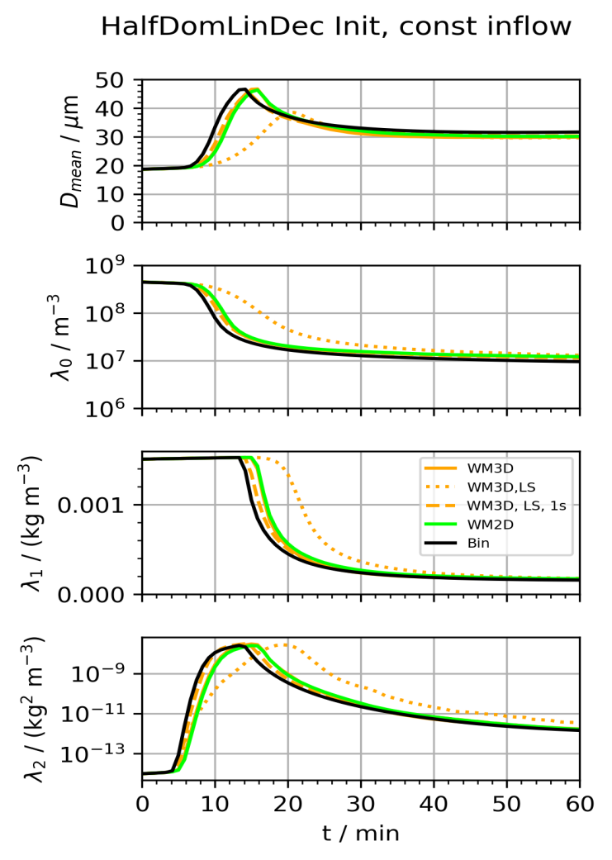
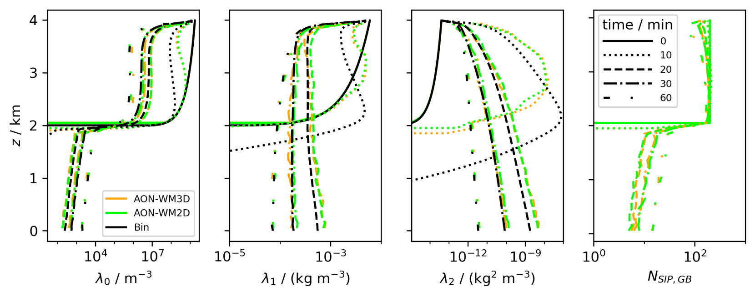
Real column model application
As in the pure sedimentation case, prescribe droplets in the upper half of the domain + influx at domain top.
Vertical profiles of various moments and SIP number:
Temporal evolution of various total moments and mean diameter:
Excellent agreement between Eulerian (black) and Lagrangian (orange + green) approach! In this example, only O(10) SIPs per GB are present in lower half.

Slide 8
Conclusions
All plots are taken from Unterstrasser, Hoffmann, Lerch, 2020, GMDD: Collection/Aggregation in a Lagrangian cloud microphysical model: Insights from column model applications using LCM1D (v0.9), https://doi.org/10.5194/gmd-2019-343
All presented figures and findings can be found in Unterstrasser et al, 2020, GMDD (in review for GMD).
Switching from a box model to a column model, the Lagrangian approach needs fewer SIPs per grid box for a converging collisional growth treatment.
The column model results demonstrate a very good agreement between established Eulerian models and the particle-based approach using AON.
More tests are shown in the latter manuscript:
„Linear Sampling“ vs „Quadratic Sampling“ of SIP combinations.
Usually the collision growth algorithms assume that the droplets of a SIP are well-mixed in the grid box volume. Alternative approach based on Sölch & Kärcher, 2010: Keep vertical coordinate and assume that droplets are well-mixed in the horizontal plane. Check for explicit overtakes. Results between both versions are small, implying that the assumption of „3D-well-mixedness“ is not too strong.
A further „real“ column model setup is analysed.
Due to a small bug in Unterstrasser et al, 2017, we were too optimistic about the convergence of AON. In the corrected version used in the present work, AON needs more SIPs for convergence.
All in all, our work strongly suggests that besides the more realistic representation of cloud microphysics, LCMs might also become a computationally feasible alternative to detailed cloud models used in the past.

